Slide 1
Data Engineering with Streamlit
Completed By: Sharath Katta Sridhar
Contact: sk8671@nyu.edu

Slide 2
Introduction
Data Engineering at a Glance:
Data engineering involves the collection, processing, and transformation of raw data into a structured format suitable for analysis.
Importance of Data Transformations:
Transforming data is a critical step in preparing it for analysis.
It ensures data quality, consistency, and usability.
Streamlit Application:
This Streamlit application serves as a powerful tool for data engineers.
It facilitates seamless uploading of Parquet files and applying essential data transformations.
Enhancing Data Processing Workflows:
The application streamlines and enhances data processing workflows.
Empowering data engineers to make informed decisions based on transformed and enriched data.
User-Friendly Interface:
A user-friendly interface makes it accessible for both technical and non-technical users.
Simplifies the complex task of data engineering for diverse stakeholders.
Efficiency and Collaboration:
Boosts efficiency by automating repetitive tasks.
Encourages collaboration among team members with a centralized platform for data manipulation.

Slide 3
Application Overview
User-Friendly Data Ingestion:
Drag-and-drop Parquet file upload.
Real-time validation and instant preview.
Customizable Data Transformation:
JSON rules for cleansing and parsing.
One-click transformation, side-by-side comparison.
Quick Data Analysis:
OpenAI ChatGPT API integration.
Summarized insights and selectable analysis types.
SQL Database Integration:
Direct connection, new/append options.
Robust error handling for clean data.
Security Measures:
Brief overview of implemented measures.
User Experience Design:
Emphasis on usability and user-friendly design.
Resource Utilization:
Efficient analysis using a data sample.
Future Enhancements:
Discussion of planned enhancements.
Additional Information:
Tech Stack: Streamlit, Python (Pandas), SQL, OpenAI GPT.

Slide 4
Parquet File Contents
Data Sets:
Credit/debit card user info.
Transaction records.
Credit/debit card details.
Data Origin:
Synthetic data by IBM.
20 million+ transactions.
Covers 2000 consumers in the U.S.
Format:
Parquet format.
Columnar storage for efficiency.
Highly compressible.
Significance:
Efficient for big data processing.
Ideal for finance data analytics.
Allows specific column queries.
Data Description:
Check Data Dictionary for field details.
Additional datasets from reputable sources.
Additional Information:
Files:
credit_card_transaction_data_de.parquet
credit_card_users_de.parquet
sd254_cards_de.parquet
Data Generation Source:
Synthesizing Credit Card Transactions.

Slide 5
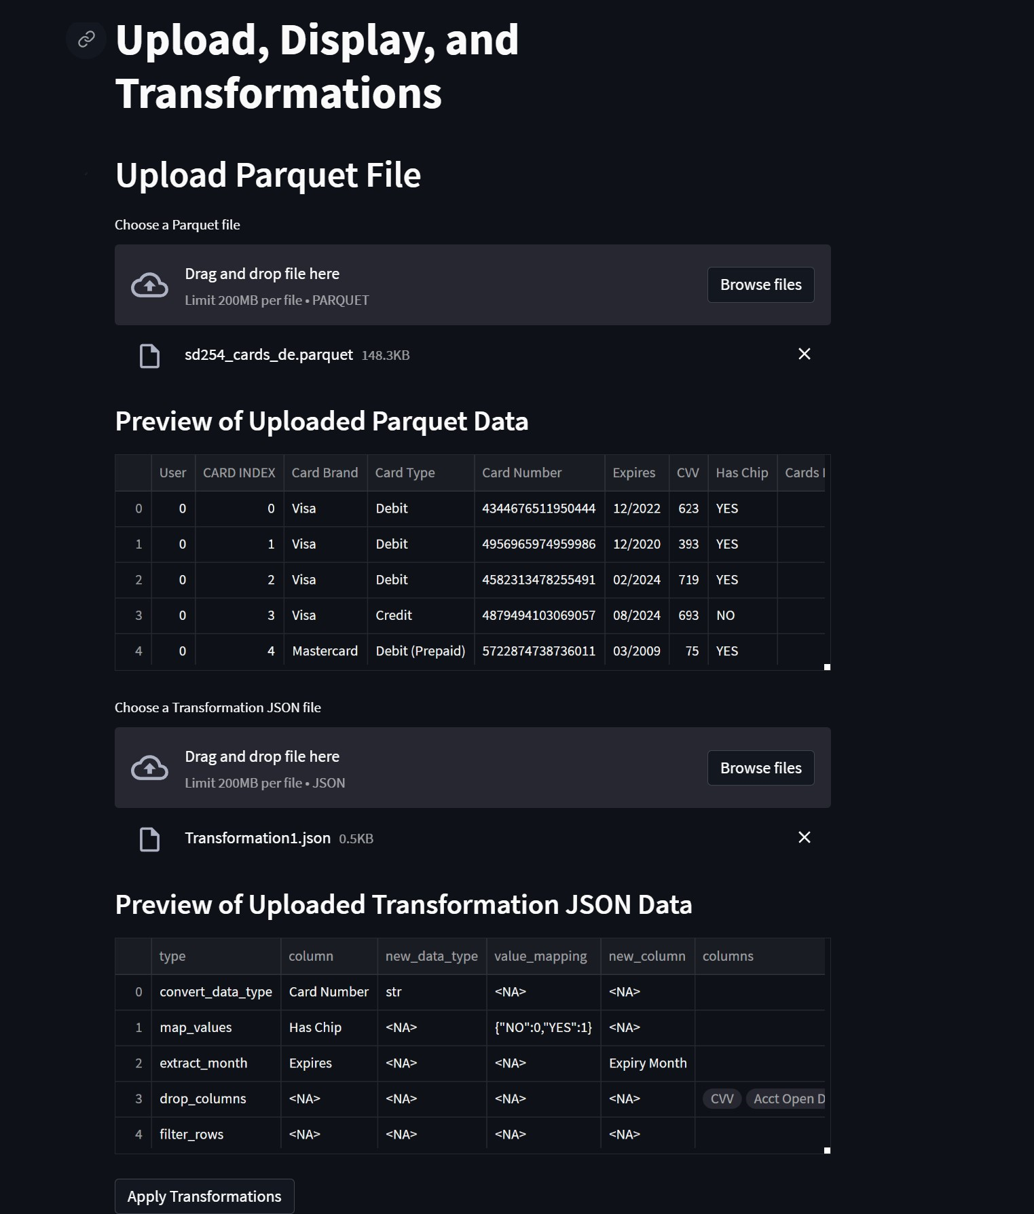
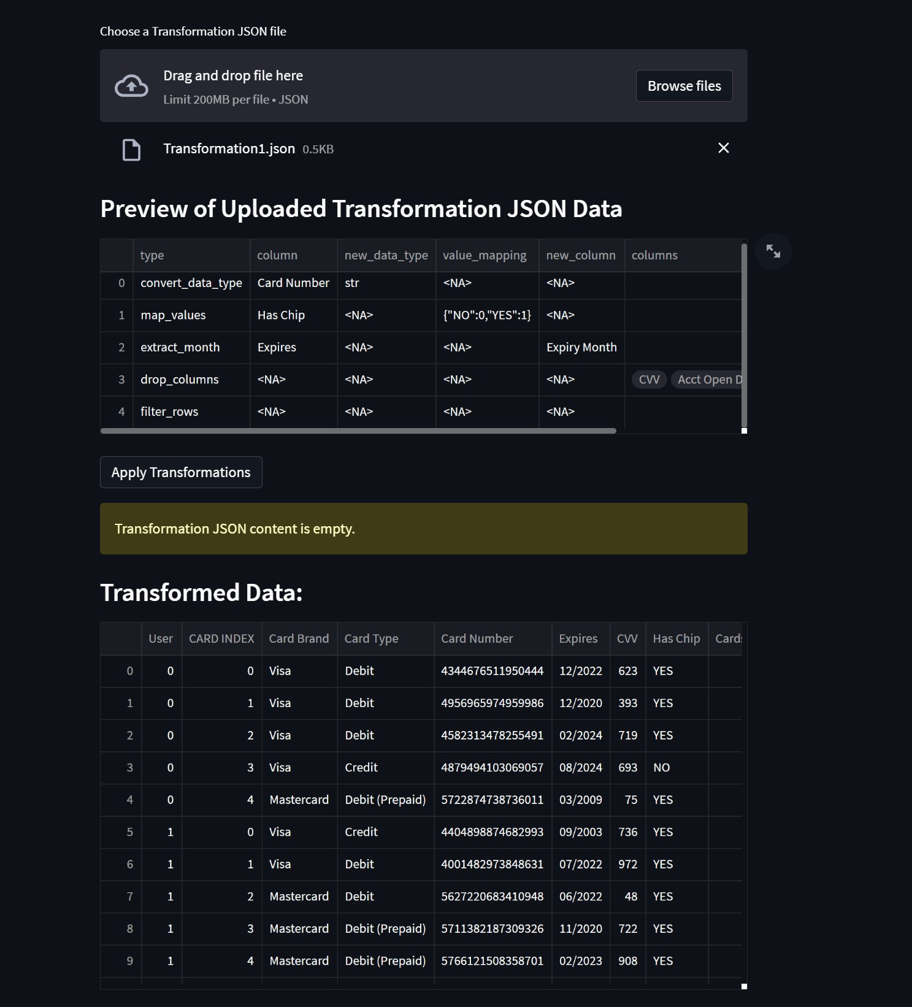
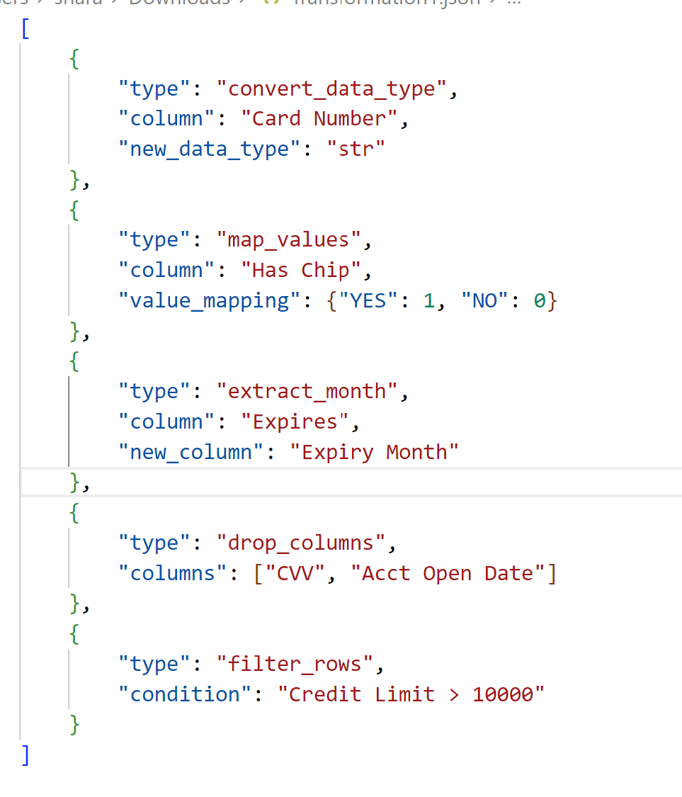
Data Transformation's
Example JSON Transformation File for sd245 parquet and the result:

Slide 6
Export to SQL Database
Features:-
Allows for Seamless SQL integration for efficient data storage
Can create new tables or append data to existing tables
Robust error handling and data validation
Code Snippet:
# Function to export data to SQL Database
def export_to_sql(df, connection, table_name, create_table=True):
try:
if create_table:
df.to_sql(table_name, connection, index=False, if_exists='replace')
else:
df.to_sql(table_name, connection, index=False, if_exists='append')
except Exception as e:
st.error(f"Error exporting to SQL Database: {e}")
Explanation:
The export_to_sql function facilitates exporting data to an SQL Database.
Users can choose to create a new table (create_table=True) or append data to an existing table (create_table=False).
The function utilizes the to_sql method from the Pandas library for seamless integration.
Key Features:
User-Friendly: Enables users to easily export cleaned, transformed data to their SQL databases directly from the application.
Custom Table Handling: Users can create new tables with a specified name or append data to existing tables.
Error Handling: Robust error handling ensures smooth data export and provides informative error messages in case of issues.

Slide 7
Download Transformed Data
Features :-
- Easy download of transformed data
- Customizable CSV file naming
- Seamless data sharing with colleagues
Code Snippet:
```python
# Function to export data to CSV
def export_to_csv(df, file_name):
try:
df.to_csv(file_name, index=False)
st.success(f"Data exported to CSV file '{file_name}'.")
except Exception as e:
st.error(f"Error exporting data to CSV: {e}")
```
Explanation:
- The `export_to_csv` function facilitates the download of transformed data in CSV format.
- Users can specify a custom name for the CSV file, allowing for easy organization and sharing.
Key Features:
- User-Friendly Download:- Users can quickly download the transformed data in CSV format with just a few clicks.
- Custom File Naming:- Enables users to provide a custom name for the exported CSV file, enhancing organization and clarity.
- Seamless Sharing:- Exported CSV files can be easily shared with colleagues or used for further analysis in other tools.

Slide 8
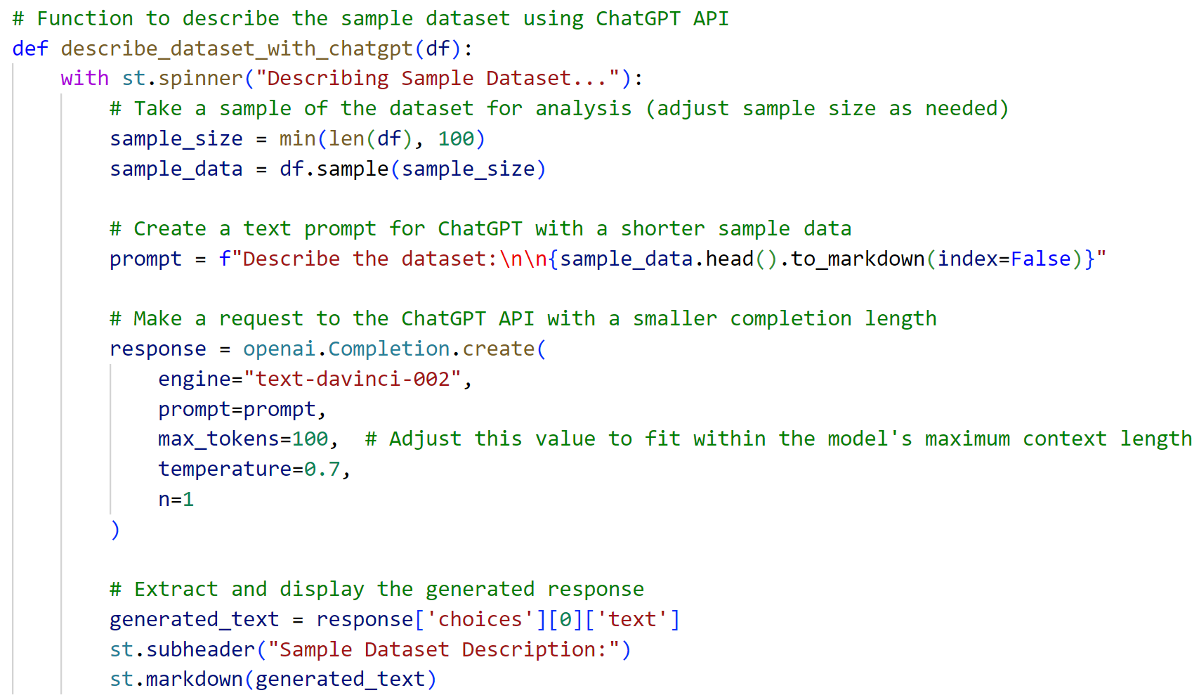
GPT API
Features:-
- Integration of OpenAI's ChatGPT API
- Automated data analysis
- Summarized insights for quick understanding
Explanation:
- The `describe_dataset_with_chatgpt` function utilizes OpenAI's ChatGPT API to automatically generate a textual description of the dataset.
- A sample of the dataset is used to create a prompt for ChatGPT, and the API responds with a summarized analysis.
Key Features:
- **Automation:** Streamlines the process of generating dataset descriptions without manual input.
- **Summarized Insights:** Provides concise and informative insights into the dataset's characteristics.
- **Quick Understanding:** Users can quickly grasp key aspects of the data without extensive manual analysis.

Slide 9
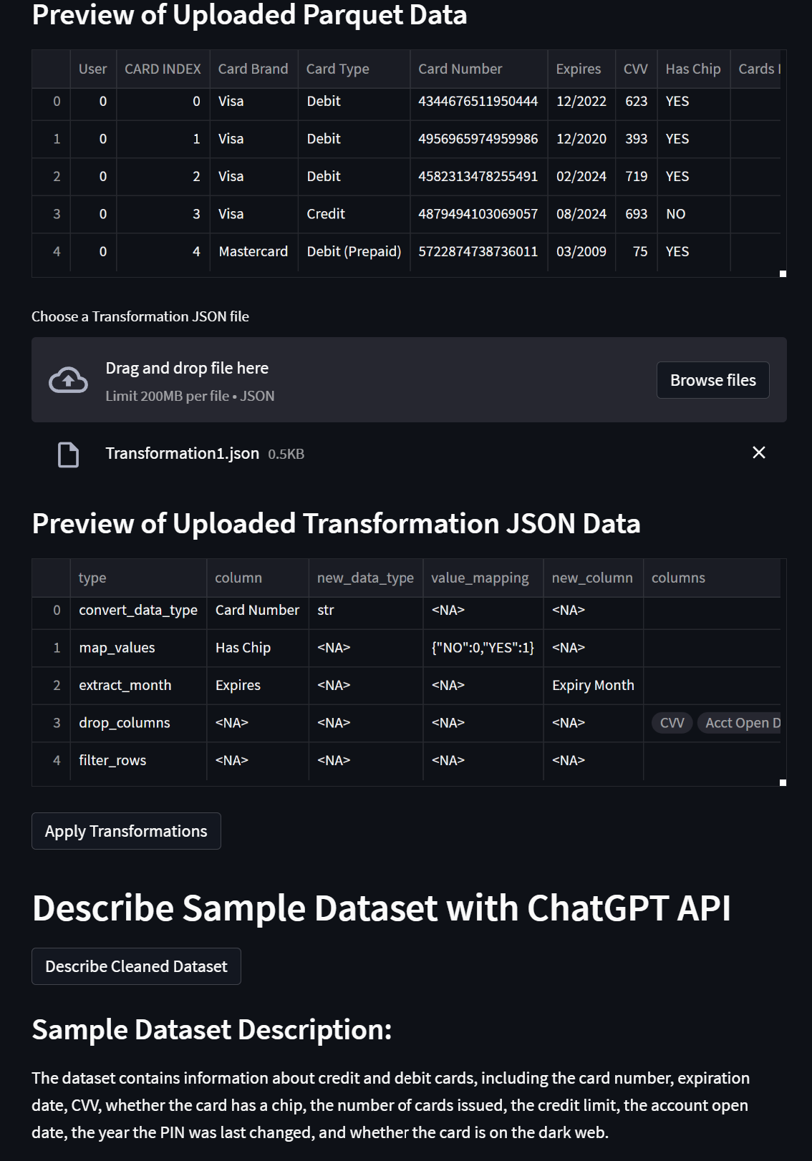
GPT Response Example

Slide 10
Future Enhancements
- Cloud hosting for SQL database: Migrate from in-memory SQLite to a cloud-hosted database for scalability and accessibility.
- Real-time data streaming: Implement Apache Kafka for real-time data streaming and processing to enable instant insights.
- User authentication: Introduce user authentication mechanisms to secure access and manage user-specific data.
- Enhanced data visualizations: Explore advanced visualization libraries for more interactive and insightful displays.
- Machine learning integration: Integrate machine learning models for predictive analytics and continuous improvement.
Explanation:
Cloud Hosting: Transitioning to a cloud-hosted SQL database allows for better scalability, accessibility, and long-term data storage.
Real-time Data Streaming: Leveraging Apache Kafka enables the application to handle real-time data updates and streaming, enhancing responsiveness.
User Authentication: Implementing user authentication ensures secure access and personalized data management for different users.
Enhanced Visualizations: Exploring advanced visualization libraries can improve the user interface and provide more interactive and informative displays of data.
Machine Learning Integration: Introducing machine learning models into the application allows for predictive analytics, aiding in continuous improvement and fraud detection.
Key Benefits:
Scalability: Cloud hosting facilitates scalability, supporting the application's growth and increasing data volume.
Real-time Insights: Real-time data streaming enhances the application's responsiveness, providing users with up-to-the-minute insights.
Security: User authentication adds an additional layer of security, protecting sensitive data and ensuring controlled access.
User Experience: Advanced visualizations and machine learning integration contribute to a richer user experience and more powerful data analysis capabilities.
Note: These enhancements aim to elevate the application's capabilities, making it more robust, secure, and feature-rich for users.

Slide 11
Conclusion
- Successful creation of a streamlined data ingestion and manipulation tool for the finance sector.
- Accomplished objectives, including user-friendly data upload, customizable transformations, insightful analysis, and seamless database integration.
- Empowering data professionals to handle large datasets efficiently, enhancing fraud detection processes.
- Continuous improvement and expansion planned through future enhancements.
Explanation:
Success Summary: The project has successfully delivered a comprehensive solution for data professionals in the finance sector, offering a streamlined approach to data manipulation and analysis.
Objective Achievement: The set objectives, encompassing user-friendly data upload, customizable transformations, insightful analysis, and seamless database integration, have been accomplished.
Empowering Data Professionals: The tool empowers data professionals to efficiently handle large datasets, enabling more effective fraud detection processes and enhancing overall data management capabilities.
Commitment to Improvement: The project remains dynamic, with continuous improvement and expansion plans outlined through future enhancements.
Key Takeaways:
Achievements: The tool's achievements are highlighted, emphasizing its positive impact on data-related tasks within the finance sector.
User Empowerment: Users are now equipped with a tool that simplifies complex data processes, making their tasks more efficient and effective.
Commitment to Excellence: The commitment to continuous improvement reflects a dedication to maintaining the tool's relevance and effectiveness over time.

Slide 12
Thank You

