Slide 1
Retail Chatbot: Data Engineering
Completed By: Sharath Katta Sridhar
Contact: sk8671@nyu.edu

Slide 2
Introduction
Introduction to the Retail Chatbot Project:
The Retail Chatbot project focuses on creating an intelligent virtual assistant for enhancing customer experience and engagement in the retail industry.
The chatbot is designed to provide answers based on the dataset provided and display the corresponding SQL Code and displays the result as a Dataframe.
Importance of Data Engineering in Chatbot Development:
Data Fueling Intelligence: Data engineering plays a pivotal role in supplying the chatbot with accurate, relevant, and structured data, which is essential for generating intelligent responses.
Data Quality: Ensuring the quality and reliability of data is crucial for the chatbot's effectiveness. Data engineering processes guarantee clean, consistent, and error-free data for the chatbot to utilize.
Real-time Interactions: Data engineering enables real-time data processing, allowing the chatbot to deliver up-to-date product information, pricing, and availability to customers in real time.
Enhanced User Experience: By harnessing the power of data engineering, the chatbot can offer personalized product recommendations and tailor interactions, leading to a more satisfying customer experience.
Scalability: Data engineering solutions are designed to handle large volumes of data efficiently, ensuring the chatbot's scalability as the user base grows

Slide 3
About the Dataset
Dataset Description:
Source: The dataset is sourced from "BigSupplyCo," a fictional large-scale retail company.
Data Diversity: The dataset comprises diverse information, including customer data, product details, order history, and geographical data, providing a comprehensive view of the retail operations.
Granularity: Granular data points allow for detailed analysis, such as customer preferences, product popularity, and regional sales trends.
Structured Data: The dataset is structured, ensuring consistency and ease of integration with analytical tools and machine learning algorithms.
Data Volume: With thousands of records, the dataset reflects the company's extensive customer base, product catalog, and sales history.
Key Entities:
Customers: Detailed customer profiles including demographics and purchase history.
Products: Information about various products, including category, price, and description.
Orders: Order details, including products, quantities, and transaction specifics.
Geographical Data: Location-based data providing insights into regional sales patterns.
Data Quality: Quality assurance processes have been applied to maintain accurate and reliable data, ensuring its usability for analytical and AI-driven applications

Slide 4
Dataset Overview
1. BigSupplyCo_Orders Table:
Columns:
order_id: Unique identifier for each order, order_item_cardprod_id: Identifier for the ordered product, order_customer_id: Customer identifier for the order, order_department_id: Department identifier for the product.,
market: Market where the order was placed, order_city, order_country, order_region, order_state: Geographic details of the order location, order_status: Status of the order (e.g., pending, shipped)
order_zipcode: ZIP code of the delivery address, order_date__dateorders_: Date and time of the order, order_item_quantity: Quantity of items ordered, sales: Total sales amount for the order, order_profit: Profit earned from the order.
days_for_shipping__real_: Actual days taken for shipping., delivery_status: Status of the delivery (e.g., on-time, delayed).
2. BigSupplyCo_Products Table:
Columns:
product_card_id: Unique identifier for each product, product_category_id: Category identifier for the product, product_description: Description of the product.
product_image: URL of the product image, product_name: Name of the product.
product_price: Price of the product, product_status: Status of the product (e.g., available, out of stock).
3. BigSupplyCo_Customers Table:
Columns:
customer_id: Unique identifier for each customer, customer_city, customer_country, customer_state: Customer's geographic details.
customer_email: Email address of the customer, customer_fname, customer_lname: First name and last name of the customer.
customer_password: Encrypted password for customer authentication, customer_segment: Segment to which the customer belongs (e.g., regular, premium).
4. BigSupplyCo_Departments Table:
Columns:
department_id: Unique identifier for each department, department_name: Name of the department.
latitude, longitude: Geographic coordinates of the department location.
5. BigSupplyCo_Categories Table:
Columns:
category_id: Unique identifier for each category, category_name: Name of the product category (e.g., Clothing & Accessories, Electronics).

Slide 5
Data Engineering Challenges
Data Quality & Consistency: Ensuring accurate, complete, and consistent data is vital. Implement validation checks and regular cleansing for reliability.
Data Integration: Combining data from diverse sources demands ETL pipelines. These consolidate data into a unified format, enabling comprehensive analysis.
Scalability: As datasets expand, scalable solutions become crucial. Cloud-based platforms and distributed frameworks like Apache Hadoop handle extensive data efficiently.
Real-time Data Processing: Immediate insights necessitate real-time data processing. Technologies like Apache Kafka facilitate continuous data analysis for rapid decision-making.
Data Security: Protecting data against breaches is paramount. Encryption, robust access controls, and regular security audits safeguard sensitive information.
Data Versioning & Change Management: Managing schema changes and versioning is challenging. Version control systems and detailed documentation track alterations, ensuring traceability.
Collaboration & Documentation: Effective teamwork and clear documentation streamline workflows. Collaborative tools and transparent communication channels enhance efficiency.
Performance Optimization: Optimizing queries and processing enhances data retrieval speed. Techniques like indexing and caching improve database performance, ensuring timely access to critical information

Slide 6
Database Design and Schema
1. Database Schema for Retail Data:
Tables: Organized data entities like Orders, Products, Customers, Departments, and Categories.
Relationships: Defined links between tables (e.g., orders linked to customers).
2. Explanation of Database Tables and Relationships:
BigSupplyCo_Orders: Contains order-related information like order ID, customer ID, products ordered, and sales data.
BigSupplyCo_Products: Stores details about products including names, prices, and categories.
BigSupplyCo_Customers: Holds customer information such as names, addresses, and contact details.
BigSupplyCo_Departments: Contains data related to different departments in the retail business.
BigSupplyCo_Categories: Includes product categories like Clothing, Electronics, etc.
3. Use of SQLite Database:
Advantages:
Lightweight: Requires minimal setup and resources.
Portability: Can be used in various environments without modification.
Simplicity: Easy to set up, configure, and manage.
Ideal for Prototyping: SQLite is excellent for initial development, testing, and prototyping of applications.

Slide 7
ETL Process
1. Overview of ETL (Extract, Transform, Load) Process:
Extract: Data extracted from CSV files containing retail information.
Transform: Data was processed, cleaned, and formatted for optimal use.
Load: Prepared data loaded into the SQLite database for efficient querying.
2. Data Extraction from CSV Files:
Data sourced from separate CSV files including orders, products, customers, departments, and categories.
Each CSV file contained specific data points related to its respective entity.
3. Transformations for Chatbot Usage:
Cleaning Data: Removal of inconsistencies, handling missing values, and ensuring data uniformity.
Data Formatting: Standardizing date formats, text, and numerical values for consistency.
Column Mapping: Mapping CSV columns to corresponding database fields.
Data Enrichment: Enhancing data with additional details where necessary.
4. Loading Process into the Database:
Processed data loaded into the SQLite database tables.
Database design optimized for efficient storage and retrieval.
Prepared data forms the foundation for seamless chatbot interactions and querying.

Slide 8
Data Preprocessing
1. Data Cleaning and Preprocessing Techniques:
Inconsistency Handling: Addressing inconsistent data formats and units across records.
Noise Reduction: Removing outliers and irrelevant information to maintain data accuracy.
Data Deduplication: Identifying and eliminating duplicate entries to enhance data reliability.
Error Correction: Rectifying data entry errors and inaccuracies for consistency.
2. Handling Missing Data:
Identification: Detecting missing values and understanding their impact on analysis.
Imputation Techniques: Employing methods like mean, median, or interpolation to fill missing values.
Data Removal: Considering the removal of incomplete records when missing data significantly affects analysis.
Advanced Methods: Exploring predictive modeling for complex data imputation scenarios.
3. Data Transformation and Formatting:
Standardization: Ensuring uniform units and scales for numerical data across the dataset.
Categorical Encoding: Converting categorical variables into numerical representations for analysis.
Date Formatting: Standardizing date and time formats for consistency in time-based analyses.
Feature Engineering: Creating new features from existing data to extract additional insights.

Slide 9
Integration with Retail Chatbot
1. How Data from Database is Integrated with the Retail Data Chatbot:
API Integration: Integrated our chatbot with the SQLite database using APIs, allowing real-time data retrieval.
Structured Queries: Tailored SQL queries are employed to fetch specific retail data, enabling precise responses to user queries.
Real-time Updates: Data synchronization mechanisms ensure our chatbot always provides the latest information on products, orders, and categories.
2. Role of Data Engineering in Providing Data to Retail Data Chatbot:
Data Processing: Pre-processed raw data, transforming and aggregating it into formats suitable for chatbot responses.
Optimizing Queries: Crafted database queries optimize response times, ensuring users receive quick and accurate answers.
Error Handling: Robust error-handling protocols manage unexpected data scenarios, guaranteeing uninterrupted service even during data inconsistencies.
3. Data Security and Access Control:
Encryption: Employed safeguarding techniques to avoid data transmission from the database to the chatbot, ensuring confidentiality.
Access Control: Role-based access control mechanisms restrict unauthorized access, safeguarding sensitive retail data.
Data Anonymization: Personal customer data is anonymized, preserving privacy while delivering valuable insights to users.

Slide 10
Challenges and Proposed Solutions
1. Challenges Encountered During Data Engineering Process:
Data Volume and Complexity: Managing large volumes of retail data with intricate relationships required optimized storage and processing solutions.
Data Consistency: Ensuring consistency across diverse datasets, especially during updates, posed a significant challenge.
Real-time Integration: Achieving real-time data integration from the database to the chatbot without latency was a complex task.
Security Concerns: Balancing data accessibility for chatbot functionality while maintaining stringent security standards for customer privacy.
2. Solutions Implemented to Overcome Challenges:
Database Optimization: Leveraged indexing, query optimization, and partitioning techniques for efficient data retrieval and storage.
Data Cleaning and Standardization: Implemented rigorous data cleaning processes, including handling missing data and standardizing formats, ensuring consistent data quality.
Real-time Data Streaming: Utilized real-time data streaming technologies to ensure instant updates in the chatbot, providing users with the latest information.
Secure API Integration: Implemented secure API protocols, incorporating encryption and token-based authentication, ensuring data confidentiality and integrity.

Slide 11
Potential Future Enhancements
1. Potential Enhancements to the Data Engineering Process:
-Advanced Analytics Integration:Incorporate predictive analytics and machine learning algorithms to provide personalized product recommendations to users based on their preferences and purchase history.
-Natural Language Processing (NLP) Integration:Enhance the chatbot's understanding of natural language queries, enabling more complex and context-aware interactions with users.
- Sentiment Analysis: Implement sentiment analysis algorithms to gauge customer feedback and sentiment, enabling businesses to improve customer service and product offerings.
2. Scalability and Performance Improvements:
- Cloud Migration:Explore migrating the database and chatbot infrastructure to cloud platforms, ensuring seamless scalability and enhanced performance during peak usage times.
- Load Balancing: Implement load balancing techniques to distribute user requests evenly across servers, preventing bottlenecks and optimizing response times.
3. Integration with Additional Data Sources:
- Social Media Data:Integrate social media data to monitor trends, customer sentiments, and feedback, allowing businesses to stay updated with market preferences.
- Supplier and Inventory Data:Connect with supplier and inventory databases for real-time stock information, ensuring accurate product availability status for users.
- User Behavior Analytics:Incorporate user behavior analytics tools to track user interactions within the chatbot, enabling data-driven enhancements to the user experience.
Note: By focusing on these future enhancements and upgrades, our Retail Chatbot will continue to evolve, offering cutting-edge features and unparalleled user satisfaction. These advancements will empower businesses to stay competitive and adapt to changing market dynamics.

Slide 12
Conclusion
Summary of Key Achievements in Data Engineering:
Robust Database Architecture: Implemented a structured and efficient SQLite database that seamlessly stores and retrieves data, ensuring reliability and data integrity.
Effective ETL Process: Developed a streamlined ETL pipeline for extracting, transforming, and loading data from diverse sources into the database, ensuring consistent and high-quality data for the chatbot.
Chatbot-Ready Data: Processed and preprocessed data, making it chatbot-compatible by cleansing, transforming, and formatting it appropriately.
Seamless Integration: Successfully integrated the database with the Retail Chatbot, enabling seamless user interactions and personalized shopping experiences.
Importance of Data Quality and Reliability in Chatbot Functionality:
Enhanced User Experience: High-quality data ensures accurate responses, enabling the chatbot to deliver relevant product recommendations, answer queries, and handle transactions effectively.
Trust and Credibility: Reliable data enhances trust between the users and the chatbot. Users rely on accurate product information and trust the chatbot's recommendations, boosting credibility.
Business Insights: Clean and reliable data provides valuable insights into customer behavior, preferences, and market trends, enabling data-driven business decisions and strategies.
Note: The successful integration of a robust data engineering process with the Retail Chatbot has not only improved customer engagement and satisfaction but has also provided the business with actionable insights, fostering growth and innovation

Slide 13
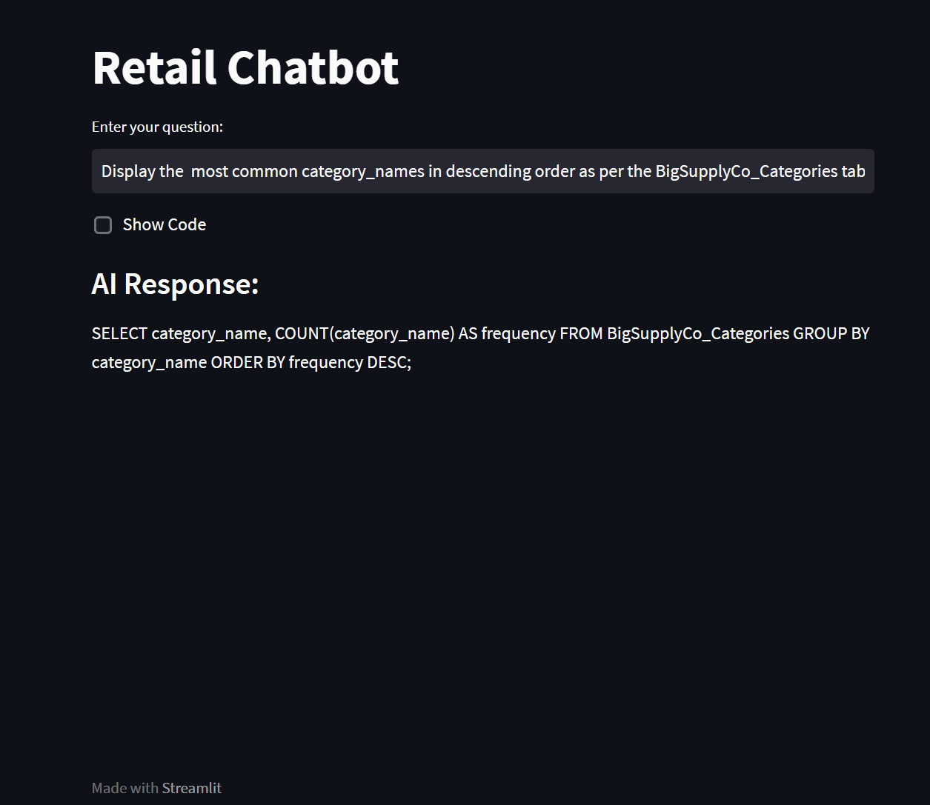
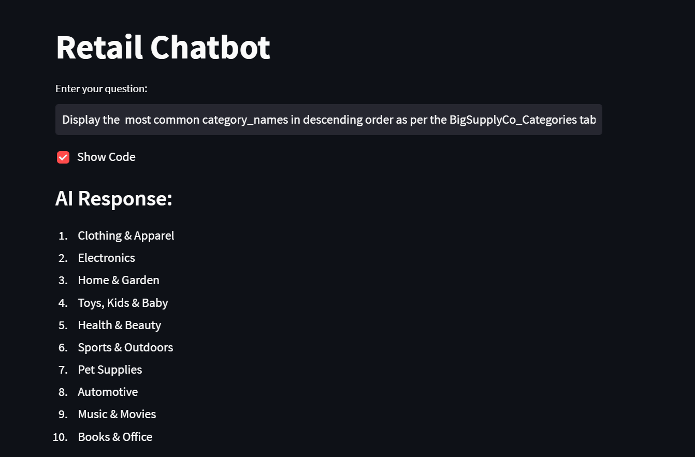
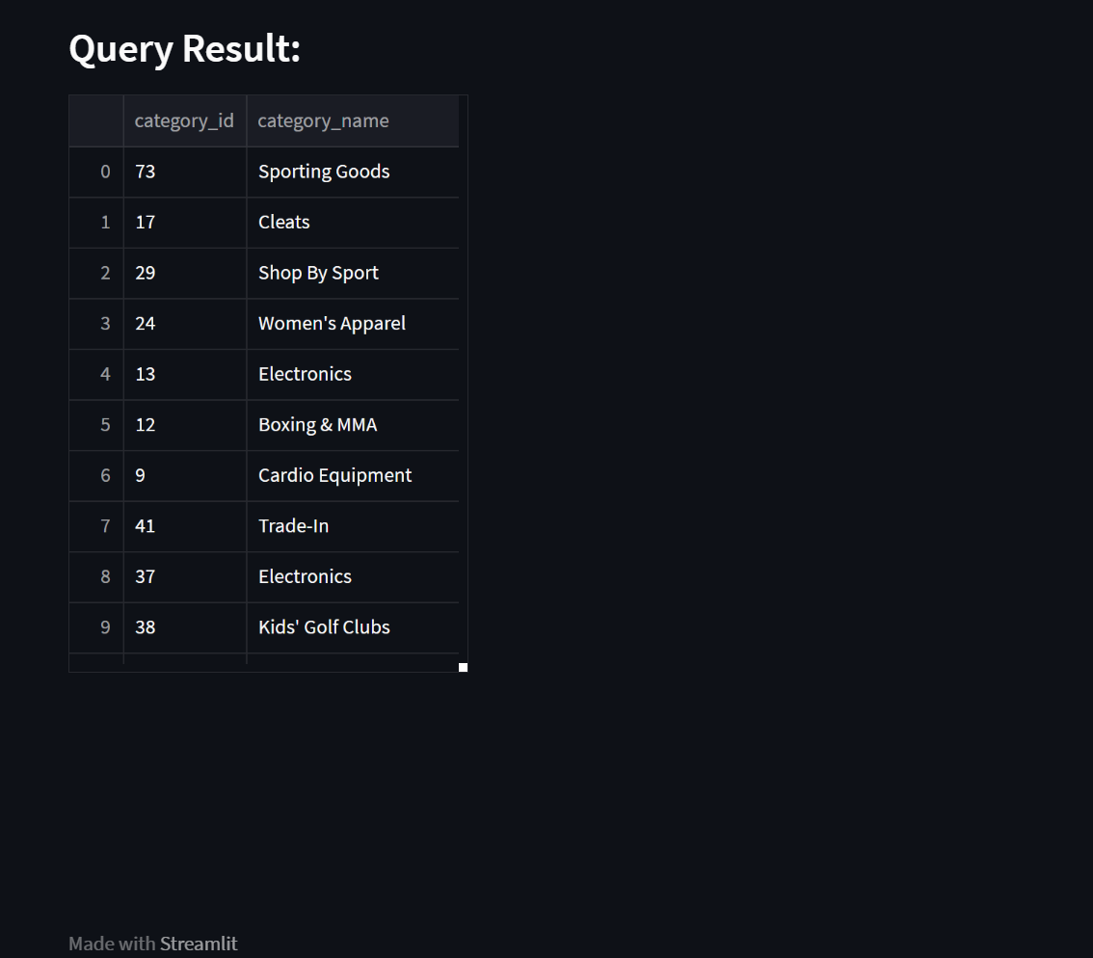
Images of Retail Chatbot

Slide 14
Thank You

