Slide 1
Apache Commons Text
A software dependability analysis

Slide 2
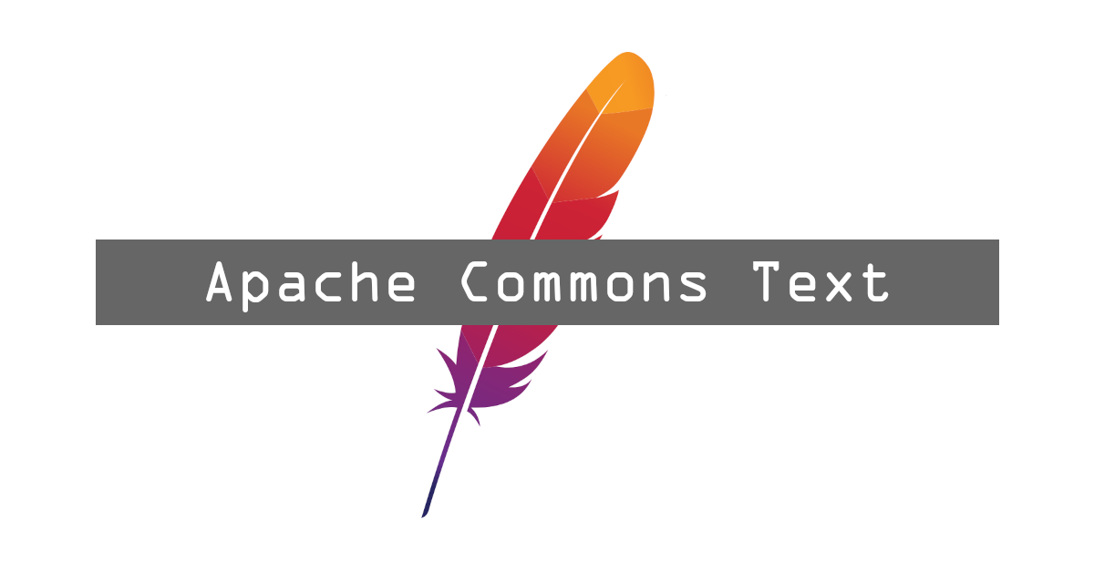
Similarity scores (Cosine, Fuzzy score, Jaccard, Jaro-Winkler, Longest Common Subsequent)
Edit distances (Cosine, Hamming, Jaccard, Jaro-Winkler, Levenshtein, Longest Common Subsequence)
Differences between texts

Slide 3
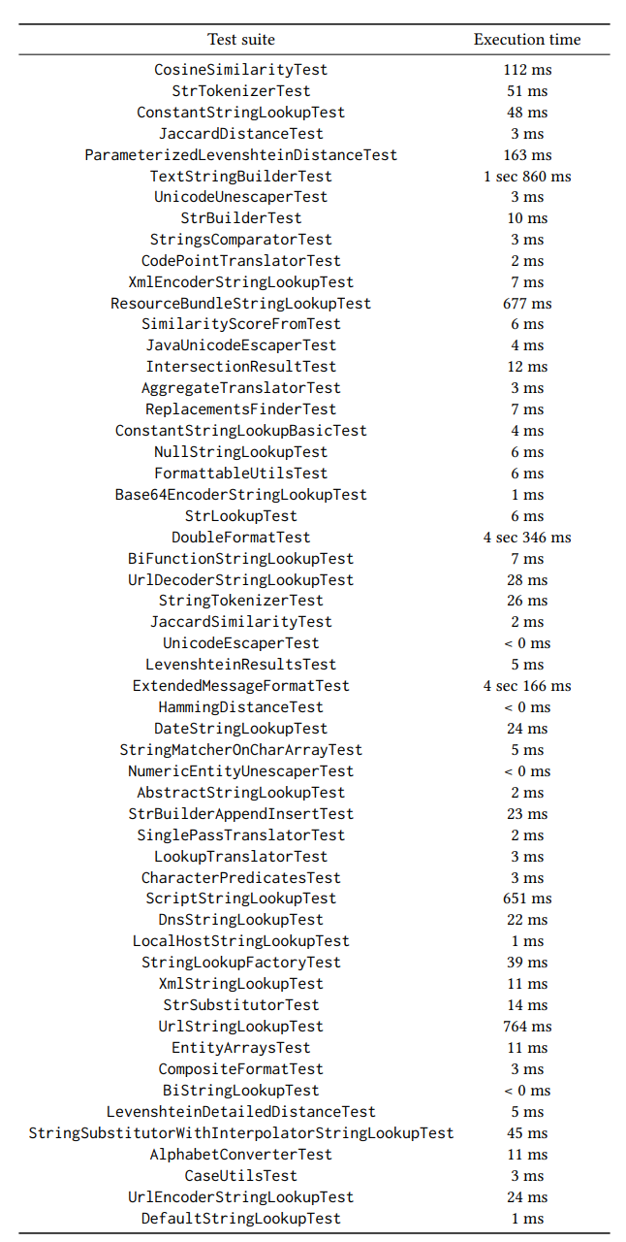
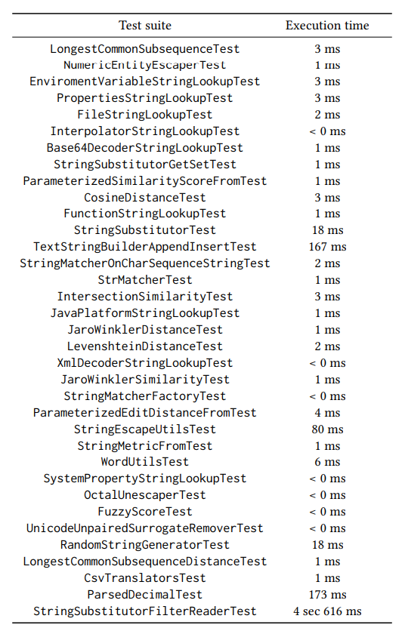
Performance testing

Slide 4
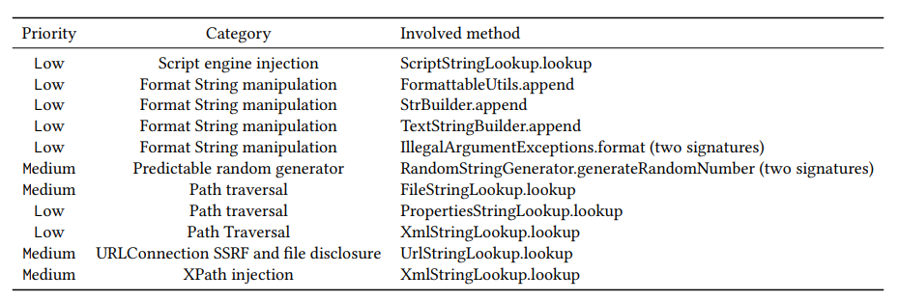
Security analysis
OWASP DC has spotted just one dependency, Apache Commons Lang. No vulnerabilities have emerged.

Slide 5
Automated test case generation
The classes subject to automated test case generation were: EditDistanceFrom, SimilarityScoreFrom, CharSequenceTranslator.
EditDistanceFrom coverage: remained at 75%.
SimilarityScoreFrom coverage: remained at 75%.
CharSequenceTranslator coverage: from 77,14% to 88,57%.
Overall project coverage: from 96,91% to 96,98%.

Slide 6

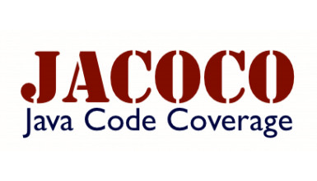
Code coverage

Slide 7
Line coverage
Overall coverage: 96,98%.
5828 tracked lines over 86 files.
5652 covered lines, 78 partially covered lines, 98 missed lines.

Slide 8
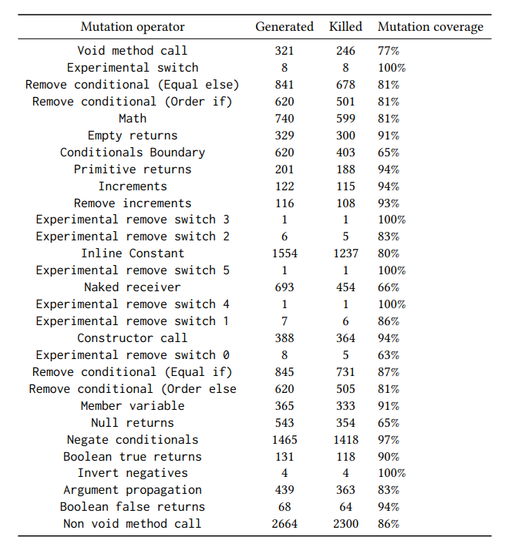
Mutation coverage
13.721 generated mutations, 11.410 have been successfully killed.
Overall mutation coverage of 83%.
287 surviving mutations are not covered by tests. Test strength of 85%.

Slide 9

Quality analysis
4 potential bugs, 2 with low severity and 2 with medium severity.
2429 code smells, 46 with high severity, 179 with medium severity and 2204 with low severity.

Slide 10
Potential bugs
2 potential bugs affect deprecated classes.
1 potential bug is caused by an overriding clone method in the StringTokenizer class. It is a false positive.
1 bug affects the TextStringBuilder class and concerns a subtraction between integer numbers whose result is assigned to a long variable.

Slide 11
Code smells
Empty method (4)
Test case without assertion (8)
Not serializable field in a serializable class (1)
Literal duplication (5)
Constant names do not follow conventions (3)
Confusing fields’ names (1)
Usage of generic wildcard types (2)
Too complex methods (20)
Overriding of Object.clone (2)

