Slide 1
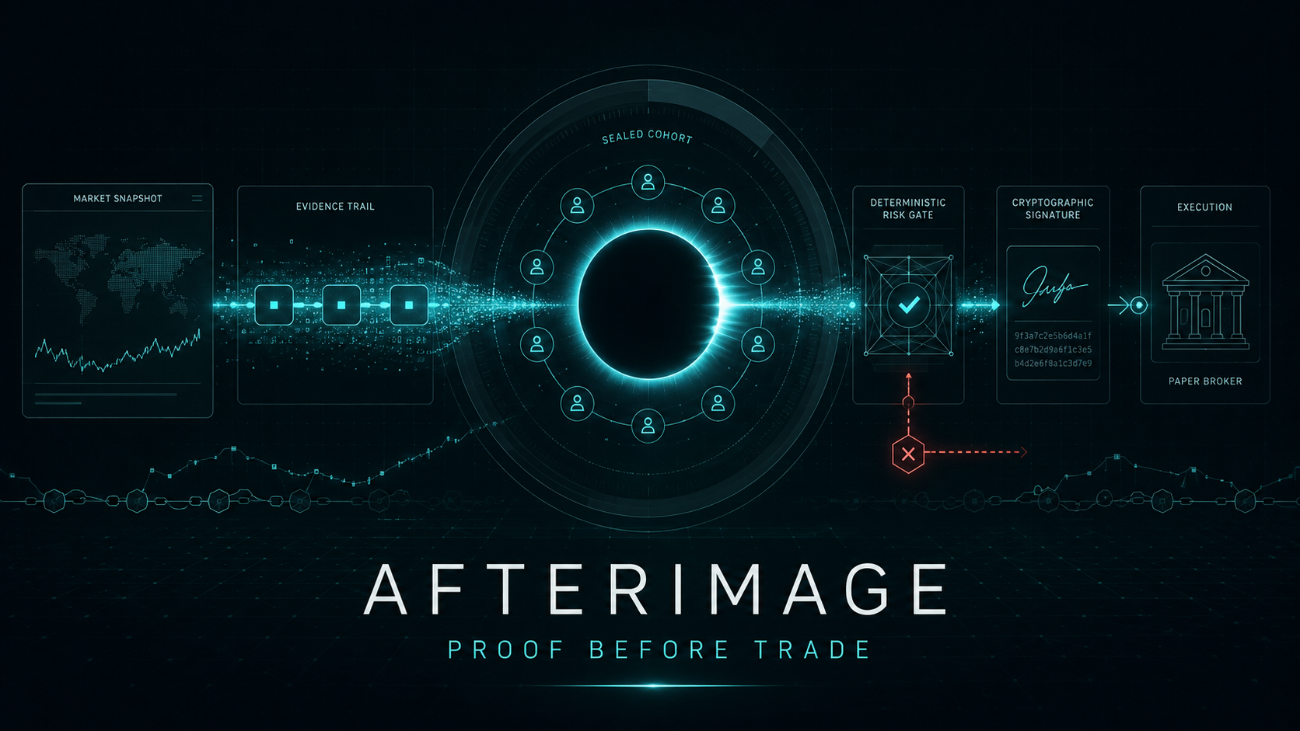
JUDGE EVIDENCE DECK · SEPTEMBER 2026
Deterministic SPY options research agent · Alpaca paper execution
Notes:
AFTERIMAGE is a paper-only research and execution-control system.
Cover asset: /home/john/Alpacaman/docs/submission/assets/afterimage-cover.png

Slide 2
THE VERDICT BEFORE THE PITCH
02
A trading agent that can prove why it did not trade
We tested the current opening-range family on real Alpaca data. It lost. AFTERIMAGE did the useful thing: refused to promote it and preserved the evidence.
32,346
12 / 12
−$126
NONE
real SPY 5-minute RTH bars
option paths validated; 0 exclusions
one-lot modeled P&L after slippage
no strategy met the promotion threshold
Why this is the product
Most agent demos optimize for a confident answer. AFTERIMAGE optimizes for a defensible decision: provenance, role-separated model testimony, deterministic risk, signed authority, and broker reconciliation.
AFTERIMAGE · PAPER-ONLY · PROOF BEFORE TRADE
Notes:
Sources:
/home/john/Alpacaman/evidence/research/spy-real-v1-manifest.json
/home/john/Alpacaman/evidence/research/spy-option-trade-bars-v1.json
/home/john/Alpacaman/evidence/tournament/spy-real-v1-results.json
The option study uses synchronized 5-minute trade-bar closes, not bid/ask fills. Its result is not broker P&L.

Slide 3
SYSTEM ARCHITECTURE
03
Every trade must survive a six-link proof chain
01
02
03
04
05
06
MARKET
SIGNAL
JURY
RISK
WARRANT
BROKER
Alpaca bars
+ strict schema
Deterministic
+ strategy
GLM-5.3
+ Flash
Exposure
+ drawdown gates
Ed25519
+ signed intent
Paper order +
+ reconcile
Any malformed payload, abstaining role, stale input, risk breach, invalid signature, or reconciliation mismatch stops the chain.
AFTERIMAGE · PAPER-ONLY · PROOF BEFORE TRADE
Notes:
Sources:
/home/john/Alpacaman/src/afterimage/orchestration/coordinator.py
/home/john/Alpacaman/src/afterimage/agents/desk.py
/home/john/Alpacaman/src/afterimage/risk/engine.py
/home/john/Alpacaman/src/afterimage/risk/warrant.py
/home/john/Alpacaman/src/afterimage/execution/cli_gateway.py

Slide 4
REAL HISTORICAL OPTION VALIDATION
04
The current candidate family does not earn deployment
−$126
aggregate modeled P&L
Mean return
−0.272R
Evidence boundary
• Real Alpaca historical options
• Synchronized 5-minute trade bars
• $0.01 one-way slippage per leg
• Not bid/ask or broker P&L
AFTERIMAGE · PAPER-ONLY · PROOF BEFORE TRADE
Notes:
Source: /home/john/Alpacaman/evidence/research/spy-option-trade-bars-v1.json
The chart is editable and contains the complete literal 12-observation series.
Historical option metadata is current-contract reference metadata; point-in-time metadata was unavailable. Pricing uses synchronized trade-bar closes, not quotes.

Slide 5
LIVE FEATHERLESS RECEIPT
05
Exact models reached. The jury said no.
ROUTES VERIFIED
OUTCOMES HIDDEN
ORDER BLOCKED
Strategist
zai-org/GLM-5.3
SUPPORT
Snapshot supports a thesis; outcomes unverified
Regime witness
zai-org/GLM-5.3-Flash
ABSTAIN
No explicit regime observations
Options witness
zai-org/GLM-5.3-Flash
ABSTAIN
No quotes, liquidity, Greeks, or IV
Prosecutor
zai-org/GLM-5.3
CHALLENGE
Breakeven and thesis were misaligned
Fail-closed result: every role must return non-abstaining evidence. One abstention is enough to prevent authority.
AFTERIMAGE · PAPER-ONLY · PROOF BEFORE TRADE
Notes:
Source: /home/john/Alpacaman/evidence/research/spy-live-model-receipt-v1.json
The receipt records response hashes, prompt hashes, model IDs, latencies, status, findings, and falsifiers for each role.

Slide 6
EXECUTION AUTHORITY
06
Models advise. Deterministic code owns the keys.
AI courtroom
Deterministic authority
Produces claims, evidence keys, falsifiers, and abstentions. It cannot sign or submit an order.
Checks freshness, exposure, sizing, daily loss, drawdown, expiry, session timing, and complete jury status.
NO BROKER CREDENTIALS
Issue an Ed25519 warrant bound to the exact order intent
1
NO SIGNING KEY
NO ORDER METHOD
2
Submit to the Alpaca paper endpoint only
3
Reconcile broker truth and emit append-only evidence
Structured output is treated as untrusted testimony.
AFTERIMAGE · PAPER-ONLY · PROOF BEFORE TRADE
Notes:
Sources:
/home/john/Alpacaman/src/afterimage/agents/desk.py
/home/john/Alpacaman/src/afterimage/risk/engine.py
/home/john/Alpacaman/src/afterimage/risk/warrant.py
/home/john/Alpacaman/src/afterimage/execution/cli_gateway.py

Slide 7
WHAT A JUDGE CAN VERIFY
07
Connected. Testable. Explicit about what is unproven.
REAL DATA
32,346 SPY bars · immutable hashes · 5-session embargo
Current truth
85
automated tests passing
REAL OPTIONS
12 synchronized historical option paths · 0 exclusions
Paper fills / broker P&L
0 / $0
REAL MODELS
Exact GLM-5.3 + GLM-5.3-Flash routes with receipt hashes
A paper order is allowed only if a natural signal survives every gate. No forced demo trade. No profit claim without a fill.
REAL BROKER
ACTIVE $100k Alpaca paper account · Level 3 · zero live-money paths
The differentiator is not prediction theater. It is verifiable restraint under uncertainty.
AFTERIMAGE · PAPER-ONLY · PROOF BEFORE TRADE
Notes:
Sources:
/home/john/Alpacaman/evidence/README.md
/home/john/Alpacaman/evidence/research/spy-real-v1-manifest.json
/home/john/Alpacaman/evidence/research/spy-option-trade-bars-v1.json
/home/john/Alpacaman/evidence/research/spy-live-model-receipt-v1.json
The paper account status was verified read-only on 2026-09-04. Do not present this as live-money capability or achieved broker P&L.

