Slide 1
Machine-Learned Surrogates for Reactive Transport: Numerical and HPC Integration Challenges for Industrial CFD
Thibault Faney

Slide 2
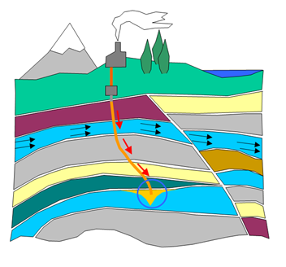
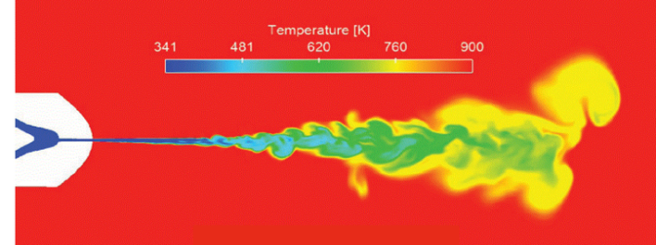
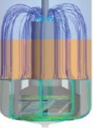
Reactive Transport Simulation at IFPEN
Flow in porous media
Combustion
Chemical processes
reservoir / basin modeling
EOR
CO₂ sequestration
H₂ storage
internal combustion engines
H₂ combustion
gas turbines
Refining
Biofuels
Batteries

Slide 3
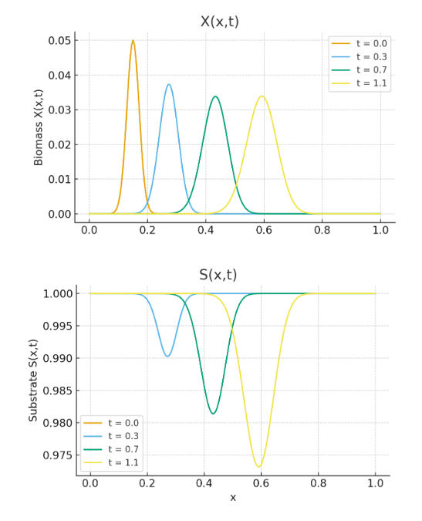



Issue with traditional solvers
Reactive Transport PDE
$$\frac{∂u}{∂t}+𝒯\left(u\right)+𝒞\left(u\right)=0$$
Monod system
$$\frac{∂S}{∂t}+vS_{x}=DS_{xx}−\frac{μS}{K+S}X$$
$$\frac{∂X}{∂t}+vX_{x}=DX_{xx}+Y\frac{μS}{K+S}X$$

Slide 4
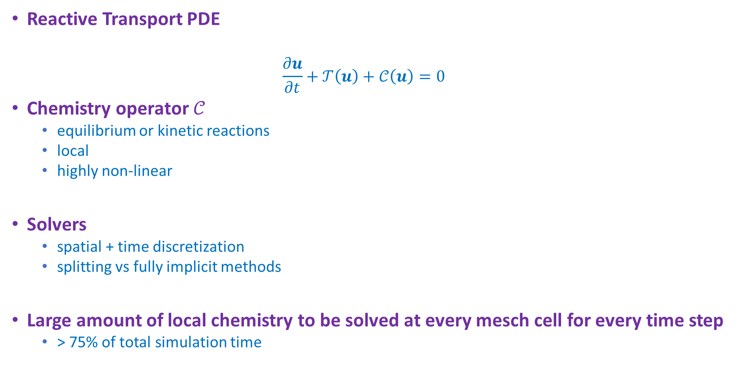
Issue with traditional solvers
Reactive Transport PDE
$$\frac{∂u}{∂t}+𝒯\left(u\right)+𝒞\left(u\right)=0$$
Chemistry operator $𝒞$
equilibrium or kinetic reactions
local
highly non-linear
Solvers
spatial + time discretization
splitting vs fully implicit methods
Large amount of local chemistry to be solved at every mesch cell for every time step
> 75% of total simulation time

Slide 5
Promise of chemistry surrogate modeling
Constraints in reactive transport
Geometry
Initial and Boundary conditions
Parameters (diffusion coefficients, reaction constants, etc.)
Chemical system
Redundancy
inter-simulations (optimisation, control, UQ, real-time)
intra-simulation (combustion front, mineral dissolution, etc.)
Strong potential of surrogate modeling
redudancy + space parallelism !

Slide 6
A Practical example : Thermodynamical Equilibrium

Slide 7




FLASH calculations
feed composition
$$z_{2}$$
$$z_{N}$$
$$z_{1}$$
Phase Condition
+
Composition
P
T

Slide 8
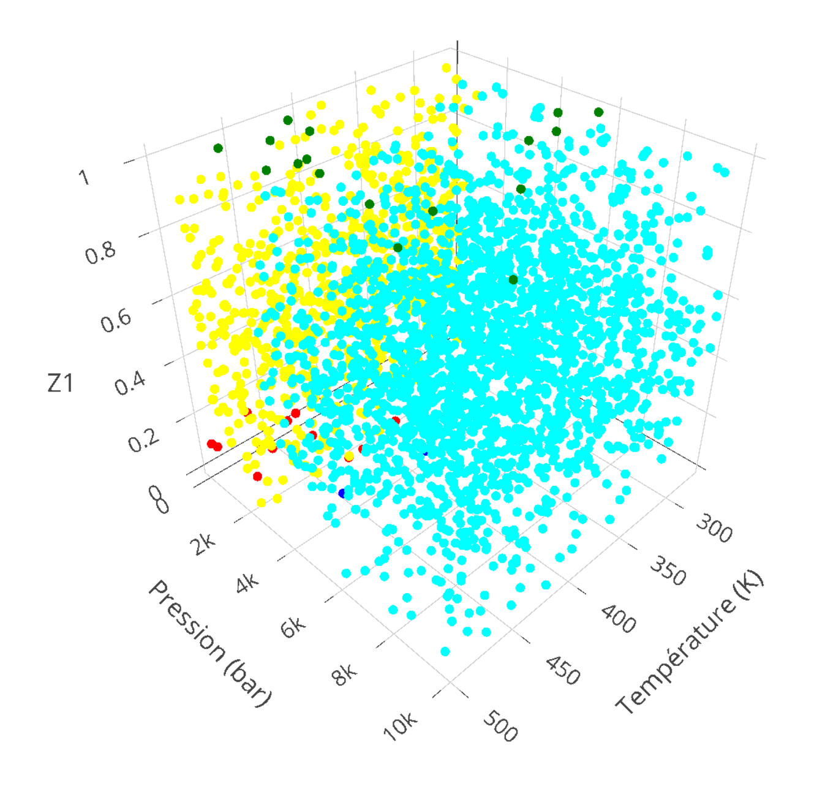
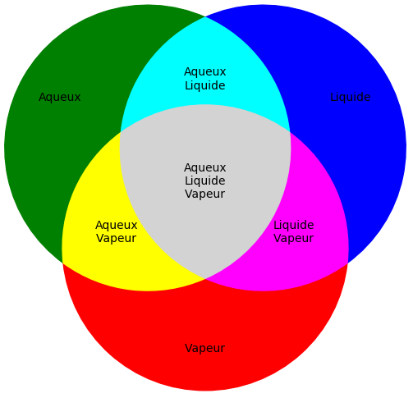
SAMPLING
H₂O-CH₄ binary mixture

Slide 9
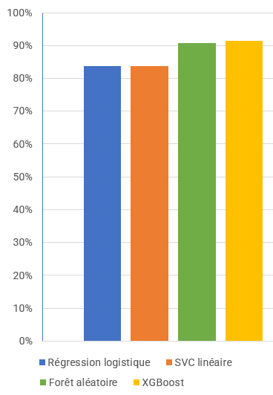
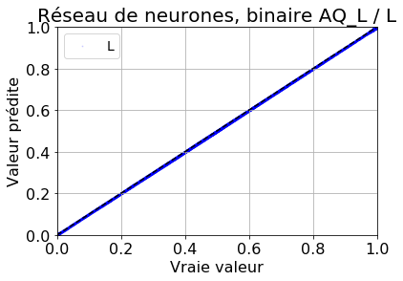
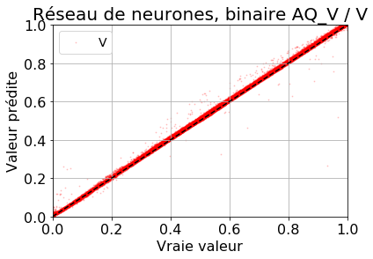
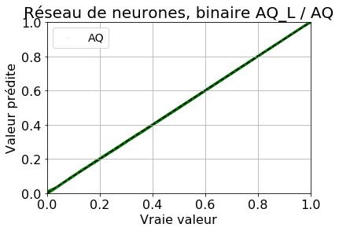
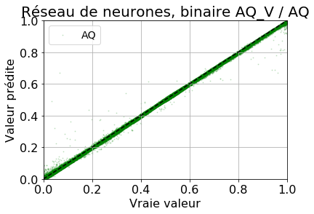
« Black-box » supervised learning model
Results
Classification Accuracy
Regression MSE = 8,1×10⁻⁵
Integration in Reactive Transport Solver (Vectorization is essential)

Slide 10
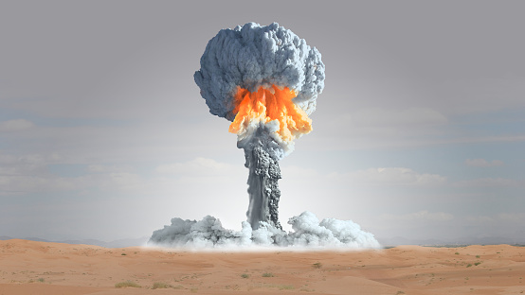
« Black-box » supervised learning model
CATACLISM : Coupling AI, Transport And Chemistry for Large-scale Innovative Simulation and Modeling
Local, small errors blow up in finite time
Why ? No guarantee on the solution, no physics → no stability

Slide 11
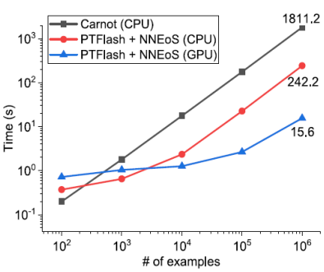
« Black-box » supervised learning model
Performance heavily depends on parallelism
GPU not necessarily a clear winner

Slide 12
Basic Challenges
Numerical challenges
Precision
Stability
Generalisation
Computational challenges
Fast surrogates

Slide 13
Some leads and some more challenges

Slide 14
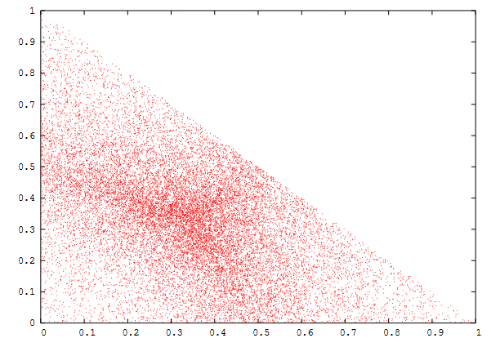
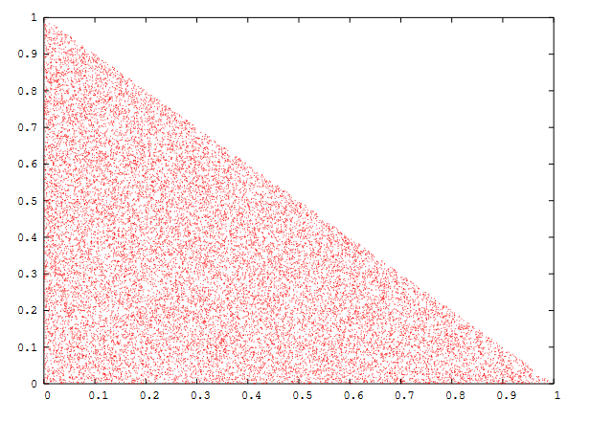
SAMPLING
High dimensional sampling on simplex (∑𝑧_{𝑖}=1): Dirichlet distribution

Slide 15
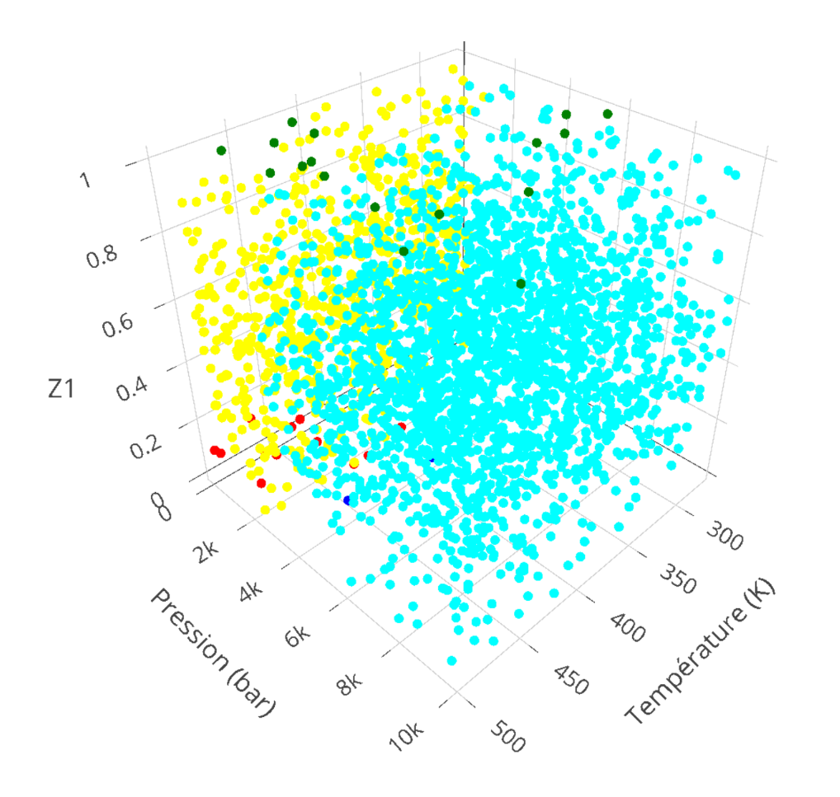
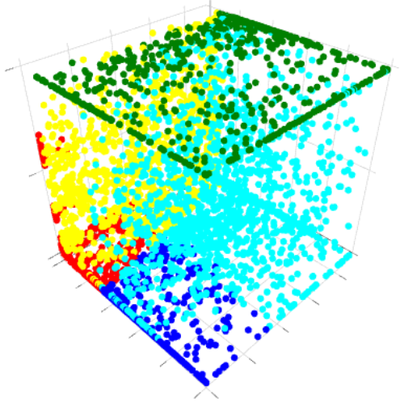
SAMPLING
Unbalanced classes: Add random noise to samples
$$X_{oversampled}=X+ε$$

Slide 16
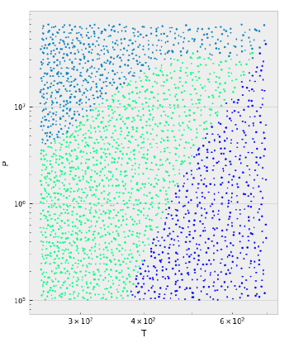
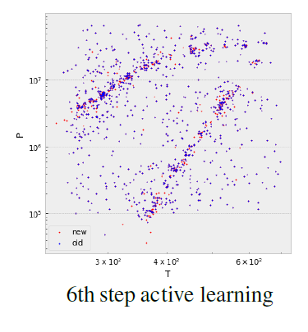
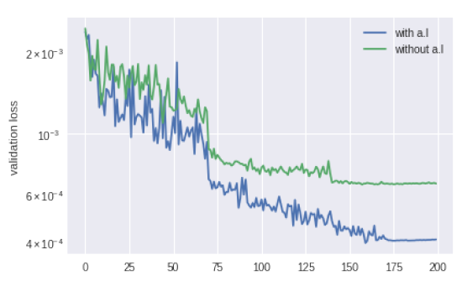
SAMPLING
Active Learning

Slide 17
SAMPLING
Online learning
Flag bad predictions and add them to database
Retrain model periodically
New challenges
UQ for chemistry models
Move data to GPU to retrain model during computation

Slide 18




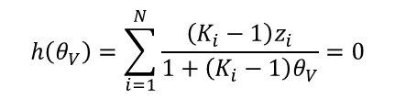

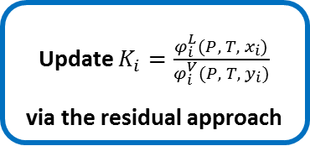





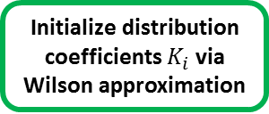


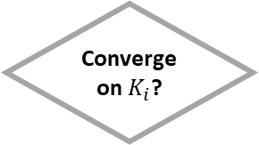

Intrusive Models
Jingang Qu’s PhD thesis (IFPEN – LIP6 at Sorbonne University)
Numerical PT-flash calculations for vapor-liquid equilibrium
Phase condition determination
Initialization
Successive substitution
Output
Yes
$$x_{i}^{\left(k\right)}$$
$$y_{i}^{\left(k\right)}$$
P
$$K_{i}^{\left(k\right)}$$
$$θ_{V}$$
$$x_{i}$$
$$y_{i}$$
Update $K_{i}=\frac{φ_{i}^{L}(P, T, x_{i})}{φ_{i}^{V}(P, T, y_{i})}$
via the residual approach
$$K_{i}^{\left(k+1\right)}$$
Phase stability analysis
Initialize distribution coefficients $K_{i}$ via Wilson approximation
Solve Rachford-Rice equation
Converge on $K_{i}$?
T
Single phase ?
$$z_{1}$$
No
Yes
$$z_{N}$$
$$k=k+1$$
No
Rachford-Rice equation
$$h\left(θ_{V}\right)=\sum_{i=1}^{N}{\frac{\left(K_{i}−1\right)z_{i}}{1+\left(K_{i}−1\right)θ_{V}}}=0$$
Wilson approximation
The residual approach
$$K_{i}=\frac{P_{c,i}}{P}\exp\left(5.373\left(1+ω_{i}\right)\left(1−\frac{T_{c,i}}{T}\right)\right)$$
$$θ_{V}$$
$$F=\frac{A^{r}\left(T,V,n\right)}{RT}$$
$$x_{i}=\frac{z_{i}}{1+\left(K_{i}−1\right)θ_{V}}$$
$${\ln{φ}}_{i}\left(P,T,n\right)={\left(\frac{∂F}{∂n_{i}}\right)}_{T, V}−\ln{Z}$$
$$y_{i}=\frac{K_{i}z_{i}}{1+\left(K_{i}−1\right)θ_{V}}$$

Slide 19



Intrusive Models
Data-driven PT-flash calculations for vapor-liquid equilibrium
Phase condition determination
Initialization
Successive substitution
Output
Yes
$$x_{i}^{\left(k\right)}$$
$$y_{i}^{\left(k\right)}$$
P
$$K_{i}^{\left(k\right)}$$
$$θ_{V}$$
$$x_{i}$$
$$y_{i}$$
NN proxy calculator
$$K_{i}^{\left(k+1\right)}$$
NN
proxy classifier
NN proxy initializer
Solve Rachford-Rice equation
Converge on $K_{i}$?
T
Single phase ?
$$z_{1}$$
No
Yes
$$z_{N}$$
$$k=k+1$$
No

Slide 20
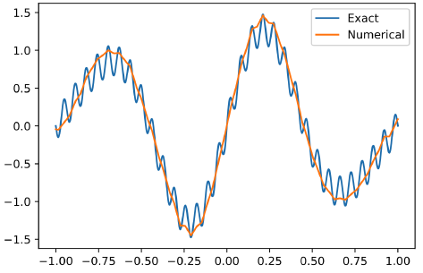
Intrusive Models
Neural bias of neural networks towards predicting low frequency components of the solution
Poisson equation fit with ReLU activation function¹
Good synergy with the quadratic convergence of Newton methods near the solution
¹ Jinchao Xu, CEMRACS 2023 Lecture Notes

Slide 21
Intrusive Models
Convergence guaranteed
Downsides
Very problem dependent
“Limited” computational gains
Requires low latency hybrid HPC / AI computations

Slide 22
Adding physical constraints
Soft constraints
Training issues
Can be difficult to express

Slide 23
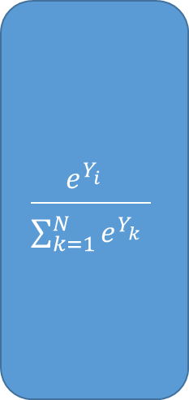
Adding physical constraints
Hard constraints
Problem dependent
Gradient issues → hard to train
Y₁
$$\frac{e^{Y_{i}^{}}}{\sum_{k=1}^{N}{e^{Y_{k}^{}}}}$$
Y₂
. . .
. . .
. . .
. . .
Y_{N}
Y(t)
Softmax
Y(t+dt)

Slide 24
Adding physical constraints
Hard constraints
Problem dependent
Gradient issues → hard to train
Y₁
Projection on linear subspace
Y₂
. . .
. . .
. . .
. . .
Y_{N}
Y(t)
Y(t+dt)

Slide 25
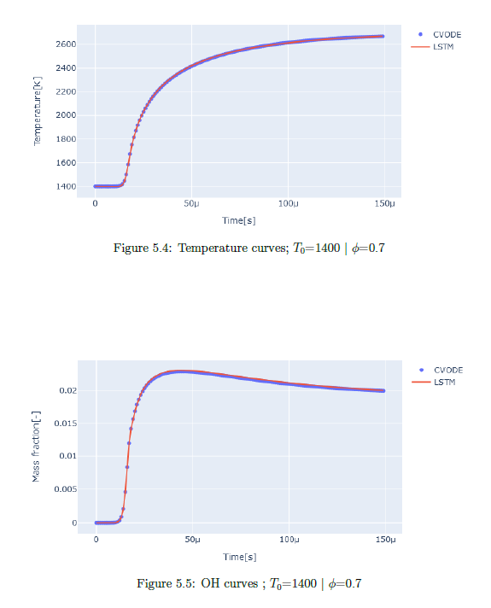
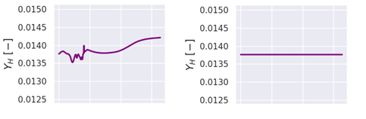
Adding physical constraints
Results
Conservation of hydrogen mass without (left) and with (right) network enforced mass conservation
Cédric Mehl, IFPEN

Slide 26
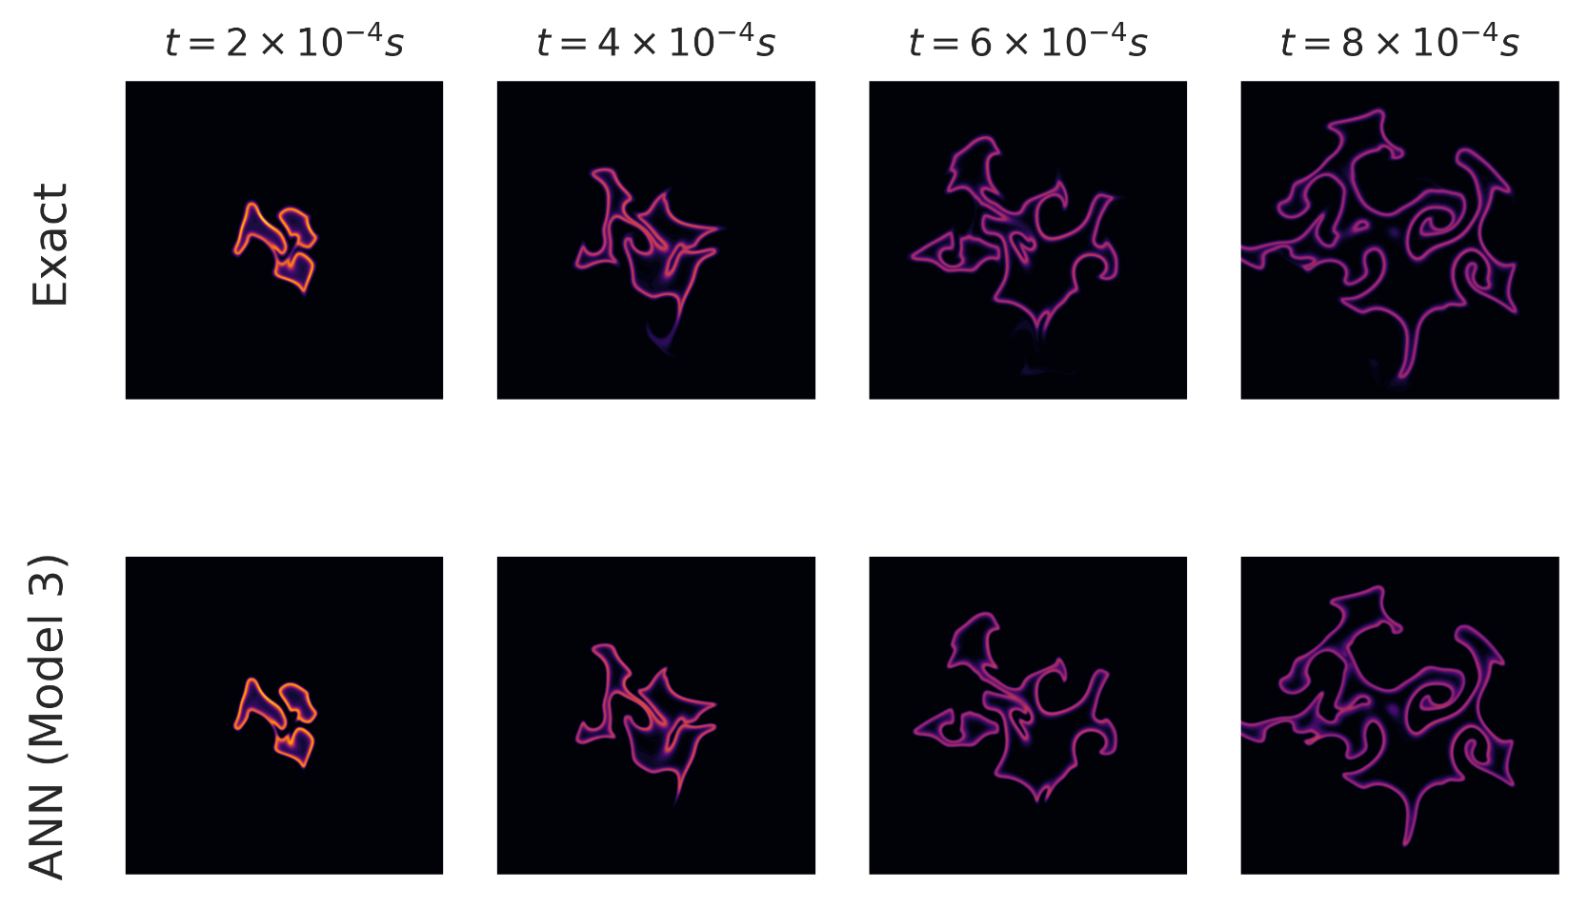
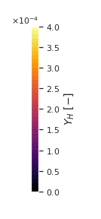
Adding physical constraints
Results
Cédric Mehl, IFPEN

Slide 27
Challenges

Slide 28
Challenges with hybrid ML / HPC solvers for reactive transport
Numerical challenges
Precision and Stability
Intrusive models
Physics informed models
Sampling
UQ
Mixed precision integration
Learn over PDE trajectories
Generalisation
One model to rule several chemical systems
Fondational models
Computational challenges
Online Learning
Low latency inference
Revisiting the performance / accuracy trade-off

Slide 29
Recommendations
Stability
A posteriori (trajectory) learning
Problem dependent structural form for the corrector model
Adding noise (both a priori and a posteriori)
Consistency with chemical equations (soft /hard)
Linearize surrogate model to study stability (eigenvalues)
Generalization
Use probablistic classifier output (instead of hard classifier)
Samples need to be representative of the time evolution
PDE NO : use smooth rhs
NO with autoencoder trained on base chemical system + retrain to add new species on the fly
Online Learning
Focus on dynamic local time stepping
Bayesian model to decide on the fly the use of surrogate model
Training a very simple domain for inactive chemical points and « track » that domain

