Slide 1
Researchers want to know about things that have happened after an article they are reading was published

Slide 2
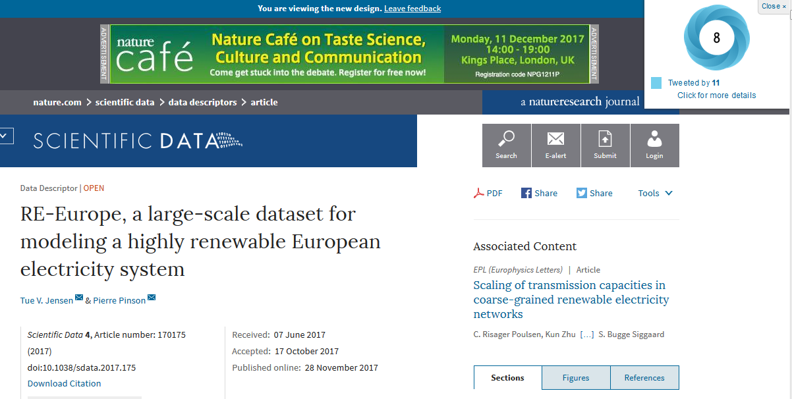
Altmetric browser plugin
Alerts reader to post-publication social media attention

Slide 3
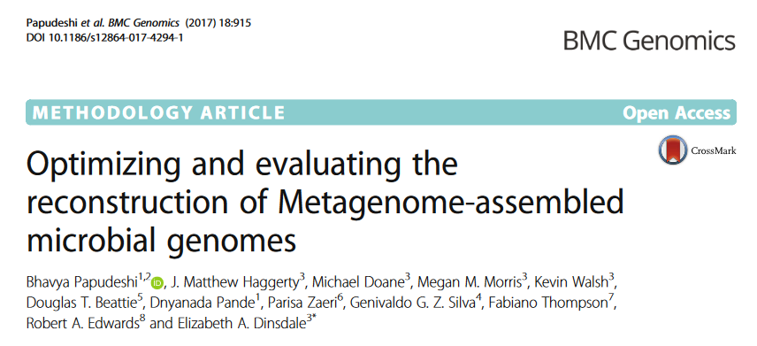
CrossMark alerts readers to post-publication corrections to an article

Slide 4
Why can’t we do this with data?

Slide 5

Introducing D’OI for data

Slide 6
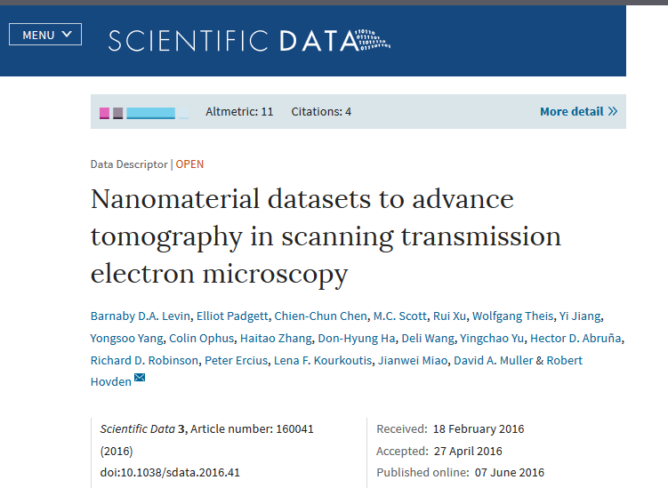
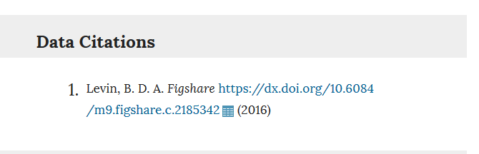
Find a dataset DOI

Slide 7
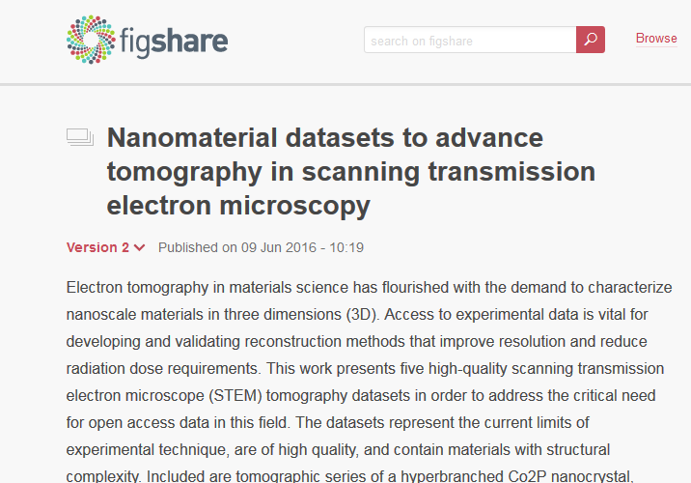
Call the figshare API to see whether there has been an update

Slide 8
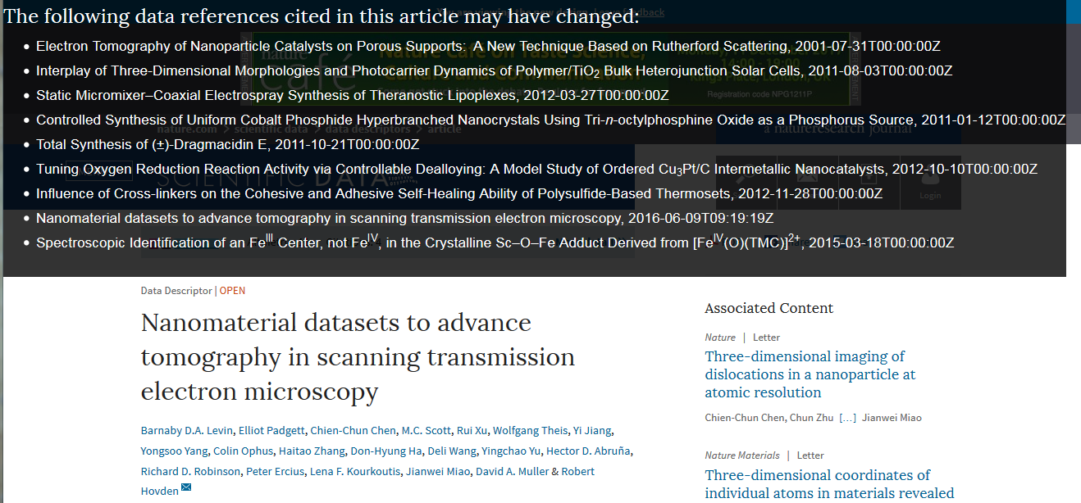
Display an alert on the article
Current implementation finds figshare datasets associated with both articles in the references AND with the current publication

Slide 9
Our code
https://github.com/ScientificDataLabs/dataset-updates-plugin
MIT licensed

