Slide 1
Meta-Learning with Latent Embedding Optimization
Rusu et al. ICLR, 2019
Notes:
Hello everyone, today we will introduce Meta-Learning with Latent Embedding Optimization as an extension to the MAML framework. This paper presents a novel modification to MAML, and we will dive deep into the motivation, modification and final results.

Slide 2


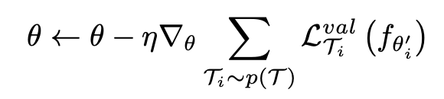
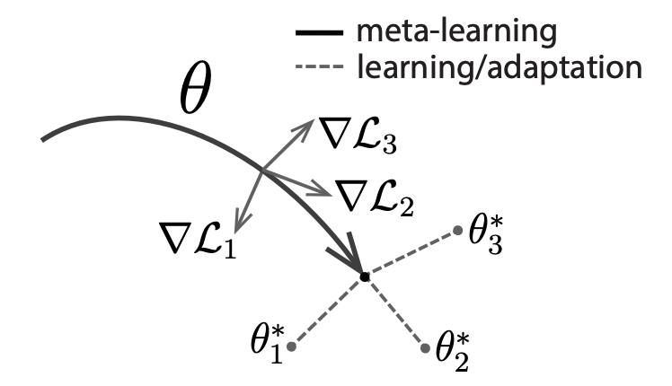
Recap: MAML
Slow Net (θ), Fast Net (θ’)
Slow Net provides an initialization θ for Fast Net (aka “outer loop”).
Fast Net (aka “inner loop”) takes a few gradient update updates on θ to obtain θ’.
We compute the validation loss for the task, take deritivative w.r.t. θ, and sum the gradients over sampled tasks.
Update Slow Net weight θ
Notes:
\mathcal{T}_i \sim p(\mathcal{T})
\mathcal{T}_i = (\mathcal{D}^{tr}, \mathcal{D}^{val})
Let’s do a simple recap on MAML. You guys are supposed to be experts on MAML now after 2 weeks of lecture. MAML computes a good universal initial parameters that can adapt well to all tasks from the distribution. Another way of looking at MAML is to think of a slow net and a fast net, where slow net keeps the meta parameters, fast net adapts to specific tasks.

Slide 3
Recap: MAML
Last week, we discussed several challenges in the original MAML algorithm and different proposals for improving it.
One limitation that hasn’t been addressed is that, tasks might not uniformly exist in the task space. Using a universally shared θ might not be optimal when the task space has structure.
θ¹
θ*
V.S.
θ³
θ²
Notes:
Last week, in the lecture, we discussed several challenges for MAML and how they are addressed.
One problem MAML doedsn’t address is that tasks have relationships amongst each other. Some tasks are more similar, some are more different.
MAML tries to initialize θ over the average distance to all tasks. This is not very flexible.

Slide 4


Challenge: How many tasks are out there?
In the few-shot meta-learning setting, we don’t have number of tasks. The question becomes: how do we propose a θ for a new task that also conforms to the task space structure?
Solution: Black-box Adapatation
Model
Notes:
\mathcal{T}_i
x^{ts}

Slide 5
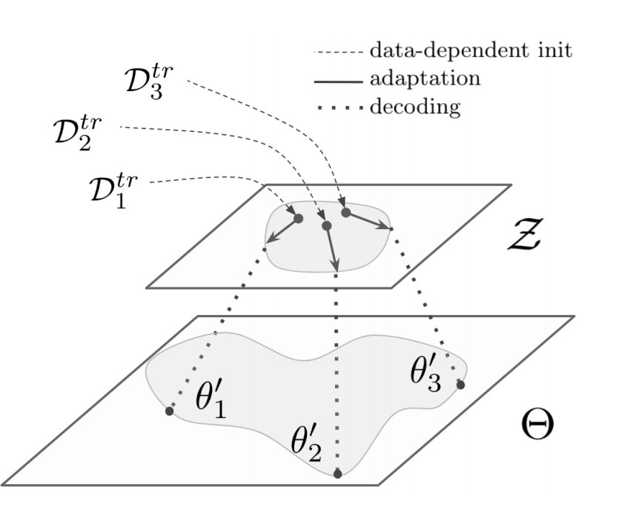
LEO: Learning task-dependent θ
LEO learns a function to propose θ by taking data points as input by mapping data point x into a latent vector z, then decode into θ for final classification.
Several advantages for the latent space:
Easier optimization (a smaller gradient step in latent space can have a larger impact on final parameter space)
Easier adaptation (more expressive than a single θ)
Task agnostic (if z is inferred from data x, y)
Notes:
Θ here is θ’ in MAML...not the weights for the slow network.

Slide 6
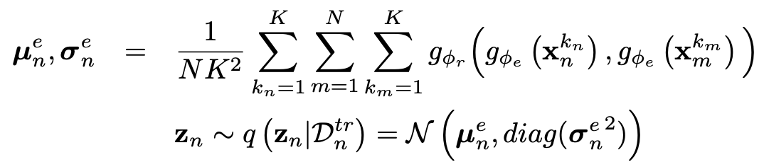
First Step: Encoding Data (Outer Loop)
Encoder: Φ_{e} x → h
Relation network: Φ_{r} inspired by non-parametric few-shot learning, we don’t just want to map a datum to its hidden representation, we need to consider the relationship of classes in our training example.
Class n
Every other class

Slide 7

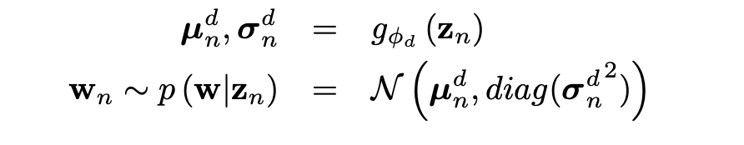

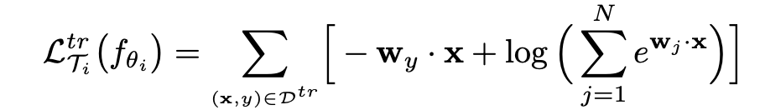
Second Step: Decoding Z (Inner Loop)
Decoder: Φ_{d} after obtaining the latent representation z, we need to enter the “inner loop”, getting θ so that we can fine-tune for the adaptation tasks.
Since we used relation network, we will actually obtain
Again, inspired by non-parameteric few-shot learning:
These are equivalent to label embedding matrix

Slide 8


Adaptation Procedure: Inner Loop
Adaptation by Latent Embedding Optimization (LEO) (The “Inner Loop”)
Repeat N times:
End Repeat
We update inner loop to obtain θ’ for outer loop update.
Only update z, no update on decoder parameters Φ_{d}
Notes:
z^\prime_n = z_n - \alpha \nabla_{z_n} \mathcal{L}_{\mathcal{T}_i}^{tr}
\mathcal{D}^{tr} \sim \mathcal{T}_i

Slide 9
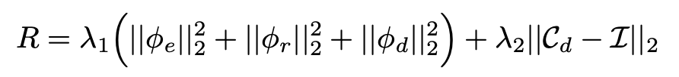
Meta-Training Procedure: Outer Loop
For each sampled task, we update the encoder Φ_{e} , relation network Φ_{r} and decoder Φ_{d} once via the validation data in that task.
We use the updated z’ to learn z, use MSE loss to update parameters for encoder and relation network. We use the validation loss to update decoder parameters.
This means decoder is part of the “slow network”
Correlation matrix on rows of Φ_{d}
Notes:
Last term is to increase expressivity

Slide 10
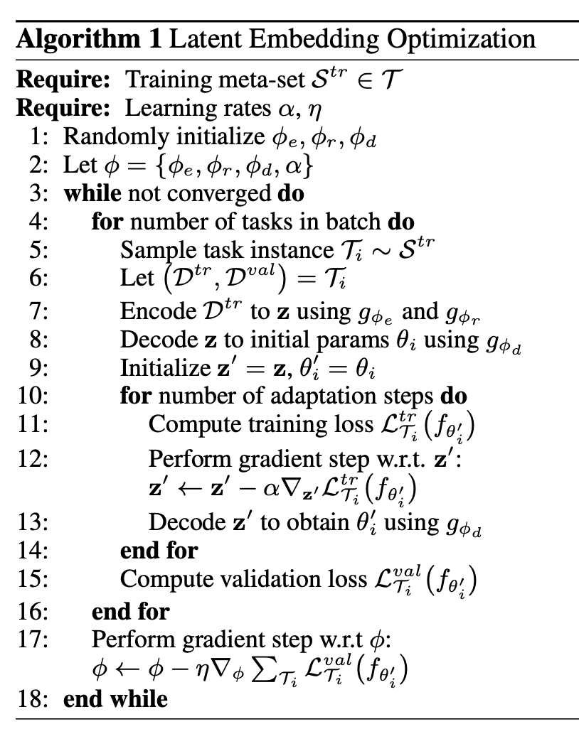
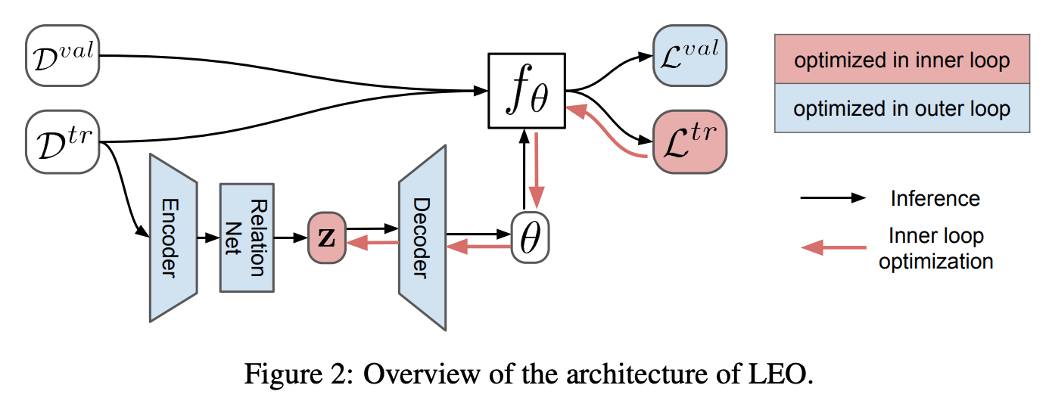
The LEO Algorithm

Slide 11
Evaluation
Is LEO capable of modeling a distribution over model parameters when faced with uncertainty?
Can LEO learn from multimodal task distributions and is this reflected in ambiguous problem instances?
Is LEO competitive on large-scale few-shot learning benchmarks?
Notes:
MAML [7] uses the original SGD as meta-learner, but the initialization is learned via meta-learning. In contrast, Meta-SGD also learns the update direction and the learning rate, and may have a higher capacity.

Slide 12
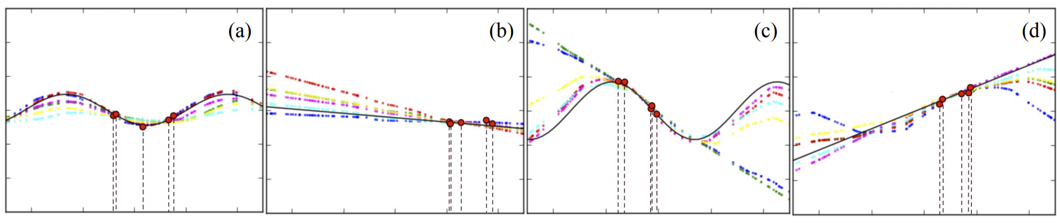
Results - Few shot regression
1D regression problems (5-shot). Points are sampled from a sine wave or a line with 50/50.
(with random amplitude and phase and with random slope and intercept)
(a) and (b) illustrate how LEO captures some of the uncertainty in problem instances within each mode.
(c) and(d) shows LEO can sample different models to represent parametric uncertainty appropriately.
Notes:
are generated in equal proportions using either a sine wave with random amplitude and phase, or a line with random slope and intercept

Slide 13
Results - Few shot classification
Dataset:
miniImageNet (100 classes, each class has 600 images, train 64 classes, val 16 classes, and test 20 classes)
tieredImageNet (779,165 images) grouped into 34 classes that has train 20 classes, val 6 classes, test 8 classes.
Pre-training: Wide Residual Net (WRN-28-10), pick up the last linear softmax layer as the feature extractor (before LEO).
Fine-tuning: few steps adaptation in latent or parameter space via few-shot learning like MAML
Notes:
WRN-28-10 where 28 conv layers depth, and 10 is widening factor (10 times wider than the original residual block) 640 dim output

Slide 14
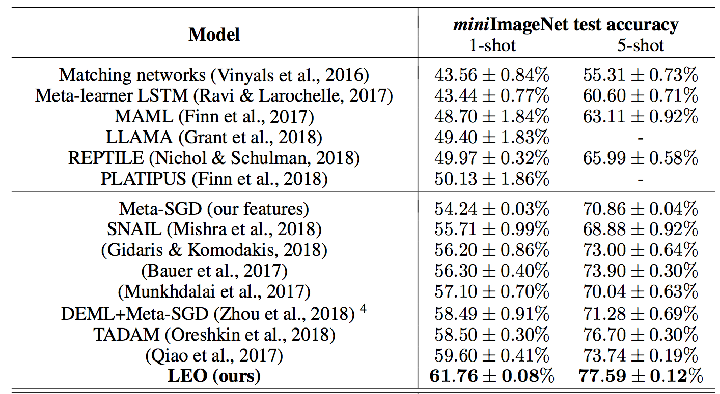
Results - miniImageNet

Slide 15
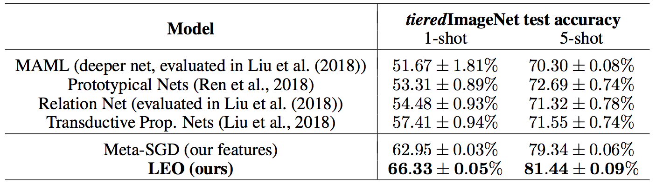
Results - tieredImageNet
Notes:
The classification accuracies for LEO and other baselines are shown in Table 1. LEO sets the new state-of-the-art performance on the 1-shot and 5-shot tasks for both miniImageNet and tieredImageNet datasets. We also evaluated LEO on the “multi-view” feature representation used by Qiao et al. (2017) with miniImageNet, which involves significant data augmentation compared to the approaches in Table 1. LEO is state-of-the-art using these features as well, with 63.97 ± 0.20% and 79.49 ± 0.70% test accuracies on the 1-shot and 5-shot tasks respectively.

Slide 16
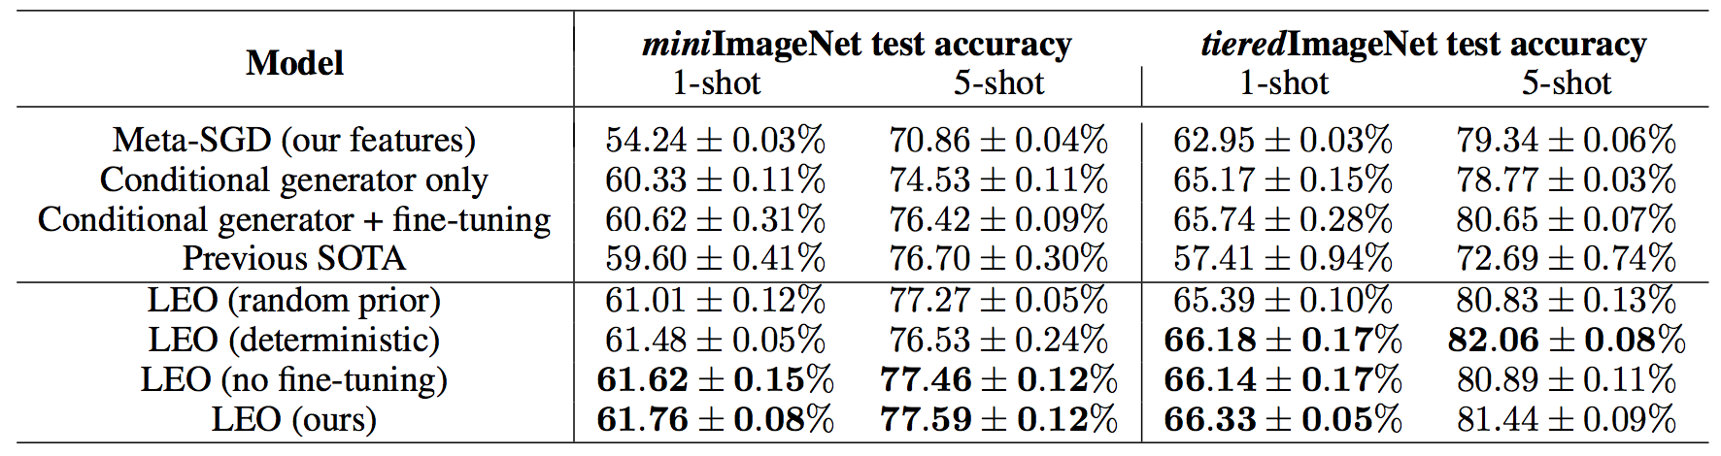
Results - Ablation study
Both the data-conditional encoding and latent space adaptation are critical to the performance of LEO
Notes:
The importance of the data-dependent encoding is highlighted by the “random prior” case, in which the encoding process is replaced by the prior p(z_n), and performance decreases

Slide 17
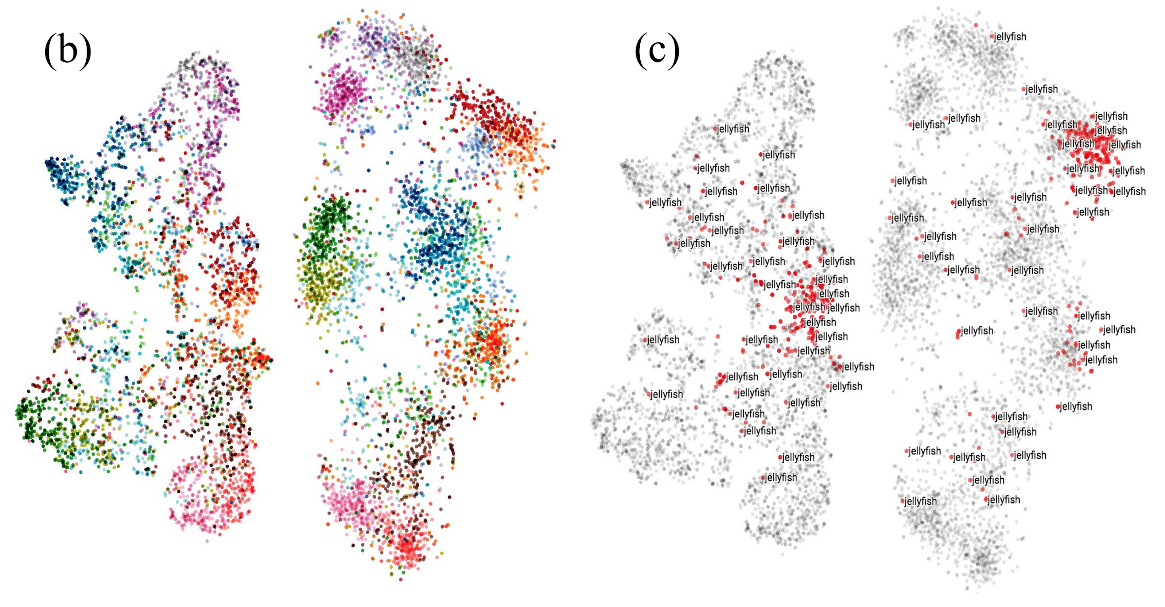
Results - tSNE on Latent space
Left figure is z_{n}, right figure is z’_{n}.

Slide 18
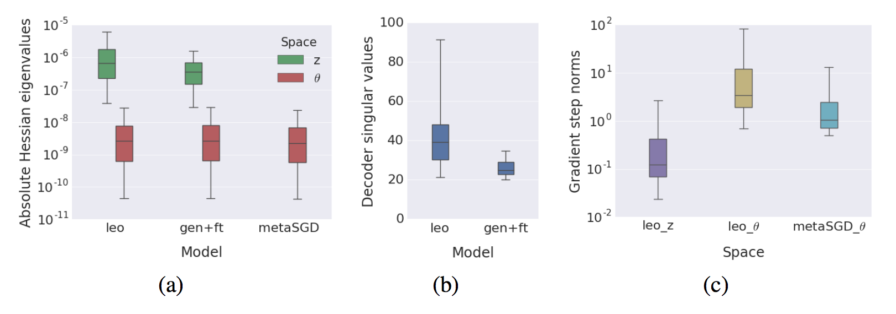
Results - curvature and coverage
Notes:
performing the inner-loop optimization in a lower-dimensional latent space, the adapted solutions do not need to be close together in parameter space, as each latent step can cover a larger region of parameter space and effect a greater change on the underlying function.
The “conditional generator only” case (without adaptation in latent space) yields a poorer result than LEO, and even adding fine-tuning in parameter space does not recover performance;
Figure 5(a), the curvature for LEO in z space (the absolute eigenvalues of the Hessian of the loss) is 2 orders of magnitude higher than in θ, indicating that a fixed step in z will change the function more drastically than taking the same step directly in θ. This is also observed in the “gen+ft” (conditional generator and fine-tuning) case, where the latent embedding is still used, but adaptation is performed directly in θ space. This suggests that the latent bottleneck is responsible for this effect. Figure 5(b) shows that this is due to the expansion of space caused by the decoder. In this case the decoder is linear, and the singular values describe how much a vector projected through this decoder grows along different directions, with a value of one preserving volume. We observe that the decoder is expanding the space by at least one order of magnitude. Finally, Figure 5(c) demonstrates this effect along the specific gradient directions used in the inner loop adaptation: the small gradient steps in z taken by LEO induce much larger steps in θ space, larger than the gradient steps taken by Meta-SGD in θ space directly. Thus, the results support the intuition that LEO is able to ‘transport’ models further during adaptation by performing meta-learning in the latent space

Slide 19
Discussion & Takeaways
Parameter Efficiency: Optimizing over a latent space is more parameter-efficient than optimizing over parameters from the entire network.
Flexibility/Expressivity: Data/Task-dependent parameters allow more expressivity/flexibility in final adaptation.
Parameter Space: Similar to VAE, but using latent embedding to represent parameter space instead of image space.
Marginal improvement: Improvement from final adaptation is only marginal (decoder is more important in the network).

Slide 20
Questions
Thanks

