Slide 1
Fast Context Adaptation via Meta-Learning
Luisa Zintgraf¹ Kyriacos Shiarlis¹² Vitaly Kurin¹² Katja Hofmann³ Shimon Whiteson¹²
CS 330 Paper Presentation
October 9, 2019
¹ University of Oxford ² Latent Logic ³ Microsoft Research
Proceedings of the 36th International Conference on Machine Learning

Slide 2

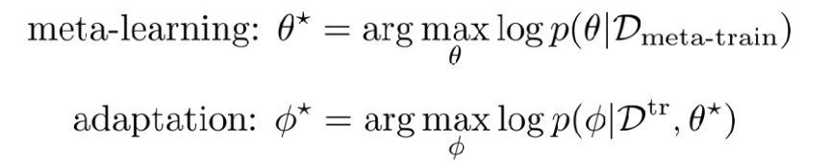
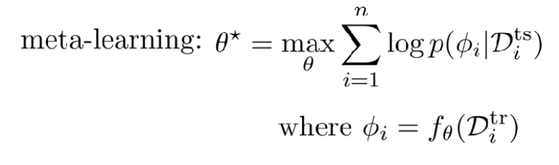
Problem formulation
Standard meta-learning formulation:

Slide 3
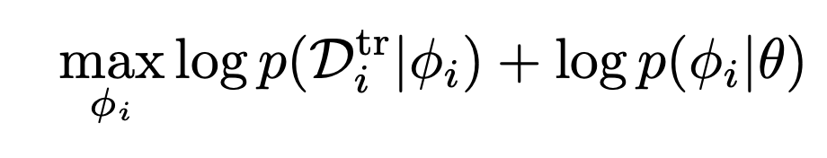
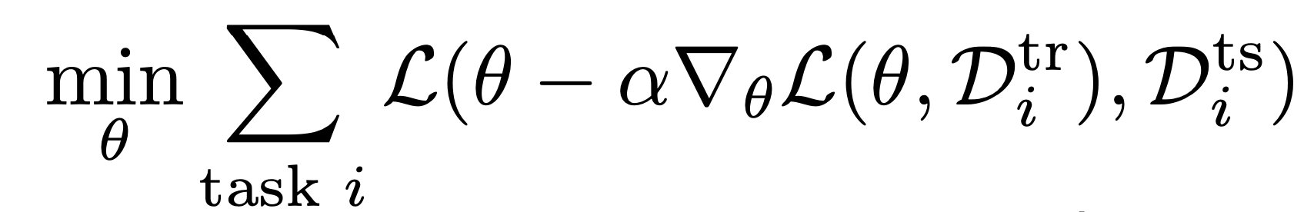
Optimisation-based approaches
MAML
θ serves as a prior over tasks.
We assume the tasks have some shared structure.

Slide 4
Problems/questions
Why update the whole model/prior θ at test time, when we know the tasks have shared structure that doesn’t need updating, so much of θ is shared?
(worse for large θ, e.g. meta-RL)

Slide 5
Problems/questions
2. Multi-task and bi-level optimisation is very tricky. MAML is not always robust, and meta-overfits easily.
e.g. Mishra et al. (2018) on MAML:
“1-shot, 5-way mini-ImageNet: 30.1% & 75.2% on the test and training set respectively”

Slide 6
Problems/questions
3. Many tasks in current benchmarks require no generalisation beyond inferring a (low-dimensional) underlying task.
(e.g. sine regression, moving 2d points, half-cheetah forwards/backwards)

Slide 7
Problems/questions
4. MAML is not interpretable. No way to infer the task we solved from θ, even when it works.

Slide 8
Problems/questions
5. MAML is not easy to parallelise.
Can’t run many tasks and share the underlying structure, since it’s fully updated at test-time.

Slide 9
Problems/questions
6. MAML is almost too “meta-agnostic.” Not many ways to specify how much structure should truly be shared between tasks, since the whole model is updated at test-time.

Slide 10
Related Work (that might help)
MAML Extensions (with better optimisation/task inference)
Meta-SGD (Li et al., 2017): “meta-learn the inner loop learning rate and direction”
LEO (Rusu et al., 2019): “learn encoder/decoder for distribution of θ”
MT-Nets (Lee and Choi, 2018): “meta-learn both inner loop learning rate (T-Net), and which parameters to update (M-Net)”
Pre-MAML Task Embeddings (from MTL literature)
Context-sensitive MTL (Silver et al, 2008): “learn context embedding for individual tasks, and fully share all other structure”

Slide 11
CAVIA: Context adaptation via meta-learning
Concept: MAML but...
Inner loop parameters (ϕ) and outer loop parameters (θ) are disjoint
Fix θ at test time, and only update ϕ
Fix initialisation of ϕ at train time
Intuition:
Learn (possibly low-dimensional) task/context embedding from training data provided at test time. Still get benefits of MAML bi-level optimisation.

Slide 12
How does this answer those problems?
More robust optimisation, and meta-overfits less.
More efficient: no need to update whole θ at test-time
Better inductive bias if the main problem is task inference.
Provides interpretable (possibly low-dimensional) task embeddings.
Can parallelise and share underlying structure
Can parameterise shared vs. non-shared dimension.
(?) Shows that the MAML benchmarks resolve to fairly simple task inference?

Slide 13
Method Overview
Context adaptation via meta-learning (CAVIA)

Slide 14
Method Overview
Context adaptation via meta-learning (CAVIA)
Context parameters 𝜙
Model parameters 𝜃_{MAML}
Shared parameters 𝜃

Slide 15
Method Overview
Context adaptation via meta-learning (CAVIA)
In MAML, 𝜃_{MAML} is adapted to each task.
In CAVIA, only 𝜙 is adapted to each task.
𝜃 remain fixed at adaptation time.
Context parameters 𝜙
Model parameters 𝜃_{MAML}
Shared parameters 𝜃

Slide 16
Method Overview
Context adaptation via meta-learning (CAVIA)
In MAML, 𝜃_{MAML} is adapted to each task.
In CAVIA, only 𝜙 is adapted to each task.
𝜃 remain fixed at adaptation time.
Context parameters 𝜙
Model parameters 𝜃_{MAML}
Shared parameters 𝜃
In MAML, 𝜃_{MAML} is meta-learned to maximize performance of adapted 𝜃_{MAML}.
In CAVIA, 𝜃 is meta-learned to maximize performance of fixed 𝜃 with adapted 𝜙.
𝜙 is not meta-learned; it is initialized to 𝜙₀.

Slide 17
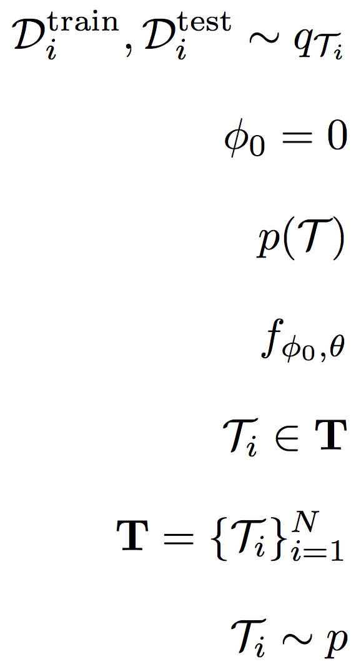
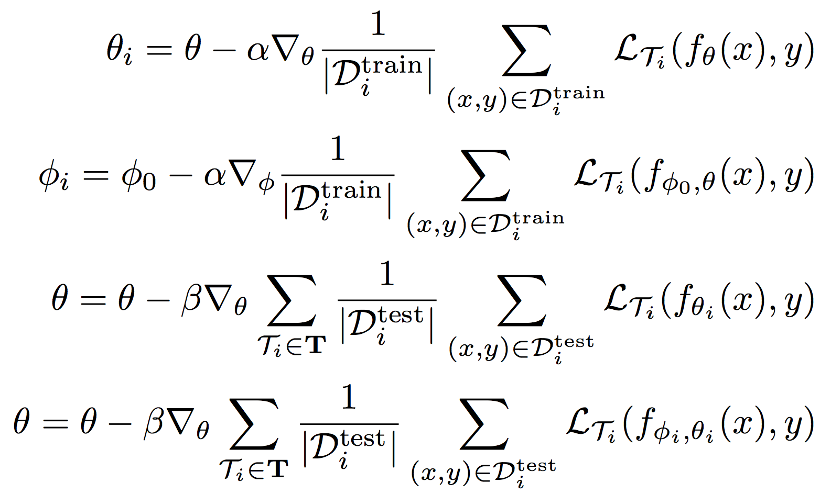
MAML for Supervised Learning
Let be a distribution over tasks, 𝛼 and 𝛽 be step sizes.
Initialize 𝜃 randomly
for iteration 1, 2, 3, … do
Sample batch of tasks where
for all do
end for
end for

Slide 18
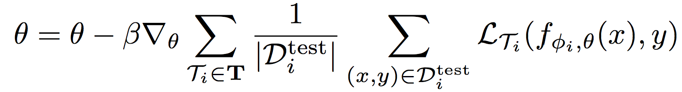
CAVIA for Supervised Learning
Let be a distribution over tasks, 𝛼 and 𝛽 be step sizes.
Initialize 𝜃 randomly
for iteration 1, 2, 3, … do
Sample batch of tasks where
for all do
, initialize
end for
end for

Slide 19
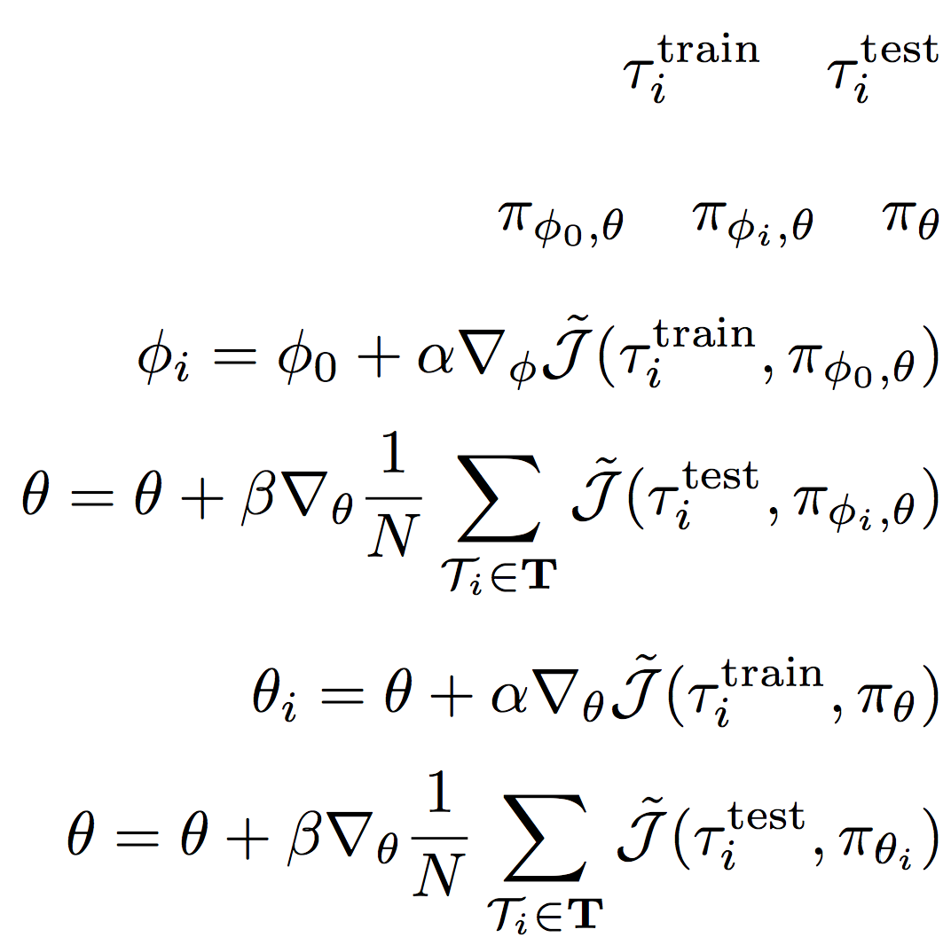
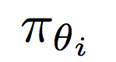
MAML for Reinforcement Learning
Let be a distribution over tasks, 𝛼 and 𝛽 be step sizes.
Initialize 𝜃 randomly
for iteration 1, 2, 3, … do
Sample batch of tasks where
for all do
Collect rollout using
Collect rollout using
end for
end for

Slide 20
CAVIA for Reinforcement Learning
Let be a distribution over tasks, 𝛼 and 𝛽 be step sizes.
Initialize 𝜃 randomly
for iteration 1, 2, 3, … do
Sample batch of tasks where
for all do
Initialize
Collect rollout using
Collect rollout using
end for
end for

Slide 21
Conditioning on Context Parameters
In Lecture 2, we saw some common choices for conditioning.
For fully connected networks, the authors of CAVIA concatenate 𝜙 to the inputs.
𝜙
input x
concatenate
multiply
...
𝜃^{(1,𝜙)}
𝜃^{(1,x)}

Slide 22
Context Parameter Initialization
How should 𝜙 be initialized? Should 𝜙₀ be meta-learned?
Suppose 𝜙₀ are learned in the outer loop.
Notice:
+
=
+
𝜃^{(1,𝜙)}
𝜙₀
b^{(1,𝜙)}
𝜃^{(1,𝜙)}
0
b′^{(1,𝜙)}
Values learned for 𝜙₀ can be subsumed into the bias parameter b.
So no need to meta-learn 𝜙₀. Authors just initialize to zero.

Slide 23
CAVIA Visualization
Initialize 𝜃 randomly and 𝜙₀ to zeros.
𝜙₀
input x
concatenate
multiply
...
𝜃^{(1,𝜙)}
𝜃^{(1,x)}

Slide 24
CAVIA Visualization
In the inner loop, we fix 𝜃 and learn 𝜙_{i} on .
𝜙_{i}
input x
concatenate
multiply
...
𝜃^{(1,𝜙)}
𝜃^{(1,x)}

Slide 25
CAVIA Visualization
In the outer loop, we evaluate the model on using 𝜃, 𝜙_{i} and update 𝜃.
𝜙_{i}
input x
concatenate
multiply
...
𝜃^{(1,𝜙)}
𝜃^{(1,x)}

Slide 26
Experiments
Regression
  Sine curves
  Image completion
Classification
  Mini-ImageNet
Reinforcement Learning
  MuJoCo Cheetah

Slide 27
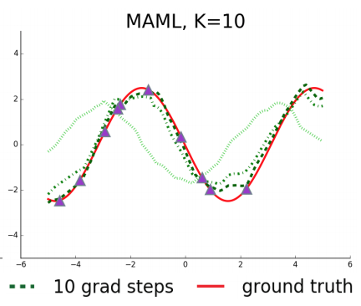
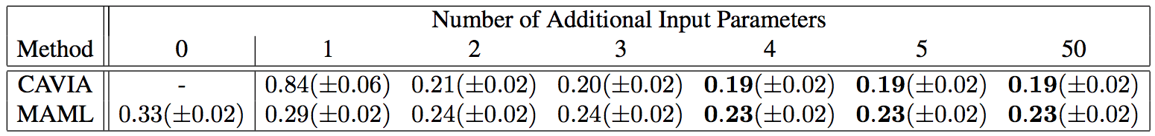
Regression: Sine Curves
Problem: Fit sine curve with randomly sampled
amplitude and phase.
Train on k=10 training points, test on rest of curve.
Loss is MSE.
To test CAVIA, use between 2 and 50 context
parameters.

Slide 28
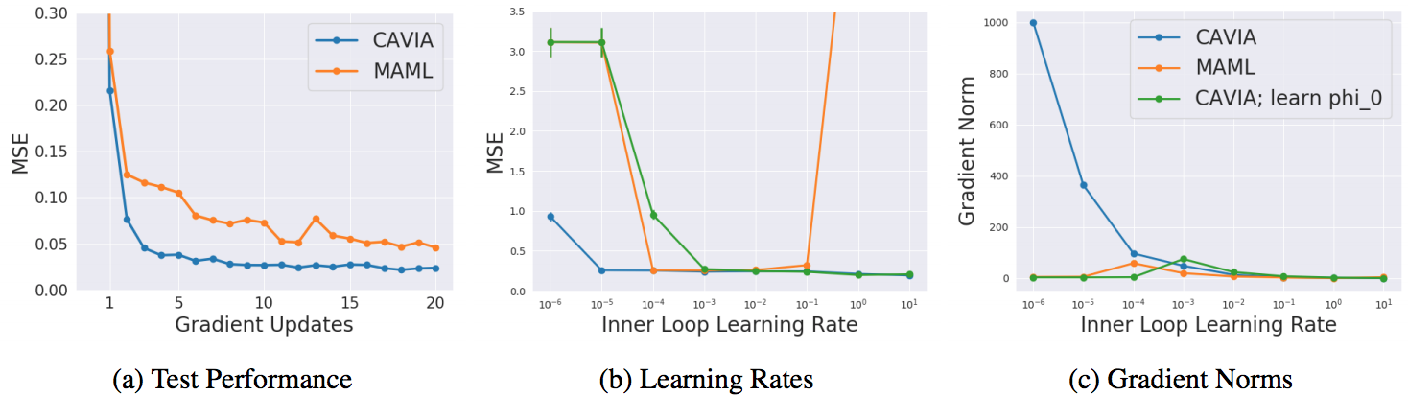
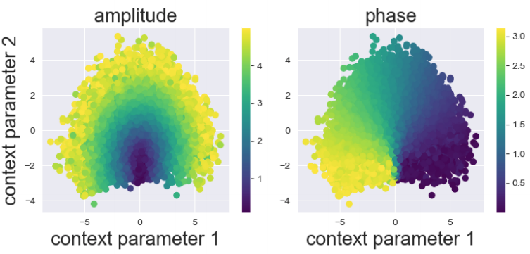
Regression: Sine Curves

Slide 29
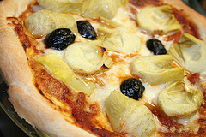
Classification: Mini-Imagenet (5-way, 1- or 5-shot)
Architecture:
𝜙
context params
image
3x conv
FiLM
conv
FC
output

Slide 30
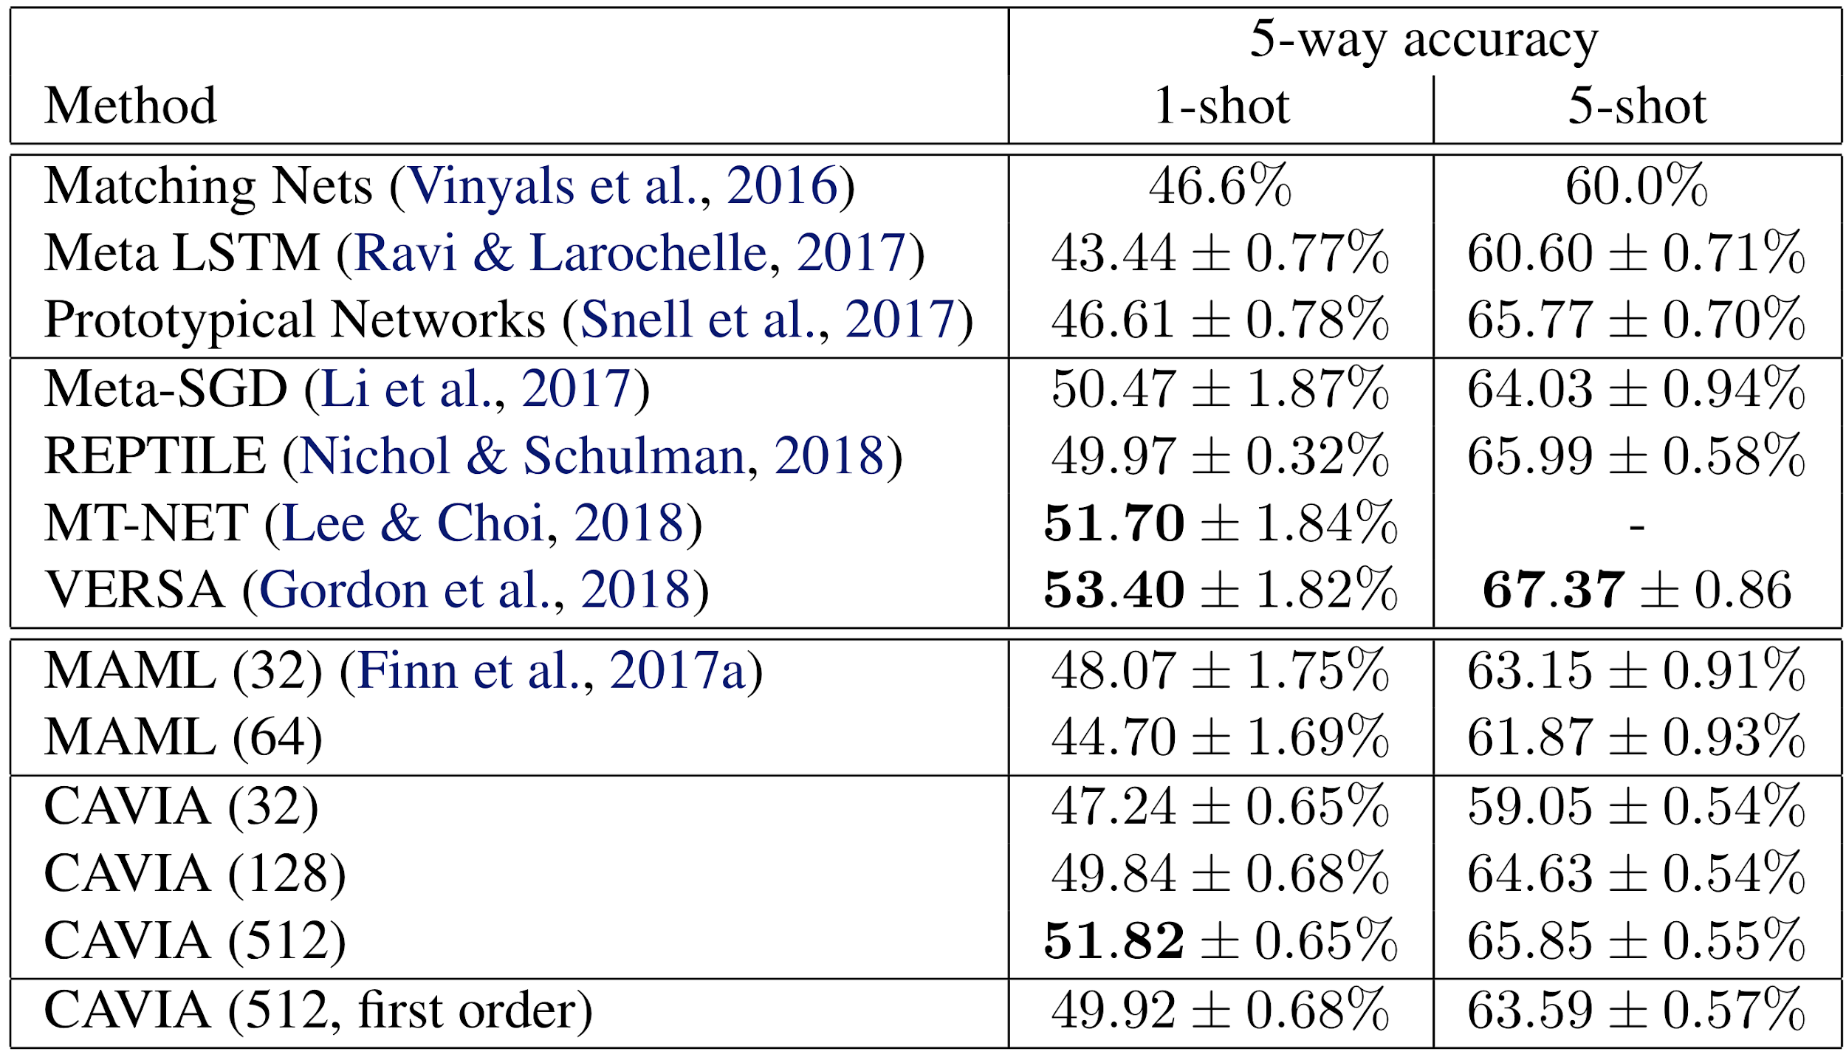
Classification: Mini-Imagenet Results

Slide 31
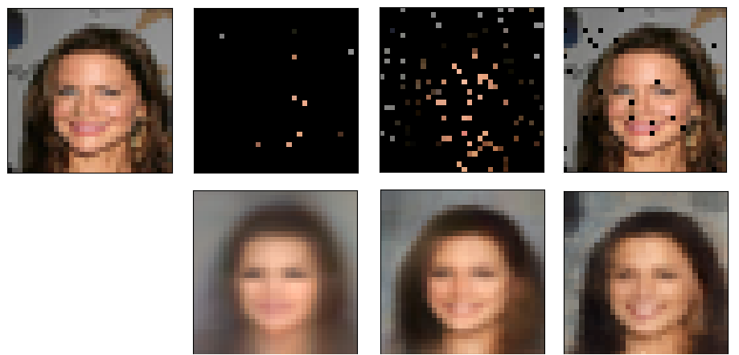
Image Completion: Example
Full image
K=10
K=100
K=1000
Input
Completion

Slide 32
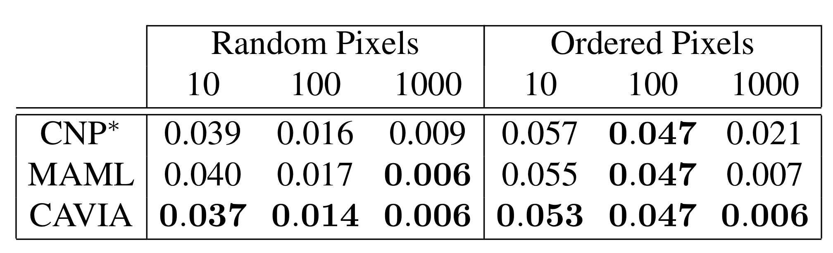
Image Completion: Results

Slide 33
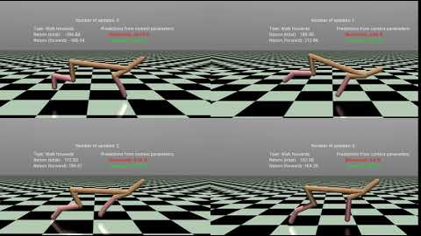
Reinforcement Learning: Cheetah
Task: Move in desired direction or at desired velocity.
Inner loop: 1 step (20 rollouts) on policy gradient with advantage
Outer loop: TRPO

Slide 34
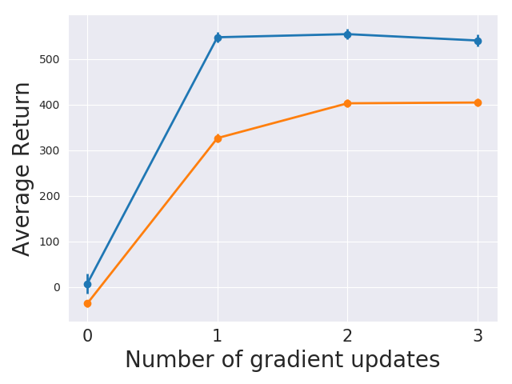
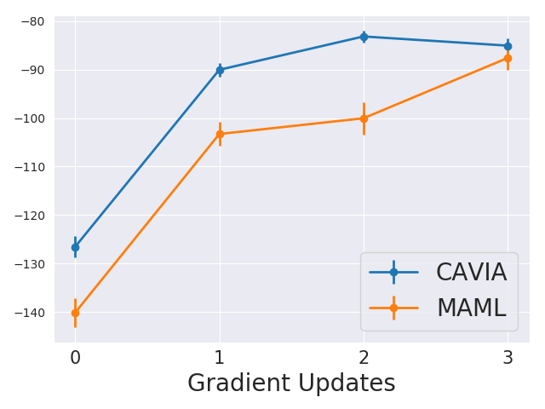
Reinforcement Learning: Cheetah Results
Direction:
Velocity:

Slide 35
Summary:
CAVIA is a variant of MAML which splits the model parameters into context parameters (adapted to each task) and shared parameters (meta-learned across tasks).
Context parameters yield a low-dimensional task embedding, which results in less meta-overfitting and more interpretability.

Slide 36
Discussion: Pros & Cons
Strengths:
Weaknesses:
easy to understand
robustness to hyperparameters
interpretability
generalization (less meta-overfit)
connections to multi-task learning
novelty (largely the same as MAML)
could use more experiments
unclear performance gain over state-of-the-art
introduces additional hyperparameters

Slide 37
Discussion & Future Work
Is CAVIA more or less expressive than MAML? Why?
Could other architectures (e.g. multiplicative gating, concatenation) better leverage the learned task embedding?
Should CAVIA perform well in complex or unstructured domains? When does there exist a good embedding for a task?
How do we choose the size of the context parameters?
What happens as we send the # of context parameters to zero?

Slide 38
Appendix

Slide 39
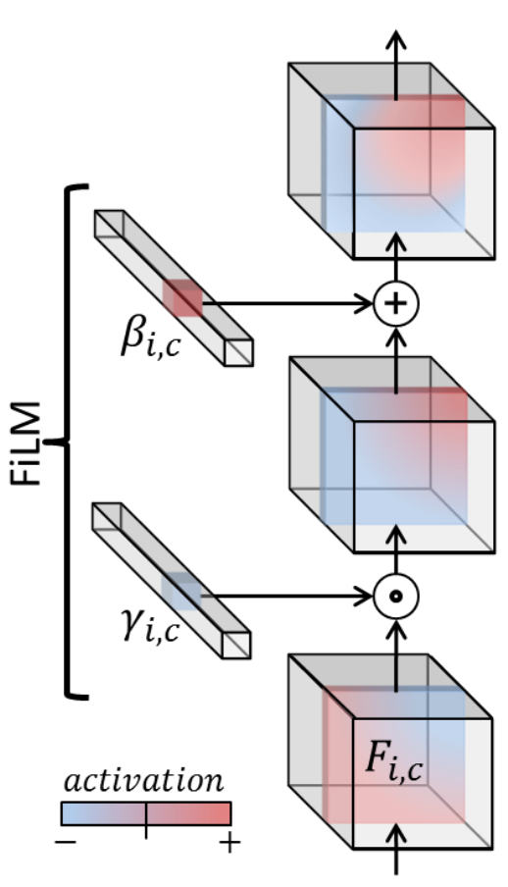
Conditioning on Context Parameters
For CNNs, the authors of CAVIA use feature-wise linear modulation (FiLM, Perez 2017).

Slide 40
brainstorm
Experiments
  Regression: sine curves
  Image completion
  Classification
  Reinforcement learning
Takeaways, strengths & weaknesses, limitations
  See reviews at https://openreview.net/forum?id=BylBfnRqFm
  Still not enough experiments
Additional discussion points
  Worth mentioning some of the apparent instabilities? (e.g. 0.84 MSE on sine curves with 1 phi)
Motivation
  MAML optimization is hard
  MAML easily meta-overfits
  Task embeddings are useful and can be interpretable
  Related work & background (MAML, …)
Method overview
  Separation of parameters into 2 parts:
    Context parameters (phi)
    Shared parameters (theta)
    Phi is initialized from zero and learned on each task
    Theta is updated after each meta-batch
  Architecture
    Fully connected network: phi concatenated to input
    CNN: use FiLM, which performs affine transformation on feature maps
    Initialization to zeros

