Slide 1
Few-Shot Learning with Graph Neural Networks
CS 330 Paper Presentation

Slide 2
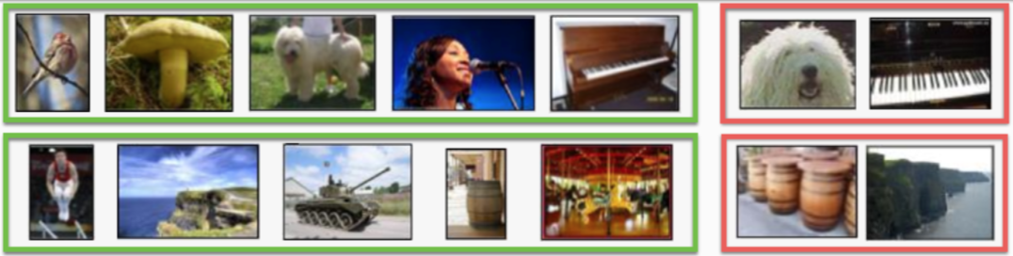
Problem
Some approaches to few-shot learning:
Support Set Distance Approximation: Koch et al. (2015), Snell et al. (2017)
Meta-learning: Ravi & Larochelle (2016), Finn et al. (2017), Mishra et al. (2017)
Image source: Ravi, Sachin, and Hugo Larochelle. “Optimization as a model for few-shot learning,” 2017, 11.
Notes:
The paper cites several papers that have tackled the few-shot learning problem. They can be split into two major groups: distance approximation and meta-learning. Note that these two groups align well with two of the three groups mentioned on Monday: non-parametric and optimization-based meta-learning.

Slide 3
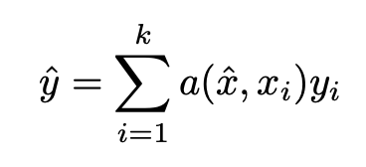

Problem
Vinyals et al. cast the few-shot learning problem as the task of mapping a support set of images into the desired label:
Where ( , ) is an unlabeled example, ( , ) are examples in the support set, and is a learned similarity function.
Image source: Ravi, Sachin, and Hugo Larochelle. “Optimization as a model for few-shot learning,” 2017, 11.
Notes:
The primary source of inspiration for this paper is from Vinyals et al’s approach. Described as the above. Note that this is in line with Monday’s lecture as a non-parametric approach, it is also similar to KNN.. Vinyals et al. framed the few shot learning task as the task of learning the similarities between each image in the support set with the unlabeled images.

Slide 4
Problem
Idea: represent the images as a fully connected graph.
Vinyals et al. cast the few-shot learning problem as the task of mapping a support set of images into the desired label:
Node := Image
Edge := Similarity
Where ( , ) is an unlabeled example, ( , ) are examples in the support set, and is a learned similarity function.
Image source: Ravi, Sachin, and Hugo Larochelle. “Optimization as a model for few-shot learning,” 2017, 11.
Notes:
Where we construct a fully connected graph where each node is an image and each edge is a weight describing how similar the two connect images are.

Slide 5
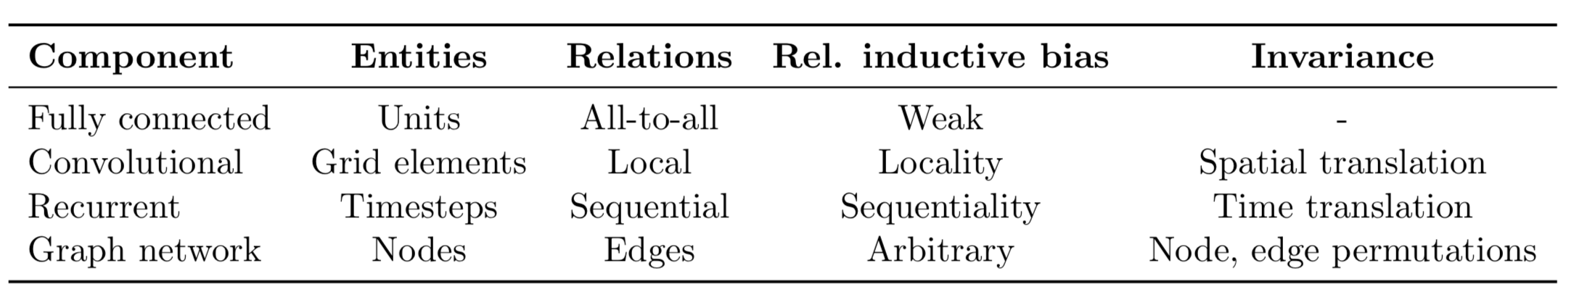
Why Graphs?
Battaglia, Peter W., et al. "Relational inductive biases, deep learning, and graph networks." arXiv preprint arXiv:1806.01261 (2018).
Image source: Ravi, Sachin, and Hugo Larochelle. “Optimization as a model for few-shot learning,” 2017, 11.
Notes:
If we use a graph, we are able to leverage graph neural networks (GNNs). These take in nodes and edges as input and can output information per node or for the entire graph.

Slide 6
Why Graphs?
Graph Neural Networks (GNNs) can learn both node features and node relationships (edge features) in order to make predictions.
Battaglia, Peter W., et al. "Relational inductive biases, deep learning, and graph networks." arXiv preprint arXiv:1806.01261 (2018).
Image source: Ravi, Sachin, and Hugo Larochelle. “Optimization as a model for few-shot learning,” 2017, 11.
Notes:
The nice thing about GNNs is that they can learn both node features and node relationships beyond those given as input in order to make predictions. Learn relationships end to end is more efficient

Slide 7
Primary Contributions
Reframes the few-shot learning problem as a supervised task using Graph Neural Networks.
Matches SOTA performance on Omniglot with fewer parameters.
Extends the model to semi-supervised and active learning regimes.
Image source: Ravi, Sachin, and Hugo Larochelle. “Optimization as a model for few-shot learning,” 2017, 11.
Notes:
So with that high level understanding in mind, let’s take a look at this paper’s primary contributions. Reframes the few-shot learning problem as a supervised message-passing task. Matches SOTA performance on Omniglot and Mini-Imagenet tasks with fewer parameters. It does relatively well on Mini-imagenet, but does not beat TCML, something we will talk about in the results. Extends the model to semi-supervised and active learning regimes.

Slide 8








Problem Formulation
Dataset:
Input-output pairs where describes one of sets of images.
Input consists of images and (some) labels. There are three subgroups of images:
1. Group of labeled images.
2. Unlabeled images. only in semi-supervised and active learning environments.
3. Unlabeled images. The model will predict the labels for these images. Loss will be computed on these images alone.
Output consists of labels for the third subgroup.
Notes:
Where MLP is a feedforward neural network outputting a scalar for the vector describing the differences between the features of node i and node j

Slide 9
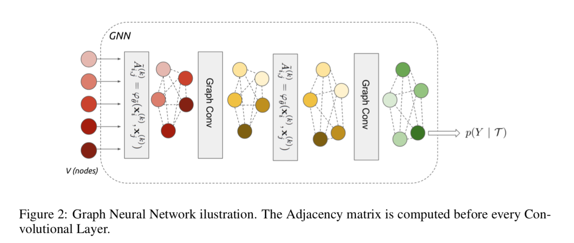
GNN Model
Notes:
Few shot learning as posterior inference using message passing with neural networks defined over graphs

Slide 10
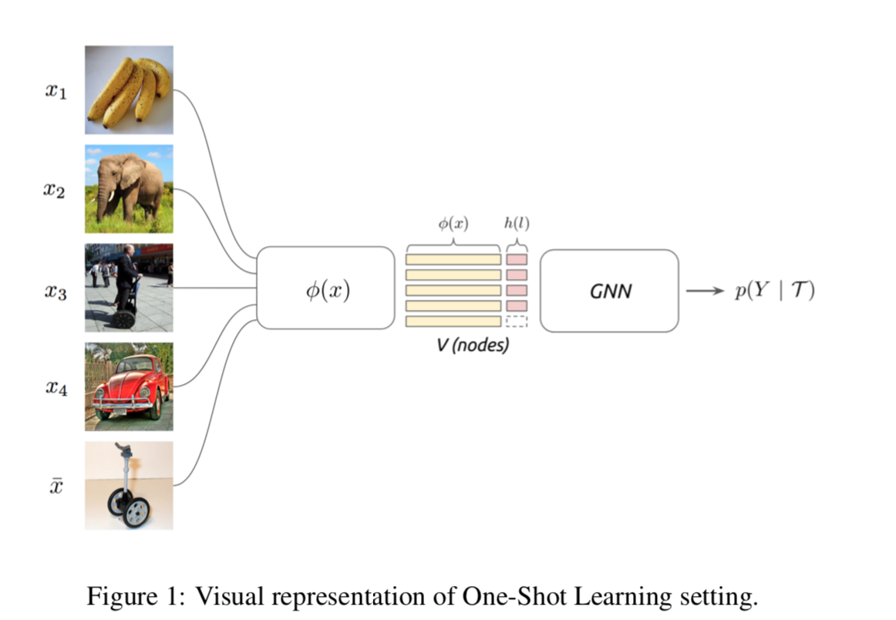
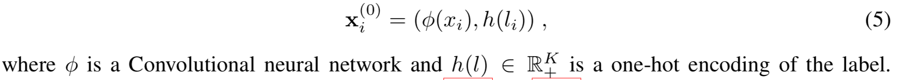
Problem Formulation

Slide 11
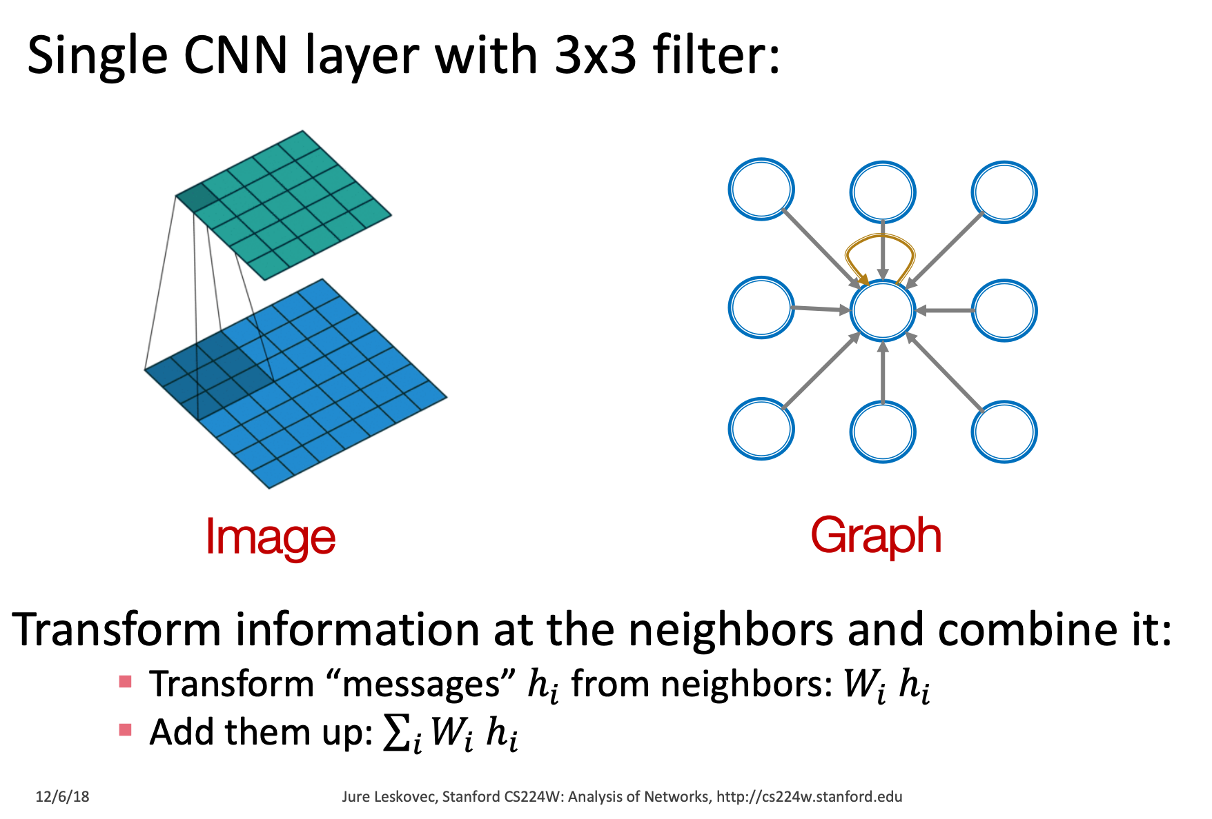
GNN Overview
Message Passing:
Each vertice updates its belief by aggregating neighborhood information

Slide 12
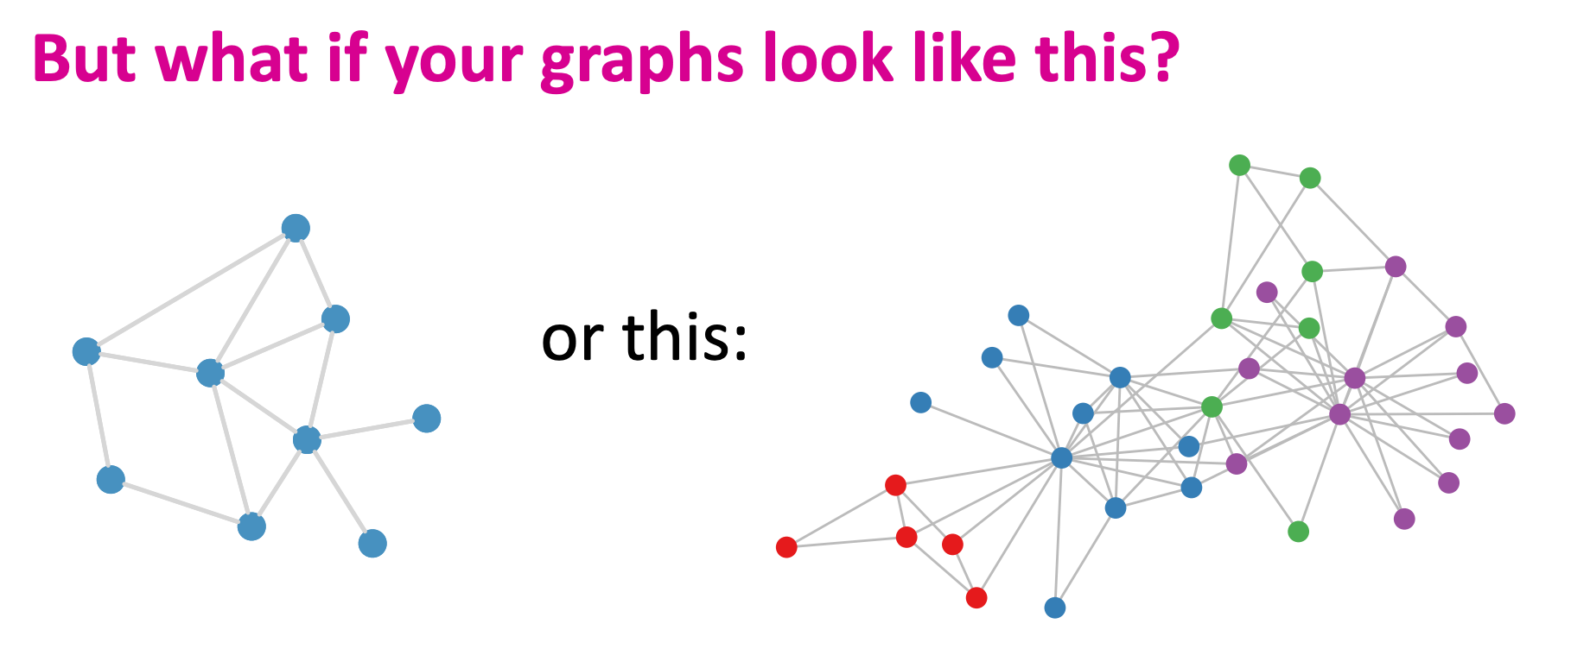
GNN Overview

Slide 13
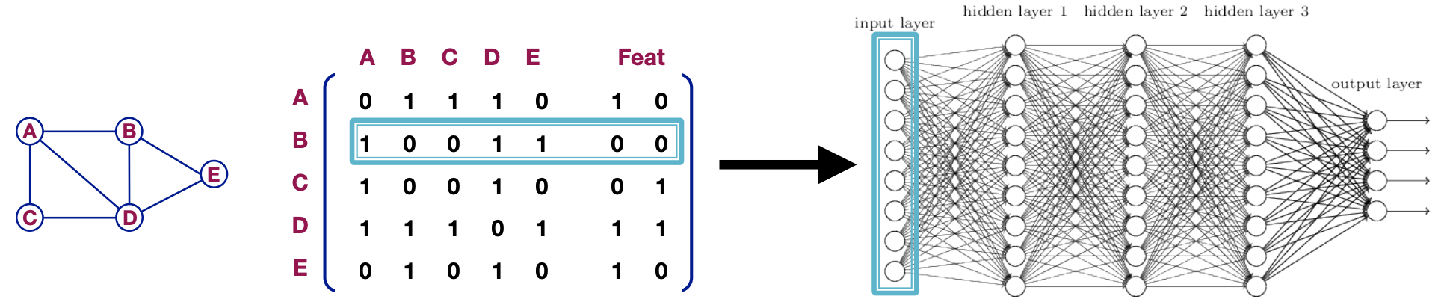

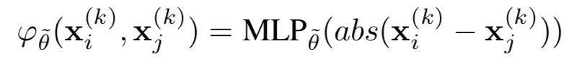
GNN Overview - Adjacency Matrix
In this paper, the authors considered a family of learned adjacency operators and an identity matrix (self-edge to aggregate vertex’ own features)
Adjacency kernel is learned through a MLP on the absolute pairwise difference of node features, then normalized by softmax.

Slide 14
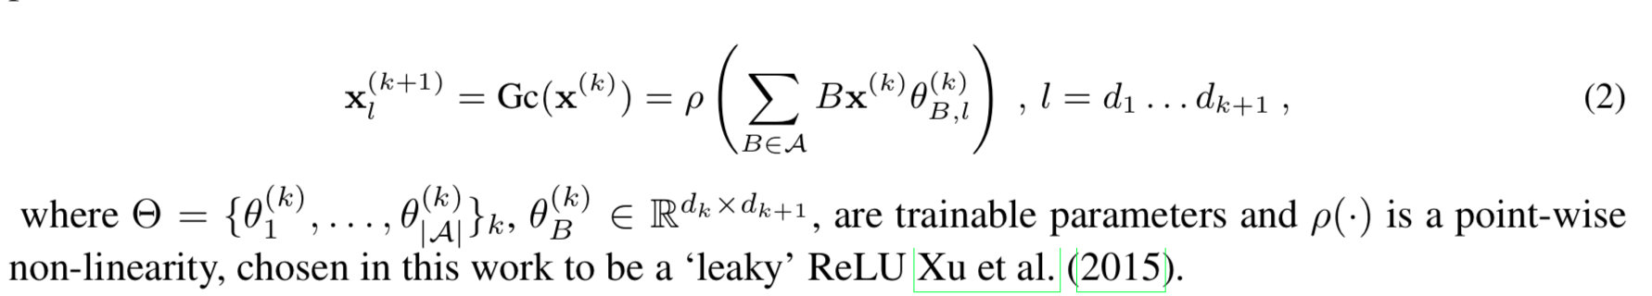
GNN Overview - Graph Conv
In this paper, the authors use a simple version of Gc formulation:
Notes:
There are other formulations . THe auhtors claim that they find this method suffice when stack multiple GCN layers together Cascaded operations in the form (2) are able to approximate a wide range of graph inference tasks

Slide 15
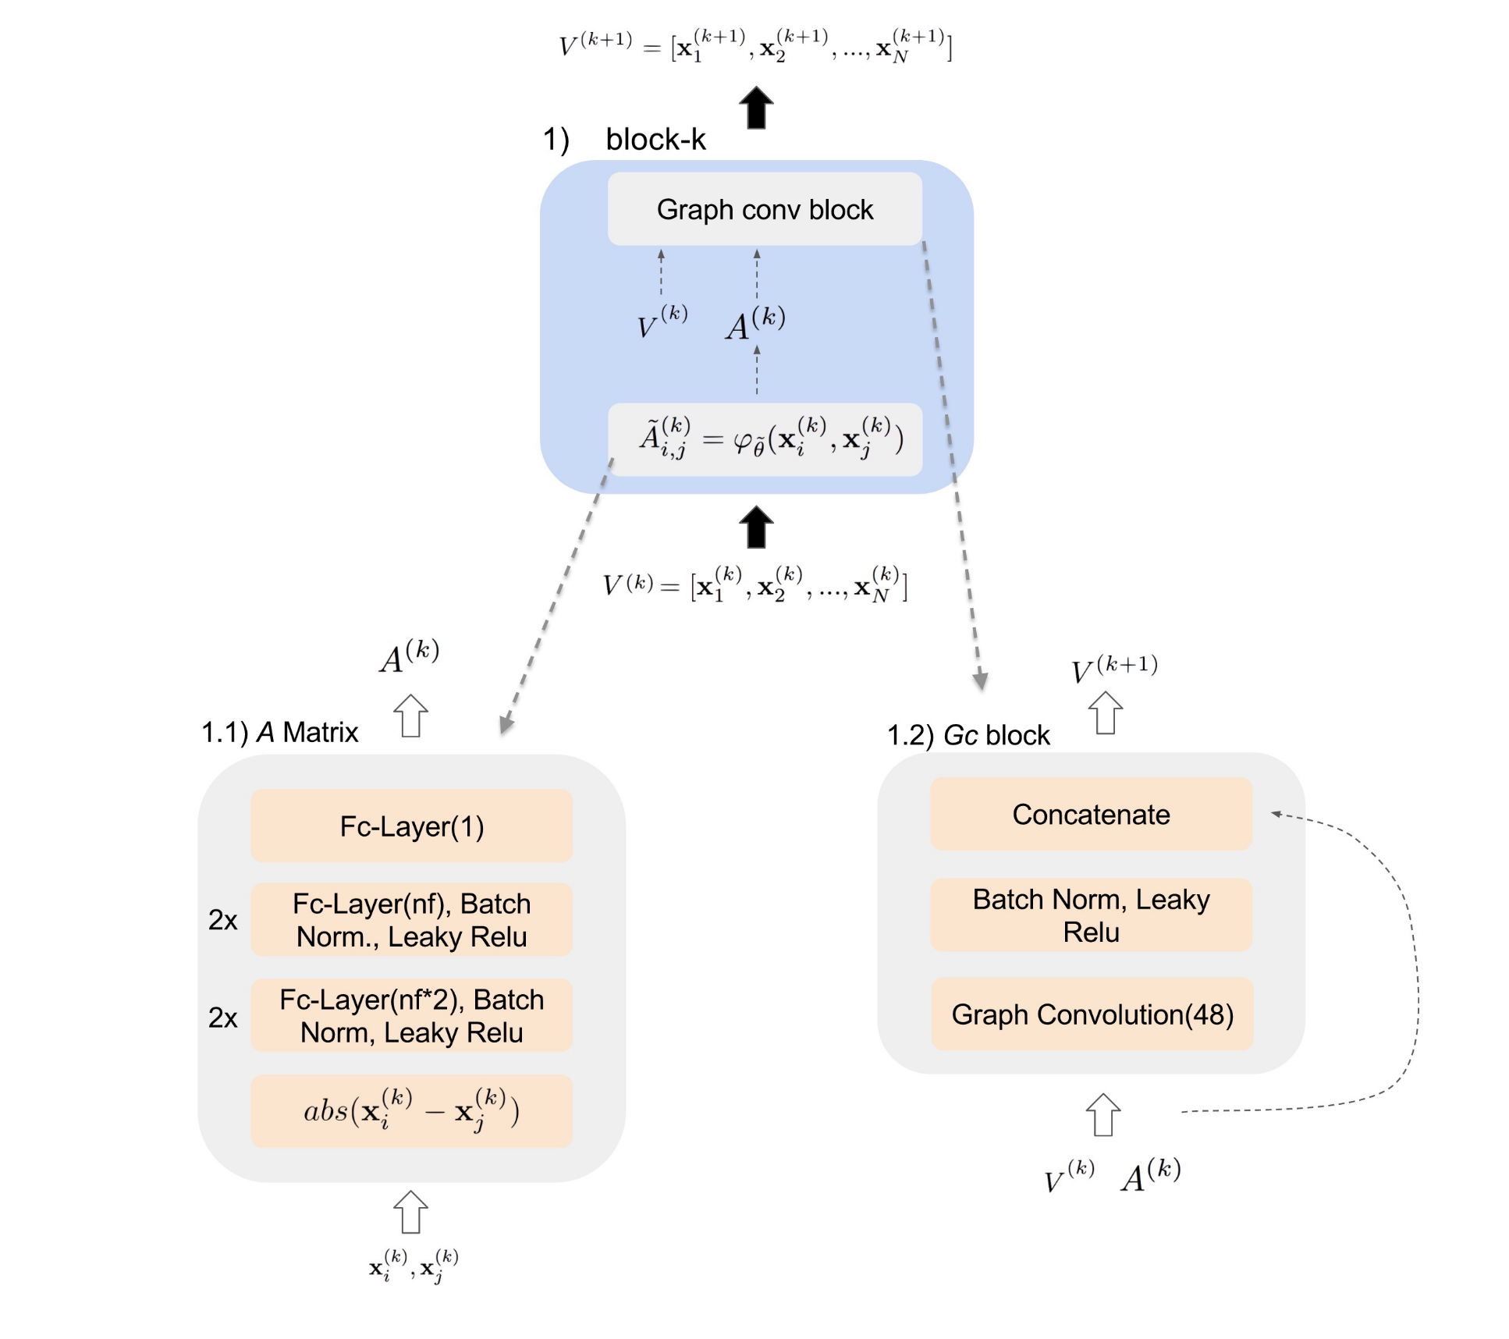
Architecture

Slide 16
Training
Loss: Categorical Cross-Entropy on the labeled sample per task.
Test Metrics: Calculated based on the predicted and gold label of the test image.
Few-shot and Semi-supervised:
  Training samples initial features are set to be 1-hot encoding of the corresponding labels.
Active Learning:
  After the first layer of GNN, network queries for one of the labels from the unsupervised set.
  The queried label is chosen by applying an attention layer on the first layer activations.
  Random sampling based on attention multinomial probability is used to choose the queried label during training. Argmax is used at the test time.
  Intuition: The network will learn to ask for the most informative label in order to classify the target sample.

Slide 17
Experiment Settings
q-shot, K-way:
  For every task T, K random classes from the dataset are chosen.
  From each class q random samples are selected.
  One extra sample to classify is chosen from one of that K classes.
Semi-supervised:
  Performed on the 5-way 5-shot setting.
  Experiments done when 20% and 40% of the samples are labeled.
  The labeled samples are balanced among classes in all experiments.
Active-learning:
  performed on the 5-way 5-shot setting.
  20% of the samples are labeled.
  The results are compared with the random baseline where the network chooses a random sample to be labeled.
Datasets: Omniglot and Mini-Imagenet are experimented with.

Slide 18
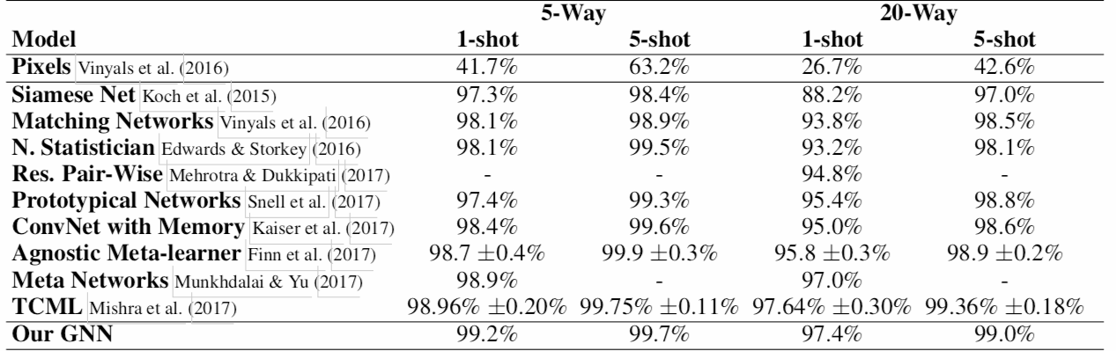
Few-Shot Learning on Omniglot
Key insights
Exceeds or achieves comparable performance with SOTA models across selected tasks.
Uses only ~300K model parameters (as compared to >5M in TCML).
Notes:
geoff

Slide 19
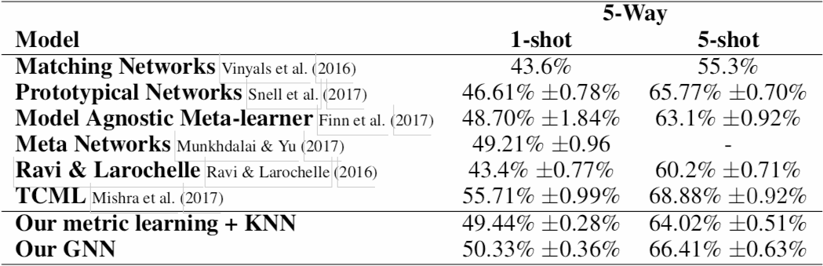
Few-Shot Learning on Mini-Imagenet
Key insights
Outperforms 5 out of 6 SOTA models across selected tasks (outperformed by TCML).
Uses only ~400K model parameters (as compared to ~11M in TCML).
Notes:
geoff

Slide 20
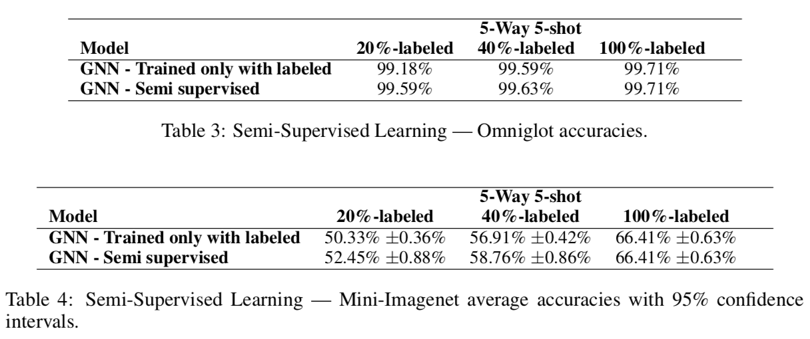
Semi-Supervised Learning on Omniglot
Experiment objective: Determine performance gap between two models:
“GNN - Trained only with labeled” := supervised few-shot setting.
5-way, 5-shot, 20%-labeled setting: equivalent to the 5-way, 1-shot learning setting.
“GNN - Semi supervised” := semi-supervised method.
5-way, 5-shot, 20%-labeled setting: GNN receives as input 1 labeled, 4 unlabeled samples per class.
Key insights:
Performance is saturated with only a single labeled image (i.e. 5-way 1-shot).
Experiments conducted with 1 labeled, 4 unlabeled images performs equivalently as experiments conducted with 2 labeled images.
Results are extremely similar with or without the unlabeled images in the training set.
Notes:
geoff

Slide 21
Semi-Supervised Learning on Mini-Imagenet
Experiment objective: Determine performance gap between two models:
“GNN - Trained only with labeled” := supervised few-shot setting.
5-way, 5-shot, 20%-labeled setting: equivalent to the 5-way, 1-shot learning setting.
“GNN - Semi supervised” := semi-supervised method.
5-way, 5-shot, 20%-labeled setting: GNN receives as input 1 labeled, 4 unlabeled samples per class.
Key insights:
The semi-supervised approach improves GNN performance by ~2% in the 20% and 40% cases.
Notes:
geoff

Slide 22
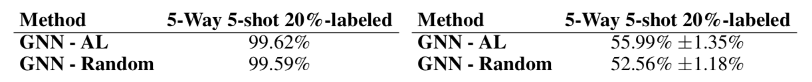
Active Learning
Experiment objective: Determine performance gap between two active learning methods:
“GNN - AL” := Active learning; selects the unsupervised sample that has the highest attention score.
“GNN - Random” := Randomly selects samples.
Omniglot
Key insights
Performance is saturated with only a single labeled image (i.e. 5-way 1-shot)
Performance with 1 additional labeled image chosen at random is the same as without (99.59%)
Mini-Imagenet
Key insights
AL approach improves GNN performance by ~3%
Notes:
Semi supervised learning on Omniglot

Slide 23
Strengths
Match SOTA performance on Omniglot with much fewer parameters.
The graph formulation is very generic and can be extended to several training setups (semi-supervised, active-learning)
End-to-end graph conv and stacked adjacency learning on image-label embeddings are used efficiently to predict the label of an unseen image.

Slide 24
Limitations
It only has SOTA experiment results on simple datasets - Omniglot, which is too simple & saturated to draw conclusion on performance improvement.
There is no discussion of the statistical significance of the semi-supervised nor active-learning performance improvements on the Omniglot dataset.
More robust analysis on parameter count comparison and why GNN can be expressive with fewer parameters
It could explain when we scale up the training to have much more classes or nodes, how it will affect GNN’s accuracy and runtime complexity.
It is not entirely clear what is the contribution of the adjacency matrix and Graph Conv training to improvements in the performance. An ablation study could better clarify this.
Notes:
One significant limitation to this paper is the use of the Omniglot dataset. The performance of all the models on the Omniglot dataset was so close to 100% that no real statistically significant improvements were demonstrated. The results would have been much more powerful on a dataset with lower performance were a statistically significant improvement could have been demonstrated.
In addition, likely because of the lack of statistically significant results, the author fail to address whether or not the improvements they show and discuss are significant or not.

Slide 26
Relationship with Existing Models
Siamese Networks: Non-parametric.
Prototypical Networks: Non-parametric.
Matching Networks:
  the label and image fields are treated separately throughout the model aggregated only at the final step.
  Uses attention over support set features versus stacked adjacency matrix learning in GNN.

