Slide 1

Twitter Viral Prediction
Robomaniacs21
1 – Yash Shethwala
2 – Praveen tamrakar
3 – Teja madduri
4 – Saikat mukherjee

Slide 2
Approach: Based on the twitter dataset we trained a model and trying to predict what tweets will become viral and the sentiment of the tweet.

Slide 3
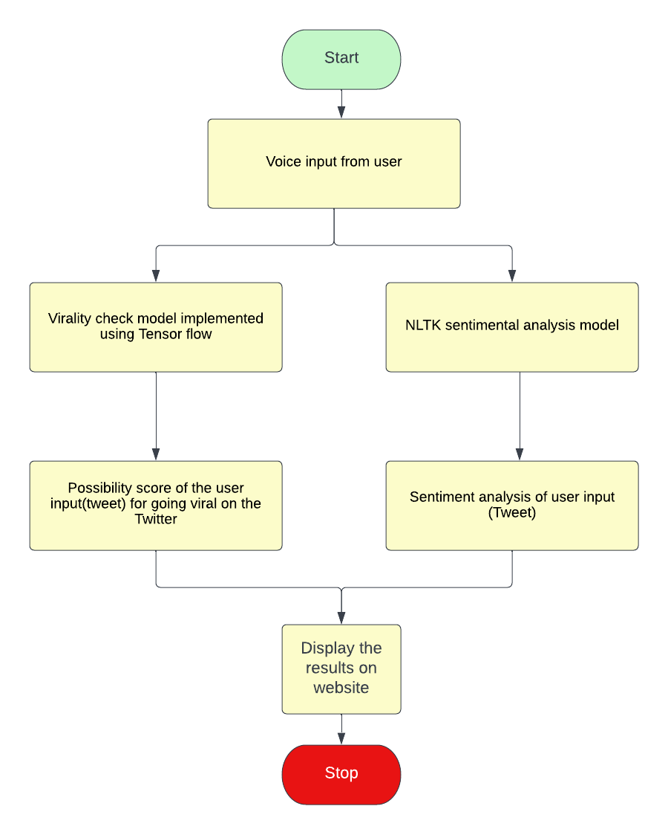
Flow Chart

Slide 4
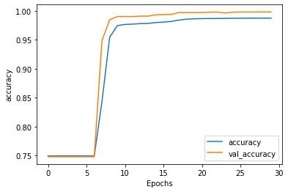
Training and Validation accuracy

Slide 5
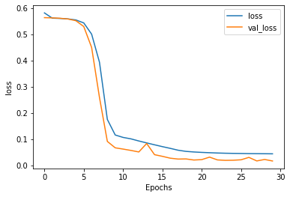
training and validation loss

Slide 6
Demo

Slide 7
Conclusion
. Using this model we can predict virality score
. Types of tweets that are making to become viral based on sentiment analysis

