Slide 1

STATISTICS FOR ENGINEERS
MAT2001
Dr. VINOTH D
Assistant Professor,
Department of Mathematics,
School of Advanced Sciences,
Vellore Institute of Technology.

Slide 2
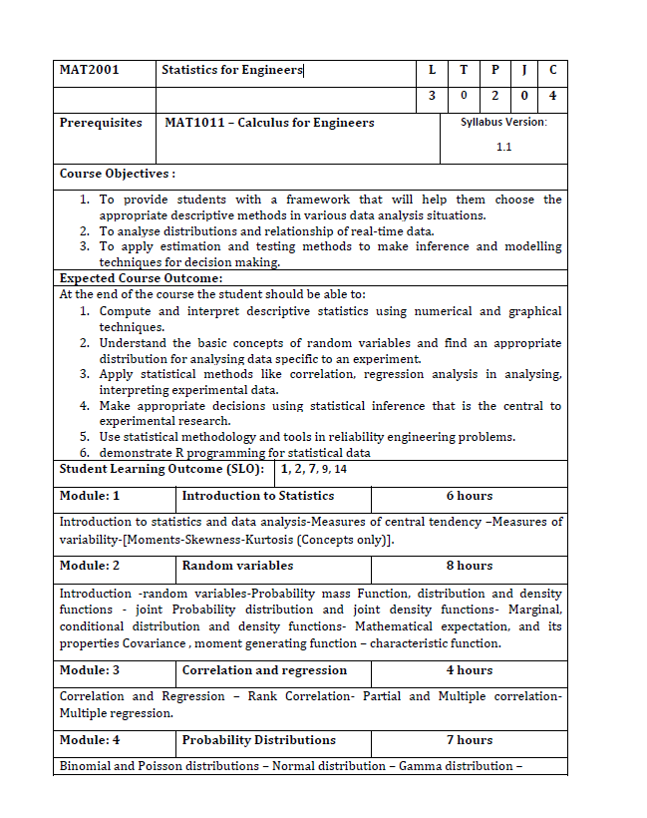
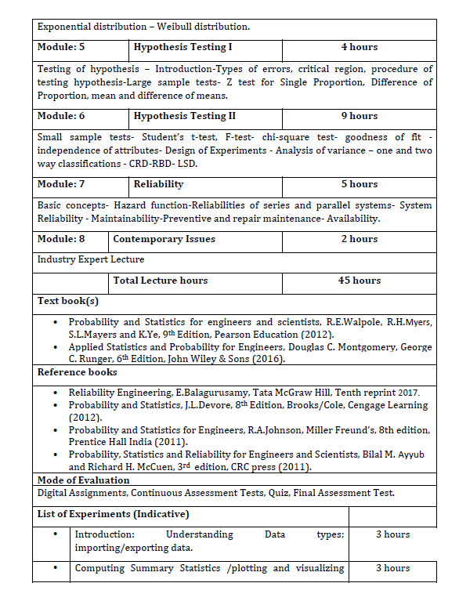
Notes:
MAT2001

Slide 3
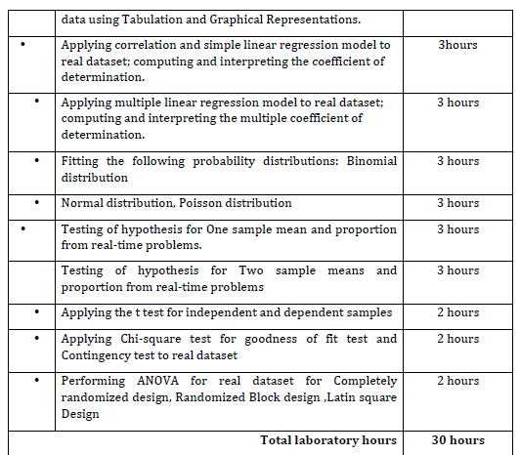

Slide 4
Module 1 Introduction to Statistics
Introduction to statistics and data analysis
Measures of central tendency
Measures of variability
Moments, Skewness, Kurtosis

Slide 5
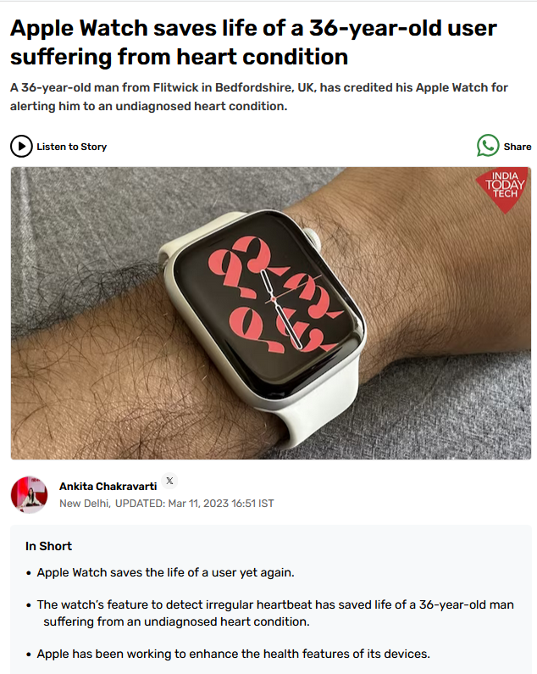
Introduction to statistics and data analysis
Statistics:
Statistics is the branch of mathematics that involves collecting, analyzing, interpreting, presenting, and organizing data.
It provides methods for making inferences and decisions based on data and helps understand and quantify patterns, relationships, and trends.

Slide 6
What is Statistics Engineering?
Statistics Engineering refers to the application of statistical principles, methods, and tools within the context of engineering to solve problems, optimize processes, and ensure the quality and reliability of products and systems.
It is an interdisciplinary field that combines statistical techniques with engineering practices to address.

Slide 7
Why Statistics Engineering?
Data Analysis and Interpretation - Collecting and analyzing data from experiments
Design of Experiments - Using statistical methods
Quality Control - Monitor and improve the quality of products or services
Predictive Modeling - Developing models to predict
Process Optimization - Find the best possible solutions
Reliability Engineering - Applying statistical methods standards.

Slide 8
Basic Steps in a Statistical Study:
For any statistical study, there are some basic steps to be followed once we draw a sample. These are:
Step 1: Gather first-hand information from the sample and this is called the raw data.
Step 2: Tabular representation of the raw data, i.e., represent the raw data in a table.
Step 3: Pictorial representation of the data, i.e., draw diagrams with the organized data in a table.
Step 4: Numerically summarize the data, i.e., describe the entire data set with some key numbers.
Step 5: Analyze the data using mathematical formulae.
Step 6: Draw the final inference or conclusion about the population under study.

Slide 9
Measures of central tendency
Arithmetic Mean
Median
Mode
Geometric Mean
Harmonic Mean

Slide 10
Data:
Ungrouped Data: Ungrouped data refers to raw data that has not been organized or categorized into groups or intervals. It is a simple list of individual values or observations. Each value in the dataset is presented without any grouping.
Grouped Data: Grouped data refers to data that has been organized into groups, classes, or intervals.
Discrete distribution or Discrete frequency distribution:
Using the frequency of the variable we can arrange it. This representation of the data is known as frequency distribution.
Continuous distribution or Continuous frequency distribution:
Again, we can arrange it for the class intervals. For this situation, it is called the Grouped frequency distribution of the variable.

Slide 11
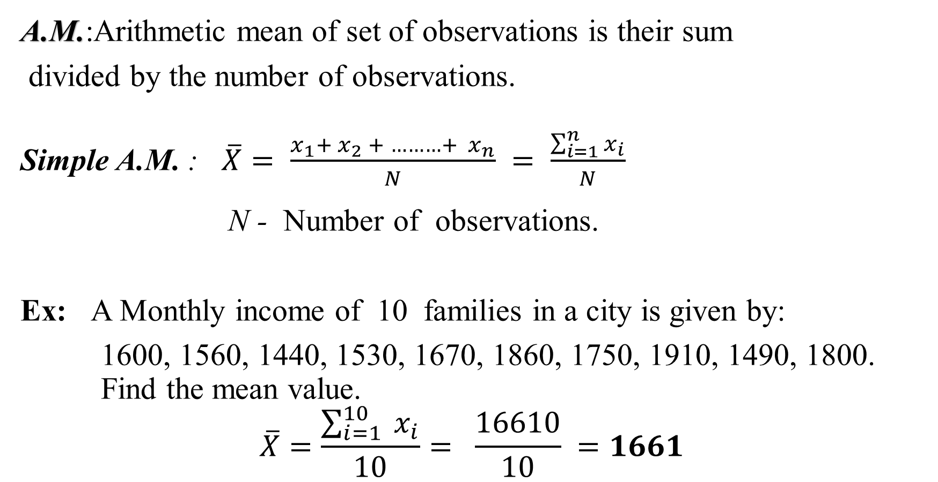
Arithmetic Mean (A.M.)
A.M.:Arithmetic mean of set of observations is their sum
divided by the number of observations.
Simple A.M. : $\overline{X}= \frac{x_{1}+ x_{2} + ………+{ x}_{n}}{N} = \frac{\sum_{i=1}^{n}{x_{i}}}{N}$
N - Number of observations.
Ex: A Monthly income of 10 families in a city is given by:
1600, 1560, 1440, 1530, 1670, 1860, 1750, 1910, 1490, 1800. Find the mean value.
$$\overline{X}=\frac{\sum_{i=1}^{10}{{ x}_{i}}}{10}= \frac{16610}{10} =1661$$

Slide 12
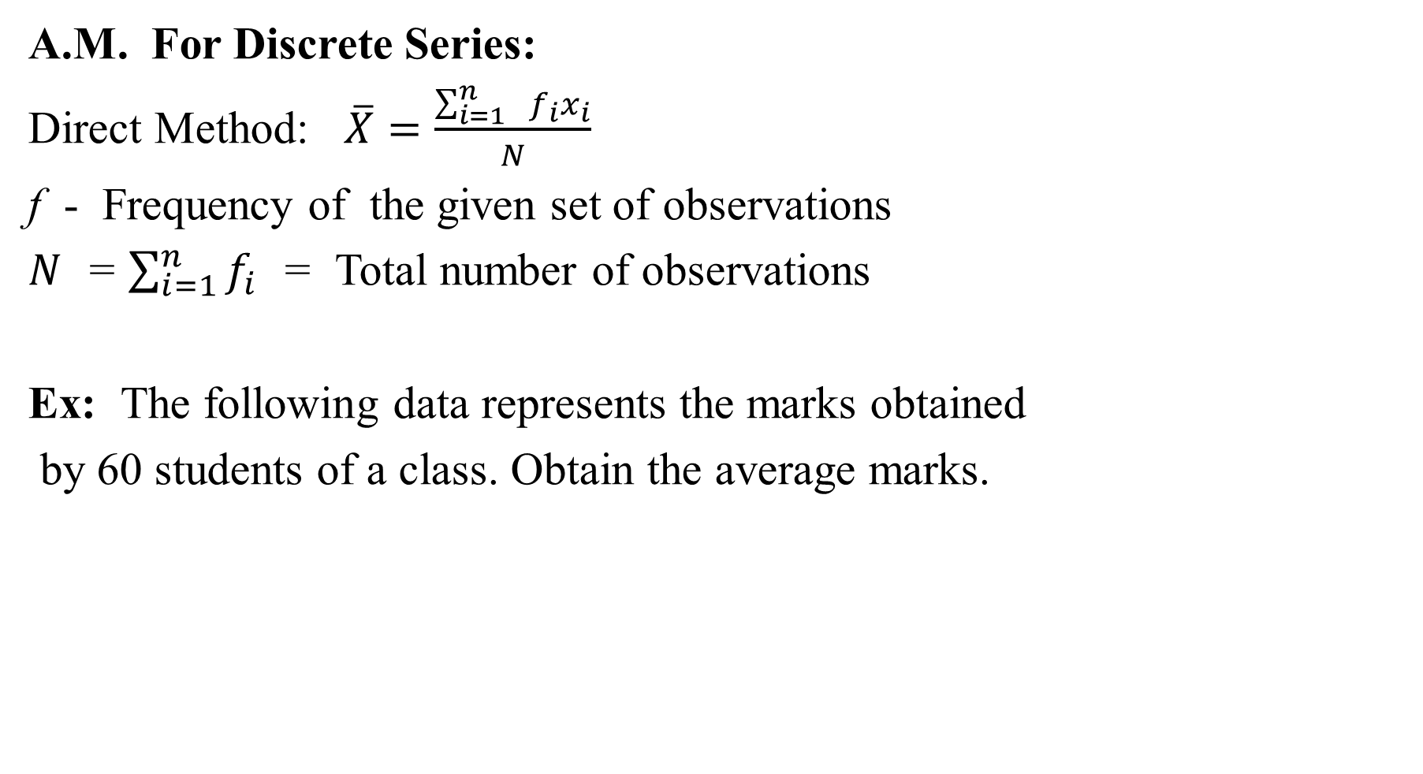
A.M. For Discrete Series:
Direct Method: $\overline{X}=\frac{\sum_{i=1}^{n}{{ f_{i}x}_{i}}}{N}$
f - Frequency of the given set of observations
$N$ = $\sum_{i=1}^{n}{f_{i}}$ = Total number of observations
Ex: The following data represents the marks obtained
by 60 students of a class. Obtain the average marks.
Marks | 20 | 30 | 40 | 50 | 60 | 70
No. of Students | 8 | 12 | 20 | 10 | 6 | 4

Slide 13

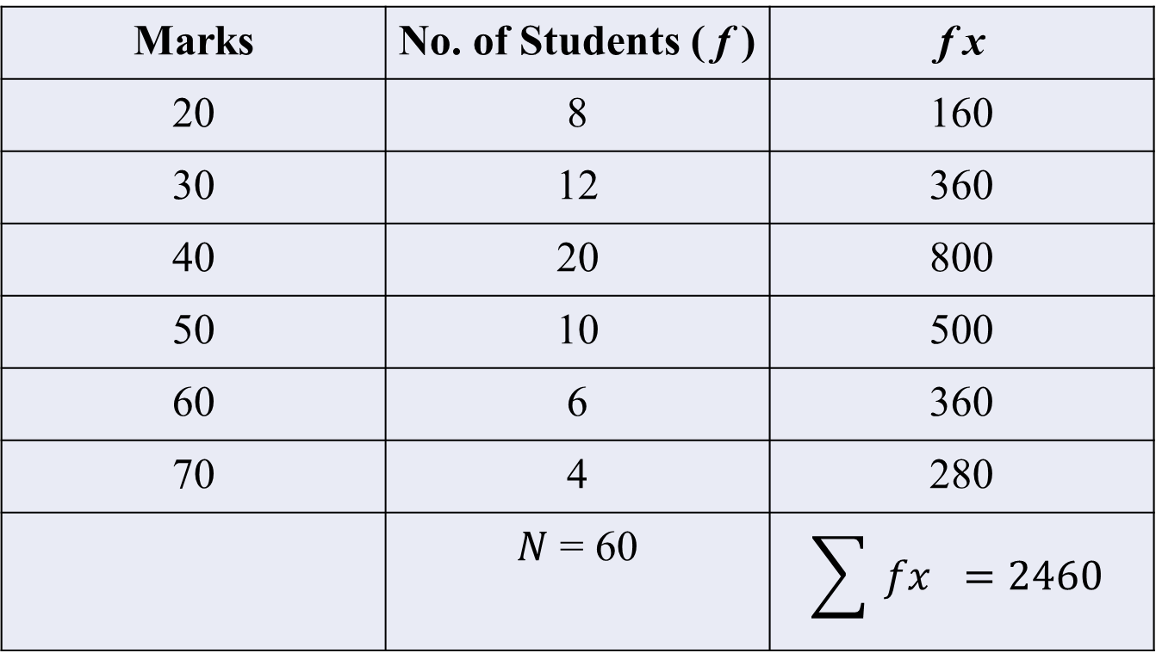
Marks | No. of Students ( f ) | f x
20 | 8 | 160
30 | 12 | 360
40 | 20 | 800
50 | 10 | 500
60 | 6 | 360
70 | 4 | 280
 | $N$ = 60 | $$\sum{ fx} =2460$$
$$\overline{X}=\frac{\sum{{ f_{i}x}_{i}}}{N}$$
$=\frac{2460}{60}=41$

Slide 14
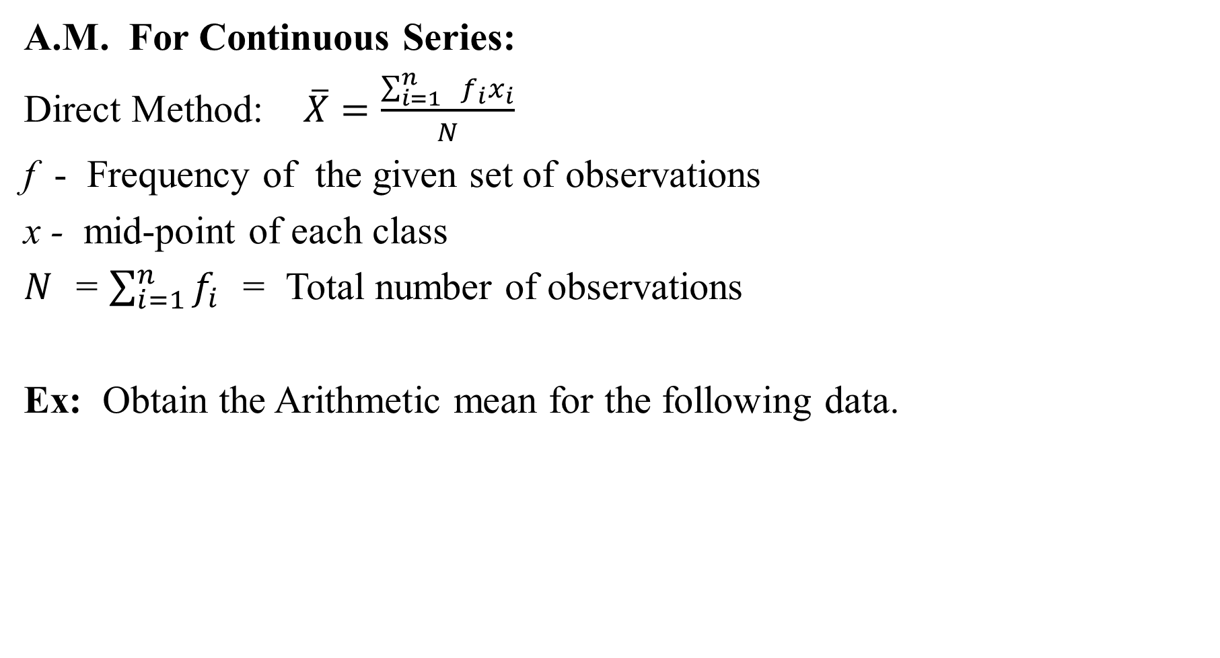
A.M. For Continuous Series:
Direct Method: $\overline{X}=\frac{\sum_{i=1}^{n}{{ f_{i}x}_{i}}}{N}$
f - Frequency of the given set of observations
x - mid-point of each class
$N$ = $\sum_{i=1}^{n}{f_{i}}$ = Total number of observations
Ex: Obtain the Arithmetic mean for the following data.
Marks | 0-10 | 10-20 | 20-30 | 30-40 | 40-50 | 50-60
No. of Students | 12 | 18 | 27 | 20 | 17 | 6

Slide 15
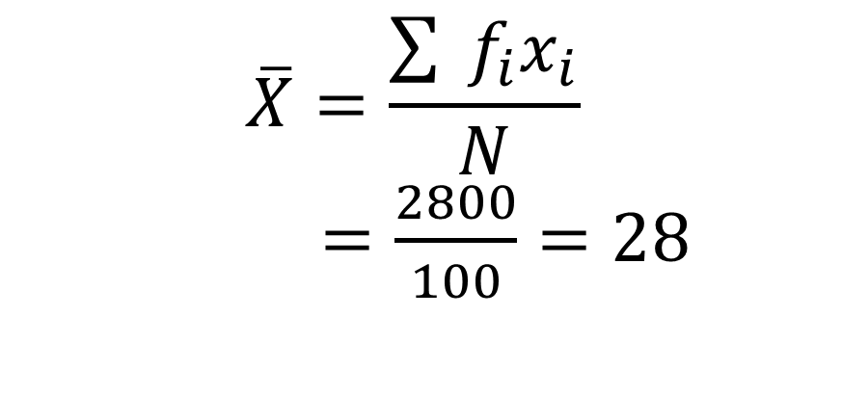
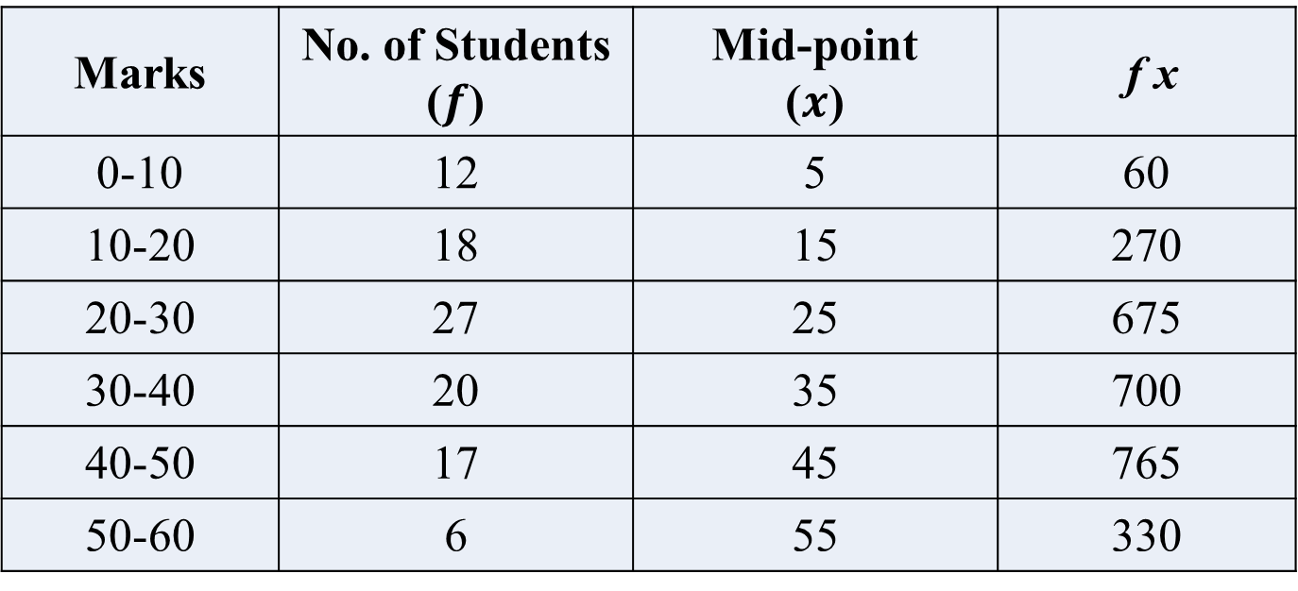
Marks | No. of Students ($f$) | Mid-point ($x$) | f x
0-10 | 12 | 5 | 60
10-20 | 18 | 15 | 270
20-30 | 27 | 25 | 675
30-40 | 20 | 35 | 700
40-50 | 17 | 45 | 765
50-60 | 6 | 55 | 330
$$\overline{X}=\frac{\sum{{ f_{i}x}_{i}}}{N}$$
$=\frac{2800}{100}=28$

Slide 16
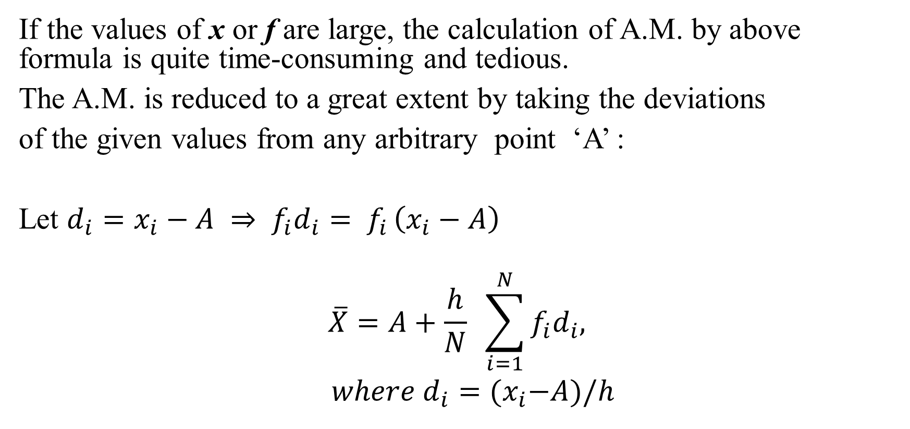
Using the Deviation:
If the values of x or f are large, the calculation of A.M. by above formula is quite time-consuming and tedious.
The A.M. is reduced to a great extent by taking the deviations
of the given values from any arbitrary point ‘A’ :
Let $d_{i}=x_{i}−A ⇒ f_{i}d_{i}= f_{i }\left(x_{i}−A\right)$
$$\overline{X}=A+\frac{h}{N} \sum_{i=1}^{N}{{f_{i}d}_{i}, }$$
$where d_{i}={(x}_{i}−A)/h$

Slide 17
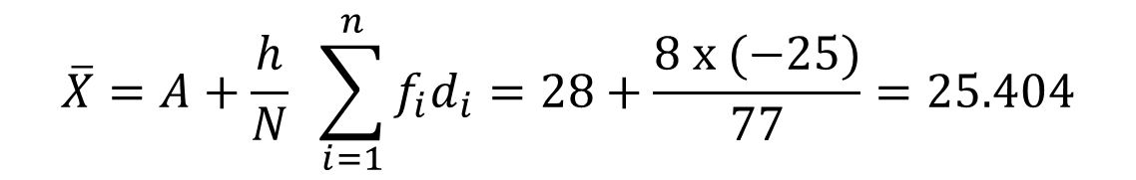
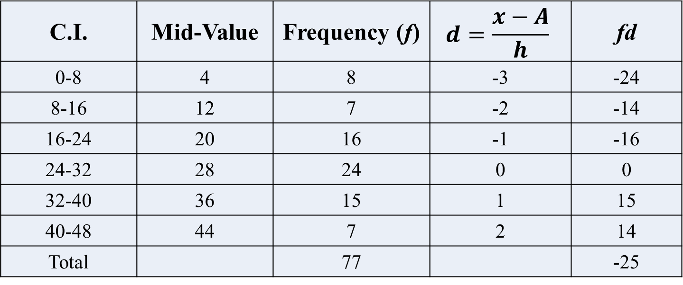
C.I. | 0-8 | 8-16 | 16-24 | 24-32 | 32-40 | 40-48
Frequency | 8 | 7 | 16 | 24 | 15 | 7
Ex:
C.I. | Mid-Value | Frequency (f) | $$d=\frac{x−A}{h}$$ | fd
0-8 | 4 | 8 | -3 | -24
8-16 | 12 | 7 | -2 | -14
16-24 | 20 | 16 | -1 | -16
24-32 | 28 | 24 | 0 | 0
32-40 | 36 | 15 | 1 | 15
40-48 | 44 | 7 | 2 | 14
Total |  | 77 |  | -25
$$\overline{X}=A+\frac{h}{N} \sum_{i=1}^{n}{{f_{i}d}_{i}}=28+\frac{8 x (−25)}{77}=25.404$$

Slide 18
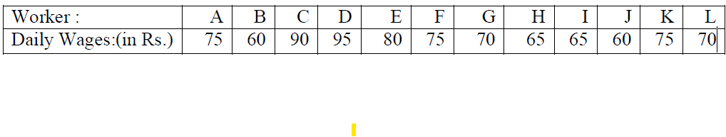
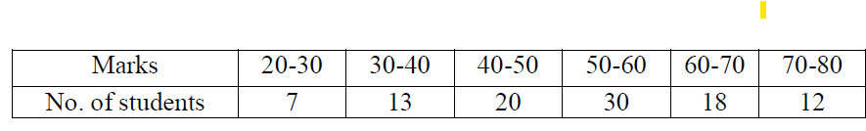
Exercise Problems
Calculate the mean height of the following 10 measurements Height (in cms): 120, 115, 140, 141, 125, 124, 127, 130, 130, 133. Ans:128.5 cms
Compute the arithmetic mean of daily wages of workers in a factory.
Ans: Rs. 73.33.
3. The following data relates to the marks of 100 students in statistics. Calculate the A.M. marks of students.
Ans: 52.5

Slide 19

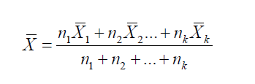
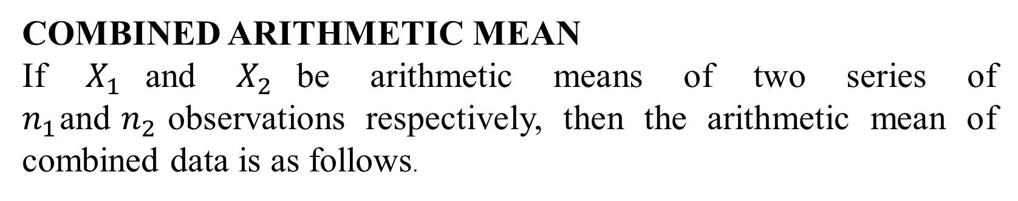
COMBINED ARITHMETIC MEAN
If $X_{1}$and $X_{2}$be arithmetic means of two series of $n_{1}$and$n_{2}$observations respectively, then the arithmetic mean of combined data is as follows.
This formula can be generalized for many number of groups say $k$

Slide 20
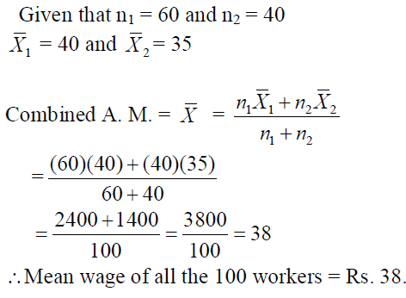
Ex: The mean wage of workers in a factory running two shifts of 60 and 40 workers are Rs.40 and Rs.35 respectively. Find the mean wages of all the 100 workers put together.

Slide 21
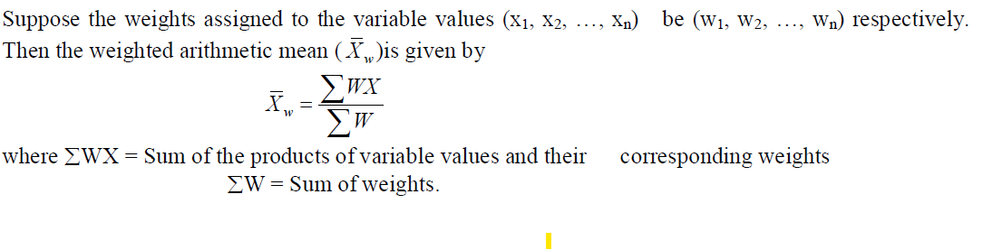
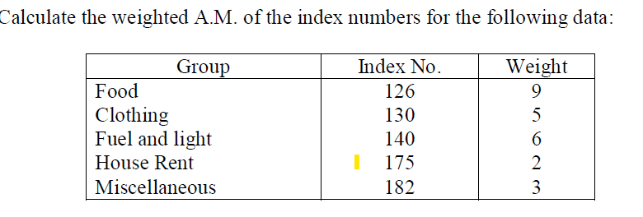
Weighted Arithmetic Mean
Ex

Slide 22
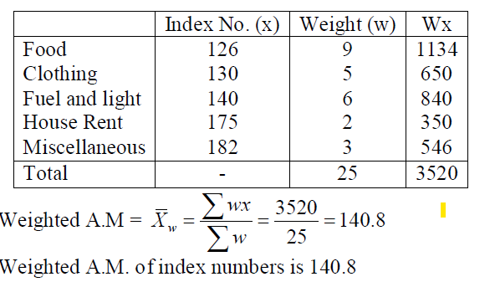

Slide 23
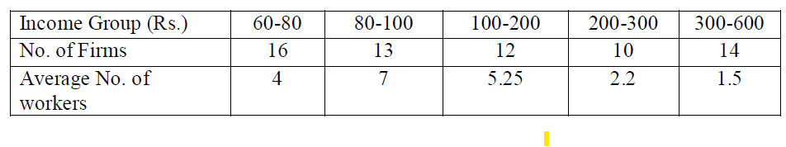
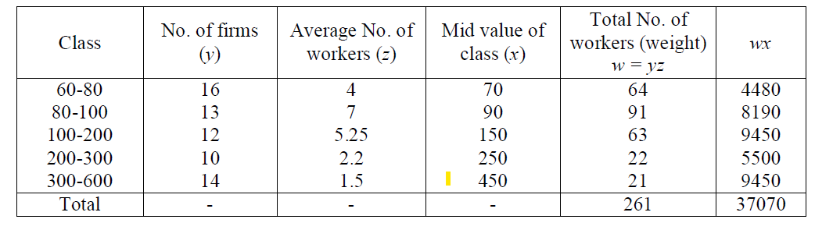
Ex: Calculate the average salary paid in the whole industry, using the data given below:
Solution :

Slide 24
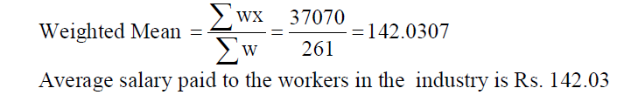
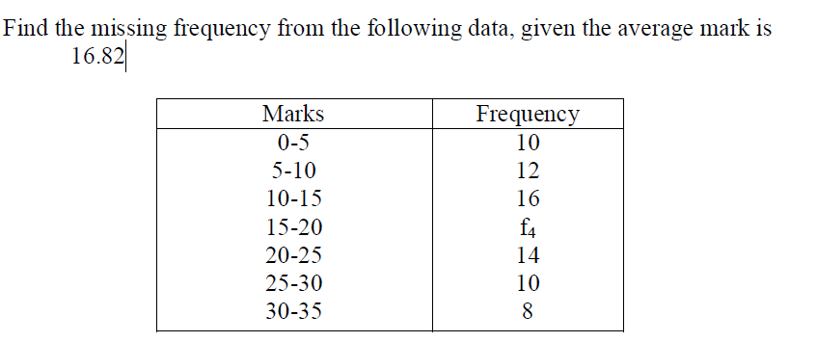
Missing Frequency problem

Slide 25
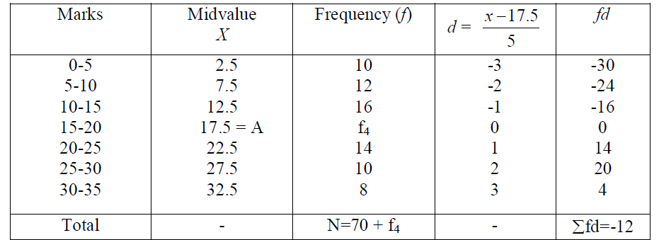
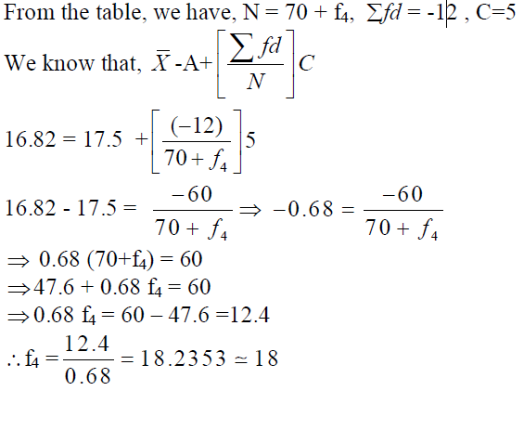

Slide 26
Geometric Mean: The geometric mean of a set of n observations is the nth root of their product
Ungrouped data:
Grouped data:

Slide 27
Harmonic mean: The harmonic mean of a number of observations is the reciprocal of the arithmetic mean of the reciprocals of the given values.
Ungrouped data:
Grouped data

Slide 28
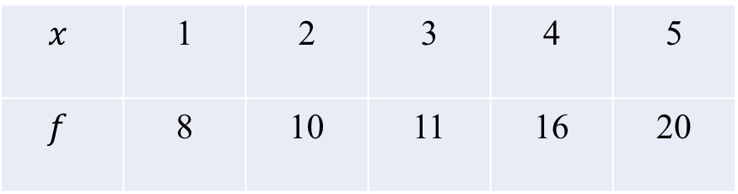
Calculate the geometric mean and harmonic mean of the following distribution
$$x$$ | 1 | 2 | 3 | 4 | 5
$$f$$ | 8 | 10 | 11 | 16 | 20

Slide 29
Median:
Median of a distribution is the value of the variable which divides it into two equal parts. It is the value which exceeds and is exceeded by the same number of observations. Thus the median is called as a “positional average”.
Evaluation of Median: For ungrouped data,
(i) Odd number of observations.
(ii) Even number of observations.
Ex: Find the median of the values 18, 25, 20, 15, 35.
Ascending order: 15, 18, 20, 25, 35.
Median = 20
Find the median of the values 8, 20, 50, 25, 15, 30.
Ascending order: 8, 15, 20, 25, 30, 50
Median = ½(20+25) = 22·5

Slide 30
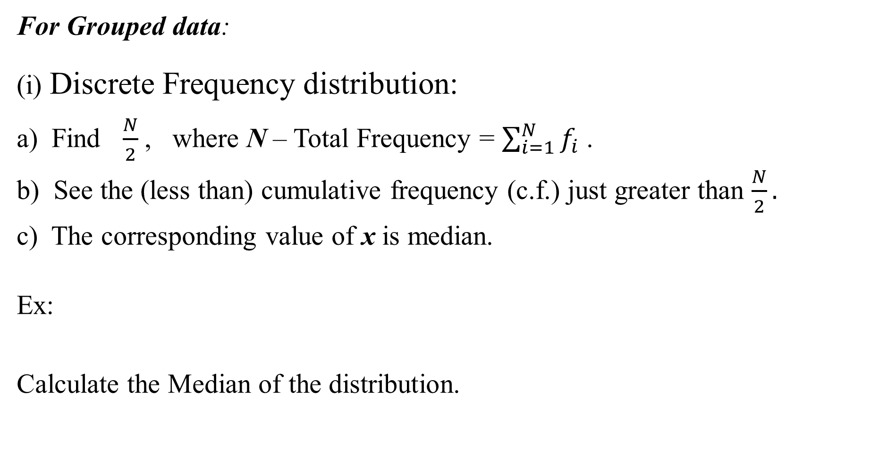
For Grouped data:
(i) Discrete Frequency distribution:
a) Find $\frac{N}{2}$, where N – Total Frequency = $\sum_{i=1}^{N}{f_{i}}$ .
b) See the (less than) cumulative frequency (c.f.) just greater than $\frac{N}{2}.$
c) The corresponding value of x is median.
Ex:
Calculate the Median of the distribution.
x | 1 | 2 | 3 | 4 | 5 | 6 | 7 | 8 | 9
f | 8 | 10 | 11 | 16 | 20 | 25 | 15 | 9 | 6

Slide 31
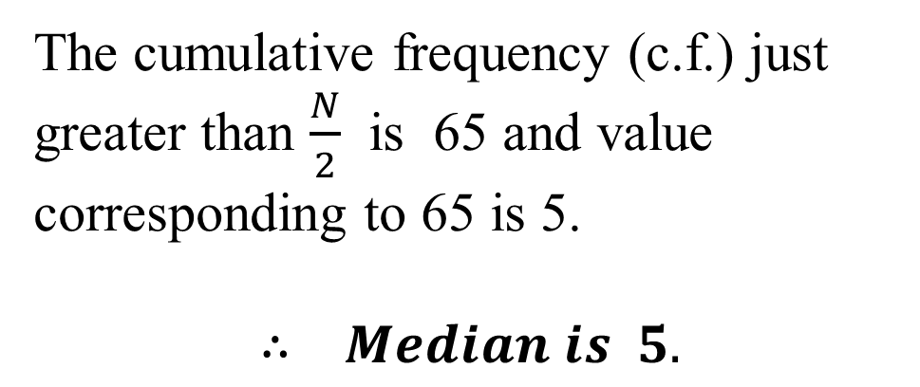
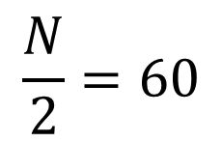
x | f | c.f.
1 | 8 | 8
2 | 10 | 18
3 | 11 | 29
4 | 16 | 45
5 | 20 | 65
6 | 25 | 90
7 | 15 | 10
8 | 9 | 114
9 | 6 | 120
 | N = 120
$$\frac{N}{2}=60$$
The cumulative frequency (c.f.) just greater than $\frac{N}{2}$ is 65 and value corresponding to 65 is 5.
$$∴ Median is 5.$$

Slide 32
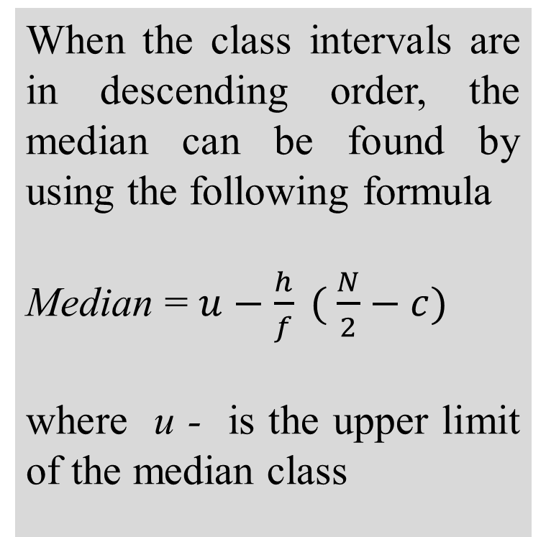
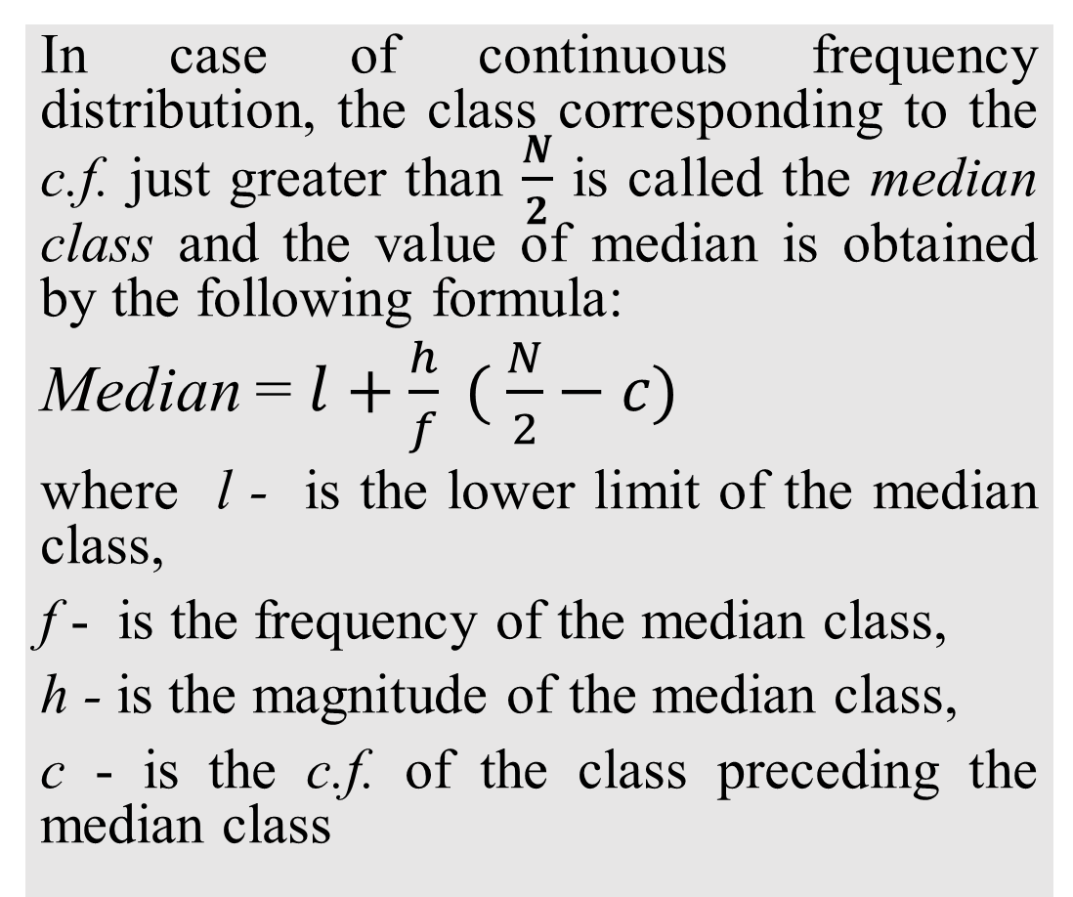
(ii) Continuous Frequency Distribution:
In case of continuous frequency distribution, the class corresponding to the c.f. just greater than $\frac{N}{2}$ is called the median class and the value of median is obtained by the following formula:
Median = $l+\frac{h}{f} ( \frac{N}{2}−c)$
where l - is the lower limit of the median class,
f - is the frequency of the median class,
h - is the magnitude of the median class,
c - is the c.f. of the class preceding the median class
When the class intervals are in descending order, the median can be found by using the following formula
Median = $u−\frac{h}{f} ( \frac{N}{2}−c)$
where u - is the upper limit of the median class

Slide 33
Ex: Find the median of the following data:
Wages (in Rs.) | 20-30 | 30-40 | 40-50 | 50-60 | 60-70
No. of workers | 3 | 5 | 20 | 10 | 5

Slide 34
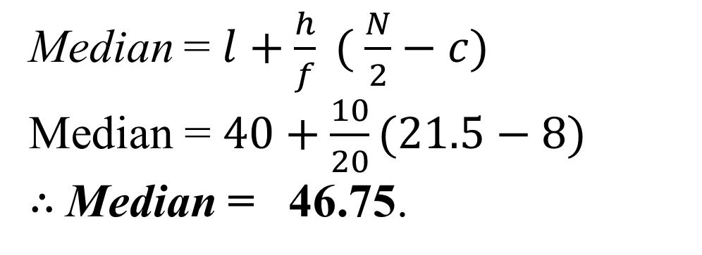
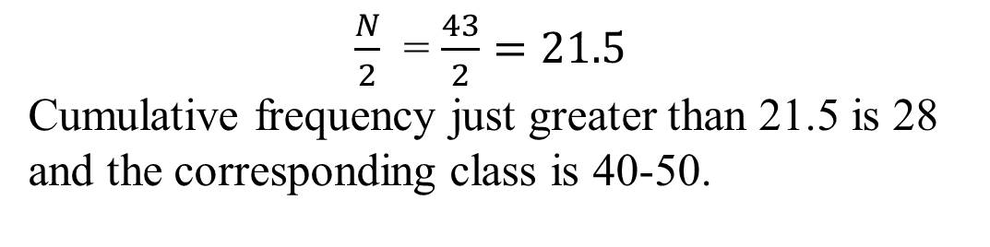
$\frac{N}{2}$ = $\frac{43}{2}=21.5$
Cumulative frequency just greater than 21.5 is 28 and the corresponding class is 40-50.
Solution:
Wages (in Rs.) | No. of Employees | c.f.
20-30 | 3 | 3
30-40 | 5 | 8
40-50 | 20 | 28
50-60 | 10 | 38
60-70 | 5 | 43
 | N = 43
Thus the median class is 40-50.
l = 40; h = 10; f = 20; c = 8
Median = $l+\frac{h}{f} ( \frac{N}{2}−c)$
Median = $40+\frac{10}{20}(21.5−8)$
$∴$Median = 46.75.

Slide 35
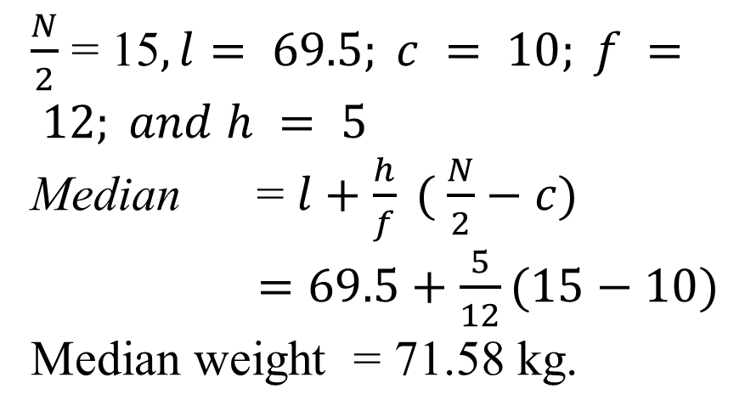
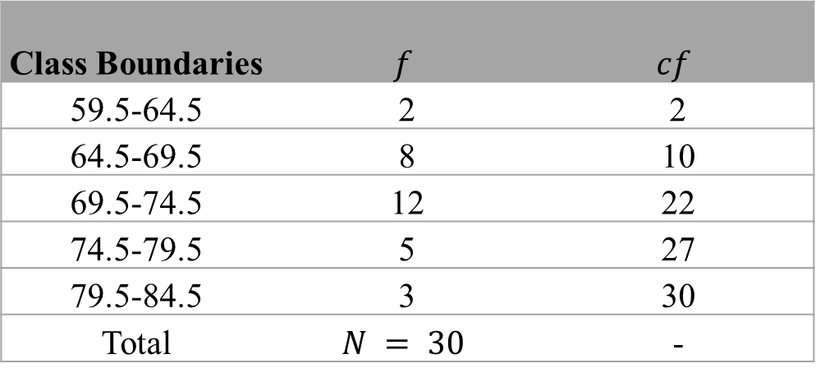
The weight of 30 students are given in the following frequency distribution. Determine the median weight of the students.
Weight in kgs | 60-64 | 65-69 | 70-74 | 75-79 | 80-84
No. of students | 2 | 8 | 12 | 5 | 3
$\frac{N}{2}$ = 15$, l= 69.5; c = 10; f = 12; and h = 5$
Median = $l+\frac{h}{f} ( \frac{N}{2}−c)$
$=69.5+\frac{5}{12}(15−10)$
Median weight = 71.58 kg.
Class Boundaries | $$f$$ | $$cf$$
59.5-64.5 | 2 | 2
64.5-69.5 | 8 | 10
69.5-74.5 | 12 | 22
74.5-79.5 | 5 | 27
79.5-84.5 | 3 | 30
Total | $$N = 30$$ | -

Slide 36
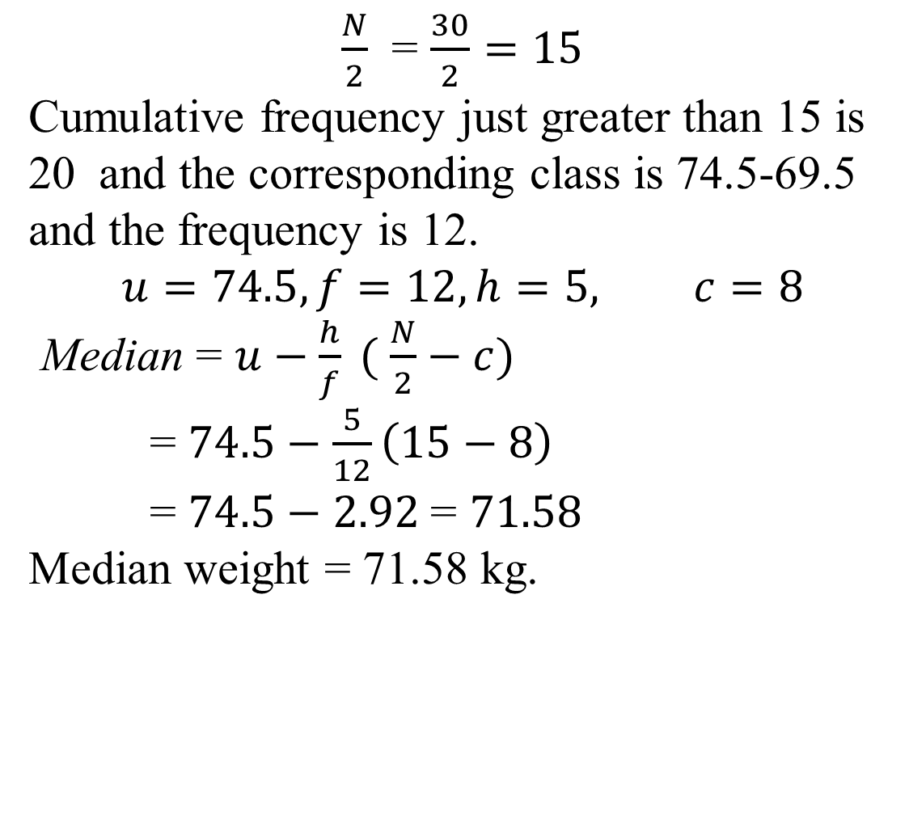
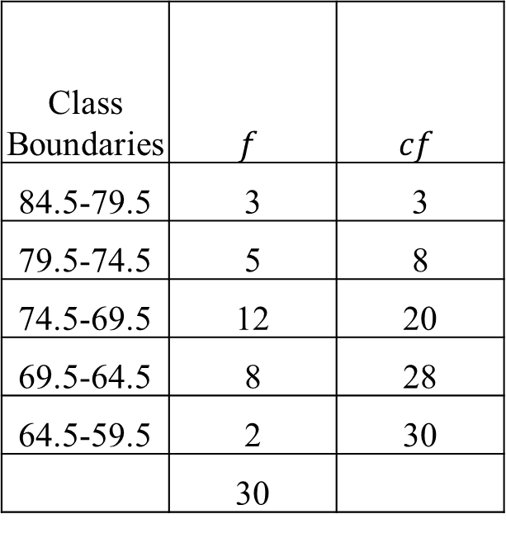
Find the median weight for the following table:
Weight in kgs | 84-80 | 79-75 | 74-70 | 69-65 | 64-60
No. of students | 3 | 5 | 12 | 8 | 2
Solution: The class intervals are given in the descending order:
$\frac{N}{2}$ = $\frac{30}{2}=15$
Cumulative frequency just greater than 15 is 20 and the corresponding class is 74.5-69.5 and the frequency is 12.
$$u=74.5, f=12, h=5, c=8$$
Median = $u−\frac{h}{f} ( \frac{N}{2}−c)$
= $74.5−\frac{5}{12}\left(15−8\right)$
= $74.5−2.92$= $71.58$
Median weight = 71.58 kg.
Class Boundaries | $$f$$ | $$cf$$
84.5-79.5 | 3 | 3
79.5-74.5 | 5 | 8
74.5-69.5 | 12 | 20
69.5-64.5 | 8 | 28
64.5-59.5 | 2 | 30
 | 30

Slide 37
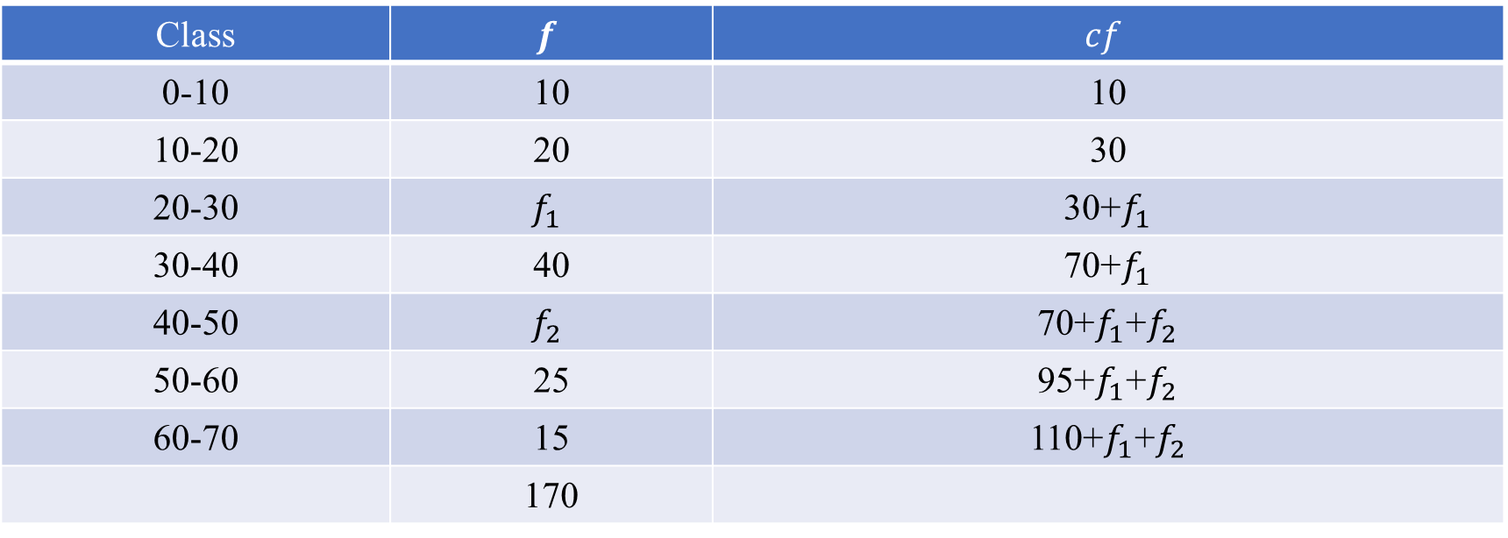
In the frequency distribution of 170 families given below, the number of families corresponding to expenditure groups 20-30 and 40-50 are missing in the table. However, the median is known to be 35. Find the missing frequencies.
Expenditure | 0-10 | 10-20 | 20-30 | 30-40 | 40-50 | 50-60 | 60-70
No. of families | 10 | 20 | ? | 40 | ? | 25 | 15
Class | $$f$$ | $$cf$$
0-10 | 10 | 10
10-20 | 20 | 30
20-30 | $$f_{1}$$ | 30+$f_{1}$
30-40 | 40 | 70+$f_{1}$
40-50 | $$f_{2}$$ | 70+$f_{1}$+$f_{2}$
50-60 | 25 | 95+$f_{1}$+$f_{2}$
60-70 | 15 | 110+$f_{1}$+$f_{2}$
 | 170

Slide 38
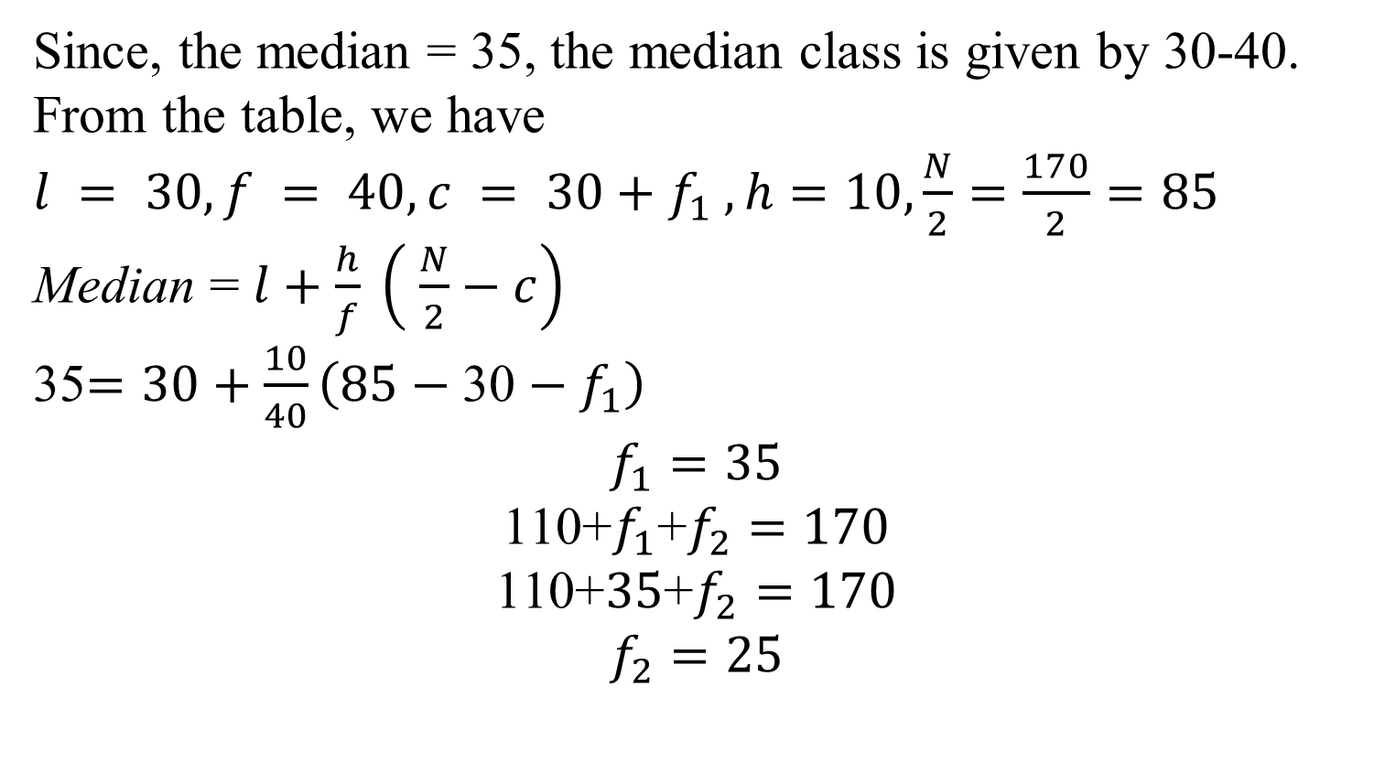
Since, the median = 35, the median class is given by 30-40. From the table, we have
$l = 30, f = 40, c = 30+f_{1} , h=10,\frac{N}{2}=\frac{170}{2}=85$
Median = $l+\frac{h}{f} \left( \frac{N}{2}−c\right)$
35$=30+\frac{10}{40}\left(85−\text{30}−f_{1}\right)$
$$f_{1}=35$$
$$\text{110+}f_{1}\text{+}f_{2}=170$$
$$\text{110+}35\text{+}f_{2}=170$$
$$f_{2}=25$$

Slide 39
Calculate the median for the following frequency distribution.
Variable X | 3 | 4 | 5 | 6 | 7 | 8
Frequency (f) | 2 | 4 | 7 | 9 | 10 | 16
Ans: 7

Slide 40
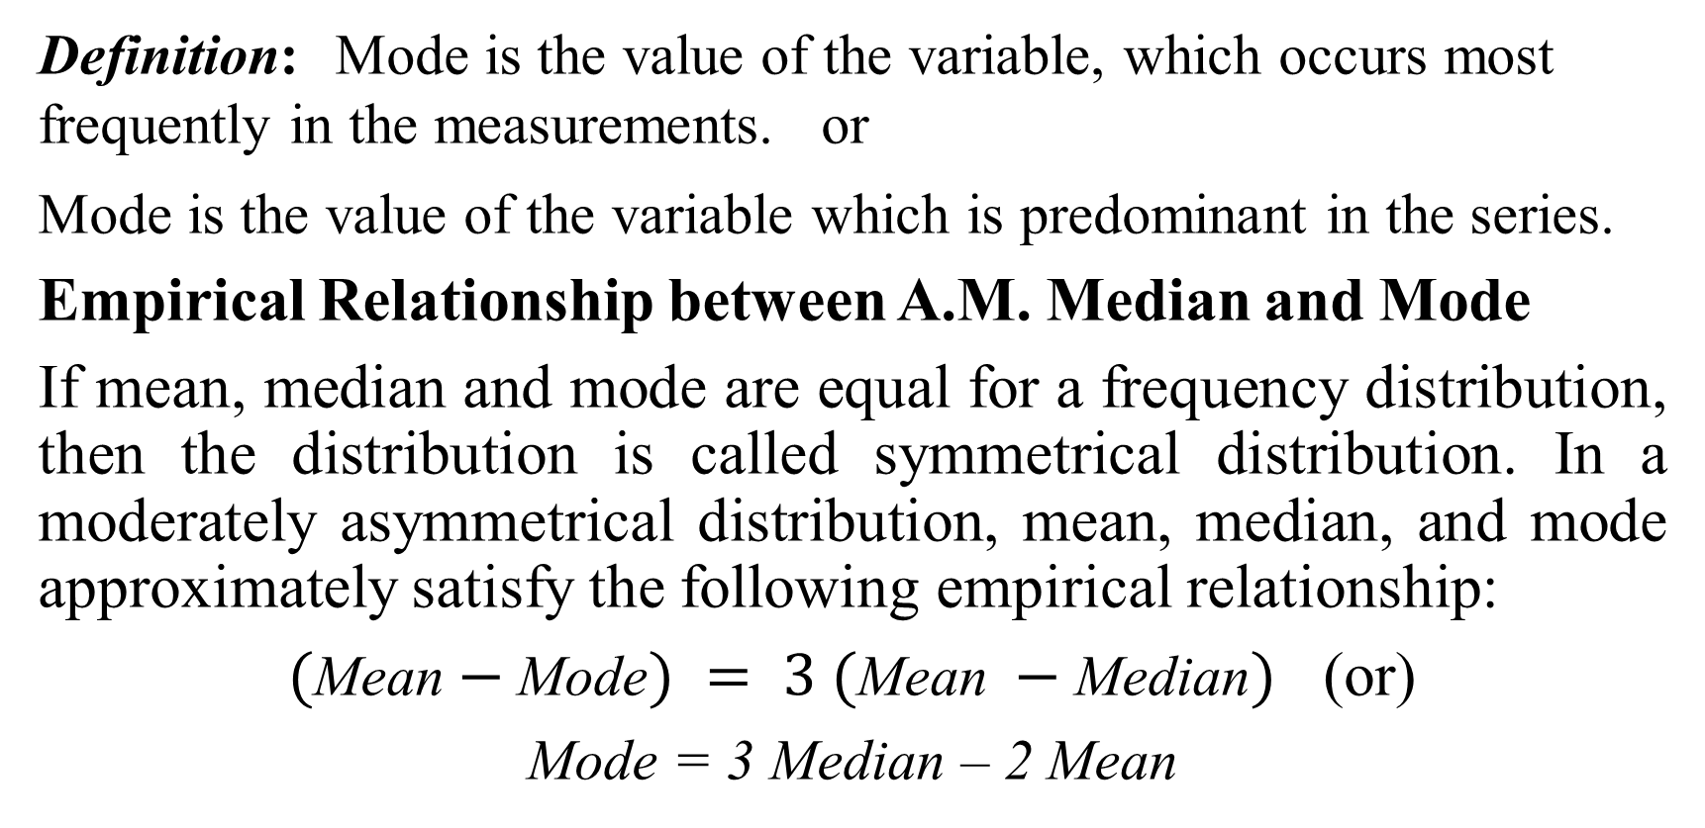
MODE
Definition: Mode is the value of the variable, which occurs most frequently in the measurements. or
Mode is the value of the variable which is predominant in the series.
Empirical Relationship between A.M. Median and Mode
If mean, median and mode are equal for a frequency distribution, then the distribution is called symmetrical distribution. In a moderately asymmetrical distribution, mean, median, and mode approximately satisfy the following empirical relationship:
$(\text{Mean}−\text{Mode}) = 3 (\text{Mean} −\text{Median})$ (or)
Mode = 3 Median – 2 Mean

Slide 41
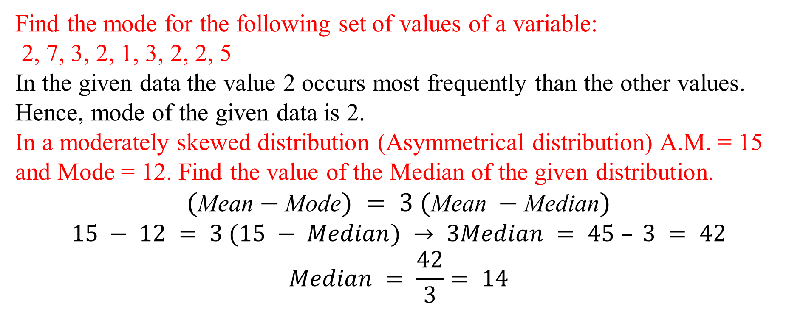
Find the mode for the following set of values of a variable:
2, 7, 3, 2, 1, 3, 2, 2, 5
In the given data the value 2 occurs most frequently than the other values.
Hence, mode of the given data is 2.
In a moderately skewed distribution (Asymmetrical distribution) A.M. = 15 and Mode = 12. Find the value of the Median of the given distribution.
$(\text{Mean}−\text{Mode}) = 3 (\text{Mean} −\text{Median})$
$$15 − 12 = 3 (15 − Median) → 3Median = 45 – 3 = 42$$
$$Median = \frac{42}{3}= 14$$
Find the mode of the following frequency distribution

Slide 42
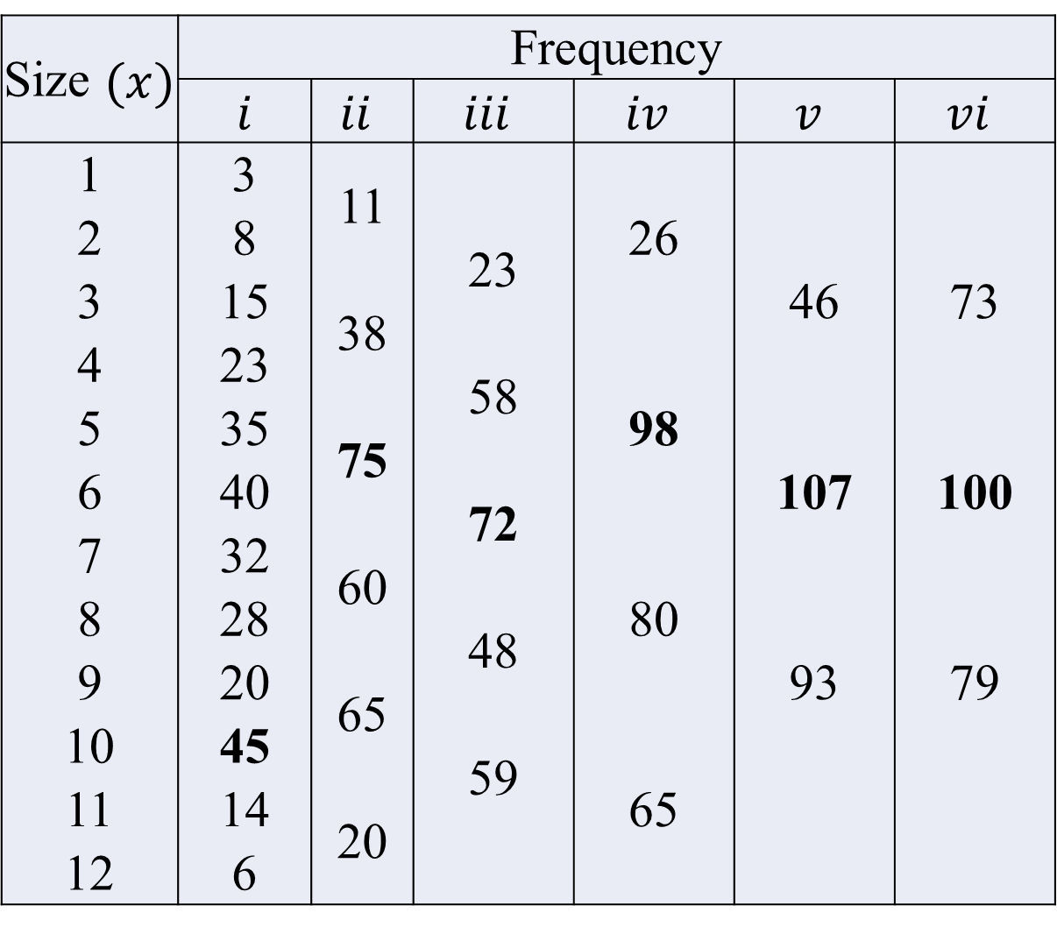
The frequencies in column (i) are the original frequencies. Column (ii) is obtained by combining the frequencies two by two.
If we leave the first frequency
and combine the remaining frequencies two by two we get column (iii).
Combining the frequencies two by two after leaving the first two frequencies results in a repetition of column (ii).
We combine the frequencies three by three thus getting column (iv).
The combination of frequencies three by three after leaving the first frequency results in column (v) and after leaving the first two frequencies results in column (vi).
Size $(x)$ | Frequency
 | $i$ | $$ii$$ | $$iii$$ | $$iv$$ | $$v$$ | $$vi$$
1 | 3 | 11 |  | 26
2 | 8 |  | 23 |  | 46 | 73
3 | 15 | 38
4 | 23 |  | 58 | 98
5 | 35 | 75 |  |  | 107 | 100
6 | 40 |  | 72
7 | 32 | 60 |  | 80
8 | 28 |  | 48 |  | 93 | 79
9 | 20 | 65
10 | 45 |  | 59 | 65
11 | 14 | 20
12 | 6

Slide 43
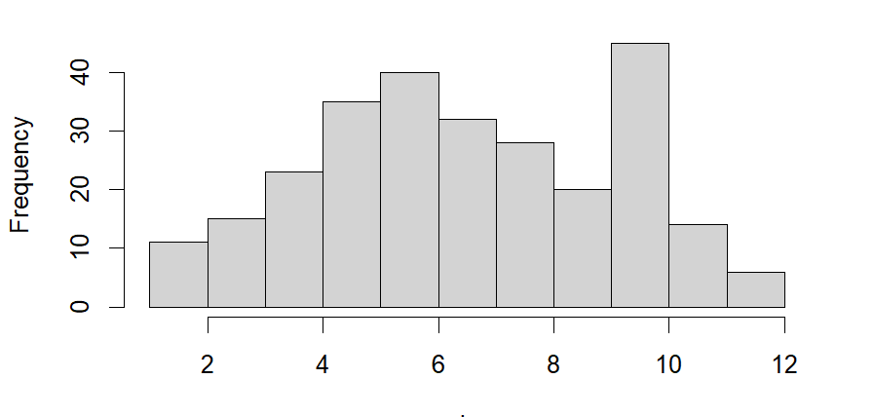
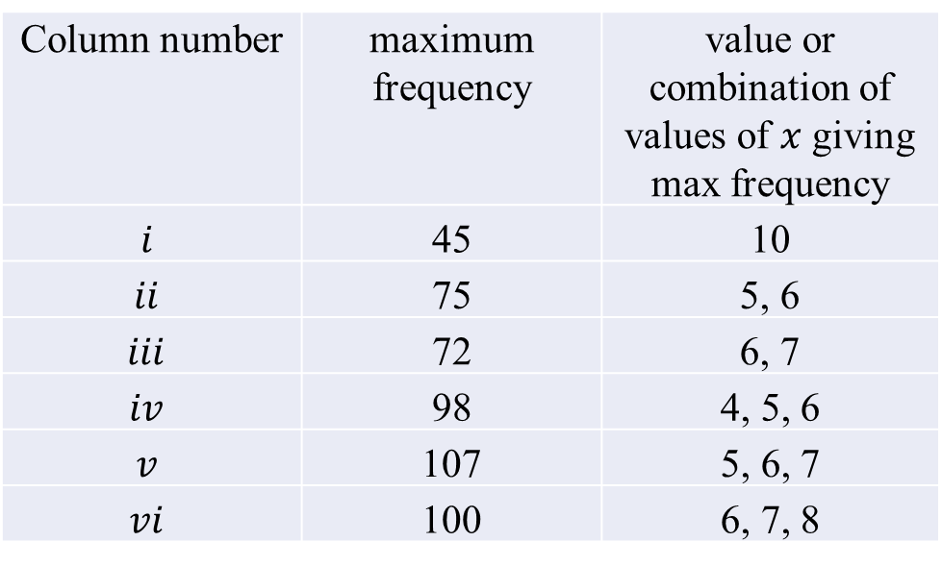
Column number | maximum frequency | value or combination of values of $x$ giving max frequency
$$i$$ | 45 | 10
$$ii$$ | 75 | 5, 6
$$iii$$ | 72 | 6, 7
$$iv$$ | 98 | 4, 5, 6
$$v$$ | 107 | 5, 6, 7
$$vi$$ | 100 | 6, 7, 8
we find that the value 6 is repeated the maximum number of times and hence the value of mode is 6 and not 10 which is an irregular item.

Slide 44
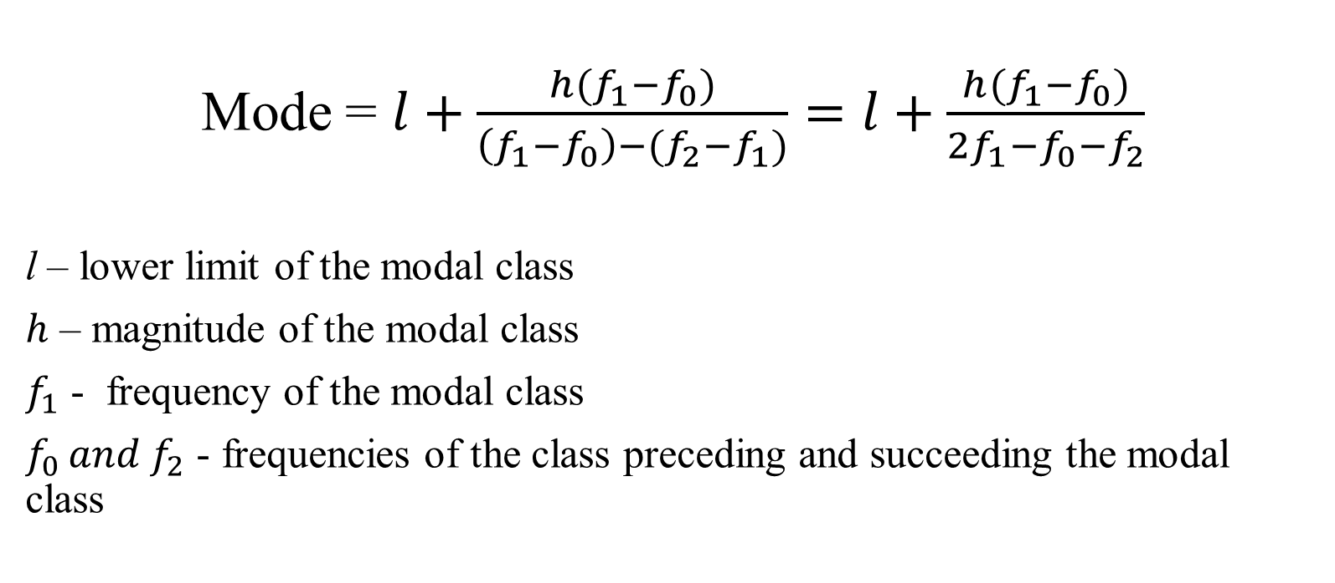
For Continuous Frequency distribution:
Mode = $l+\frac{h(f_{1}−f_{0})}{\left(f_{1}−f_{0}\right)−(f_{2}−f_{1})}=l+\frac{h(f_{1}−f_{0})}{2f_{1}−f_{0}−f_{2}}$
l – lower limit of the modal class
$h$ – magnitude of the modal class
$f_{1}$ - frequency of the modal class
$f_{0 }and{ f}_{2}$ - frequencies of the class preceding and succeeding the modal class

Slide 45
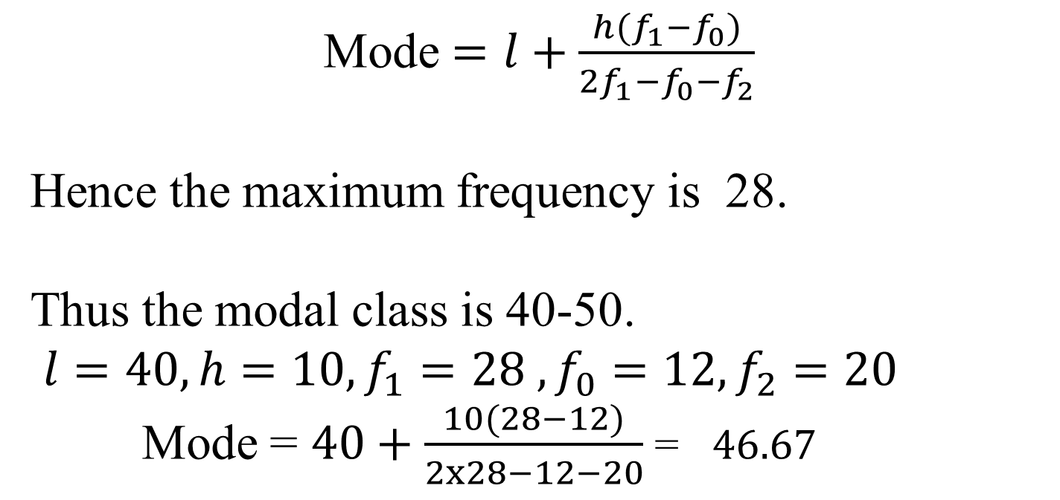
C.I. | 0-10 | 10-20 | 20-30 | 30-40 | 40-50 | 50-60 | 60-70 | 70-80
Frequency | 5 | 8 | 7 | 12 | 28 | 20 | 10 | 10
Mode $=l+\frac{h(f_{1}−f_{0})}{2f_{1}−f_{0}−f_{2}}$
Hence the maximum frequency is 28.
Thus the modal class is 40-50.
$l=40, h=10, f_{1}=28 ,f_{0}=12, f_{2}=20$
Mode = $40+\frac{10(28−12)}{2x28−12−20}$ = $46.67$

Slide 46
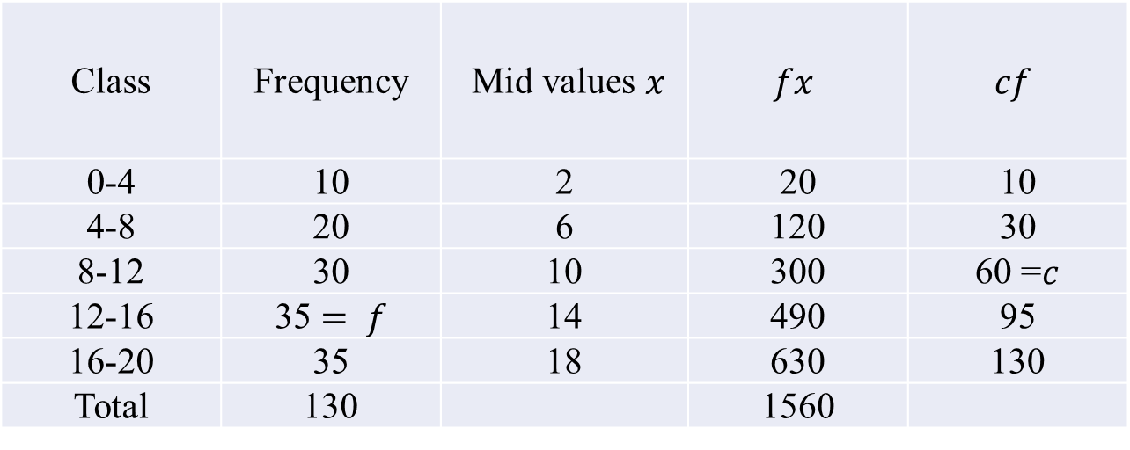
Compute Mode for the following data :
Solution: The highest frequency is 35 and it corresponds the two bottom most class intervals of frequency table. Hence, the given distributions is a bimodal. In this case, we use the empirical relationship between A.M., Median and Mode.
Class | Frequency | Mid values $x$ | $$fx$$ | $$cf$$
0-4 | 10 | 2 | 20 | 10
4-8 | 20 | 6 | 120 | 30
8-12 | 30 | 10 | 300 | 60 =$c$
12-16 | 35 $= f$ | 14 | 490 | 95
16-20 | 35 | 18 | 630 | 130
Total | 130 |  | 1560

Slide 47


$l$=$12, c = 60, f = 35, N = 130, h = 4$
$$\left(\text{Mean}−\text{Mode}\right)= 3 \left(\text{Mean} −\text{Median}\right)$$
12 – $Mode$ = 3 (12 – 12.5714)
12 – $Mode$ = 3 (- 0.5714)
12 – $Mode$ = - 1.7142
$Mode$ = 12 + 1.7142
$Mode$ = 13.7142

Slide 48
The median and mode of the following wage distribution are known to be Rs. 335 and Rs. 340 respectively. Find the three missing frequencies in the frequency distribution given below.
Wages (in Rs.) | Frequency
0-100 | 4
100-200 | 16
200-300 | 60
300-400 | ?
400-500 | ?
500-600 | ?
600-700 | 4
Total | 230

Slide 49


Solution:
230 = 84 + $f_{1}$ +$f_{2}$+$f_{3}$ ⇨ $f_{3}$ = 230 – 84 – $f_{1}$ – $f_{2}$ = 146 – ($f_{1}$ +$f_{2})$
Since the median and mode are 355 and 340,
Wages (in Rs.) | Frequency | $$cf$$
0-100 | 4 | 4
100-200 | 16 | 20
200-300 | 60 | 80
300-400 | $$f_{1}$$ | 80 + $f_{1}$
400-500 | $$f_{2}$$ | 80 + $f_{1}$ +$f_{2}$
500-600 | $$f_{3}$$ | 80 + $f_{1}$ + $f_{2}$+$f_{3}$
600-700 | 4 | 84 + $f_{1}$ +$f_{2}$+$f_{3}$
Total | 230

Slide 50
Hence, the missing frequencies are 100, 40 and 6 respectively

Slide 51
Calculate the mode for the following data :
Ans: Mode = 143.3235
Calculate the mean, median and mode for the following data.
Ans:Mean =39.52 Median=39.77 Mode =40.6
Calculate the Mean, Median and Mode for the following data
Ans: Mean = 24.19 Median = 23.96 Mode =23.6
Class | 130-134 | 135-139 | 140-144 | 145-149 | 150-154 | 155-159 | 160-164
Frequency | 5 | 15 | 28 | 24 | 17 | 10 | 1
Wages (in lakhs.) | 15-19 | 20-24 | 25-29 | 30-34 | 35-39 | 40-44 | 45-49 | 50-54 | 55-59 | 60-64
No. of workers | 31 | 47 | 59 | 78 | 104 | 113 | 81 | 60 | 52 | 25
Variable | 10-13 | 13-16 | 16-19 | 19-22 | 22-25 | 25-28 | 28-31 | 31-34 | 34-37 | 37-40
Frequency | 8 | 15 | 27 | 51 | 75 | 54 | 36 | 18 | 9 | 7

Slide 52
Measure of Dispersion
Scatteredness (homogeneity or heterogeneity)
The degree to which numerical data tend to spread about an average value is called variation or dispersion of data.
Measures of Dispersion: Range
Quartile Deviation
Mean Deviation
Standard Deviation

Slide 53

Range
Definition: Difference between the value of the smallest item and the value of the largest item in the distribution.
Range = $L−S$
L – Largest Value, S- Smallest Value
The relative measure corresponding to range is called the coefficient of range,
Coefficient of Range = $\frac{L−S}{L+S}$

Slide 54

The following are the prices of shares of a company from Monday to Saturday:
Calculate the range and its coefficient.
Solution: Range = L – S = 250 – 160 = 90
Range = Rs. 90
Coefficient of Range = $\frac{L−S}{L+S}$ = $\frac{250−160}{250+160}=\frac{90}{410}=0.22$
Days | Monday | Tuesday | Wednesday | Thursday | Friday | Saturday
Price(Rs.) | 200 | 210 | 208 | 160 | 220 | 250

Slide 55

In a frequency distribution, range is calculated by taking the difference between the lower limit of the lowest class and the upper limit of the highest class.
Calculate the range and its coefficient.
Range = L – S = 70 – 10 = 60
Coefficient of Range = $\frac{L−S}{L+S}$ = $\frac{70−10}{70+10}=\frac{60}{80}=0.75$
Marks | 10-20 | 20-30 | 30-40 | 40-50 | 50-60 | 60-70
No. of Students | 12 | 18 | 27 | 20 | 17 | 6

Slide 56

Quartiles, Deciles, Percentiles:
The three points which divide the series into four equal parts are called quartiles.
The first quartile, $Q_{1}$ is the value which exceed 25% of the observations
The second quartile, $Q_{2}$ is the value which exceed 50% of the observations (i.e, median)
The third quartile, $Q_{3}$ is the value which exceed 75% of the observations
The nine points which divide the series into ten equal parts are called deciles whereas percentiles are the ninety-nine points which divide the series into hundred equal parts.

Slide 57



Eight coins were tossed together and the number of heads resulting was noted. The operation was repeated 256 times and frequencies (f) that were obtained for different values of x. the number of heads, are shown in the following table. Calculate median, Quartiles, 4th decile and 27th percentile.
Solution
Here N/2 = 256/2 = 128. Cumulative frequency ($cf$ > than 128 is 167. Thus, median = 4).
$Q_{1}$ : Here N/4 = 64. cf > 64 is 95. Hence. $Q_{1}$ = 3.
Q3 : Here 3N/4 = 192 and cf >192 is 219. Thus Q3 = 5.
$D_{4}$= 4 x 25.6 = 102·4 and cf >102· 4 is 167. Hence D=4.
$P_{27}$= 27 x 2·56 = 69·12 and cf > 69·12 is 95. Hence $P_{27}$= 3.
$$x$$ | 0 | 1 | 2 | 3 | 4 | 5 | 6 | 7 | 8
$$f$$ | 1 | 9 | 26 | 59 | 72 | 52 | 29 | 7 | 1
$$x$$ | 0 | 1 | 2 | 3 | 4 | 5 | 6 | 7 | 8
$$f$$ | 1 | 9 | 26 | 59 | 72 | 52 | 29 | 7 | 1
$$cf$$ | 1 | 10 | 36 | 95 | 167 | 219 | 248 | 255 | 256

Slide 58

Quartile Deviation : Average amount by which the two quartiles differ from the median.
$$Q.D = \frac{Q_{3}−Q_{1}}{2}$$
The Median $±$ Q.D. covers exactly 50 per cent of the observations.
When Q.D. is very small, it describes high uniformity or small variation of the central 50% items, and a high Q.D. means that the variation among the central items is large.
Coefficient of Q.D. = $\frac{Q_{3}−Q_{1}}{Q_{3}+Q_{1}}$

Slide 59


Compute the value of Q.D. and coefficient of Q.D. from the following data
Q₁ = Size of $\frac{N}{4} th$item = Size of $\frac{67}{4}$ = 16.75thitem.
Q₁ lies in the interval 20-30
Q₃= Size of $\frac{3N}{4} th$item = Size of $\frac{3×67}{4}$ = 50.25thitem.
Q₃ lies in the class 50-60.
$Q.D. =\frac{Q_{3}−Q_{1}}{2}= \frac{54.72−22.5}{2}$ = 16.11
Coefficient of Q.D. = $\frac{Q_{3}−Q_{1}}{Q_{3}+Q_{1}}= \frac{54.72−22.5}{54.72+22.5}=$0.4172
C.I. | 10-20 | 20-30 | 30-40 | 40-50 | 50-60 | 60-70 | 70-80
f | 12 | 19 | 5 | 10 | 9 | 6 | 6
Marks | $$f$$ | $$cf$$
10-20 | 12 | 12
20-30 | 19 | 31
30-40 | 5 | 36
40-50 | 10 | 46
50-60 | 9 | 55
60-70 | 6 | 61
70-80 | 6 | 67
 | N = 67

Slide 60

Standard deviation ($σ$): It is the positive square root of the arithmetic mean of the squares of the deviations of the given values from their arithmetic mean.
Ungrouped data:
Grouped data:
Mean square deviation is given by

Slide 61

Variance ($σ^{2}$): The square of standard deviation is called the variance and is given by
Ungrouped data:
Grouped data:
Co-efficient of Variation: 100 times the Co-efficient of dispersion(C.D) based upon standard deviation is called Co-efficient of Variation(C.V)

Slide 62

Calculate the mean and standard deviation for the following table giving the age distribution of 542 members. Also find CD and CV.
Solution:
Age in years: | 20-30 | 30-40 | 40-50 | 50-60 | 60-70 | 70-80 | 80-90
No. of members | 3 | 61 | 132 | 153 | 140 | 51 | 2
Age in years: | $$x$$ | $$f$$ | $$d$$ | $$fd$$ | $$fd^{2}$$
20-30 | 25 | 3 | -3 | -9 | 27
30-40 | 35 | 61 | -2 | -122 | 244
40-50 | 45 | 132 | -1 | -132 | 132
50-60 | 55 | 153 | 0 | 0 | 0
60-70 | 65 | 140 | 1 | 140 | 140
70-80 | 75 | 51 | 2 | 102 | 204
80-90 | 85 | 2 | 3 | 6 | 18
 |  | 542 |  | -15 | 765

Slide 63

Moment: The rth moment of a variable $x$ about any point $x=A$ usually denoted by $μ_{r}^{′}$

Slide 64

Pearson Coefficient: Karl Pearson Coefficient defined by the following four coefficients based on the moment about the mean
Skewness: Literally skewness means lack of symmetry. A distribution is said be skewed if
Mean median and mode fall at different points. i.e., Mean $≠$ Median $≠$ Mode
Quartile are not equidistant from median and
The curve drawn with the help of the given data is not symmetrical but stretched more to one side than to the other.

Slide 65



Measure of Skewness: Various measures of skewness are
Coefficients of Skewness:
Karl Pearson's Coefficient of skewness: $S_{k}=\frac{M−M_{0}}{σ}$
Bowley's Coefficient of skewness: $S_{k}=\frac{Q_{3}+Q_{1}−2M_{d}}{Q_{3}−Q_{1}}$
Based upon moments, co-efficient of
skewness: $S_{k}=\frac{\sqrt{β_{1}}( β_{2}+3)}{2(5 β_{2}−6 β_{1}−9)}$

Slide 66



Kurtosis: It enables us to have an idea about the flatness or peakedness of the curve. It is measured-by the co-efficient $β_{2}$ or its derivation $γ_{2}$ given by
Leptokurtic $γ_{2}$ >0
Normal curve or. mesokurtic curve $γ_{2}$ =0
platykurtic $γ_{2}$ <0

