Slide 1
Module: 7 Reliability
Basic concepts- Hazard function- Reliabilities of series and parallel systems- System Reliability - Maintainability-Preventive and repair maintenance- Availability.

Slide 2
Reliability – The probability that a failure may not occur in a given time interval.
Definition: Reliability of unit (product) is the probability that the unit performs its intended function adequately for a given period of time under the stated operating conditions or environment.
By a unit – an element, a system or a part of a system, or the like.
The definition of Reliability stresses four elements namely:
Probability
Intended function
Time
Operating conditions

Slide 3
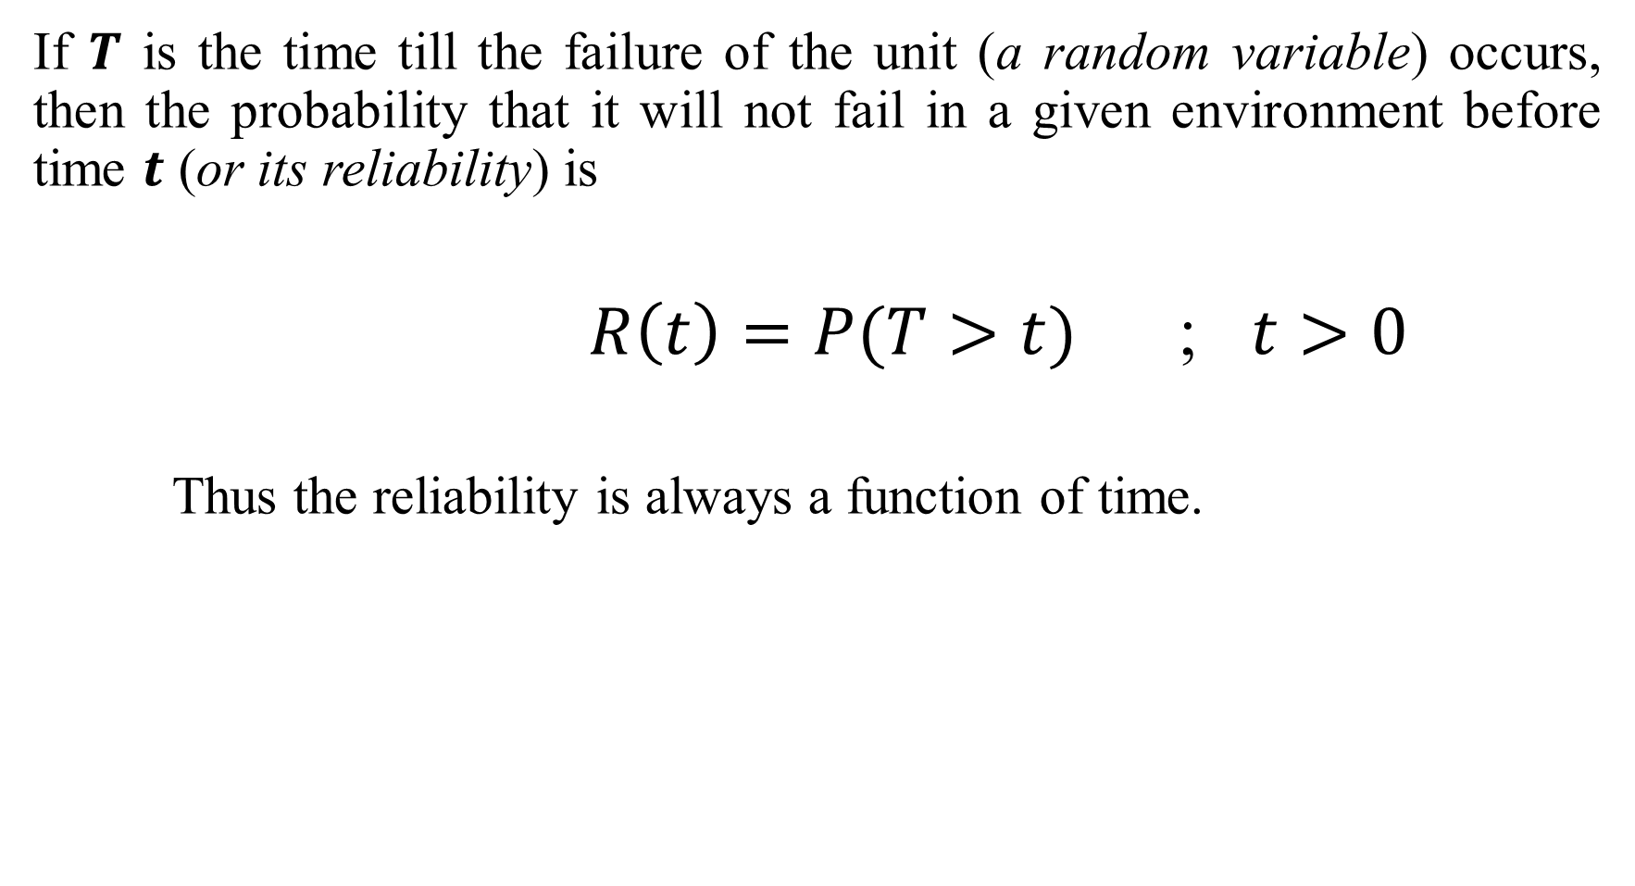
If $T$ is the time till the failure of the unit (a random variable) occurs, then the probability that it will not fail in a given environment before time $t$ (or its reliability) is
$R\left(t\right)=P(T>t)$ ; $t>0$
Thus the reliability is always a function of time.

Slide 4
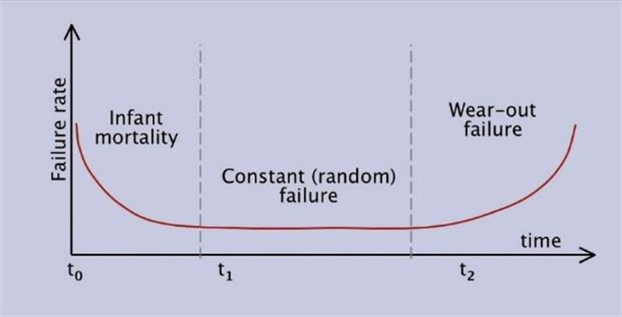

Slide 5

$R\left(t\right)=P(T>t)$ or $1−P(T≤t)$
$=$ $1−F(t)$
$F\left(t\right)=\int_{0}^{t}{f\left(t\right) dt}$
Thus, $R\left(t\right)=1− \int_{0}^{t}{ f(t}) dt$ $=$ $\int_{t}^{∞}{f\left(t\right) dt}$
Since $F\left(0\right)=0$ and $F\left(∞\right)=1$ by the property of c.d.f. $R\left(0\right)=1$ and $R\left(∞\right)=0$ ; i.e.,$0≤R(t)≤1$

Slide 6
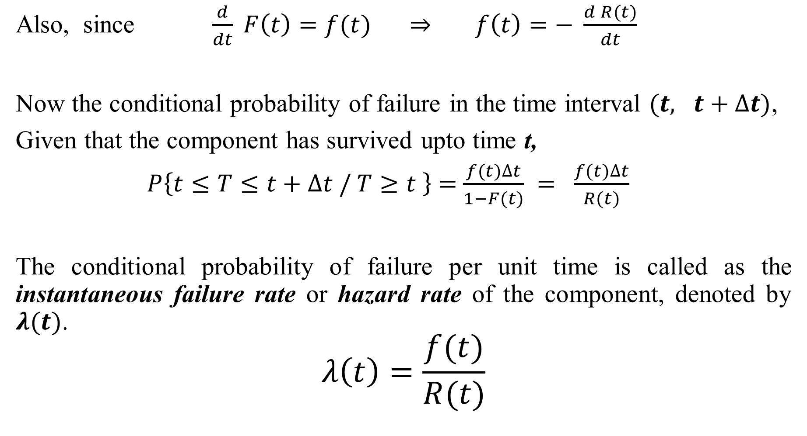
Also, since $\frac{d}{dt} F\left(t\right)=f(t)$ $⇒$ $f\left(t\right)=− \frac{d R(t)}{dt}$
Now the conditional probability of failure in the time interval $(t, t+∆t)$,
Given that the component has survived upto time t,
$P\left\{t≤T≤t+∆t / T≥t \right\}$ $=$ $\frac{f(t)∆t}{1−F(t)}$ $=$ $\frac{f(t)∆t}{R(t)}$
The conditional probability of failure per unit time is called as the instantaneous failure rate or hazard rate of the component, denoted by $λ(t)$.
$$λ\left(t\right)=\frac{f(t)}{R(t)}$$

Slide 7

$$− \frac{R^{′}\left(t\right)}{R\left(t\right)} = λ\left(t\right)$$
Integrating on both sides w.r.t to $t$ between $0$ and $t$ ,
$\int_{0}^{t}{ \frac{R^{′}\left(t\right)}{R\left(t\right)} dt} =$ $−\int_{0}^{t}{λ\left(t\right)dt}$
${\left\{\log{R(t)}\right\}}_{0}^{t}$ $=$ $−\int_{0}^{t}{λ\left(t\right)dt}$
$\log{R(t)}−\log{R(0)}$ $=$ $−\int_{0}^{t}{λ\left(t\right)dt}$
$\operatorname{loge}{R(t)}$ $=$ $−\int_{0}^{t}{λ\left(t\right)dt}$
$R\left(t\right)= e^{−\int_{0}^{t}{λ\left(t\right)dt}}$
$∴$ $f\left(t\right)=λ\left(t\right) e^{−\int_{0}^{t}{λ\left(t\right)dt}}$

Slide 8

Mean Time to Failure (MTTF)
$MTTF =$ $E(T)$ $=$ $\int_{0}^{∞}{t f\left(t\right) dt } =$ $−\int_{0}^{∞}{t{ R}^{′}\left(t\right) dt }$
$=$ ${[t R(t)]}_{0}^{∞}+$ $\int_{0}^{∞}{ R\left(t\right) dt }$
(On integration by parts)
$MTTF$ $=$ $\int_{0}^{∞}{ R\left(t\right) dt }$
$Var \left(t\right)=\int_{0}^{∞}{t^{2}f\left(t\right) dt} − {\left(MTTF\right)}^{2}$

Slide 9
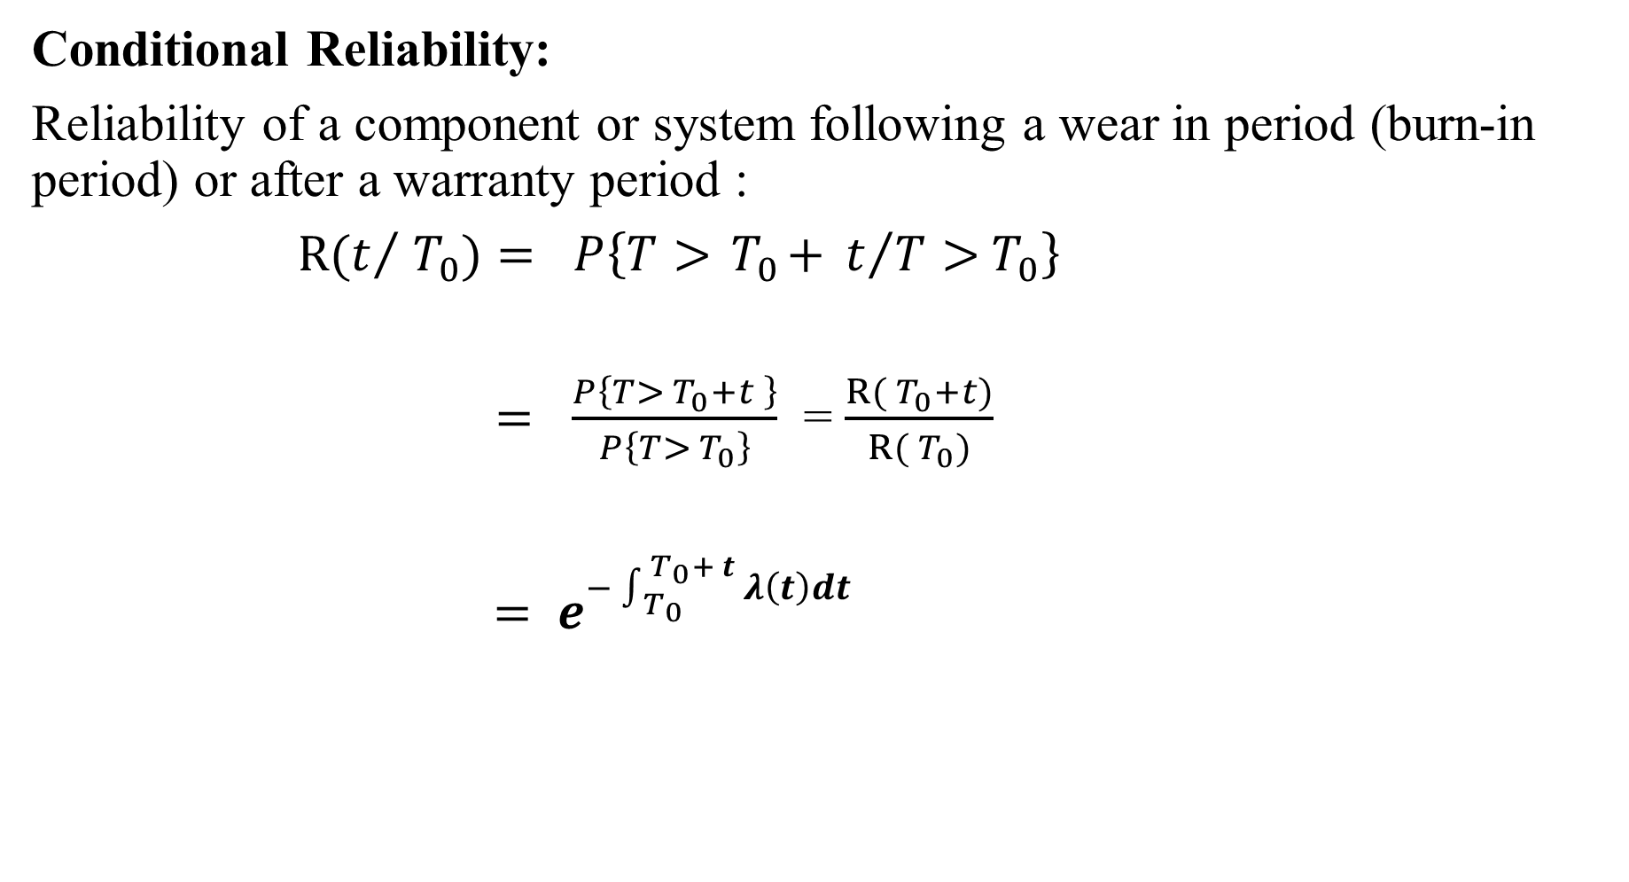
Conditional Reliability:
Reliability of a component or system following a wear in period (burn-in period) or after a warranty period :
$R(t/{{ T}_{0}})$ $=$ $P\left\{T>{ T}_{0}+ t/{T>{ T}_{0}}\right\}$
$=$ $\frac{P\left\{T>{ T}_{0}+t \right\}}{P\left\{T>{ T}_{0}\right\}}$ = $\frac{R({ T}_{0}+t)}{R({ T}_{0})}$
$=$ $e^{−\int_{{ T}_{0}}^{{ T}_{0}+ t}{λ\left(t\right)dt}}$

Slide 10
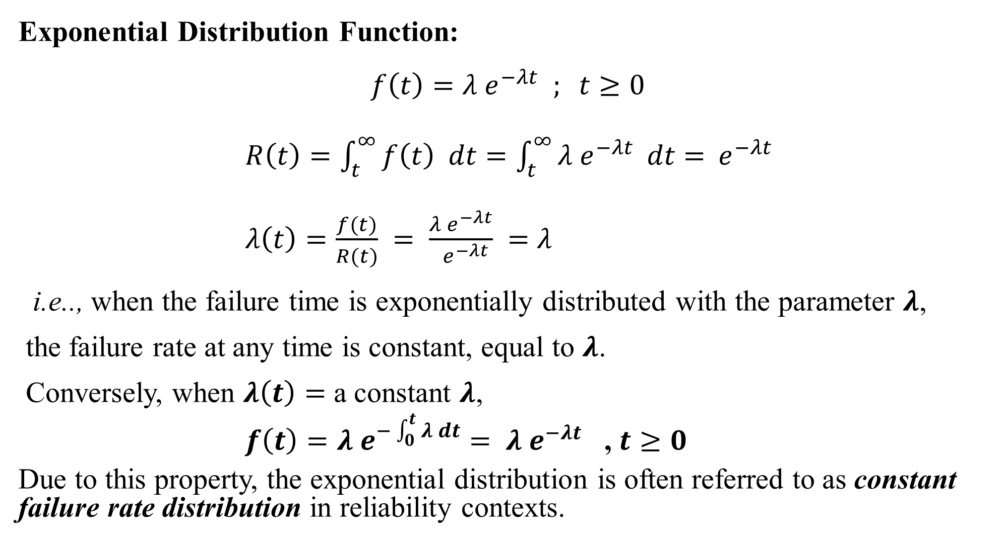
Exponential Distribution Function:
$$f\left(t\right)={λ e}^{−λt} ; t≥0$$
$R\left(t\right)=\int_{t}^{∞}{f\left(t\right) dt}=\int_{t}^{∞}{{λ e}^{−λt}} dt$ $={ e}^{−λt}$
$λ\left(t\right)=\frac{f(t)}{R(t)}$ $=$ $\frac{{λ e}^{−λt}}{{ e}^{−λt}}$ $=$ $λ$
i.e.., when the failure time is exponentially distributed with the parameter $λ$,
the failure rate at any time is constant, equal to $λ$.
Conversely, when $λ\left(t\right)=$ a constant $λ$,
$f\left(t\right)=λ e^{−\int_{0}^{t}{λ dt}}$ $= {λ e}^{−λt}$ , $t≥0$
Due to this property, the exponential distribution is often referred to as constant failure rate distribution in reliability contexts.

Slide 11
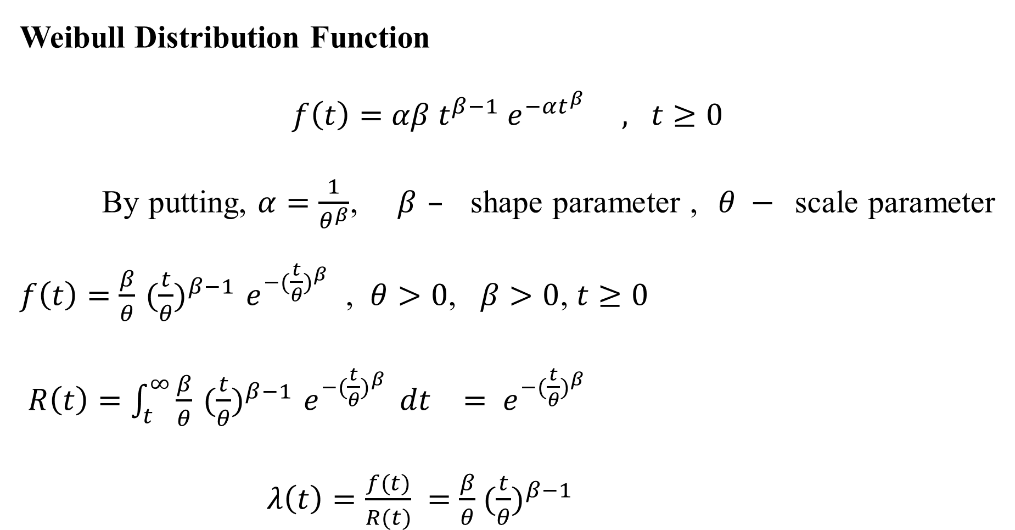
Weibull Distribution Function
$f\left(t\right)=$ $αβ{ t}^{β−1} e^{−αt^{β}} , t≥0$
By putting, $α=\frac{1}{θ^{β}}$, $β$ $–$ shape parameter , $θ −$ scale parameter $f\left(t\right)=$ $\frac{β}{θ}{ (\frac{t}{θ})}^{β−1} e^{−{(\frac{t}{θ})}^{β}}$ , $θ>0$, $β>0$, $t≥0$
$R\left(t\right)=\int_{t}^{∞}{\frac{β}{θ}{ (\frac{t}{θ})}^{β−1} e^{−{(\frac{t}{θ})}^{β}}} dt$ $=$ $e^{−{(\frac{t}{θ})}^{β}}$
$λ\left(t\right)=\frac{f(t)}{R(t)}$ $=$ $\frac{β}{θ}{ (\frac{t}{θ})}^{β−1}$

Slide 12

$MTTF = E\left(T\right)=$ $θ Γ \left(1+\frac{1}{β}\right)$ ;
Var (T) = $θ^{2}\left\{Γ \left(1+\frac{2}{β}\right) −{\left[Γ \left(1+\frac{1}{β}\right) \right]}^{2}\right\}$

Slide 13
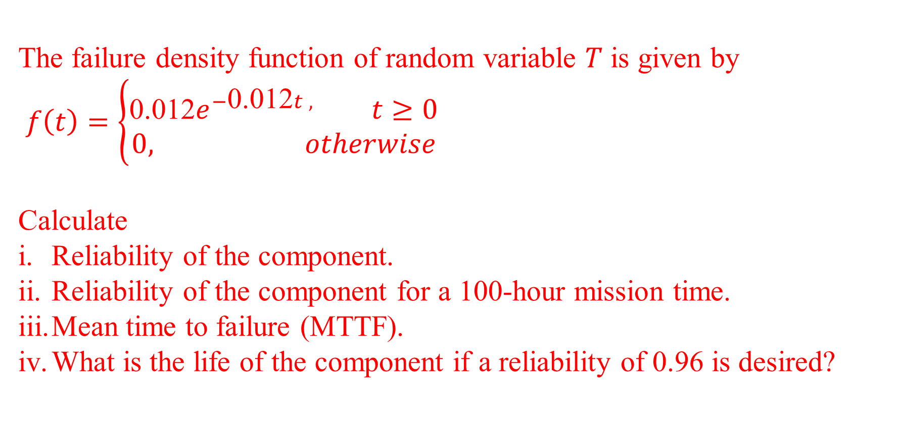
The failure density function of random variable $T$ is given by
$f\left(t\right)=\left\{\begin{aligned}\text{0.012}e^{−\text{0.012}t , }t≥0 \\ 0, otherwise\end{aligned}\right.$
Calculate
Reliability of the component.
Reliability of the component for a 100-hour mission time.
Mean time to failure (MTTF).
What is the life of the component if a reliability of 0.96 is desired?

Slide 14
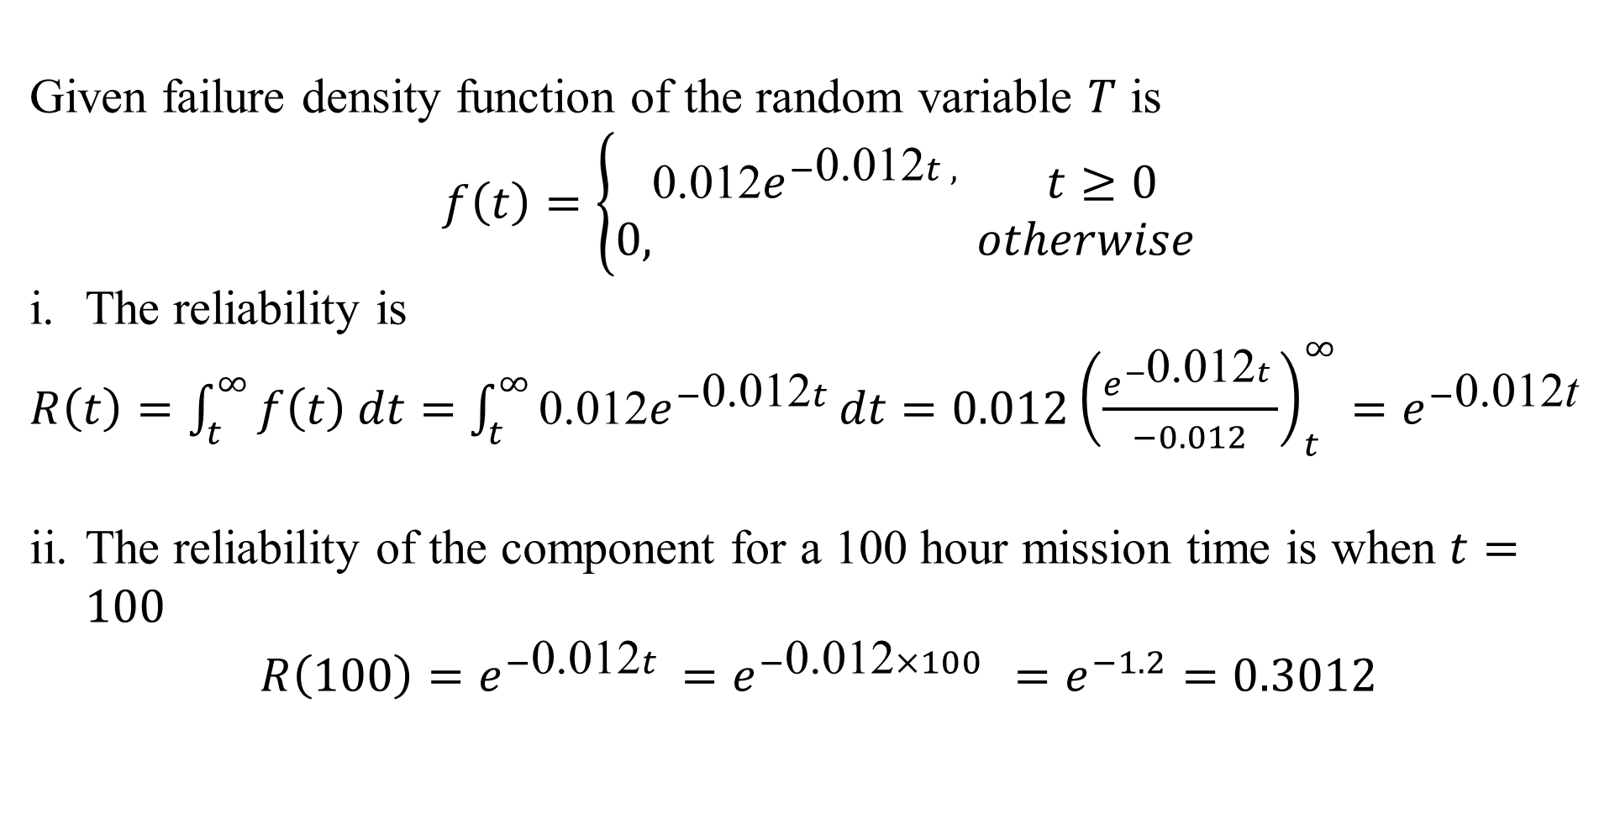
Given failure density function of the random variable $T$ is
$$f\left(t\right)=\left\{\begin{aligned}\text{0.012}e^{−\text{0.012}t , }t≥0 \\ 0, otherwise\end{aligned}\right.$$
The reliability is
$R\left(t\right)=\int_{t}^{∞}{f\left(t\right) dt=}$ $\int_{t}^{∞}{\text{0.012}e^{−\text{0.012}t }dt}=0.012{\left(\frac{e^{−\text{0.012}t }}{−0.012}\right)}_{t}^{∞}=e^{−\text{0.012}\text{t}}$
The reliability of the component for a 100 hour mission time is when $t=100$
$$R\left(100\right)=e^{−\text{0.012}t }=e^{−\text{0.012}×100 }=e^{−1.2}=0.3012$$

Slide 15
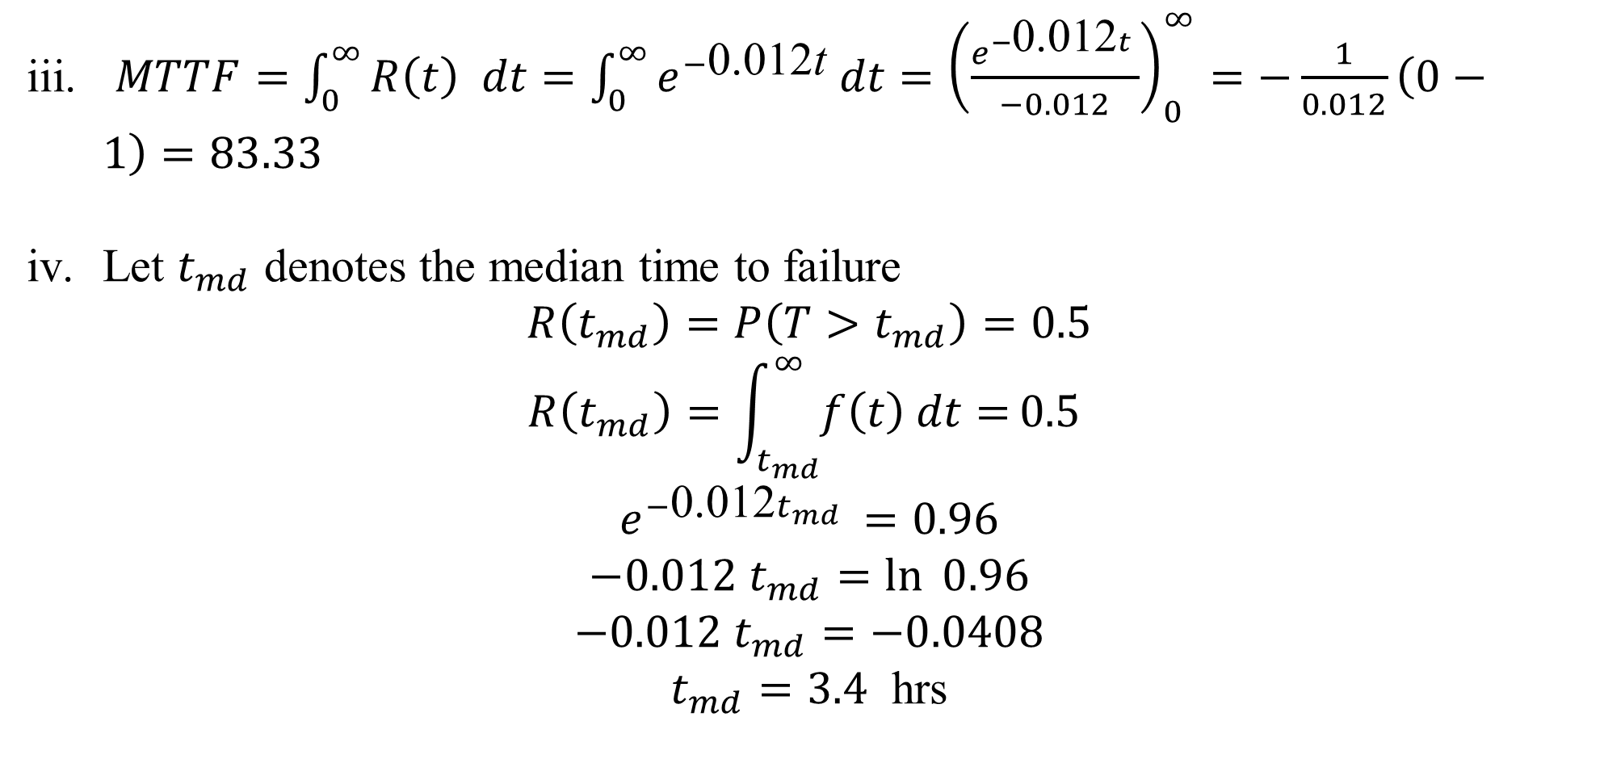
$MTTF=\int_{0}^{∞}{R\left(t\right) dt=\int_{0}^{∞}{e^{−\text{0.012}\text{t}} dt={\left(\frac{e^{−\text{0.012}t }}{−0.012}\right)}_{0}^{∞}=−\frac{1}{0.012}\left(0−1\right)=83.33}}$
Let $t_{md}$ denotes the median time to failure
$$R\left(t_{md}\right)=P\left(T>t_{md}\right)=0.5$$
$$R\left(t_{md}\right)=\int_{t_{md}}^{∞}{f\left(t\right) dt=}0.5$$
$$e^{−\text{0.012}t_{md} }=0.96$$
$$−0.012 t_{md}=\ln{0.96}$$
$$−0.012 t_{md}=−0.0408$$
$t_{md}=3.4$ hrs

Slide 16
System Reliability
A system is generally understood as a set of components assembled to perform a certain function.
To evaluate the reliability of a complex system, we may apply a particular-failure law to the entire system.
But it will be proper if we determine an appropriate reliability model for each component and then compute the reliability of the system by applying the relevant rules of probability according to the configuration of the components within the system.

Slide 17
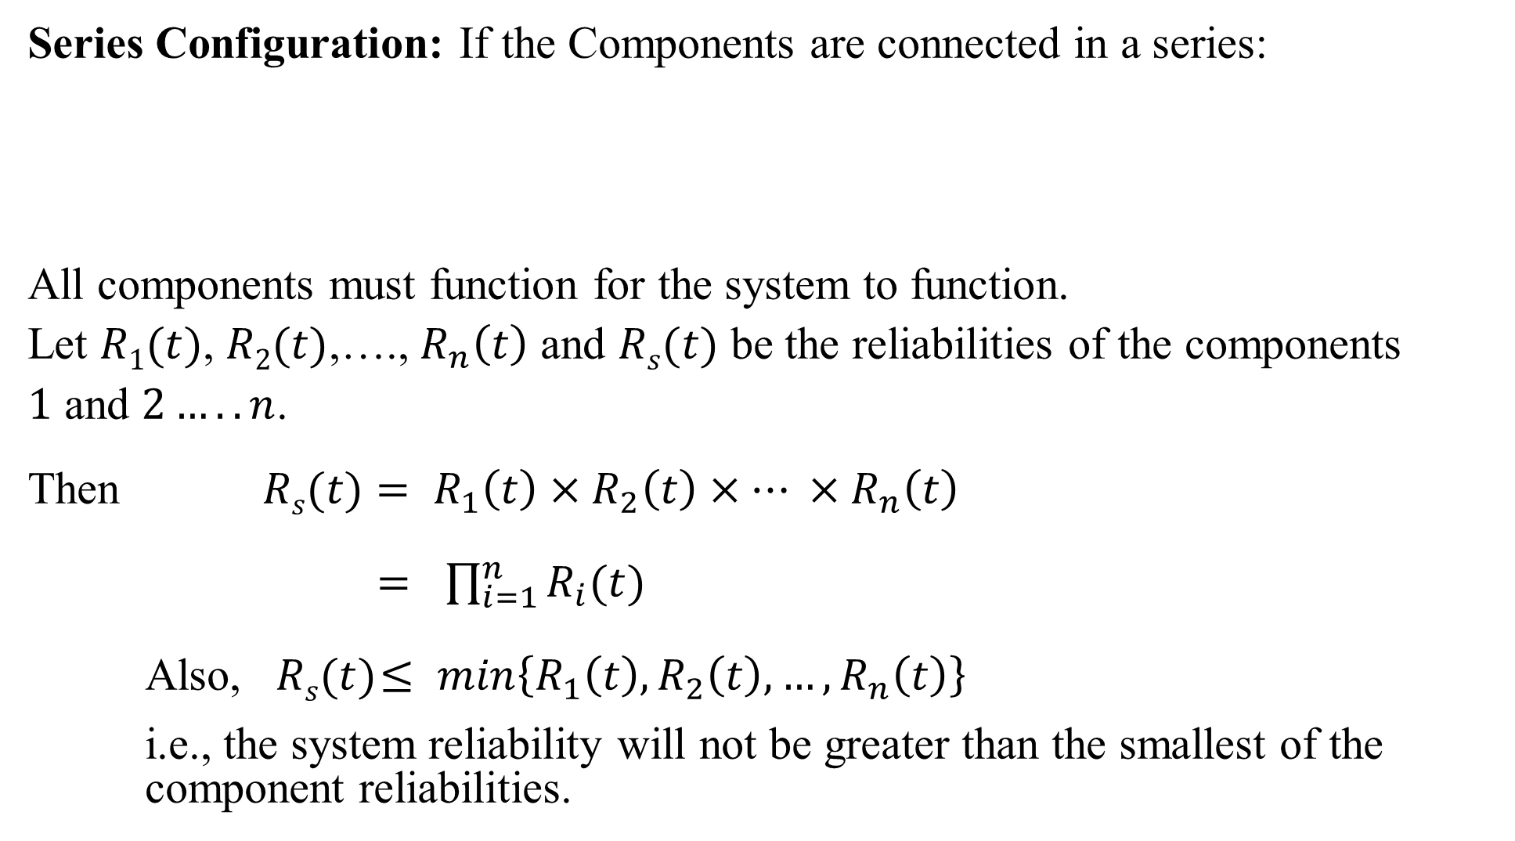
Series Configuration: If the Components are connected in a series:
All components must function for the system to function.
Let $R1(t)$, $R2(t)$,…., $R_{n}\left(t\right)$ and $Rs(t)$ be the reliabilities of the components
$1$ and $2…..n$.
Then $Rs(t)=$ $R_{1}\left(t\right)×R_{2}\left(t\right)×… ×R_{n}\left(t\right)$
$=$ $\prod_{i=1}^{n}{R_{i}(t)}$
Also, $Rs(t)$ $≤$ $min\left\{R_{1}\left(t\right), R_{2}\left(t\right),…,R_{n}\left(t\right)\right\}$
i.e., the system reliability will not be greater than the smallest of the component reliabilities.

Slide 18
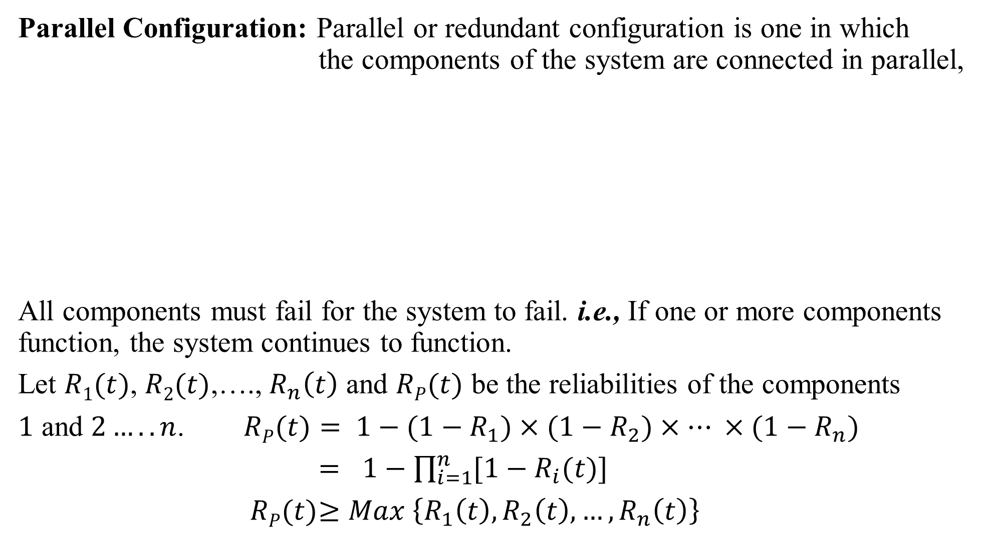
Parallel Configuration: Parallel or redundant configuration is one in which the components of the system are connected in parallel,
All components must fail for the system to fail. i.e., If one or more components function, the system continues to function.
Let $R1(t)$, $R2(t)$,…., $R_{n}\left(t\right)$ and $RP(t)$ be the reliabilities of the components
$1$ and $2…..n$. $RP(t)=$ ${1−(1−R}_{1})×{(1−R}_{2})×… ×{(1−R}_{n})$
$=$ $1−\prod_{i=1}^{n}{{[1−R}_{i}(t)]}$
$RP(t)$ $≥$ $Max \left\{R_{1}\left(t\right), R_{2}\left(t\right),…,R_{n}\left(t\right)\right\}$

Slide 19
Parallel – Series (low-level redundancy)
Series – Parallel (high-level redundancy)

Slide 20
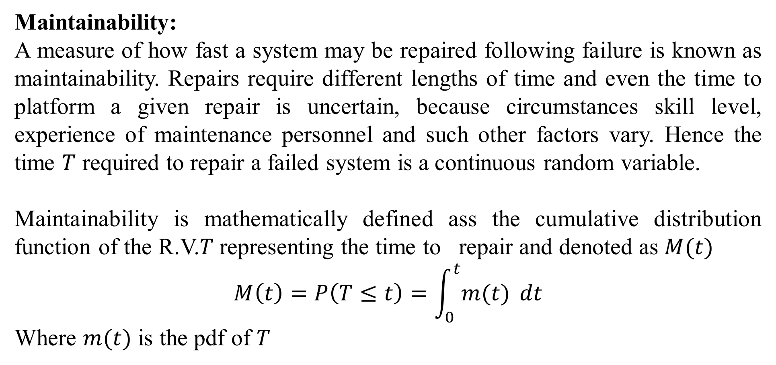
Maintainability:
A measure of how fast a system may be repaired following failure is known as maintainability. Repairs require different lengths of time and even the time to platform a given repair is uncertain, because circumstances skill level, experience of maintenance personnel and such other factors vary. Hence the time $T$ required to repair a failed system is a continuous random variable.
Maintainability is mathematically defined ass the cumulative distribution function of the R.V.$T$representing the time to repair and denoted as $M(t)$
$$M\left(t\right)=P\left(T≤t\right)=\int_{0}^{t}{m(t)} dt$$
Where $m(t)$ is the pdf of $T$

Slide 21
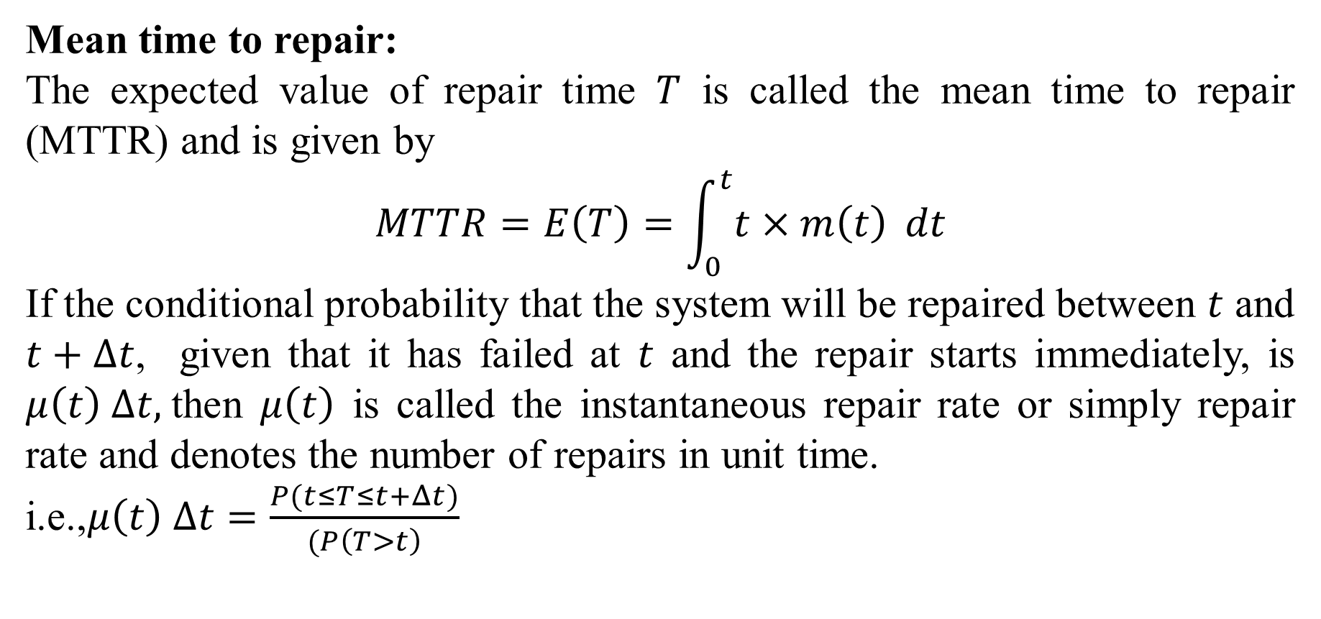
Mean time to repair:
The expected value of repair time $T$ is called the mean time to repair (MTTR) and is given by
$$MTTR=E\left(T\right)=\int_{0}^{t}{t×m\left(t\right)} dt$$
If the conditional probability that the system will be repaired between $t$ and $t+Δt$, given that it has failed at $t$ and the repair starts immediately, is $μ\left(t\right) Δt,$then $μ\left(t\right)$ is called the instantaneous repair rate or simply repair rate and denotes the number of repairs in unit time.
i.e.,$μ\left(t\right) Δt=\frac{P(t≤T≤t+Δt)}{(P\left(T>t\right)}$

Slide 22

$$μ\left(t\right)=\frac{\left(m\left(t\right)\right)}{1−M\left(t\right)}$$
$$m\left(t\right)=\frac{d}{dt}M\left(t\right) ,$$
$$μ\left(t\right)=\frac{M′\left(t\right)}{1−M\left(t\right)}$$
$$M\left(t\right)=1−e^{−\int_{0}^{t}{μ\left(t\right) dt} }$$
$$m^{′}\left(t\right)=μ\left(t\right)e^{−\int_{0}^{t}{μ\left(t\right) dt} }$$

Slide 23
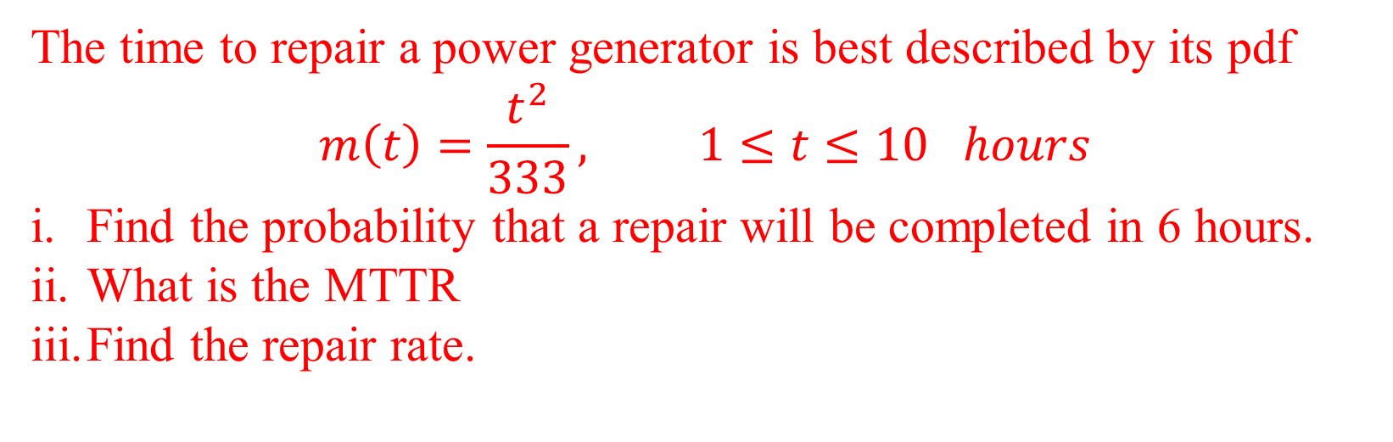
The time to repair a power generator is best described by its pdf
$$m\left(t\right)=\frac{t^{2}}{333}, 1≤t≤10 hours$$
Find the probability that a repair will be completed in 6 hours.
What is the MTTR
Find the repair rate.

Slide 24
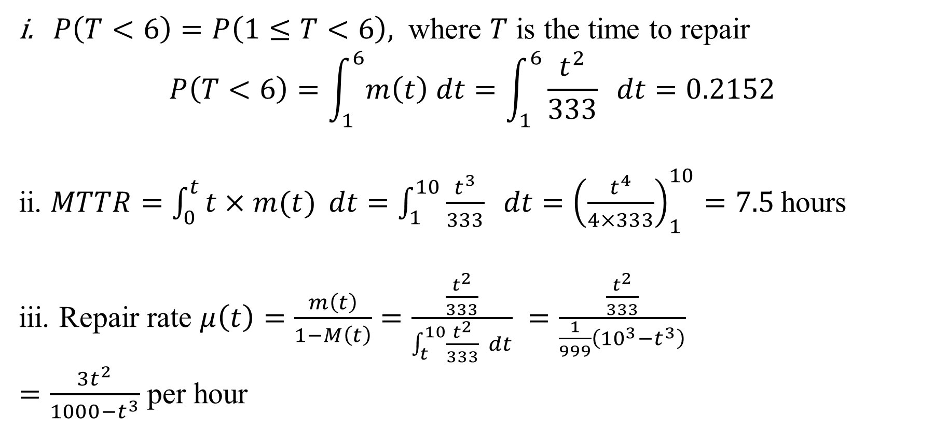
$P\left(T<6\right)=P\left(1≤T<6\right),$ where $T$ is the time to repair
$$P\left(T<6\right)=\int_{1}^{6}{m\left(t\right) dt}=\int_{1}^{6}{\frac{t^{2}}{333}} dt=0.2152$$
ii. $MTTR=\int_{0}^{t}{t×m(t)} dt=\int_{1}^{10}{\frac{t^{3}}{333} dt}={\left(\frac{t^{4}}{4×333}\right)}_{1}^{10}=7.5$hours
iii. Repair rate $μ\left(t\right)=\frac{m\left(t\right)}{1−M\left(t\right)}=\frac{\frac{t^{2}}{333}}{\int_{t}^{10}{\frac{t^{2}}{333}} dt} =\frac{\frac{t^{2}}{333}}{\frac{1}{999}\left({10}^{3}−t^{3}\right)}$
$=\frac{3t^{2}}{1000−t^{3}}$ per hour

Slide 25
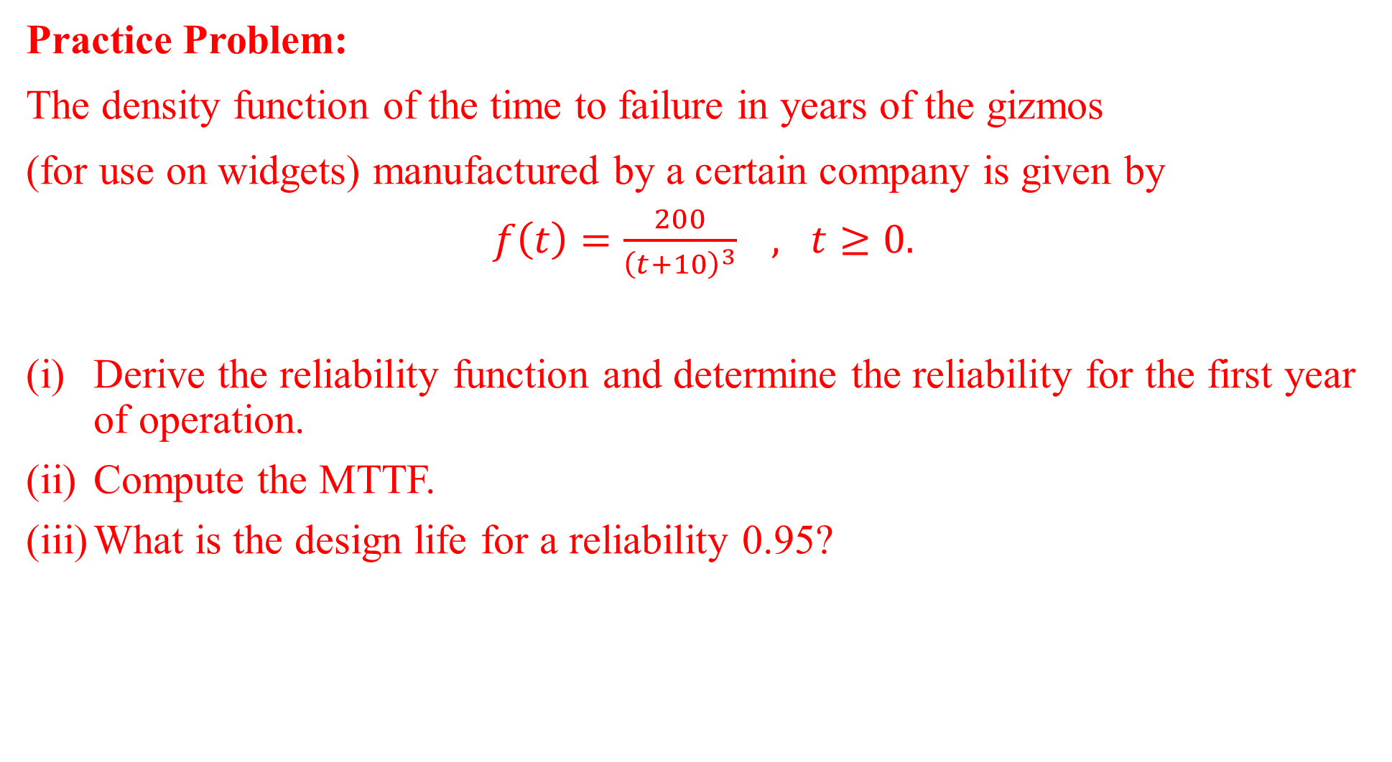
Practice Problem:
The density function of the time to failure in years of the gizmos
(for use on widgets) manufactured by a certain company is given by
$f\left(t\right)=\frac{200}{{\left(t+10\right)}^{3}} , t≥0.$
Derive the reliability function and determine the reliability for the first year of operation.
Compute the MTTF.
What is the design life for a reliability 0.95?

