Slide 1

Anubis
A proposal submission and handling system
Per Kraulis
SciLifeLab
https://github.com/pekrau/Anubis

Slide 2
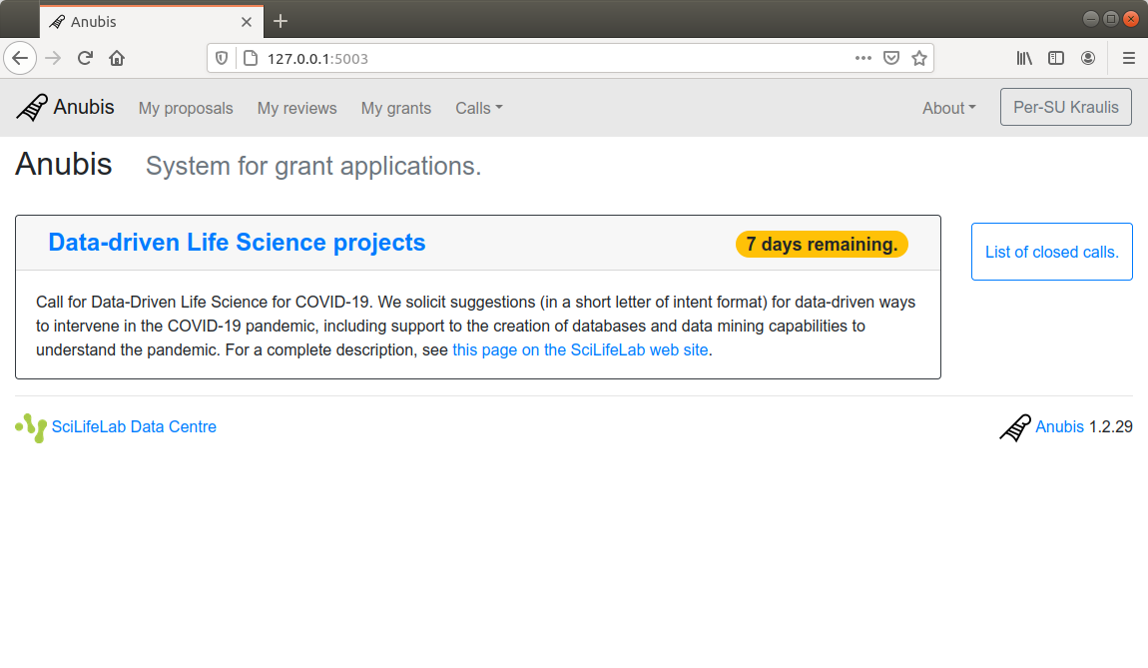
Home page: List of open calls

Slide 3
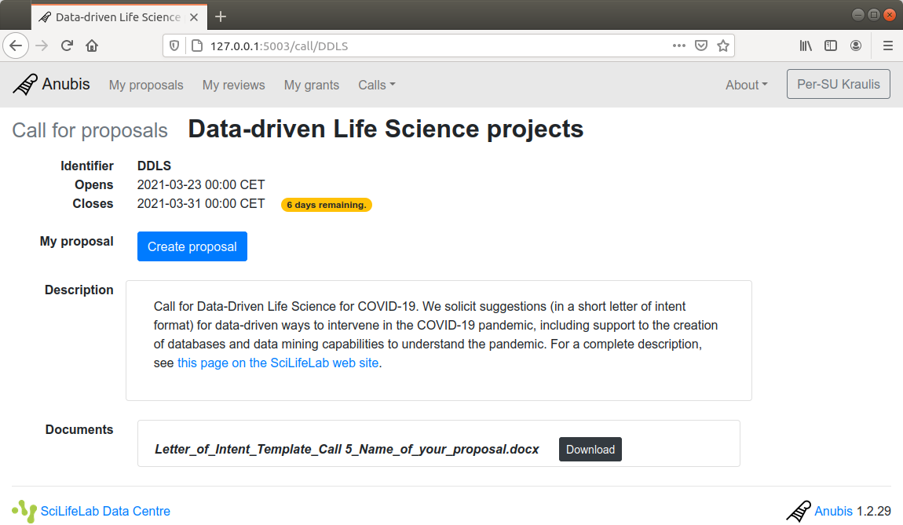
Look at an open call

Slide 4
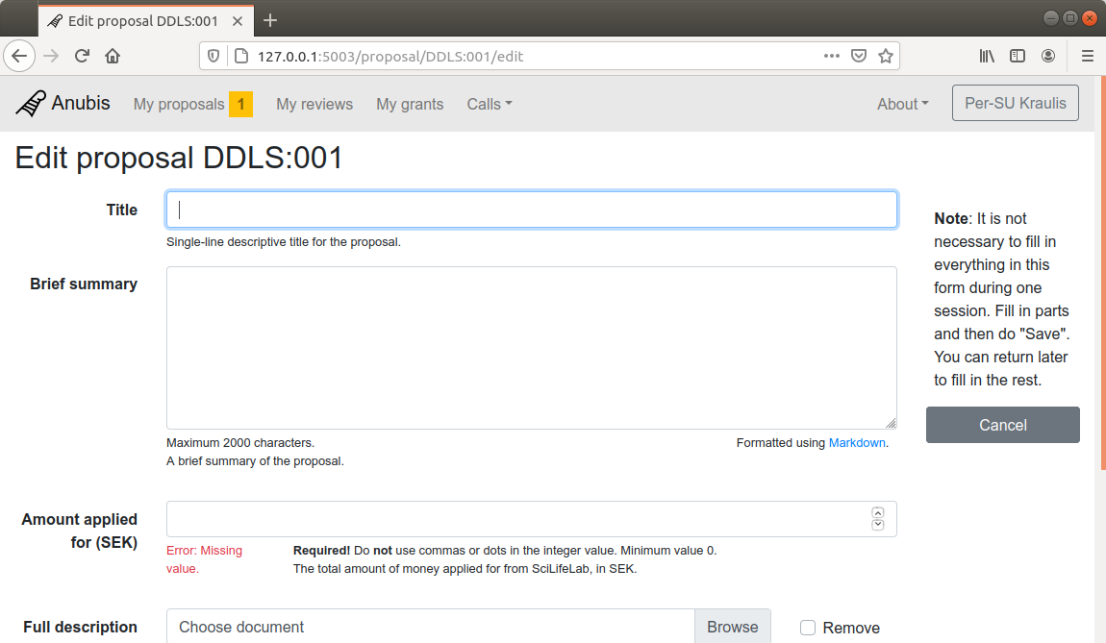
After clicked “Create proposal” (must be logged in)

Slide 5
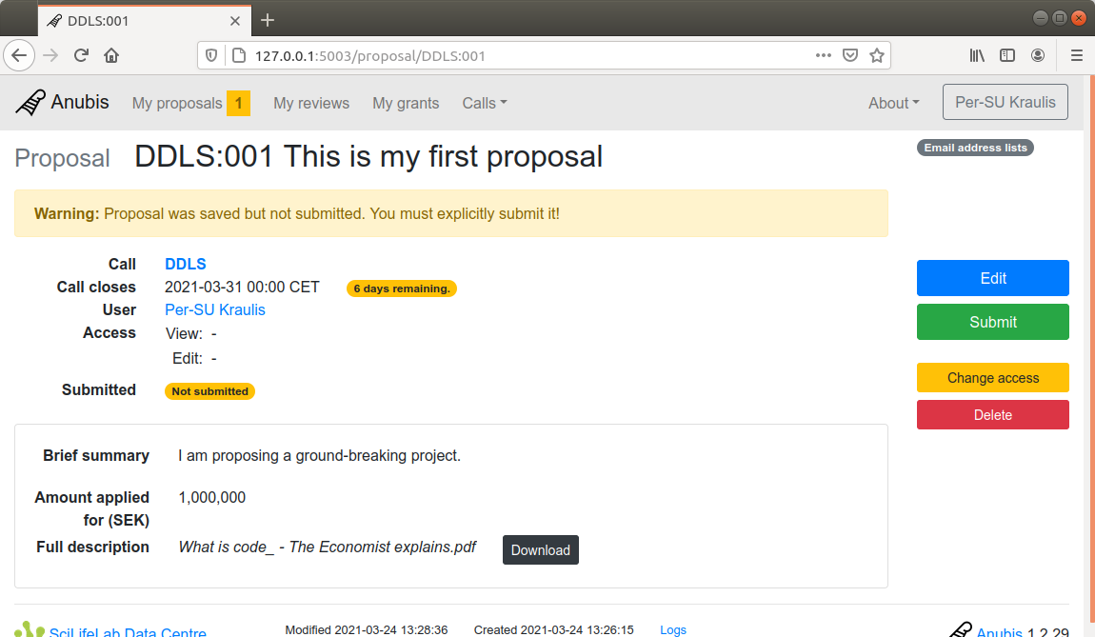
Filled in values, clicked “Save”

Slide 6
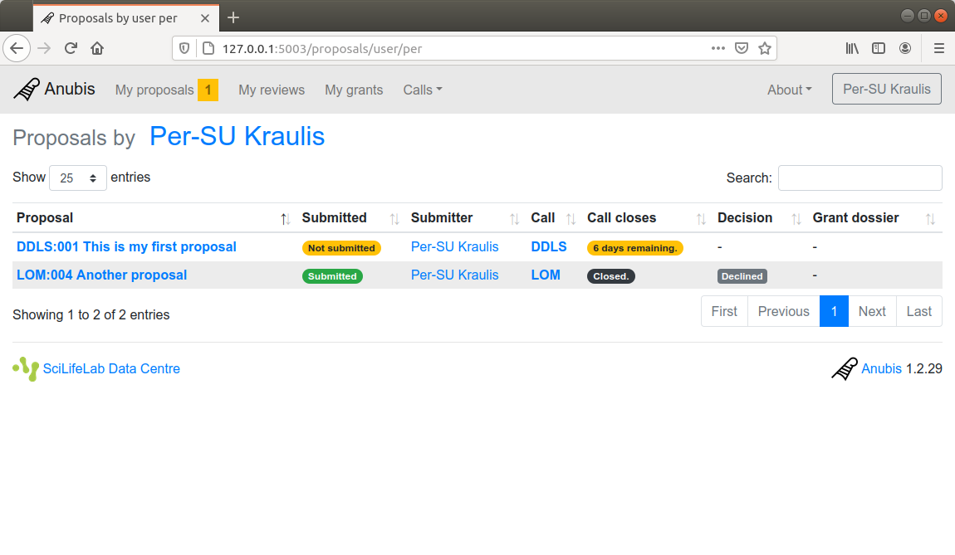
My list of proposals (Note: one previous; declined)

Slide 7
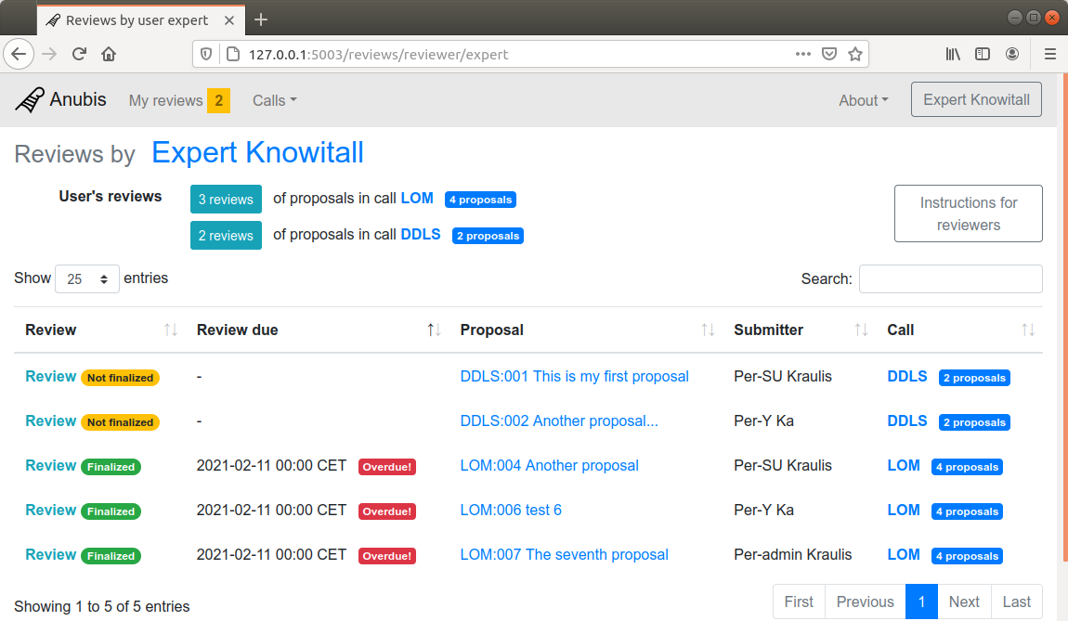
Reviewer list of reviews to work on

Slide 8
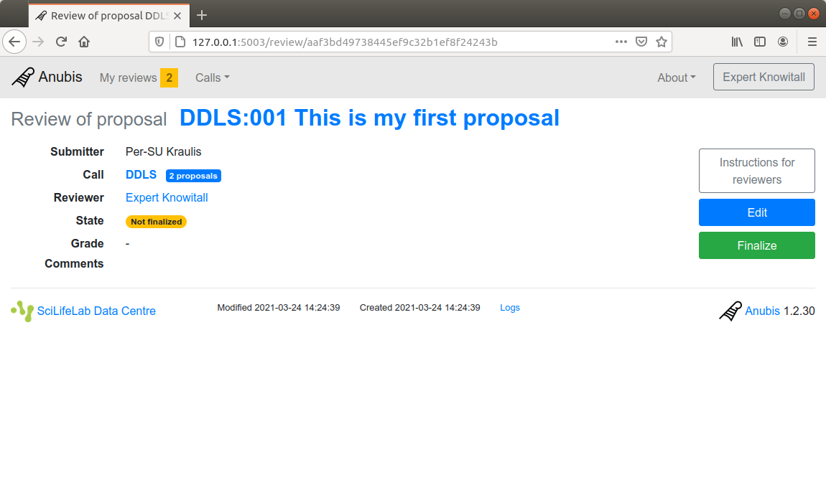
Display of a review

Slide 9
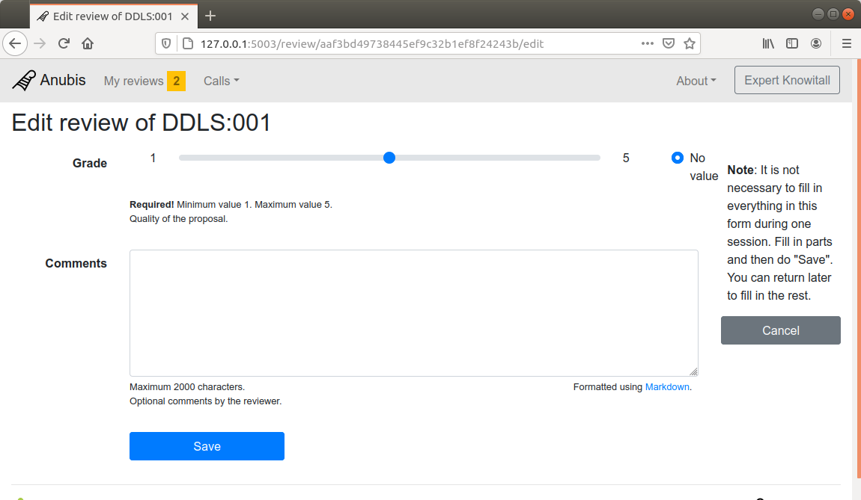
Reviewer edits a review

Slide 10
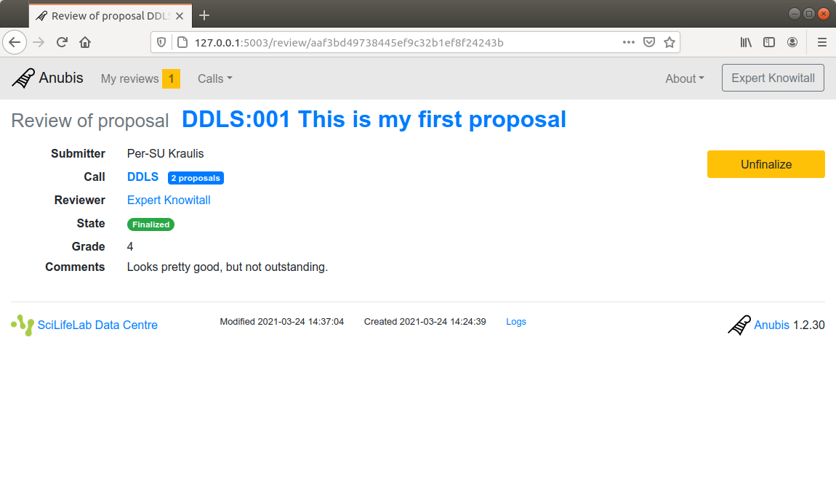
Finalized review

Slide 11
Other possible actions (no screenshots)
By user
Edit the proposal again
Submit it before the call closes
Await decision; review not visible to user
If “Accepted”, then fill in “Grant dossier”
By admin and reviewers
Admin defines review form
Admin selects reviewers
Admin creates review forms for reviewers
Review chair collates, or makes decisions, depending on policy
Admin defines and creates grant dossiers

