Slide 1
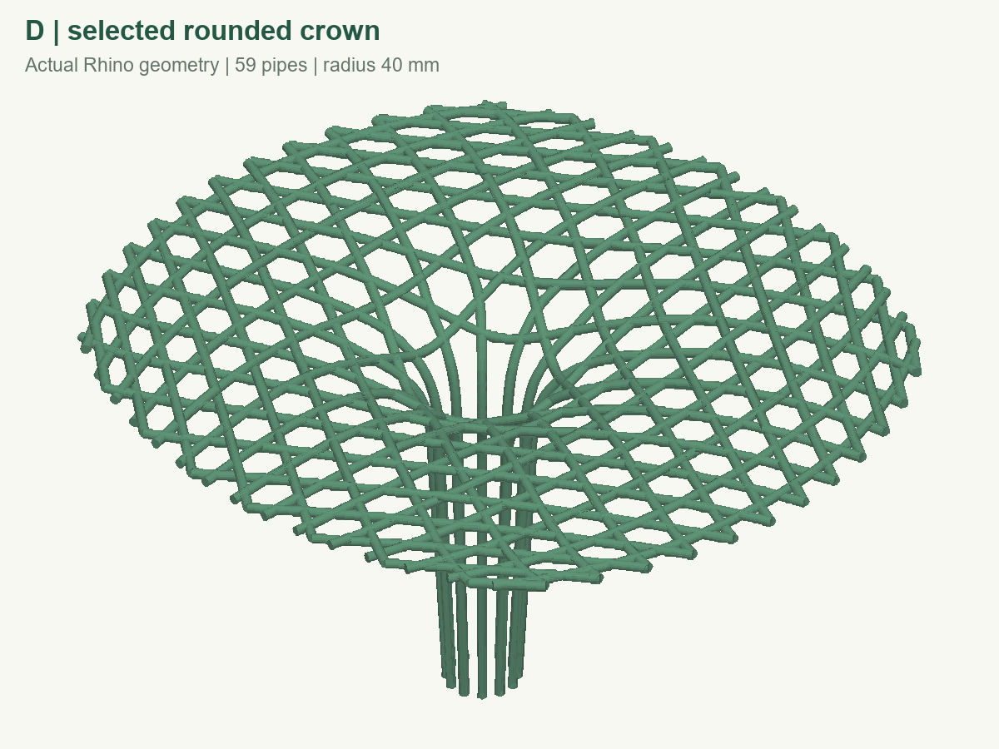
GREEN BUILDING
DESIGN & GEOMETRY
A tree-like canopy for shaded rest
Rounded geometry. Climbing plants. An open pedestrian edge.
THE DESIGN INTENT
Support vegetation.
Organise useful shade.
The D canopy creates a local pause point while keeping circulation open.
Thermal comfort and airflow gains remain to be verified.
D / SELECTED ROUNDED CROWN
6.22 × 6.66 m
3.48 m
59
OVERALL PLAN EXTENT
MAXIMUM HEIGHT
CLOSED PIPE SOLIDS
Source: supplied D geometry and performance report. Geometry shown; vegetation not modelled here.
DEMO
Notes:
One-slide style sample only, not the final deck or its first slide. Final slide 1 must show all five team members and their responsibilities. No display date or school logo. The model preview shows geometry rather than actual planting. Figures use supplied D analysis; no field cooling or CFD results are claimed.

