Slide 1
San Francisco Housing Sales Price
Applied Data Science Capstone by IBM/Coursera

Slide 2
Introduction: Business Problem
In this project, I'll analyze each neighborhood in San Francisco and try to find a relationship between San Francisco Housing Sales Price and nearby venues.
Specifically, this report will be targeted to stakeholders interested in investing a real estate in San Francisco, helping them to choose the regions with their favorite venues or lower real estate costs.
I'll create a map with each neighborhood in San Francisco segmented and clustered according to housing sales prices and nearby venues.

Slide 3
Data
In consider of our problem, I found following data sets:
I found Median Value Per Squre foot data of each neighborhood in San Francisco, from Apr 1996 to Jul 2019. The csv file contains the Region Name, City, CountyName, SizeRank and median_value_per_sqft during this time period in USD.
I used Forsquare API to get the most common venues of given neighborhood of San Francisco.
I used Google Maps API geocoding to get the center cooridnates of each neighborhood.

Slide 4

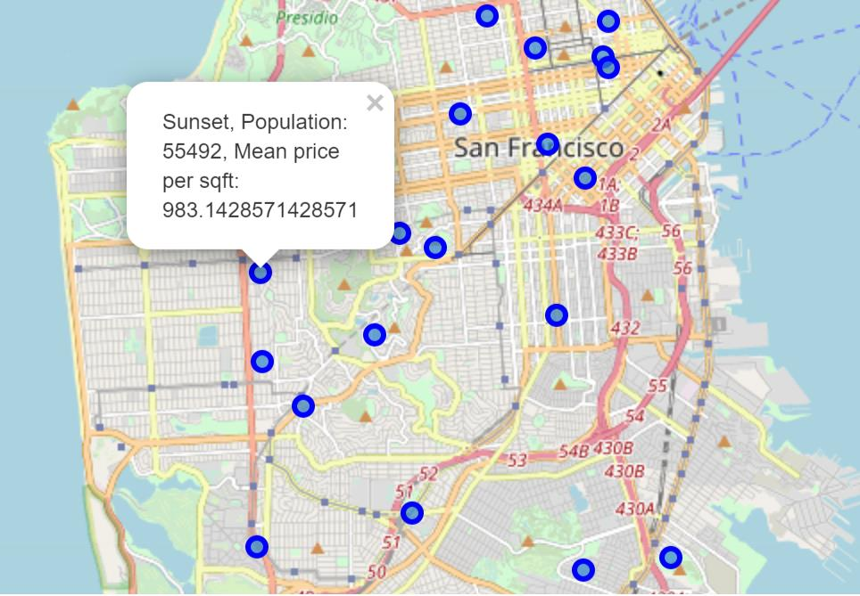
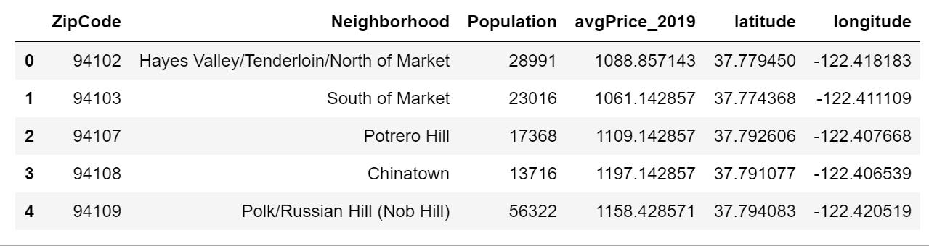
map of San Francisco

Slide 5
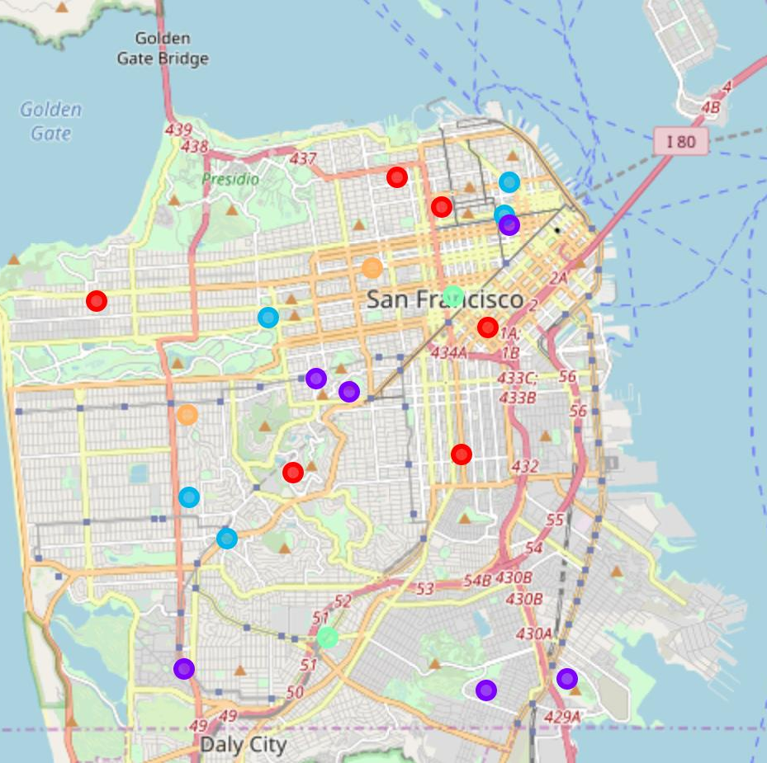
analysis
We choose K-means Clustering Model to cluster all neighborhoods. K-means Modeling can use in neighborhood segmentation.
With K-means Modeling, neighborhoods can be clustered to k partitions. Each cluster have most similar features and same label.

Slide 6
Conclusion
Now we have segmented all neighborhoods in San Francisco into 5 Clusters based on the average housing price, population and venue numbers and most common venue in each neighborhood. The same labeled neighborhoods are those have most similar house price, population and venues. The stakeholders will be able to know which cluster of neighborhood to invest, considering their financial status and preference of venues.

