Slide 1
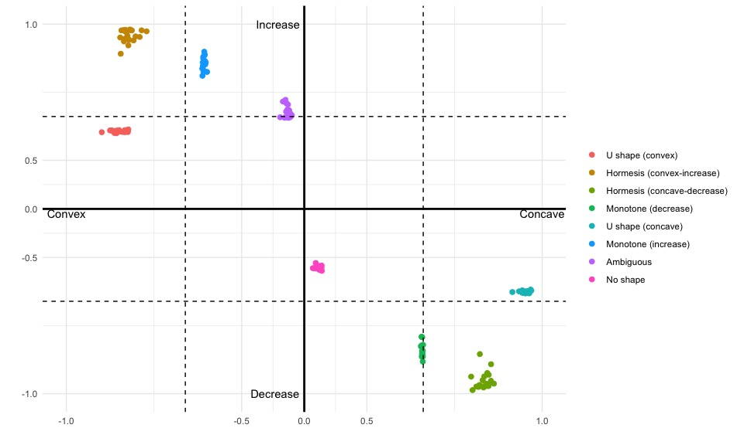
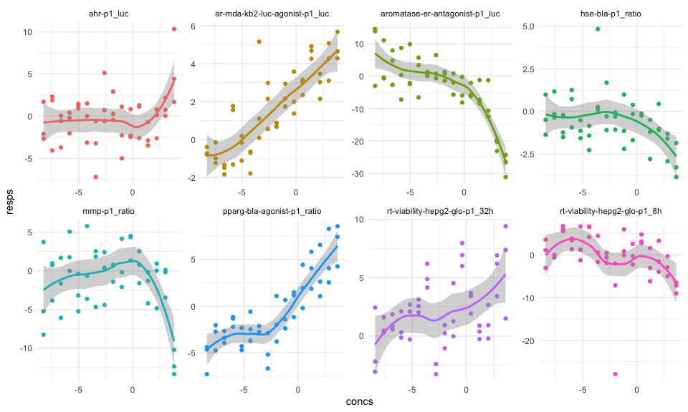
Chemical: Annatto Oil Soluble (NCGC00372615-01)

Slide 2
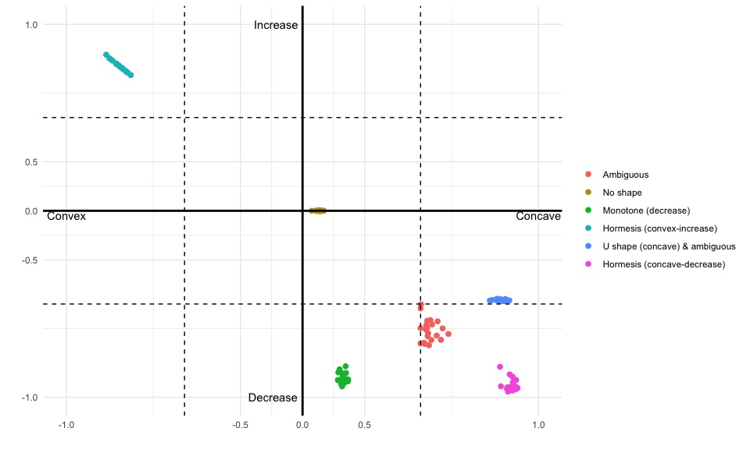
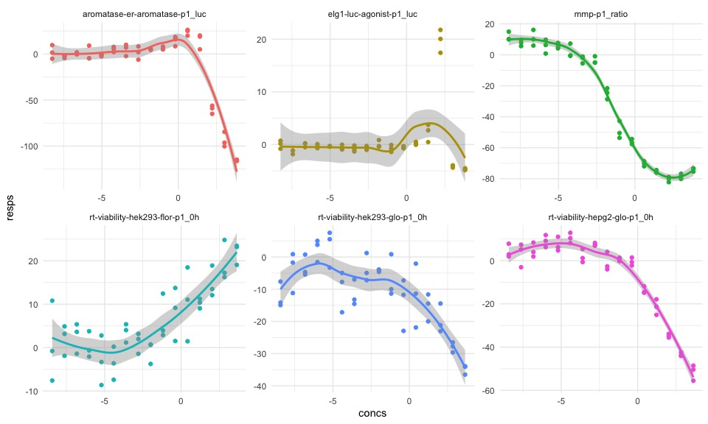
Turmeric (lot 90H73) (NCGC00372872-01)

Slide 3
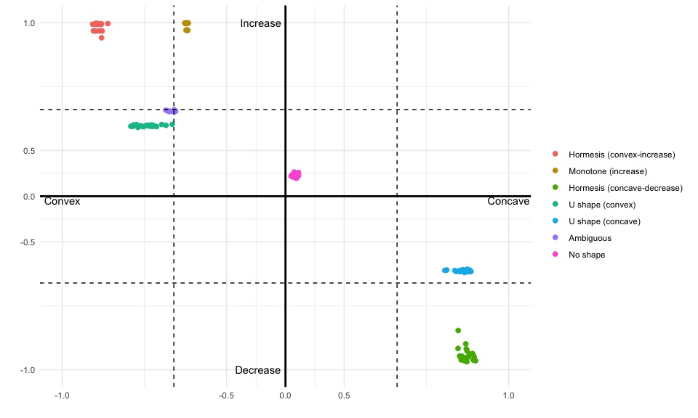
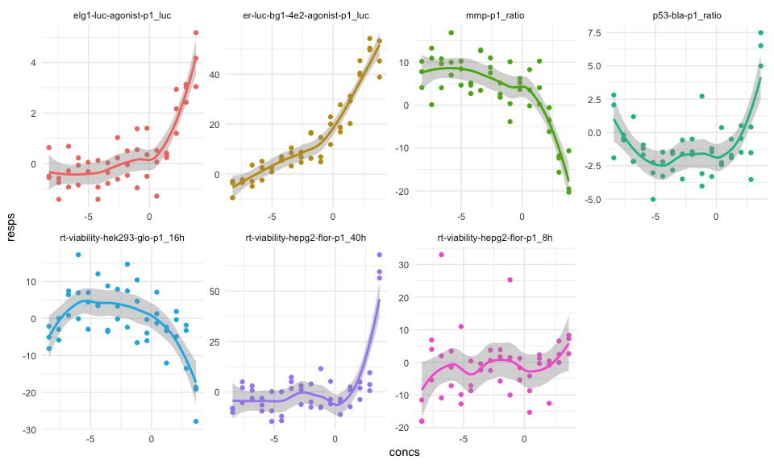
Kava kava extract (lot 562) (NCGC00372872-01)

