Slide 1
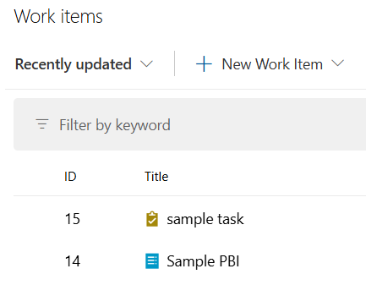
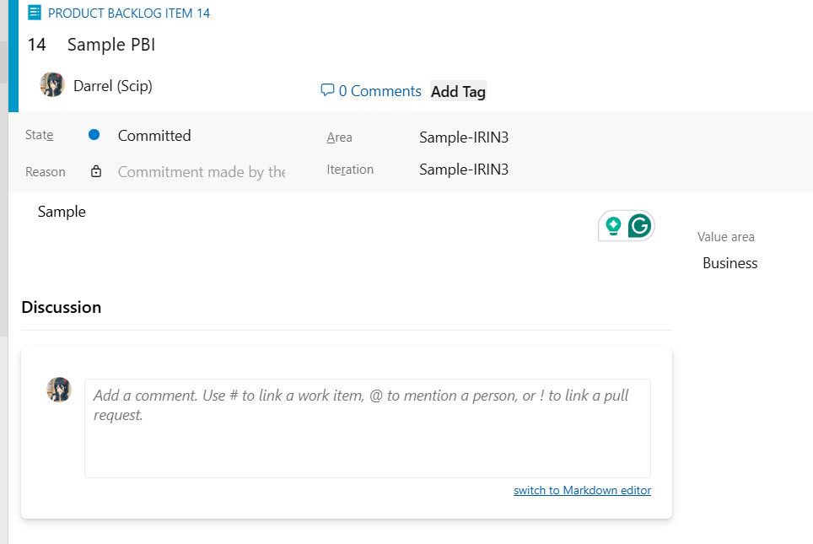
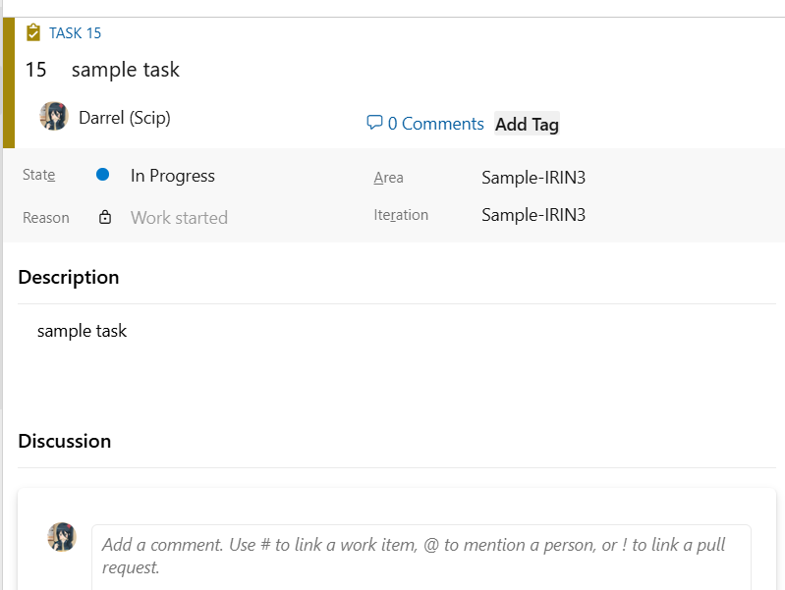
Foundation Task
Our lead can assign people, describe the issue, outline the acceptance criteria for its completion, and we can post our findings in it

Slide 2
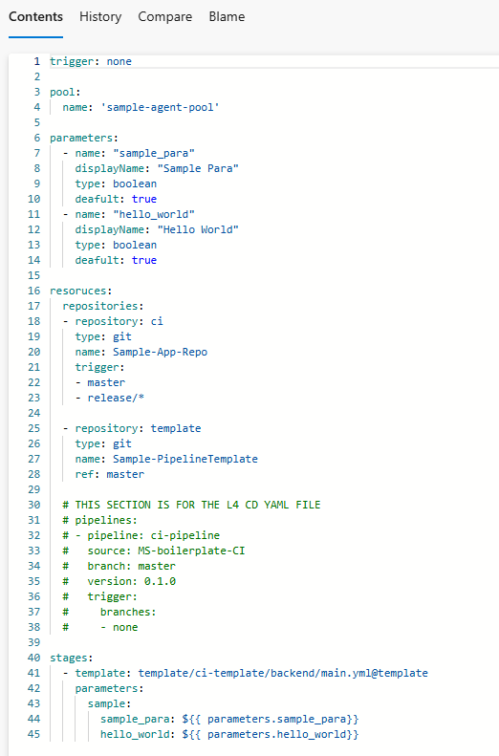
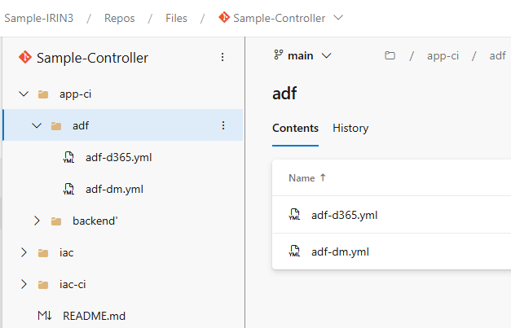
Foundation Controller
CI - continuous integration
CD - continuous deployment
The Controller Repo stores different CI pipeline trigger files.
The one that I work on is app-ci, which is divided based on app type. In the folder contains the yaml file that will trigger when the specified app repo master branch is updated.

Slide 3
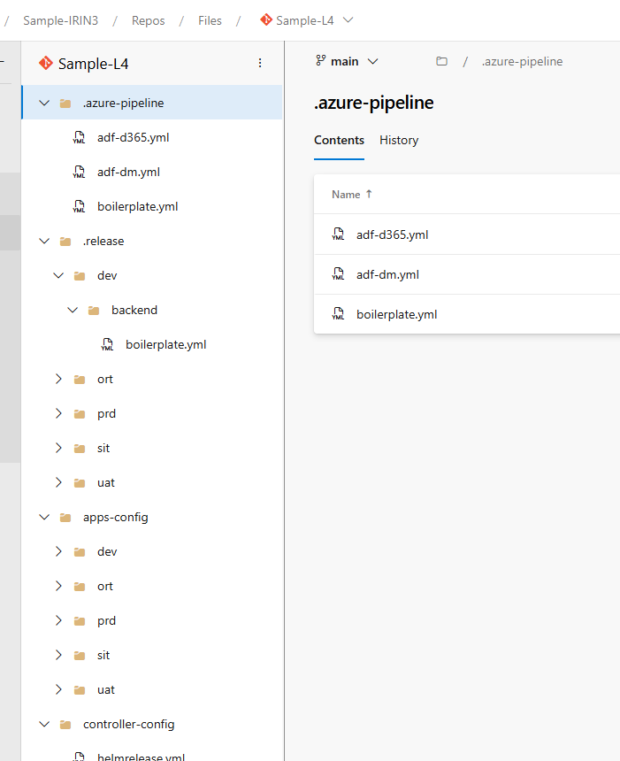
Foundation L4
CI - continuous integration
CD - continuous deployment
The L4 stores the different CD pipeline trigger files in the .azure-pipeline folder, similar to the controller. This will tirgger the CD pipeline, which can be either be triggered by DSO Team or queued by the CI Pipeline via a script
It also helps to combine different application configuration from app-config, controller-config and other variables and output the result into .release folder. We call this process baking.
The app team will mainly update the app-config folder as the release folder is protected by rules, only the build service account is able to commit to it.
This “baking” process will only happen in the CD part of the pipeline.

Slide 4
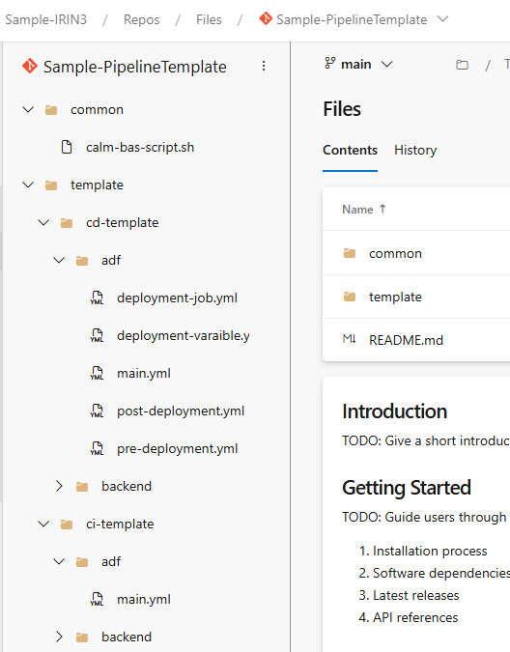
Foundation
Pipeline Template
The pipeline Template Repo stores all the yaml files that is used in the pipeline.
Common: This files are called and used by multiple jobs and task in different pipelines. File located here are accessed and reused, for example pipeline validator scripts or scripts for Scanning (SonarQube, Fortify, Mend)
CD-Template:
This folder stores all the yaml files that are used in CD pipelines and are divided base on their app type. There will always be 5 files:
Main: The main file calls the other files to run, specify which environment to deploy to and pass in parameter for the other jobs to run Pre-deployment: Validate the pipeline before deployment and does any pre-checks if needed Deployment-job: Where the deployment magic happens
post-deployment: Typically used to validate if deployment is successful and notify if there are issues
deployment-variables: Stores all the parameters that is needed for the pipeline to run. The jobs will refer to this.
CI-Template:
This folder stores the CI pipeline files. The file folder is divided into different app type and only contains 1 file: Main Main: Does the validation, building, scanning and publishing of the pipeline template and the application contents, where it will be used in the CD for deployment

Slide 5
Foundation Basic Pipeline Flow
PR – Pull Request
Initialize refers to:
Verifying the pipeline runtime and version
Retrieving secret values from AKV (if needed)
(For CD) Downloading the artifact from the artifact feed using the specified version, as indicated by the pipeline build ID
1
2
3
4
5
App Repo Feature branch
PR Pipeline
App Repo Master branch
App CI Pipeline
App CD Pipeline
1) When the app team makes a PR (Pull Request) from their feature branch to merge to master, it will trigger a PR Pipeline.
The PR will not pass until it satisfies the requirements.
4) Each App Pipeline has a different workflow but will generally follow the same pattern:
- Initialize pipeline - Build the app code and run test cases if needed
- Scan the app code (e.g., SonarQube, Fortify, Mend)
- Publish the pipeline artifact as a universal package into the artifact feed
- Update the L4 with the new version
- Run a script that will trigger the App CD
2) The PR pipeline follows the App’s CI Pipeline format but includes PR validations and does not publish the source code to the artifact feed or update the version
To allow the PR to pass, it will ensure that - The branch meets naming convention standards
- The approval of the PR does not have any previous commits (to prevent conflicts of interest)
- All pipeline jobs pass and the code quality meets the standard
5) In App CD, most CDs will have 5 environments: DEV, SIT, UAT, ORT, PRD.
In CDE, we only use DEV to ORT, as PRD is in AB.
Each Environment (Env) is protected by environment-pipeline policies. They will need app lead approval to run. The Pipeline will run from lower to high, deploying first to Dev, then SIT till ORT.
At the start of every CD pipeline, it will take in the app CI BuildID and refer to it for the resources to use in deployment. It performs some validations, such as checking if the artifact built by the pipeline exists to be used. It will also initialize the pipeline
As mentioned in slide 3, there are 3 main jobs: Pre-Deployment, Deployment, and Post-Deployment. Their functions are the same as describe in slide 3
3) Once the PR is approved, it will update the App Repo’s master branch.
As mentioned in slide 1, when the App Repo’s master branch is updated, the controller repo will trigger the App CI pipeline.

Slide 6
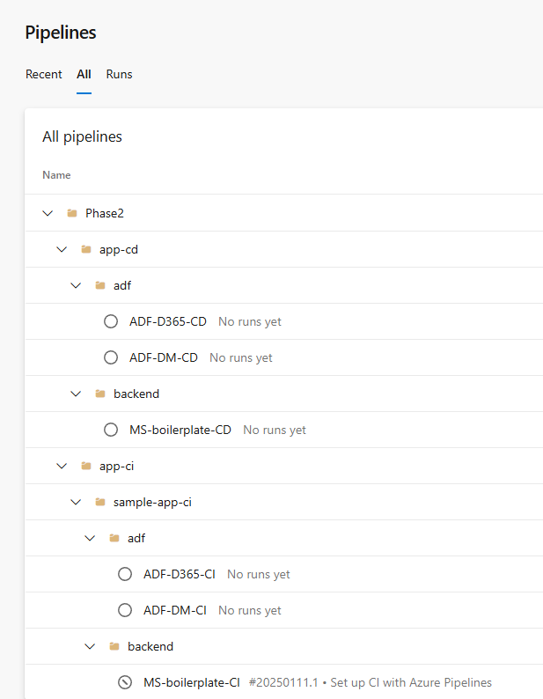
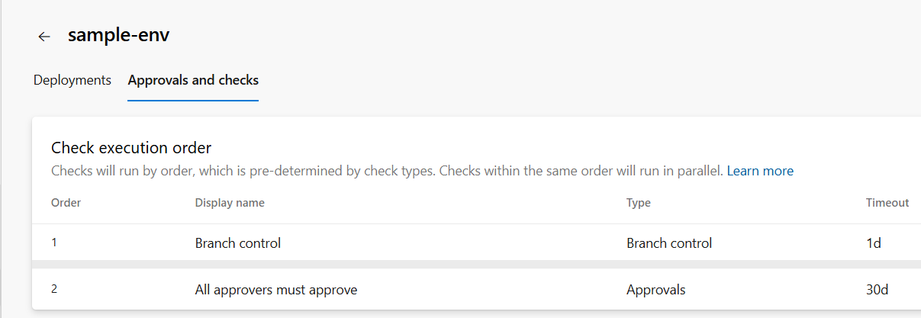
Foundation
Pipelines
This is where we can view all the pipelines, and this is a sample of how it is structure. In Phase 2 (CDE) , there are different folders for the pipelines. In this case split via app-cd and app-ci Afterwards it split via the different app type.
For CD Runs, the pipeline to deploy to various env (DEV,SIT…) are protected by the pipeline-environments

Slide 7
MS Pipeline CI
AKV – Azure Key Vault ACR – Azure Container Registry SemVer - Semantic versioning APIM - API Management PreProd – Pre-Production
2) Validate
Verify PR approval and Repo
Retrieve secrets from AKV
4) Mend and Fortify
Run Fortify and Mend Scan
Publish the scan results
1) Initialise
Ensure template version is latest and using correct run type
Retrieve secrets from AKV
6) Publish
Validate that the swagger, APIM and .Net pipeline artifact exist
Retrieve the SemVer and commit it to the L4
Publish the pipeline artifact as a universal artifact into the artifact feed
Trigger App CD Pipeline
3) Build
Validate Docker and API Policies files
Build the application with .Net and run test cases
Scan the code with SonarQube and publish result
Up the SemVer
Publish APIM Package, .Net and Swagger files as pipeline artifacts
5) Container Build
Authenticate to the Azure Container Registry (ACR) and pull base image from staging ACR
Build the different container types (App, Outbox, PDF, Bulk) with the code and certificates
Perform Prisma Cloud Scan (Twistlock) and publish result
Sign the image
Upload container image to PreProd ACR

Slide 8
MS Pipeline CD
HR - HelmRelease
1) Initialise
Ensure template version is latest and using correct run type
Retrieve secrets from AKV
Retrieve and validate artifact
Retain Pipelines
Env can be DEV/SIT/UAT/ORT
2) {Env} Release
Pre-Deployment
Check if pipeline is superseded
Run Fortify Scan
Validate ACR Images and Perform Prisma Cloud Scan (Twistlock), as well as validate that image is signed
Check the Kubernetes pods and validate they are healthy
Deployment
Bake the L4 (refer to slide 3) to merge the application Helm Release changes
Deploy the Swagger Files into the APIM Services
Deploy APIM Child Policies to the APIM Services
Post-Deployment
Wait 15 minute for AKS to sync and pick up the changes in the L4
Check the HelmRelease and Pod Status, and if they been updated with new version
Verify that the APIM Services has been updated with the latest changes
Cancel older pipeline runs

Slide 9
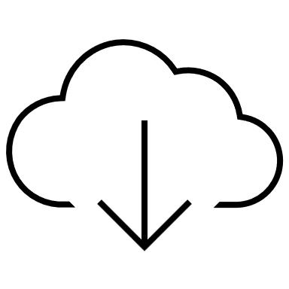
MS Network Architecture
Vnet - Virtual Network SaaS - Software as a Service
AzDO SaaS
Mend SaaS
Azure
Internet
Intranet
Vnet1
APIM Services
Transit Gateway
Vnet2
App Workload
DevOps Spoke
DevOps Vnet
ACR
BuildAgent
AKV
SonarQube
Fortify
Twistlock

Slide 10
ADF WorkFlow (From C935)
AZDO ADF Repo (adf_publish Branch)
ADF (Master Branch)
2
AZDO ADF Repo.publish (master Branch)
ADF (Dev Branch)
1
AZDO ADF Repo (Master Branch)
Pipeline CI (Copy adf_publish branch into publish repo)
Pipeline CI (Trigger CD)
3
Pipeline CI (Build Artifact)
Referencing build artifact
ADF – Azure Data Factory AZDO – Azure DevOps
After the developer have finish making their changes, they will trigger a Pull Request (PR) from their branch to the master branch. Once it merge, a pipeline will trigger automatically
1
2
The changes will also reflect in their ADF Master branch, where they can review the changes. They can then press the publish button, which will generate an ARMTemplate that has all of their changes into the adf_repo Branch, which will trigger another pipeline automatically
3
Tigger CD to the different environments for testing and other purposes

Slide 11
ADF Pipeline CI
2
3) Copy to adf_publish
Get Source Build ID
Commit all changes into Publish Repo
Only run at 2
1) Initialise
Ensure template version is latest and using correct run type
2) Validate
Verify PR approval and Repo
5) Publish
Commit Git Tag to App Repo
Create a pipeline artifact
4) Build
Up the SemVer
3
3) Publish
Retrieve the SemVer and pipeline artifact from the source Build ID
Commit SemVer it to the L4 Commit Git Tag to .publish Repo
Publish the pipeline artifact as a universal artifact into the artifact feed
Trigger Pipeline CD
1) Initialise
Ensure template version is latest and using correct run type
2) Validate
Verify PR approval and Repo
Can learn more about the adf implementation here https://learn.microsoft.com/en-us/azure/data-factory/continuous-integration-delivery-improvements#:~:text=with%20older%20versions.-,Current%20CI/CD%20flow,-Each%20user%20makes

Slide 12
ADF Pipeline CD
1) Initialise
Ensure template version is latest and using correct run type
Retrieve and validate artifact
Retain Pipelines
Env can be DEV/SIT/UAT/ORT
2) {Env} Release
Pre-Deployment
Check if pipeline is superseded
Deployment
Bake the L4
Update ARMTemplate with the L4 parameters
Minify the ARMTemplate and deploy it to the ADF
Post-Deployment
Verify that ARMTemplate has been deployed

Slide 13
ADF Network Architecture
AzDO SaaS
Azure
Internet
Intranet
Vnet1
ADF
Transit Gateway
DevOps Spoke
DevOps Vnet
BuildAgent

Slide 14
D365 WorkFlow (From C935)
D365 (Dev Branch)
1
AZDO D365 (Master Branch)
Pipeline CI
Pipeline CD
2
Build
Scan
Deploy to SIT
a)After the developer have finish making their changes, they will trigger a Pull Request (PR) from their branch to the master branch.
b)Once it merge, a pipeline will trigger automatically
D365 – Dynamic D365 AZDO – Azure DevOps
1
In the CI, there are different stages, mainly Build, Scan, and deploy to SIT. Build is to build the code and do .Net Testing. Scan is to scan for vulnerabilities in the code. Deploy to SIT is to allow the D365 team to test and verify in the lowest environment, before going to the higher environment.
2

Slide 15
D365 Pipeline CI
2) Validate
Verify PR approval and Repo
Retrieve secrets from AKV
4) Mend and Fortify
Run Fortify and Mend Scan
Publish the scan results
1) Initialise
Ensure template version is latest and using correct run type
Retrieve secrets from AKV
6) Publish
Validate that the Plugins. Workflow, CustomAPI, Web and DPA pipeline artifact exist
Retrieve the SemVer and commit it to the L4
Publish the pipeline artifact as a universal artifact into the artifact feed
Trigger App CD Pipeline
3) Build
Up the SemVer
Restore NuGet and .Net
Build the application with .Net and run test cases
Scan the code with SonarQube and publish result
Publish Plugins. Workflow, CustomAPI, Web and DPA as pipeline artifacts
5) Customization Master
Download MSCRM Tool, Avanade DSS Installer
Resolve connections and verify that solutions exist
Deploy Web Resources, Web Workflow, Plugins and Custom API to the SIT SAAS endpoint workspace
Export Solution Drop (CRM_Solutions ) from SIT (to use in higher env)
Package and publish the CRM_Solutions as a pipeline artifact

Slide 16
D365 Pipeline CD
1) Initialise
Ensure template version is latest and using correct run type
Retrieve secrets from AKV
Retrieve and validate artifact
Retain Pipelines
Env can be DEV/SIT/UAT/ORT
2) {Env} Release
Pre-Deployment
Check if pipeline is superseded
Scan the code with Fortify and publish result
Deployment
Download Tools (MSCRM, Avanade DSS, DPA) Download the artifact from artifact feed
Ensure solution exist and import it to the env SaaS endpoint workspace
Import Master Data
Post-Deployment
Ensure solution is deployed to the D365 Env
Cancel older pipeline runs

Slide 17
D365 Network Architecture
AzDO SaaS
Mend SaaS
D365 SaaS
Azure
Internet
Intranet
Transit Gateway
DevOps Spoke
DevOps Vnet
AKV
BuildAgent
SonarQube
Fortify

Slide 18
Database/Storedproc Pipeline CI
2) Validate
Verify PR approval and Repo
Retrieve secrets from AKV
1) Initialise
Ensure template version is latest and using correct run type
Retrieve secrets from AKV
5) Publish
Retrieve the SemVer and commit it to the L4 Publish latest git tag
Publish the SQL Storedproc package as a universal artifact into the artifact feed
Trigger App CD Pipeline
4) Fortify
Run Fortify Scan
Publish the scan results
3) Build
Up the SemVer
Scan the script with SonarQube and publish result
Parse Database secrets
Validate SQL Scripts against database

Slide 19
Database/Storedproc Pipeline CD
1) Initialise
Ensure template version is latest and using correct run type
Retrieve secrets from AKV
Retrieve and validate artifact
Retain Pipelines
Env can be DEV/SIT/UAT/ORT
2) {Env} Release
Pre-Deployment
Check if pipeline is superseded
Parse Database Secrets
Deployment
Download SQL Package
Deploy the SQL Files to the Database
Post-Deployment
Cancel older pipeline runs

Slide 20
Database/Storedproc Network Architecture
AzDO SaaS
Azure
Internet
Intranet
Vnet1
Database
Transit Gateway
DevOps Spoke
DevOps Vnet
AKV
BuildAgent
SonarQube
Fortify

Slide 21
PowerBI Pipeline CI
2) Validate
Verify PR approval and Repo
Retrieve secrets from AKV
4) Publish
Retrieve the SemVer and commit it to the L4
Package Repo file contents
Publish the package as a universal artifact into the artifact feed
Trigger App CD Pipeline
1) Initialise
Ensure template version is latest and using correct run type
Retrieve secrets from AKV
3) Build
Up the SemVer

Slide 22
PowerBI Pipeline CD
1) Initialise
Ensure template version is latest and using correct run type
Retrieve secrets from AKV
Retrieve and validate artifact
Retain Pipelines
Env can be DEV/SIT/UAT/ORT
2) {Env} Release
Pre-Deployment
Check if pipeline is superseded
Retrieve PowerBi SPN
Deployment
Download PowerBI Package
Validate Paginated and NonPaginated Reports
Deploy the Reports to the PowerBI Workspace
Post-Deployment
List the Reports that is supposed to be deployed
Verify that the files is successful deployed
Cancel older pipeline runs

Slide 23
PowerBI Network Architecture
AzDO SaaS
Mend SaaS
PowerBI SaaS
Azure
Internet
Intranet
Vnet1
Synapse Workspace
Transit Gateway
DevOps Spoke
DevOps Vnet
AKV
BuildAgent

Slide 24
White Source Mend Stage (CI)
Pipeline trigger mend task
Agent run the job
Pipeline display result
1
User checks
2
Resolve the dependencies and scans them
Submit Report to mend Server
The build agent will resolve the packages/dependencies from their specified source destination. After that it will scan it all locally in the pod
1
2
After scanning, the agent will then submit the report to the server which the results will be display in the portal. The agent will also retrieve the results and display in the pipeline under “Extension” tab. If there are vulnerabilities, the pipeline will be cancelled. Else it will continue

Slide 25
SonarQube CI
Pipeline trigger SonarQube task
Agent run the job and connect with server
Pipeline stops or continues
User checks
1
2
Download tools from server and scans
Report uploaded to server
3
The build agent will establish a connection with the SonarQube Server and download the required resources and tools for scanning, and then scan the codes base on the configuration
1
2
After scanning, the agent will then submit the report to the server which the results will be display in the portal.
The pipeline will only display if the code coverage pass or fails. If it fails, the user will have to access the SonarQube Web Portal to view the report of why the scan fail and which code cause the problem
3

