Slide 1


Lesson 3. Tensorflow and Keras
Build Generative AI Application
Khanh Pham Dinh
Hà Nội, 21/Sep/2024

Slide 2
Content
Introduction Tensors
Keras Model
Keras API components
Practice

Slide 3
Introduction Tensors
Scalar, vector, matrice, tensor

Slide 4
What are main DL frameworks
DL Framework | Explain | Using situation
Pytorch | - PyTorch is an open-source machine learning framework primarily developed by Facebook's AI Research Lab (FAIR). - PyTorch is widely known for its dynamic computational graph (also called "define-by-run" framework), which allows for flexibility in building and modifying models on the fly. - It is also supported by a strong ecosystem, including libraries like Torchvision (for computer vision) and Hugging Face (for NLP). | - Research and Prototyping: Ideal for researchers and developers who want a flexible and easy-to-debug deep learning framework. - Natural Language Processing (NLP): Hugging Face, a popular library for NLP, is built on PyTorch, making it the go-to framework for NLP tasks. - Computer Vision: Strong support through libraries like Torchvision for handling image-related tasks.
Tensorflow | - TensorFlow is an open-source framework developed by Google Brain. Keras is a high-level neural networks API integrated into TensorFlow 2.0 - Supports both static graphs and dynamic graphs through its eager execution mode. - TensorFlow Serving and TensorFlow Lite strong support for production environments for mobile deployment. | - Production and Deployment: TensorFlow is great for building models that need to scale to production environments, thanks to its mature deployment tools. - Beginner-Friendly: Keras makes it easy for beginners to quickly prototype models while still benefiting from TensorFlow’s advanced capabilities. - Cross-Platform: TensorFlow is well-suited for deploying models across various platforms, including web, mobile, and edge devices.
MXNet | - MXNet is an open-source deep learning framework initially developed by the Apache Software Foundation and supported by Amazon Web Services (AWS). - MXNet offers a hybrid computation graph that allows for both dynamic and static graphs. It is known for its scalability and efficient memory usage, making it a popular choice for deploying models in cloud environments, particularly with AWS. | - Cloud-Based Solutions: MXNet is especially effective when working with large-scale machine learning models in cloud environments, particularly on AWS. - Resource-Constrained Environments: MXNet’s memory-efficient design makes it suitable for situations where resources are limited. - Multiple Language Support: MXNet supports a variety of programming languages, making it versatile in diverse coding environments.
JAX | - JAX is an open-source framework developed by Google. - JAX is unique in that it combines NumPy-like syntax with the ability to automatically differentiate functions and run on GPUs and TPUs. It excels at automatic differentiation (autodiff) and just-in-time (JIT) compilation, making it highly efficient for research in machine learning and scientific computing. | - High-Performance Research: JAX is highly suitable for researchers working on advanced machine learning and optimization problems requiring efficient computation. - Numerical and Scientific Computing: Its seamless integration with NumPy and support for hardware accelerators (GPUs, TPUs) makes JAX suitable for a wide range of scientific computing tasks. - Complex Differentiation: JAX is highly optimized for applications that involve automatic differentiation and parallel computing, making it excellent for tasks involving complex gradients.

Slide 5
1.1. Scalar, vector, matrice, tensor
Note: import tensorflow as tf
Types of Tensor | Explain | Example
scalar | is a constant | tf.constant(20)
vector | is an one dimensional tensor like 1D-array in numpy | For constant: x = tf.constant([1, 1.2, 1.5, 1.8, 2]) For variable: x = tf.Variable([1, 1.2, 1.5, 1.8, 2])
matrice | is a two dimensional tensor like 2D-array in numpy | A=tf.constant([[0, 1, 2], [3, 4, 5], [6, 7, 8]], dtype = tf.float32)
tensor | is created by Google to represent a general of matrices with more than 2 dimensions. For instance, 3D-array in numpy | A = tf.constant([[[1, 2, 3], [3, 2, 1]], [[2, 1, 2], [1, 3, 0]]])
Introduction Tensors with Tensorflow

Slide 6
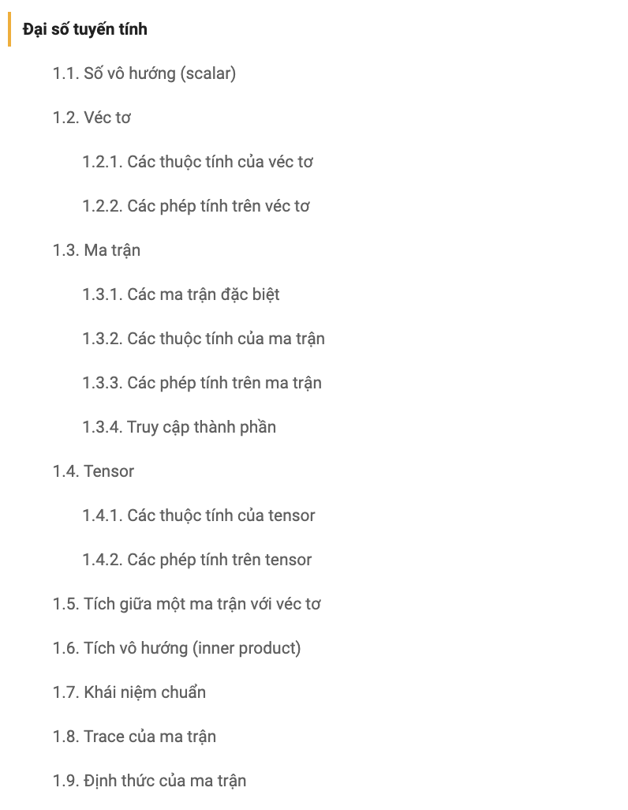
1.2. Practice with tensors in Tensorflow
Introduction Tensors with Tensorflow

Slide 7
2. Keras Model
Main ways of initializing Model in Keras

Slide 8
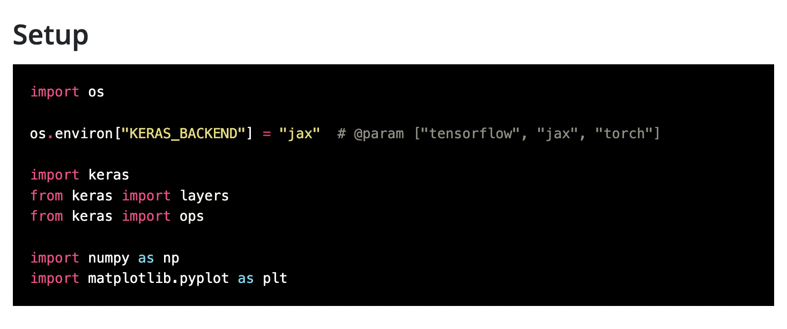
2.1. Introduce Keras 3.0
Adaptable with multiple kind of backends
Tensorflow
Keras 3.0
JAX
Pytorch
Backend engine

Slide 9
2.1. Introduce Keras 3.0
2. A high-level design with many necessary components for training and evaluating DL model.
Tensorflow
Keras 3.0
JAX
Models
Layers
Pytorch
Metrics
Callbacks
Components
Backend engine

Slide 10
2.1. Introduce Keras 3.0
3. Including many state-of-the-art pretrained NLP and CV models.
Tensorflow
Keras NLP:
BERT,
RoBERTa,GPT-2,...
Keras CV:
VGG19,Inception Net, ViT ,...
Keras
JAX
Models
Layers
Pytorch
Metrics
Callbacks
Components
Backend engine
Keras CV - backbone ; Keras NLP -backbone

Slide 11
2.1. Introduce Keras 3.0
4. Customizing for fine-tuning pretrained models
Tensorflow
BERT,
RoBERTa,GPT-2,...
New data
Keras NLP
JAX
fine-tuning
Models
Layers
Pytorch
Metrics
Callbacks
Components
Backend engine

Slide 12
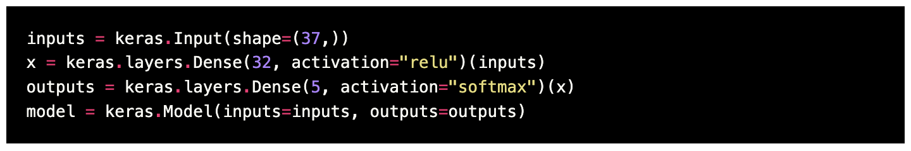
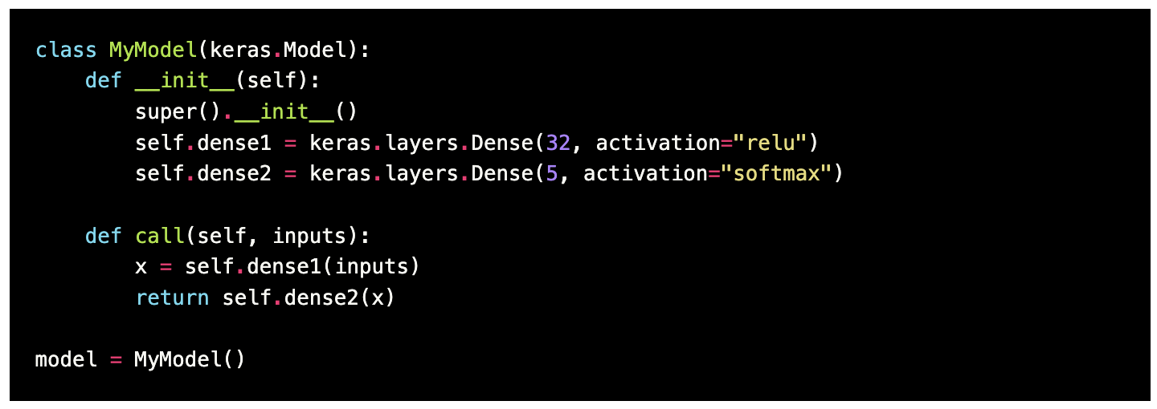
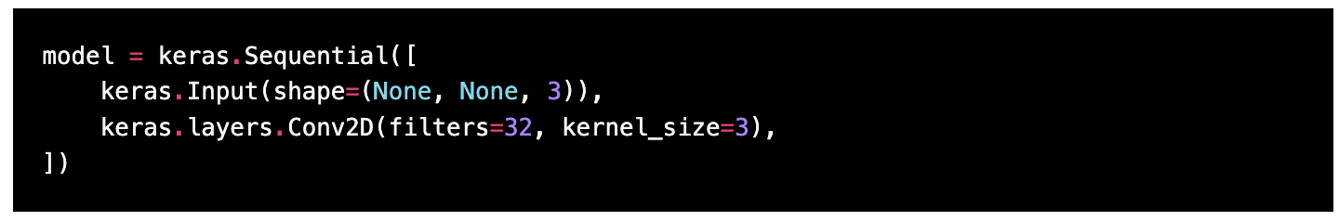
2.2. Model
Functional API
(declare inputs and outputs)
Subclass Model
(implement Model class, operation is in call method)
Model
Sequential Class
(stacking layers in a sequential follow)
Keras Model API

Slide 13
3. Keras API components
Model, Layer, Activation, Optimizer, Loss, DataGenerator

Slide 14
3.1. Model
Code | Usage
model = Model from Functional API, Subclass Model, or Sequential class | Initializing a deep neural network models.
model.co­mpi­le(­opt­imizer, loss, metrics) | Configures the model for training.
history = model.fit(x, y, epoch) | Trains the model for a fixed number of epochs (itera­tions on a dataset).
history = model.fit_generator(train_generator, steps_per_epoch, epochs,validation_data, validation_steps) | Fits the model on data yielded batch-­by-­batch by a Python generator.
model.ev­alu­ate(x, y) | Returns the loss value & metrics values for the model in test mode.
model.pr­edi­ct(x) | Generates output predic­tions for the input samples.
model.su­mma­ry() | Prints a string summary of the network.
model.save(path) | Saves a model as a TensorFlow SavedModel or HDF5 file.
model.stop_training | Stops training when true.
model.save('path/my_model.h5') | Save a model in HDF5 format.
new_model = tf.keras.models.load_model('path/my_model.h5') | Reload a fresh Keras model from the saved model.

Slide 15
3.2. Layer in Tensorflow (keras.layers)
Layers | Code | Usage
Dense | tf.keras.layers.Dense(units, activation, input_shape) | Dense layer is the regular deeply connected neural network layer. It is most common and frequently used layer.
Flatten | tf.keras.layers.Flatten() | Flattens the input.
Conv2D | tf.keras.layers.Conv2D(filters, kernel_size, activation, input_shape) | Convolution layer for two-di­men­sional data such as images.
MaxPooling2D | tf.keras.layers.MaxPool2D(pool_size) | Max pooling for two-di­men­sional data.
Dropout | tf.keras.layers.Dropout(rate) | The Dropout layer randomly sets input units to 0 with a frequency of rate at each step during training time, which helps prevent overfitting.
Embedding | tf.keras.layers.Embedding(input_dim, output_dim, input_length) | The Embedding layer is initialized with random weights and will learn an embedding for all of the words in the dataset.
GlobalAveragePooling1D | tf.keras.layers.GlobalAveragePooling1D() | Global average pooling operation for temporal data.
Bidirectional LSTM | tf.keras.layers.Bidirectional(tf.keras.layers.LSTM(units, return_sequence)) | Bidirectional Long Short-Term Memory layer
Conv1D | tf.keras.layers.Conv1D(filters, kernel_size, activation, input_shape) | Convolution layer for one-dimentional data such as word embeddings.
Bidirectional GRU | tf.keras.layers.Bidirectional(tf.keras.layers.GRU(units)) | Bidirectional Gated Recurrent Unit
Simple RNN | tf.keras.layers.SimpleRNN(units, activation, return sequences, input_shape) | Fully-connected RNN where the output is to be fed back to input.
Lambda | tf.keras.layers.Lambda(function) | Wraps arbitrary expressions as a Layer object.

Slide 16
3.3. Activation Function (keras.activations)
Name | Code | Usage
relu | tf.keras.activations.relu() | the default activation for hidden layers.
sigmoid | tf.keras.activations.sigmoid() | binary classi­fic­ation.
tanh | tf.keras.activations.tanh() | faster conver­gence than sigmoid.
softmax | tf.keras.activations.softmax() | multiclass classi­fic­ation.

Slide 17
3.4. Optimizer (keras.optimizers)
Name | Code | Usage
Adam | tf.keras.optimizers.Adam | Adam combines the good properties of Adadelta and RMSprop and hence tend to do better for most of the problems.
SGD | tf.keras.optimizers.SGD | Stochastic gradient descent is very basic and works well for shallow networks.
AdaGrad | tf.keras.optimizers.Adagrad | Adagrad can be useful for sparse data such as tf-idf.
AdaDelta | tf.keras.optimizers.Adadelta | Extension of AdaGrad which tends to remove the decaying learning Rate problem of it.
RMSprop | tf.keras.optimizers.RMSprop | Very similar to AdaDelta.

Slide 18
3.5. Loss Function (keras.losses)
Name | Code | Usage
MeanSquaredError | tf.keras.losses.MeanSquaredError() | Default loss function for regression problems.
MeanSquaredLogarithmicError | tf.keras.losses.MeanSquaredLogarithmicError() | For regression problems with large spread.
MeanAbsoluteError | tf.keras.losses.MAE() | More robust to outliers.
BinaryCrossEntropy | tf.keras.losses.BinaryCrossentropy() | Default loss function to use for binary classi­fic­ation problems.
Hinge | tf.keras.losses.Hinge() | It is intended for use with binary classi­fic­ation where the target values are in the set {-1, 1}.
SquaredHinge | tf.keras.losses.SquaredHinge() | If using a hinge loss does result in better perfor­mance on a given binary classi­fic­ation problem, is likely that a squared hinge loss may be approp­riate.
CategoricalCrossEntropy | tf.keras.losses.categorical_crossentropy() | Default loss function to use for multi-­class classi­fic­ation problems.
SparseCategoricalCrossEntropy | tf.keras.losses.SparseCategoricalCrossentropy() | Sparse cross-­entropy addresses the one hot encoding frustr­ation by performing the same cross-­entropy calcul­ation of error, without requiring that the target variable be one hot encoded prior to training.
KLD | tf.keras.losses.KLD() | KL divergence loss function is more commonly used when using models that learn to approx­imate a more complex function than simply multi-­class classi­fic­ation, such as in the case of an autoen­coder used for learning a dense feature repres­ent­ation under a model that must recons­truct the original input.
Huber | tf.keras.losses.Huber() | Less sensitive to outliers

Slide 19
3.6. Data Generator (keras.preprocessing)
from tensorflow.keras.preprocessing.image import ImageDataGenerator
# Image augmentation
train_datagen = ImageDataGenerator(
rescale=1./255,
rotation_range=40,
width_shift_range=0.2,
height_shift_range=0.2,
shear_range=0.2,
zoom_range=0.2,
horizontal_flip=True,
fill_mode='nearest')
validation_datagen = ImageDataGenerator(rescale=1/255)
# Flow training images in batches of 128 using train_datagen generator
train_generator = train_datagen.flow_from_directory(
'/tmp/horse-or-human/', # This is the source directory for training images
target_size=(300, 300), # All images will be resized to 300x300
batch_size=128,
# Since we use binary_crossentropy loss, we need binary labels
class_mode='binary')
# Flow training images in batches of 128 using train_datagen generator
validation_generator = validation_datagen.flow_from_directory(
'/tmp/validation-horse-or-human/', # This is the source directory for training images
target_size=(300, 300), # All images will be resized to 300x300
batch_size=32,
# Since we use binary_crossentropy loss, we need binary labels
class_mode='binary')

Slide 20
4. Practice
Training a simple network in Keras

Slide 21
VII. Practice
Deep Neural Network - Tensorflow

Slide 22
VIII. Good Sources about tensorflow
Tutorial:
https://keras.io/examples
https://www.tensorflow.org/tutorials/quickstart/beginner
https://keras.io/api
https://keras.io/keras_cv
https://keras.io/keras_nlp
Search function:
https://www.tensorflow.org/api_docs/python/tf/all_symbols
Cheatsheet:
https://github.com/ryanxjhan/TensorFlow-2.x-Cheat-Sheet
Application:
https://www.tensorflow.org/
https://www.tensorflow.org/lite/examples
Books:
https://www.tensorflow.org/resources/learn-ml

