Slide 1

Identifying correlation between RNA-seq data and different types of AML
Maria Hurtado, Fernando Sckaff (Team 11)
December 2nd, 2022

Slide 2
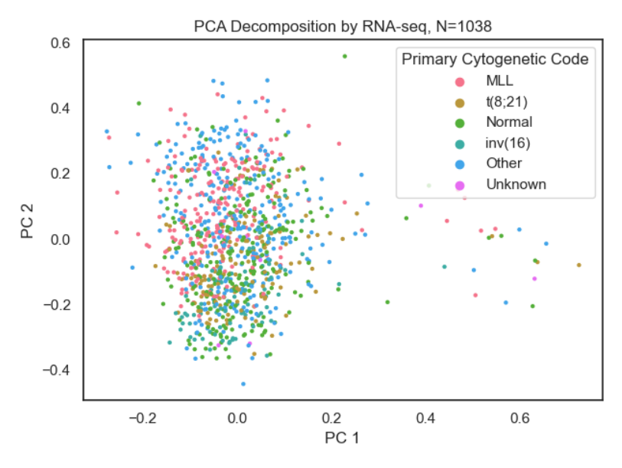
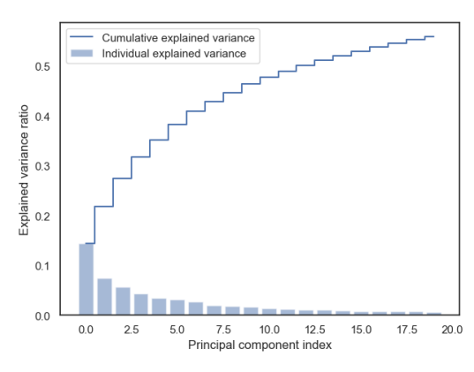
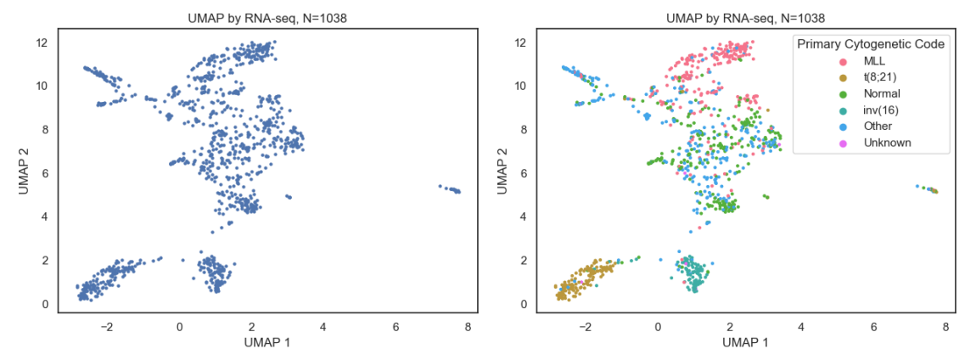
Introduction
Acute myeloid leukemia (AML) is a cancer of the blood and bone marrow.
Characterized by the abnormal production of immature blood cells, which crowd out healthy blood cells and can lead to serious health problems.
Gene expression is the process by which information from a gene is used in the synthesis of a functional gene product.
In cancer cells, gene expression is often dysregulated, meaning that some genes are expressed at abnormally high or low levels relative to normal cells.
This dysregulation can lead to changes in cell function that contribute to cancer development and progression.
RNA-seq is a powerful tool that can be used to study the gene expression of a cell or tissue.
We utilized NCI TARGET data for the analysis of this project.
TARGET: Therapeutically Applicable Research To Generate Effective Treatments
National Cancer Research, Office of Cancer Genomics: BCCA Cohort
Gene Expression of 1038 pediatric patients (0- 30 years of age)
This is a PCA plot along with its explained variance. For 2 dimensions, roughly 22% of the data is explained – deeming not good for visualization purposes.
As you can see, UMAP is able to cluster similar types of AML based solely on RNA-seq data. We are now able to assert that it can classify different types of AML based on unlabeled RNA-seq data!

Slide 3


Hypothesis
Can we identify different types of pediatric AML based on unlabeled RNA-seq data?
In other words, does different types of AML (usually characterized by their Primary Cytogenetic Code) have significant alterations on gene expression? If so, we hope to account for the variance in gene expression through RNA-seq.
Why?
By understanding which genes are expressed in cancer cells, we can better diagnose the specific form of cancer someone has and identify potential treatments for that patient.
How?
Our approach utilized unsupervised dimensionality reduction models and giving them nothing but gene expression data from our samples.
If the models can cluster the data in a lower dimension abiding to the individual’s primary cytogenetic code (what we usually use do separate different types of leukemia), then we can identify different types of pediatric AML based on unlabeled RNA-seq data.

Slide 4
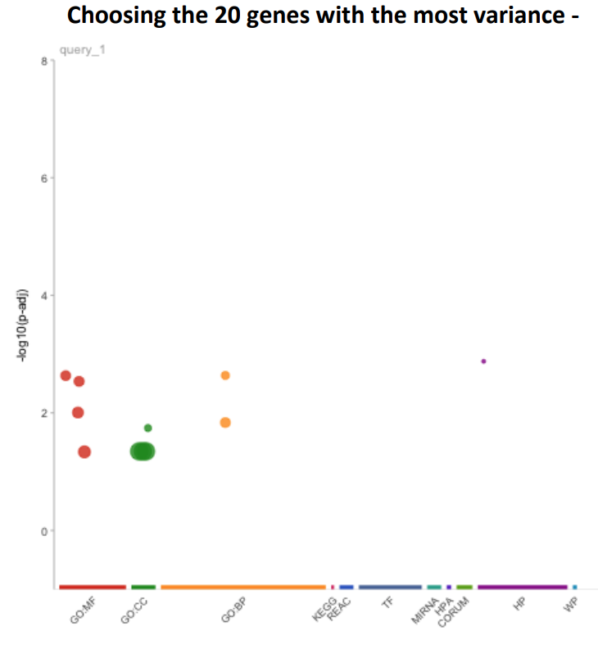
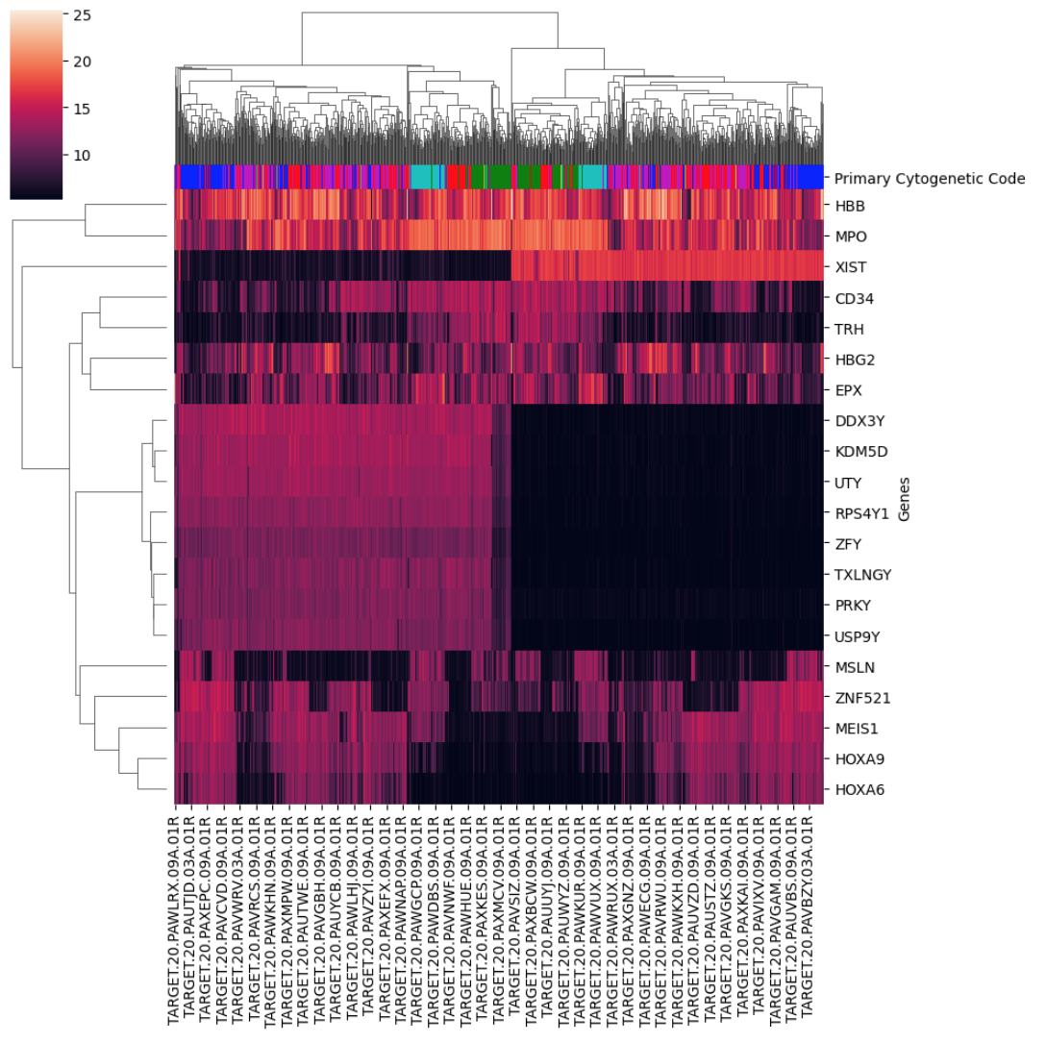
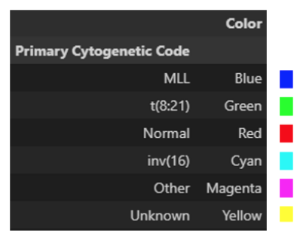
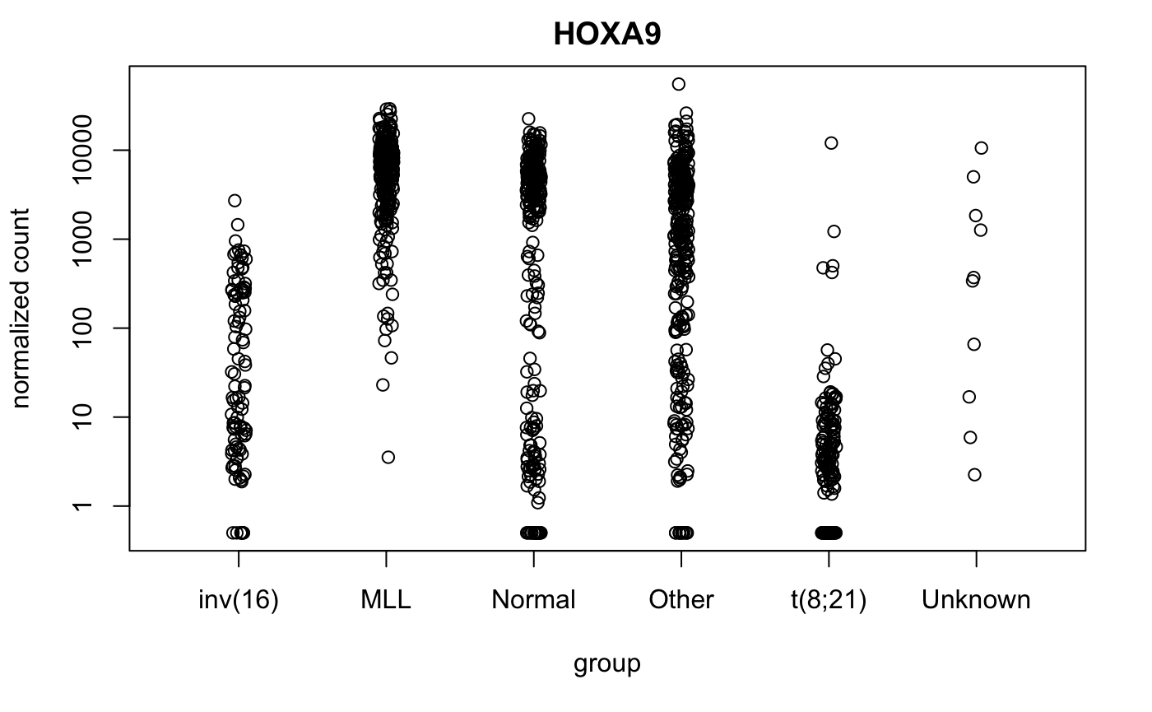
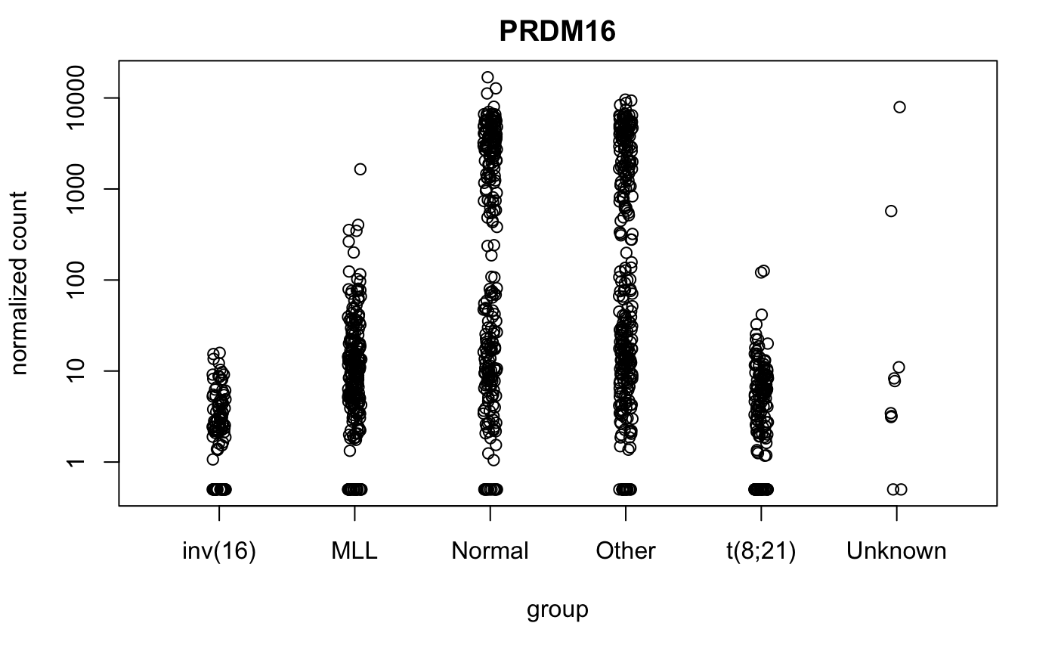
Differential Expression and Enrichment Analysis
Emphasis on the importance of
Cellular component
Molecular Function
The heatmap was done with all the 1038 individuals on the x-axis and the 20 genes with the highest variance (in the 0.99943 quantile). These genes are known to be very correlated to AML. Also, it is very interesting to see MLL clustering at the complete opposite borders of the heatmap and having t(8:21) in the middle. MLL is very different from t(8:21).
From enrichment analysis, we were able to separate our genes in terms of variance and their different expression. But how do they truly change between each type of AML?
By observing their normalized count for each primary cytogenetic code(PCC), we derived:
different genes are affected differently
Some genes can be described by other things other than PCC.

Slide 5
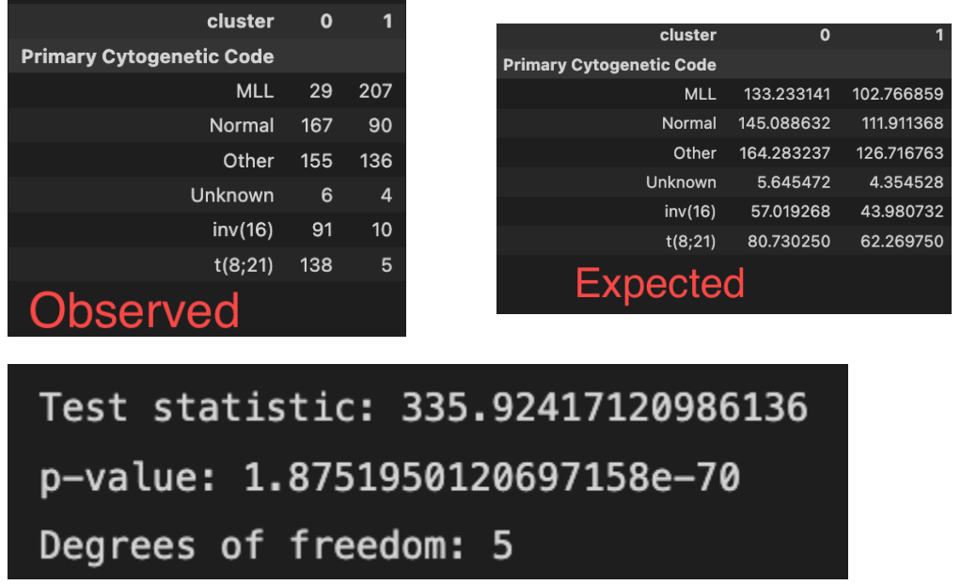
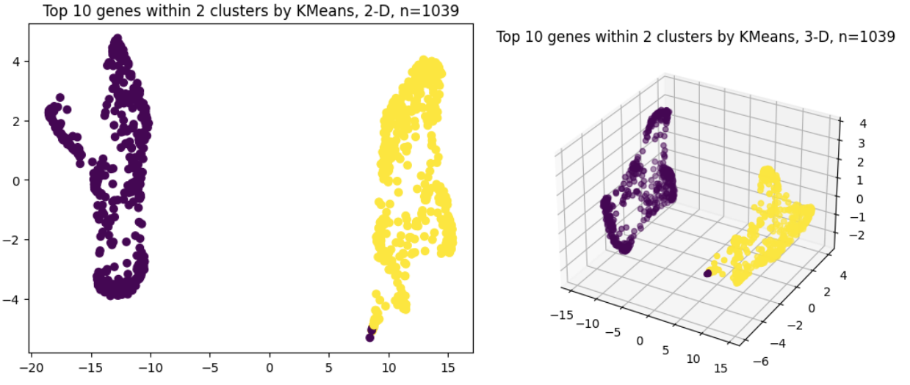
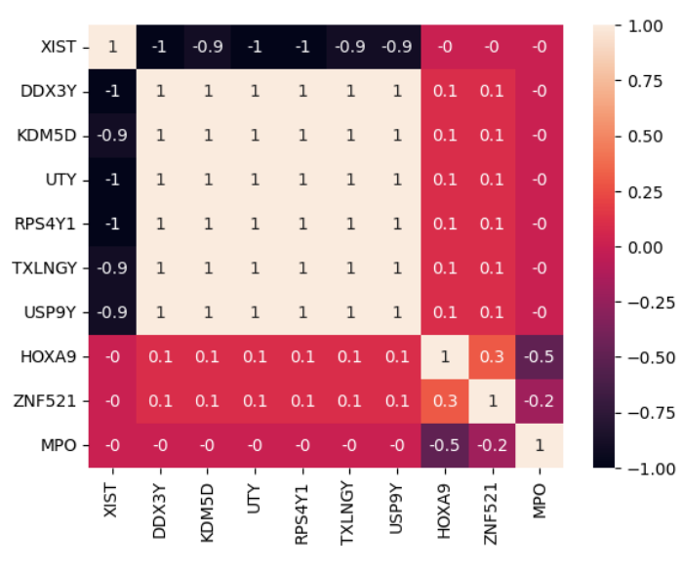
Clustering & Enrichment Analysis
Of all the 1039 patients, KMeans was able to almost perfectly mimic the PaCMAP clustering performed in the dimensionality reduction. It’s a practically perfect separation between two groups. This means there might be a lot of differences explained within the first 10 genes.
Chi-Square Test for Independence with Kmeans-2 clustering.
Adjusting for multiple hypotheses with Bonferroni.
p=0.05, n=1039, Bonferroni = p/n = 4.8e-5
Our p-values are lower than Bonferroni. 1.87e-70 < 4.8e-5
The resulting clusters of variance of normalized RNA-seq counts highly depend on Primary Cytogenetic Code in Pediatric AML patients. Observe, MLL is known as a very harmful mutation compared to inv(16) and t(8;21). The clusters are precisely divided on that matter - with no metadata/supervision.
We can conclude that primary cytogenetic code does influence gene expression.
Correlation matrix. Here we can see, from the 10 most variable genes, there are a lot of dependent genes (genes with similar functionalities, behaving in similar manner.) This can potentially be detrimental to our research, as minimizing the number of dependent genes in an analysis is ideal.

Slide 6
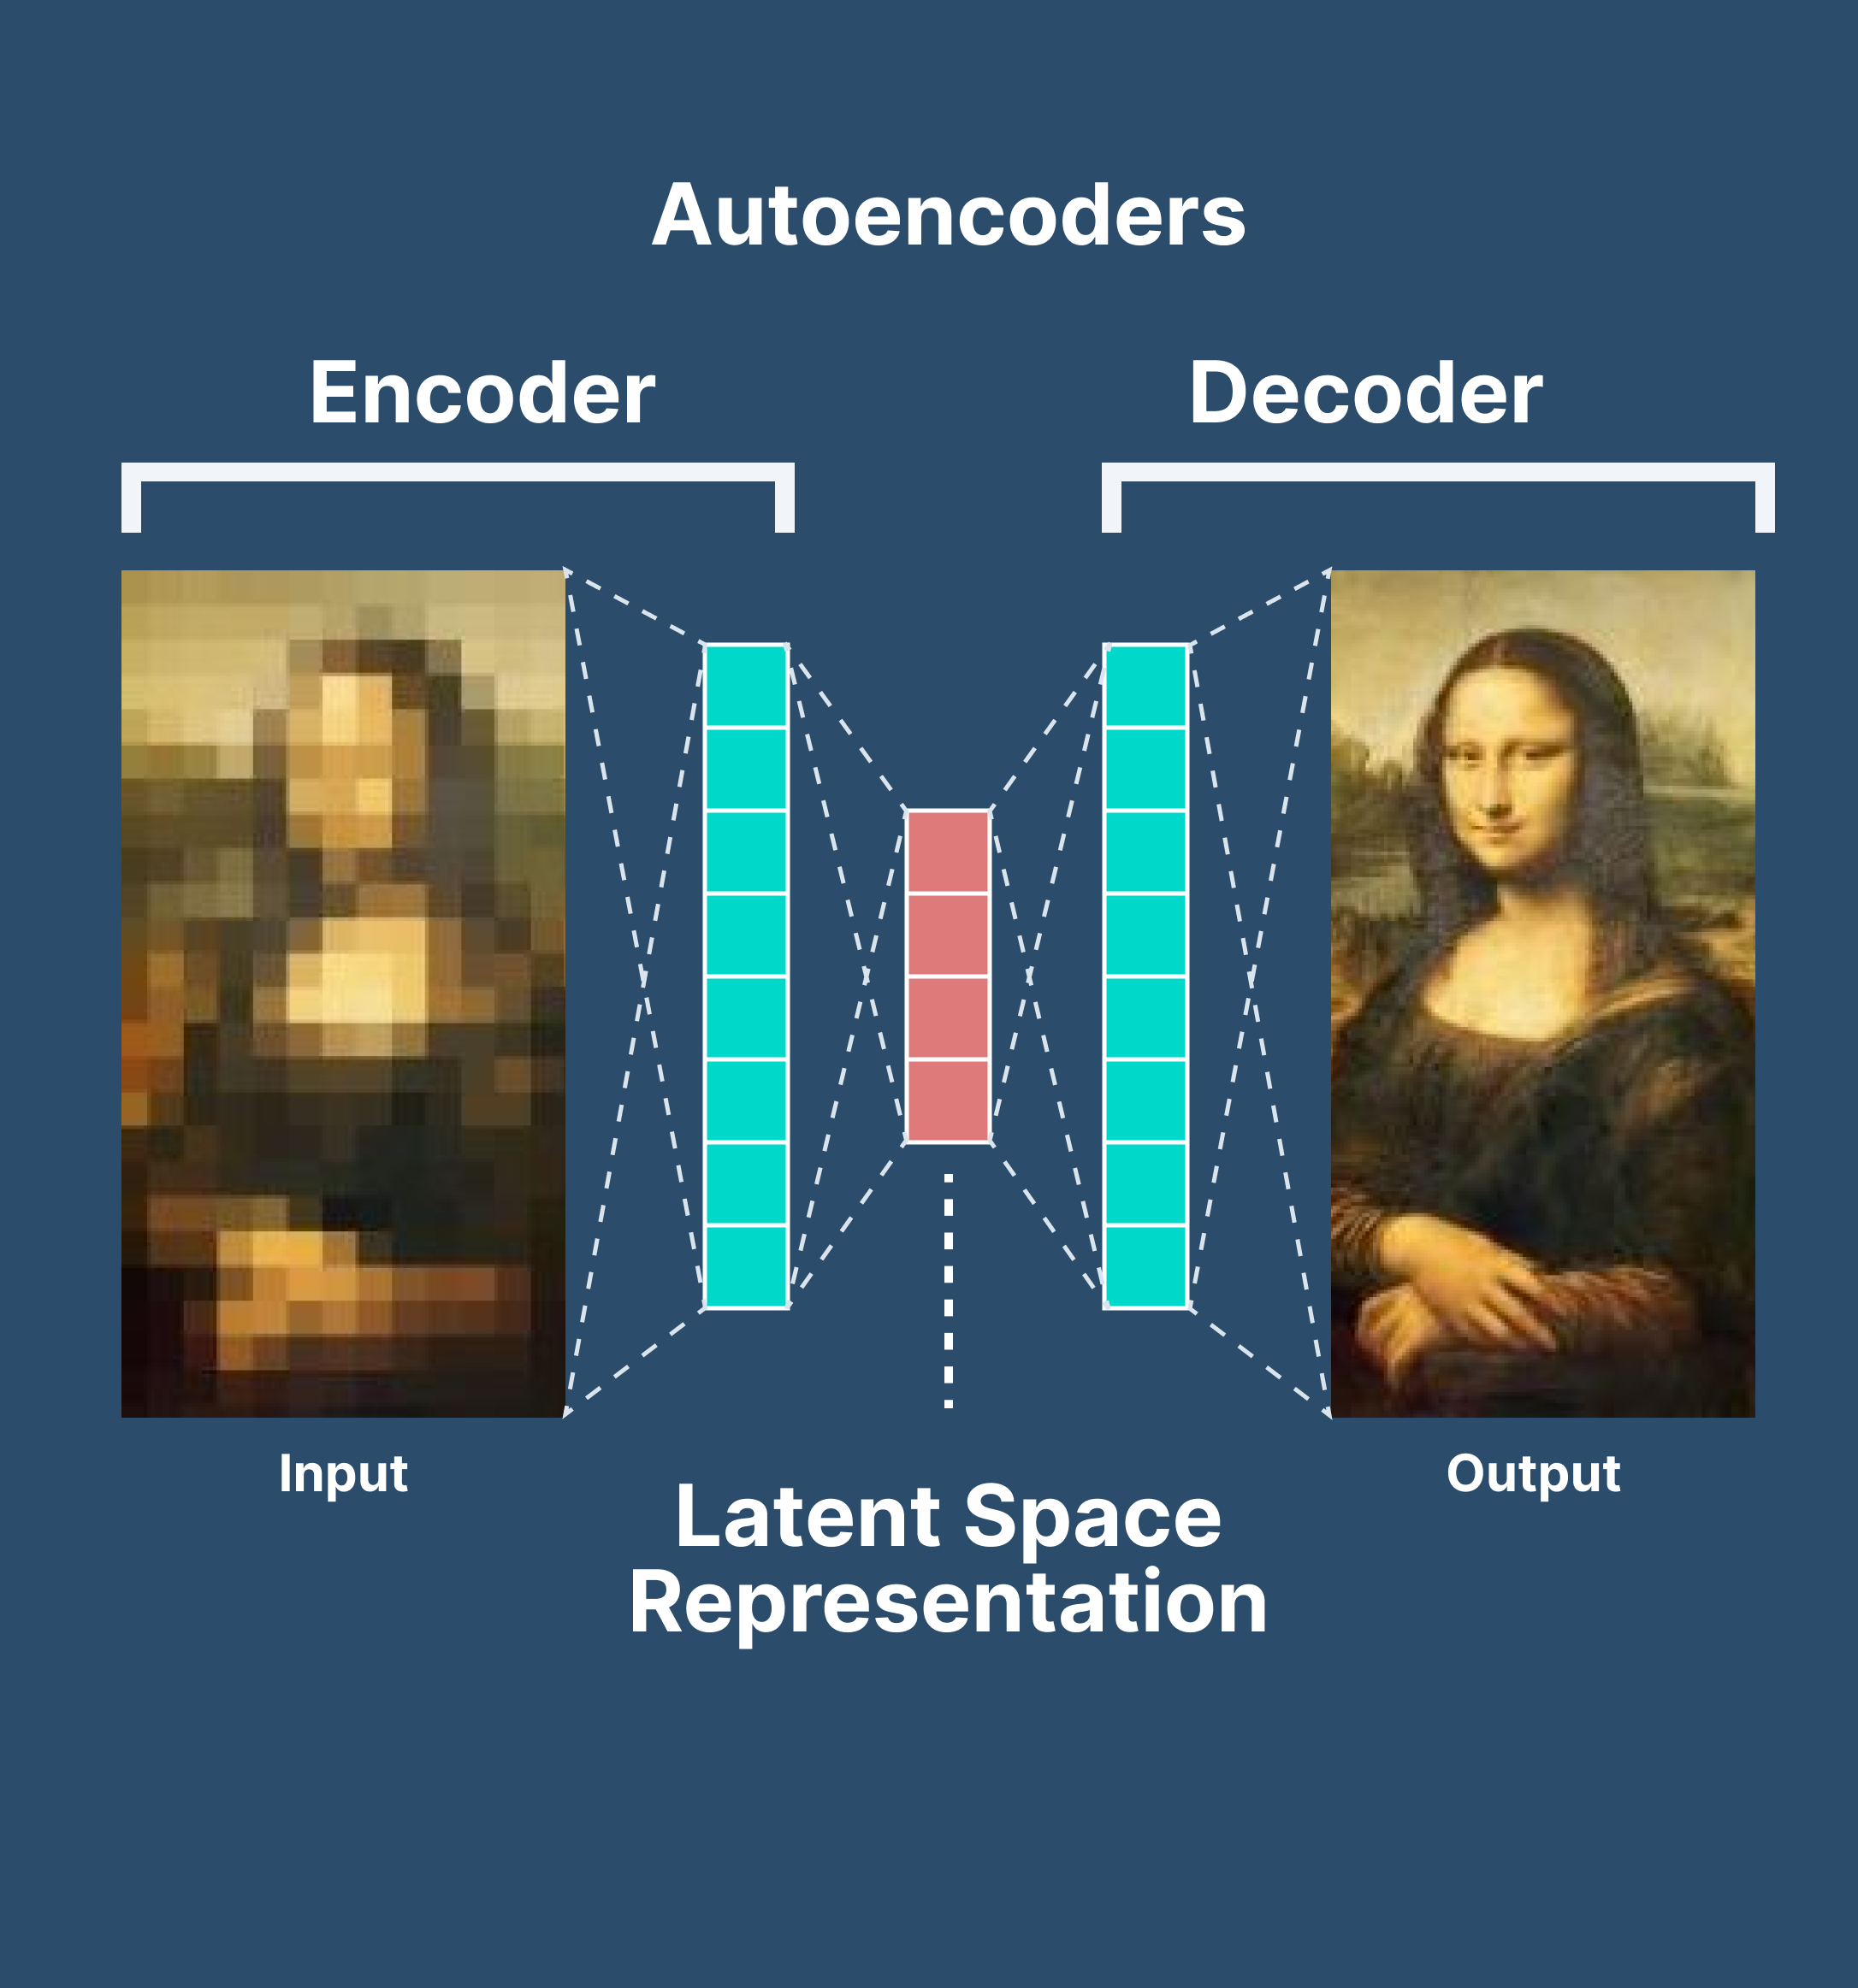
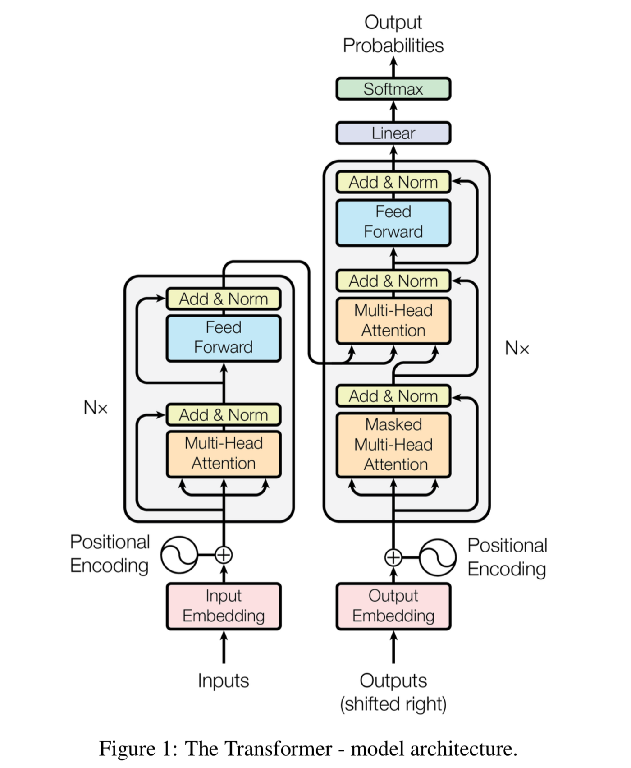
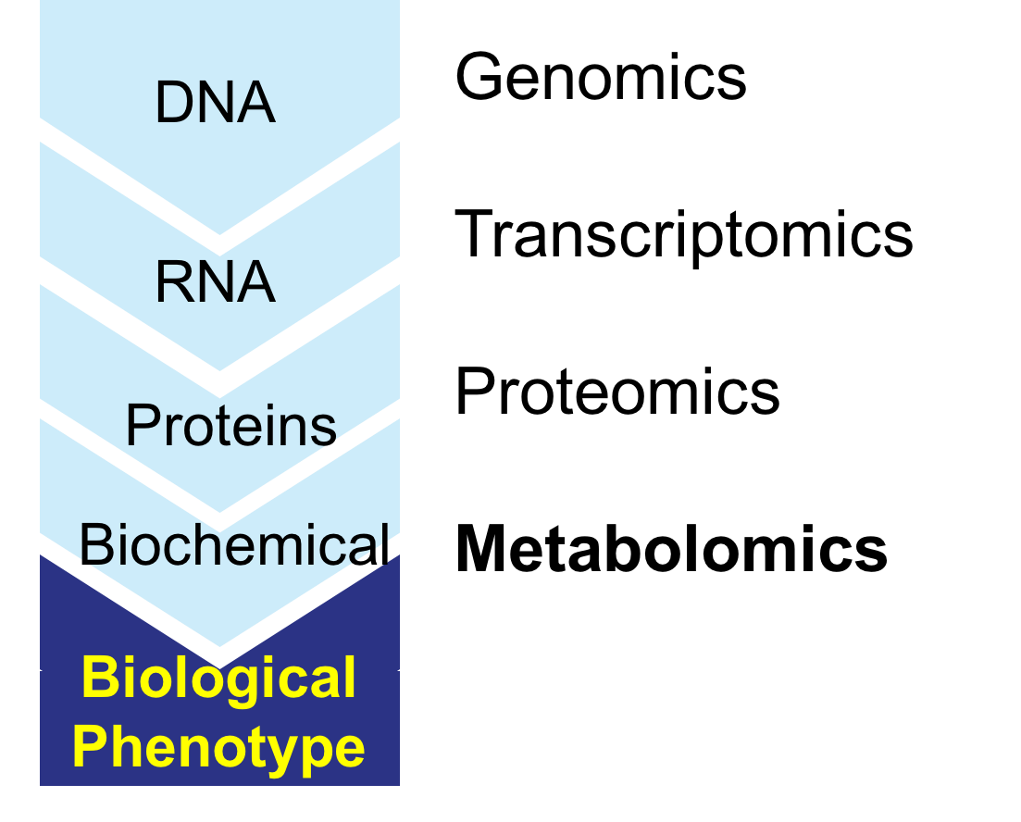
Conclusions & Future Work
AML is a heterogeneous disease, meaning that there are many different subtypes, each with different characteristics.
These subtypes are typically distinguished by their primary cytogenetic code, which refers to the specific chromosomal abnormalities that are present in the cancerous cells.
In this study, we used RNA-seq data to examine gene expression changes in different types of AML. We performed differential gene expression analysis followed by gene ontology, variability selection, and most-variable gene extraction.
We found that there were significant differences in gene expression between the various subtypes of AML, indicating that it may be possible to accurately identify these subtypes based on their gene expression profiles.
Additionally, we found that RNA-seq data can provide insights into potential targets for therapy and shed light on mechanisms involved in disease development and progression.
FURTHER QUESTIONS:
Could we derive more accurate results with different omics? (Metabolomics, proteomics, methylomics)
Can we combine all omics, acquire a more holistic view, and more accurately describe the disease?
Utilize Deep Learning to achieve more accurate results/insights.
Architectures such as Auto-Encoders, and Transformers

