Slide 1


Chonnam National University
Advanced Project for AI
Yang Hyung Jeong Prof.

Slide 2



Problems
Education Situation
The COVID-19 has resulted in schools shutting all across the world. Globally, over 1.2 billion children are out of the classroom. As a result, education has changed dramatically, with the distinctive rise of e-learning, whereby teaching is undertaken remotely and on digital platforms.

Slide 3

Disadvantage
Teacher
Managing students' attendance is difficult and wastes a lot of time. It affects teaching and learning.
Student
Require concentration, self-motivation ability, and lack practice opportunities.
QUESTION?
Can we manage students' attendance and measure students' concentration in lessons AUTOMATICALLY?

Slide 4

PROJECT NAME
Combining Video Class Solution with Face Recognition Solution
company name
㈜케 이 테 크 양 재 동
representative
address
전 주 시 덕 진 구 백 제 대 로 5 6 7 자 연 과 학 대 학 본 관 6 0 2 호
h t t p s : / / w w w . k n o w l e d g e t e c h . c o . k r

Slide 5
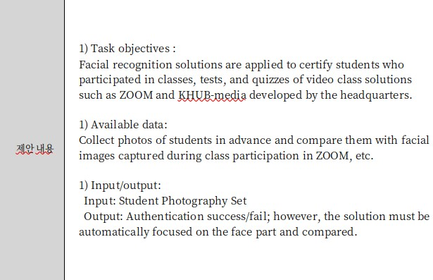


Project Proposal

Slide 6
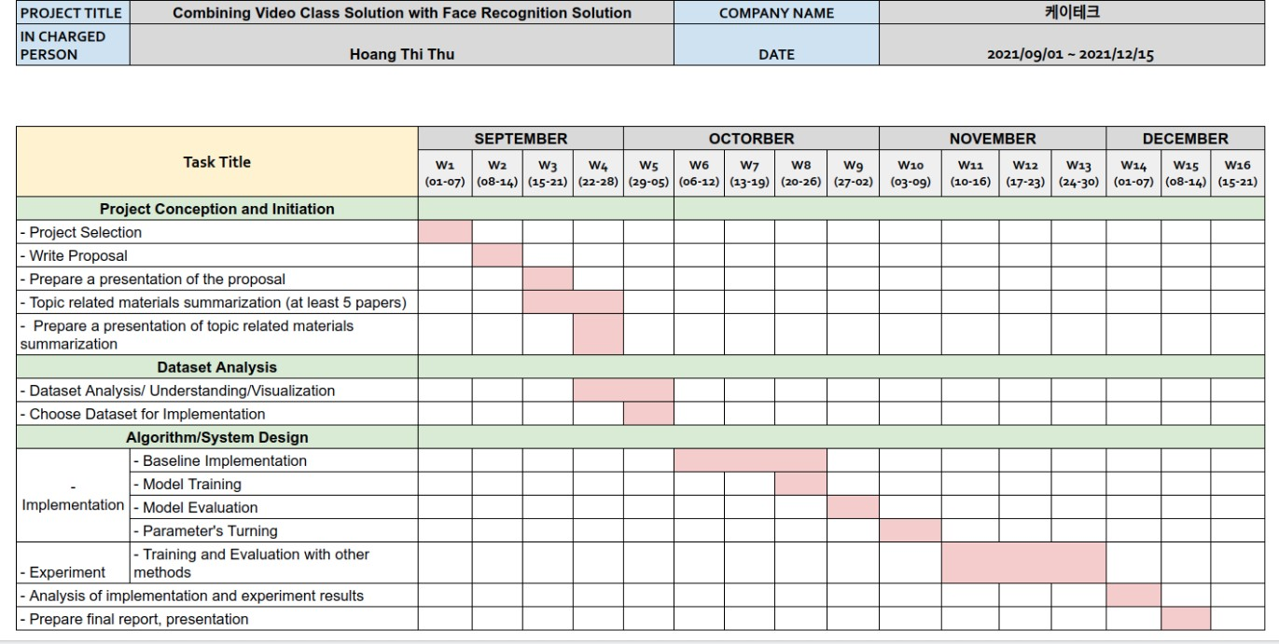
PROJECT ROADMAP

Slide 7



AGENDA
01
02
03
Project
Requirement Analysis
Project Implementation
Project Demonstration

Slide 8


Project Analysis
Data Format
Student Photography Set: Collecting 10 photos in advance per student
Image captured during students participating on Zoom Class: Using record function of Zoom application
Requirements
Data
Authentication Result
From student photography set and images captured during students participating on Zoom Class, the application need to detect face area and compare facial representations to conclude that students participated in Zoom class or not

Slide 9
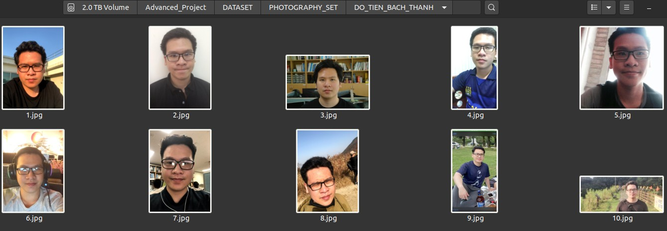
Project Analysis
Each student, 10 images are collected in advance

Slide 10
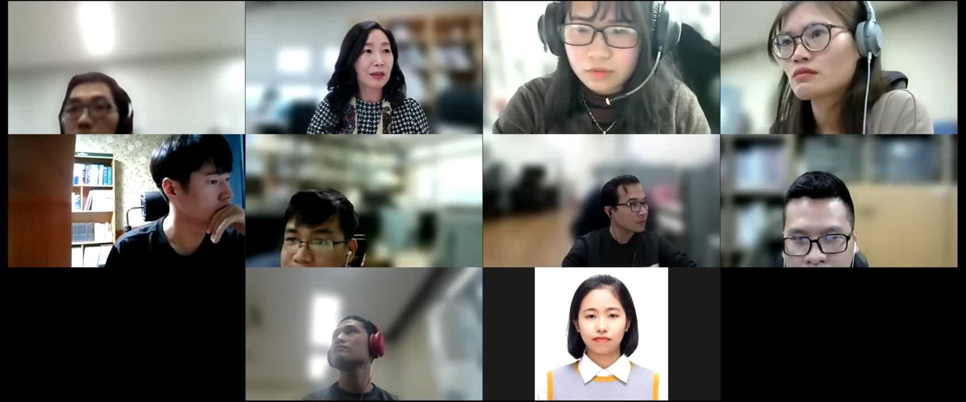
Project Analysis
Recorded video on Zoom Class

Slide 11


Project Implement
TKINTER
Tkinter is a Python binding to the Tk GUI toolkit. It is the standard Python interface to the Tk GUI toolkit Tkinter is easy for beginners to design GUI
PYTORCH
It is easy to learn and simpler to code.
Rich set of powerful APIs to extend the Pytorch Libraries. It has computational graph support at runtime.
It is flexible, faster, and provides optimizations. It has support for GPU and CPU.
Easy to debug using Pythons IDE and debugging tools.

Slide 12
Project Implement
Data
PROCESSING DATA
CHECK ATTENDANCE
LOAD RESULT
Result
STEP 1
STEP 2
STEP 3
Fig 1. An overview workflow of the Smart Attendance System

Slide 13
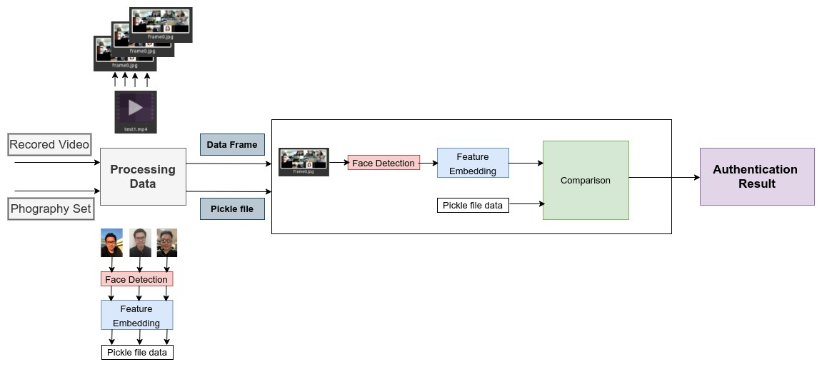
Project Implement
Fig 2. An overview of the Smart Attendance System

Slide 14
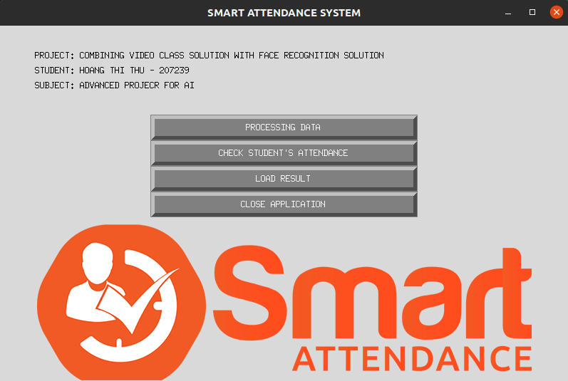
Project Implement
Fig 3. An GUI of the Smart Attendance System

Slide 15

Project Implement
Use InsightFace Library
InsightFace is an integrated Python library for 2D&3D face analysis. InsightFace efficiently implements a rich variety of state of the art algorithms of face recognition, face detection and face alignment, which optimized for both training and deployment.
Research institute and industrial organizations can get benefits from InsightFace library.

Slide 16

Project Implement
Face Detection
- Method: RetinaFace
RetinaFace is a practical single-stage face detector which is accepted by CVPR 2020.
Pretrained Model: RetinaFace-R50 is a medium size model with ResNet50 backbone trained on WebFace260M dataset
Face Recognition
- Method: ArcFace

Slide 17
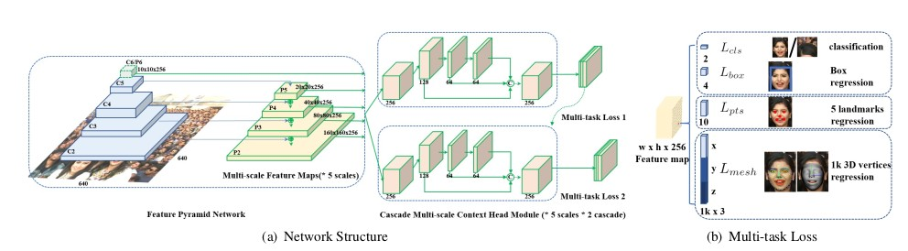
Project Implement
RetinaFace
Deng, Jiankang, et al. "Retinaface: Single-shot multi-level face localisation in the wild." Proceedings of the IEEE/CVF Conference on Computer Vision and Pattern Recognition. 2020.
Fig 4. The artchitecture of RetinaFace method

Slide 18
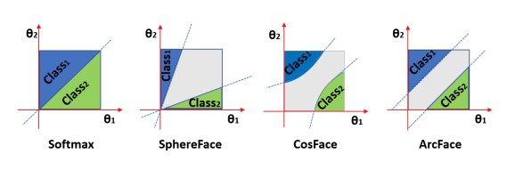
Project Implement
ARCFACE
Deng, Jiankang, et al. "Arcface: Additive angular margin loss for deep face recognition." Proceedings of the IEEE/CVF Conference on Computer Vision and Pattern Recognition. 2019.
Fig 5. Comparing the classification boundary under binary classification case

Slide 19
Demonstration Video

Slide 20
FRONT-END
Design creative GUI and easy to users Packaged into a complete application
BACK-END
Bendmark with a huge dataset Try with other environments Improve the speed of application
NEXT PLAN

Slide 21

Thank you!
Q&A

