Slide 1
Combining Video Class Solution with Face Recognition Solution
Final Report
Student: Vo Thi Tuong Vi
2021-12-09

Slide 2
Instructions for this project
Task objectives
Facial recognition solutions are applied to certify students who participated in classes, tests, and quizzes of video class solutions such as ZOOM and KHUB-media developed by the headquarters
Available data
Collect photos of students in advance and compare them with facial images captured during class participation in ZOOM, etc.
Company name: ㈜ 케이테크
https://www.knowledgetech.co.kr

Slide 3
Automated Face Recognition Attendance System
1

Slide 4
Face Recognition Process Flow
Image/Video
Face Detection
Face Alignment
Feature Extraction
Feature Matching
Face ID
Database of Enrolled Users

Slide 5
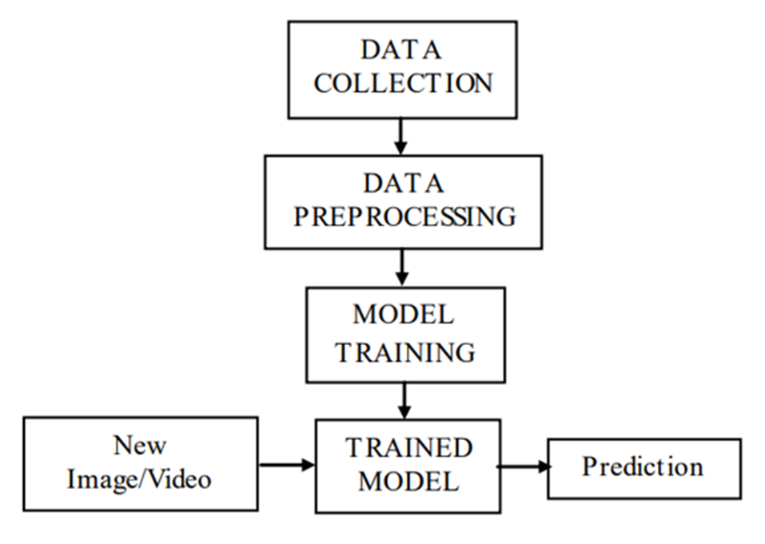
FlowWork Flow of the face recognition methodology

Slide 6
BACK END
SQLite
Face Recognition module
Local Camera Application
Angular CLI

Slide 7
Take image
Face image
Face Detection
Registration system
Student
Take snapshot
Image
Face Detection
Face recognition
Video
Student Id
Generate Report
Attendance
Student Attendance
Attendance
information
Record Attendance
Student
Attendance Report

Slide 8
Demonstration
2

Slide 9
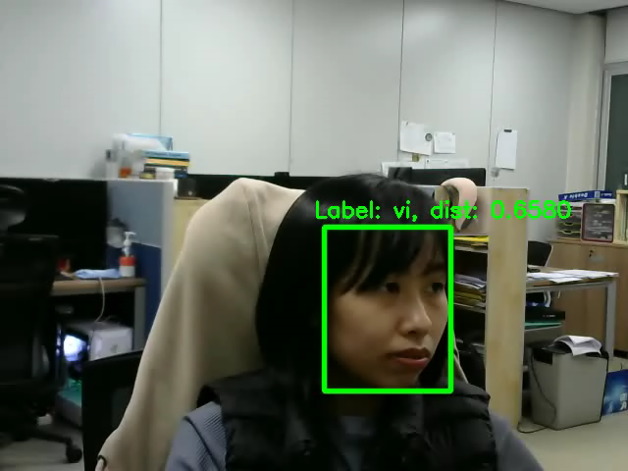

Slide 10
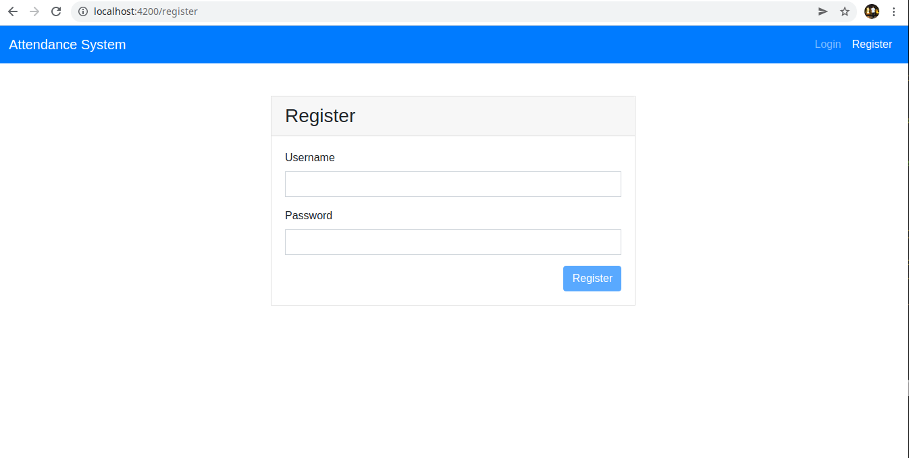

Slide 11
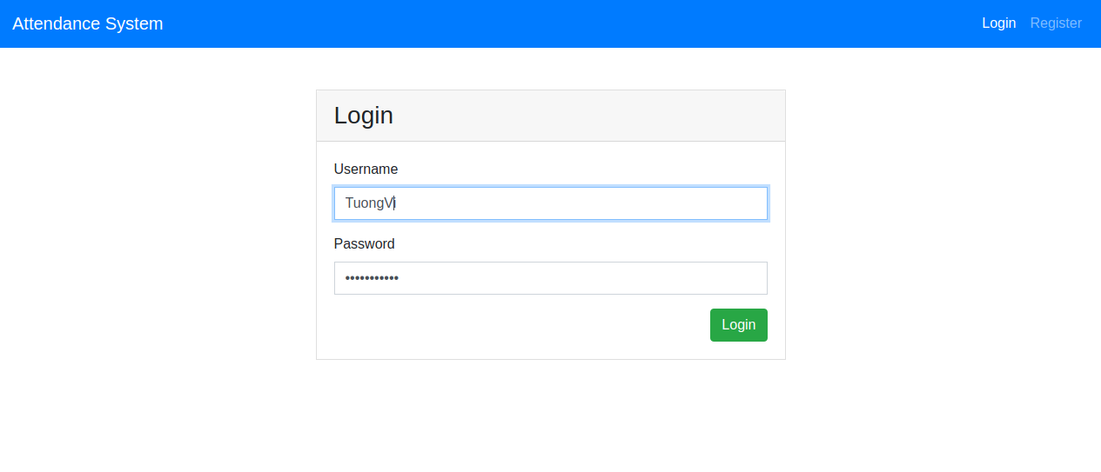

Slide 12


Slide 13
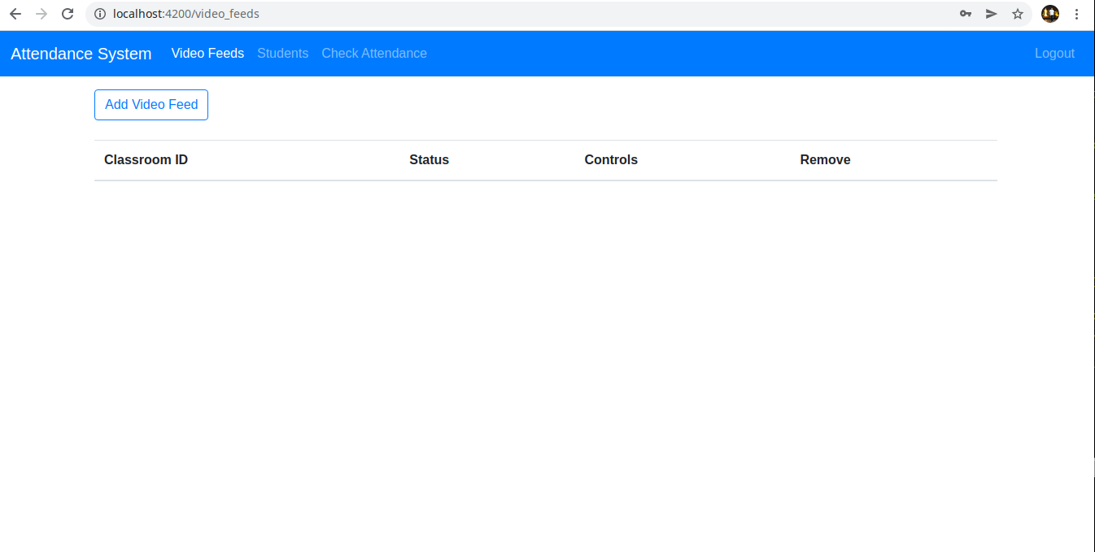

Slide 14
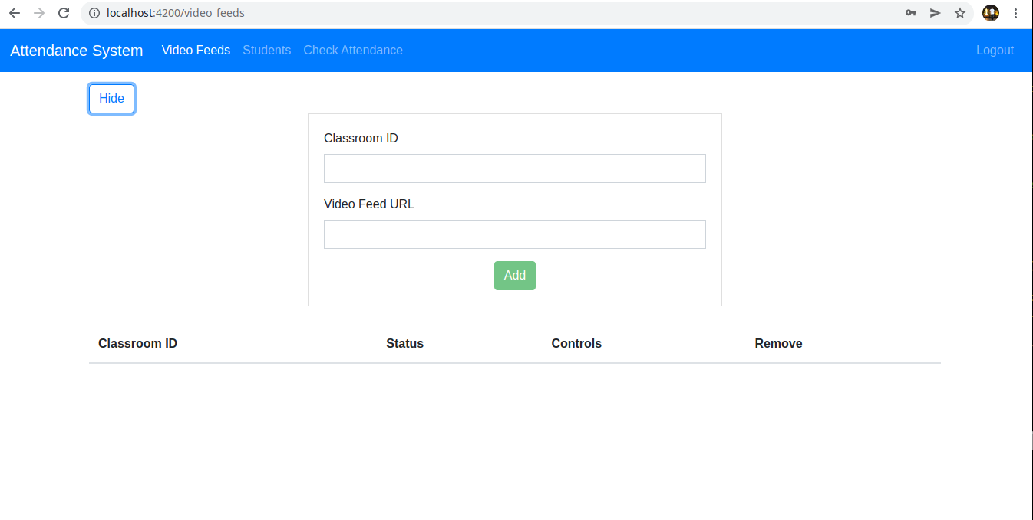

Slide 15
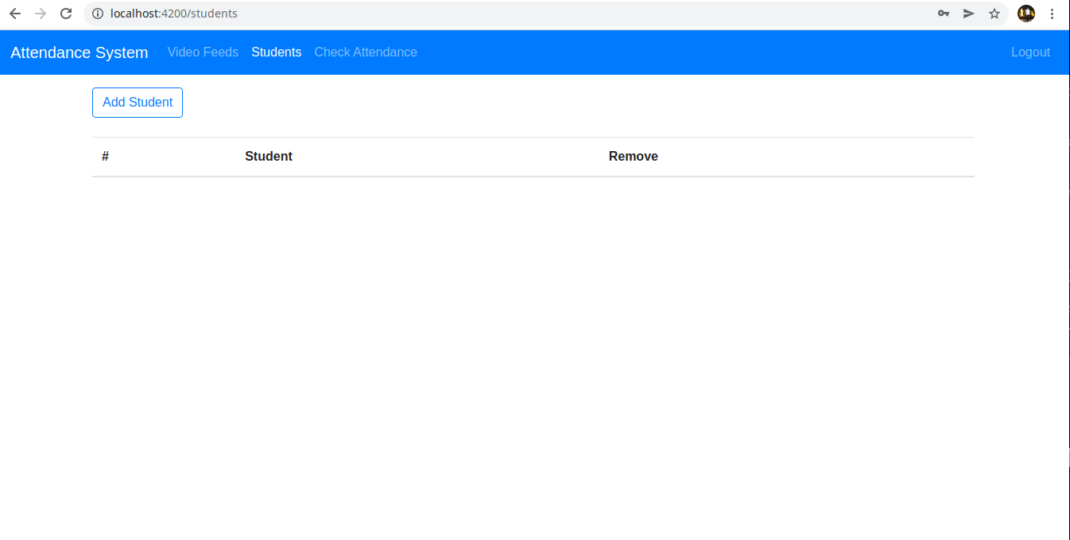

Slide 16


Slide 17
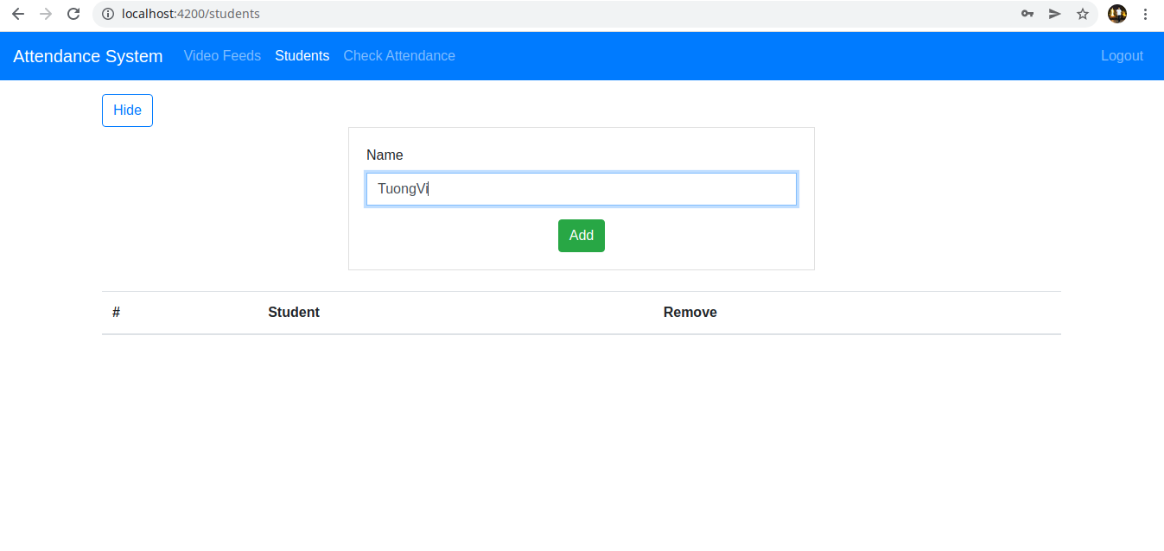

Slide 18
Project Schedule
 | Week |  |  |  |  |  |  | Week
 | 1 | 2 | 3 | 4 | 5 | 6 | 7 | 8 | 9 | 10 | 11 | 12 | 13 | 14 | 15
Topic selection
Survey papers
Data collection
Data pre-processing
Model and training
Evaluaton
Conduct system
Report |  |  |  |  |  |  |  |  |  |  |  |  |  |  | ◆

Slide 19
Thank you for your attention!

