Slide 1


Development of AI model and API service for lung cancer prognosis
Vo Minh Cong
Chonnam National University
2021.12.09

Slide 2
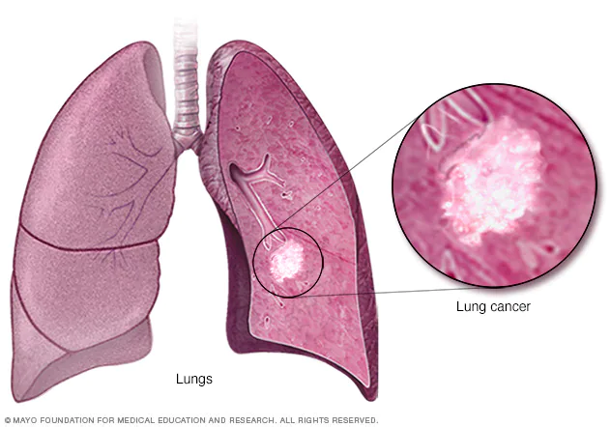
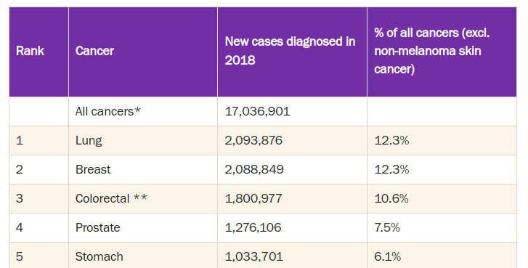
1 - Lung Cancer
Lung cancer is the leading cause of cancer deaths worldwide.
Lung cancer consists of two major histological types:
Non-small-cell lung cancer (NSCLC) (85%)
Small-cell lung cancer (SCLC).
The precise classification of patients with NSCLC into groups according to survival outcomes is a crucial step in treatment, especially for early-stage patients.
https://www.wcrf.org/dietandcancer/worldwide-cancer-data/
Source: World Cancer Research Fund (2018)
Notes:
Lung cancer is the most commonly diagnosed cancer in the word.
Lung cancer consists of two major histological types: Non-small-cell lung cancer (NSCLC), which accounts for approximately 85%, and small-cell lung cancer (SCLC). The precise stratification of patients with NSCLC into groups according to survival outcomes represents a crucial step in treatment.
However, this procedure usually has been done manually by experts without the assistance from the current cutting-edge technology.
In this project, we bridge the gap between expertise and technology by introducing the lung cancer prognosis application.

Slide 3
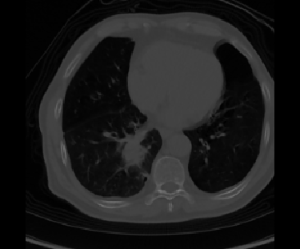
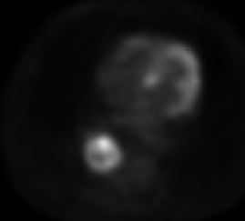
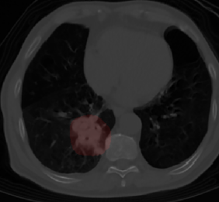
2 - Project Description
Goal: Development an AI model and API service for prognosis survival probability on early-stage lung cancer patients
Company: Gwangju Artificial Intelligence Center lnc.
CT
System
Survival Probability
Frontend/GUI
PET
Backend/API
Age
Gender
Cancer Stages
...
AI Models
Clinical Information
Lung Location Prediction

Slide 4
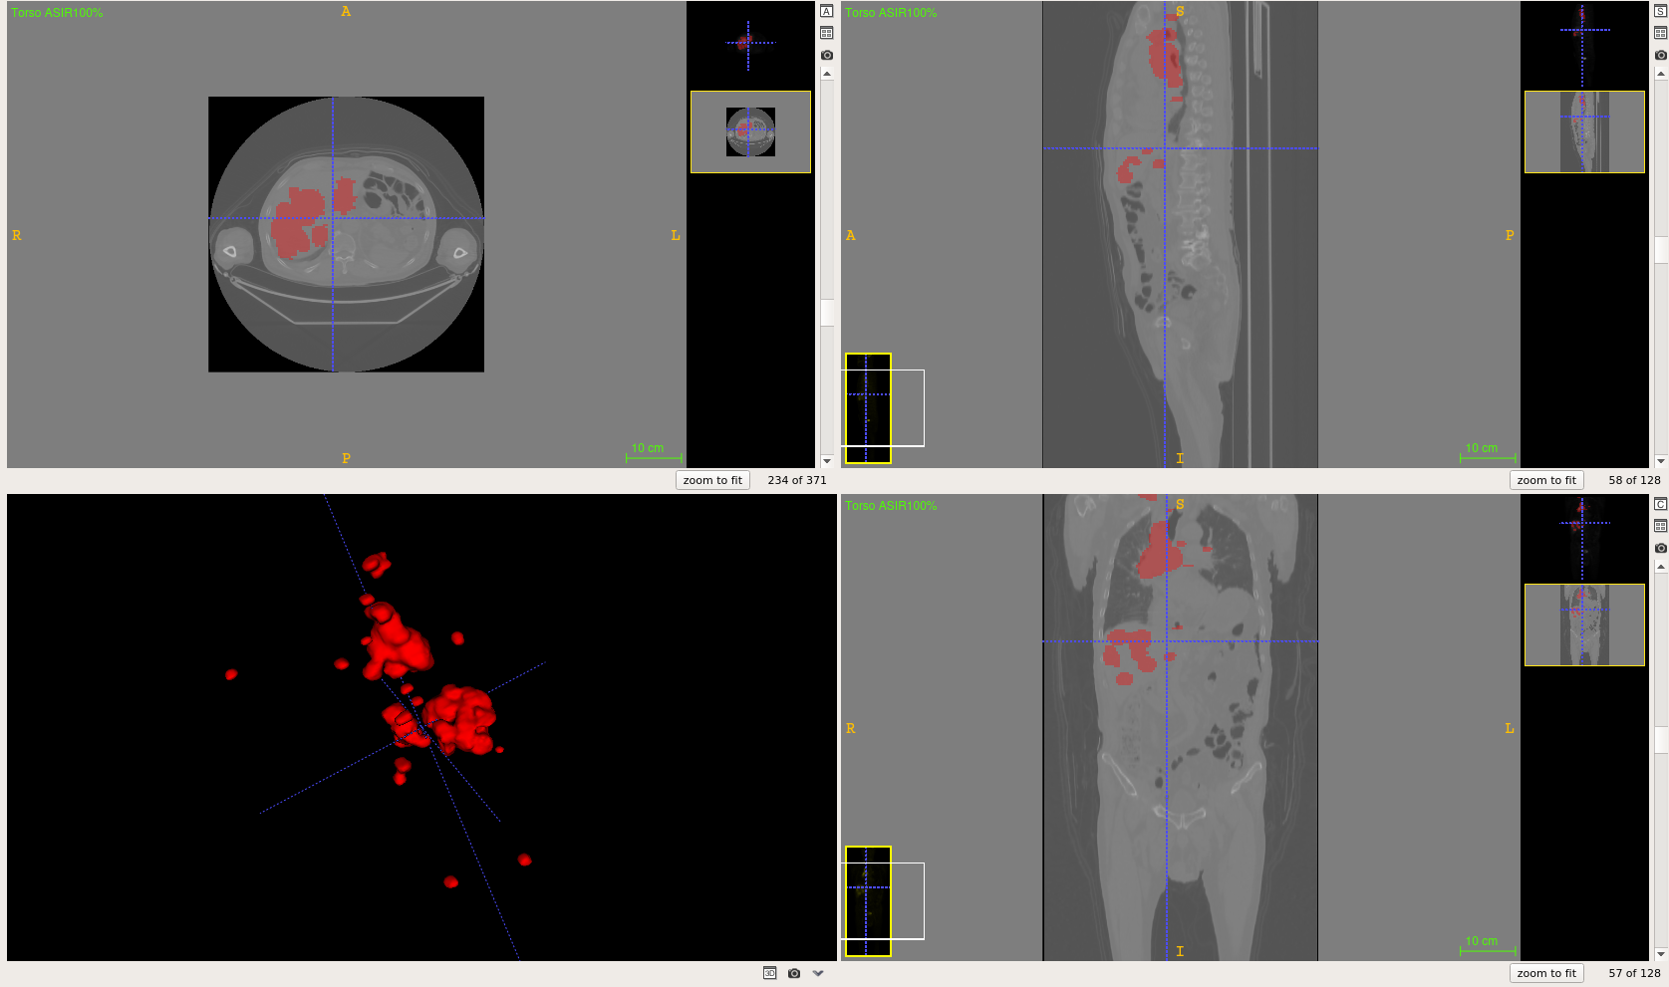
3 - Lung Cancer Dataset
1 - AIDATA-LC-NSCLC (n=400)
Data Types:
Clinical Information
CT/PET Images
Seg. Cancer Annotations
Num. samples: 400
→ For training segmentation model
2 - AIDATA-LC-NSCLC (n=2687)
Data Types:
Clinical Information
CT/PET Images
Num. samples: 2687
→ For training and testing survival analysis
A raw CT/PET sample on AIDATA-NSCLC-SCLC dataset

Slide 5
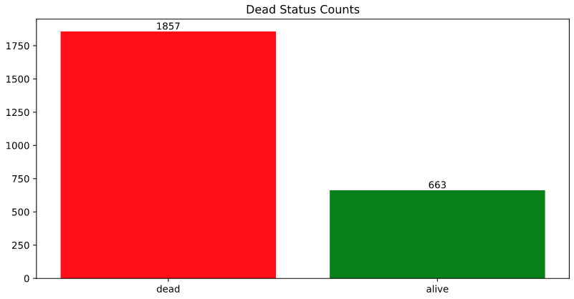
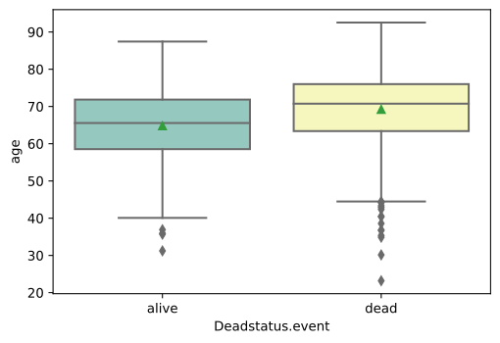
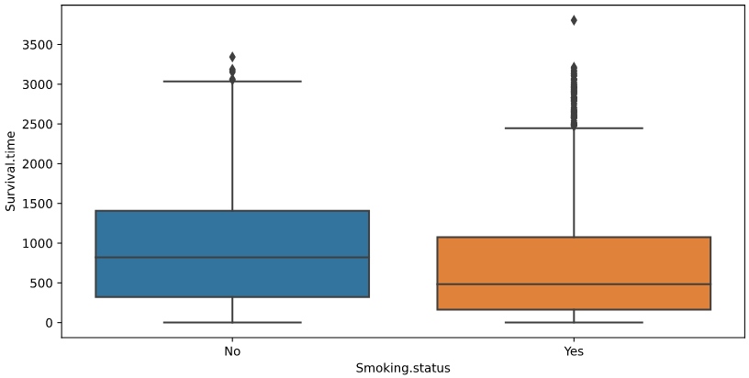
3 - Lung Cancer Dataset: Clinical Insights
The relation between Age and Patient's status
The relation between Smoking status and Patient's status
Patient’s status
- The majority of lung cancer patients is old people
- Smoking can shorten survival time

Slide 6
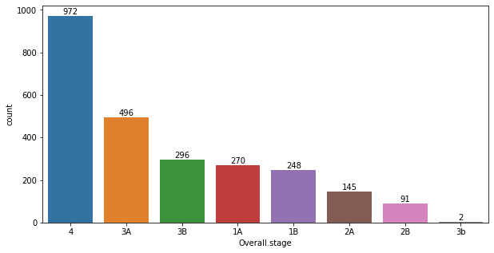
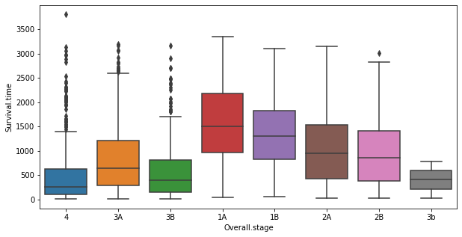
3 - Lung Cancer Dataset: Clinical Insights
The distribution of overall cancer stages
The relation between survival time and overall cancer stage
Late-stage patients account for the largest percentage.
The worse situation, the shorter survival time

Slide 7
3 - Lung Cancer Dataset: Early-stage Focused
Help doctors find the best treatments to prolong early-stage patient’s survival time

Slide 8
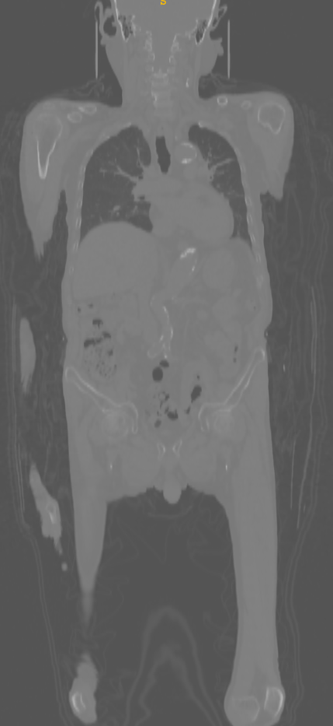
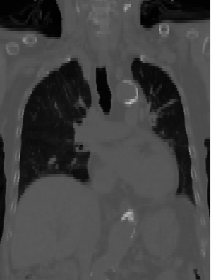
3 - Lung Cancer Dataset: PET and CT Images
1 - Crop Lung Region
2 - Normalize Pixel Intensity
(Hounsfield Scale for CT Image)
Preprocessed Image for later processes
CT (or PET Image)

Slide 9
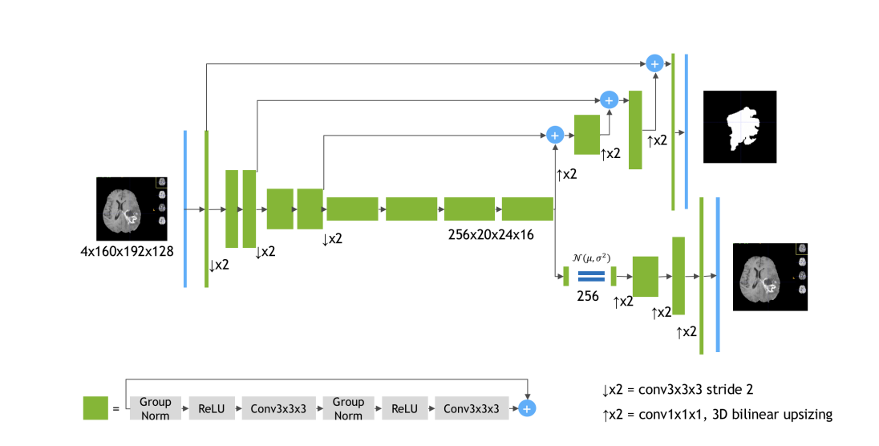

4 - Lung Cancer Segmentation
Current performance on the validation set (20%) of AIDATA-NSCLC-SCLC (n=400)
Method | DiceScore
SegResnet | 0.81
SegResnet [1]
CT
Encoder
Decoder
PET
[1] Myronenko, Andriy. "3D MRI brain tumor segmentation using autoencoder regularization." International MICCAI Brainlesion Workshop. Springer, Cham, 2018.

Slide 10
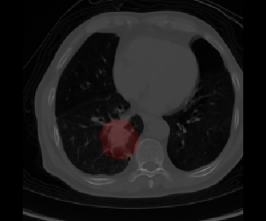
5 - Radiomic Features Extraction
Radiomic features are the features related to size and shape based–features, descriptors of the image intensity histogram, descriptors of the relationships between image voxels, neighborhood gray tone difference, etc.
108 features
First Order Statistics
Shape-based (3D)
Shape-based (2D)
Gray Level-based
…
Extract
Radiomic Features
(Pyradiomic [1])
[1] https://pyradiomics.readthedocs.io/en/latest/features.html
Notes:
First-order statistics describe the distribution of voxel intensities within the image region defined by the mask through commonly used and basic metrics.
Shape-based (3D) (16 features)
Shape-based (2D) (10 features)
Gray Level Cooccurence Matrix (24 features)
Gray Level Run Length Matrix (16 features)
Gray Level Size Zone Matrix (16 features)
Neighbouring Gray Tone Difference Matrix (5 features)
Gray Level Dependence Matrix (14 features)

Slide 11
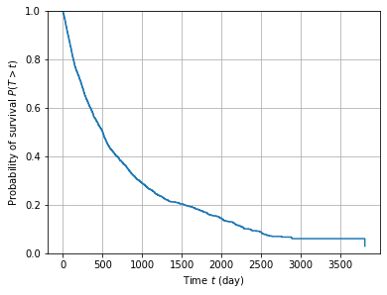
6 - Survival Model
First Order Statistics
Shape-based (2D)
...
Survival Model
Survival Time Prediction
Radiomic Features
Cumulative Hazard Rate
(Breslow Estimator [2])
Survival
Function
DeepSurv [1]
y
Age
Gender
Stages
...
Clinical
Features
Predicted
Hazard
Rate
[1] Katzman, Jared L., et al. "DeepSurv: personalized treatment recommender system using a Cox proportional hazards deep neural network." BMC medical research methodology 18.1 (2018): 1-12.
[2] Lin, D. Y. "On the Breslow estimator." Lifetime data analysis 13.4 (2007): 471-480.
Notes:
https://www.researchgate.net/publication/287595146_An_Ontology-Based_System_for_Cancer_Diseases_Knowledge_Management/figures?lo=1

Slide 12
7 - The Overall Approach
Radiomic
Features
Extraction
First Order Statistics
Shape-based (2D)
...
Extract
Radiomic Features
Encoder
Decoder
SegResnet [1]
First Order Statistics
Shape-based (2D)
...
Survival Model
Survival Time Prediction
Radiomic Features
Cumulative Hazard Rate
(Breslow Estimator [2])
Survival
Function
DeepSurv [1]
y
Age
Gender
Stages
...
Clinical
Features
Predicted
Hazard
Rate
[1] Katzman, Jared L., et al. "DeepSurv: personalized treatment recommender system using a Cox proportional hazards deep neural network." BMC medical research methodology 18.1 (2018): 1-12.
[2] Lin, D. Y. "On the Breslow estimator." Lifetime data analysis 13.4 (2007): 471-480.
Notes:
https://www.researchgate.net/publication/287595146_An_Ontology-Based_System_for_Cancer_Diseases_Knowledge_Management/figures?lo=1

Slide 13
8 - Experimental Results
Current performance on validation set for early-stage patients (500 patients)
Method | C-Index | MAE(0.5) | MAE(0.7) | MAE(0.9)
DeepSurv w/ Clinical Feature | 0.713 | 535.1 | 531.5 | 730.4
DeepSurv w/ Radiomic Feature | 0.712 | 534.2 | 614.3 | 770.3
DeepSurv w/ Combined Features | 0.737 | 526.6 | 597.3 | 763.6

Slide 14
9 - Inference Time
Inference Time on GPU NVIDIA-3090, CPU Intel® Core™ i9-10900 CPU
Module | Second(s)
Lung Cancer Segmentation | 2.11
Survival Prediction | 0.02
Total | 2.13

Slide 15
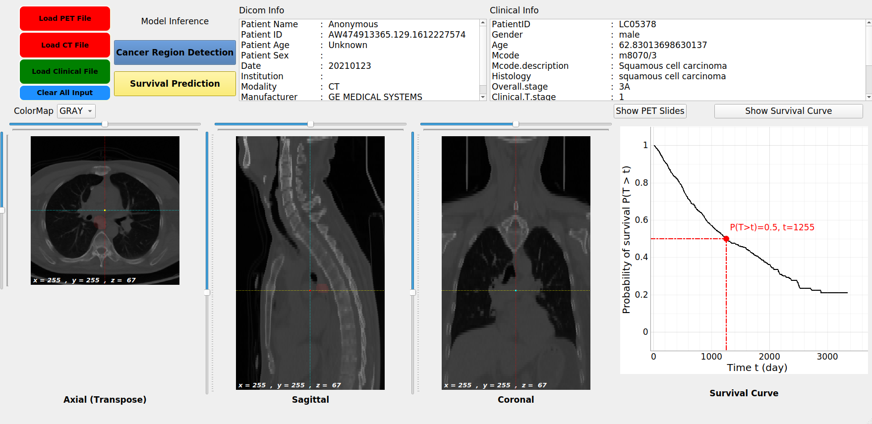
9 - GUI Design
Language: Python
Framework: PyQt5
Support:
Multi-modalities View
Clinical/Dicom Information View
…

Slide 16
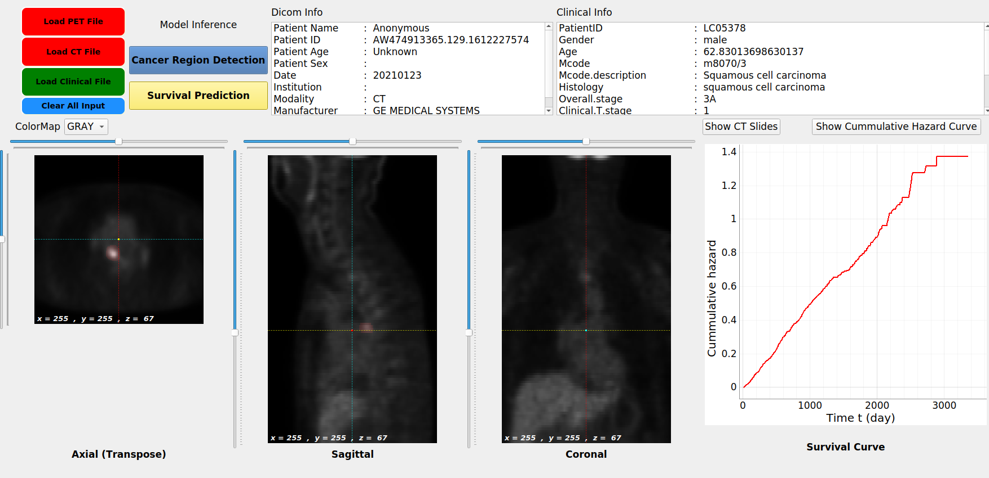
9 - GUI Design
Language: Python
Framework: PyQt5
Support:
Multi-modalities View
Clinical/Dicom Information View
…

Slide 17
10 - Demo

Slide 18
Thank you!

