Slide 1
EDA And Modelling Using Spark MLLIB.
By: Mohammad shaan
A21018

Slide 2
Business Problem
The dataset is based on customer information which is used by a bank to provide loans to the customers. Now the bank uses various attributes to either provide or deny loan to a customer.
The attributes in the given data set are: Gender, Married, Loan Amount, Applicant Income, Dependents, Co Applicant Income, Education, Credit Score, Self Employed, Loan Amount Term, Property Area.
Each of these attributes help the bank to decide whether to approve loan or not.
Our goal is to build a Machine Learning Model to predict the approval or denial of loan for the customer.

Slide 3
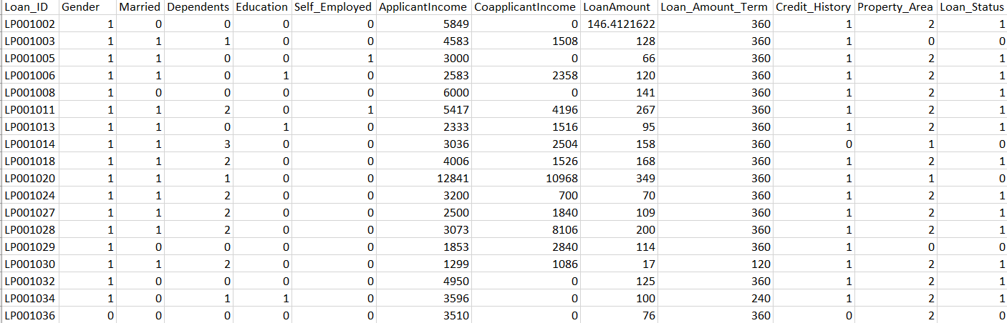
A quick look at the Data
Number of rows = 614 & Number of Columns = 13

Slide 4
Load Data
The dataset stored in object known as Resilient Distributed Dataset or RDD.
An RDD is a distributed collection of elements. All work in Spark is expressed as either creating new RDDs, transforming existing RDDs, or calling actions on RDDs to compute a result.Spark automatically distributes the data contained in RDDs across your cluster and parallelism the operations you perform on them.
We have our data file loaded into the ‘df’ RDD.

Slide 5
Exploratory Data Analysis
Exploring the RDD our dataset.
The most basic thing we can do to check that we got our RDD contents right is to count() the number of lines loaded from the file into the RDD and the no of rows in our dataset is 614.
The following are the features used for our modelling to predict whether an applicant will get a loan or not.
Loan_ID,Gender,Married,Dependents,Education,Self_Employed,ApplicantIncome,CoapplicantIncome, LoanAmount,Loan_Amount_Term,Credit_History,Property_Area,Loan_Status.

Slide 6
The filter Transformation
This transformation can be applied to RDDs in order to keep just elements that satisfy a certain condition. More concretely, a functions is evaluated on every element in the original RDD. The new resulting RDD will contain just those elements that make the function return True.
Here we are removing header from the RDD by using filter method we are filtering the non-header rows.
header = df.first() #extract header
df = df.filter(lambda x:x != header) #filter out header

Slide 7
Parsing Method:
In this method we will parse the required features of all rows into vectors i.e numerical arrays to perform descriptive statistics.
·
This method accepts parameter as a single dimension row (line item). We will split the line by split method using delimiter (‘,’) and get the all rows and require features by list comprehension.
At last the method generate and return vector.
We will map the RDD to call parse method any using map() method and get the vectors for our statistical analysis.

Slide 8
Descriptive Statistics
Spark's MLlib provides column summary statistics for RDD[Vector] through the function colStats available in Statistics. The method returns an instance of Multivariate Statistical Summary, which contains the column-wise max, min, mean, variance, and number of nonzeros, as well as the total count.
from pyspark.mllib.stat import Statistics
from math import sqrt
summary = Statistics.colStats(vector_data)

Slide 9
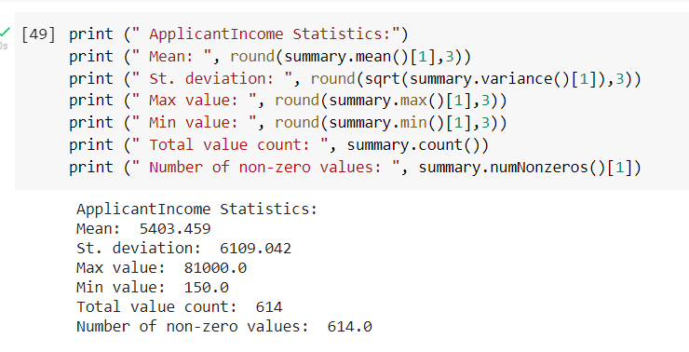
Summary
Applicant Income Statistics:
The average applicant income is 5403.459 and the standard deviation is 6109.042

Slide 10
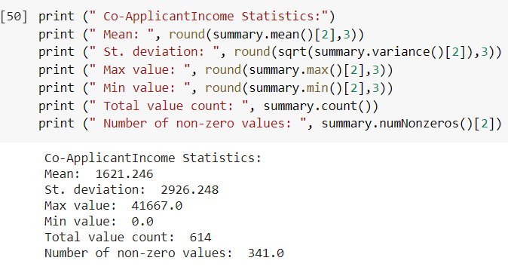
Summary
Co-Applicant Income Statistics:
The average co-applicant income is 1621.246 and the standard deviation is 2926.248.

Slide 11
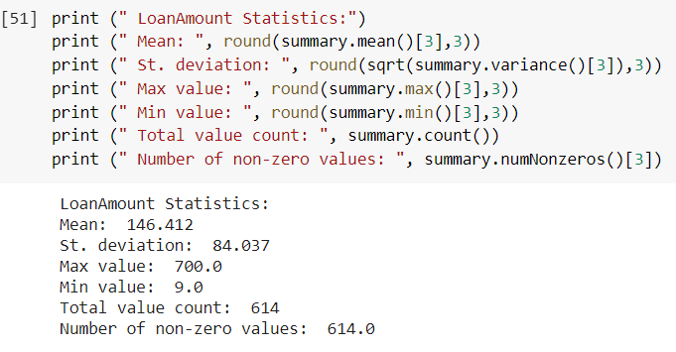
Summary
Loan Amount Statistics:
The average Loan Amount is 146.412 and the standard deviation is 84.037.

Slide 12
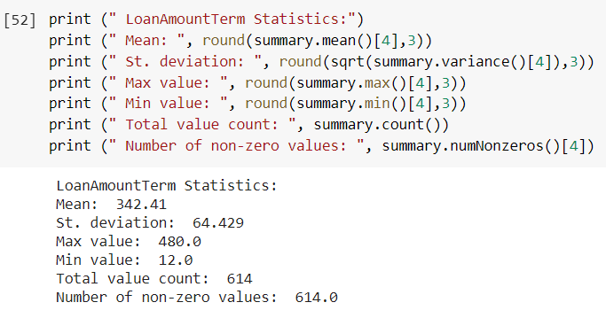
Summary
Loan Amount Term Statistics:
The average loan amount term is 342.41 and the standard deviation is 64.429.

Slide 13
Splitting The Data
We split the data set into two parts as the training data and the test data.
Here we have split the data into 70:30 ratio, where 70% acts as the training data and 30% is the test data.
df_train, df_test = df.randomSplit([0.70,0.30])

Slide 14
Label Point Generation
Labeled Points:
A labeled point is a local vector associated with a label/response. In MLlib, labeled points are used in supervised learning algorithms and they are stored as doubles. For binary classification, a label should be either 0 (negative) or 1 (positive).
Preparing the training data:
In our case, we are interested in predicting whether borrower will get the loan or not. So there will be a binary loan_status 0.0 - No and 1.1 - Yes.
Preparing the testing data:
Similarly, we process our test data file.

Slide 15
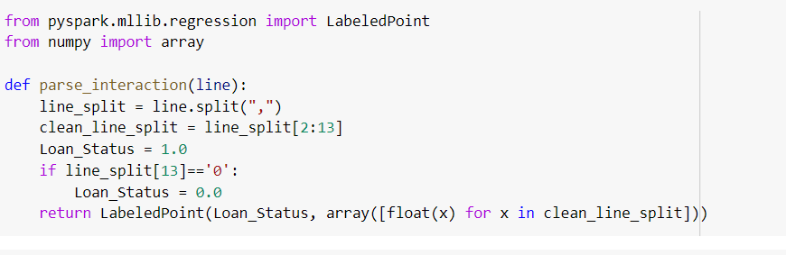
Label Point Parsing Working
In the data set we have column 0 and 1 as categorical, so with label point we removed them and we kept all other columns for their numerical nature.
We have assigning float value 0.0 as 1.0 as binary values accordingly in my target variable.

Slide 16
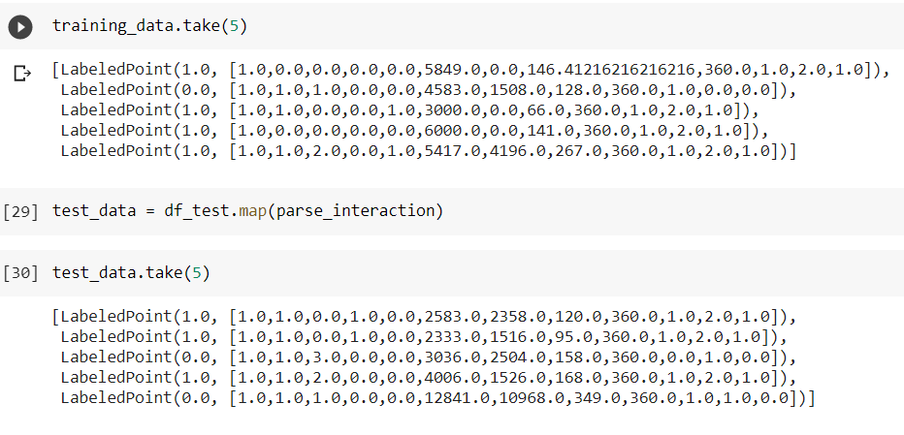
Label Points Created
The created label points for the training and the test data.

Slide 17
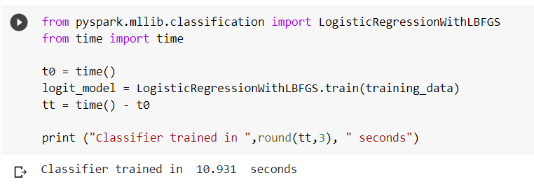
Machine Learning Modelling
Predicting if an applicant will get the loan or not using Logistic Regression:
Logistic regression is widely used to predict a binary response. Spark implements two algorithms to solve logistic regression: mini-batch gradient descent and L-BFGS. L-BFGS is recommended over mini-batch gradient descent for faster convergence.
Following the logistic regression training on training_data(Labelpoint data) and ready for prediction on test data.

Slide 18
Modelling
Logit:
Logit Function is log odds of probability of success and failure ratio which predicts the probability of class.
In order to measure the classification error on our test data, we use map on the test_data RDD and the model to predict each test point class.
labels_and_preds = test_data.map(lambda p: (p.label, logit_model.predict(p.features)))
In label_and_preds will contain a tuple of actual values and model predicted values predicted by logit function of logistic regression model.

Slide 19
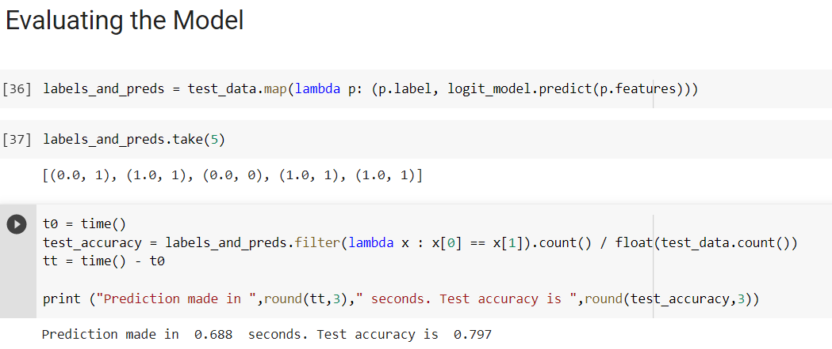
Model Evaluation
Classification results are returned in pars, with the actual test label and the predicted one. This is used to calculate the classification error by using filter and count as follows.

Slide 20
Conclusion
The main goal of the building the model is to predict the applicants getting the loan correctly.
The accuracy is 79.7% which entitles that the model is able to classify 79% of the applicants getting the loan precisely.

Slide 21
Thank You

