Slide 1


Python
GRADE 7 & 8
Lesson 09

Slide 2





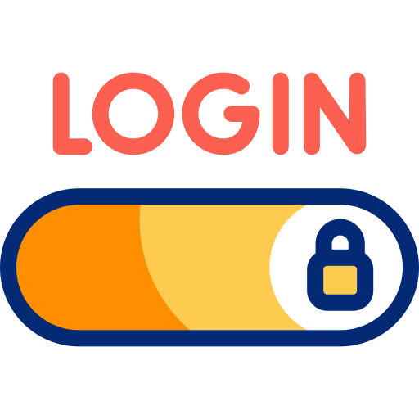
CLASS RULES
Stay Seen
Focus Zone
Keep your camera on, stay connected!
Keep backgrounds and actions distraction free.
Mic Manners
Laptop & Wi-Fi Ready
Mute unless it’s your turn to talk.
Strong connection, smooth learning.
Hands Up
Login & Go
Use the virtual hand to speak up.
Have all platforms and passwords handy.

Slide 3

ICE BREAKER
If our app could greet you in another language, which one would you choose and why?
What's the funniest or most unexpected way someone has ever greeted you?
Do you know how do you greet in some other foreign language?
Imagine you were designing a greeting app. What unique feature would you add to make it stand out?
Notes:
Teacher Reference:
Prompt the students for funny and weird answers.

Slide 4

Recap
Matplot library
Functions with parameters
Bar graph and Pie chart plots

Slide 5
Learning Outcomes
Perform installation of Python and Visual Studio Code.
Learn to navigate through the IDE
Understand GUI Basics using Tkinter
Understand how to handle button clicks and link user actions to specific functions in the app
Design a Basic GUI Layout
Learn to run the Tkinter app and troubleshoot basic errors.
Notes:
Teacher Reference:
Understand the Python Installation Process: Students will learn how to download and install Python from the official website, ensuring the Python interpreter is added to the system's PATH.
Install and Set Up Visual Studio Code: Students will understand how to download, install, and configure Visual Studio Code (VSC) for Python development, including installing necessary extensions like the Python extension.
Navigate the IDE: Students will become familiar with the basic features of VSC, such as the editor, terminal, extensions, and debugging tools.
Understand GUI Basics using Tkinter: Students will understand the structure of a GUI application, including the use of widgets like labels, entry fields, and buttons.
Event Handling: Students will understand how to handle button clicks and link user actions to specific functions in the app.
Design a Basic GUI Layout: Students will practice aligning and organizing widgets in the app using Tkinter's layout managers (pack, grid, or place).
Run and Debug a GUI Application: Students will learn to run their Tkinter app and troubleshoot basic errors.

Slide 6
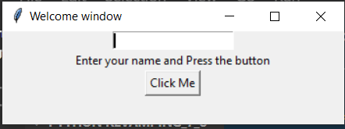
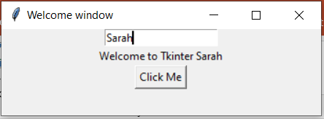
PROBLEM STATEMENT
"Personalized Greeting App for a Community Event“
You're helping organize a community event where attendees will receive a personalized greeting based on their name. To streamline this process, you decide to create a simple Python app using Tkinter.
The app should have the following:
A label at the top that says, "Enter your name to get a personalized greeting!"
A text input field where the user can type their name.
A button labeled "Greet Me!" that, when clicked, displays a greeting like "Hello, [Name]! Welcome to the Community Event!" in a pop-up or below the button.
Notes:
Teacher Reference:
Refer and explain the output of the application that we will be creating in this class.

Slide 7
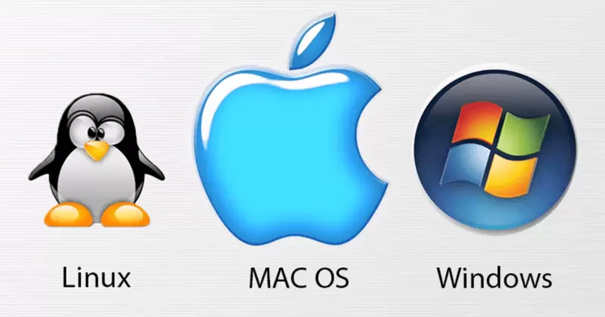
Download Python
Download installer
Go to the official Python website.
Download the latest version of Python. Ensure you choose the correct installer (32-bit or 64-bit) based on your system architecture.
Go to the official Python website.
Download the latest version of Python for macOS.
Open Terminal.
Run sudo apt update to update the package list.
Notes:
Teacher Reference:
Let's start by installing Python on our systems. I’ll provide a link based on your operating system. Simply open the link and download the appropriate version for your OS.
For Windows Users: Make sure to select the correct installer (32-bit or 64-bit) depending on your system architecture.
For macOS Users: Download the latest version of Python specifically for macOS.
For Linux Users (especially Ubuntu): Open a terminal by right-clicking on your desktop and selecting "Open Terminal" from the menu. In the terminal, run the command sudo apt update
NOTE: IF ALL THE STUDENTS IN THE BATCH HAVE SAME OS, PROCEED WITH EXPLANATION ONLY FOR THAT OS. THIS WILL HELP SAVE THE TIME.

Slide 8
Download Python
Run installer
Locate and run the downloaded installer file .
Check the box that says "Add Python to PATH". This is important for running Python from the command line.
Click "Install Now" to install Python with the default settings.
Locate the downloaded.pkg file and run it.
Follow the on-screen instructions to complete the installation.
Run sudo apt install python3 to install Python 3.
Run sudo apt install python3-pip to install pip for Python 3.
Notes:
Teacher Reference:
Once the installer is downloaded, locate the file and run it:
For Windows Users: When the installer starts, ensure you check the option to "Add Python to PATH" on the first screen. This step is crucial for running Python from the command line. After that, click "Install Now."
For macOS Users: Find the downloaded .pkg file, open it, and follow the on-screen instructions to complete the installation.
For Linux Users: Run the commands displayed on the screen to install Python 3.
Probing Questions:
Why is it important to check the "Add Python to PATH" option during installation?

Slide 9
Verify Installation
Open Command Prompt (type cmd in the start menu).
Type python --version and press Enter. You should see the Python version you installed.
Also, try pip --version to ensure pip (Python package manager) is installed.
Open Terminal (you can find it in Applications > Utilities).
Type python3 --version and press Enter.
You should see the Python version you installed.
Also, try pip3 --version to ensure pip is installed.
Type python3 --version and press Enter.
You should see the Python version installed.
Type pip3 --version to check the pip version.
Notes:
Teacher Reference:
To verify the installation:
For Windows Users: Open the command prompt and type python --version or python3 --version. The installed version of Python should be displayed. This step can be demonstrated practically by the teacher.
For macOS and Linux Users: Open the terminal and run the command python3 --version. Students can follow the process independently to confirm that Python is installed correctly.
Probing Questions:
How do you verify if Python is correctly installed on your system?
How can you check which Python version is installed?

Slide 10
Visual Studio Code installation
Click here to view the process of VSC download and installation on Windows
Click here to view the process of VSC download and installation on Mac Os
Click here to view the process of VSC download and installation on Linux
Notes:
Teacher Reference:
Now that we have successfully installed Python, we need to install visual studio code as an offline IDE.
[ Teachers are given the documentation for download and installation of Visual Studio code on three operating systems.
Please ask the students to follow the process]

Slide 11
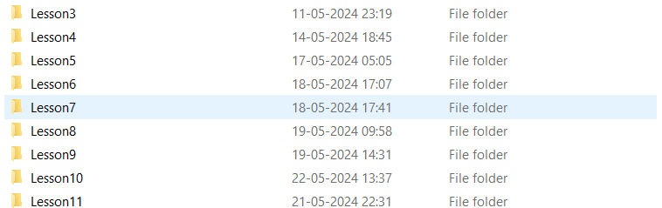
Organizing the folders
Create a Master Folder for Python Programming to maintain all the coding material.
Make a habit to open the folder in VSC and create .py file in the folder for the respective class.
Notes:
Teacher Reference:
Now you are ready to begin Python programming in an offline environment!
To keep things organized, it's essential to structure your Python material, including code and media files, especially for projects like games or applications. Here's how:
Create a master folder named Python Programming to store all your work.
Inside the master folder, create separate folders for each class.
Name each folder appropriately (as shown in the image).
Save all the Python files and related materials for a specific class in its corresponding folder.
This structure helps maintain order and ensures easy access to your work for each session.

Slide 12
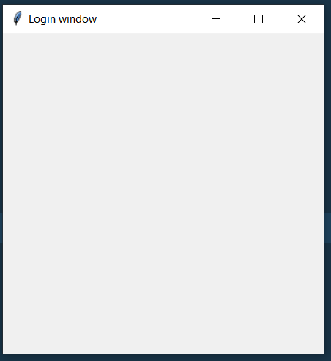
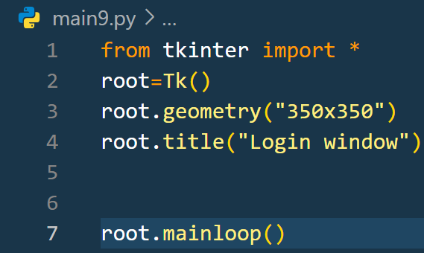
Main Activity
Notes:
Teacher Reference:
Learn to Create a tkinter window using above code.
root=tk() # creates an object of tkinter library package
root.geometry- specifies the dimensions of the window
root.title appears as the name of the window

Slide 13
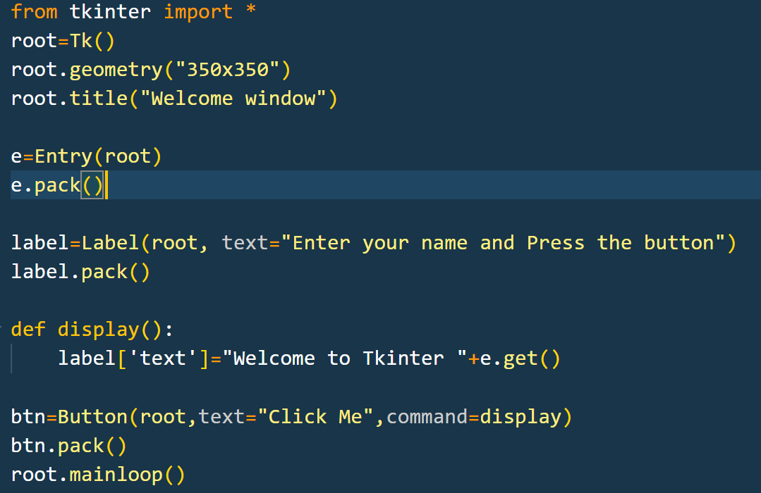
Additional Activity- 01
Notes:
Teacher Reference:
The program will use Tkinter to create a GUI with:
Entry Field: For the user to input their name.
Button: When clicked, the app displays a greeting message.
Label: To show the personalized greeting.
IMP: If not able to complete the execution of the activity, make sure you explain this while the python and VSC gets downloaded.
Probing Questions:
What is the purpose of mainloop() in a Tkinter application?
How would you explain the role of widgets like Label, Entry, and Button in a Tkinter application?
How can you arrange widgets in a Tkinter window

Slide 14
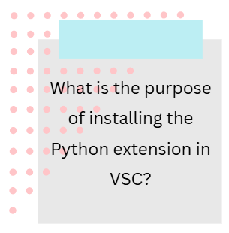
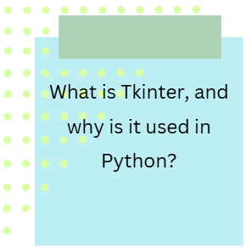
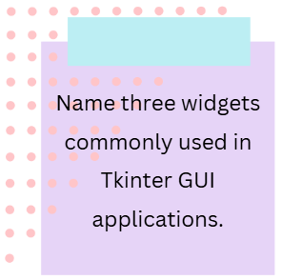
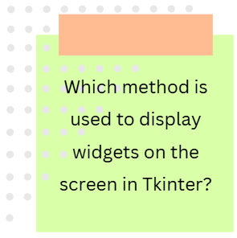
QUIZ
Notes:
Teacher Reference:
The Python extension in Visual Studio Code provides a seamless development experience for Python programming.
Tkinter is Python's standard GUI (Graphical User Interface) library, which allows developers to create interactive desktop applications.
Label, Entry field, Button
Pack()

Slide 15
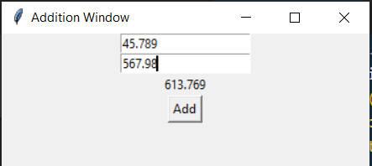
Homework Explanation
Create a Python GUI based program to add two numbers and display their result.
Notes:
Teacher Reference:
There must be 2 entry fields to enter 2 numbers to be added. You can create a label to display the result and a button which, when clicked must display the result.

Slide 16
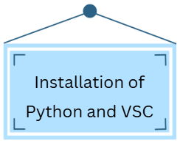
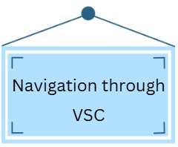
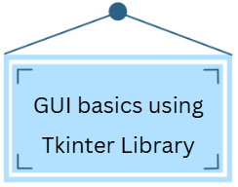
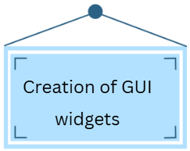
SUMMARY

Slide 17
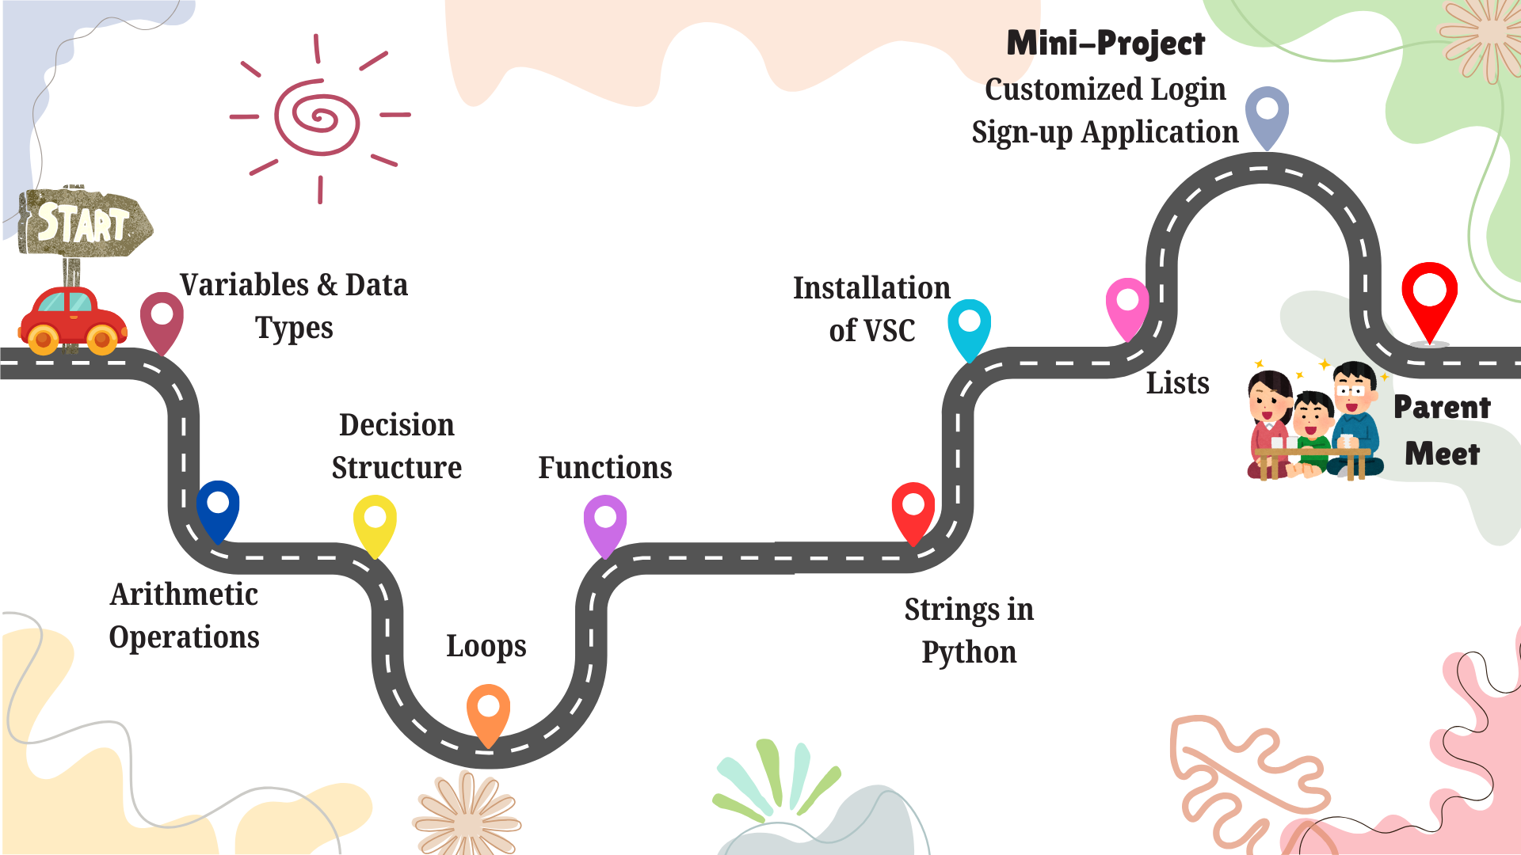

Slide 18





RATE & RELATE
ShowTime
Take a moment to rate today’s class after you leave. Your feedback is valuable!
Share your creativity with your family – they’ll love seeing what you've built!
HOMEWORK
Be Early
IMPORTANT!
“Consistency is key”:
10 minutes of coding daily can make you a pro!
Join a few minutes early for our next session to kick things off smoothly.

Slide 19
Thank You!

