Slide 1


Python
GRADE 7 & 8
Lesson 10

Slide 2






CLASS RULES
Stay Seen
Focus Zone
Keep your camera on, stay connected!
Keep backgrounds and actions distraction free.
Mic Manners
Laptop & Wi-Fi Ready
Mute unless it’s your turn to talk.
Strong connection, smooth learning.
Hands Up
Login & Go
Use the virtual hand to speak up.
Have all platforms and passwords handy.

Slide 3


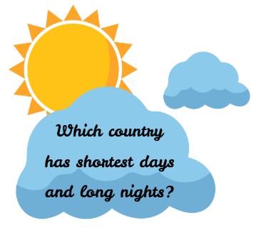
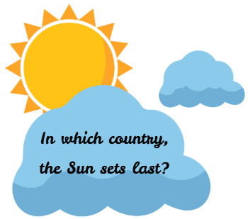
ICE BREAKER
Notes:
Teacher Reference:
Answers:
Japan
The country with the longest days is Norway, particularly in its northern regions above the Arctic Circle.
The country with the shortest days (in terms of daylight hours) is typically located near the South Pole—Antarctica.
The country where the Sun sets last is typically American Samoa, located in the Pacific Ocean.

Slide 4

Recap
Installation of Python and Visual Studio Code
Introduction to Tkinter Library
A simple greeting application with Tkinter

Slide 5

Learning Outcome
Understand the concept of geographical coordinates (latitude and longitude).
Gain hands-on experience with the ephem library to calculate celestial events.
Learn to use Python libraries and functions to solve real-world problems.
Enhance research skills by finding geographical coordinates for their hometown.

Slide 6

PROBLEM STATEMENT
Alex, a curious explorer, wants to calculate sunrise and sunset times for cities around the world. Your challenge is to build a Python program that:
Calculates the next sunrise and sunset times for five cities (London, Tokyo, Sydney, New York, and New Delhi) using their geographical coordinates.
Adds your hometown to the list and finds its sunrise and sunset times.
Displays all results in a clean, tabular format.
Notes:
Teacher Reference:
Story: One fine morning, when the warmth of Sunrays touched Alex, he woke up. Alex is a curious boy. He wondered when would people in other parts of the world wake up.
So, he decided to find out the sunrise timings for 5 different cities in different parts of the world.
To build a Python program that:
a.) Calculates the next sunrise and sunset times for these five cities using their geographical coordinates.
b.) Displays the results in a clean, tabular format.
#Additional: Research and add your hometown to the list of cities in the program. Test it to find the next sunrise and sunset times for where you live!

Slide 7
List
Lists are used to store multiple items in a single variable.
Ex:
Fruits = [“kiwi”, “apple”, ”mango”]
Persons= [“Harry”,40, True , 34.89]
Places= [ “London” ,”New York", "Paris”, “Rome”]
Dataset= [ {“name": "Banana”, “nutrient:”potassium”},
{“name”: “Avocado”, “nutrient”: ”Fats”},
{“name”: “Berries”, “nutrient” : “Vitamin C”} ]
Indexed
Ordered
Mutable
Notes:
Teacher Reference:
Lists are used to store multiple items in a single variable .
For example, this fruit basket contains different types of fruits, apple, orange, banana, etc.
List items are indexed, list items can be accessed through their locations as we have seen in the string.
Lists are ordered that means they have specific locations.
And list items can be added and removed that means lists are mutable unlike strings.
Major difference between a list and string that a string is immutable where as a list is mutable.
Note:
{“name": "Banana”, “nutrient:”potassium”} : This part is known as dictionary. They have key: value pairs. We will be learning about them in next class project.

Slide 8
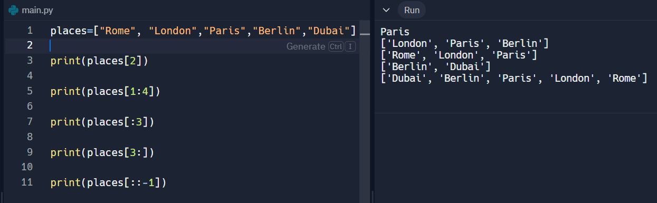
List slicing
List items can be accessed using its index
Notes:
Teacher Reference:
In the above example,
List [ start: end ] ➔ actual values are start and end-1, but you need to specify till end
Start missing ➔ from the first element of the list
End missing ➔ till the last element of the list
List [ : : -1] ➔ reverse a list

Slide 9

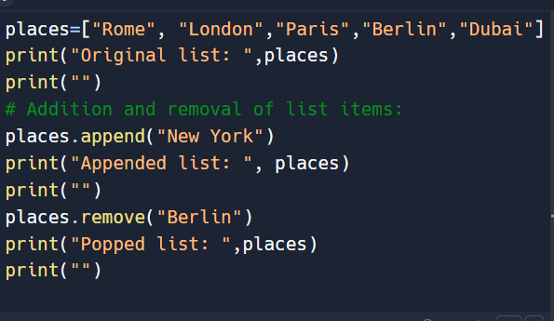

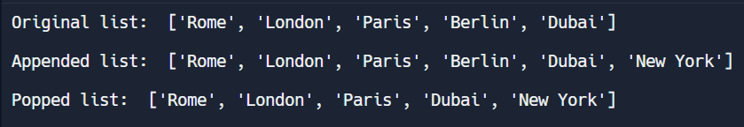
List
Adds items to the list
Removes items from the list
Notes:
Teacher Reference:
.append() method – add the element at the last place in the list.
.remove() method- removes the specified element from the list.

Slide 10
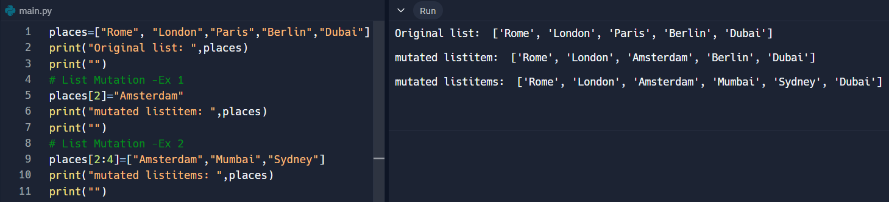
List Mutation
Items in a list can be changed.
Notes:
Teacher Reference:
To change a particular item in the list can be done using the index location of the list.
List slicing can also be done in the same way as it is done for strings.
Mutation – changing an element or some of the elements in a list as shown above.

Slide 11
Inbuilt Functions
Method | Description
Clear() | Removes all the elements from the list
Copy() | Returns a copy of the list
Count() | Returns the number of elements with the specified value
Index() | Returns the index of the first element with the specified value
Insert() | Adds an element at the specified position
Pop() | Removes the element at the specified position
Reverse() | Reverses the order of the list
Sort() | Sorts the list
Notes:
Teacher Reference:
Explain the inbuilt functions. The best part of this inbuilt functions are that there is no necessity of adding any other library for these operations.
Probing Questions:
What happens if you try to access an index that does not exist in a list?
How can you merge two lists into one?
What are the advantages of using lists in Python?

Slide 12
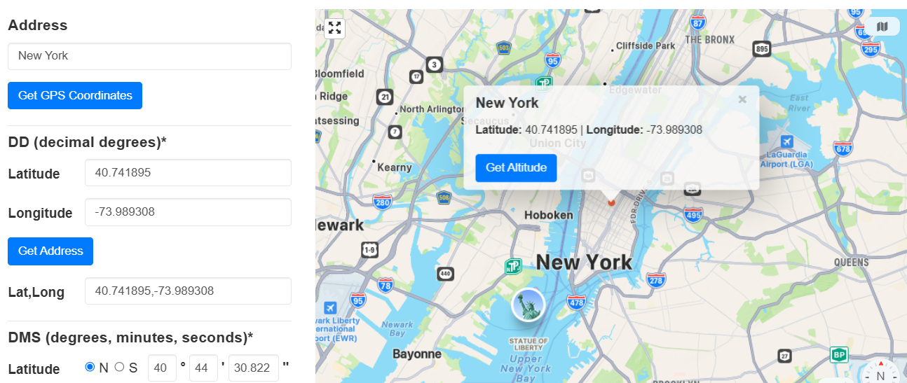
Latitude and Longitude
https://www.gps-coordinates.net/
Latitude and Longitude Finder
Notes:
Ask Students:
What is latitude and longitude?
How do you find it for your location?
Teacher Reference:
Click on the given link to find the location co-ordinates of your place.

Slide 13

PyEphem Library
The ephem library in Python is used to calculate the positions of astronomical objects like the Sun, Moon, planets, and stars.
It is commonly used for tasks such as determining the rise and set times of celestial bodies, which are based on precise astronomical algorithms.
Key Features:
Calculates sunrise, sunset, and other celestial events accurately.
Requires observer details, such as latitude, longitude, elevation, and time.
Handles time zones and date calculations.
Notes:
Teacher Reference:
Observer Object: Represents the location on Earth from where observations are made. It requires geographical coordinates:
lat: Latitude of the location.
lon: Longitude of the location.
date: The current date and time.
Sunrise and Sunset Calculation: Use the next_rising and next_setting methods to calculate the next sunrise and sunset times for a given location.

Slide 14
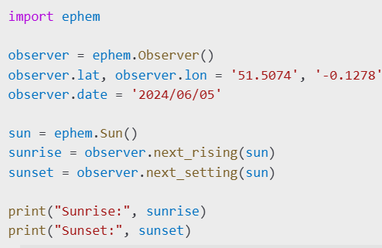
PyEphem Library - Example
Notes:
Teacher Reference:
Here, next_rising and next_setting return the times of the next sunrise and sunset as ephem.Date objects.

Slide 15
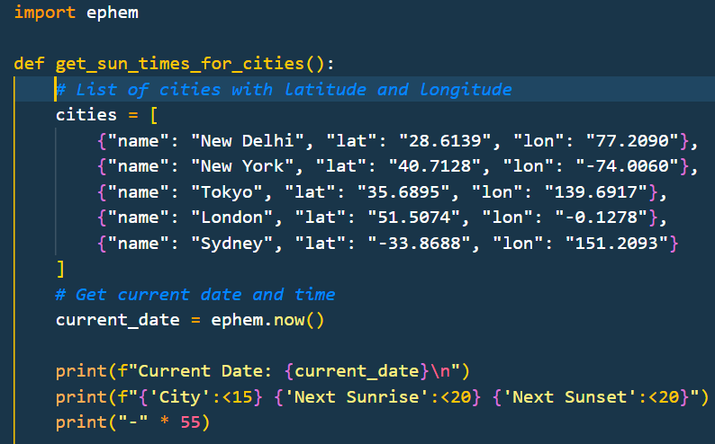
Main Activity
Notes:
Teacher Reference:
Define the function to get the times of sunrise and sunset
Create a list of cities, their latitudes and longitudes respectively.
ephem.now() – gets the current date

Slide 16
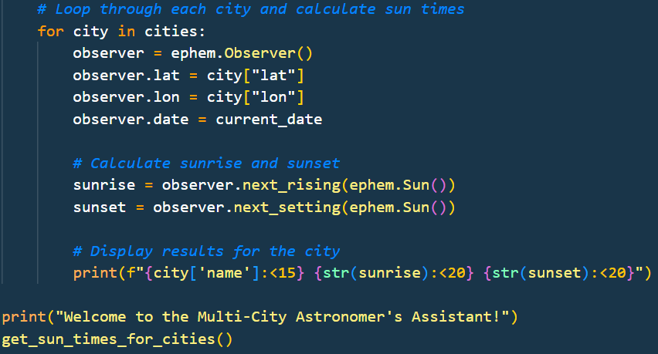
Main Activity
Notes:
Teacher Reference:
Here, next_rising and next_setting return the times of the next sunrise and sunset as ephem.Date objects.
Decoding the print format statement:
print(f"{city['name']:<15} {str(sunrise):<20} {str(sunset):<20}")
city['name']: Displays the name of the city (assumed to be part of a dictionary).
:<15: Ensures the city name occupies 15 characters with left alignment (padding with spaces if needed).
str(sunrise) and str(sunset): Converts the calculated sunrise and sunset times into strings for display.
:<20: Ensures each time occupies 20 characters with left alignment.

Slide 17

Additional Activity- 01
Research Based Activity:
Add your Hometown to the list.
Research for the co-ordinates of your town.
Find the next sunrise and sunset timings for your town.
Notes:
Probing Questions:
What are some real-world applications of the ephem library?
How would you calculate the sunrise and sunset times for a specific location using ephem?
How does the ephem library handle time zones or coordinate systems?
What are some alternative libraries to ephem for astronomical computations?

Slide 18


QUIZ
What is the purpose of the ephem library in Python?
a) To perform mathematical calculations
b) To calculate astronomical events like sunrise and sunset
c) To process geographical maps
d) To display tables in Python
What details are required to create an ephem.Observer object?
Latitude and longitude
Time zone
Observer's name
Latitude, longitude, and date
Which method of the ephem.Observer object is used to calculate the next sunrise?
observer.sunrise()
observer.next_rising()
observer.rising_time()
observer.sunrise_next()
What does the negative index -1 represent in a Python list?
The first element of the list
b) The last element of the list
An undefined position in the list
A syntax error
Notes:
Answer:
B
D
B
B

Slide 19
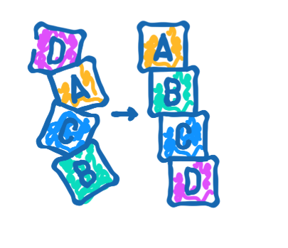
Homework Explanation
Chasing the Sun
Imagine you are building a tool for travelers who love to chase sunrises and sunsets across different cities.
Your task is to create a program that calculates the next sunrise and sunset times for a list of cities based on their geographic locations.
To make it easier for travelers to plan their journeys, add the ability to sort the cities based on either their next sunrise or next sunset times.
Notes:
Teacher Reference:
Objective:
Allow users to view the cities sorted by the earliest sunrise or sunset, helping them decide where to experience these magical moments first.
Example: If the cities are New York, London, and Tokyo, the program should display them in ascending order of sunrise or sunset times when chosen.

Slide 20


SUMMARY
List and List operations
List and List operations
Properties of List
PyEphem Library

Slide 21
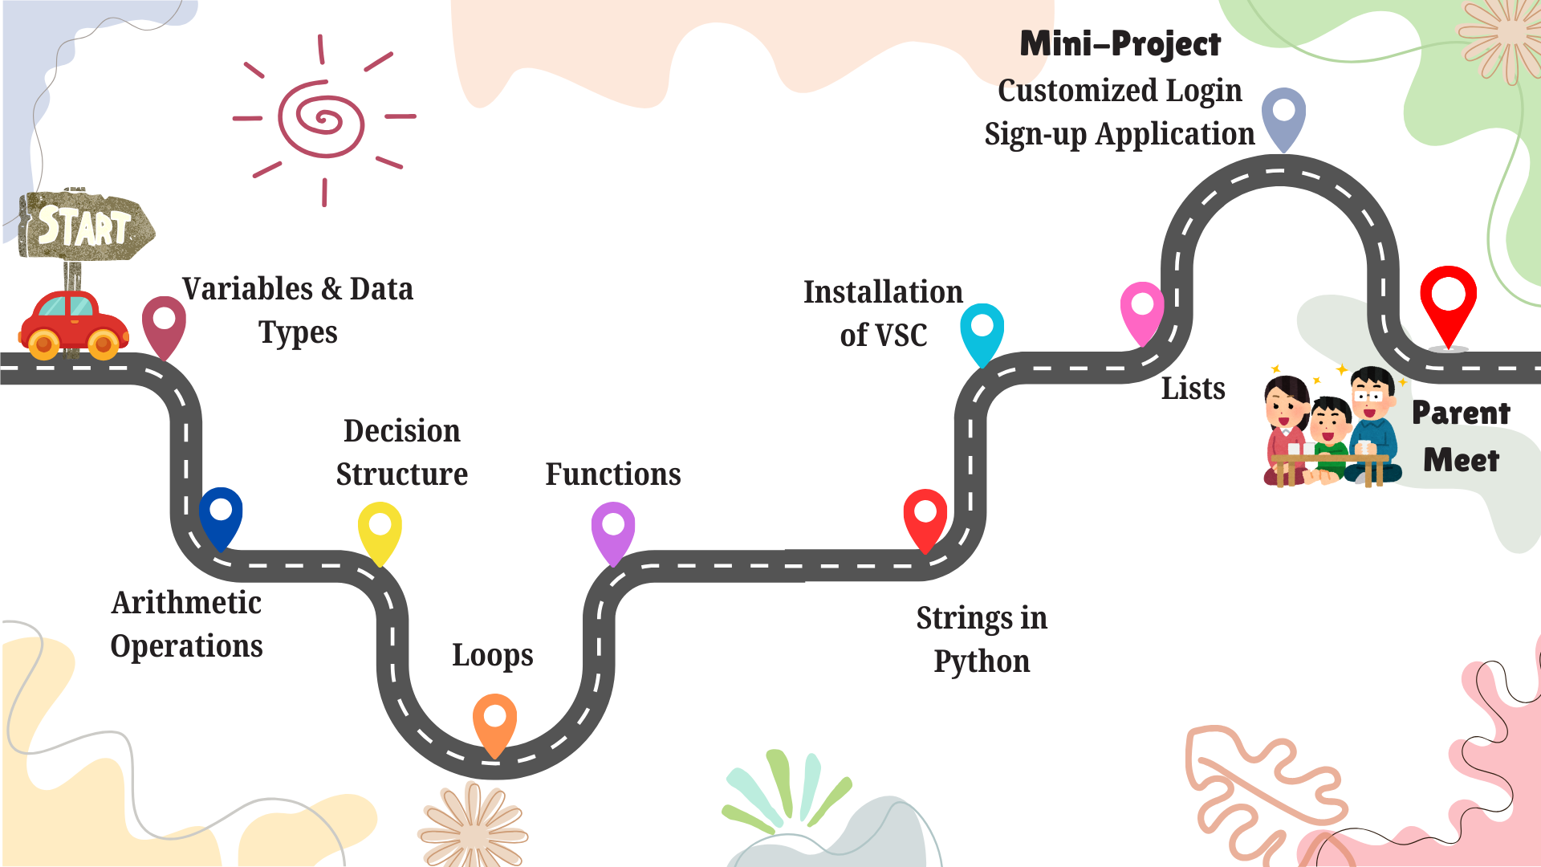

Slide 22





RATE & RELATE
ShowTime
Take a moment to rate today’s class after you leave. Your feedback is valuable!
Share your creativity with your family – they’ll love seeing what you've built!
HOMEWORK
Be Early
IMPORTANT!
“Consistency is key”:
10 minutes of coding daily can make you a pro!
Join a few minutes early for our next session to kick things off smoothly.

Slide 23
Thank You!

