Slide 1

WEB Development
Grade 7&8

Slide 2
Recap of the last class
Notes:
Objective: Review key concepts from the last class.
Teacher's Instructions:
Start the Class:
Good morning/afternoon, everyone! Let's start by recapping what we learned in our last class.
Review Key Points:
We explored the <div> tag, which helps structure content, and the <img> tag for embedding images.
We also applied basic styling techniques using inline CSS to change the color of a heading.
Engage Students:
Can anyone give me an example of where we used the <div> or <img> tag? How about an example of changing a heading's color using inline CSS?

Slide 3

I'm a tag that loves to group, that much is clear,
In Class 2, my role did you hear.
Though my style is plain, I'm a web page's heart,
Guess my name, and we'll have a good start.
What am I?
Notes:
Answer: The answer is the <div> tag!
Objective: Introduce CSS with an engaging activity.
Teacher's Instructions:
Introduce the Riddle: Alright, let's have some fun with a riddle to get started.
Read the Riddle: I'm a tag that loves to group, that much is clear, In Class 2, my role did you hear. Though my style is plain, I'm a web page's heart, Guess my name, and we'll have a good start.
Encourage Participation:
Who can guess the tag I'm describing? That's right, it's the <div> tag!"

Slide 4

Introduction to CSS Colors and Backgrounds

Slide 5

Sarah Want's to Fill Some Color
Sarah got really good at making basic websites, but they were boring with no colors.
She really wanted to make her website more fun and show everyone the cool stuff she's been up to.
So, all you smart coders out there, let's help Sarah make something way cooler this time!
But how can Sarah make her website colorful and exciting?
Notes:
The answer is simple:- Sarah can make her website colorful and exciting by using CSS to add different colors, fonts, and backgrounds to her web pages.
Objective: Set the stage for learning CSS by presenting a problem to solve.
Teacher's Instructions:
Introduce Sarah's Problem:
Meet Sarah. She's great at making basic websites, but they look a bit boring without colors.
Pose the Question:
How can we help Sarah make her website colorful and exciting? Let's think about some ways we can add style.
Transition to Learning CSS:
Today, we're going to dive into CSS to learn how to make websites vibrant and engaging.

Slide 6

Exploring CSS Wonderland
What is CSS?
CSS stands for Cascading Style Sheets.
It’s used to style and layout web pages.
Example: Think of CSS as analogous to clothing and accessories. Just as clothing adds style, color, and personality to a person's appearance, CSS adds style, layout, and visual appeal to web pages.
Notes:
Objective: Introduce the concept and purpose of CSS.
Teacher's Instructions:
Explain CSS:
CSS stands for Cascading Style Sheets. It's what we use to style and layout web pages.
Make an Analogy:
Think of CSS as clothing and accessories. Just like clothes add style and personality to a person, CSS adds style and visual appeal to a web page.
Engage with Examples:
For example, if we want to make text blue, we use CSS to do that. Let’s see how.

Slide 7
Exploring CSS Wonderland
CSS Colors
Applying color to the text.
Example: color: blue;
Different ways to define colors:
names (red),
hex codes (#FF0000),
RGB (rgb(255,0,0)).
Notes:
Objective: Teach how to apply colors using CSS.
Teacher's Instructions:
Introduce CSS Colors:
Let's start with applying color to text. The property we use is color.
Show Examples:
For instance, to make text blue, we write color: blue;.
Explain Color Formats:
We can define colors in different ways: using:-
names like red,
hex codes like #FF0000,
RGB values like rgb(255,0,0).

Slide 8
Exploring CSS Wonderland
CSS Background Colors
Adding background colors.
Example: background-color: yellow;
Same color formats can be used for CSS Background also (names, hex, RGB).
Notes:
Objective: Teach how to apply background colors using CSS.
Teacher's Instructions:
Introduce Background Colors:
Next, let's look at how to add background colors using background-color.
Show Examples:
For example, to make a background yellow, we write background-color: yellow;.
Explain Color Formats:
The same color formats apply here as well: names, hex codes, and RGB values.

Slide 9
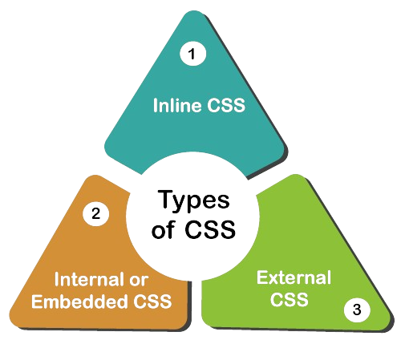
Different CSS modes
Inline CSS
Internal CSS
External CSS
Notes:
Objective: Introduce the three types of CSS.
Teacher's Instructions:
Overview of CSS Types:
There are three main ways to apply CSS: Inline CSS, Internal CSS, and External CSS.
Briefly Define Each:
"Inline CSS is written directly in the HTML tags."
"Internal CSS is written in the <style> tag within the HTML document."
"External CSS is written in a separate CSS file and linked to the HTML document."

Slide 10
Inline CSS
Definition: Inline CSS is applied directly to HTML elements using the style attribute.
Explanation: Inline CSS overrides any external or internal CSS. It's useful for making quick style changes to individual elements.
Notes:
Objective: Explain and demonstrate inline CSS.
Teacher's Instructions:
Define Inline CSS:
Inline CSS is applied directly to HTML elements using the style attribute.
Explain Its Use:
It’s useful for making quick style changes to individual elements.
Show an Example:
Here’s an example: <p style="color: blue;">This is a blue paragraph.</p>.

Slide 11
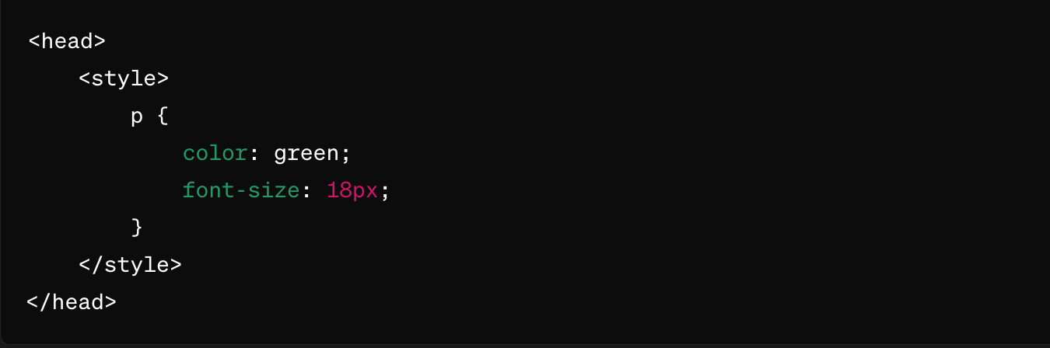
Internal CSS
Definition: Internal CSS is placed within the <style> element in the HTML document's <head> section.
Explanation: Internal CSS applies styles to the entire HTML document. It's useful for styling multiple elements within the same document.
Notes:
Objective: Explain and demonstrate internal CSS.
Teacher's Instructions:
Define Internal CSS:
Internal CSS is placed within the <style> element in the HTML document’s <head> section.
Explain Its Use:
It’s useful for styling multiple elements within the same document.
Show an Example:
Here’s an example of internal CSS: <style> p { color: red; } </style>."

Slide 12

External CSS
Definition: External CSS is defined in a separate CSS file and linked to the HTML document using the <link> element.
Explanation: External CSS allows for the separation of style from content, making it easier to maintain and update styles across multiple HTML pages.
Notes:
Objective: Explain and demonstrate external CSS.
Teacher's Instructions:
Define External CSS:
External CSS is defined in a separate CSS file and linked to the HTML document using the <link> element.
Explain Its Use:
This method allows for the separation of style from content, making it easier to maintain and update styles across multiple HTML pages.
Show an Example:
Here’s how you link an external CSS file: <link rel="stylesheet" type="text/css" href="style.css">.

Slide 13
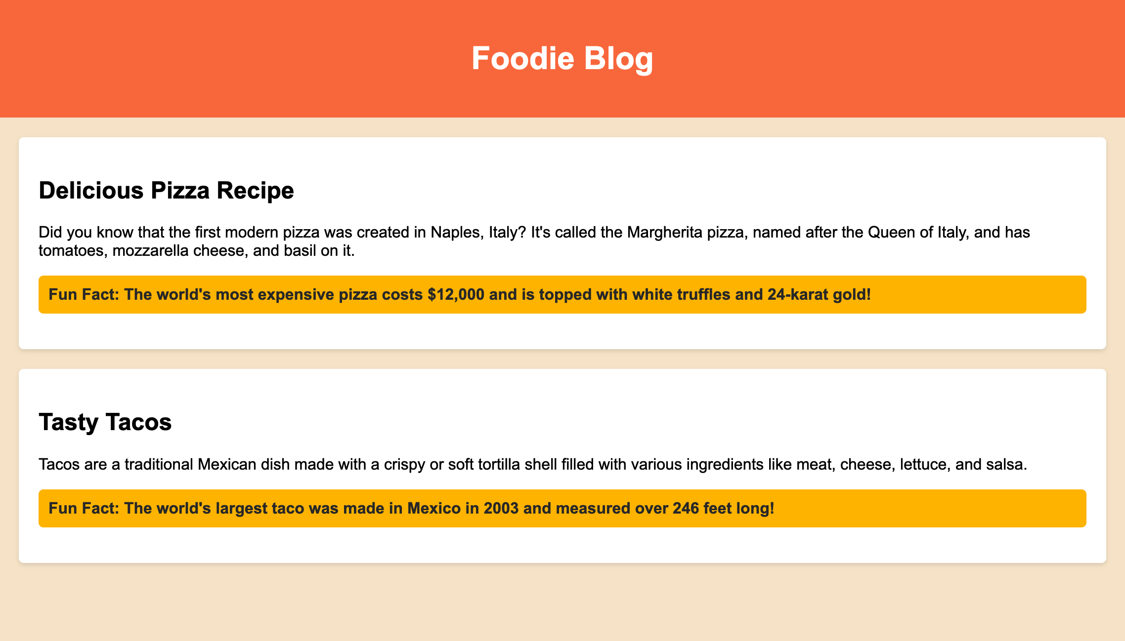
Creating the Project
Notes:
Project link: https://replit.com/@curriculumsmana/Project-Class-3-G-5and6#index.html
Objective: Show a preview of the final project.
Teacher's Instructions:
Preview the Project:
Here’s a screenshot of the final project we’ll be creating today.
Provide the Project Link:
You can follow along with the link provided to see the project in action.

Slide 14
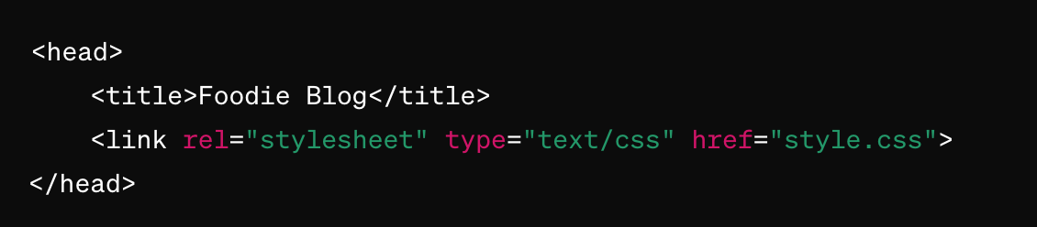
Explanation of the HTML code
Head Section:
<link rel="stylesheet" type="text/css" href="style.css"> : Links an external CSS file (style.css) for styling the webpage.
Notes:
Objective: Explain the head section of the HTML code.
Teacher's Instructions:
Introduce the Head Section:
Let's look at the head section of our HTML document.
Show and Explain the Code:
Here, we link our external CSS file with this line of code: <link rel="stylesheet" type="text/css" href="style.css">.
This tells the browser to use the styles defined in style.css to style our webpage.

Slide 15
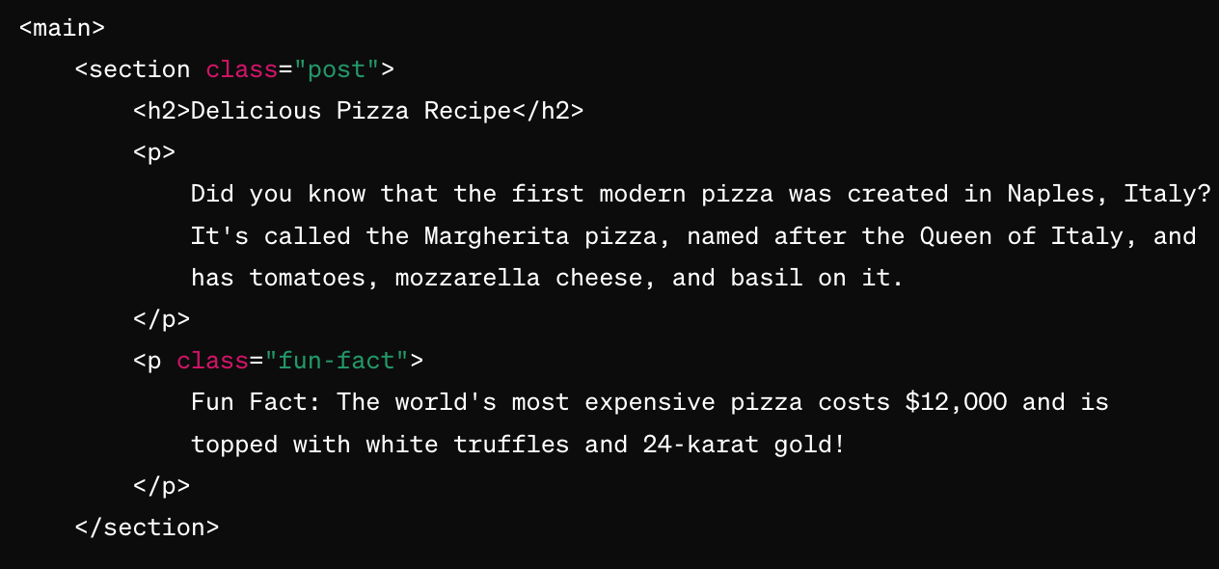
Explanation of the HTML code
Body Section:
Notes:
Objective: Explain the body section of the HTML code (Part 1).
Teacher's Instructions:
Introduce the Body Section:
Now, let's move on to the body section of our HTML document.
Show and Explain the Code:
In the body section, we have the main content wrapped in a <main> tag.
This represents the main content of the document.
Within the <main> tag, we use <section class="post"> to define a section.
Each section has a class of 'post' to apply specific styles.

Slide 16
Explanation of the HTML code
Body Section:
<main>: Represents the main content of the document.
<section class="post">: Defines a section within the document. Each section has a class of "post" to apply specific styles.
<h2>: Second-level heading for each post.
<p>: Paragraph elements containing text.
<p class="fun-fact">: Paragraph elements with the class "fun-fact" to apply specific styles or to differentiate these paragraphs from others.
Notes:
Objective: Explain the body section of the HTML code (Part 2).
Teacher's Instructions:
Continue Explaining the Body Section:
Each section includes headings and paragraphs. For example, <h2> is used for second-level headings.
Highlight Specific Classes:
We also have paragraphs with a class 'fun-fact', like <p class="fun-fact">. This allows us to apply specific styles to these elements to make them stand out.

Slide 17
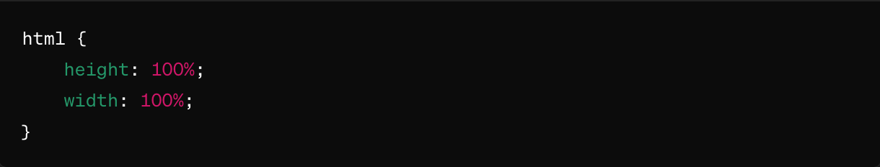
Explanation of the CSS Code
HTML Element Styles:
html { height: 100%; width: 100%; } : Sets the HTML element to take up the full height and width of the viewport.
Notes:
Objective: Explain the CSS styles applied to the HTML element.
Teacher's Instructions:
Introduce HTML Element Styles:
Let's see how we style the HTML element itself.
Show and Explain the Code:
We set the HTML element to take up the full height and width of the viewport with html { height: 100%; width: 100%; }.

Slide 18
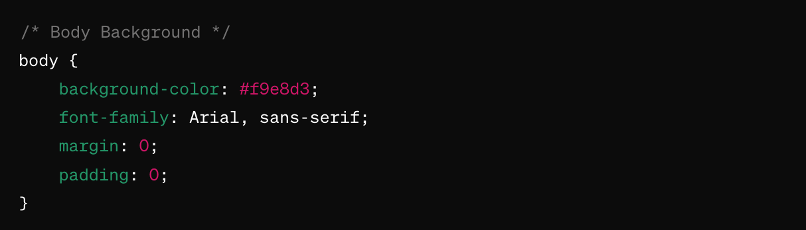
Explanation to CSS Code
Body Styles:
Notes:
Objective: Explain the CSS styles applied to the body element (Part 1).
Teacher's Instructions:
Introduce Body Styles:
Now, let's look at how we style the body of the document.
Show and Explain the Code:
We set a light beige background color for the entire webpage with background-color: #f9e8d3;.
We also set the default font to Arial with font-family: Arial, sans-serif;.

Slide 19
Explanation to CSS Code
Body Styles:
background-color: #f9e8d3; : Sets a light beige background color for the entire webpage.
font-family: Arial, sans-serif; : Sets the default font for the text to Arial, falling back to a generic sans-serif if Arial is unavailable.
margin: 0; padding: 0; : Removes any default margin and padding from the body to ensure there's no unwanted spacing around the edges of the page.
Notes:
Objective: Explain the CSS styles applied to the body element (Part 2).
Teacher's Instructions:
Continue Explaining Body Styles:
To ensure there's no unwanted spacing around the edges of the page, we remove any default margin and padding with margin: 0; padding: 0;.

Slide 20
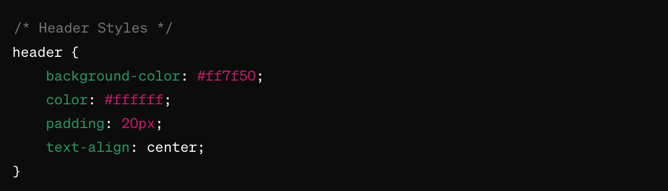
Explanation to CSS Code
Header Styles:
Notes:
Objective: Explain the CSS styles applied to the header (Part 1).
Teacher's Instructions:
Introduce Header Styles:
Next, let's see how we style the header of the document.
Show and Explain the Code:
We set the background color of the header to coral with background-color: #ff7f50; and the text color to white with color: #ffffff;.

Slide 21
Explanation to CSS Code
Header Styles:
background-color: #ff7f50; : Sets the header background to a coral color.
color: #ffffff; : Sets the text color within the header to white.
padding: 20px; : Adds padding inside the header to space out the content.
text-align: center; : Centers the text within the header.
Notes:
Objective: Explain the CSS styles applied to the header (Part 2).
Teacher's Instructions:
Continue Explaining Header Styles:
To space out the content inside the header, we add padding with padding: 20px; and center the text with text-align: center;.

Slide 22
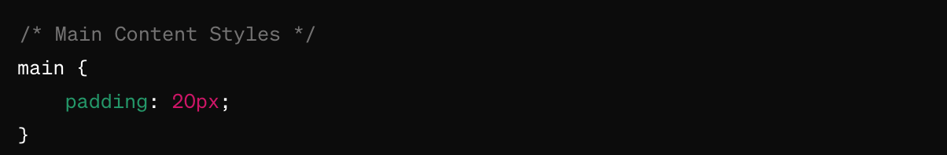
Explanation to CSS Code
Main Content Styles:
padding: 20px; : Adds padding around the main content to create space between the content and the edges of the main section.
Notes:
Objective: Explain the CSS styles applied to the main content.
Teacher's Instructions:
Introduce Main Content Styles:
Now, let's look at how we style the main content of the page.
Show and Explain the Code:
We add padding around the main content to create space between the content and the edges of the main section with padding: 20px;.

Slide 23
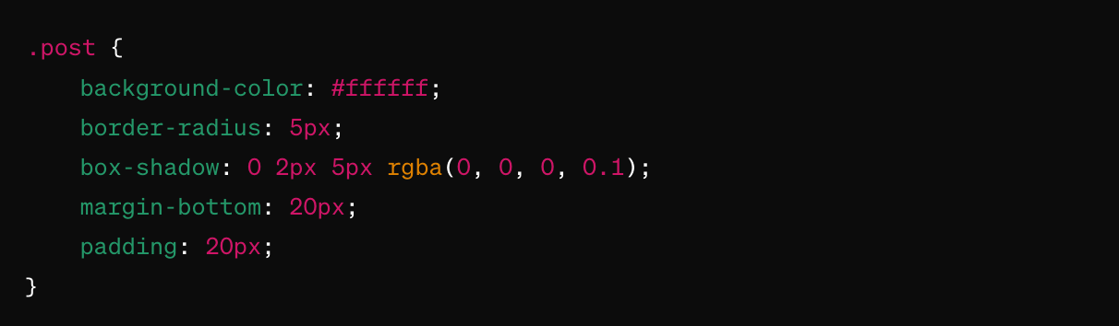
Explanation to CSS Code
Post Styles:
Notes:
Objective: Explain the CSS styles applied to posts (Part 1).
Teacher's Instructions:
Introduce Post Styles:
Next, let's see how we style each post on the page.
Show and Explain the Code:
We target elements with the class 'post' using .post { ... }.
We set the background color to white with background-color: #ffffff;.

Slide 24
Explanation to CSS Code
Post Styles:
.post { ... } : Targets elements with the class post.
background-color: #ffffff; : Sets the background color of each post to white.
border-radius: 5px; : Rounds the corners of each post by 5 pixels.
Notes:
Objective: Explain the CSS styles applied to posts (Part 2).
Teacher's Instructions:
Continue Explaining Post Styles: We round the corners with border-radius: 5px;.

Slide 25
Explanation to CSS Code
Post Styles:
box-shadow: 0 2px 5px rgba(0, 0, 0, 0.1); : Adds a subtle shadow below each post to create a slight 3D effect.
margin-bottom: 20px; : Adds space below each post to separate it from the next element.
padding: 20px; : Adds padding inside each post to space out the content from the edges.
Notes:
Objective: Explain the CSS styles applied to posts (Part 3).
Teacher's Instructions:
We add a subtle shadow below each post to create a slight 3D effect with box-shadow: 0 2px 5px rgba(0, 0, 0, 0.1);.
To separate each post, we add space below them with margin-bottom: 20px; and padding inside each post with padding: 20px;.

Slide 26
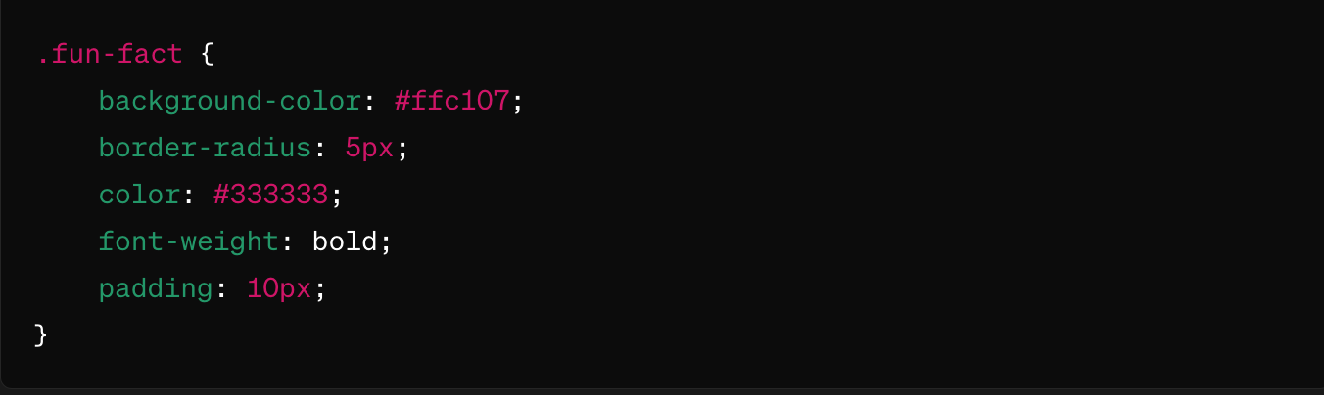
Explanation to CSS Code
Fun Fact Styles:
Notes:
Objective: Explain the CSS styles applied to fun facts (Part 1).
Teacher's Instructions:
Introduce Fun Fact Styles:
Finally, let's look at how we style the fun fact elements.
Show and Explain the Code:
We target elements with the class 'fun-fact' using .fun-fact { ... }.
We set the background color to yellow with background-color: #ffc107;.

Slide 27
Explanation to CSS Code
Fun Fact Styles:
.fun-fact { ... } : Targets elements with the class fun-fact.
background-color: #ffc107; : Sets the background color of fun fact elements to a yellow color.
border-radius: 5px; : Rounds the corners of fun fact elements by 5 pixels.
Notes:
Objective: Explain the CSS styles applied to fun facts (Part 3).
Teacher's Instructions:
Continue Explaining Fun Fact Styles:
We then round the corners with border-radius: 5px;."

Slide 28
Explanation to CSS Code
Fun Fact Styles:
color: #333333; : Sets the text color within fun fact elements to a dark gray.
font-weight: bold; : Makes the text within fun fact elements bold.
padding: 10px; : Adds padding inside fun fact elements to space out the content from the edges.
Notes:
Objective: Explain the CSS styles applied to fun facts (Part 3).
Teacher's Instructions:
Continue Explaining Fun Fact Styles:
We set the text color to dark gray with color: #333333; and make the text bold with font-weight: bold;."
Finally, we add padding inside the fun fact elements to space out the content from the edges with padding: 10px;."

Slide 29

It's your turn to Shape it
We have learned about CSS colors and backgrounds.
It's your turn to be the web designer!
Create something of your choice:
Open up your own web page and follow along with step by step.
Try changing the colors of your text and adding fun backgrounds.
Let's see your creativity shine!
Notes:
"Student's Activity"
Objective: Encourage students to apply what they've learned.
Teacher's Instructions:
Introduce the Activity:
Now it’s your turn to be the web designer! Open up your own web page and follow along step by step.
Give Instructions:
Try changing the colors of your text and adding fun backgrounds. Let’s see your creativity shine!

Slide 30

How to Save & Share the project.
Replit offers autosave option – so not worry about the same.
To share project with someone in view mode: just copy the link from the URL bar, and share the link
To share the project for collaboration
Click on "Invite" from the top right corner
If you know the username, type it in the box and click on invite
You can also turn on the toggle button "private join link" to create a public collaboration link and invite members to edit your code.
Notes:
Objective: Assess students’ Saving and sharing the project.
Instructions for the Teacher:
Explain how to save and share projects on Replit, including the options for collaboration.
Emphasize the importance of sharing projects for feedback and collaboration.
Class Activity:
Have students save their webpage projects on Replit.
Encourage them to share their projects with classmates for feedback and collaboration.

Slide 31

Hey there! It's Quiz Time
Question 1: Which CSS property changes the color of text?
A) color
B) font-size
C) background-color
D) margin
Notes:
Answer: A) color

Slide 32
Hey there! It's Quiz Time
Question 2: What does CSS stand for?
A) Computer Style Sheets
B) Creative Style Sheets
C) Cascading Style Sheets
D) Colorful Style Sheets
Notes:
Answer: C) Cascading Style Sheets

Slide 33
Hey there! It's Quiz Time
Question 3: What tool can you use to inspect and modify CSS styles on a webpage?
A) Photoshop
B) Notepad
C) Browser Developer Tools
D) Microsoft Word
Notes:
Answer: C) Browser Developer Tools

Slide 34
Hey there! It's Quiz Time
Question 4: How can you change the background color of an element using CSS?
A) background-image
B) background-color
C) color
D) text-color
Notes:
Answer: B) background-color

Slide 35
Let's Wrap it Up – What have we learnt?
In today's class, we learned how to style a Foodie Blog webpage using HTML and CSS. We applied background colors, added padding, and created rounded corners for elements like the header, main content, and individual posts. Additionally, we explored how to style specific elements differently, such as fun facts, to make them stand out.
Notes:
Instructions for the Teacher:
Summarize the key points covered in the presentation.
Reinforce the importance of practice and exploration in learning CSS.
Encourage students to continue learning and experimenting with CSS on their own.

Slide 36

Homework Discussion
Notes:
Instructions for the Teacher:
Facilitate a discussion about the homework assignment.

Slide 37

Unleash Your Creativity: Enhance Your Web Page with Images
Pick a Picture: Find an image online that inspires you.
Insert Image: Use the <img> tag in your HTML to add the image.
Adjust Size: Experiment with the image's width and height using CSS.
Add Border: Apply a border around the image to make it stand out.
Create Shadow: Give the image a subtle shadow effect using CSS.
Notes:
Instructions for the Teacher:
Motivate students to persist in learning and experimenting independently.

Slide 38

Protect Your Personal Information
Share personal details only with trusted individuals and on secure websites. Do not share your password or any other details.
Sophie met someone online who asked for her full name and address, promising to send her a gift.
Remembering her teacher's advice, she didn't share any personal details and instead told her parents about it.
The moral of the story: never tell strangers online your full name, address, or school name, and always keep your personal information private.

