Slide 1

WEB Development
Grade 7&8

Slide 2
Recap of the last Class
Notes:
Objective:
Refresh students' memory about adding background images using CSS.
Prepare students for learning about the anchor tag.
Teacher's Instruction:
Greet Students:
Welcome students to the online class and briefly mention the agenda.
Use a friendly tone to engage students right from the start.
Recap Previous Lesson:
Ask students to type in the chat or unmute to recall and explain the properties: background-image, background-size, background-repeat, and background-position.
Discuss how they used these properties in their last assignment.
Interactive Discussion:
Encourage students to share their experiences and challenges they faced with background images by typing in the chat or using the “raise hand” feature.
Transition:
Introduce the anchor tag by explaining its importance for web navigation.
Build excitement about learning a new HTML tag.

Slide 3

If You Know Me
I am an odd number; take away a letter and I become even. What number am I ?
Notes:
Answer : Seven. If you take away the letter 's', it becomes 'even'.

Slide 4

Guess The Number
What is the next number in the sequence: 1, 4, 9, 16, ____?
Notes:
Answer: "25". Each number in the sequence is obtained by squaring the consecutive natural numbers (1, 2, 3, 4, ...).

Slide 5
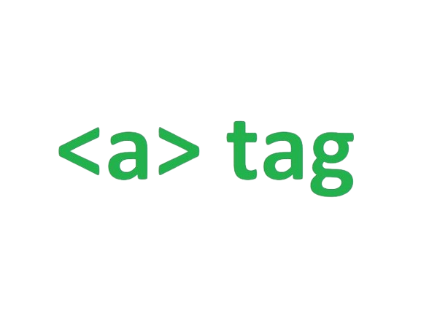
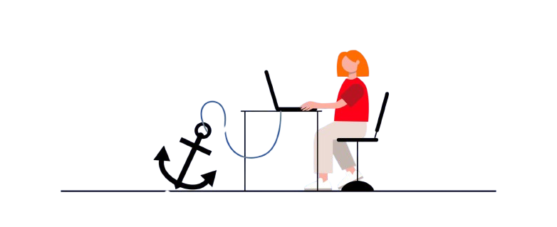
Introduction to Anchor Tag
Notes:
Objective:
Introduce the concept and importance of the anchor tag.
Teacher's Instruction:
Introduce the Topic:
Explain the purpose of the anchor tag in simple terms.
Mention its role in linking different parts of a website or different websites.
Overview:
Highlight that the next slides will cover practical examples and usage of the anchor tag.

Slide 6

Anchoring Sarah's Web Experience
Sarah's webpage was almost ready. It had colors, pictures, and cool backgrounds. But she wanted to make it easy for people to move around and read her stories. That's when she found out about the anchor tag – it's like a special button on a webpage. With it, Sarah can connect outside pages as well as inner web pages, which people can go through
Now, her webpage was even more fun and easy to use.
Do you want to know how Sarah uses the anchor tag? Let's find out!
Notes:
Objective:
Show a practical example of how the anchor tag can enhance a webpage.
Teacher's Instruction:
Storytelling:
Narrate Sarah's story to make the lesson relatable.
Engagement:
Ask students to type in the chat if they have faced similar challenges in their projects.
Encourage a brief discussion on how they think links could help improve their own web pages.

Slide 7
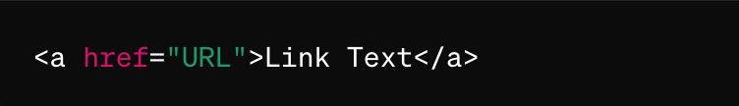
Introduction to Anchor Tag
In HTML the anchor tag is used to make links that you can click on to go to another webpage or a different part of the same page.
How it Looks:
<a> : This is the start of the anchor tag.
href="URL" : This tells the browser where to go when you click the link. "URL" is the address of the page.
Link Text: This is the part that you click on. It usually looks like blue, underlined text.
</a>: This is the end of the anchor tag.
Notes:
Objective:
Explain the syntax and components of the anchor tag.
Teacher's Instruction:
Syntax Breakdown:
Go through the provided syntax step-by-step.
Explain each part: <a>, href="URL", Link Text, </a>.
Live Demo:
Share your screen to open a code editor and demonstrate creating a simple anchor tag.
Show how the link text changes appearance and becomes clickable.
Interactive Exercise:
Ask students to type their own anchor tag in the chat or in a shared document.
Provide feedback and assistance as needed.

Slide 8
Types of Links:
Absolute Links: Full address (like sending a letter anywhere).
Relative Links: Shortcuts (like finding a class in your school).
1. Absolute Links:
Think of them as complete home addresses.
They take you anywhere on the internet.
Example: <a href="https://www.google.com">Google</a>
2. Relative Links:
Think of them as shortcuts or directions inside your school.
They take you to another place on the same website.
Example: <a href="page.html">Next Page</a>
Notes:
Objective:
Differentiate between absolute and relative links.
Teacher's Instruction:
Explanation:
Define absolute and relative links using the provided analogies.
Show examples of both types on shared screens.
Discussion:
Discuss scenarios where each type of link would be appropriate.
Ask students to provide examples of websites they use that might employ both types of links by typing in the chat or unmuting to speak.

Slide 9
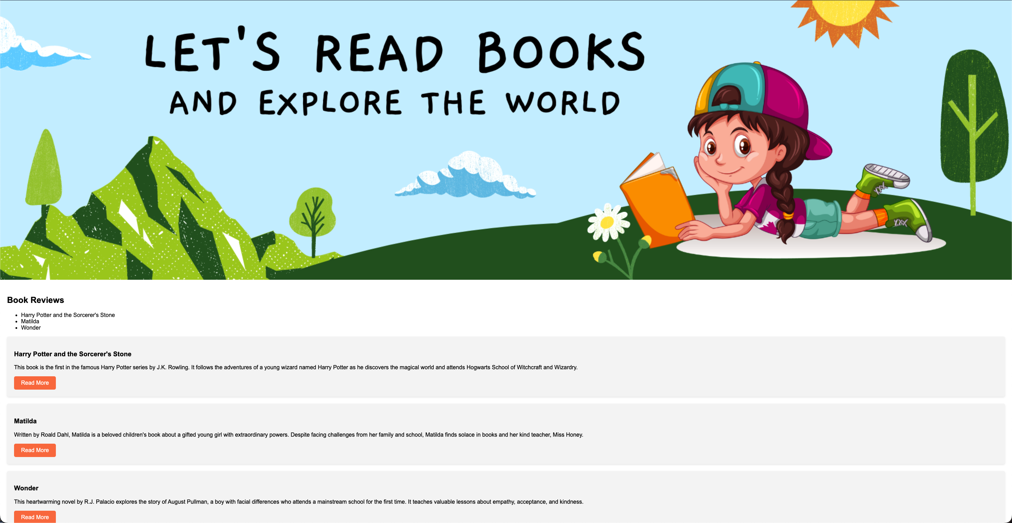
Project – Book Lover's Library
Notes:
Project Link:
https://replit.com/@curriculumsmana/Project-Class-5-Grade-5and6#index.html
Objective:
Introduce the final project and set the stage for hands-on learning.
Teacher's Instruction:
Project Overview:
Show the screenshot of the final project.
Explain that they will be working on creating a similar webpage.
Encouragement:
Highlight the skills they will practice, such as using anchor tags and applying CSS.
Motivate students by emphasizing how this project will enhance their web development skills.

Slide 10
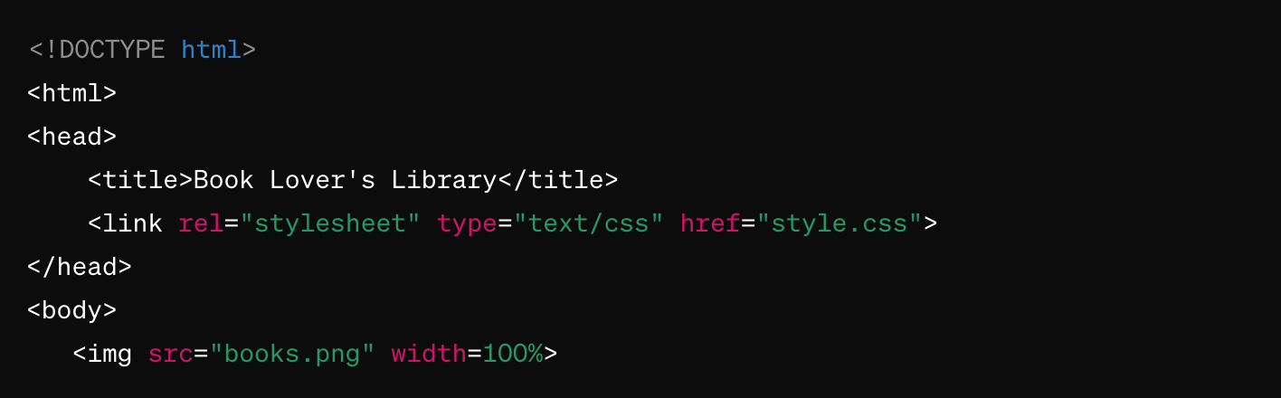
Working with the Project
HTML Code Explanation
Notes:
"Teacher's Activity"
Specific Instructions for Each Slide (7-21) These Slides contain the screenshot and the explanation of the code used in the Project.
Objective of the Class:
Provide step-by-step guidance on the project code.
Teacher's Instruction:
Detailed Walkthrough:
Explain each part of the HTML and CSS code provided in the screenshots.
Discuss the purpose and function of each tag and style rule.
Hands-On Coding:
Encourage students to follow along and code on their own devices.
Use screen sharing to demonstrate the coding process.
Allow time for students to ask questions and troubleshoot issues via chat or voice.
Interactive Learning:
Periodically pause to ask questions and check for understanding.
Use the whiteboard feature or annotations on shared screens to highlight key points and concepts.

Slide 11
Working with the Project
HTML Code Explanation
<!DOCTYPE html> : Declares the document type and version of HTML being used.
<html> : The root element of the HTML document.
<head> : Contains metadata about the document, such as the title and links to external resources like stylesheets.
<title> : Sets the title of the webpage displayed in the browser's title bar or tab.
<link rel="stylesheet" type="text/css" href="style.css"> : Links the HTML document to an external CSS stylesheet named "style.css".
<body> : Contains the visible content of the webpage.
<img src="books.png" width=100%> : Displays an image, stretching to fill the width of its container.
Notes:
Explain the basic structure of an HTML document.
Discuss the <!DOCTYPE html>, <html>, <head>, and <body> tags.
Show the provided screenshot and explain each part.
Explain the metadata tags like <title> and <link>.
Discuss the purpose of the CSS link in the <head> section.

Slide 12
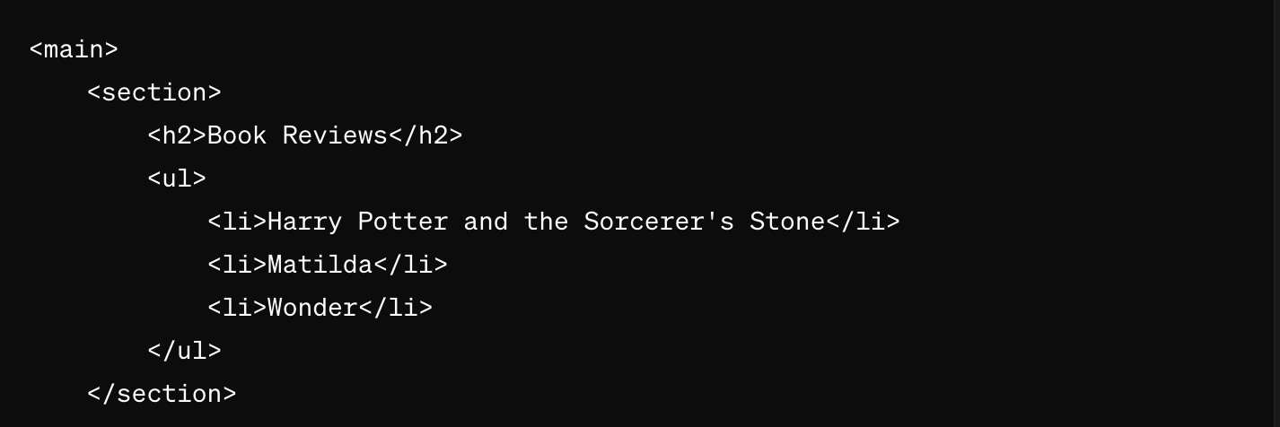
Working with the Project
HTML Code Explanation
Notes:
Explain the purpose of the <main> and <section> tags.
Discuss how these tags help organize content.

Slide 13
Working with the Project
HTML Code Explanation
<main> : Contains the main content of the webpage.
<section> : Divides the content into sections.
<h2> : Heading indicating a section for book reviews.
<ul> : Unordered list to hold the titles of the books.
<li> : List items containing the titles of three books.
Notes:
Discuss the use of headings (<h2>) and lists (<ul>, <li>) for structuring content.

Slide 14
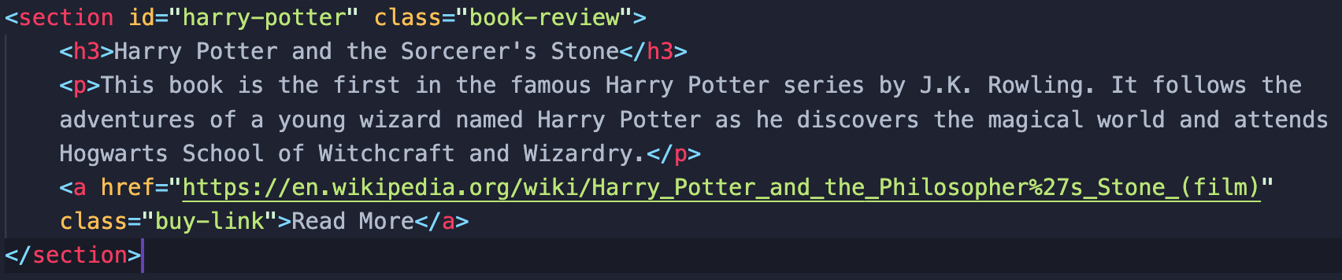
Working with the Project
HTML Code Explanation
Notes:
Explain the use of <section> with specific IDs and classes for styling and identification.

Slide 15
Working with the Project
HTML Code Explanation
<section> : This tag is used to group together a part of the webpage that talks about a specific topic. Here, it groups all the information about the book "Harry Potter and the Sorcerer's Stone."
id="harry-potter" : This is an identifier for the section. It helps the web designer find this specific part of the page easily.
class="book-review" : This is another identifier that helps the web designer style the section. It tells the website that this section is a book review.
Notes:
Explain the use of <section> with specific IDs and classes for styling and identification.

Slide 16
Working with the Project
HTML Code Explanation
<h3> : This tag is used for headings. The text inside <h3> is "Harry Potter and the Sorcerer's Stone," which is the title of the book. Headings help organize the content and make it easy to read.
<p> : This tag is for paragraphs. It contains the main text that describes the book. In this case, it tells us that it's the first book in the Harry Potter series and a bit about the story.
<a> : This tag is for links. The text inside the <a> tag, "Read More," is clickable. When you click on it, it takes you to another webpage for more information about the book.
Notes:
Discuss the use of the <h3>, <p>, and <a> tags within sections to create structured content and links.

Slide 17
Working with the Project
HTML Code Explanation
href="https://en.wikipedia.org/wiki/Harry_Potter_and_the_Philosopher%27s_Stone_(film)" : This is the URL or web address that the link goes to when you click on "Read More." It tells the browser where to go.
class="buy-link" : Like the class="book-review", this helps the web designer style the link. It tells the website that this link is related to buying or reading more about the book.
Notes:
Explain the attributes like href, class, and how they link to external pages and style elements.
"Same we did for other two sections in the Project."

Slide 18
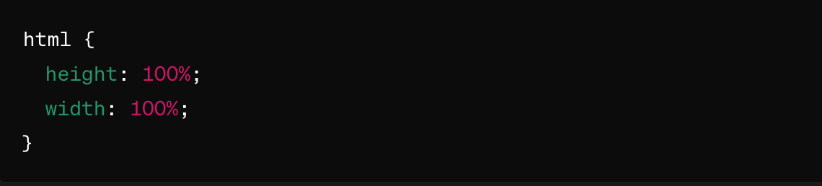
Working with the Project
CSS Code Explanation
This snippet sets the height and width of the entire HTML document to 100% of the browser window. It ensures that the HTML element takes up the full space available.
Notes:
Discuss the importance of CSS for styling HTML documents.
Explain the provided CSS rules step-by-step.
Explain how to set the height and width of the HTML document to 100% of the browser window.

Slide 19
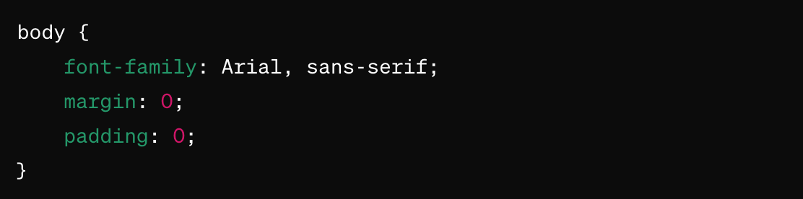
Working with the Project
CSS Code Explanation
font-family: Arial, sans-serif; : Sets the default font for the text to Arial. If Arial isn't available, it will use a generic sans-serif font.
margin: 0; : Removes the default margin around the body.
padding: 0; : Removes the default padding inside the body.
Notes:
Discuss the use of font-family, margin, and padding for styling text and layout.

Slide 20
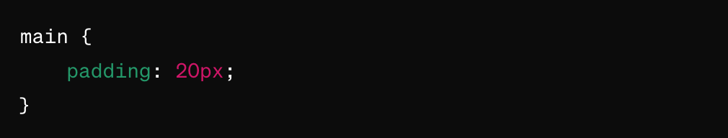
Working with the Project
CSS Code Explanation
This snippet adds padding to the <main> element:
padding: 20px; : Adds 20 pixels of space inside the main element on all sides. This helps keep the content from touching the edges.
Notes:
Explain the purpose of padding within the <main> element for better spacing.

Slide 21
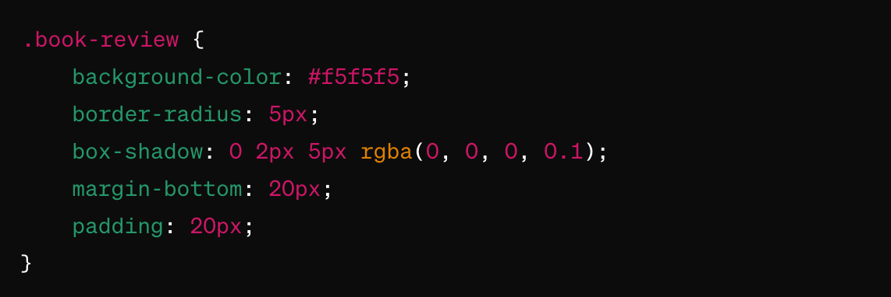
Working with the Project
CSS Code Explanation
Notes:
Discuss the background color, border-radius, box-shadow, margin-bottom, and padding for styling the book review section.

Slide 22
Working with the Project
CSS Code Explanation
background-color: #f5f5f5; : Sets a light gray background color.
border-radius: 5px; : Rounds the corners of the element by 5 pixels.
box-shadow: 0 2px 5px rgba(0, 0, 0, 0.1); : Adds a small shadow to make the box look like it's slightly raised off the page.
margin-bottom: 20px; : Adds 20 pixels of space below each book review to separate them from other content.
padding: 20px; : Adds 20 pixels of space inside the book review box, making the content inside not touch the edges.
Notes:
Discuss the background color, border-radius, box-shadow, margin-bottom, and padding for styling the book review section.

Slide 23
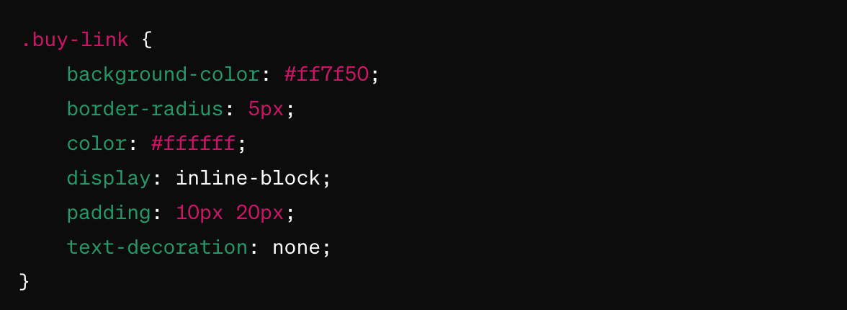
Working with the Project
CSS Code Explanation
Notes:
Discuss advanced styling techniques for links and other interactive elements.

Slide 24
Working with the Project
CSS Code Explanation
background-color: #ff7f50; : Sets the background color to a coral color.
border-radius: 5px; : Rounds the corners of the link by 5 pixels.
color: #ffffff; : Sets the text color to white.
display: inline-block; : Makes the link behave like a block element but stays inline with other elements. This allows padding and margin to be applied.
padding: 10px 20px; : Adds 10 pixels of space at the top and bottom and 20 pixels on the left and right inside the link.
text-decoration: none; : Removes the default underline from the link text.
Notes:
Summarize the CSS rules and their impact on the webpage's design and functionality.

Slide 25
Now it's your turn!
Add More Books to Your Library
Instructions:
Review the Project: Look at the "Book Lover Library" project we made together.
Choose New Books: Pick some new books.
Edit the HTML: Open the project's HTML file. Add the new books using the <a> tag. Put the book title inside the tag and link it to a website about the book.
Make Descriptions: Write a short description for each new book using <p> tags for paragraphs.
Test Your Links: Make sure all the links work by clicking on them. Check if the new books show up correctly.
Notes:
"Students' Activity"
Objective:
Apply knowledge by expanding the project.
Teacher's Instruction:
Activity Instructions:
Review the existing project and ensure everyone understands the structure.
Instruct students to choose new books, edit the HTML to add these books, and write descriptions using <p> tags.
Remind them to test their links to ensure they work correctly.
Monitor and Assist:
Encourage students to share their screens if they need help.

Slide 26

How to Save & Share the project.
Replit offers autosave option – so not worry about the same.
To share project with someone in view mode: just copy the link from the URL bar, and share the link
To share the project for collaboration
Click on "Invite" from the top right corner
If you know the username, type it in the box and click on invite
You can also turn on the toggle button "private join link" to create a public collaboration link and invite members to edit your code.
Notes:
Instructions for the Teacher:
Explain how to save and share projects on Replit, including the options for collaboration.
Emphasize the importance of sharing projects for feedback and collaboration.

Slide 27
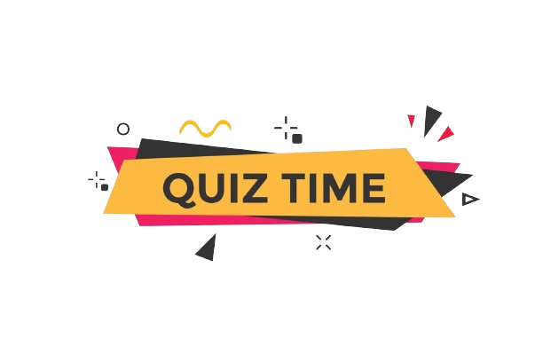

What is the purpose of anchor tags in HTML?
a) Styling text
b) Creating hyperlinks
c) Adding images
d) None of the above
Notes:
Answer: b) Creating hyperlinks

Slide 28
What is the attribute used to specify the destination URL in
anchor tags?
a) src
b) href
c) link
d) target
Notes:
Answer: b) href

Slide 29
In CSS, which property can be used to remove the underline
from a link?
a) text-decoration
b) link-decoration
c) underline-style
d) text-transform
Notes:
Answer: a) text-decoration

Slide 30
What happens if the "target" attribute in an anchor tag is
set to "_blank"?
a) The linked document opens in the same window/tab.
b) The linked document opens in a new window/tab.
c) The linked document opens in a popup window.
d) The linked document is downloaded to the user's device.
Notes:
Answer: b) The linked document opens in a new window/tab.

Slide 31

Let's Wrap it Up – What have we learnt?
Today, we learned how to use <a> Anchor tag in HTML to add Links.
We applied Various CSS styles to both the body and Anchor specific elements.
Notes:
Objective:
Summarize the day's learning outcomes.
Teacher's Instruction:
Review Key Points:
Summarize how to use the anchor tag and apply CSS styles.
Recap the steps taken in the project and the skills practiced.
Feedback Session:
Use a poll or the chat to ask students what they found most interesting or challenging.
Encourage them to share their thoughts and provide feedback on the lesson.

Slide 32


Homework Discussion
Notes:
Instructions for the Teacher: Facilitate a discussion about the homework assignment.

Slide 33

Brain Booster Bonus
Clickable links and clickable images help people move around on websites. Clickable links are usually words you click on to go to another page. Clickable images are pictures that do the same thing. Clickable images look nice and are fun to use, especially on sites with lots of pictures. Challenge: Analyze examples of websites using both clickable links and clickable images for navigation.
Modify HTML code to make an image clickable using the <a> tag instead of a text link.
Notes:
Objective of the Class:
Challenge advanced students with an additional activity.
Teacher's Instruction:
Introduction to the Bonus Activity:
Explain the task of creating both clickable links and clickable images.
Provide examples and discuss the benefits of each.
Instructions:
Guide students to modify their HTML code to include clickable images.
Ask them to analyze examples from other websites for inspiration.
Independent Work:
Allow students to work independently.
Offer support and additional resources as needed.

Slide 34
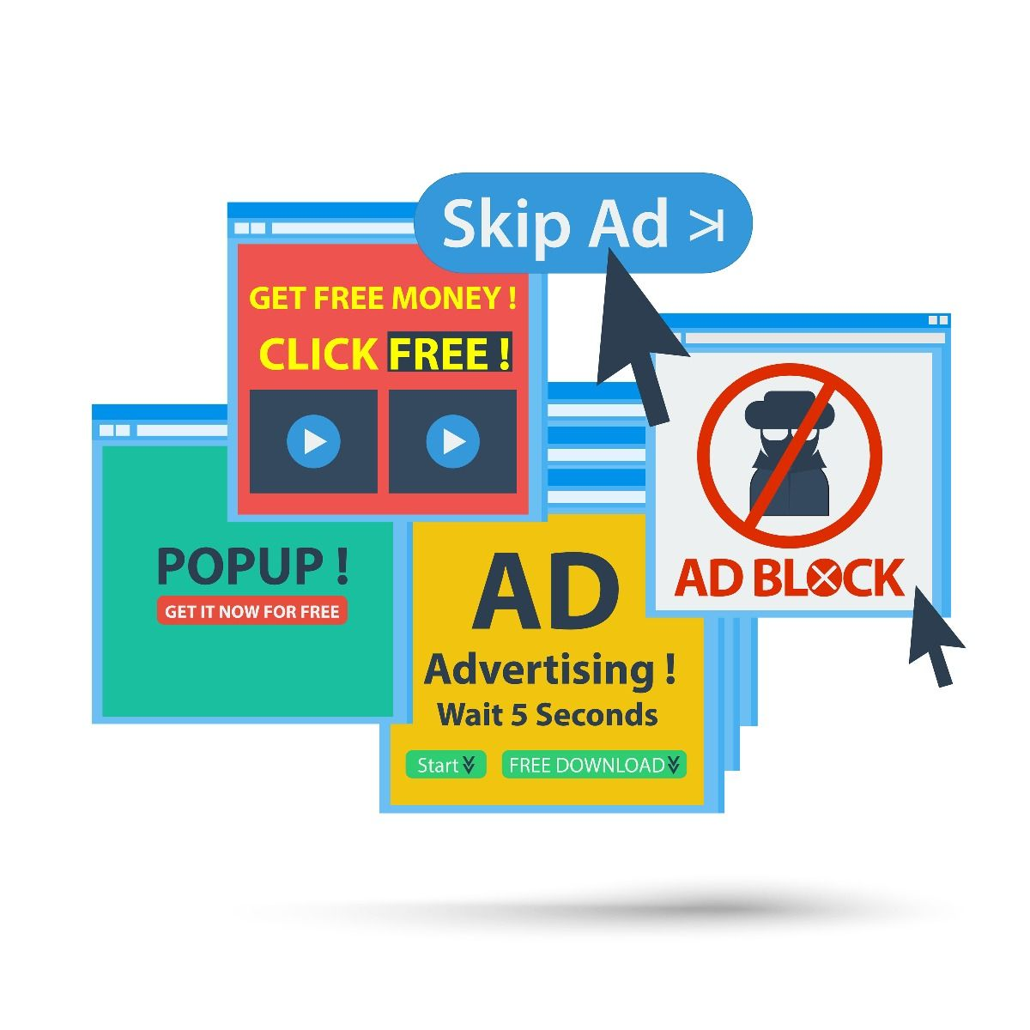
Be Wary of Pop-ups
If a pop-up says you've won something, check with an adult before clicking.
Tom saw a pop-up on his computer claiming he had won a huge prize and excitedly clicked on it.
His computer started acting weird, and he soon realized it was a trick to steal his information.
The moral of the story: ignore pop-ups that claim you've won money or prizes, and always check with an adult before clicking.

