Slide 1

WEB Development
Grade 7&8

Slide 2
Recap of the last Class
Notes:
Objective: Review the previous lesson on anchor tags and CSS styling.
Teacher's Instruction:
Recap:
Briefly review the key points from the last lesson.
Ask students to recall how to change the appearance of links using CSS.

Slide 3
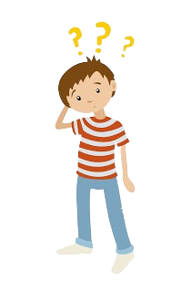
The Mystery of the Mixed-Up Socks
You have a drawer with 10 blue socks, 10 red socks, and 10 green socks, all mixed up. It’s completely dark in your room, so you can’t see which socks you’re picking.
Question: What is the minimum number of socks you need to pull out to be sure that you have at least one matching pair?
Notes:
Answer : In the worst-case scenario, you could pull out one blue sock, one red sock, and one green sock. After three socks, you don’t yet have a matching pair. But the next sock you pull out (the fourth one) must match one of the previous socks, giving you a pair.
Therefore, the minimum number of socks you need to pull out to be sure you have at least one matching pair is 4. Objective: Engage students with a warm-up puzzle to encourage critical thinking.
Teacher's Instruction:
Warm-Up Puzzle:
Present the mixed-up socks problem.
Allow time for students to think and respond.

Slide 4
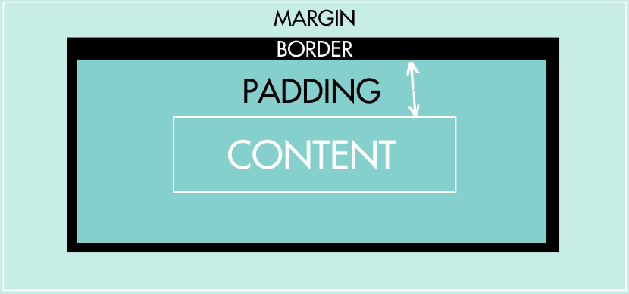
Introduction to Margin & Padding
Notes:
Objective: Introduce the concepts of margin and padding in CSS.
Teacher's Instruction:
Explanation:
Define margins and padding.
Use a visual aid to illustrate the concepts.
"Look at this diagram. The margin is the outer space around the element, and the padding is the inner space inside the element's border."

Slide 5
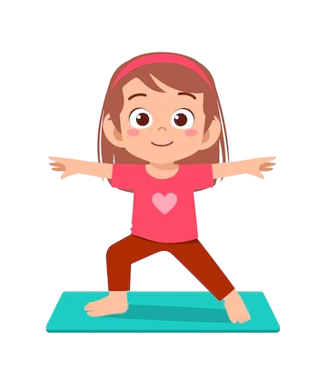
Lily's Perfect Space
Lily loves practicing yoga, but lately, her mat feels uncomfortable. Her teacher, Ms. Harmony, explains, "Imagine your yoga mat. The margin is the space around it, giving you room to stretch without bumping into others. And just like in yoga, in web design, we have padding. Padding is not the cushion inside the mat, but rather a concept in CSS. It's the space between the content and the border of an element, providing breathing room and visual separation."
By understanding both concepts, Lily creates the perfect yoga space and translates that knowledge into her web projects. Just as in yoga, finding the right balance between margin and padding can make everything more comfortable and organized on a webpage.
Notes:
Objective: Make the concepts of margin and padding relatable through a story.
Teacher's Instruction:
Storytelling:
Tell the story of Lily and her yoga mat.
"By understanding both concepts, Lily creates the perfect yoga space and translates that knowledge into her web projects. Just as in yoga, finding the right balance between margin and padding can make everything more comfortable and organized on a webpage."

Slide 6
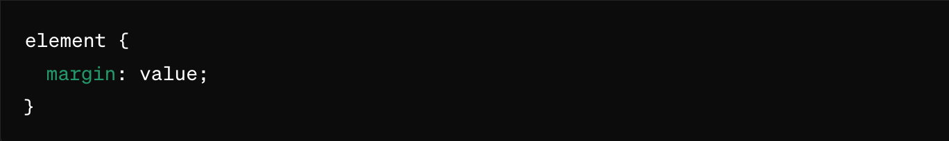
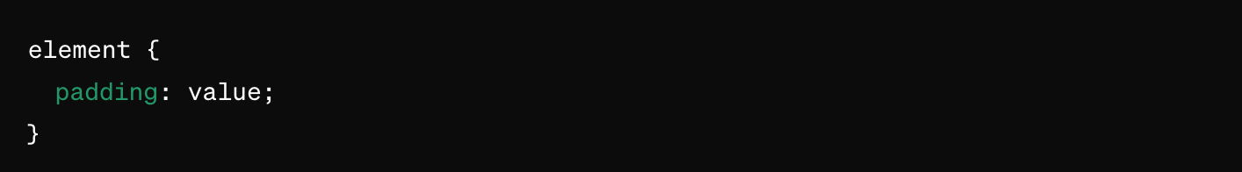
Introduction to Margin and Padding
The margin property in CSS is used to create space around elements. The padding property in CSS is used to create space inside an element.
How it Looks:
Notes:
Objective: Introduce the syntax for margin and padding in CSS.
Teacher's Instruction:
Syntax Breakdown:
Describe the properties of margin and padding.
Use a screenshot to show the syntax.
"Here's how the syntax looks: margin: 20px; and padding: 20px;. These lines create 20 pixels of space around and inside the element, respectively."

Slide 7
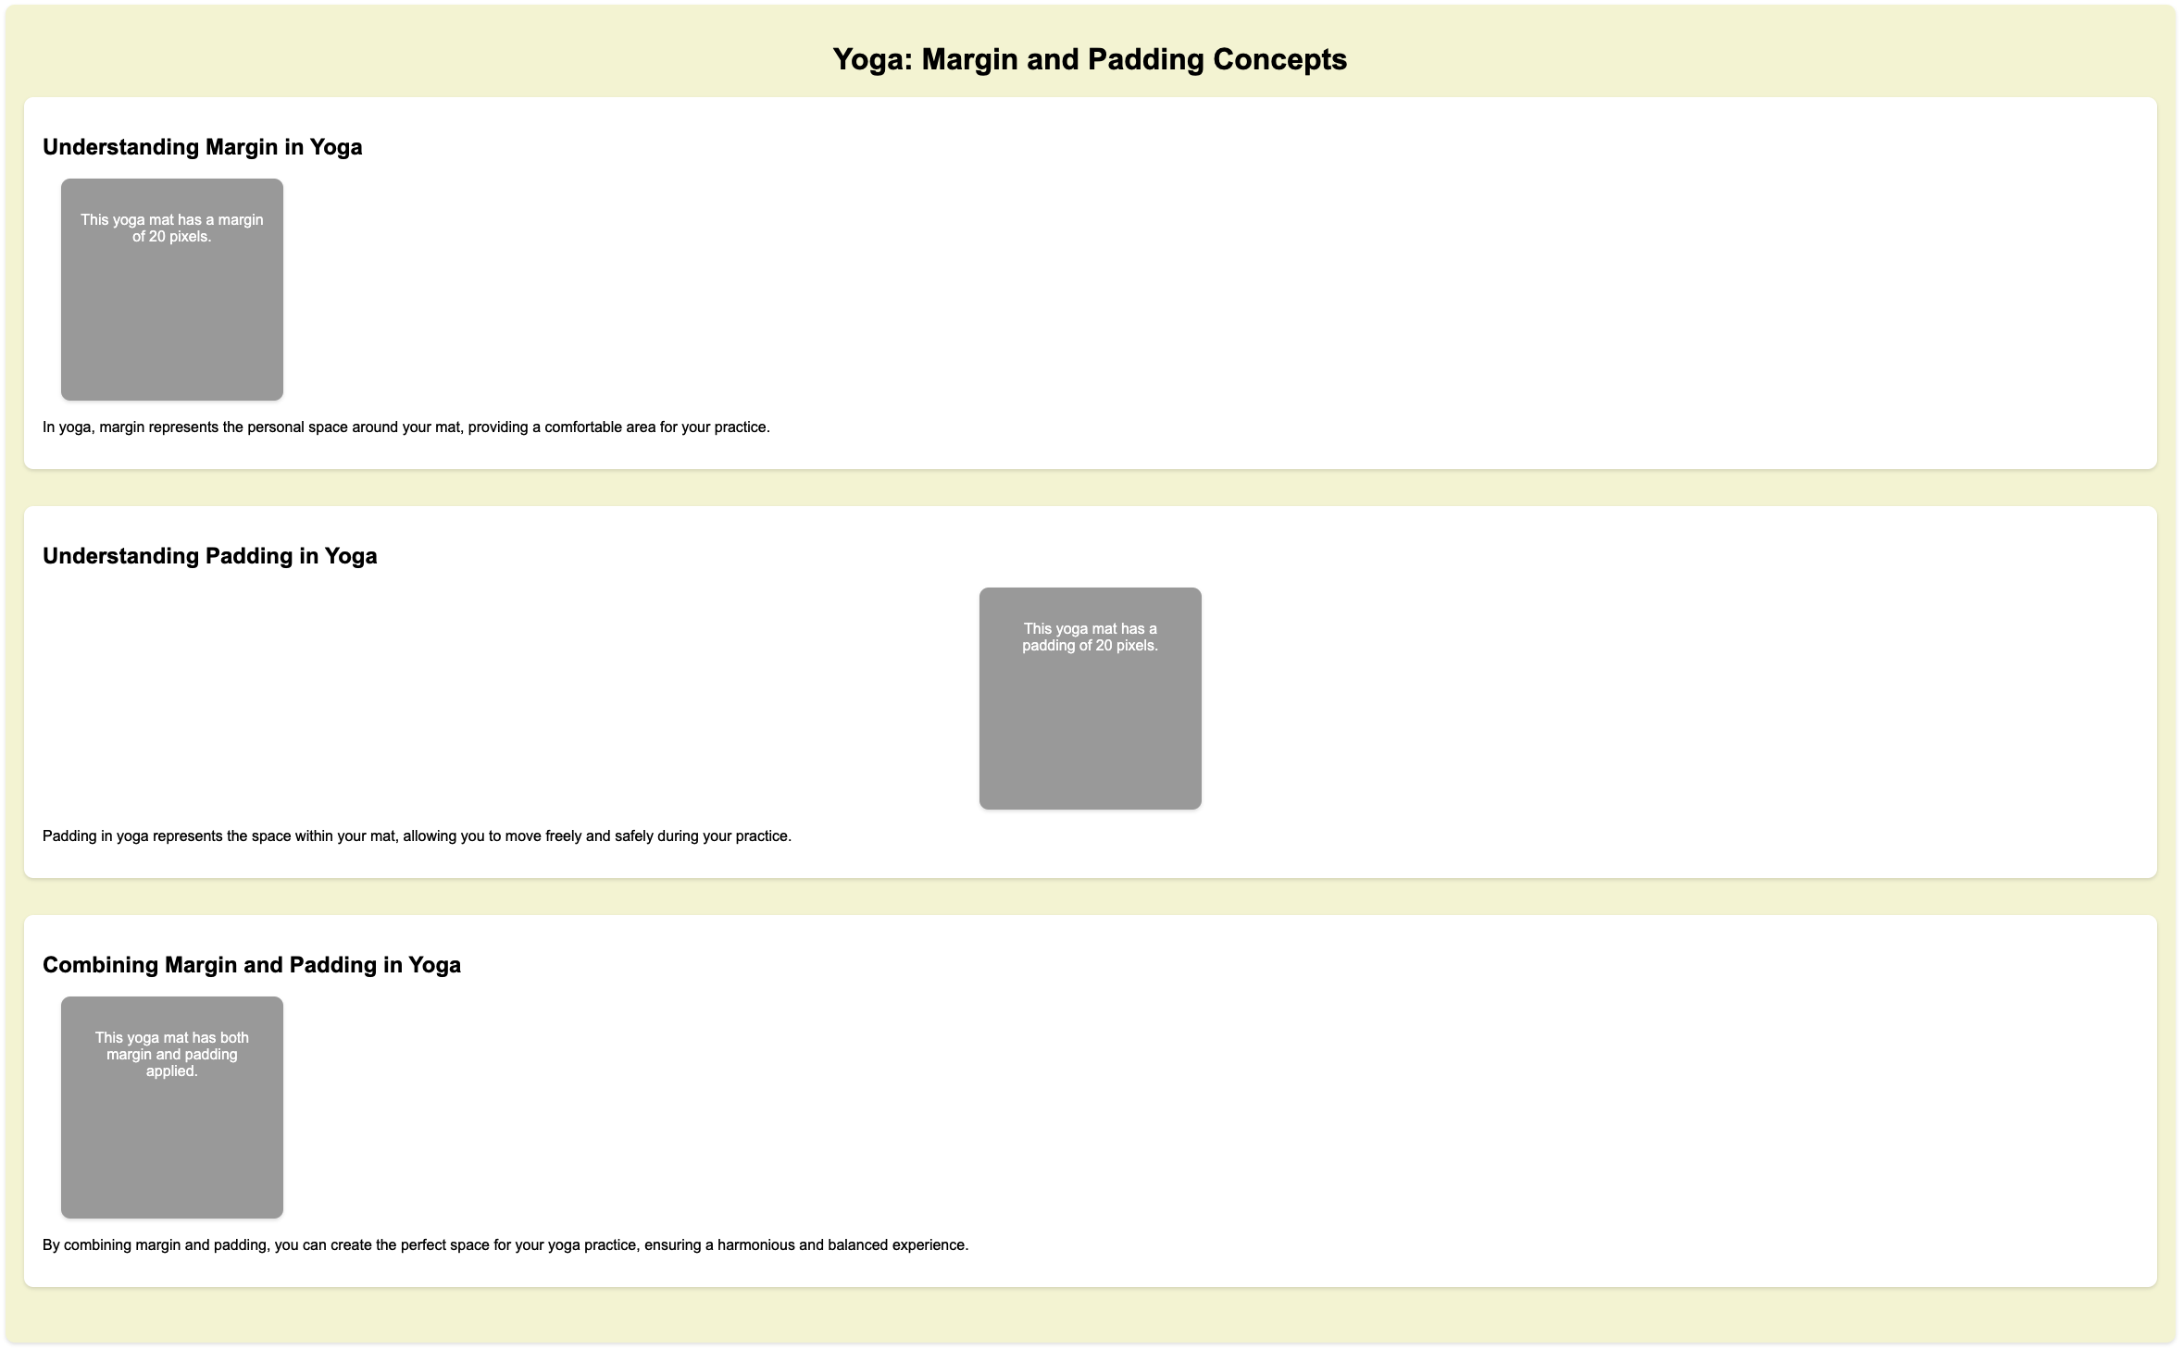
Project – Yoga Mat Spacing
Notes:
Project Link: https://replit.com/@curriculumsmana/Project-Class-6-G-5and6#index.html
Objective: Guide students through a practical example using margin and padding.
Teacher's Instruction:
Project Walkthrough:
Go through the provided HTML code step-by-step.
Use screenshots to show the code.

Slide 8
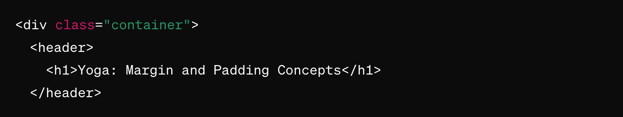
Working with the Project
HTML Code Explanation
<div class="container"> : A div (short for "division") that groups content together.
<header> : Contains the header of the page.
<h1>Yoga: Margin and Padding Concepts</h1> : Main heading of the page.
Notes:
"Teacher's Activity"
Objective: Explain the HTML code for the project in detail.
Teacher's Instruction:
HTML Code Walkthrough:
Go through the provided HTML code step-by-step.
Use screenshots to show the code.

Slide 9
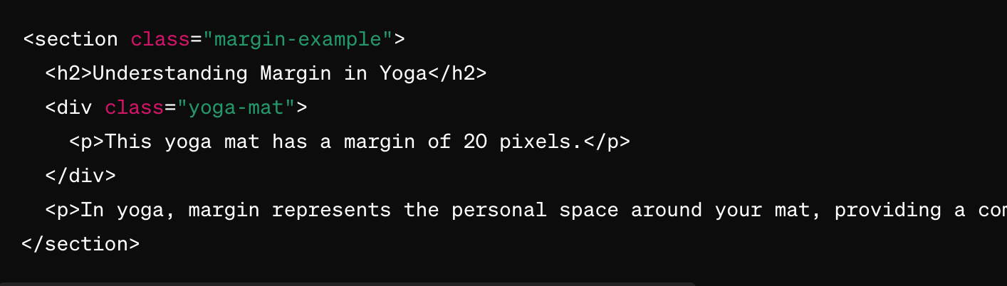
Working with the Project
HTML Code Explanation
Notes:
Objective: Explain the HTML code for the project in detail.
Teacher's Instruction:
HTML Code Walkthrough:
Go through the provided HTML code step-by-step.
Use screenshots to show the code.

Slide 10
Working with the Project
HTML Code Explanation
<section class="margin-example"> : A section for explaining margin.
<h2>Understanding Margin in Yoga</h2> : Subheading for the section.
<div class="yoga-mat"> : Div representing a yoga mat with margin.
<p>This yoga mat has a margin of 20 pixels.</p> : Paragraph explaining the margin.
<p>In yoga, margin.............</p> : Paragraph text.
Notes:
Objective: Explain the HTML code for the project in detail.
Teacher's Instruction:
HTML Code Walkthrough:
Go through the provided HTML code step-by-step.
Use screenshots to show the code.

Slide 11
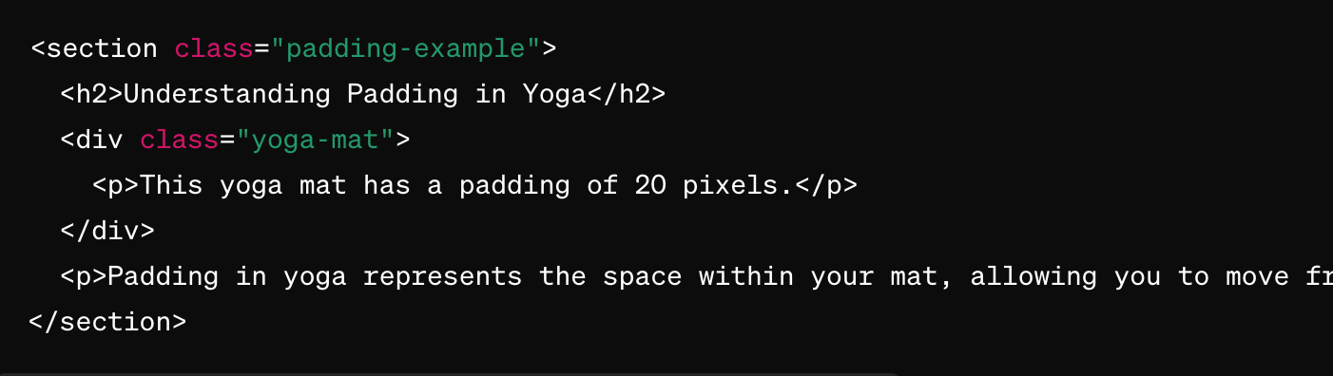
Working with the Project
HTML Code Explanation
Notes:
Objective: Explain the HTML code for the project in detail.
Teacher's Instruction:
HTML Code Walkthrough:
Go through the provided HTML code step-by-step.
Use screenshots to show the code.

Slide 12
Working with the Project
HTML Code Explanation
<section class="padding-example"> : A section for explaining padding.
<h2>Understanding Padding in Yoga</h2> : Subheading for the section.
<div class="yoga-mat"> : Div representing a yoga mat with padding.
<p>This yoga mat has a padding of 20 pixels.</p> : Paragraph explaining the padding.
<p>Padding in yoga …...........</p> : Paragraph Tag.
Notes:
Objective: Explain the HTML code for the project in detail.
Teacher's Instruction:
HTML Code Walkthrough:
Go through the provided HTML code step-by-step.
Use screenshots to show the code.

Slide 13
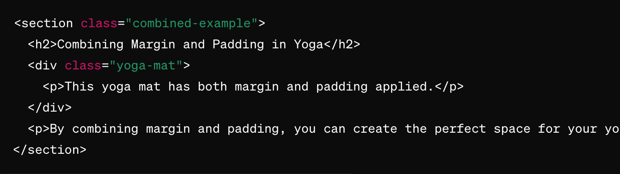
Working with the Project
HTML Code Explanation
Notes:
Objective: Explain the HTML code for the project in detail.
Teacher's Instruction:
HTML Code Walkthrough:
Go through the provided HTML code step-by-step.
Use screenshots to show the code.

Slide 14
Working with the Project
HTML Code Explanation
<section class="combined-example"> : A section for explaining the combination of margin and padding.
<h2>Combining Margin and Padding in Yoga</h2> : Subheading for the section.
<div class="yoga-mat"> : Div representing a yoga mat with both margin and padding.
<p>This yoga mat has both margin and padding applied.</p> : Paragraph explaining the combination.
<p>By combining margin and padding.......................</p>: Paragraph Tag.
Notes:
Objective: Explain the HTML code for the project in detail.
Teacher's Instruction:
HTML Code Walkthrough:
Go through the provided HTML code step-by-step.
Use screenshots to show the code.

Slide 15
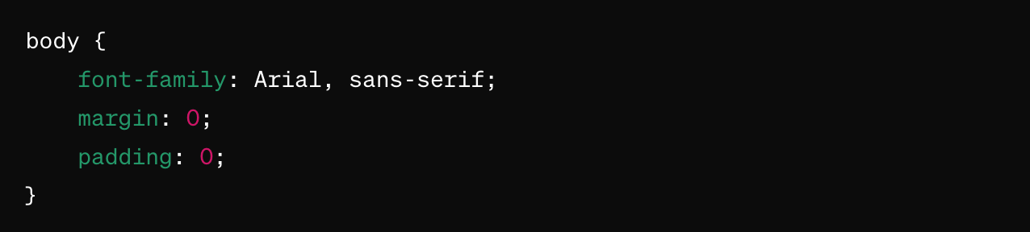
Working with the Project
CSS Code Explanation
body: Applies styles to the whole page.
font-family: Sets the font type.
margin: Removes default margin.
padding: Removes default padding.
Notes:
Objective: Explain the CSS code for the project in detail.
Teacher's Instruction:
CSS Code Breakdown:
Explain each part of the CSS code.
Use screenshots to show where each property is applied.

Slide 16
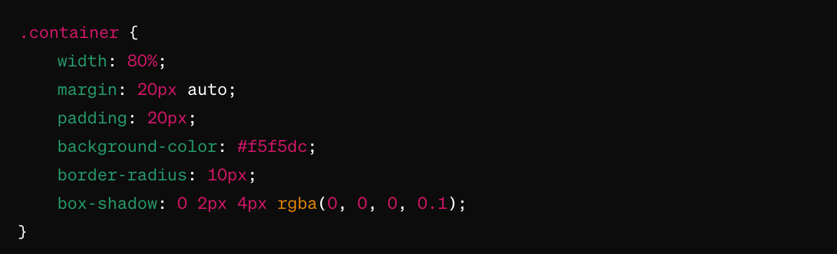
Working with the Project
CSS Code Explanation
Notes:
Objective: Explain the CSS code for the project in detail.
Teacher's Instruction:
CSS Code Breakdown:
Explain each part of the CSS code.
Use screenshots to show where each property is applied.

Slide 17
Working with the Project
CSS Code Explanation
.container: Styles for the container div.
width: Sets width to 80% of the page.
margin: Centers the container with space around it.
padding: Adds space inside the container.
background-color: Sets background color.
border-radius: Rounds the corners.
box-shadow: Adds a shadow effect.
Notes:
Objective: Explain the CSS code for the project in detail.
Teacher's Instruction:
CSS Code Breakdown:
Explain each part of the CSS code.
Use screenshots to show where each property is applied.

Slide 18
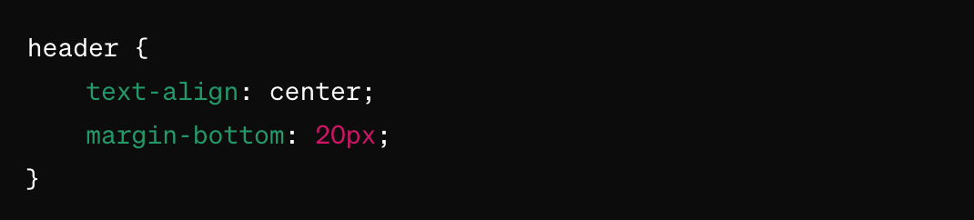
Working with the Project
CSS Code Explanation
header: Styles for the header.
text-align: Centers the text.
margin-bottom: Adds space below the header.
Notes:
Objective: Explain the CSS code for the project in detail.
Teacher's Instruction:
CSS Code Breakdown:
Explain each part of the CSS code.
Use screenshots to show where each property is applied.

Slide 19
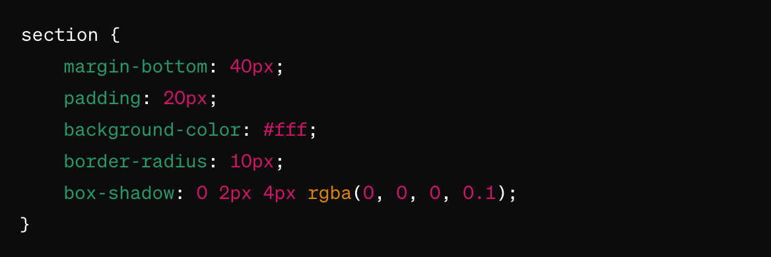
Working with the Project
CSS Code Explanation
Notes:
Objective: Explain the CSS code for the project in detail.
Teacher's Instruction:
CSS Code Breakdown:
Explain each part of the CSS code.
Use screenshots to show where each property is applied.

Slide 20
Working with the Project
CSS Code Explanation
section: Styles for each section.
margin-bottom: Adds space below the section.
padding: Adds space inside the section.
background-color: Sets background color.
border-radius: Rounds the corners.
box-shadow: Adds a shadow effect.
Notes:
Objective: Explain the CSS code for the project in detail.
Teacher's Instruction:
CSS Code Breakdown:
Explain each part of the CSS code.
Use screenshots to show where each property is applied.

Slide 21
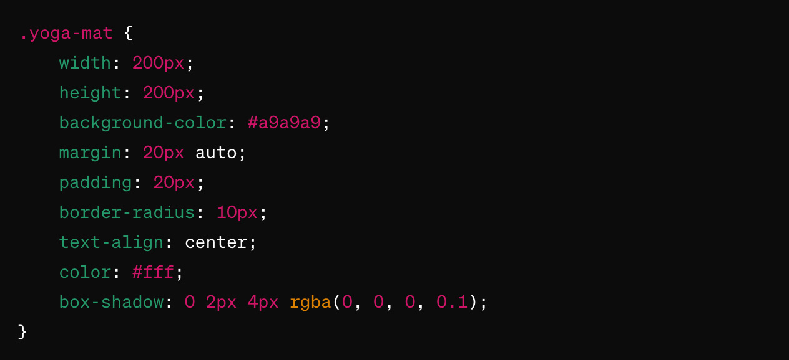
Working with the Project
CSS Code Explanation
Notes:
Objective: Explain the CSS code for the project in detail.
Teacher's Instruction:
CSS Code Breakdown:
Explain each part of the CSS code.
Use screenshots to show where each property is applied.

Slide 22
Working with the Project
CSS Code Explanation
.yoga-mat: Styles for the yoga mat div.
width: Sets width.
height: Sets height.
background-color: Sets background color.
margin: Adds space around and centers it.
padding: Adds space inside.
border-radius: Rounds the corners.
text-align: Centers the text.
color: Sets text color.
box-shadow: Adds a shadow effect.
Notes:
Objective: Explain the CSS code for the project in detail.
Teacher's Instruction:
CSS Code Breakdown:
Explain each part of the CSS code.
Use screenshots to show where each property is applied.

Slide 23
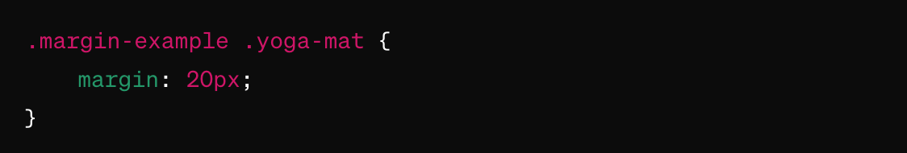
Working with the Project
CSS Code Explanation
.margin-example .yoga-mat: Styles for the yoga mat in the margin margin: Adds 20 pixels of space around.
Notes:
Objective: Explain the CSS code for the project in detail.
Teacher's Instruction:
CSS Code Breakdown:
Explain each part of the CSS code.
Use screenshots to show where each property is applied.

Slide 24
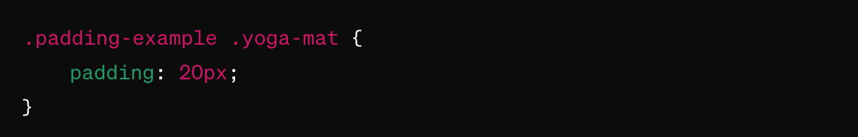
Working with the Project
CSS Code Explanation
.padding-example .yoga-mat: Styles for the yoga mat in the padding
padding: Adds 20 pixels of space inside.
Notes:
Objective: Explain the CSS code for the project in detail.
Teacher's Instruction:
CSS Code Breakdown:
Explain each part of the CSS code.
Use screenshots to show where each property is applied.

Slide 25
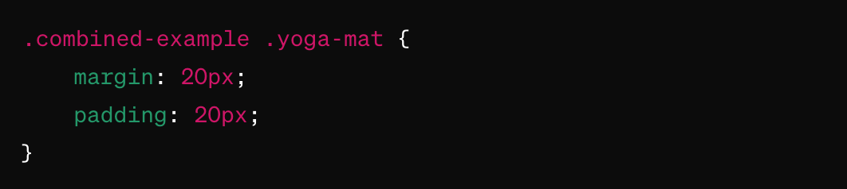
Working with the Project
CSS Code Explanation
.combined-example .yoga-mat: Styles for the yoga mat in the combined
margin: Adds 20 pixels of space around.
padding: Adds 20 pixels of space inside.
Notes:
Objective: Explain the CSS code for the project in detail.
Teacher's Instruction:
CSS Code Breakdown:
Explain each part of the CSS code.
Use screenshots to show where each property is applied.

Slide 26
Speed up with Shortcuts
Shorthand notations simplifies your CSS code and makes it easier to manage margins and paddings across different elements in your webpage.
How it Looks:
You can specify the margin for all four sides in one declaration.
Notes:
Objective: Teach shorthand notation for margin and padding.
Teacher's Instruction:
Shorthand Notation:
Introduce shorthand for margin and padding.
"Shorthand notations simplify your CSS code and make it easier to manage. For example, margin: 20px; applies a 20-pixel margin to all four sides. margin: 20px 10px; applies a 20-pixel margin to the top and bottom, and 10 pixels to the right and left."
Show examples to illustrate different values.
"If you provide three values like margin: 20px 10px 15px;, the first value is for the top, the second for the right and left, and the third for the bottom. For four values, each one applies to the top, right, bottom, and left respectively."

Slide 27
Speed up with Shortcuts
If you provide:
One value: It applies to all four sides.
Two values: The first applies to top and bottom, the second to right and left.
Three values: The first applies to top, the second to right and left, the third to bottom.
Four values: Apply individually to top, right, bottom, and left.
Notes:
Objective: Teach shorthand notation for margin and padding.
Teacher's Instruction:
Shorthand Notation:
Introduce shorthand for margin and padding.
Show examples to illustrate different values.

Slide 28
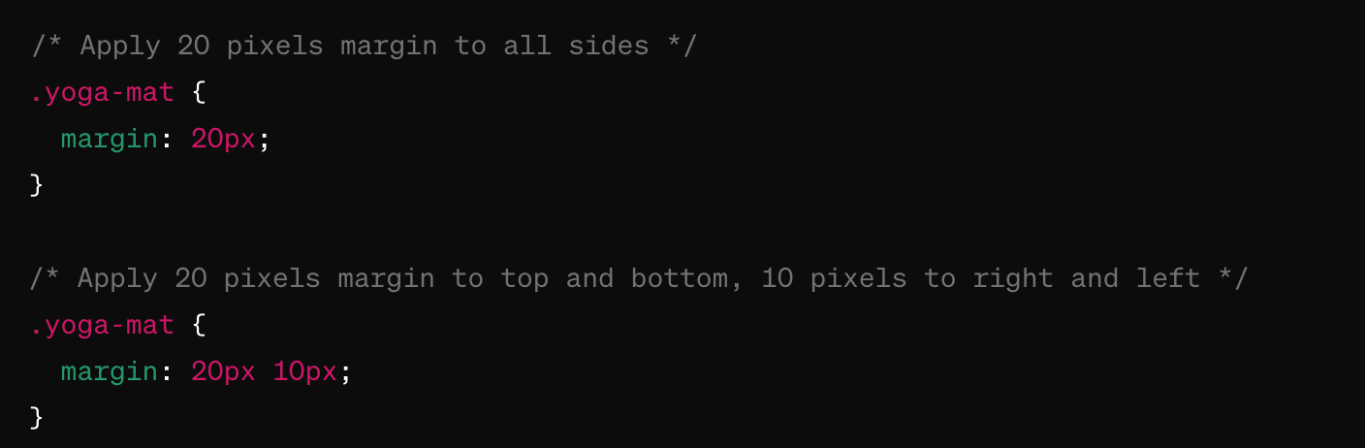
Speed up with Shortcuts
margin: 20px; applies a 20-pixel margin to all four sides of the element.
margin: 20px 10px; applies a 20-pixel margin to the top and bottom and a 10-pixel margin to the right and left.
Notes:
Objective: Teach shorthand notation for margin and padding.
Teacher's Instruction:
Shorthand Notation:
Introduce shorthand for margin and padding.
Show examples to illustrate different values.

Slide 29
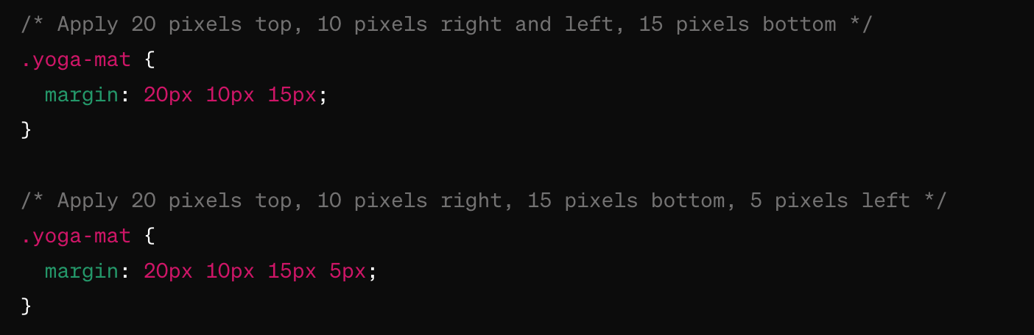
Speed up with Shortcuts
margin: 20px 10px 15px; applies a 20-pixel margin to the top, a 10-pixel margin to the right and left, and a 15-pixel margin to the bottom. margin: 20px 10px 15px 5px; applies a 20-pixel margin to the top, a 10-pixel margin to the right, a 15-pixel margin to the bottom, and a 5-pixel margin to the left.
Notes:
Objective: Teach shorthand notation for margin and padding.
Teacher's Instruction:
Shorthand Notation:
Introduce shorthand for margin and padding.
Show examples to illustrate different values.

Slide 30
Now it's your turn!
Task: Choose existing webpage and redesign it by incorporating margin and padding shortcuts.
Instructions: Analyze the layout of the chosen webpage and identify areas where margin and padding can be improved. Modify the CSS of the webpage to add or adjust margin and padding values to achieve a more visually appealing and user-friendly design.
Notes:
"Students' Activity"
Objective: Allow students to practice redesigning a webpage using margin and padding.
Teacher's Instruction:
Practice Task:
Explain the task for students to redesign a webpage.
"Take your time to experiment and see how these changes can improve the layout. If you have any questions, feel free to ask."

Slide 31

How to Save & Share the project.
Replit offers autosave option – so not worry about the same.
To share project with someone in view mode: just copy the link from the URL bar, and share the link
To share the project for collaboration
Click on "Invite" from the top right corner
If you know the username, type it in the box and click on invite
You can also turn on the toggle button "private join link" to create a public collaboration link and invite members to edit your code.
Notes:
Instructions for the Teacher:
Explain how to save and share projects on Replit, including the options for collaboration.
Emphasize the importance of sharing projects for feedback and collaboration.

Slide 32


What does margin do?
A. Adds space inside the element
B. Adds space outside the element
C. Changes the color
D. Adds a border
Notes:
Answer: B

Slide 33
How do you write shorthand for margin?
A. margin: top bottom;
B. margin: left right;
C. margin: top right bottom left;
D. margin: all-sides;
Notes:
Answer: C

Slide 34
What is the padding property used for?
A. To create space between elements
B. To create space inside an element
C. To add a background color
D. To change the font size
Notes:
Answer: B

Slide 35
Which of the following values sets equal margins on all four
sides of an element?
A. margin: 10px 5px 10px 5px;
B. margin: 10px;
C. margin: 10px 5px;
D. margin: 10px 5px 10px;
Notes:
Answer: B

Slide 36

Let's Wrap it Up – What have we learnt?
Today We Learned:
The difference between margins and padding.
How to add margins and padding to HTML elements.
The shorthand property for setting margins and padding.
Notes:
Objective: Summarize the day's lesson on margins and padding.
Teacher's Instruction:
Summary:
Review the main points of the lesson.

Slide 37


Homework Discussion
Notes:
Instructions for the Teacher: Facilitate a discussion about the homework assignment.

Slide 38

Brain Booster Bonus
Design an identity card for your real/virtual pet animal on a webpage! Include details such as the height, age, and favorite food of your pet.
Don't forget to add a cute picture of your pet to personalize the card.
Make it visually appealing by using margin and padding CSS properties to enhance its appearance! If you want you can add additional details. Related to your pet friend.
Notes:
Objective: Encourage creativity with an additional task.
Teacher's Instruction:
Bonus Task:
Assign students to design an identity card for their pet.
"For a fun bonus task, design an identity card for your real or virtual pet on a webpage. Include details like height, age, and favorite food, and don't forget to add a cute picture!"

Slide 39
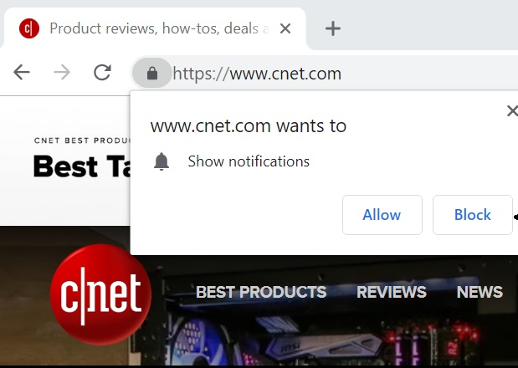
Don’t allow all notifications
Many websites will ask your permission for notifications, give access to only trusted websites.
Emily visited a new website that asked for permission to send notifications, and she agreed without thinking.
Soon, she was bombarded with annoying and suspicious alerts.
The moral of the story:
Only give notification access to trusted websites to avoid unwanted interruptions and potential threats.

