Slide 1
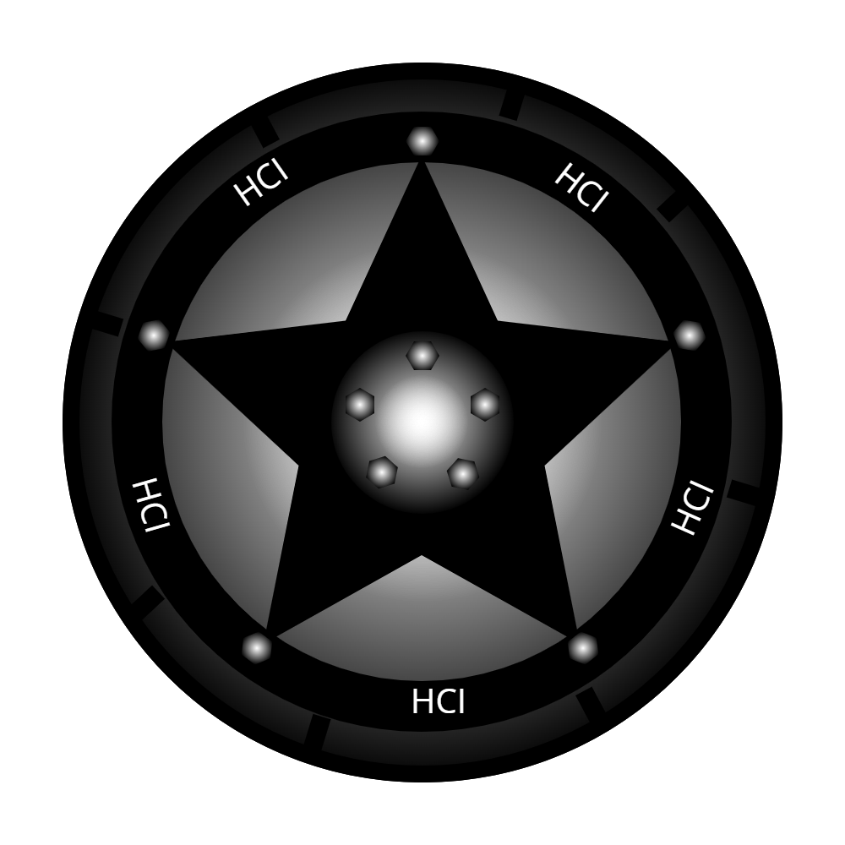
A study on 3D racing games interaction modes on mobile platforms
A study on the interaction methods for 3D racing games for smartphones

Slide 2
Objective of the project
The objective of the project is to perform the evaluation of usability and user experience of several interaction methods for mobile driving games.
To perform an evaluation a prototype of a 3D driving game was created. In this prototype several different input modes that allow the steering of the player’s car are available.

Slide 3

Prototype
I’ve used the game engine of Unity3D to create the prototype. Other than letting me create the game world and perform tests directly on top of the objective platform (mobile) during development (thanks to Unity Remote), Unity3D offers all the tools needed to create a functional and polished GUI.

Slide 4
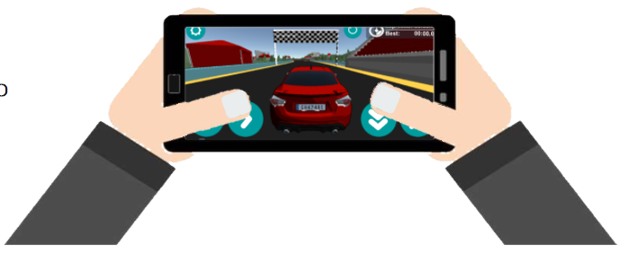
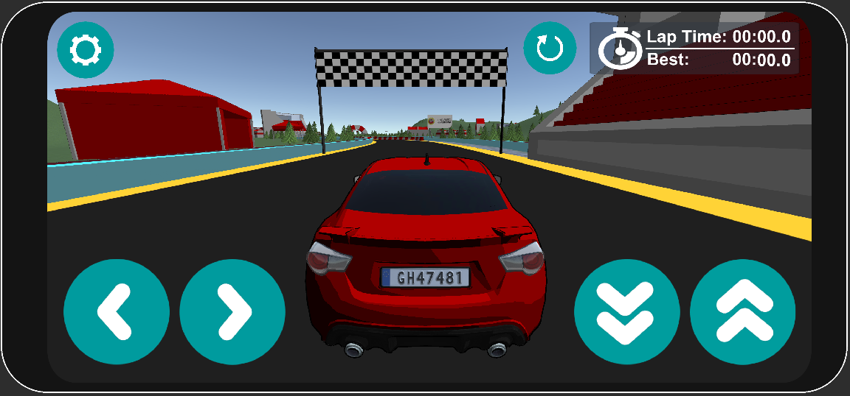
The proposed prototype is an high fidelity prototype (as it simulates in all aspects a fully working 3D racing game for mobile) and it was developed by putting the most effort on the part of the interaction with the user (vertical compromise, lot of detail only for some features).

Slide 5
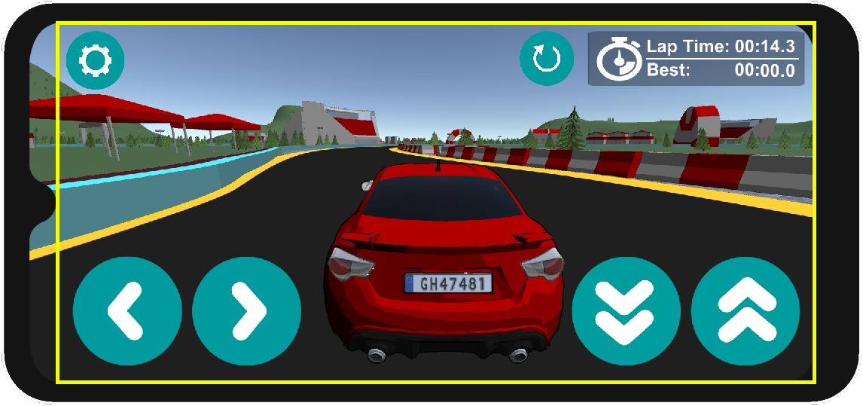
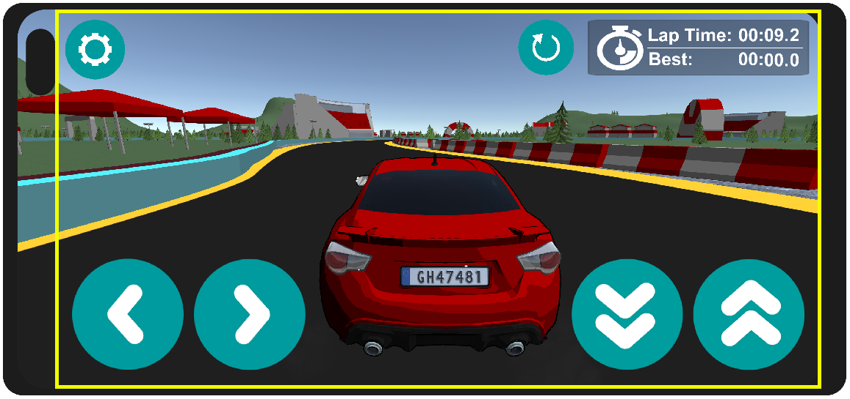
The prototype was developed and tested only for Android smartphones.
The device used for the tests has a full HD screen without notch but particular attention was put in the project in order to allow the prototype to run on any device: the GUI can in fact scale in order to accomodate all the smartphones available in the market as it gets restricted inside the area of the screen called Safe Area. This was done in order to allow all the users the prototype was sent to to perform the tests.

Slide 6
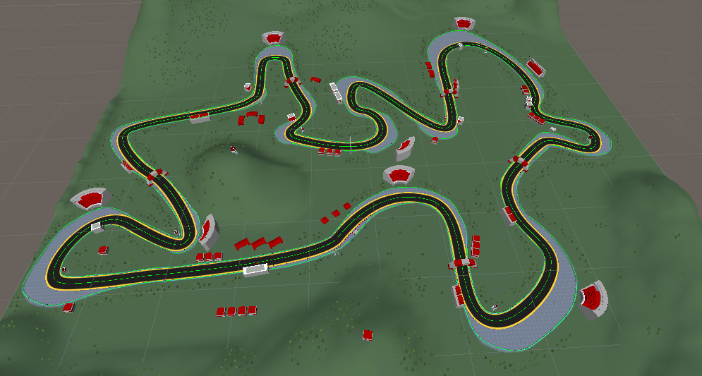
Initially the proposed track offered parabolic curves and changes in elevation of the road but after some tests I’ve decided to remove these elements as they could cause motion sickness on the users.

Slide 7



Modalità di interazione
In the prototype 3 different interaction modes (that use the touchscreen display or the gyroscopes of the mobile devices) are proposed. In particular, the available modes are:
Steering by virtual buttons on screen
Steering with virtual steering wheel on screen (swiping on top of the steering wheel will rotate it)
Steering by rotating the device (so by using the gyroscopes of the mobile devices)

Slide 8
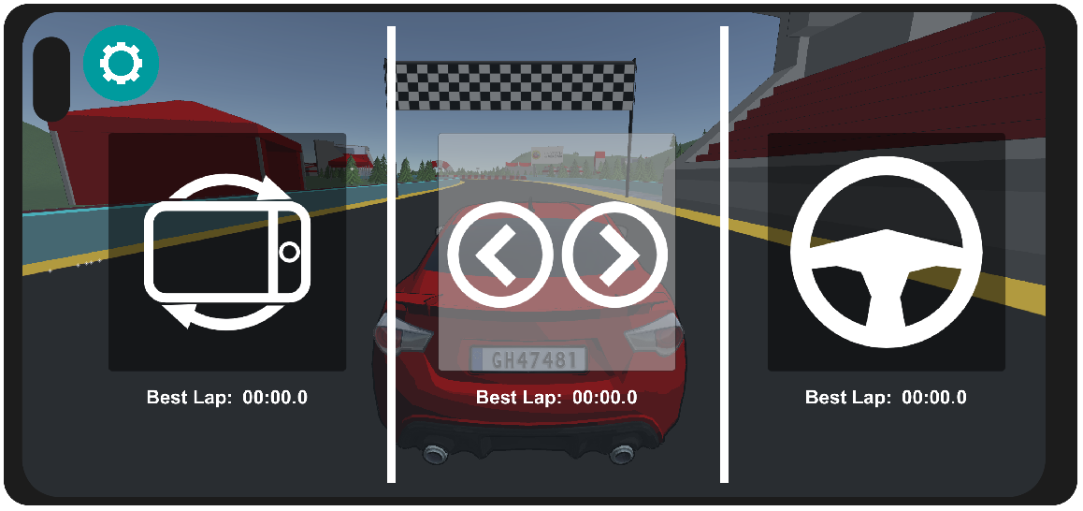
To select the interaction mode a button with the typical “settings” icon is present: it allows to open or close the menù for the selection of the interaction method. The modes are selected with 3 more buttons available in this menù, each one with the icon of the mode they are representing.

Slide 9
The interaction modes were chosen by considering products (i.e. other applications) already available in the market.
In the GUI all the icons used were chosen because of the idea they convey, also in this case considering their use in other applications (principles of affordance and consistency).
The buttons were realized in order to be easily distinguishable from the other non-interactable elements of the interface. They also let the user know when they are being pressed by changing background color (principles of visibility and feedback).
The buttons of the interface were reduced to the lowest possible number to reduce the cognitive effort required to the user in order to limit the risks of committing errors when using them (constraints principle).

Slide 10

Task proposed to the users
The objective of the prototype is to evaluate the three interaction modes.
To perform the evaluation I’ve decided to measure the lap times (up to tenths of seconds) with each mode in order to have quantitative data on which is possible to perform an accurate analysis.
The user has to complete 3 “clean” laps (this means that he shouldn’t hit the walls of the track) with the 3 different interaction methods trying to score the best possible time for each method. The time of a lap is counted between two consecutive passes under the checkered flag.

Slide 11
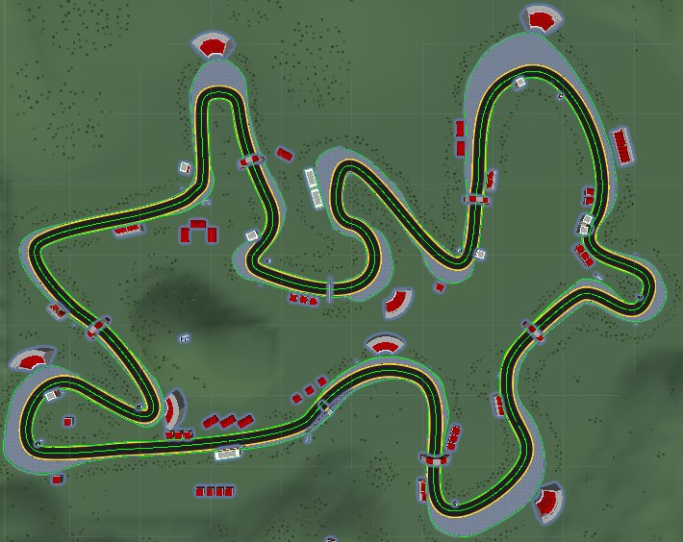
Hypothesis
Null hypothesis: the three interaction modes perform the same in terms of lap times.
Alternative hypothesis: it is possible to measure a difference in performance between the interaction modes.

Slide 12
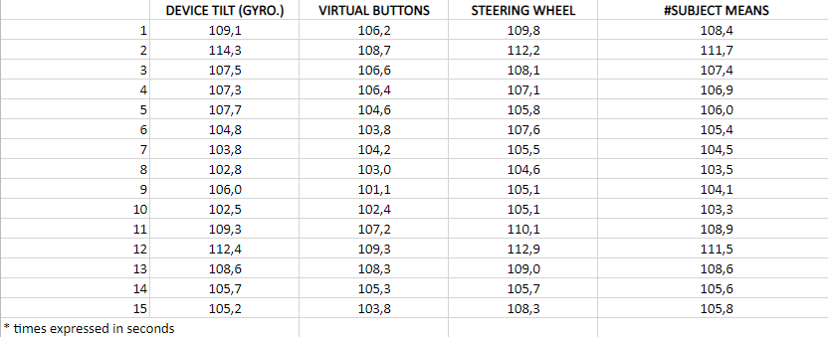
Participants
The participants of the test are people between 20 and 25 years and all of them had previous experience in mobile 3D driving games
There were 15 total participants in the test, which is considered the minimum to perform a significant statistical analysis

Slide 13
Statistical test
The test performed is a test within subject since each participant is tested on each level (the three different methods for steering).
Since the test is within subject, to limit the problem of performance improvement with practice each participant is given some time (before the test) to learn the layout of the track and get used to the three interaction methods.
Since the number of participants wasn’t known in advance it wasn’t possible to apply the latin square technique, so to minimize learning effects each participant was given a random order to perform the test (each participant trying every mode but in different orders).

Slide 14
Factors (independent variables): interaction modes
Levels: steering wheel, tilting (gyroscopes), virtual buttons
Dependent variables: lap times in seconds (with tenth of second precision) which is the quantitative data measured.
This means that we should choose a statistical test for data with 1 factor with #levels ≥ 2 in a within subject scenario. For this reason I have applied the repeated measures ANOVA test that, like other ANOVA tests, generates an F-statistic that is used to determine statistical significance.
https://statistics.laerd.com/statistical-guides/repeated-measures-anova-statistical-guide.php

Slide 15
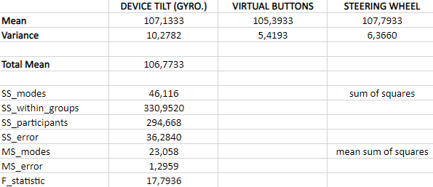
The null hypothesis (H0) states that there is no difference between the 3 modes (equal means)
The alternative hypothesis (HA) states that there is a significant difference between the three interaction modes in terms of lap times
Degrees of freedom
error | 28
modes | 2

Slide 16
 | Sum of squares | Degrees of freedom | Mean sum of squares | F value | P value
Modes | 46,116 | 2 | 23,058 | 17,7936 | 0,00001
Error | 36,2840 | 28 | 1,2959
With the F-value and the degrees of freedom of numerator and denominator (2 and 28 respectively) we can calculate the P-value.
The P-value is the probability of obtaining test results at least as extreme as the results actually observed, under the assumption that the null hypothesis is correct.
We have obtained:
P-value = 0,00001

Slide 17
We refer to statistically significant as P-value < 0,05 and statistically highly significant as P-value < 0,001.
In our case P is 0,00001 which is ≪ 0,001.
For this reason we can reject the Null hypothesis and conclude that there is a difference in performance between the three interaction modes and in particular, as we can see from the data gathered, that the one with the virtual buttons is the one obtaining the lowest lap times.

Slide 18
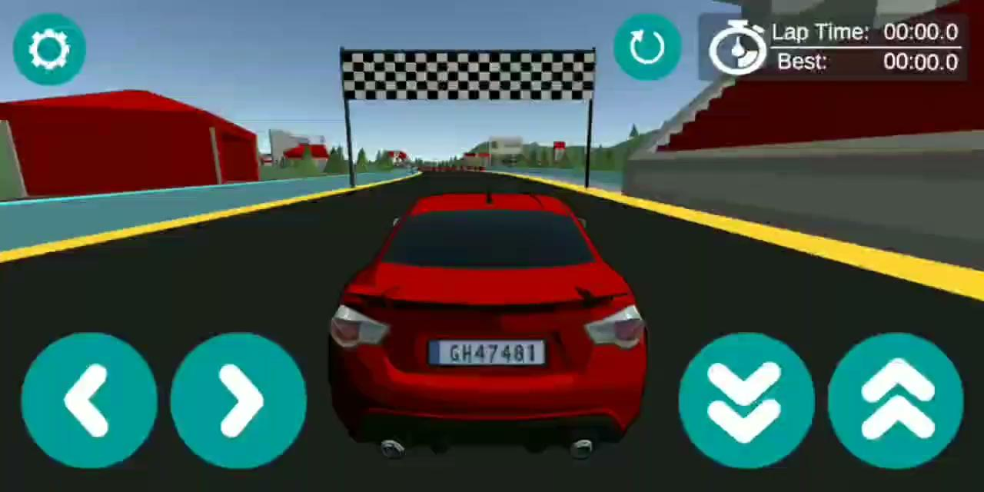
Prototype in action

Slide 19
Questionnaire & conclusions
A System Usability Scale questionnaire was proposed to the users upon completion of the test.
https://docs.google.com/forms/d/1ku5Cyuv4ChBgeszb2tHsJ_00QnMLWdd5l4_N6QsWKok/
Although we have demonstrated that there is a significant difference in terms of performance of the three interaction methods, all three modes were considered a viable alternative for a mobile racing game by the participants of the test.
The prototype was considered easy to understand and no one thought it was necessary assistance in order to perform the test since the interface is extremely simple and inspired by other famous products available in the market.

Slide 20
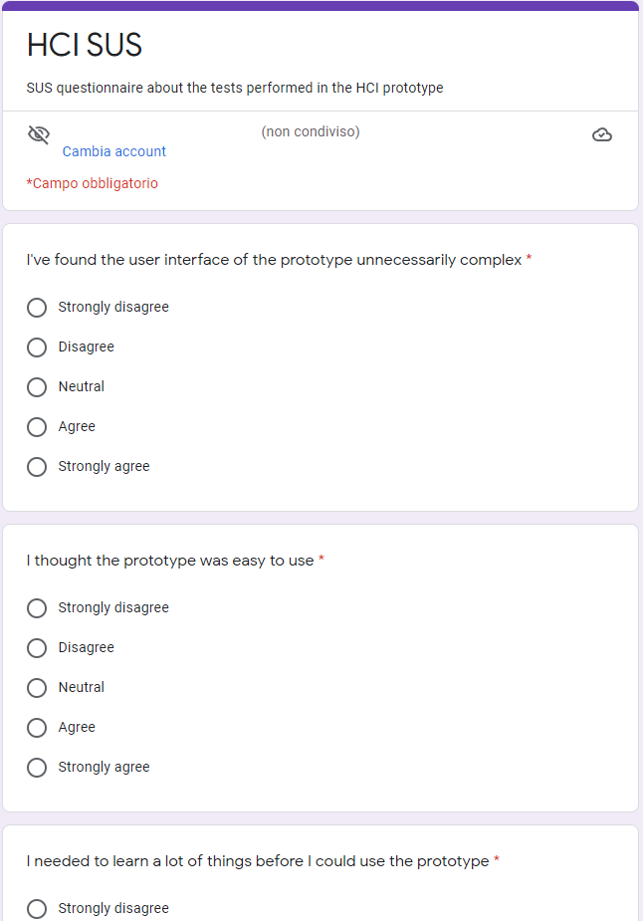
Not all methods required the same amount of effort to obtain a lap without collisions but the most difficult interaction mode (device tilting) is also considered the most immersive.
No one felt sick after completing the test but many participants were tired after using the device tilting steering method.
Some participants think that a feature that should be added to a real application is the possibility of tuning the sensitivity of each mode.

Slide 21

https://github.com/ScodroS/HCI_project

