Slide 1

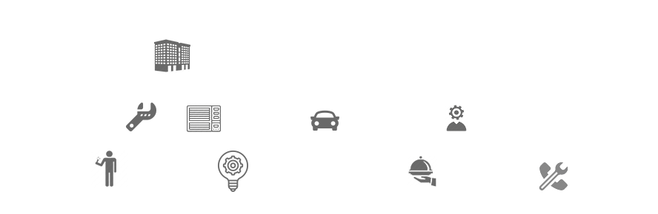
Introduction GraphQL
26 May 2022

Slide 2
Agenda
What is GraphQL
Benefits GraphQL
GraphQL With Hot Chocolate Library
Demo
Some important links

Slide 3
What is GraphQL
Created by Facebook in 2012
GraphQL is a replacement for REST
GraphQL uses Query Language
GraphQL is a Pattern not a technology

Slide 4
What is GraphQL
A query language for your API
GraphQL is a query language for APIs and a runtime for fulfilling those queries with your existing data. GraphQL provides a complete and understandable description of the data in your API, gives clients the power to ask for exactly what they need and nothing more, makes it easier to evolve APIs over time, and enables powerful developer tools.

Slide 5
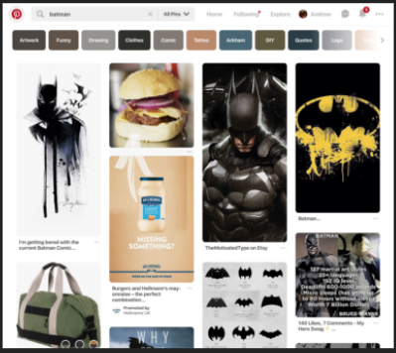
Why to chose GraphQL
Rest Applications has disadvantage with lots of information to display on one screen

Slide 6
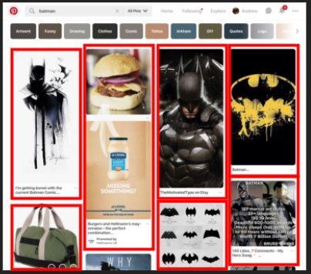
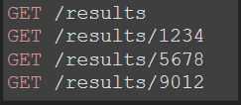
Why to chose GraphQL
Rest Applications has disadvantage with lots of information to display on one screen
One API call For collection
Then one API call per item for description

Slide 7
GraphQL vs REST
GraphQL can bundle lots of data into one query instead of many

Slide 8
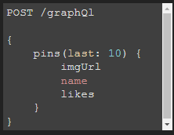
GraphQL vs REST
GraphQL can bundle lots of data into one query instead of many

Slide 9
GraphQL vs REST
REST
GraphQL
An architectural style largely viewed as a conventional standard for designing APIs
Server determines what data to return
Data fetching can cause over- and under-fetching
Multiple round trips of requests required to fetch all the data needed
End points are URLs where each of them exposes a single resource
Not suitable for hierarchical structure
Supports multiple API versions
Supports multiple data formats
A query language offering capabilities to fetch/update hierarchical data
Client query decides what data to get
Data fetching is precise, you specify what you want
Single query can return all data required in one go
Single endpoint for all requests with the full capabilities of the exposed service
Suitable for hierarchical structure
No API versioning
Supports JSON formats only

Slide 10

Where it is used

Slide 11
Hot Chocolate
Hot Chocolate is an open-source GraphQL server for the Microsoft .NET platform
Hot Chocolate compatible to all GraphQL compliant clients like Strawberry Shake, Relay, Apollo Client, and various other clients and tools.
Hot Chocolate takes the complexity away from building a fully-fledged GraphQL server and lets you focus on delivering the next big thing.

Slide 12
How does it works
Defining schema
Queries
Mutations
Object Types
Scalers
Arguments
Input Object Types
Interfaces
Unions

Slide 13
Important Links
https://graphql.org/
https://chillicream.com/docs/hotchocolate

