Slide 1
ENERGY REQUIREMENTS FOR HIGH PRODUCTION COWS
Carolina Diaz Lira
ALLFARM NZ
carolinad@allfarmnz.co.nz

Slide 2
OUTLINE
BALANCING OF DIET
CHEMICAL COMPOSITION
NDF / NFC
ENERGY UTILIZATION
MILK COMPONENTS
DIGESTION AND PASSAGE
ENERGY EFFICIENCY
FORAGE / CONCENTRATE RATIO

Slide 3
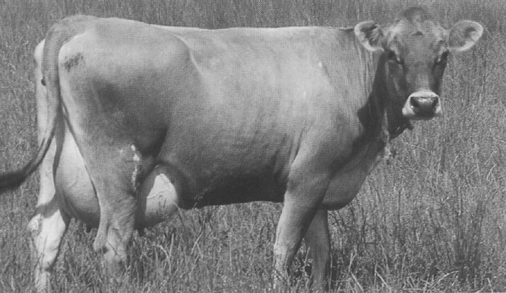
BALANCING A DAIRY RATION
Cow
Nutrients
2-Feed
Energy-Fiber
1-Composition
Protein
3-Energy Utilization
Macro-minerals
4-Energy Value
6-Protein Utilization
Micro-minerals
Vitamins
7-RDP/RUP Value
Dry Matter Intake (appetite)
Stage &
Level of Production
Proportion Mixed
Amount Offered
11
Required
Supply
9-Energy
5-Energy
12- NRC
Guidelines
10-Protein
8-Protein
Balance

Slide 4
NUTRIENTS - CHEMICAL COMPOSITION OF FEED
Non protein
Urea, amines, etc.
Nitrogenous
compounds
Free amino acids
Water
Non-essential amino acids
Protein
Essential amino acids
Organic matter
(C,H,O,N)
Simple
Fatty acids, Sterol
Lipids
Triglycerides
Feed
Compound
Phospholipids
Waxes
Non cell wall
Sugars
Carbo-
hydrates
Starches
Pectins
Cell wall
Hemicellulose
Dry
Matter
Phenolic
compounds
Cellulose
Lignin, tannins, etc.
Fat soluble
Provitamin A,
Vit. D2 ,D3, E, K
Vitamins
Vit. of B complex
Water soluble
Vitamin C
Essential
Macro
Ca, P, Mg, K, Cl, Na, S
Micro
Cr, Co, Cu, F, I, Fe,
Mn, Mo, Se,
Inorganic matter
(Minerals)
Possibly essential
Ba, Br, Ni, Sr, Sn, V

Slide 5
WHY NEUTRAL DETERGENT FIBER (NDF) IN DAIRY RATIONS?
  What is it?
  What does it do for the cow?
  ❖ “Fibrous” Feed or “Roughage”
  ❖ Cellulose + Hemicellulose
  ❖ Chewing activity (saliva)
  ❖ Forage digestibility (energy)
  If not enough…
  If too much…
  May limit intake and production
  May contribute to rumen acidosis

Slide 6
WHY NON-FIBROUS CARBOHYDRATES (NFC) IN DAIRY RATIONS?
  What is it?
  What does it do for the cow?
  ❖ Simple sugars, starches, pectins
  ❖ 100 - (NDF+Crude Protein+ Fats +
  Minerals)
  ❖ Energy for microbial growth
  ❖ Energy for the cow (VFA)
  If not enough…
  If too much…
  May contribute to rumen acidosis
  May limit intake and milk production
Potato
Oats
Corn Grain
Wheat

Slide 7
CONCENTRATES - ENERGY SOURCES
% of DM
1. Cotton seed hulls
2. Peanut hulls
3. Soybean hulls
4. Wheat bran
5. Alfalfa dehy. (17%CP)
6. Beet pulp w/Mol.
7. Wheat middlings
8. Oats
9. Corn, ear
10. Hominy feed
11. Barley
12. Wheat
13. Triticale
14. Rye
15. Corn, shelled
NFC = Non structural carbohydrates
NDF = Neutral detergent fiber
Net energy of Lactation, Mcal/Kg DM
Energy in forages

Slide 8
PHASES OF A LACTATION CYCLE
(MULTIPAROUS COW, NRC 1989)
Lactation phase
Early lactation
Mid- late lactation
Dry period
Energy balance
Negative
Null
Positive
Null or positive
Milk yield
kg/day
Production peak
Dry matter
intake
kg/day
Intake peak
Body weight
kg
Body weight
gain
Body weight
loss
Calf body weight
Weeks of lactation
0
4
8
12
16
20
24
28
32
36
40
44
48
52
6 weeks

Slide 9
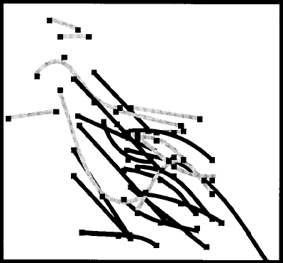
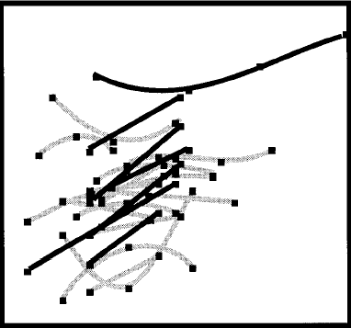
IMPACT OF DIETARY FIBER (NDF) AND CRUDE PROTEIN (CP) ON DMI
DMI, kg/d
28
DMI, kg/d
28
26
26
24
24
22
22
20
20
18
18
16
14
20
25
30
35
40
45
10
12
14
16
18
20
22
24
NDF, %DM
CP, %DM
Allen, 2000

Slide 10
ENERGY UTILIZATION

Slide 11
RUMINAL METABOLISM:
ENERGY AND MILK PRECURSORS SUPPLY
Ration
Rumen
Intestine
Fibrous carbohydrates
(NDF)
(Carbohydrates that escape
microbial fermentation)
Cellulose
(Starch)
(Glucose)
Hemicellulose
Glucose
Ammonia
Amino acids
Starch
Gases
Simple sugars
Volatile
fatty
acids
Bacterial
protein
Non-fibrous
carbohydrates (NFC)
Energy
Absorbed in the
blood
Feces
Absorbed in
the blood
Bacteria
Acetic acid
Triglycerides (Fats)
% Fat in milk
Energy
(Maintenance
pregnancy,
lactation, etc.)
Butyric acid
Propionic acid
Glucose
Lactose
(milk sugar)
Amount of milk
produced

Slide 12
ORIGIN OF MILK COMPONENTS
Lipids
Carbohydrates
Crude Protein
FEED/DIET
NDF
NFC
RDP
RUP
Acetic
Butyric
Bacterial
Protein
RUMEN
FERMENTATION
Propionic
Lactic
50%
LCFA
30%
SCFA
50%
60%
40%
UDDER
Milk Sugar
(Lactose)
Milk Protein
Milk Fat
Body
reserve

Slide 13
UTILIZATION OF ENERGY (E) BY THE COW
(NE = Net Energy)
Feed E: GE
Fecal E:
Undigested
OM
Digestible Energy: DE
Gases E:
CH₄
Urinary
E: Urea
Metabolizable Energy: ME
Pregnancy:
fetal tissues
E = NEy
Maintenance E = NEm + Heat
Body weight
/ gain
Body weight
loss
(BCS)
Heat
Heat
Heat
Heat
Heat
Tissue growth E = NEg
Milk E = NEl
Notes:
The fecal dry matter in ruminants has three origins:
(1) The first portion is made of undigested feed residues that resisted fermentation (microbial enzymes) and digestion (mammalian enzymes). The amount of this portion varies because it depends on diet quality, that is, the amount and digestibility of the diet.
(2) The largest portion of the dry matter in the feces of dairy cows is made up of the undigested microbial matter produced in the rumen (and the cecum). As indicated earlier, bacteria contain about 50-60% protein. And, 80% of this bacterial protein is digested in the small intestine. However, bacterial cell wall and bacterial genetic material (DNA), which represent about 40-50% of bacterial mass, are not digested and are found in the feces.
(3) The endogenous secretions are residues from pancreatic juices, bile, and digestive enzymes produced by the duodenum and mucous secretions of the large intestine. The body produces these secretions. After the enzymes and the bile have carried out their digestive roles they might be subjected to digestion, however, a significant portion passes into the feces. Typically, this fraction is proportional to dry matter intake. Logically, as cows eat more, more digestive secretions are required.
In most diets, undigested microbial mass is the single largest source of fecal dry matter. However, in high fiber diets, the undigested feed residue may become the largest source of fecal dry matter. As fiber in the diet increases, a greater portion of the dry matter is indigestible and bacterial production is correspondingly reduced. Diet digestibility decreases and the amount of undigested feed residue in the feces increases.

Slide 14
NEL SUPPLY FROM A FEED DEPENDS ALSO UPON ITS RATE OF DIGESTION IN THE RUMEN AND RATE OF PASSAGE FROM THE RUMEN
There is a depression in digestibility (i.e., energy value) with decrease retention time (i.e. faster passage) in cows at high intake and level of production.
Rate of
digestion
(%/h)
Feed Fraction
Residence time in rumen (h)
Composition
A fraction
100
“Soluble”
> 250
Slowly
Digestible
B fraction
(∼fiber)
Kd, %/h
0.02 - 0.15
C fraction
Indigestible
0
0
Digestion Time (h)
Notes:
The feed has been broken down into three fractions: the A fraction which is very soluble and will ferment rapidly in the rumen at >250 percent per hour. This means that in less than 15 minutes it has dissapeared from the rumen. The B fraction, typically digests at a rate we call Kd or the slowly digestable fraction, 0.2-.015. The indigestable fraction is 0 and the only way it can be digested is by passage by fermentation.
The rate of digestion happens slowly as seen by this line. The A and the B fraction give energy to the cow. A is readily available, but B is available over time. If something stays in the rumen for 72 hours, then the dissapearance of the B fraction is almost complete, so the cow benefited from the entire B fraction. But the entire rumen retention time is only half of this, then the cow benefited only a fraction of the B fraction and part of it is not digested because the feed leaves the rumen at this point.

Slide 15
FASTER RATE OF DIGESTION OF LEGUME FIBER MEANS THAT IT HAS A HIGHER ENERGY VALUE FOR HIGH PRODUCING COWS THAN GRASS FIBER
Extent of digestion of the “B (fibrous) fraction”, %
Grasses
Legumes
0
24
48
72
hours
Retention time of a
high producing cow
at high level of intake
Retention time of a
dry cow
at low level of intake
Notes:
This is the digestion curve. Legumes digest faster, but plateau earlier. Grasses digest more slowly, but have a higher plateau. The B fraction is greater in grass than the B fraction is in legumes.
If these two forages are fed to a cow who has a rumen retention time of about 24 hours, which would be a high producing cow, the legume would be more digested at 24 hours. If the same feed is fed to a dry cow, which has a rumen retention time of about 40-72 hours, the grasses give the dry cow more energy.

Slide 16
DIGESTIBILITY DECREASES AT HIGHER LEVELS OF INTAKE (AND MILK PRODUCTION)
Rate of
Digestion
Dry Matter Intake²
Rate of
Passage²
Digested,%
Relative to
maintenance
Kd
Item
Lbs/d
X 100
Kd /h
Kp /h
Kd + Kp
Fiber (slowly “digestible” feed fraction)
Alfalfa hay
0.10
1
25
0.02
83
2
40
0.04
71
3
55
0.06
63
Starch (rapidly “digestible” feed fraction)
Corn starch
0.36
1
25
0.02
95
2
40
0.04
90
3
55
0.06
86
² Assuming a cow of about 1450 lbs producing ≅ 0, 50 and 100 lbs milk, respectively.

Slide 17
WHICH DIET DO YOU PREFER AND WHY?
Ration
Ingredients, % ration DM
A
B
C
Alfalfa Silage
25.1
25.1
25.0
B - A =
Effect of drop in DMI;
C - B =
Re-balancing assuming lower DMI for same production as in ration A.
A - C = Two rations with same milk production but different intake
Corn Silage
50.1
50.1
30.0
Tallow
0.0
0.0
2.2
Corn grain
11.0
11.0
27.0
Soybean meal, solv (48%)
2.0
2.0
4.0
Soybean meal, expellers
9.0
9.0
9.0
Sodium bicarbonate
0.83
0.83
0.84
Calcium carbonate
0.48
0.48
0.48
Mono-sodium phosphate
0.16
0.16
0.16
Micro min & Vitamin premix
1.30
1.30
1.30
Total, % of ration DM
100
100
100
Dry matter intake, kg/d
24.6
22.5
22.5
Milk from Met. Protein, kg/d
38.3
34.4
38.3

Slide 18
LACTATING COWS STORE ENERGY MORE EFFICIENTLY THAN DRY COWS
75%
(lactating cow)
Body Fat
Storage
82%
Feed
59%
(dry cow)
Milk
62%
Efficiency of converting feed (ME) to milk is 62%
Converting feed (ME) to body fat (during lactation) then to milk is: 0.75 x 0.82 = 0.62
Converting feed (ME) to body fat (during dry period), then to milk is: 0.59 x 0.82 = 0.48

Slide 19
INFLUENCE OF RATION COMPOSITION ON DMI: FORAGE TO CONCENTRATE RATIO (F/C)
Forages:
Large volume
per unit of weight
Concentrates:
Small volume
per unit of weight
High forage: high F/C
High concentrate: low F/C
High volume (bulkiness)
Low volume (bulkiness)
Low energy density
High energy density

Slide 20
SUMMARY
BALANCING OF DIET IS ESSENTIAL
UNDERSTAND THE NDF AND NFC OF THE DIET
ENERGY CAN BE UTILIZED DIFFERENTLY
ENERGY CAN HELP MANAGE MILK COMPONENTS
FORAGE AND CONCENTRATE RATIOS ARE CRUCIAL TO MAXIMIZE DIGESTION AND EFFICIENCY OF ENERGY UTILIZATION

Slide 21
TAKE HOME MESSAGE ?

Slide 22
THANK YOU

