Slide 1


ScamCatch
The voice that speaks up before you send.
ScamCatch catches scams on the phone, in the moment, and opens a live AI voice that talks the person through it before any money moves.
Jonathan Kim, Founder · Mirae Opus LLC · scamcatch.io
Notes:
ScamCatch, a product of Mirae Opus LLC (California). Phone image: the live demo at scamcatch.io, showing the ScamCatch warning on a romance-investment scam.

Slide 2
Older Americans lost up to $81.5 billion to fraud in 2024
THE PROBLEM
4×
Reported losses grew from about $600 million in 2020 to $2.4 billion in 2024, driven by single losses over $100,000.
$81.5B
$83K
Average reported loss per victim age 60+ in 2024, across more than 147,000 FBI complaints.
lost to fraud by Americans 60+ in 2024
The FTC’s upper estimate, counting the many scams that are never reported. Its very conservative floor is $10.1 billion.
THE GAP
Every scam has a moment when the person is alone with the scammer, deciding. Today’s defenses, like chargebacks, police reports and account monitoring, show up after the money is gone.
Reported to the FTC $2.4B
Estimated, counting unreported scams up to $81.5B
Sources: FTC, Protecting Older Consumers 2024–2025 (Dec. 2025); FBI IC3 2024 data as reported by AARP.
Notes:
FTC, Protecting Older Consumers 2024-2025, report to Congress, December 2025: overall cost of fraud to older adults in 2024 estimated between $10.1B and $81.5B; reported losses rose from about $600M (2020) to $2.4B (2024), driven by losses over $100,000. https://www.ftc.gov/system/files/ftc_gov/pdf/P144400-OlderAdultsReportDec2025.pdf
FBI IC3 2024 data as reported by AARP: adults 60+ reported nearly $4.9B lost, 147,000+ complaints, average loss $83,000. https://www.aarp.org/money/scams-fraud/fbi-report-fraud-2024/

Slide 3
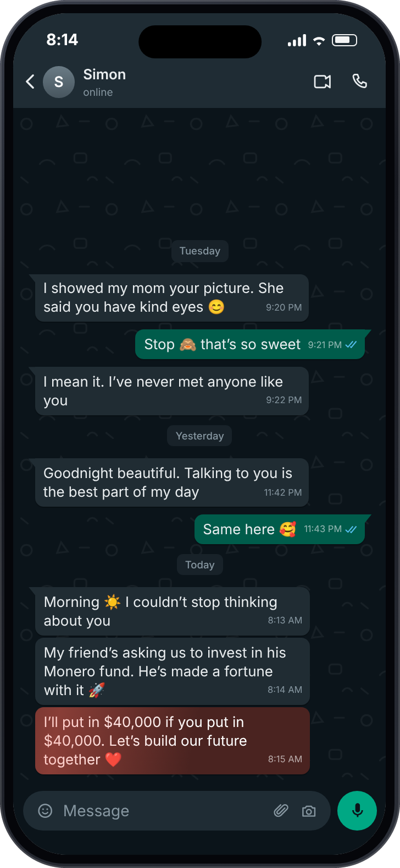
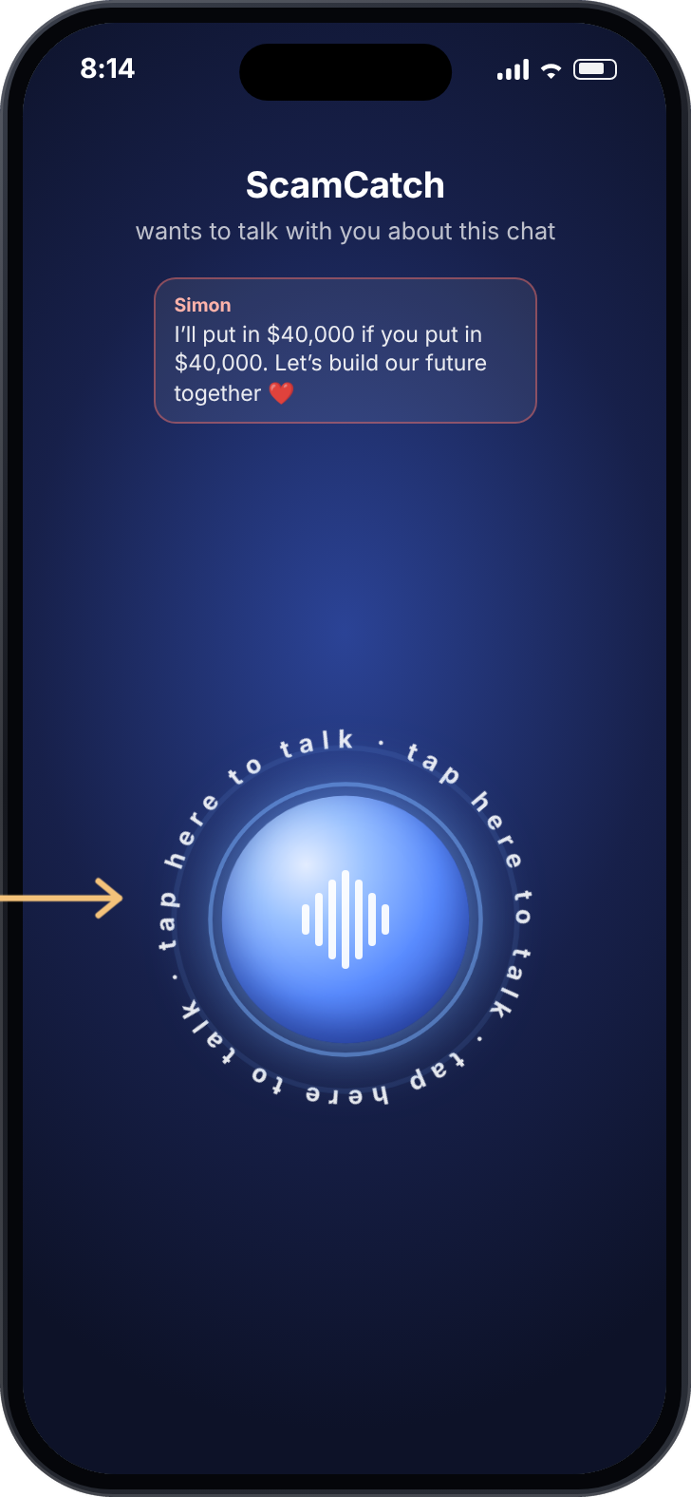
It catches the scam on the phone, then starts a conversation
THE SOLUTION
→
→
1 It reads the moment
2 It spots the pattern
3 It calls you
With permission, it reads the text on screen in the apps people already use: texts, WhatsApp, Facebook.
An AI model flags the signs: a new online relationship, urgency, secrecy, a request for money.
A live AI voice opens, listens, asks questions, and helps the person check before any money moves.
Notes:
Screens are from the live demo at scamcatch.io. The Android prototype reads on-screen text with consent (on-device OCR), runs AI scam detection on that text, and opens a live AI voice warning when a check is flagged.

Slide 4
Other tools act after the decision. ScamCatch acts during it
WHAT SETS US APART
First contact
Trust builds
The ask
The decision
Money moves
Loss reported
ScamCatch steps in here
Bank alerts
Monitoring
Account monitoring
Scam checkers
Bank fraud alerts
ScamCatch
e.g. Carefull
e.g. ZoraSafe
At payment time
In the conversation
Watches accounts and alerts family after transactions happen.
Help only if the person already suspects a scam and stops to ask.
Arrive after the person has decided. Scammers often coach victims to wave them off.
Notices the scam in the chat itself, speaks first, and helps the person reach the answer on their own.
Notes:
Carefull: financial monitoring and alerts, with view-only access for trusted contacts (getcarefull.com, checked Oct 8, 2026). ZoraSafe: suspicious-content checks with risk explanations and next steps (zorasafe.com, checked Oct 8, 2026).

Slide 5



Built for older adults. Paid for by those who protect them
TARGET CUSTOMER
The person we protect
First buyer: banks and credit unions
Also: families and senior living
Adults 60+ who live on their phones: texts, WhatsApp, Facebook. We start with Android users.
They want to stop fraud before the payment and keep their members’ trust. ScamCatch gives them a voice in that moment.
Adult children who want a safety net for Mom or Dad, and senior living communities protecting their residents.
Beachhead: community credit unions, which are member-owned and close to the older people they serve.
Notes:
Founder-identified buyers and channels: banks, credit unions, senior living communities, and adult children of older parents. Credit unions are proposed as the first buyer to pursue; pricing and the first paying buyer will be validated in pilots.

Slide 6
A problem worth billions, with a clear channel to reach it
THE MARKET
$81.5B
61.2M
8,452
lost by Americans 60+ in 2024
Americans age 65 and older
U.S. banks and credit unions
FTC upper estimate; floor $10.1B
U.S. Census Bureau, 2024
FDIC and NCUA, mid-2026
$734M
If institutions pay $1 per protected senior per month
across 61.2 million Americans 65+. One credit union with 20,000 members 65+ would be $240,000 a year.
Illustrative pricing. We will set real prices in pilots.
a year in revenue potential
Notes:
FTC Dec 2025: $10.1B-$81.5B overall cost of fraud to older adults in 2024. US Census Bureau Vintage 2024: 61.2M adults 65+. FDIC Quarterly Banking Profile Q2 2026: 4,238 insured institutions (ABA Banking Journal). NCUA Quarterly Data Summary Q2 2026: 4,214 federally insured credit unions, 146.1M members. Revenue figures are illustrative: $1 x 12 months x 61.2M = $734.4M; $1 x 12 x 20,000 = $240,000. Pricing is not validated.

Slide 7
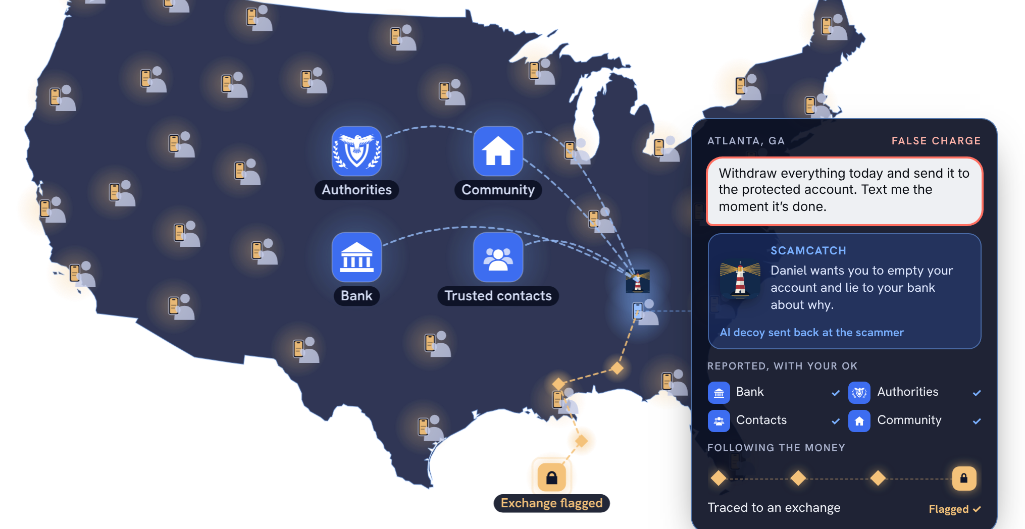
A first line of defense on every phone in America
THE VISION
NOW
Android app
Catches scams in any app, right on the phone.
NEXT
Bank-triggered calls
A risky payment at a partner bank starts a ScamCatch call first.
THEN
Every phone in America
With the person’s OK, alerts go to their bank, the authorities, family and community.
Illustration from scamcatch.io, not live data.
BEYOND
Built to scale. Text recognition runs on the phone. The AI voice costs about 5 cents a minute and only runs when a scam is flagged. One frontline layer of many, alongside banks, carriers, family and law enforcement.
Fighting back
An AI decoy ties up the scammer. Crypto tracing follows the money to the exchange.
Notes:
Map is the vision animation from scamcatch.io: illustrative, not live data. Voice cost reflects the pinned live voice model price of about $0.05 per minute (founder configuration). Text recognition runs on the phone with ML Kit. Bank-triggered calls, consent-based reports to banks, authorities, trusted contacts and the community, the AI decoy that ties up scammers, and crypto tracing are vision features, not built yet.

Slide 8

A working product, built solo. Customers come next
TRACTION
WHAT’S BUILT
WHERE WE ARE TODAY
Android app
0
0
0
$0
Reads the screen in any app, with the person’s consent.
users
pilots
contracts
revenue
AI scam detection
Pre-launch, and we say so plainly. The product works. Now it needs people.
Flags scam patterns in the text the person is reading.
Live AI voice
NEXT 90 DAYS
Opens when a scam is flagged and talks the person through it.
Test the voice with 25 older adults
Sign a first credit union pilot
Measure how often people pause and verify
Public live demo
scamcatch.io: 8 real-world scams and a live AI voice anyone can try.
Notes:
Founder-confirmed as of Oct 8, 2026: 0 users, 0 formal research studies, 0 pilots, 0 contracts, 0 customer commitments, $0 revenue. Prototype features per the project README and docs. The 90-day goals are proposed milestones for the founder to confirm.

Slide 9
Institutions license it. Families can buy it directly
REVENUE MODEL AND FUNDING
WHERE THE MONEY STANDS
Institutional license
Banks, credit unions and senior living pay per protected member per month, and offer ScamCatch free to their older customers.
Revenue | Pre-revenue: $0, with $0 MRR and ARR
Raised to date | $0, founder-funded
Raising now | No
Runway | Ongoing at prototype scale. Costs are low: hosting and per-minute AI.
Family plan
Adult children subscribe on behalf of a parent.
WHY WE BELIEVE THEY’LL PAY
Families already pay $29.99 a month for after-the-fact monitoring (Carefull, 2023).
Investors have put $19.7 million into that one company alone.
Notes:
Founder-confirmed: pre-revenue, $0 revenue, $0 MRR/ARR, $0 capital raised, not currently fundraising. Runway is the founder’s estimate at the current prototype scope (domain, hosting, and per-minute AI costs). Carefull pricing and funding: Coverager, Oct 11, 2023 ($29.99/month; $19.7M total raised).

Slide 10
One builder, a clear mission, and a short list of asks
TEAM
JK
Jonathan Kim
WHAT WE’RE ASKING FOR
Founder · Software engineer · First-time founder
1
Older adults to test ScamCatch and tell us the truth
Built every piece of ScamCatch himself: the Android app, the AI detection pipeline, the live voice, and the cloud behind scamcatch.io.
Advisors: none yet. The first seats to fill are a bank fraud-operations lead and an aging researcher.
2
A bank or credit union pilot partner
3
Mentorship through the AgeTech Collaborative accelerator
Our mission: take the money lost to scams to zero.
Notes:
Founder-confirmed: Jonathan Kim is the sole founder, a software engineer, and a first-time founder. No other team members or advisors today. Learned about AgeTech through an email exchange with Lona Choi Allum; this is not an endorsement.

