Slide 1


ScamCatch
SCAM INTERVENTION
ScamCatch catches scams on the phone, in the moment, and opens a live AI voice that talks the person through it before any money moves.
Notes:
ScamCatch, a product of Mirae Opus LLC (California). Phone image: the live demo at scamcatch.io, showing the ScamCatch warning on a romance-investment scam.

Slide 2

THE PROBLEM
Anyone can be scammed. Most victims never report it.
20 million
147,127
3 in 4
Americans may have lost money to fraud in a single year.
fraud complaints from people 60+ reached the FBI in 2024, with $4.9 billion lost.
dollars stolen from older Americans are likely never reported: $20.5B of $28.3B a year.
AARP
FBI IC3
AARP BankSafe & NORC
THE BELIEF THAT KEEPS VICTIMS QUIET
53%
47%
“Honestly, if you fall victim … a lot of that is on you.”
see scam victims as blameworthy
think reporting a scam is a lost cause
32% of Americans agree.
Sources: AARP fraud survey (2021 losses, published 2023); FBI IC3 Internet Crime Report 2024; AARP BankSafe Initiative with NORC; AARP Fraud Watch Network & FINRA Foundation, “Blame and Shame in the Context of Financial Fraud” (2022).
2
Notes:
AARP (May 2023): as many as 20 million Americans may have lost money to fraud in 2021; 81% of identified victims did not acknowledge it a year later. https://blog.aarp.org/fighting-for-you/aarp-survey-8-in-10-fraud-victims-may-not-know-theyve-experienced-a-scam
FBI IC3 2024: 147,127 complaints from people 60+, $4.885B in reported losses. https://cyberscoop.com/fbi-ic3-cybercrime-report-2024-key-statistics-trends/
AARP BankSafe with NORC: older Americans lose an estimated $28.3B a year to financial exploitation; about $20.5B is likely never reported. https://blog.aarp.org/fighting-for-you/elder-financial-exploitation-cost
AARP Fraud Watch Network and FINRA Investor Education Foundation, Blame and Shame in the Context of Financial Fraud (July 2022), survey of 1,000 U.S. adults: 85% believe fraud can happen to anyone; 53% identify victims as culpable and blameworthy; 32% agreed 'Honestly, if you fall victim ... a lot of that is on you'; 47% think reporting a scam is a lost cause. https://www.aarp.org/money/scams-fraud/info-2022/victim-blaming.html

Slide 3


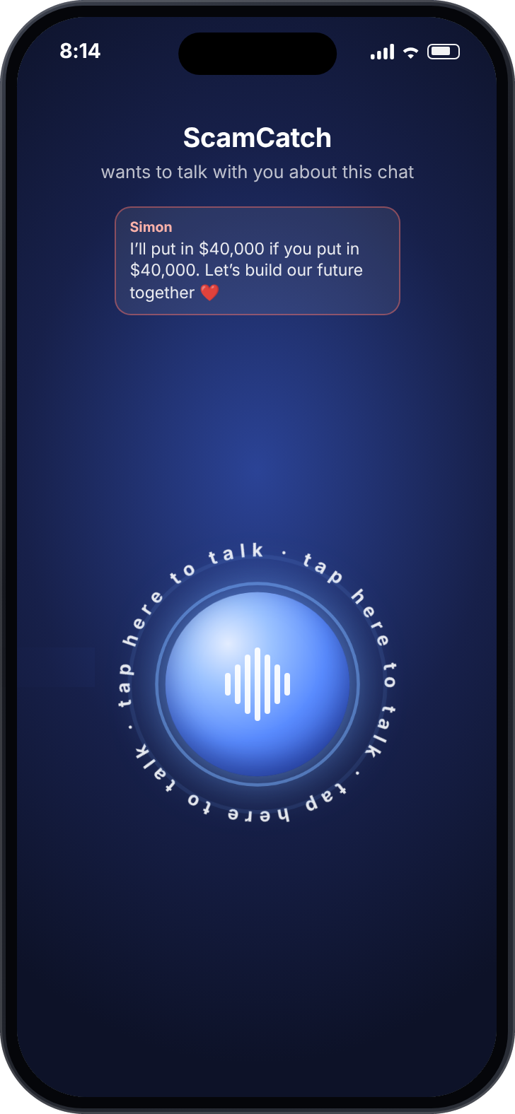
HOW IT WORKS
It catches the scam, then it intervenes.
1
It spots the scam on screen
With permission, it reads the chat in apps people already use, like texts, WhatsApp and Facebook, and flags the warning signs.
2
Then a live AI voice intervenes
It listens, asks questions, and helps the person check before any money moves.
1 The warning
2 The voice
3
Notes:
Screens are from the live demo at scamcatch.io. The Android prototype reads on-screen text with consent (on-device OCR), runs AI scam detection on that text, and opens a live AI voice warning when a check is flagged.

Slide 4





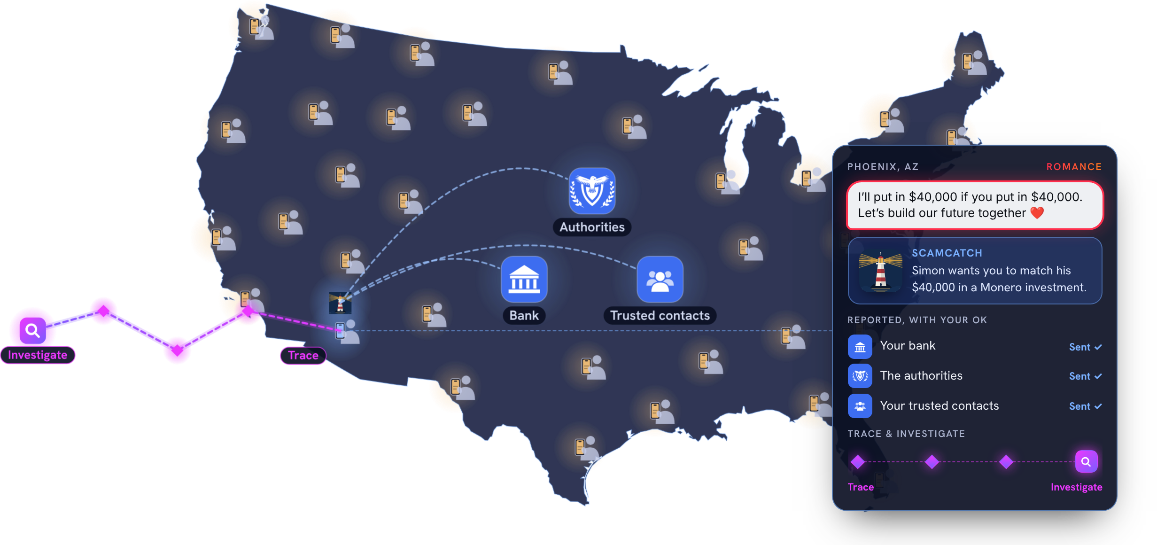
THE VISION
A first line of defense on every phone in America.
A scammer messages you.
ScamCatch intervenes and opens a voice chat.
With your OK, it alerts your bank, the authorities, and your trusted contacts.
Trace & investigate to help get back lost funds.
Illustration from scamcatch.io, not live data.
4
Notes:
The map and four steps are the vision section of scamcatch.io: illustrative, not live data. Today the Android prototype does steps 1 and 2 (it reads on-screen text with consent, flags likely scams, and opens a live AI voice). Alerts to banks, authorities and trusted contacts, and tracing funds, are future plans.

Slide 5

WHAT SETS US APART
Other tools act after the decision. ScamCatch acts during it.
First contact
Trust builds
The ask
The decision
Money moves
Loss reported
ScamCatch speaks up here
Bank fraud alerts
Account monitoring
Monitoring tools like Carefull alert family after transactions happen. Scam checkers like ZoraSafe only help if the person already suspects a scam and stops to ask. Scammers often coach victims to wave off bank alerts.
IT TALKS LIKE SOMEONE WHO’S ON YOUR SIDE
It listens before it warns.
It gives a reason to check, not a verdict.
The person stays in charge.
“That sounds like someone who means a lot to you. How did you two meet?”
“Before anything moves, let’s look up that platform together.”
“You decide who else hears about this, if anyone.”
5
Notes:
Carefull: financial monitoring and alerts, with view-only access for trusted contacts (getcarefull.com, checked Oct 8, 2026). ZoraSafe: suspicious-content checks with risk explanations and next steps (zorasafe.com, checked Oct 8, 2026).
Voice examples are from the voice section of scamcatch.io.

Slide 6
MARKET
A problem worth billions, with a clear channel to reach it.
$81.5B
61.2M
8,452
lost by Americans 60+ in 2024
Americans age 65 and older
U.S. banks and credit unions
FTC upper estimate; floor $10.1B
U.S. Census Bureau, 2024
FDIC and NCUA, mid-2026
$734M
If institutions pay $1 per protected senior per month
across 61.2 million Americans 65+. One credit union with 20,000 members 65+ would be $240,000 a year. Illustrative pricing; we will set real prices in pilots.
a year in revenue potential
Built to scale. Text recognition runs on the phone. The AI voice costs about 5 cents a minute and only runs when a scam is flagged.
6
Notes:
FTC Dec 2025: $10.1B-$81.5B overall cost of fraud to older adults in 2024. US Census Bureau Vintage 2024: 61.2M adults 65+. FDIC Quarterly Banking Profile Q2 2026: 4,238 insured institutions (ABA Banking Journal). NCUA Quarterly Data Summary Q2 2026: 4,214 federally insured credit unions, 146.1M members. Revenue figures are illustrative: $1 x 12 months x 61.2M = $734.4M; $1 x 12 x 20,000 = $240,000. Pricing is not validated.
Map is the vision animation from scamcatch.io: illustrative, not live data. Voice cost reflects the pinned live voice model price of about $0.05 per minute (founder configuration). Text recognition runs on the phone with ML Kit. Bank-triggered interventions, consent-based reports to banks, authorities, trusted contacts and the community, the AI decoy that ties up scammers, and crypto tracing are vision features, not built yet.

Slide 7




TARGET CUSTOMER
Built for older adults. Paid for by those who protect them.
The person we protect
First buyer: banks and credit unions
Also: families and senior living
Adults 60+ who live on their phones: texts, WhatsApp, Facebook. We start with Android users.
They want to stop fraud before the payment and keep their members’ trust. ScamCatch gives them a voice in that moment.
Adult children who want a safety net for Mom or Dad, and senior living communities protecting their residents.
Beachhead Community credit unions, which are member-owned and close to the older people they serve.
7
Notes:
Founder-identified buyers and channels: banks, credit unions, senior living communities, and adult children of older parents. Credit unions are proposed as the first buyer to pursue; pricing and the first paying buyer will be validated in pilots.

Slide 8
TRACTION, REVENUE MODEL AND FUNDRAISING
A working product, built solo. Customers come next.
Traction
Revenue model
Fundraising
Working Android prototype: reads the screen, flags scams, opens a live AI voice.
Public live demo at scamcatch.io with 8 real-world scams.
0 users, 0 pilots, 0 contracts so far.
Families already pay $29.99 a month for after-the-fact monitoring (Carefull).
Banks, credit unions and senior living license it per protected member per month.
Families can subscribe on behalf of a parent.
Pre-revenue today: $0 MRR and ARR.
$0 raised to date, founder-funded.
Not fundraising now.
Runway: ongoing at prototype scale. Costs are low: hosting and per-minute AI.
8
Notes:
Founder-confirmed as of Oct 8, 2026: 0 users, 0 formal research studies, 0 pilots, 0 contracts, 0 customer commitments, $0 revenue. Prototype features per the project README and docs. The 90-day goals are proposed milestones for the founder to confirm.
Founder-confirmed: pre-revenue, $0 revenue, $0 MRR/ARR, $0 capital raised, not currently fundraising. Runway is the founder’s estimate at the current prototype scope (domain, hosting, and per-minute AI costs). Carefull pricing and funding: Coverager, Oct 11, 2023 ($29.99/month; $19.7M total raised).

Slide 9


TEAM AND ADVISORS
One builder, one clear mission.
Jonathan Kim
Founder · Software engineer · First-time founder
Built every piece of ScamCatch himself: the Android app, the AI detection pipeline, the live voice, and the cloud behind scamcatch.io.
Advisors: none yet. The first seats to fill are a bank fraud-operations lead and an aging researcher.
Our goal: $0 lost to scams.
ScamCatch
Built by Mirae Opus LLC in California. © 2026
9
Notes:
Founder-confirmed: Jonathan Kim is the sole founder, a software engineer, and a first-time founder. No other team members or advisors today. Learned about AgeTech through an email exchange with Lona Choi Allum; this is not an endorsement. Photo and goal line are from the About section of scamcatch.io.

