Slide 1
Project 2: Puzzle!
Ryan Garland and Sam Cooney

Slide 2
Outline
Introduction
What extra features we chose
User
Design
Testing
Demo
Show source code

Slide 3
User: How do you make a 15 Slide Puzzle?
Problem:
Create a puzzle game
Add the following extra features:
End-of-game notification
Multiple backgrounds
Extra Animation (after winning)
Game time with some music file
Inputs
User shuffles the board
User clicks movable pieces to solve the game
Outputs
Current board state
Time elapsed
Number of moves made
Win screen

Slide 4
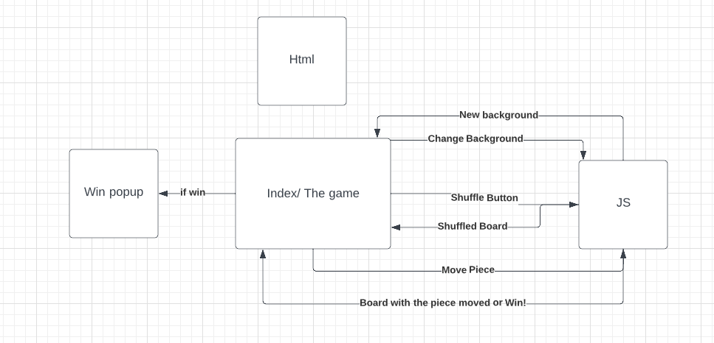
SCRUM and UML
Benefits
Allows to the plan out the roadmap for the project
Allowed us to reformat certain elements
Allowed to split work evenly

Slide 5
Design: Flow of the game
Index/Game Screen
Contains buttons to change background, and shuffle the board
Shows current board state
If the player won, a window will pop up saying a message, move count and time elapsed
Javascript
Handles shuffle logic
Handles moving pieces and updating the board
Handles changing the background
Keeps and returns time elapsed
Keeps and returns moves made

Slide 6
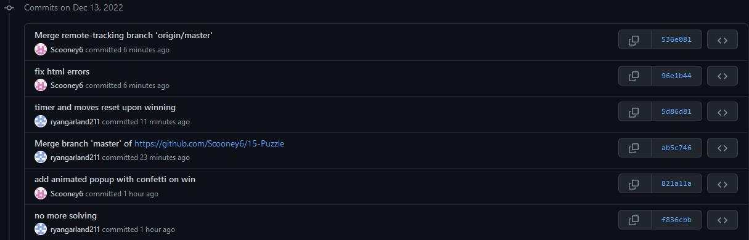
Testing
Tested Features after implementation
Example tests:
Checking if shuffle resets the timer and moves
Check to see if win pop up comes after winning
Time can increase past 60 seconds
Game can be reshuffled after winning

Slide 7
Demo

Slide 8
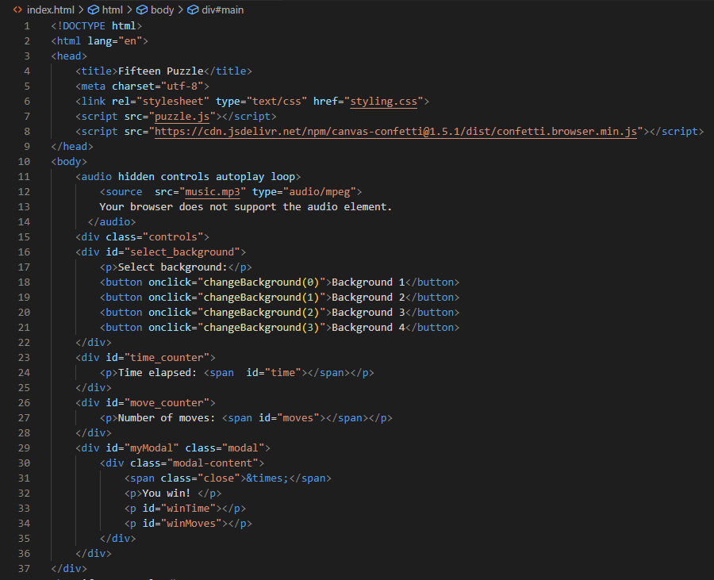
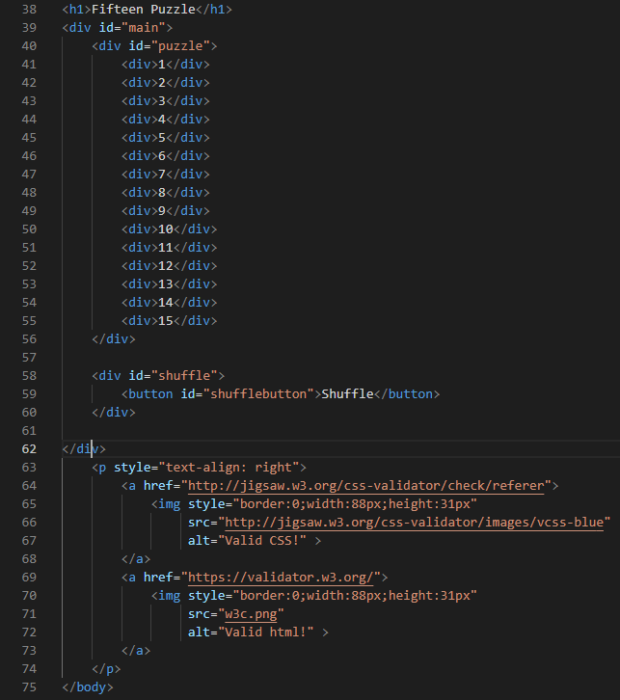
The Code: index.html

Slide 9
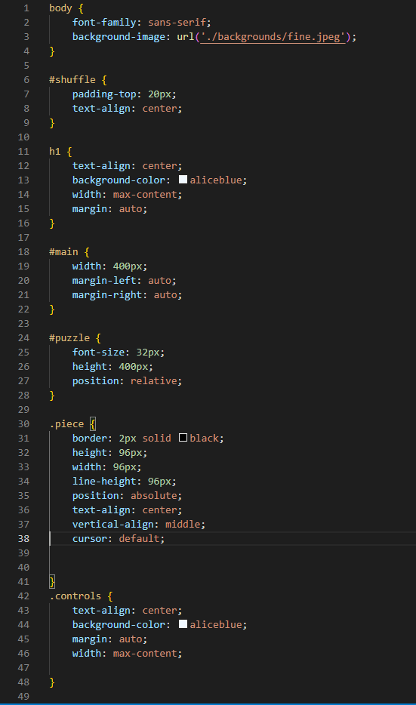
The Code: Styling

Slide 10
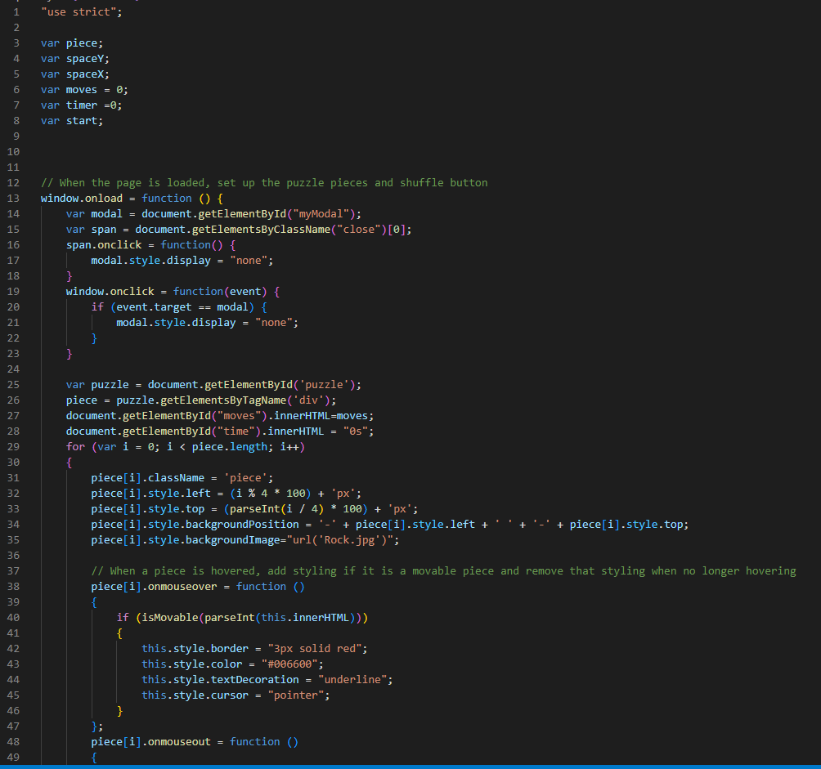
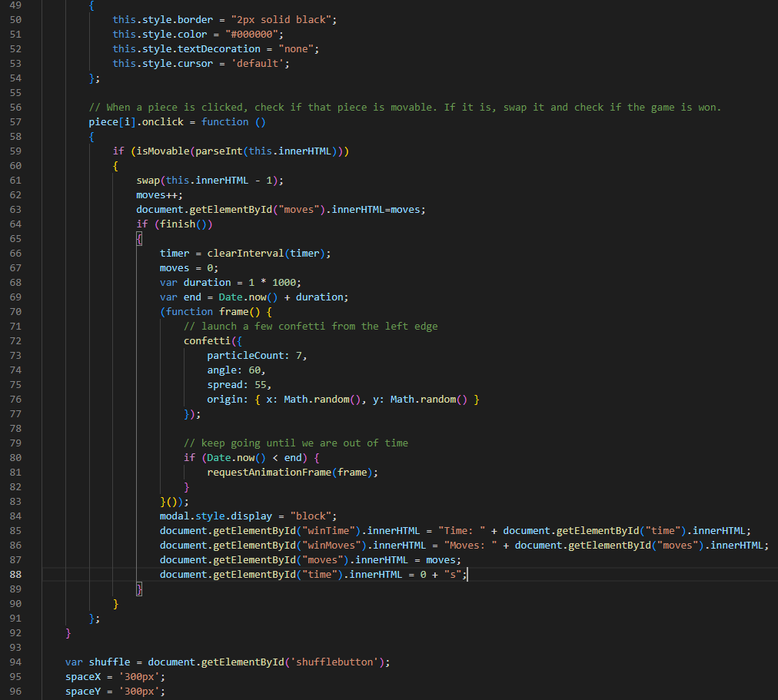
The Code: puzzle.js

Slide 11
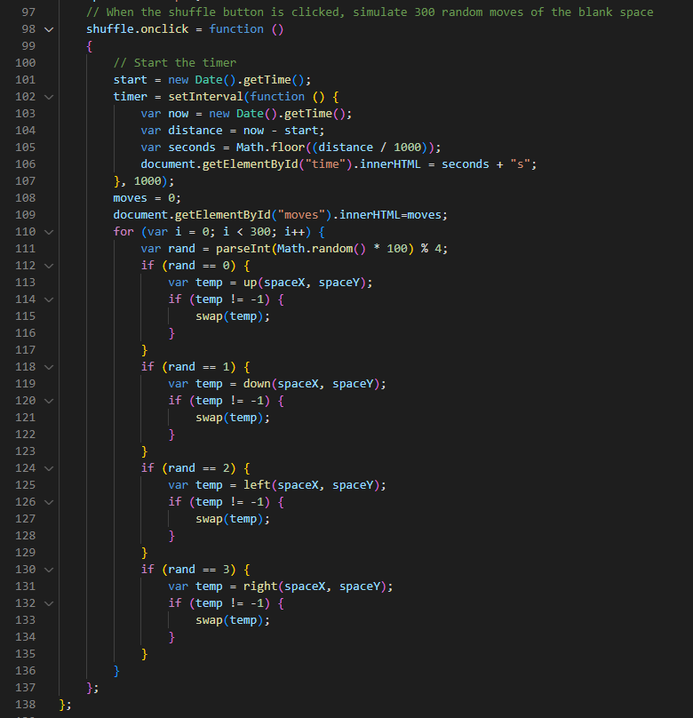
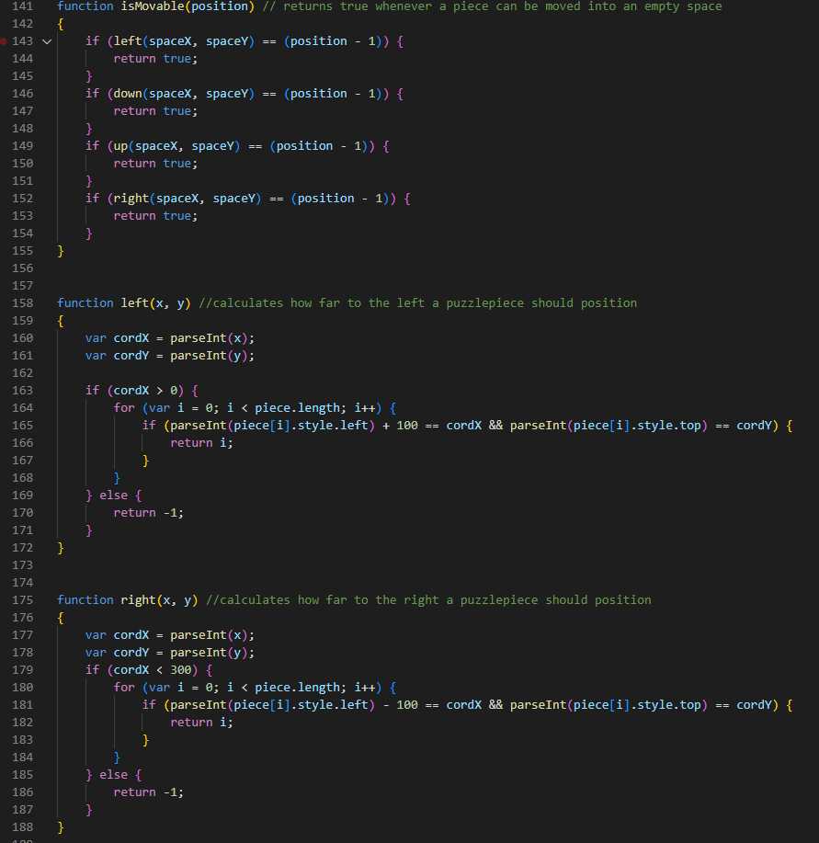
The Code: puzzle.js (cont.)

Slide 12
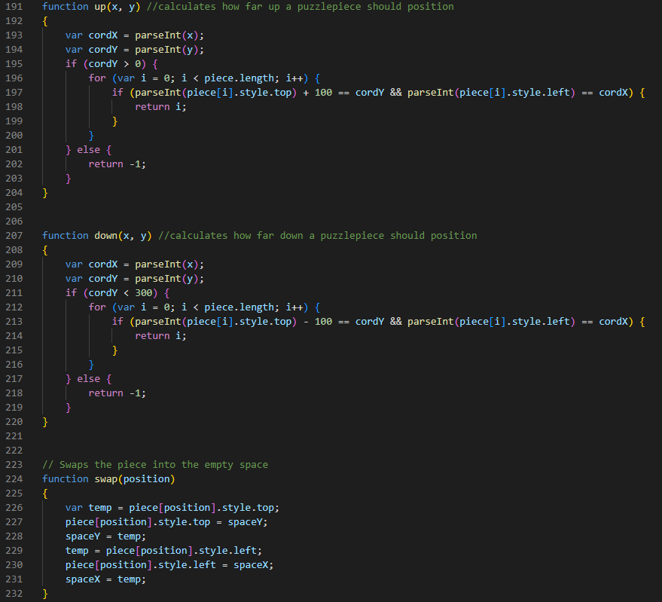
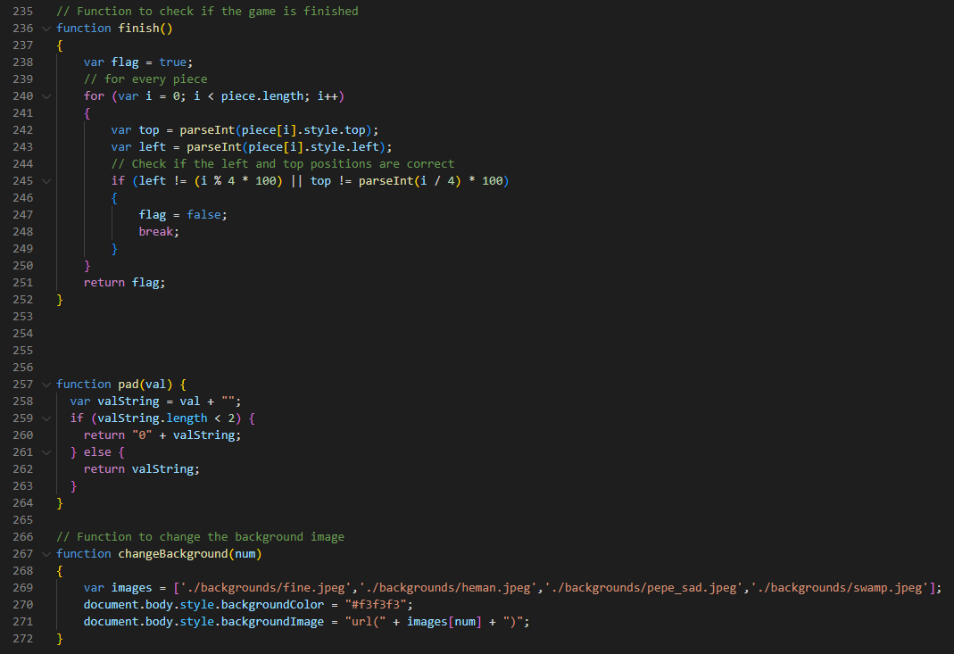
The Code: puzzle.js (cont.2)

Slide 13
The End, Thank you!

