Slide 1
TEAM PROJECT
PROPOSAL
By: Sam Cooney, Aman Baig, Pedro Silverio, Mridula Venkatasamy, Jenny Dinh

Slide 2
TABLE OF CONTENTS
01
04
Project Introduction
Process Flow Map
02
05
Project Goals
HTML Demo
03
06
UML Diagrams
Conclusion
What the project is about
Also known as the Road Map
The Purpose of our web application
Behind the Scenes of the pages
A look at the sequence and use case diagrams
How we will go about finishing this project

Slide 3
01
ABOUT THE PROJECT
A web application for Music users to compare their music tastes. The comparison shows shared liked genres, songs, and artists as well as generating a score based on the likelihood of their music tastes.

Slide 4
02
TARGETED USERS
MUSIC LOVERS
MUSIC ARTISTS
MUSIC PROFESSIONALS
People who love music
Allows artists to get discovered by your friends
Music Marketers and Producers

Slide 5
02
TECHNICAL PLATFORMS
PROGRAMMING LANGUAGES
WEB FRAMEWORKS
DATABASES
HTML/CSS Javascript
Python
Bootstrap
Flask (Python)
MYSQL

Slide 6
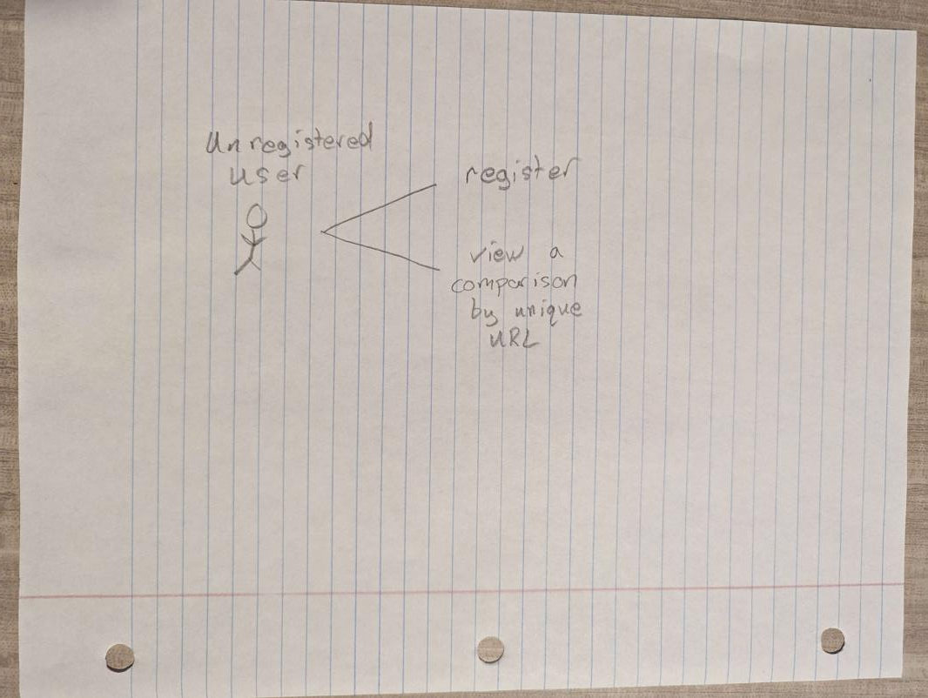
03
UML USE CASE DIAGRAM 1

Slide 7
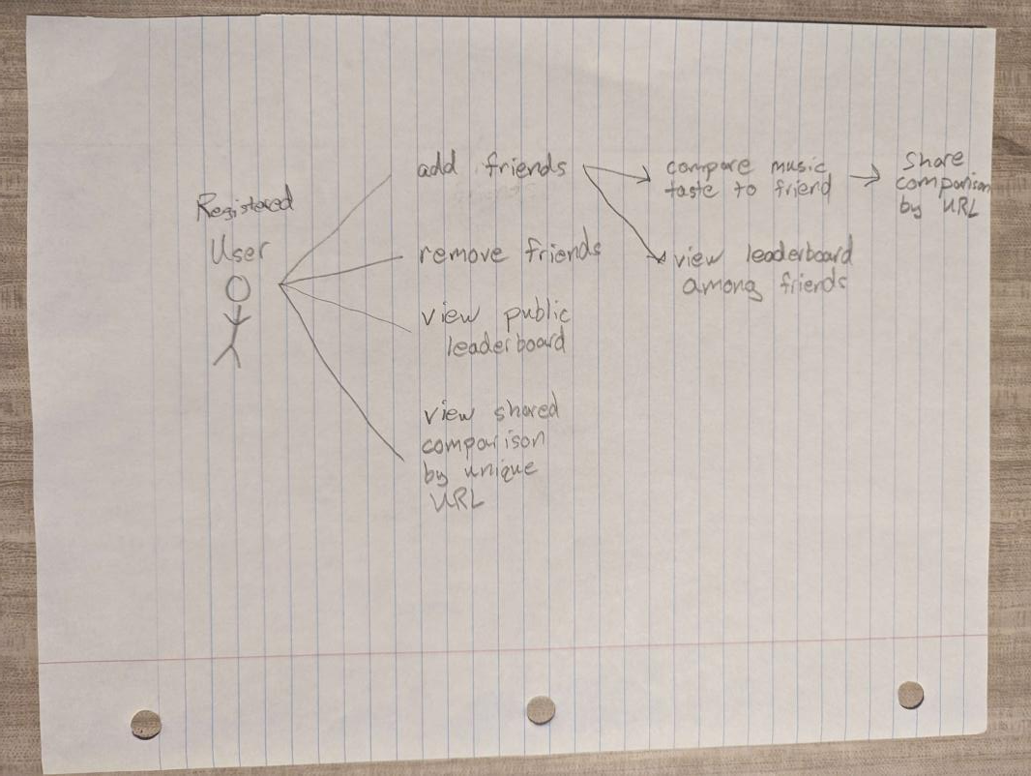
03
UML USE CASE DIAGRAM 2

Slide 8
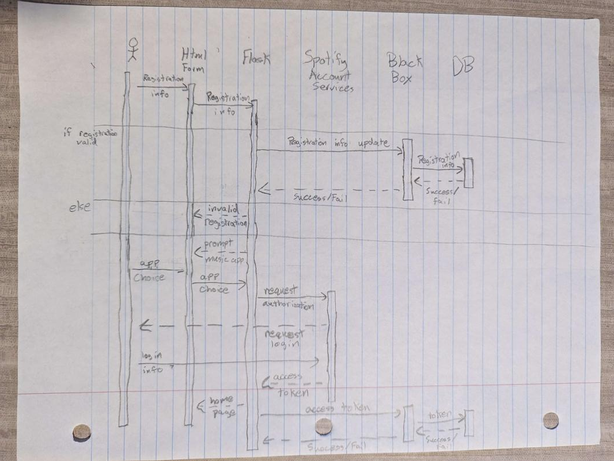
03
UML SEQUENCE DIAGRAM

Slide 9
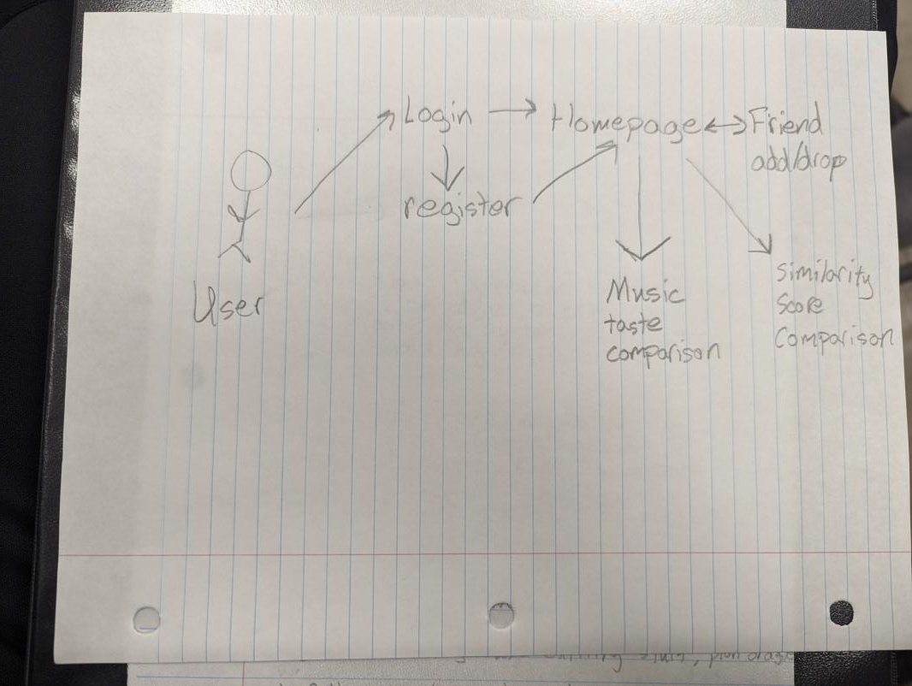
04
PROCESS FLOW MAP

Slide 10
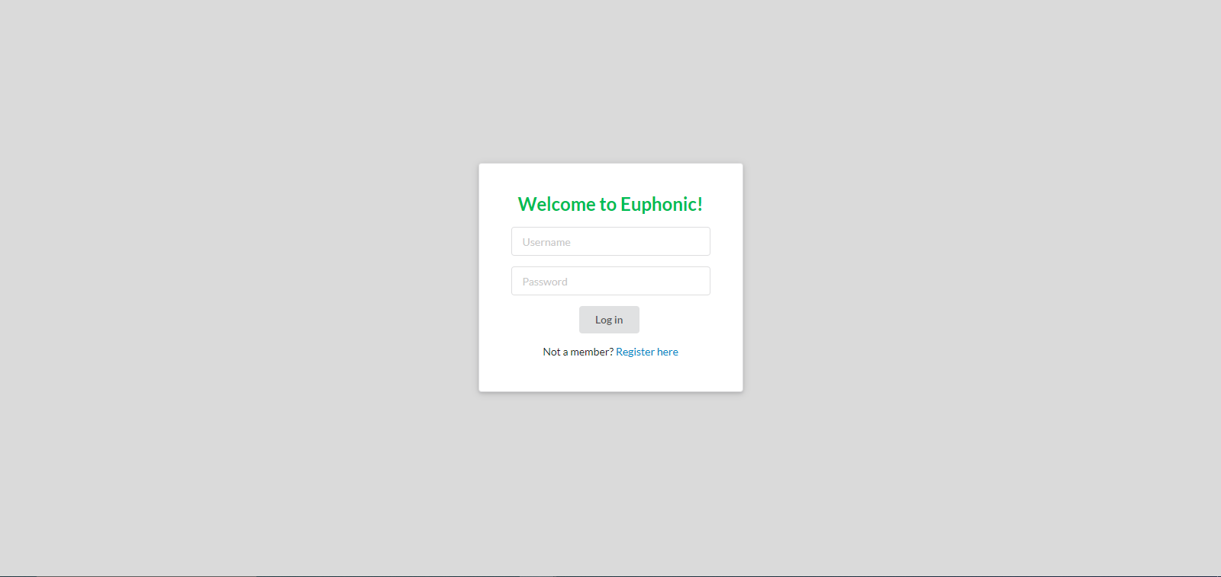
05
HTML INDEX DEMO

Slide 11
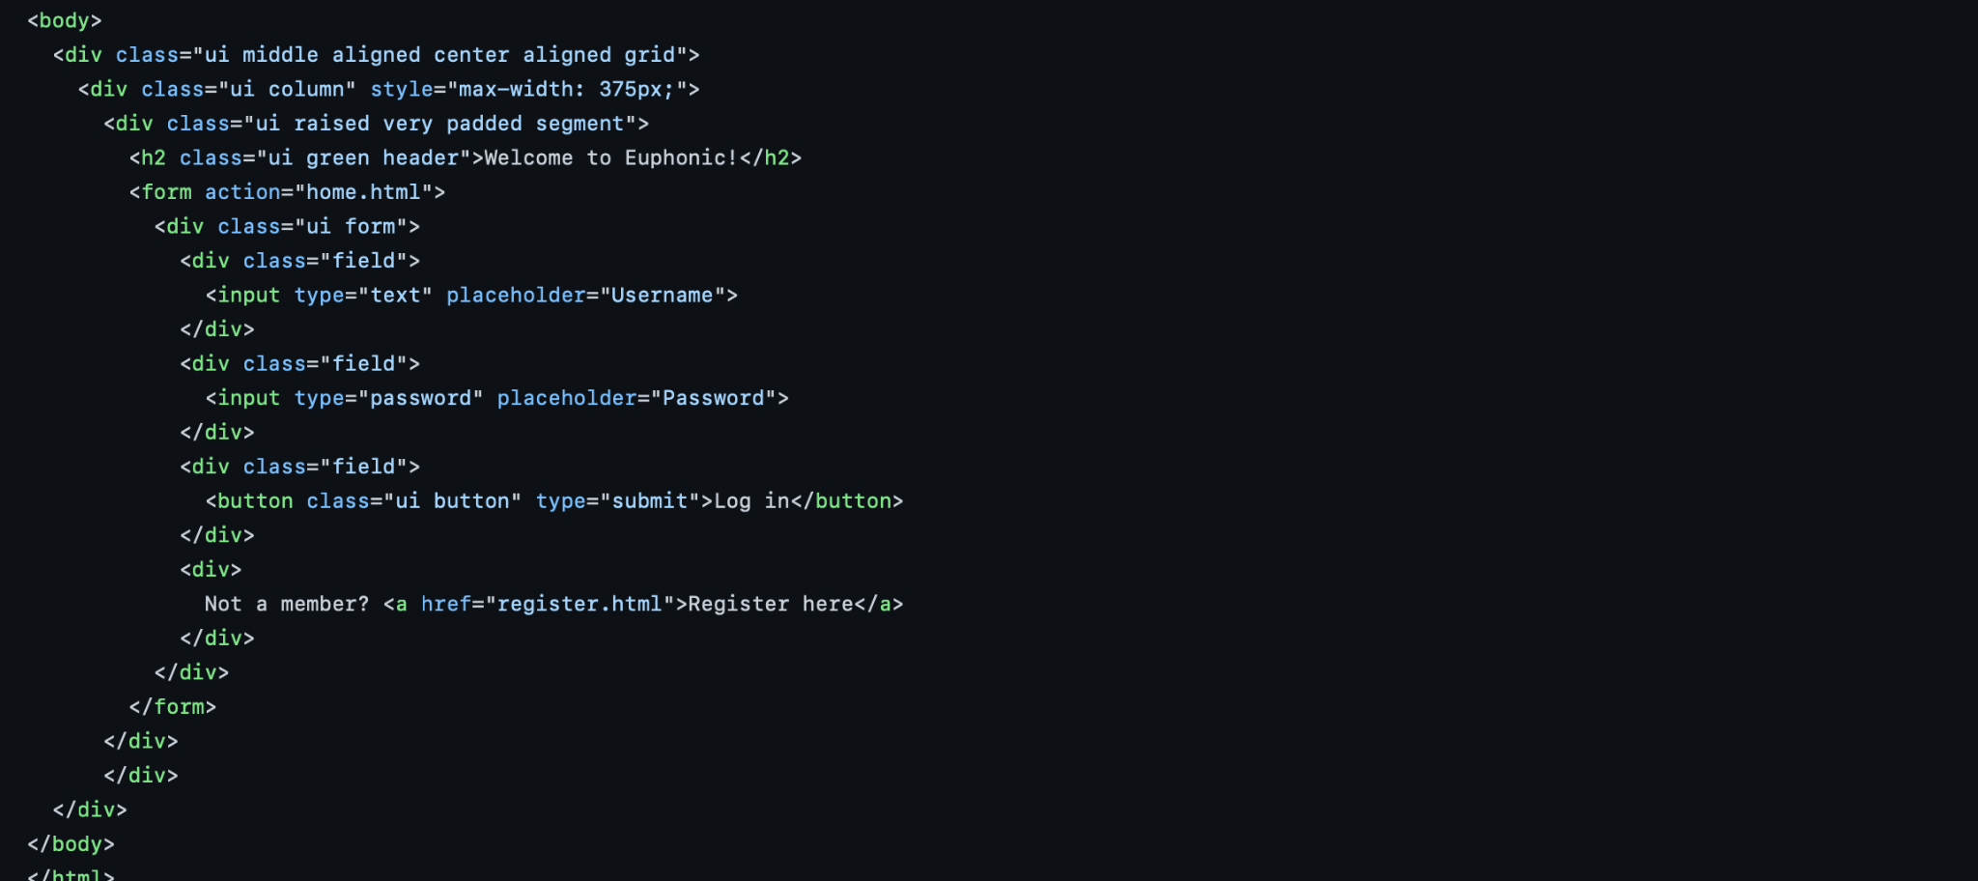
05
INDEX CODE

Slide 12
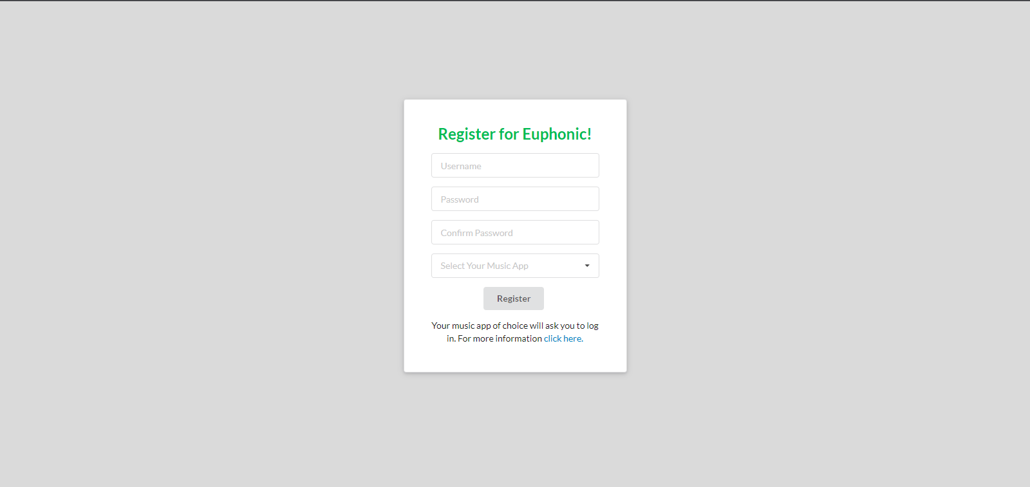
05
HTML REGISTER DEMO

Slide 13
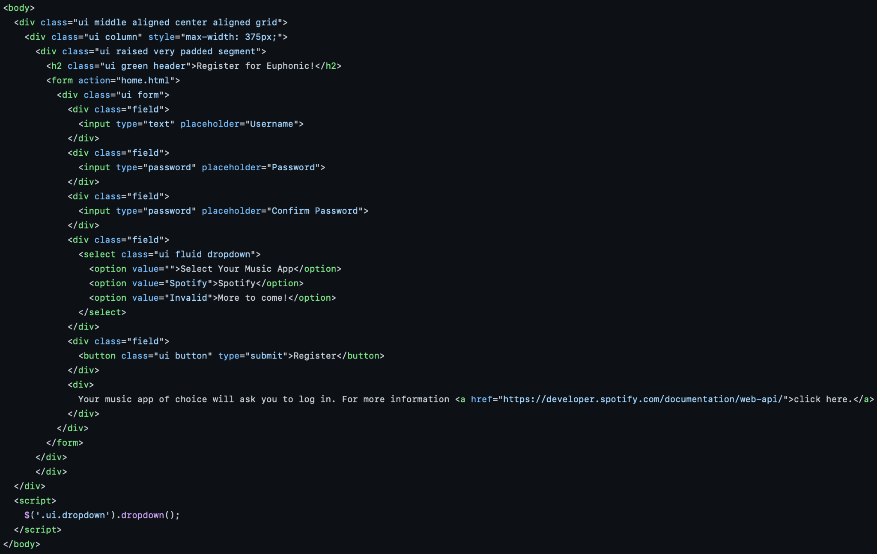
05
REGISTER CODE

Slide 14
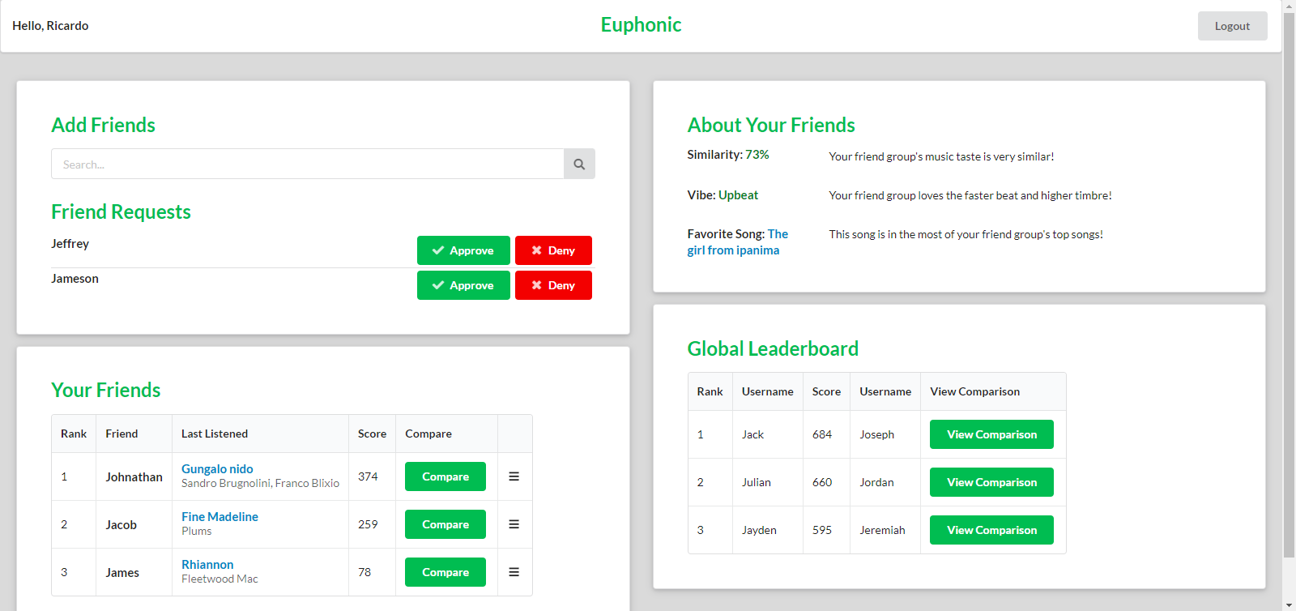
05
HTML HOME DEMO

Slide 15
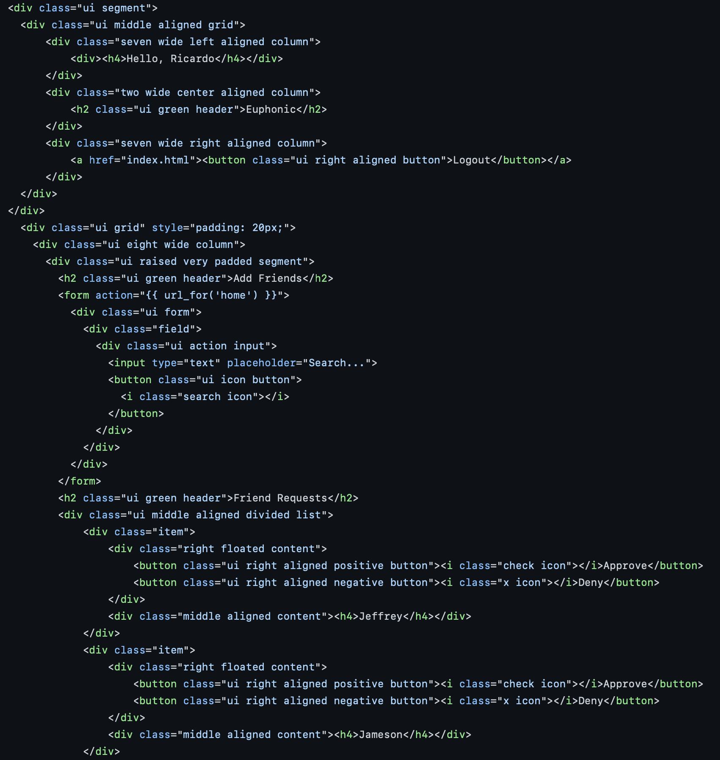
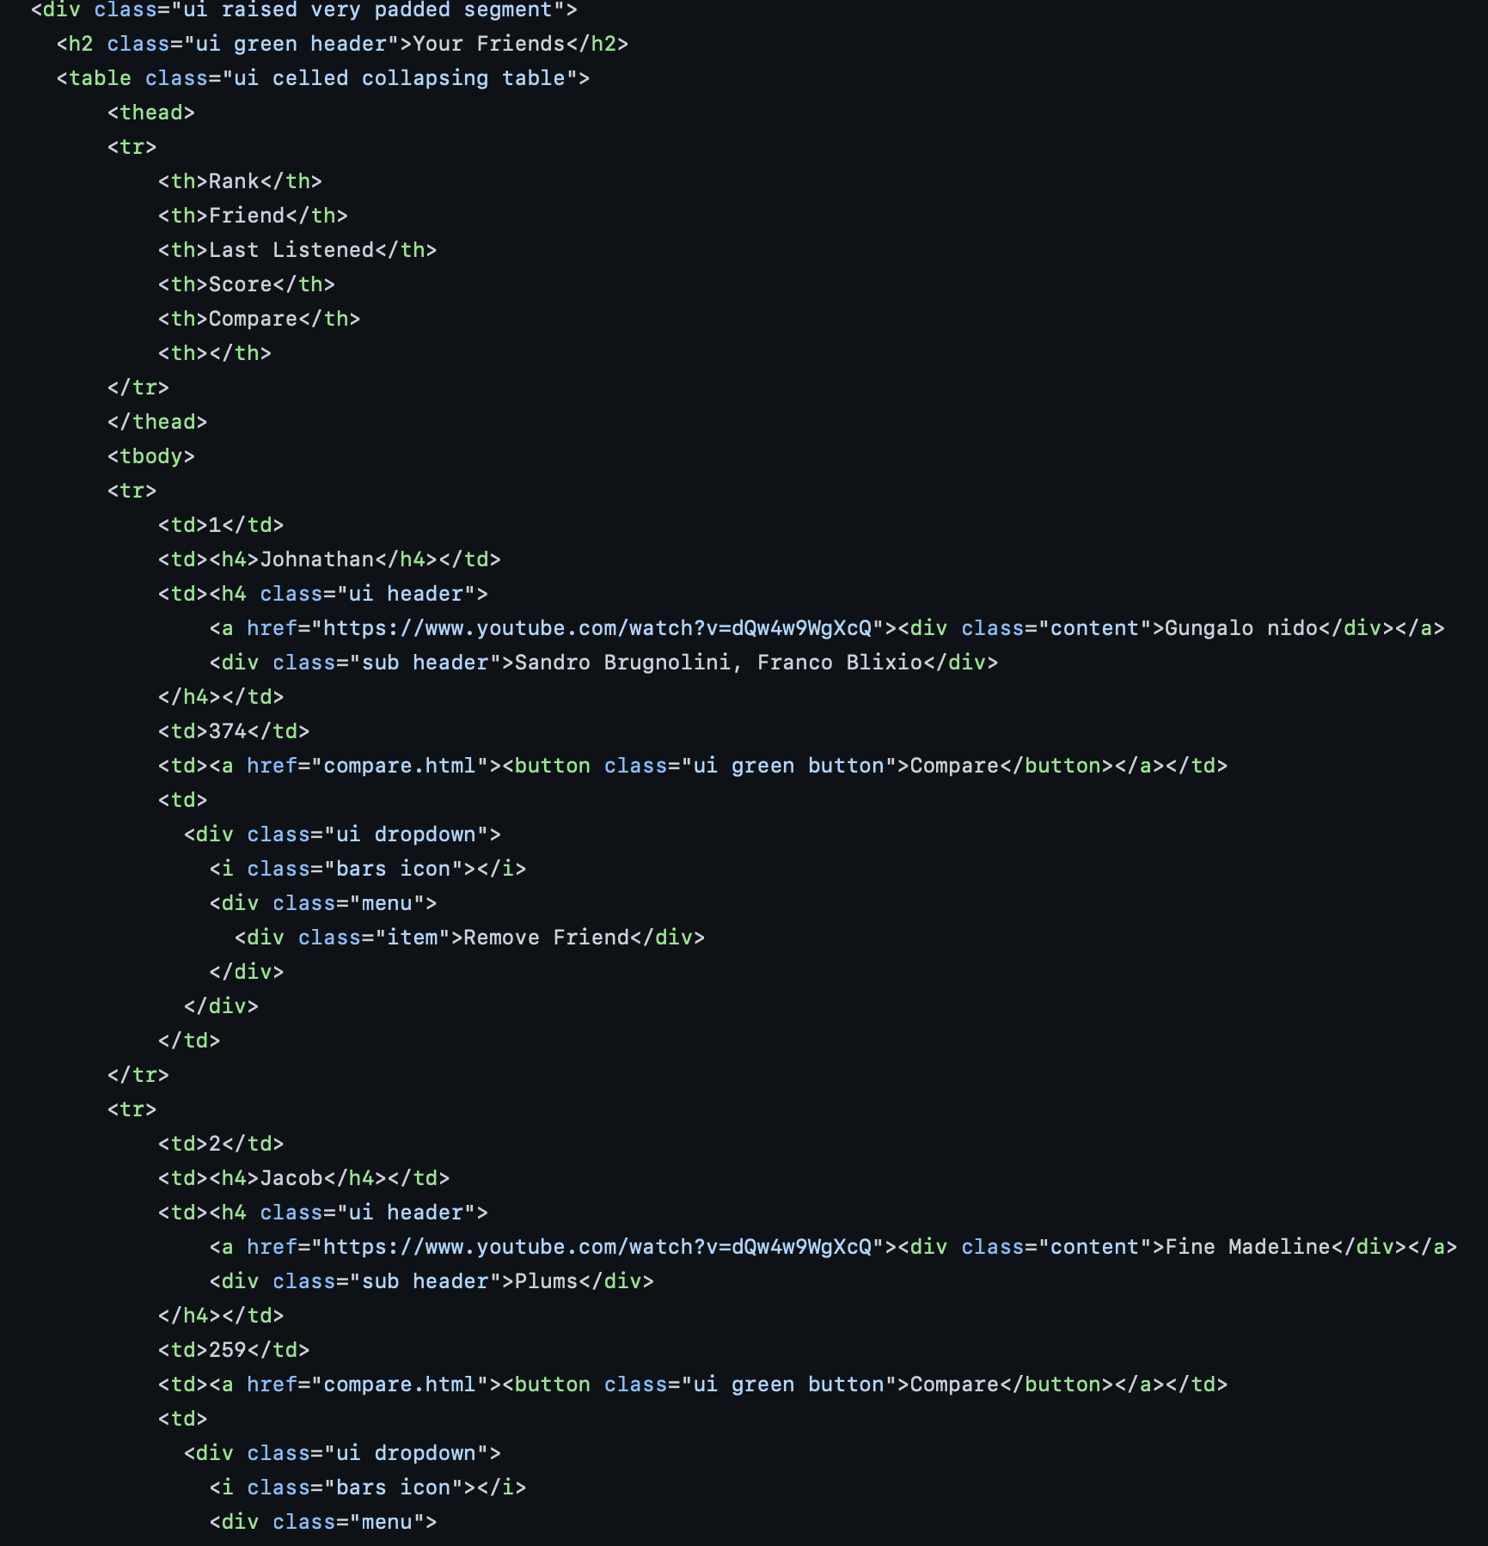
05
HOME CODE

Slide 16
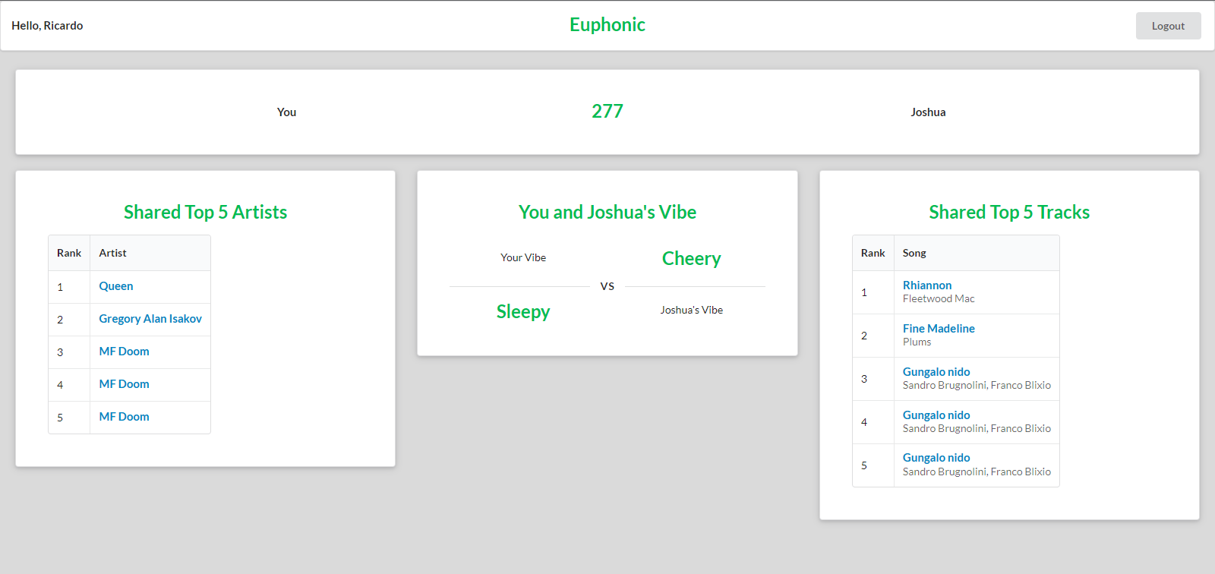
05
HTML COMPARE DEMO

Slide 17
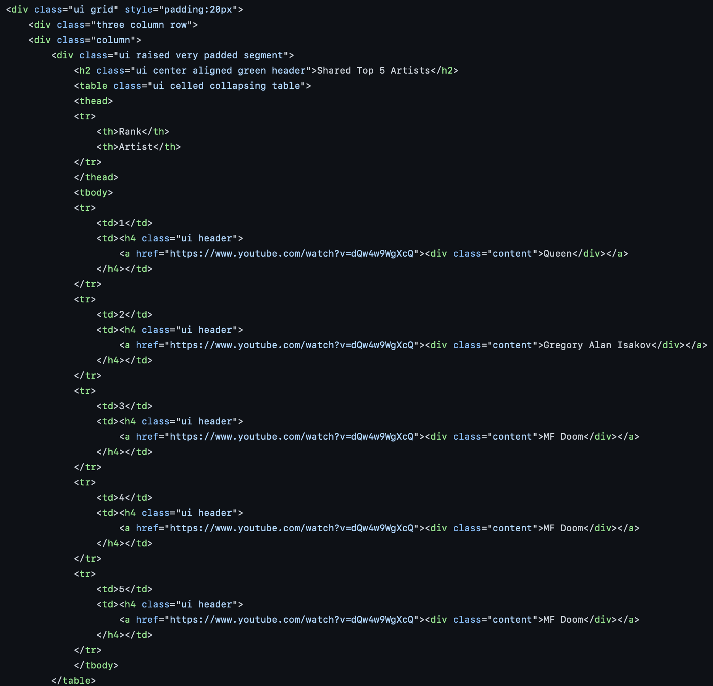
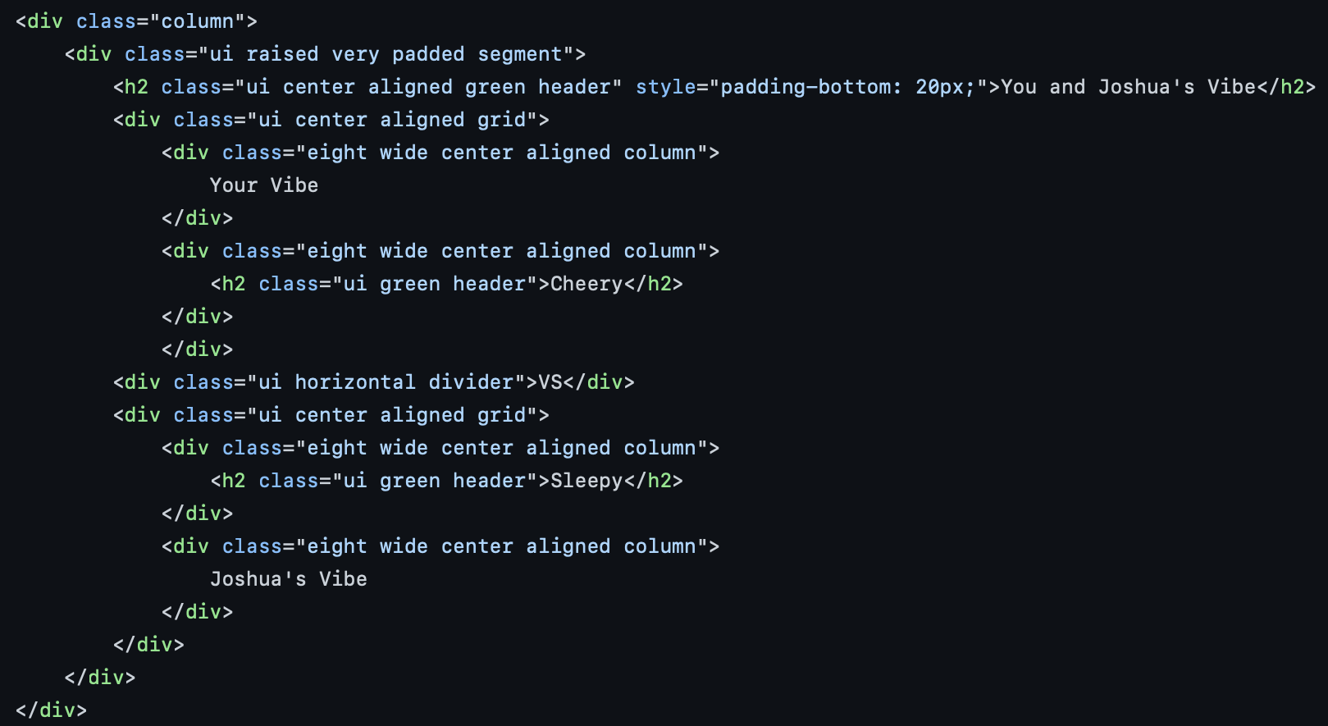
05
COMPARE CODE

Slide 18
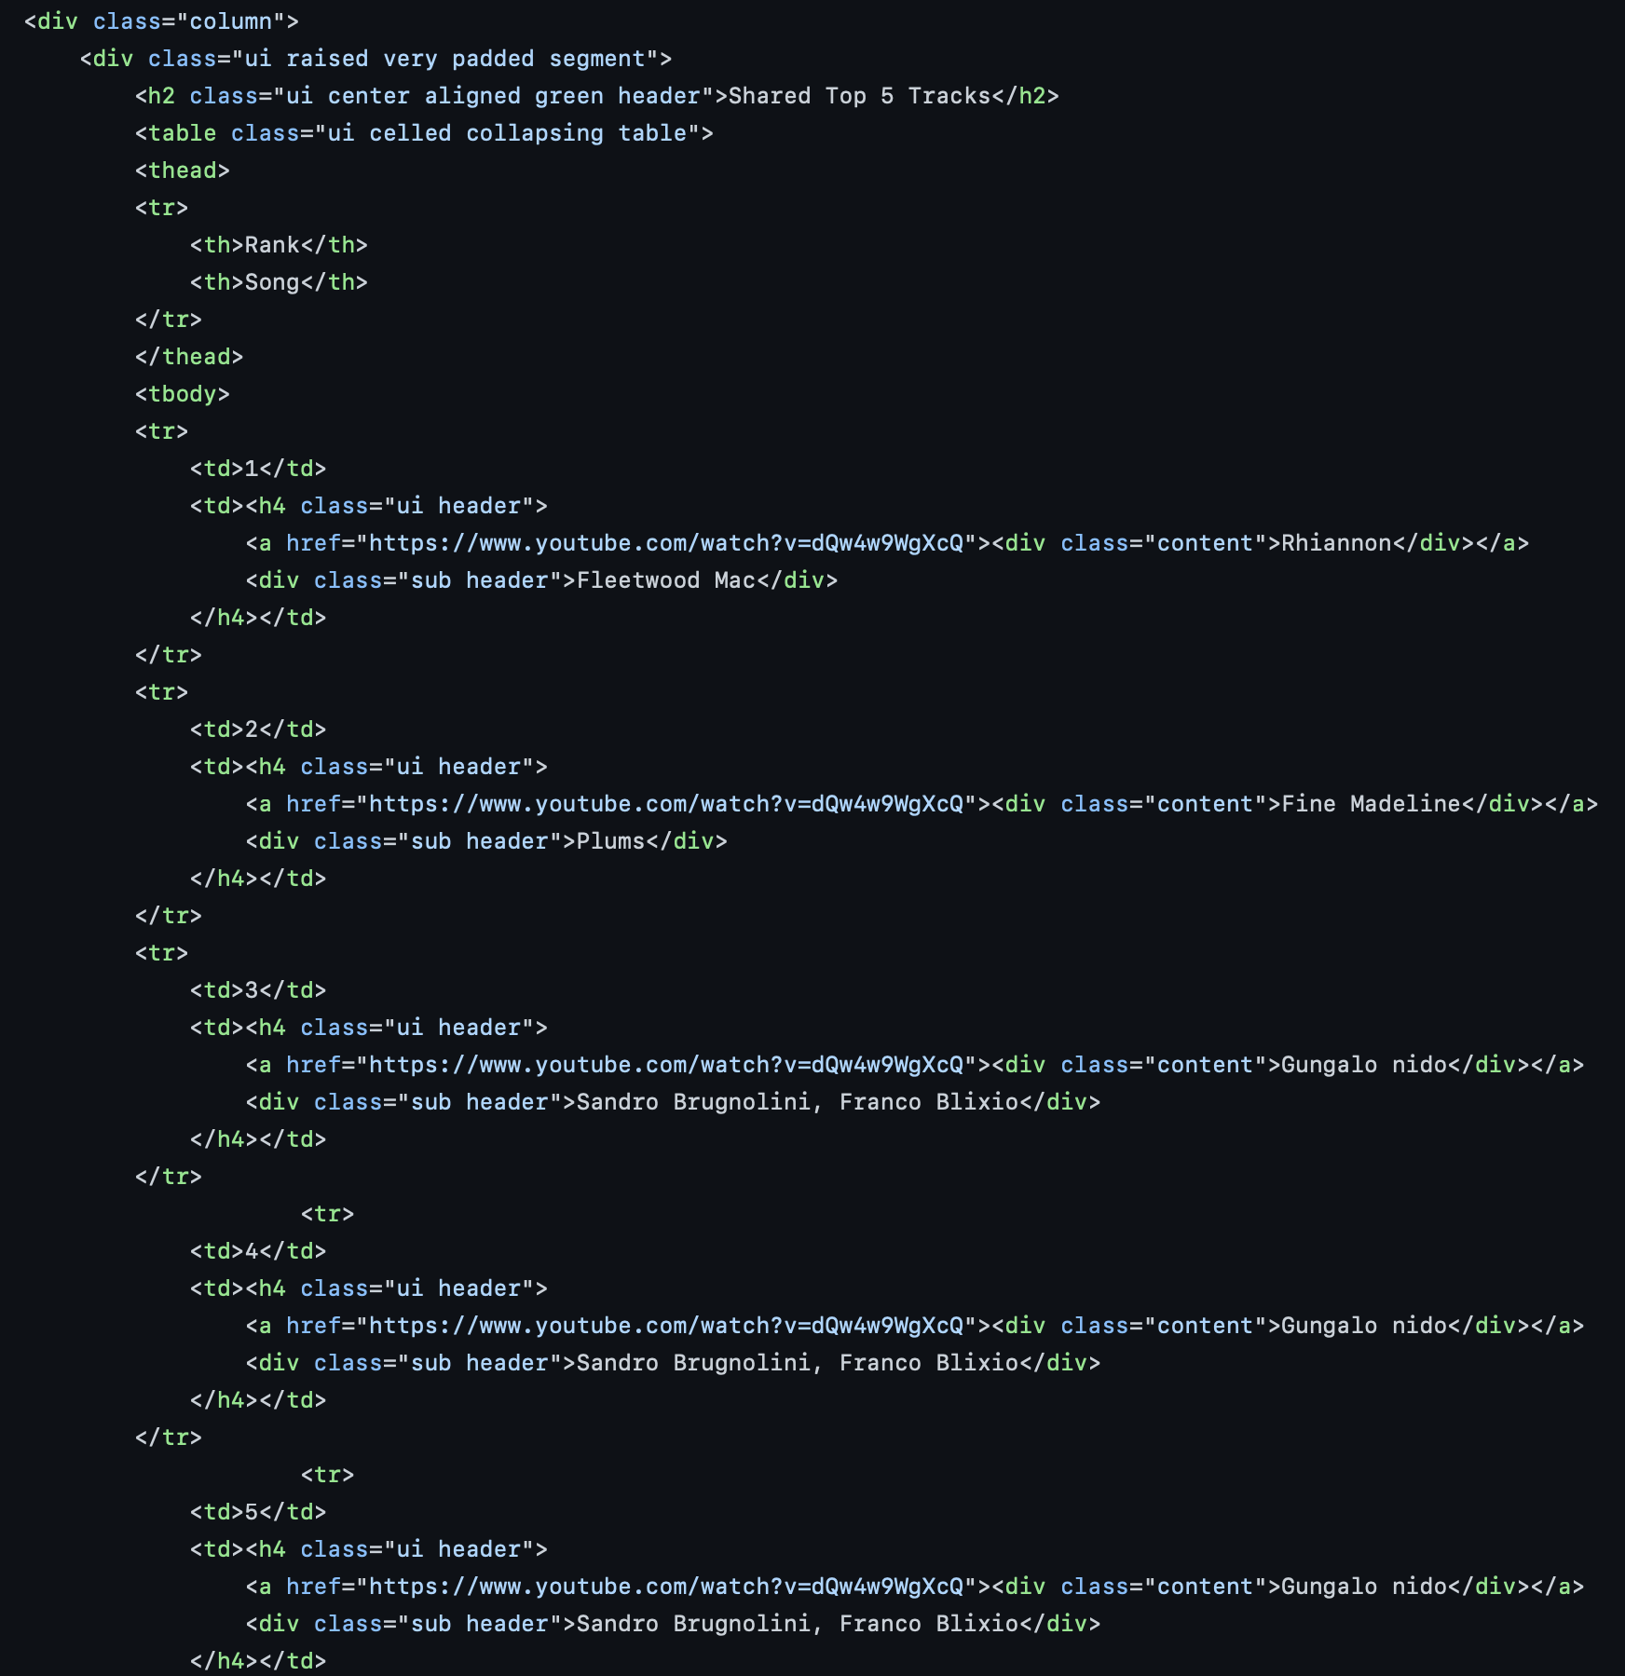
05
COMPARE CODE

Slide 19
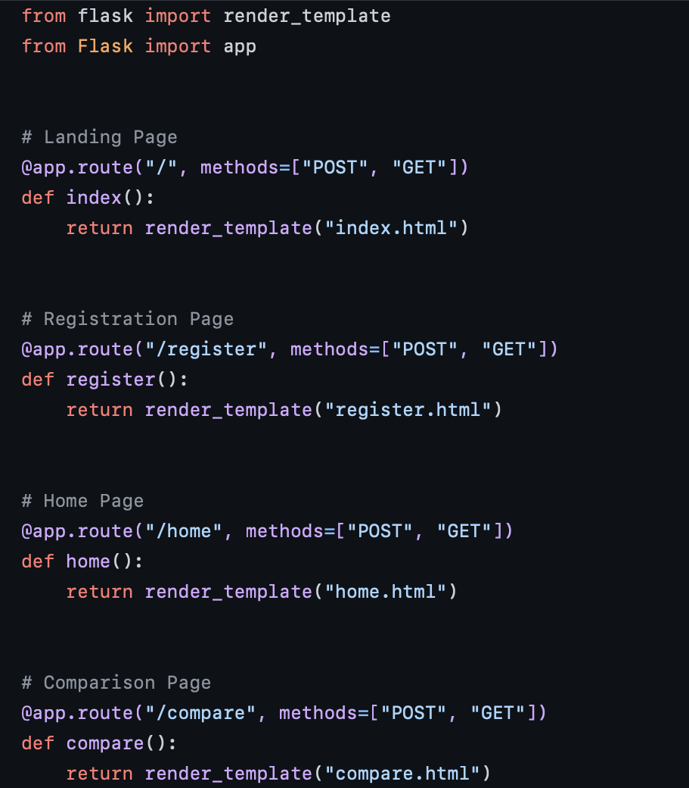
05
BACKEND CODE

Slide 20
THANKS!
Does anyone have any question?

