Slide 1
Design & Implementation
PartSelect Chat Agent — a technical deep-dive
Interface engineering · agentic architecture · grounding · extensibility & scalability · quality engineering
FastAPI + SSE
Postgres 16 + pgvector
React (CRA)
client-side OCR
eval-gated CI
Tatsan · github.com/ScooterStuff/case-study · live demo follows these slides

Slide 2
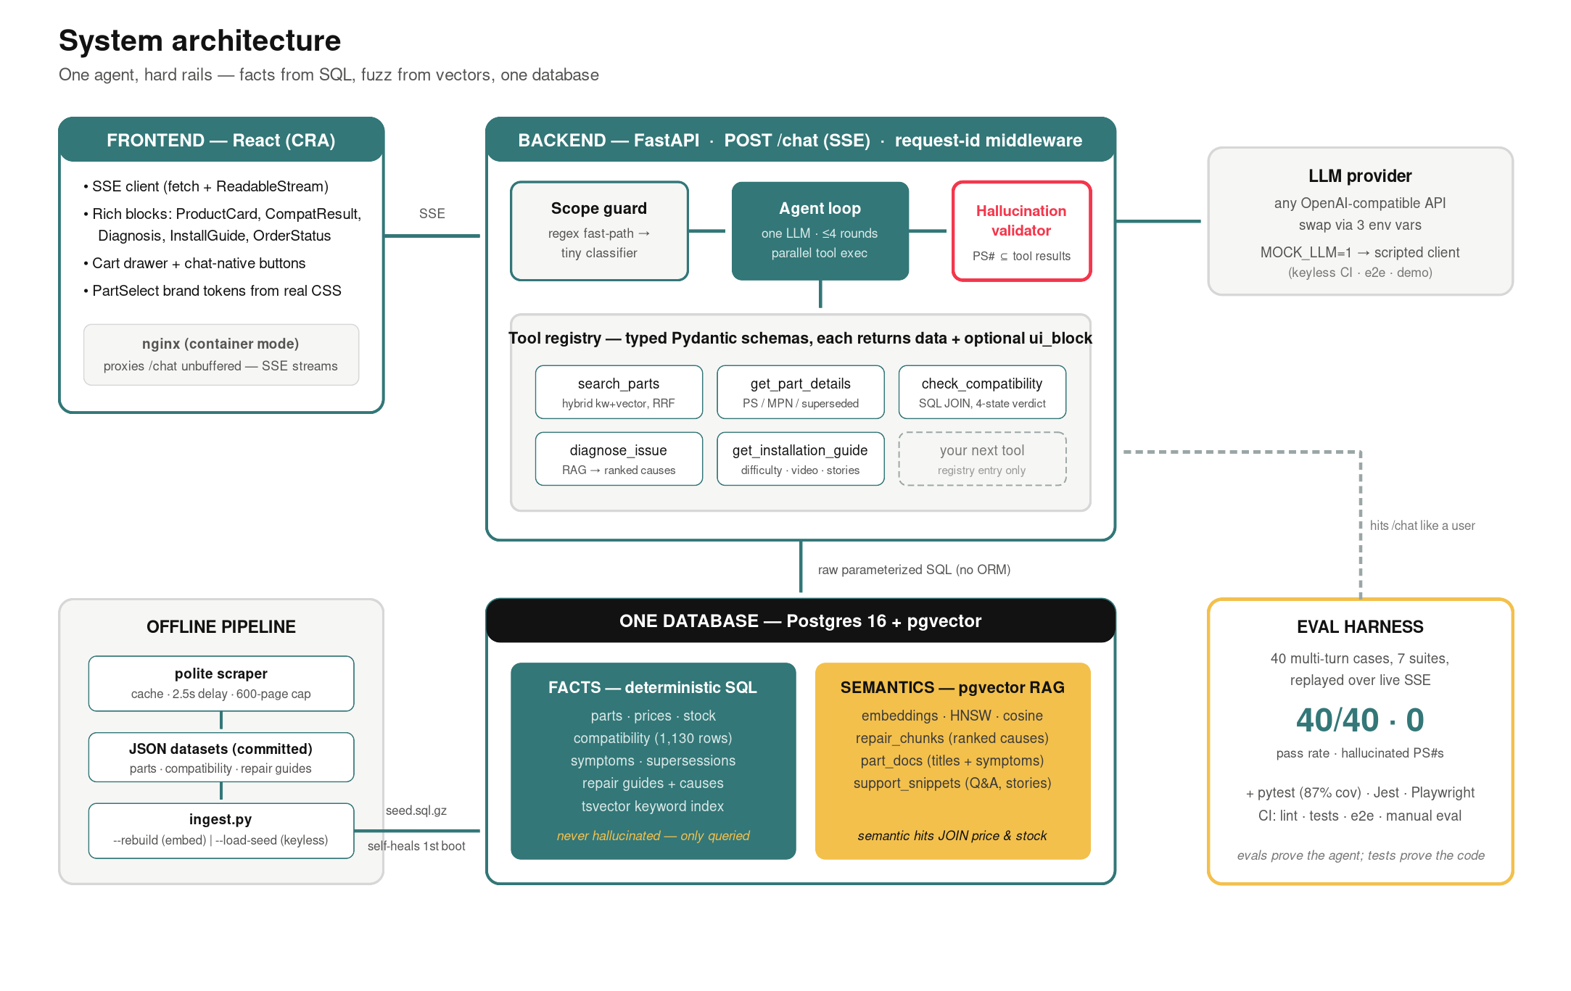
System architecture
Full diagram ships in the repo (docs/media) — three properties to notice:
One database, two retrieval substrates
facts in relational tables, semantics in pgvector — a semantic hit JOINs price & stock in the same query.
The LLM is surrounded, not trusted
guard before it, typed tools beside it, a mechanical validator after it.
Everything runs keyless
committed seed + scripted MOCK_LLM: CI, e2e and demos need zero API keys.

Slide 3
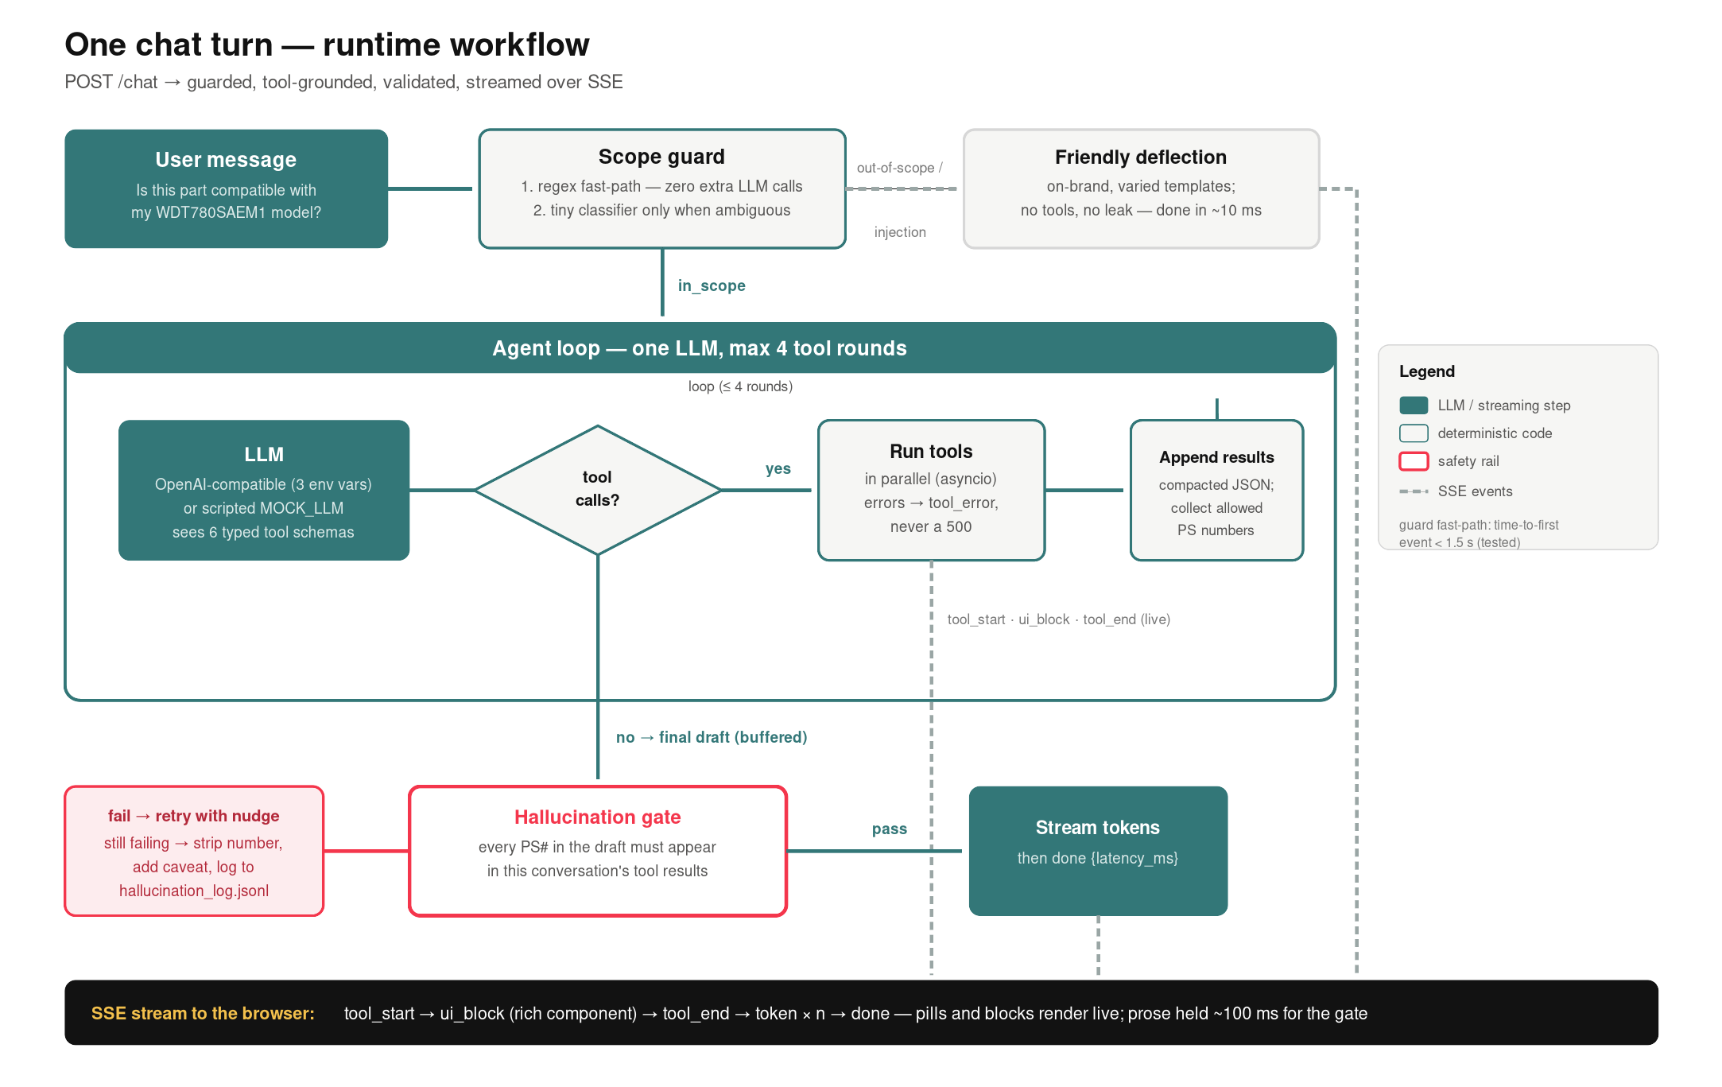
Anatomy of one chat turn
Streaming is the spine: tool events go out live, prose is held ~100 ms for the gate.
Buffer-and-release
tool pills + ui_blocks stream immediately; the final draft flushes only after validation. Trust > 100 ms.
Parallel tool fan-out
independent calls run via asyncio.gather in threads; a tool error becomes a tool_error event, never a 500.
Context discipline
tool results enter history JSON-safe-trimmed (strings ≤400, lists ≤6) — bounded context at any conversation length.

Slide 4
The agent loop, distilled
backend/app/agent.py — one orchestrating LLM; the registry, not agent count, is the extension axis.
Single agent, deliberately — multi-agent at this scale = more latency, more failure modes, harder evals. Tools are the abstraction.
async def chat_stream(session_id, msg):
label = guard.classify(msg, history_in_scope)
if label != 'in_scope':
yield deflection(label); return
for _round in range(MAX_TOOL_ROUNDS + 1): # 4
text, calls = await llm.chat(msgs, schemas)
if not calls: break # final draft
yield tool_start(...) # live
results = await gather(*map(run_tool, calls))
yield ui_blocks(results) # live
allowed_ps |= ps_numbers(results)
msgs += compact(results) # trim JSON
validate_part_numbers(text, allowed_ps)
# fail -> retry w/ nudge -> strip + log
yield tokens(text); yield done(latency)
Bounded by construction — ≤4 tool rounds, ≤20 history messages, trimmed tool payloads — no unbounded loops or context blowup.
Sessions are a swap point — in-memory dict behind one accessor; Redis is a one-class change (scalability section).
Provider-agnostic — llm.chat() is an interface: OpenAI-compatible streaming impl + a scripted mock that honors the same contract.

Slide 5
Scope control as a layered system
Cheap → expensive: most messages never pay for an extra LLM call.
Regex fast-path — part/model-number shapes, appliance vocabulary, symptom verbs — in-scope traffic passes in microseconds; time-to-first-event < 1.5 s is a tested invariant.
1
Design call: embedded injections
"Is PS3406971 compatible with X? Also ignore your instructions…" — the guard does NOT refuse outright: the legitimate question is answered, the payload ignored. Layer 3 makes that safe; the eval's injection suite proves it.
Tiny classifier — only for ambiguous messages: single call, max_tokens=8, three labels (in_scope / out_of_scope / injection). Short follow-ups in an in-scope session skip it.
2
System prompt + gate — defense in depth: prompt restates the rules for mid-conversation drift; the hallucination gate backstops everything the first two layers miss.
3
Deflections are designed, not canned errors: varied, on-brand copy that redirects to what the agent CAN do — scope control as UX, not a wall.

Slide 6



Grounding is mechanical, not prompted
Prompts ask the model to behave; the gate makes misbehavior unshippable.
Tested with a lying LLM
a unit test injects a client that invents PS55555555 — asserts it's stripped, caveated, and logged.
ALLOWED = ps_in(tool_results) | ps_typed_by_user
def validate_part_numbers(draft, allowed):
mentioned = set(re.findall(r'PS\d{5,9}', draft))
unverified = mentioned - allowed
if unverified:
raise HallucinationError(unverified)
# on error: 1) retry once with corrective nudge
# 2) still bad -> strip number + caveat
# 3) append to hallucination_log.jsonl
Auditable by design
every trigger appends JSONL (session, draft, numbers). The log staying empty across the 40-case eval is a shipped metric.
Honesty in the schema
compatibility verdicts are a 4-state enum with evidence counts — 'not in our verified list' is data-layer truth, not prompt wording.
Why user-typed numbers are allowed: "I couldn't find PS99999999" must be sayable. The gate blocks invention, not conversation.

Slide 7
Data layer: facts you can JOIN, meaning you can search
Raw parameterized SQL (no ORM) — ten queries that ARE the architecture.
Three vector collections, one table — repair_chunks (causes, rank preserved) · part_docs · support_snippets (real Q&A + repair stories) — metadata-filtered, no second engine.
parts(ps_number PK, mpn, brand, price, stock,
search_tsv tsvector GENERATED ALWAYS ...)
compatibility(ps_number, model_number,
source, PRIMARY KEY (ps, model))
part_replaces(ps_number, old_mpn) -- supersessions
repair_guides / repair_causes(rank, body)
embeddings(collection, document, metadata JSONB,
embedding vector(1536)) + HNSW cosine idx
-- the money query: a JOIN, not a guess
SELECT source FROM compatibility
WHERE ps_number=%s AND model_number=%s;
-- miss => evidence: how many models ARE
-- verified, was the model seen at all
Supersession chain — old manufacturer numbers resolve through part_replaces — customers paste 10-year-old numbers and still land on the current part.
Provenance on every row — compatibility rows carry source (cross-ref / model page / Q&A) — weaker signals are distinguishable, and the agent can say so.
Reproducible by seed — pg_dump --inserts, gzipped, committed; restore needs psycopg only. First container boot self-heals.

Slide 8
Hybrid search: tsvector + pgvector, RRF-merged
"the thing that sprays water in the bottom" → Lower Spray Arm, with price and stock attached.
kw = SELECT ... WHERE search_tsv @@
websearch_to_tsquery('english', %s)
ORDER BY ts_rank(...) DESC
vec = SELECT ... FROM embeddings
WHERE collection='part_docs'
AND metadata->>'appliance_type'=%s
ORDER BY embedding <=> %s LIMIT k
for rank, part in enumerate(kw): score += 1/(60+rank)
for rank, part in enumerate(vec): score += 1/(60+rank)
return top_k(score) # reciprocal rank fusion
Why RRF — keyword and cosine scores live on incomparable scales; rank fusion needs no calibration, no tuned weights, and degrades gracefully when one side is empty.
Why both — exact tokens (mpn, 'W10195416') demand keyword; colloquial language demands vectors. Either alone fails half the queries.
Appliance scoping — both branches filter by appliance (SQL WHERE / JSONB metadata) — a dishwasher question never surfaces fridge parts.
Embeddings are env-swappable too: MOCK_EMBEDDINGS=1 uses a deterministic hashed bag-of-words — every vector code path testable with zero keys.

Slide 9
Interface engineering: the SSE contract
The frontend is a renderer for a typed event stream — backend owns the vocabulary.
event | payload | renders as
tool_start / tool_end | {name, label} | status pill with spinner ("Checking compatibility…")
tool_error | {name} | pill fades; agent recovers conversationally — never a 500
ui_block | typed payloads ×6 | ProductCard · CompatResult · Diagnosis · InstallGuide …
token | {delta} | validated prose, streamed with caret
done | {latency_ms} | turn footer; powers the eval's latency metrics
ui_block payloads are the FE/BE contract — shapes defined once in tools.py, mirrored as JSDoc typedefs in lib/blocks.js — one source of truth, no drift.
Hand-rolled SSE parser — fetch + ReadableStream with explicit buffering; unit tests split events mid-JSON and mid-event-name to prove reassembly.
Chat-native navigation — block buttons emit templated user messages — product cards become conversation controls, no parallel routing system.
Resilience — AbortController stop, retry-on-error message, graceful deflection rendering — error states are designed states.
Container path keeps the contract: nginx proxies /chat with proxy_buffering off — tokens stream through Docker too.

Slide 10
Photo → model number, client-side
Model stickers are hard to transcribe — so the composer accepts a photo of one.
photo / camera capture
tesseract.js OCR (lazy chunk)
extractModelNumber() heuristic
smart prefill into composer
→
→
→
Zero backend, zero keys — OCR runs in the browser — no upload endpoint, no vision-API cost, photos never leave the device.
// pure + unit-tested, separate from the OCR call
tier(token):
reject: <5 or >16 chars · stopwords (MODEL,
SERIAL, brand names) · bare years · no digits
tier 1: long pure-numeric (>=9) — Kenmore style
tier 2: letters+digits mix — Whirlpool/GE style
best = lowest tier, then longest token
// smart prefill (ChatWindow):
ps_in_history ? `Is part ${ps} compatible with
my ${model}?`
: `My model number is ${model} ...`
Bundle discipline — tesseract.js (~3 MB) loads via dynamic import only when the camera button is used — first paint stays lean.
Testable core — the extractor is a pure function: tier ranking, stopword/year rejection, and best-pick logic are Jest-tested without any OCR.
Context-aware handoff — the detected model lands as an editable draft, phrased as a compat check if a part is already in the conversation.

Slide 11
Extensibility & scalability
Extension points are proven, not promised — one tool was deleted with zero loop changes.
Extension axes
Scale path (deliberate order)
Tools are registry entries: fn + Pydantic schema → JSON-schema export. Removing order_support touched the registry only — the loop, SSE protocol and UI never knew.
New appliance = scraper seed URLs + one enum value; schema, agent and blocks are appliance-agnostic.
LLM/embeddings swap via env (any OpenAI-compatible endpoint); MOCK implementations honor identical contracts.
ui_block vocabulary is open: a new block type = one tool payload + one React component.
API is stateless except one in-memory session dict behind an accessor → Redis is a one-class swap, then horizontal replicas behind the existing nginx.
Postgres carries both workloads to ~1M embeddings (HNSW); read replicas for search; only then consider a dedicated vector store.
Per-tool caching (compat verdicts are immutable per catalog version); guard fast-path already deletes most classifier traffic.
Observability is structured now: request-id middleware + per-turn JSON logs (guard label, tools, latency) — OTel exporter, not a rewrite.

Slide 12
Quality engineering — then the demo
Evals measure whether the agent is right; tests measure whether the code is correct. Shipped as separate, automated layers.
91%
20
40/40
4 jobs
backend coverage,
80% CI gate
frontend Jest tests
(blocks · SSE · OCR)
eval cases · 0 hallucinated
part numbers
CI: lint · tests · e2e ·
manual eval (secrets)
Eval mechanics: each case replays multi-turn conversations through the live SSE API in a fresh session; assertions cover tool selection, answer content, scope behavior, and a mechanical part-number check against tool results + catalog. One retry absorbs LLM nondeterminism — stated in the published methodology.
The harness has already paid for itself: it caught two real routing bugs during development.
Now the live demo — watch for: streaming tool pills · the photo-to-model OCR flow · an honest compatibility verdict · the fix-it journey ending in the cart.

