Slide 1
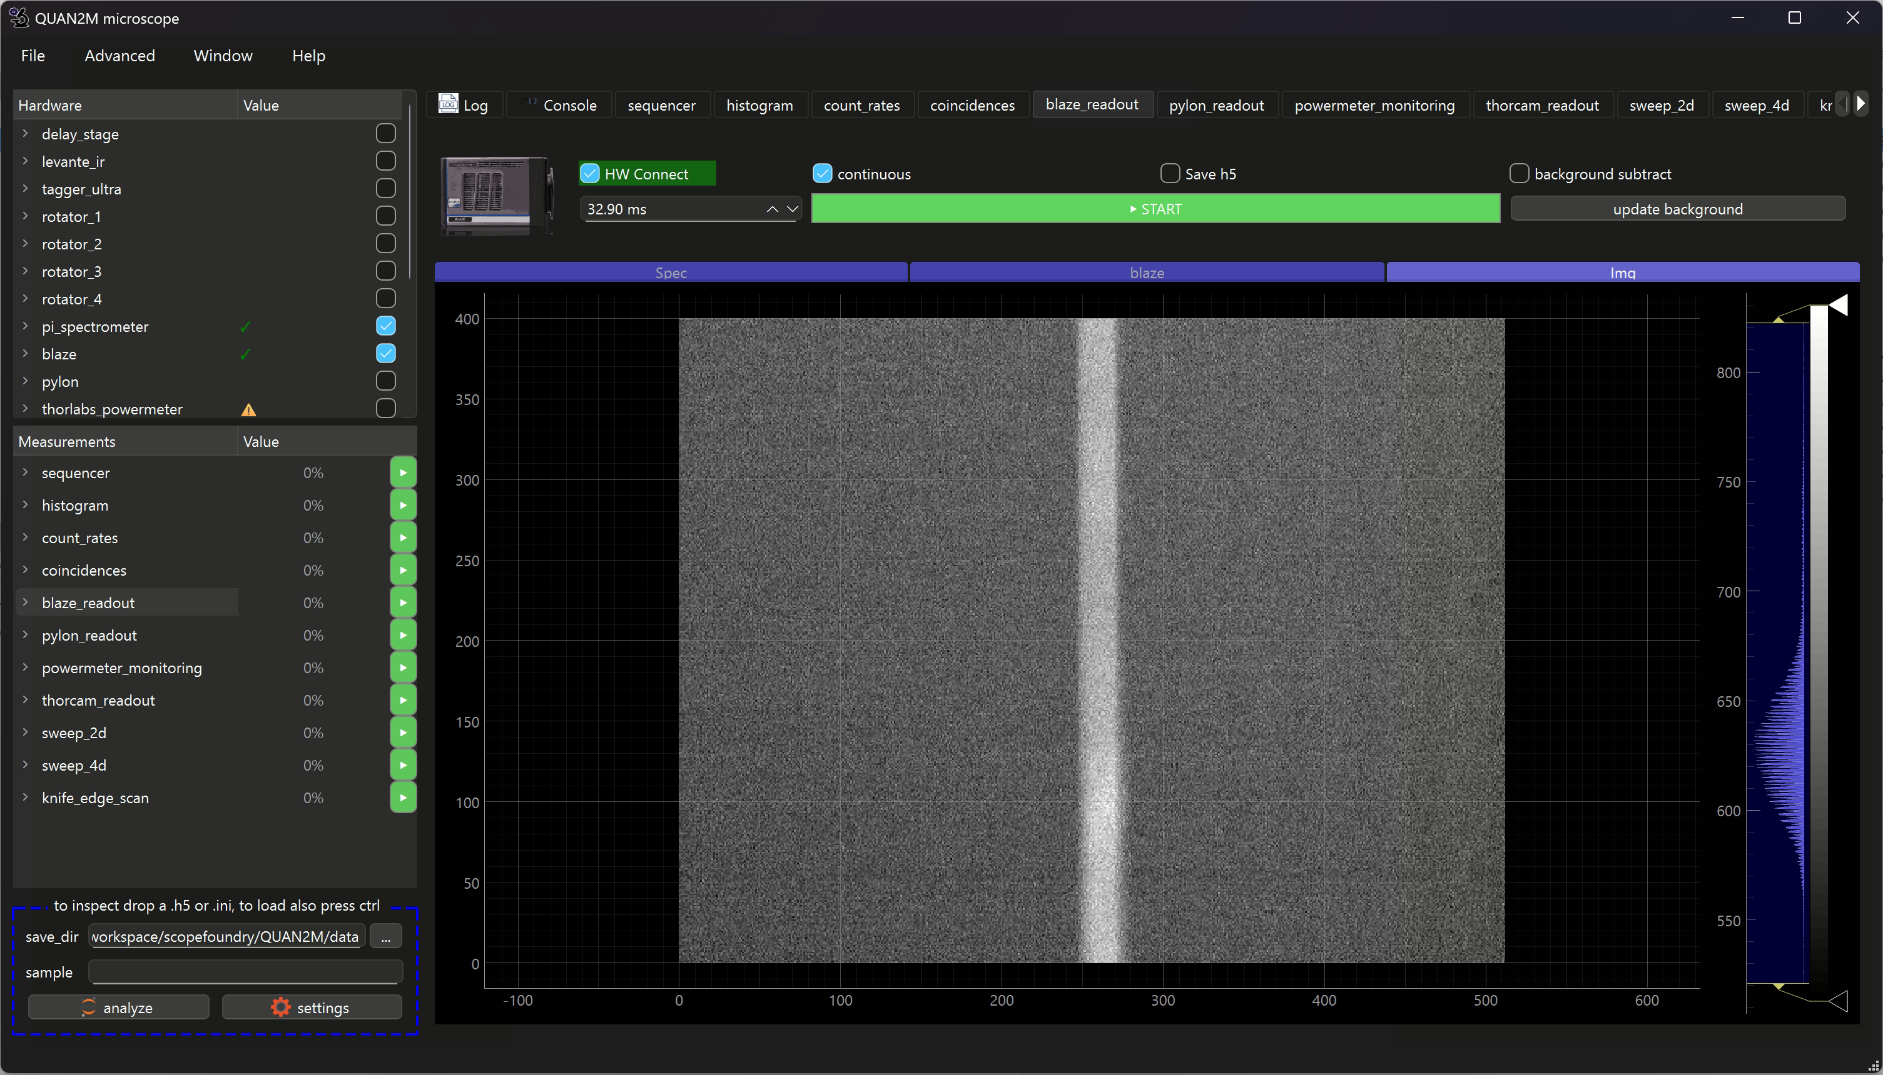
Measurement user interfaces
HardwareComponents
Measurements
App

