Slide 1

DRUG CONSUMPTION TENDENCY CLASSIFICATION
MATHEMATICS IN MACHINE LEARNING
A.A. 2021/2022
SCORCA FRANCESCO

Slide 2
DATASET EXPLORATION
1

Slide 3
DATASET DESCRIPTION
1885 instances
0 null values
12 predictors
Numeric features
Neuroticism (N)
Extroversion (E)
Openness to Experience (O)
Agreeableness (A)
Conscientiousness (C)
Barratt Impulsiveness Scale (BIS-11)
Impulsiveness Sensation-Seeking (ImpSS)
Categorical features
Age
Gender
Level of education
Ethnicity
Country of residence
E. Fehrman, A. K. Muhammad, E. M. Mirkes, V. Egan and A. N. Gorban, "The Five-Factor Model of personality and evaluation of drug consumption risk."

Slide 4
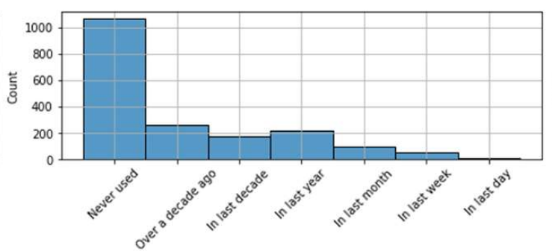
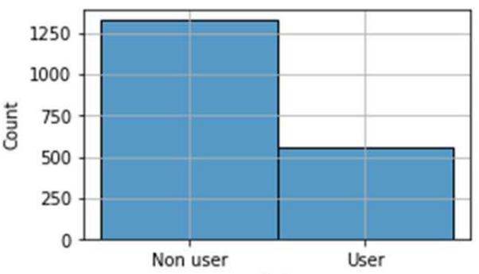
TARGET SELECTION
18 central nervous system psychoactive drugs: study focused on LSD.
Decade
based
approach
Binary classification problem
Unbalanced dataset: 70% negative instances.

Slide 5
DATASET MANAGEMENT
2

Slide 6
OVERSIGHT
Stratified splitting
80% of the samples for training, 20% for testing.
Ratio of positive and negative instances is the same in both the splits.
Pre-processing
Techniques applied
on the training sets created with the stratified k-fold technique
on the overall training set, before providing it to the tuned algorithms

Slide 7
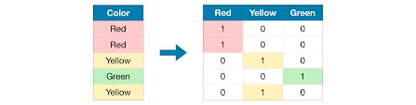
ONE-HOT ENCODING
Convert categorical features into numeric.
Add a new binary variable for each unique categorical value.

Slide 8
DATA CLEANING
Procedure that aims at finding suspicious events or items that are different from the normal form of a dataset: outliers.
Techniques employed
Isolation Forest
Local Outlier Factor (LOF)
One-Class SVM

Slide 9
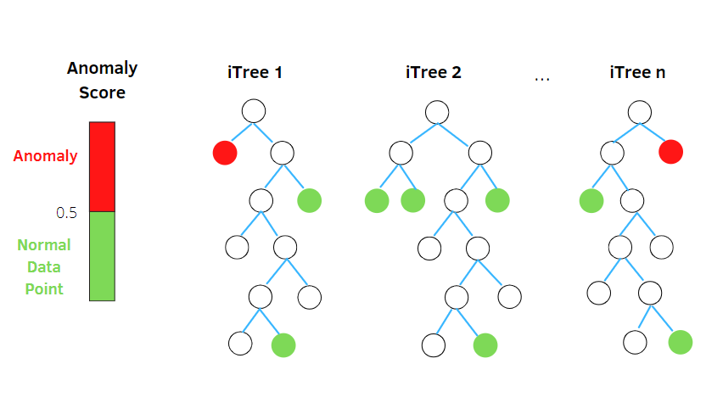


ISOLATION FOREST
Rationale
When a forest of random trees collectively produces shorter path lengths h(x) for some particular points they are likely to be anomalies.
Insight
Given
n instances
H(i) harmonic number
c(n) estimated average of h(x) on n
E(h(x)) average h(x) over a number of iTrees
s(x, n) anomaly score
We have
Fei Tony Liu, Kai Ming Ting, Zhi-Hua Zhou, “Isolation Forest”

Slide 10
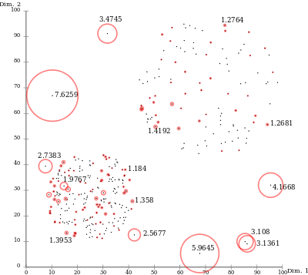
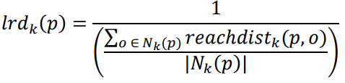
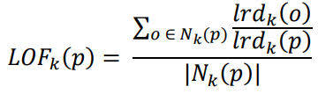
LOCAL OUTLIER FACTOR
(LOF)
Algorithm that captures the relative degree of isolation.
Definitions
k-distance(p), distance between p and o ∈ D:
for at least k objects o’∈ D \ {p} it holds that d(p, o’) ≤ d(p,o)
for at most k-1 objects o’∈ D \ {p} it holds that d(p,o’) < d(p,o)
reach-dist_{k}(p,o) = max(k-distance(o), d(p,o))
Local reachability density:
We have
Markus M. Breunig, Hans-Peter Kriegel, Raymond T. Ng, Jörg Sander, “LOF: Identifying Density Based Local Outliers”

Slide 11
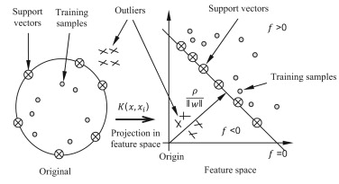
ONE-CLASS SVM
Capture regions in the input space where the probability density of the data lives.
Map data into a feature space and separate them from the origin with maximum margin.
Exploit kernels.
Amer, Mennatallah & Goldstein, Markus & Abdennadher, Slim. (2013). Enhancing one-class Support Vector Machines for unsupervised anomaly detection
Bernhard Scholkopf, Robert Williamson, Alex Smola, John Shawe-Taylort, John Platt, “Support Vector Method for Novelty Detection”

Slide 12

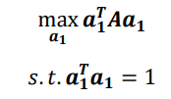

PRINCIPAL COMPONENT ANALYSIS (PCA)
Computing principal components: a smaller number of representative variables that collectively explain most of the variability in the original set.
Linear combination of the sample feature values that has the largest sample variance:
Optimization problem
Given A=X^{T}X:
Further Principal Components
Analogous optimization problem, constraining uncorrelation to the previous components.
To find m PC take m eigenvectors of A associated with the m greatest eigenvalues.
Lagrangian formulation
Solve

Slide 13
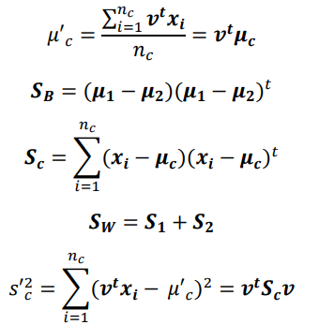


FISHER LINEAR DISCRIMINANT ANALYSIS (FDA)
FDA attempts at finding the vector that maximizes the separation between classes of the projected data.
Optimization problem
Given:
Maximize on v

Slide 14
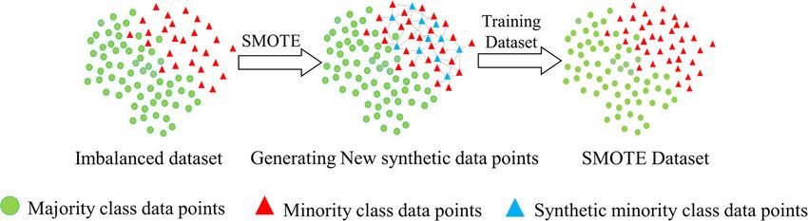
SYNTHETIC MINORITY OVER-SAMPLING TECHNIQUE
Synthetic samples
Selection of a random point along the segment between two minority class samples.
SMOTE-NC
One-hot encoding derived attributes need to assume only two levels to not lose their semantics: exclude these columns from interpolation.

Slide 15

K-FOLD CROSS VALIDATION
Method
Partition training set partitioned into k subsets
For each fold:
Train on the union of the remaining
Compute the error
Average these errors.
Implementation
Used for parameters tuning with k=5.
Tuned algorithm is retrained on the entire training set.
Stratified version.

Slide 16
MODELS
3

Slide 17

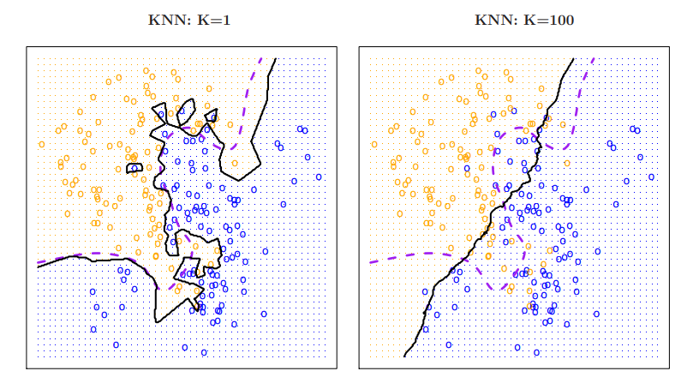
K-NEAREST NEIGHBOURS (KNN)
Memorize the training set and then predict the label of any new instance basing on the labels of its closest neighbors in the training set.
Given K, a distance metric, and a test observation x₀
Identify K-Neighbourhood N₀
Assign x₀ to the class with the highest estimated probability:

Slide 18




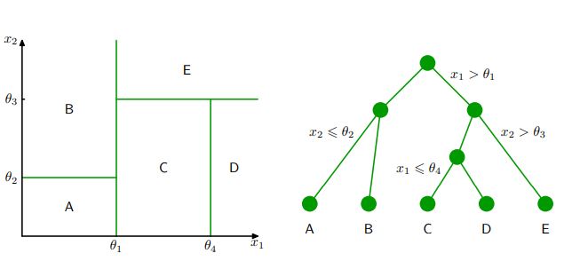
DECISION TREE
Classify an instance x by traveling from a root node of a tree to a leaf associated to a label.
Define an impurity measure.
Start with a single leaf.
Iterate:
Assign to each leaf a label according to a majority vote.
Among all possible splits, choose the one that minimizes impurity or we choose not to split the leaf at all.

Slide 19
RANDOM FOREST
Problem
Decision trees suffer from high variance.
Possible solution: Bagging
Take many training sets from the population, building separate prediction models using each training set, and averaging the resulting predictions.
We generally do not have access to multiple training set: bootstrap.
Method
Random forest goes further bagging: each time a split in a tree is considered, a random sample of m predictors is chosen as split candidates from the full set of p predictors.
Decorrelate the trees.

Slide 20
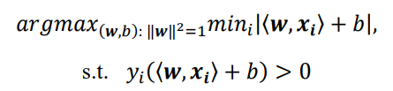
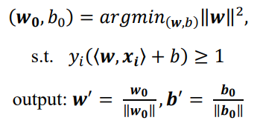
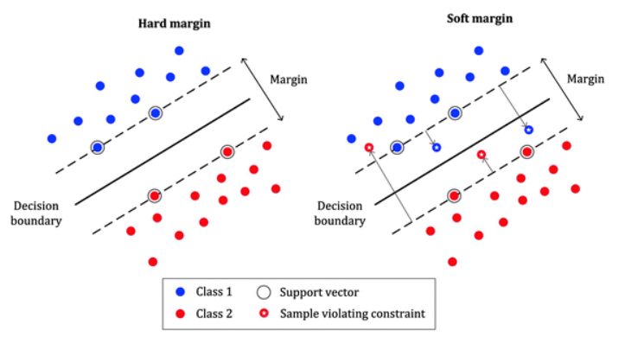
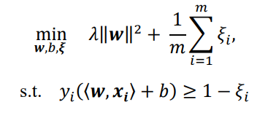
SUPPORT VECTOR MACHINES (SVM)
Hard SVM
Find hyperplane that separates the training set with the largest possible “margin”:
The solution is in the linear span of the examples that are exactly on the margin.
Riformualte
Soft SVM
Hard-SVM formulation based on the strong assumption that the training set is linearly separable: relax.

Slide 21
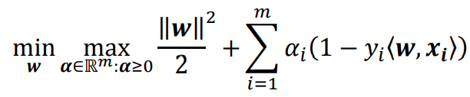
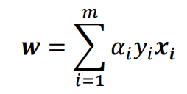
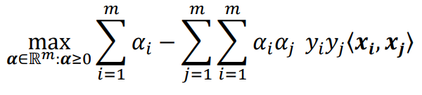
SUPPORT VECTOR MACHINES (SVM)
Lagrangian Formulation
Solve
Substitute
Kernel-based learning
The dual problem only involves inner products between instances.
Implementation of SVM with “kernels”.
Enrich the class of halfspaces by first applying a nonlinear mapping, ψ.
Allow
𝐾(𝒙, 𝒙′) = 〈𝜓(𝒙), 𝜓(𝒙′)〉.

Slide 22
EVALUATION
4

Slide 23
RESULTS
Best models:
Model | Outlier Detection | Dim. reduction | Hyperparameters | F1 | Accuracy | Recall | Precision
KNN | One-ClassSVM | None | K=7 Manhattan distance Uniform weighting | 0.64 | 0.76 | 0.73 | 0.57
Decision Tree | One-ClassSVM | None | Entropy max depth = 4 | 0.67 | 0.79 | 0.72 | 0.63
Random Forest | Isolation Forest | None | max depth = 6 100 trees | 0.69 | 0.80 | 0.76 | 0.63
SVM | Isolation Forest | PCA: 8c | C = 0.5 Rbf kernel | 0.70 | 0.79 | 0.80 | 0.61

Slide 24
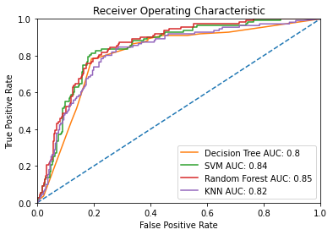
ROC CURVES
Illustrate the diagnostic ability of a binary classifier as its discrimination threshold is varied.
Models need to output probabilities rather than labels.
Random Forest AUC greater than SVM AUC.

Slide 25
ADDITIONAL SOURCES
Shalev-Shwartz, Shai, and Shai Ben-David, “Understanding machine learning: From theory to algorithms.”
James, G., Witten, D., Hastie, T., Tibshirani, R., “An Introduction to Statistical Learning with Applications in R.”
Dirk P. Kroese, Zdravko I. Botev, Thomas Taimre, Radislav Vaisman, “Data Science and Machine Learning: Mathematical and Statistical Methods”
Scikit-learn: https://scikit-learn.org/stable/index.html

