Slide 1
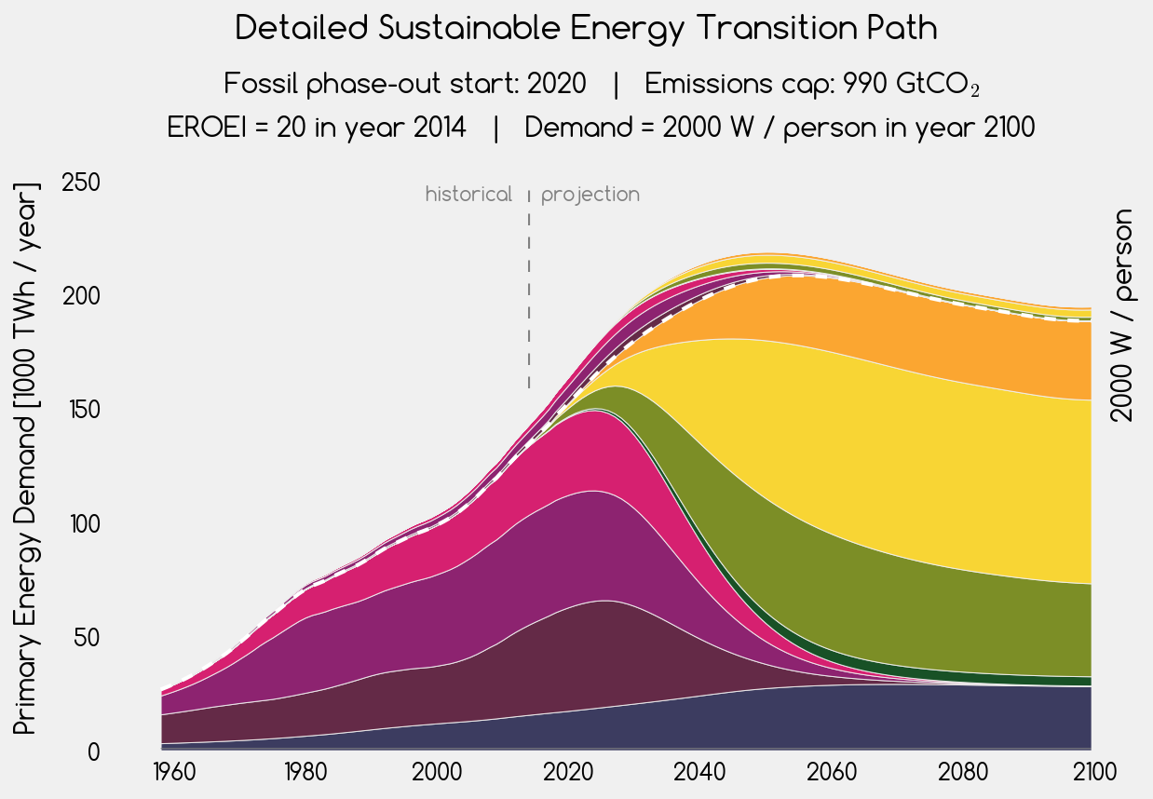











energy investment into energy
solar thermal
net energy for society
gas
photovoltaic
oil
wind
coal
geothermal
scale-limited

Slide 2
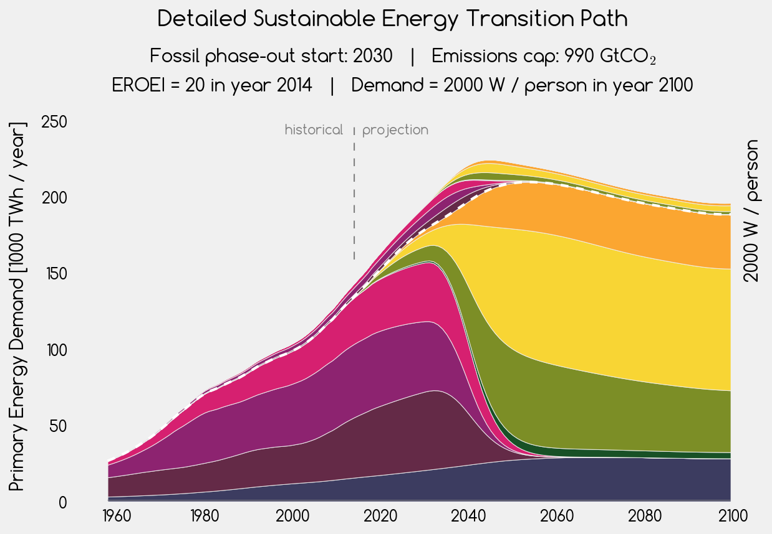
energy investment into energy
solar thermal
net energy for society
gas
photovoltaic
oil
wind
coal
geothermal
scale-limited

Slide 3
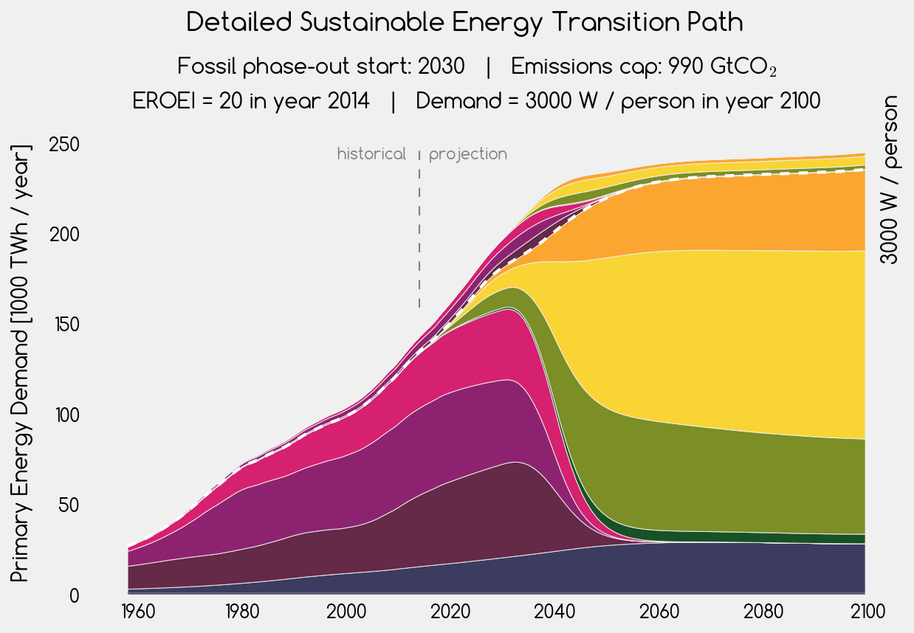
solar thermal
energy investment into energy
photovoltaic
net energy for society
gas
oil
wind
coal
geothermal
scale-limited

Slide 4
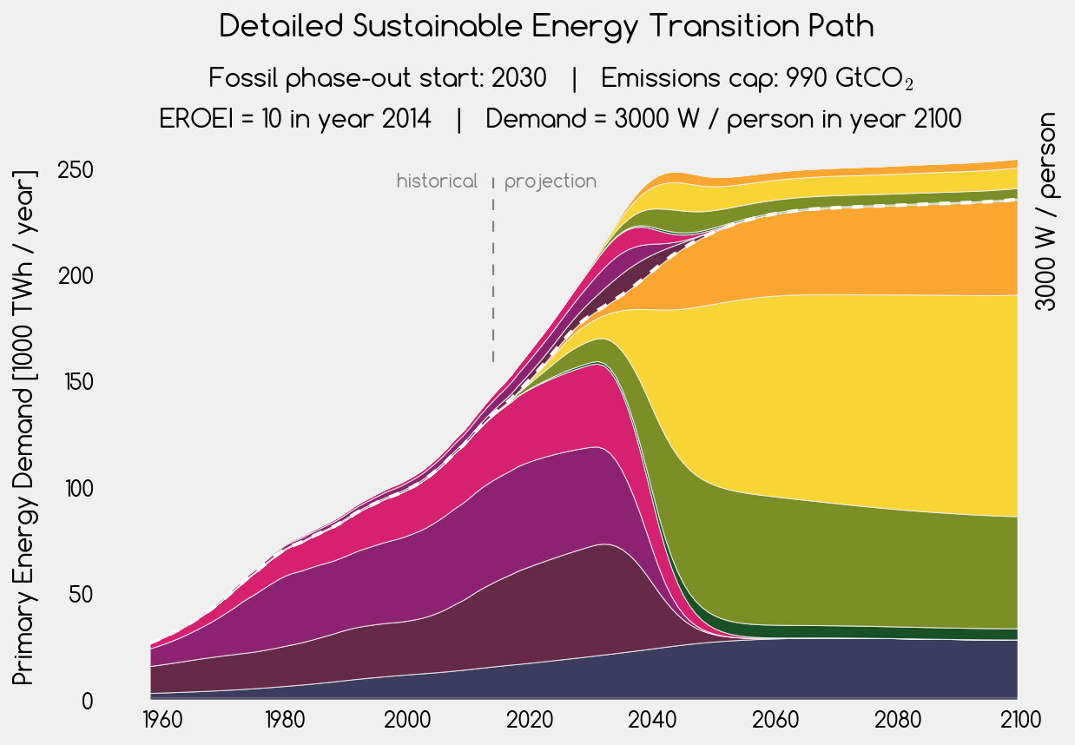
solar thermal
energy investment into energy
photovoltaic
net energy for society
gas
oil
wind
coal
geothermal
scale-limited

Slide 5
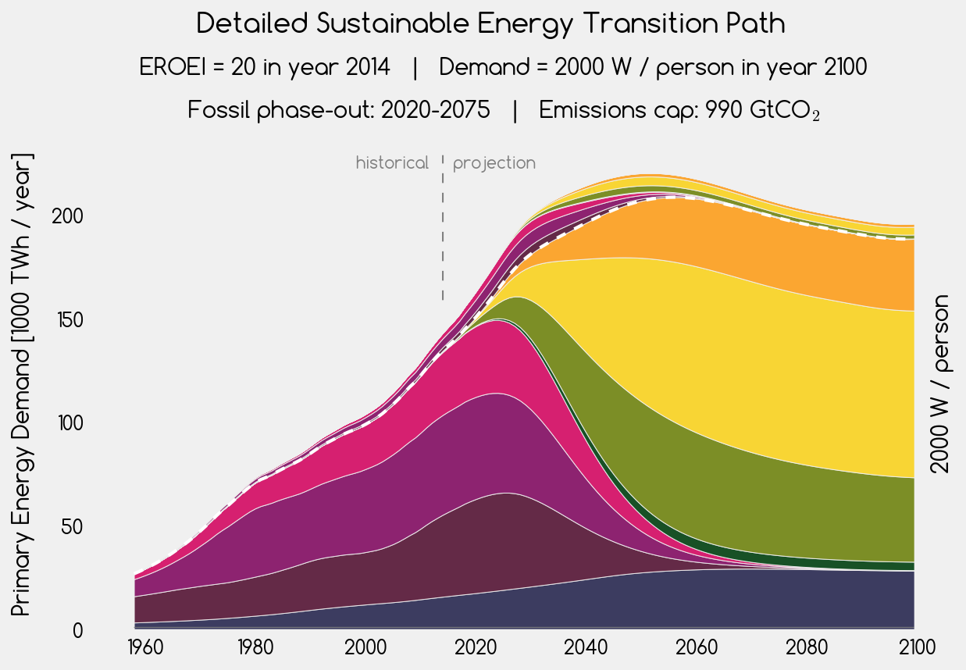
solar thermal
energy investment into energy
net energy for society
photovoltaic
gas
oil
wind
coal
geothermal
scale-limited

Slide 6
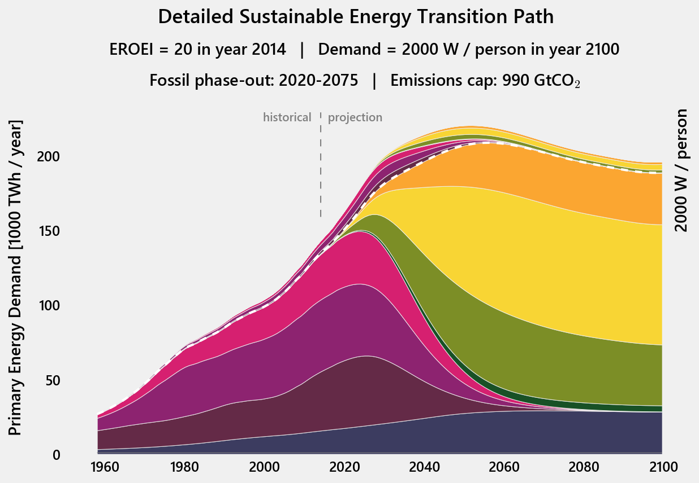
solar thermal
energy investment into energy
net energy for society
photovoltaic
gas
oil
wind
coal
geothermal
scale-limited

Slide 7
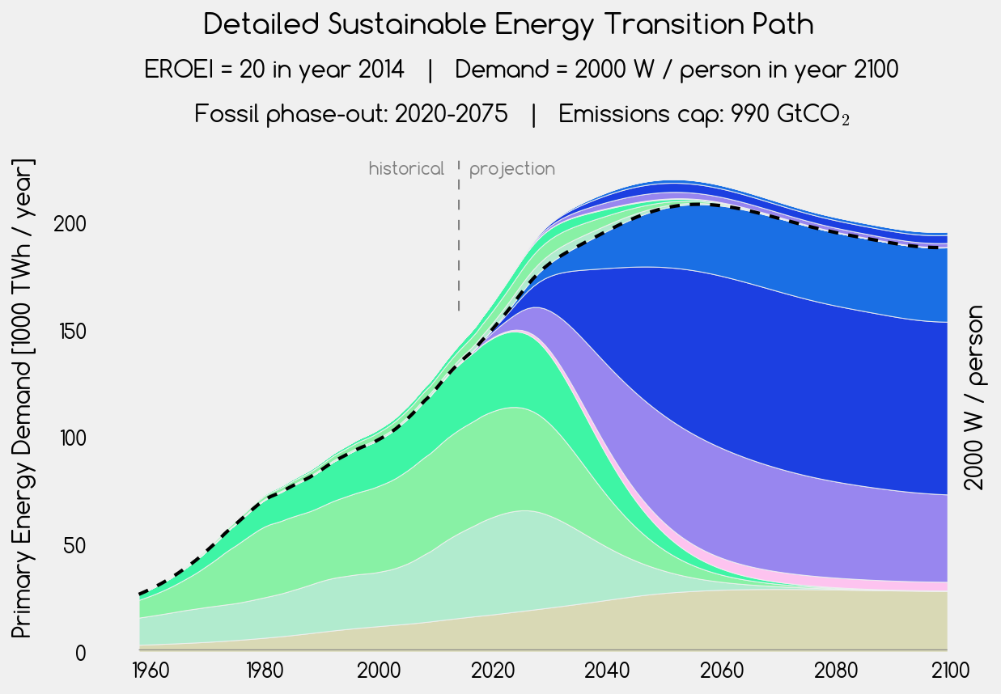
solar thermal
energy investment into energy
net energy for society
photovoltaic
gas
oil
wind
coal
geothermal
scale-limited

Slide 8











solar thermal
energy investment into energy
net energy for society
photovoltaic
gas
oil
wind
coal
geothermal
scale-limited

