Slide 1
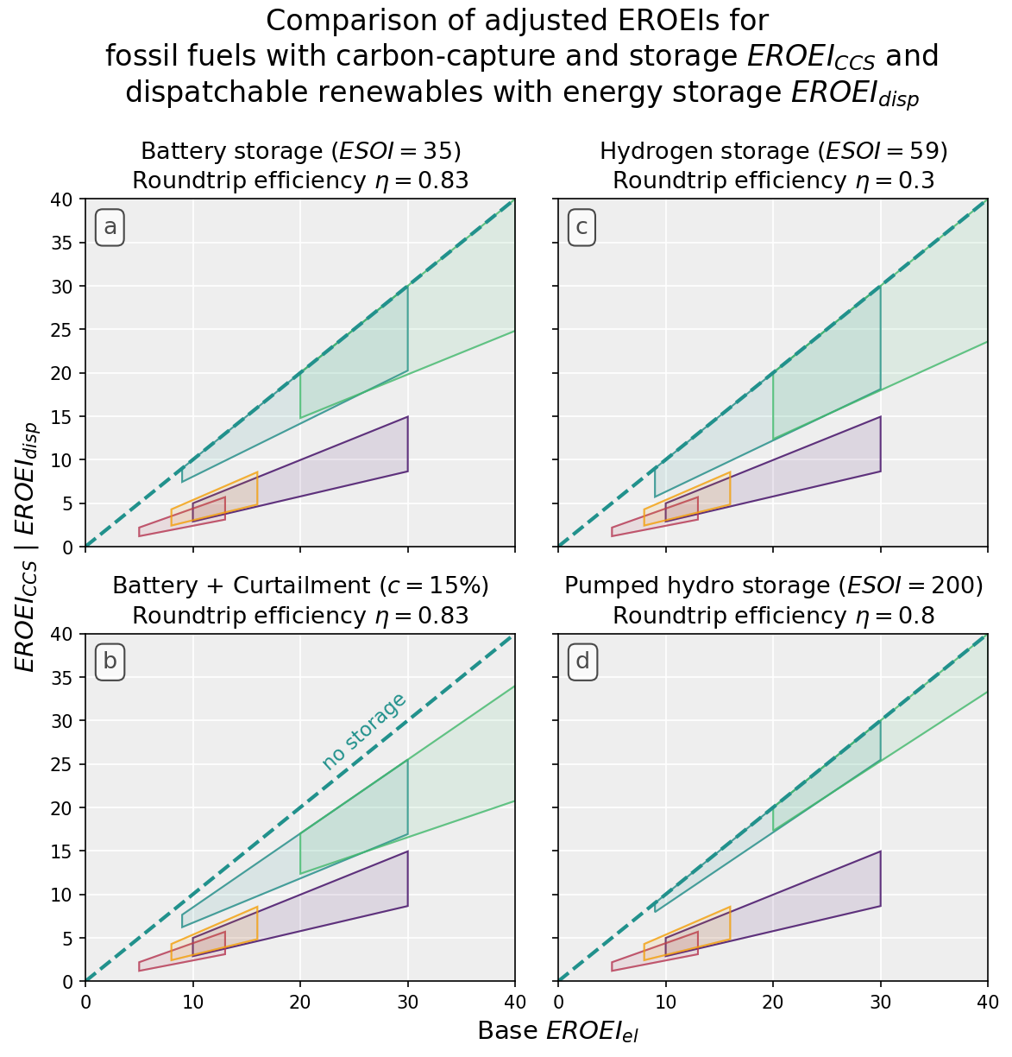
higher
storage
fraction
Wind
PV
NGCC Gas
PC
IGCC Coal
curtailment
better PV/Wind resource

