Slide 1
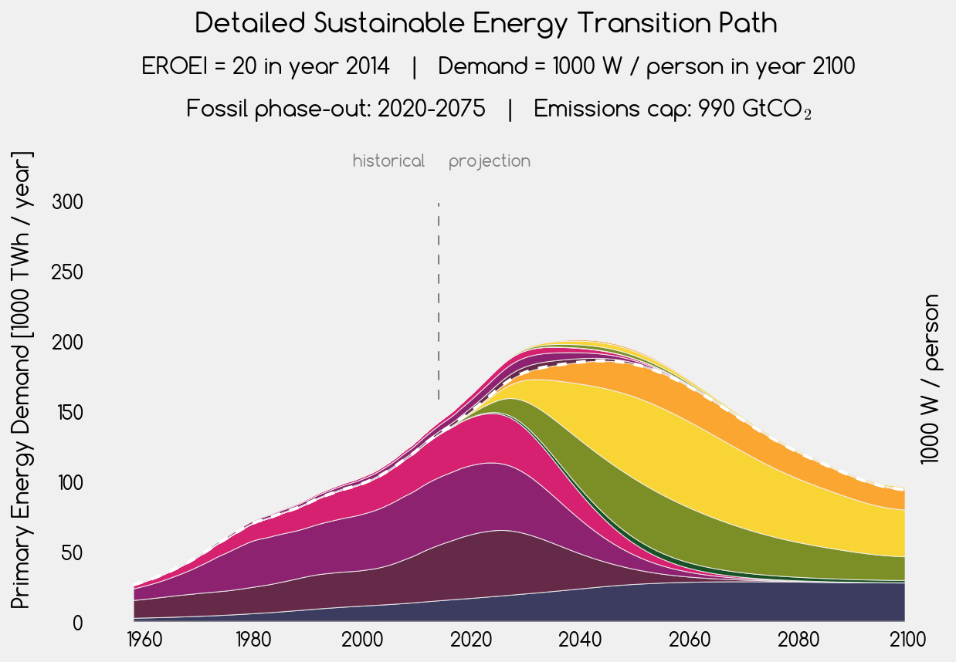








energy investment into energy
net energy for society
solar thermal
gas
oil
photovoltaic
wind
coal
geothermal

Slide 2
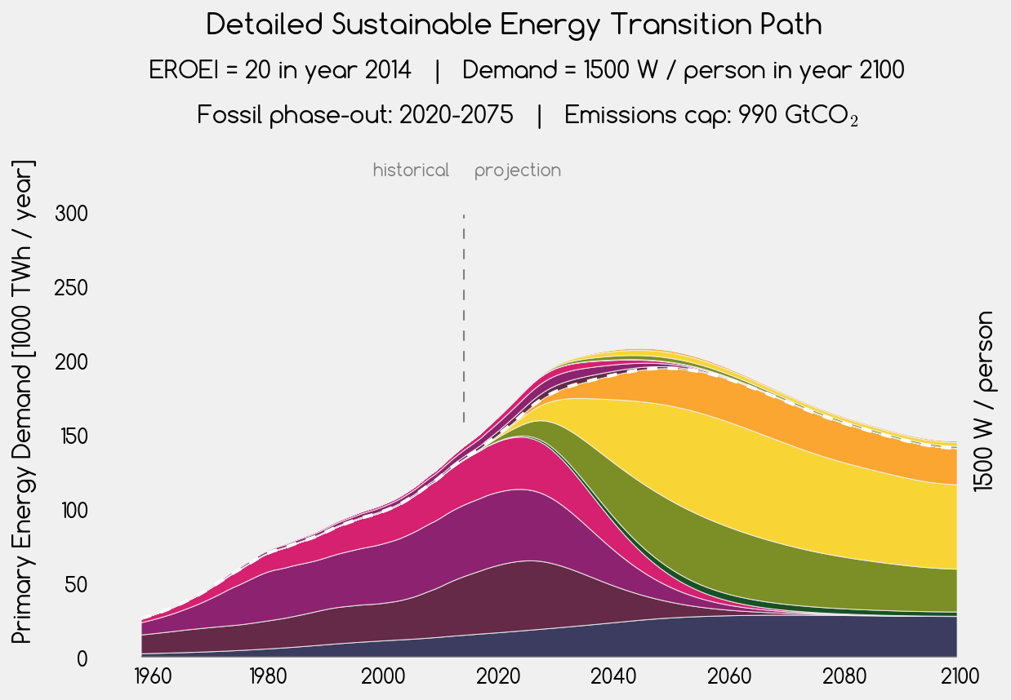
energy investment into energy
solar thermal
net energy for society
gas
photovoltaic
oil
wind
coal
geothermal

Slide 3
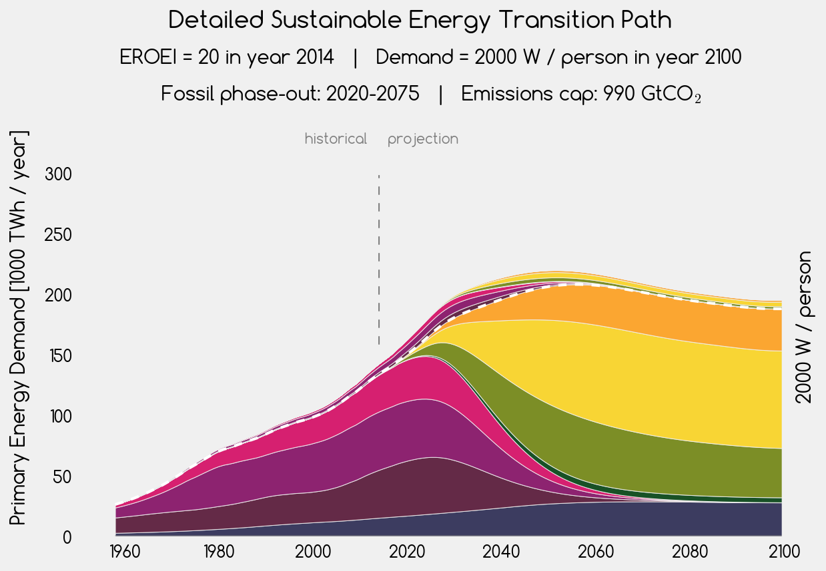
energy investment into energy
solar thermal
net energy for society
photovoltaic
gas
oil
wind
coal
geothermal

Slide 4
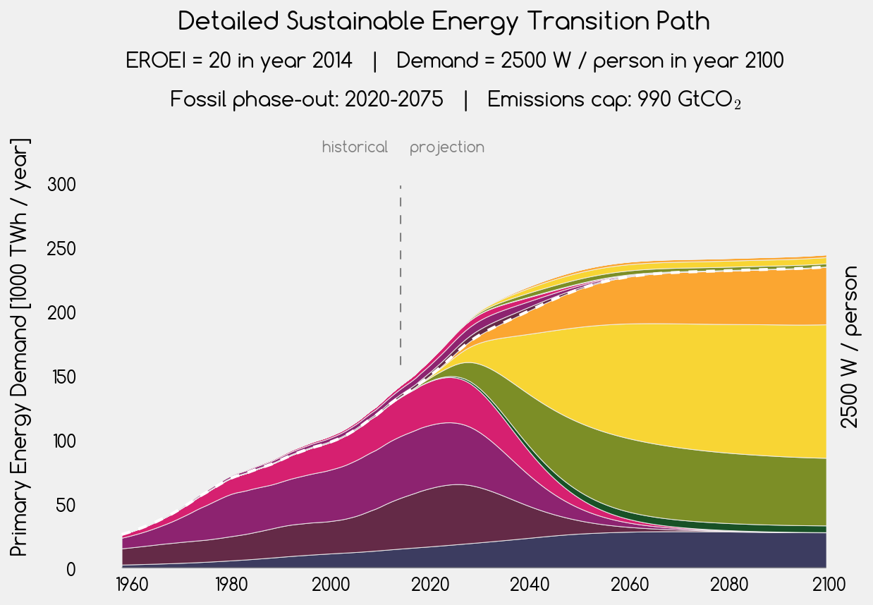
solar thermal
energy investment into energy
photovoltaic
net energy for society
gas
oil
wind
coal
geothermal

Slide 5
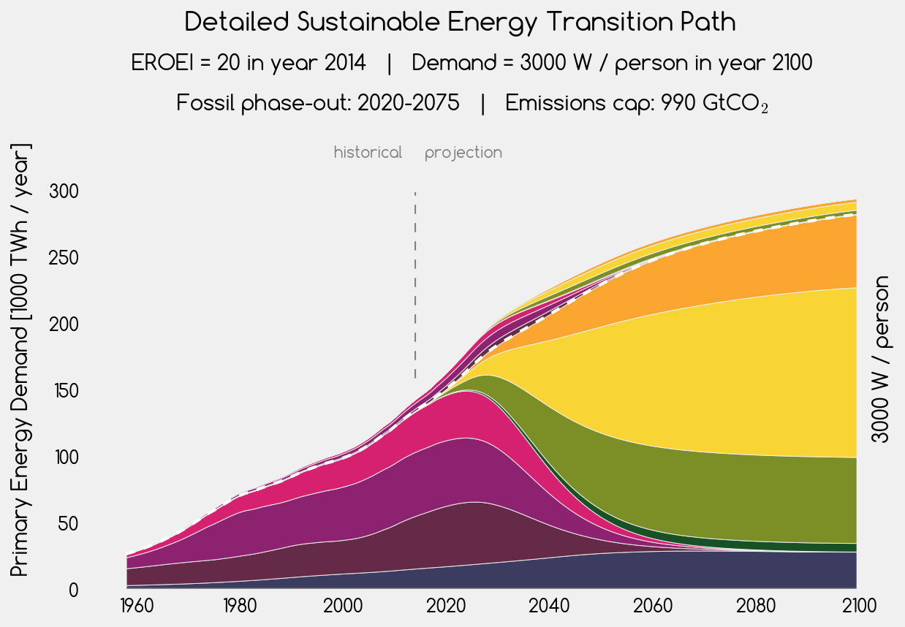
solar thermal
energy investment into energy
photovoltaic
net energy for society
gas
oil
wind
coal
geothermal

Slide 6
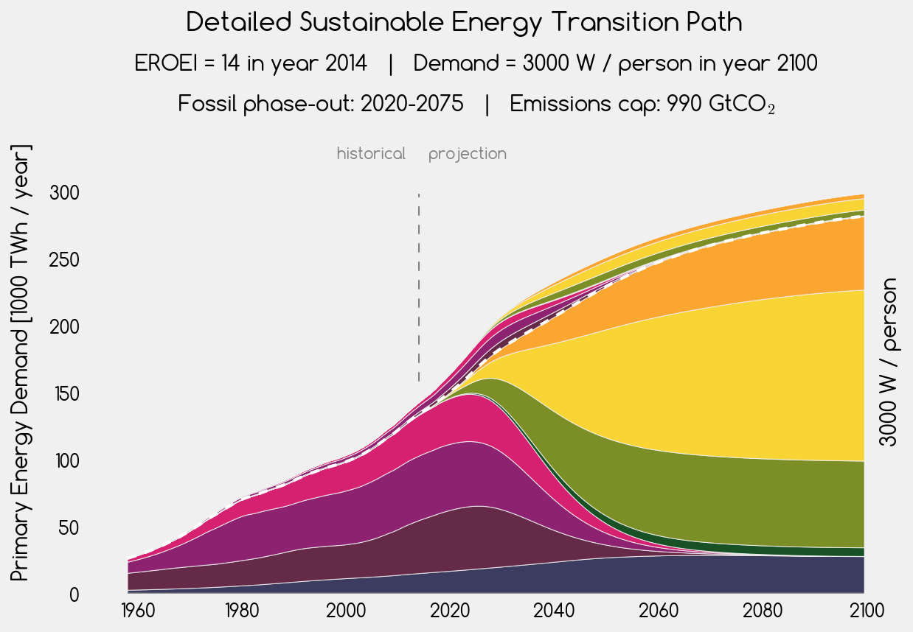
solar thermal
energy investment into energy
photovoltaic
net energy for society
gas
oil
wind
coal
geothermal

Slide 7

solar thermal
energy investment into energy
photovoltaic
net energy for society
gas
oil
wind
coal
geothermal

Slide 8
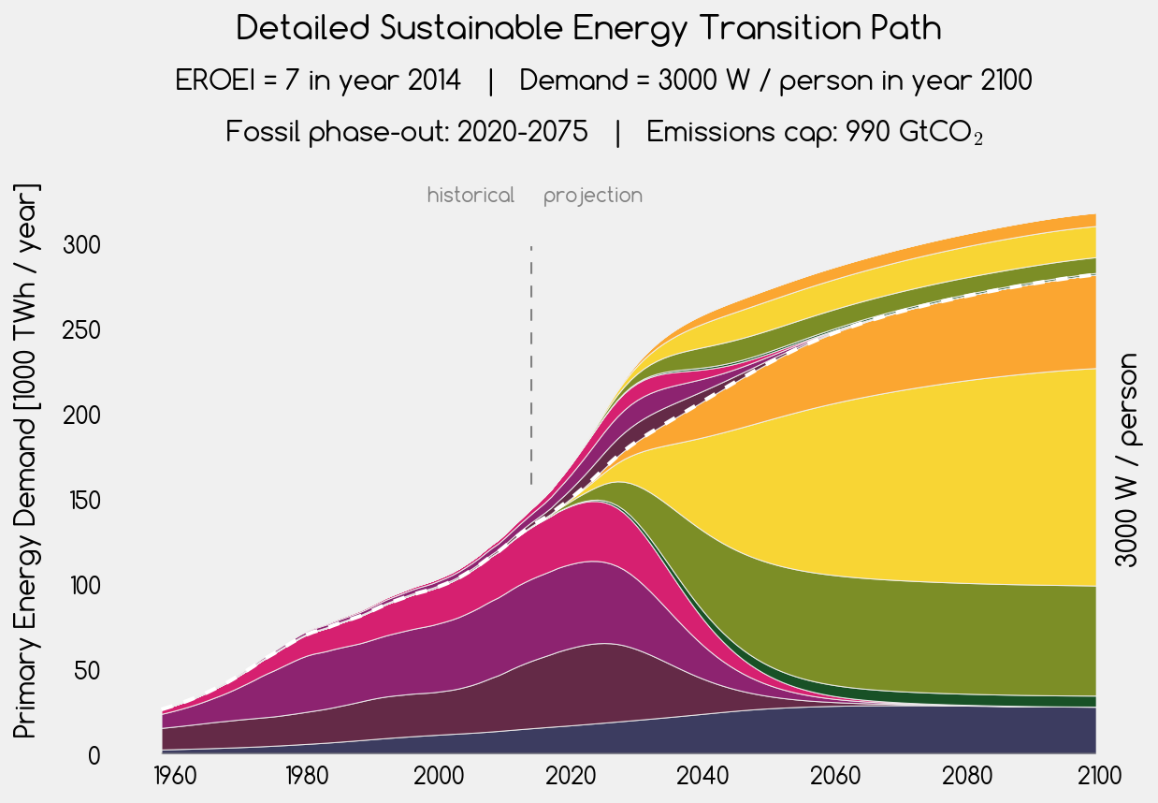
solar thermal
energy investment into energy
photovoltaic
net energy for society
gas
oil
wind
coal
geothermal

