Slide 1
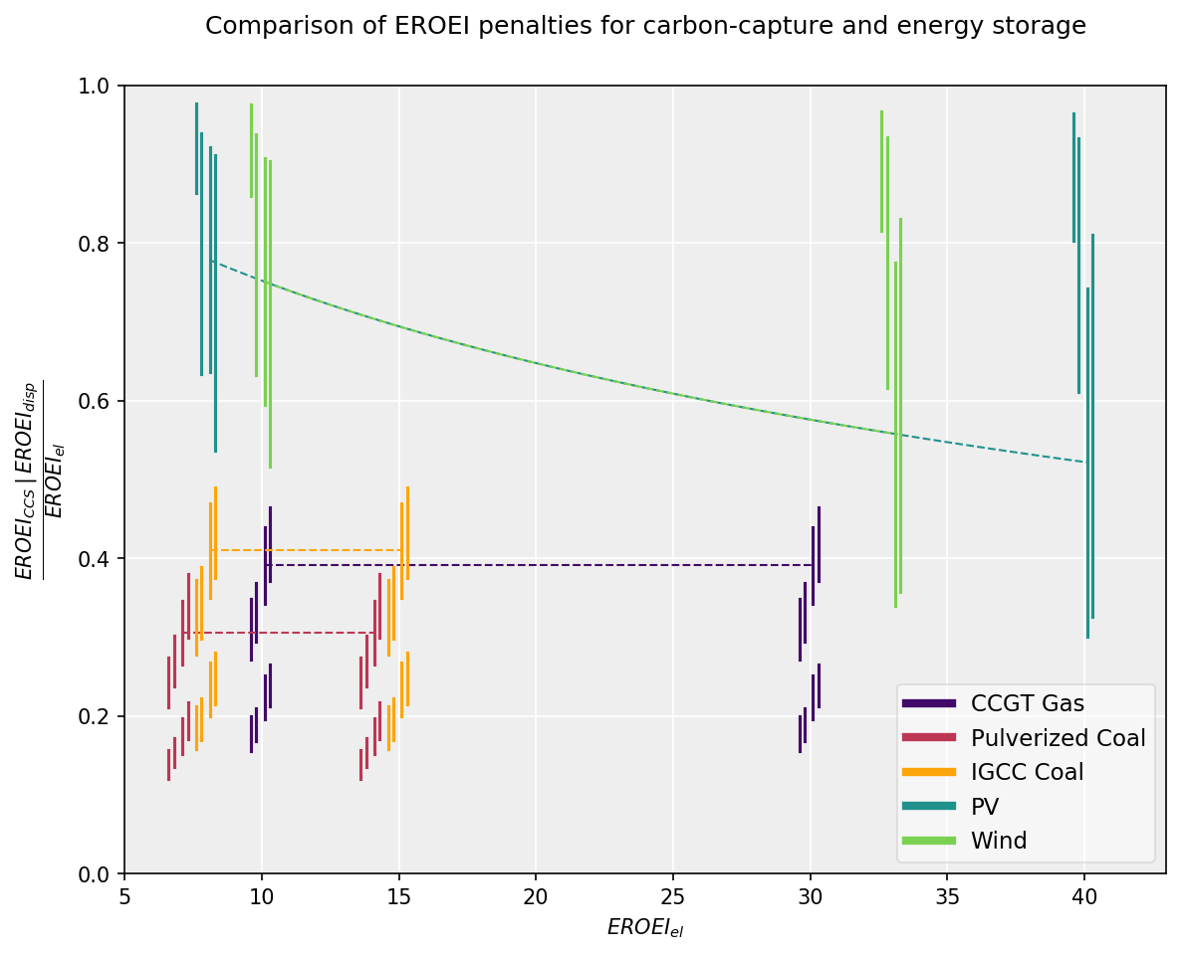

Slide 2
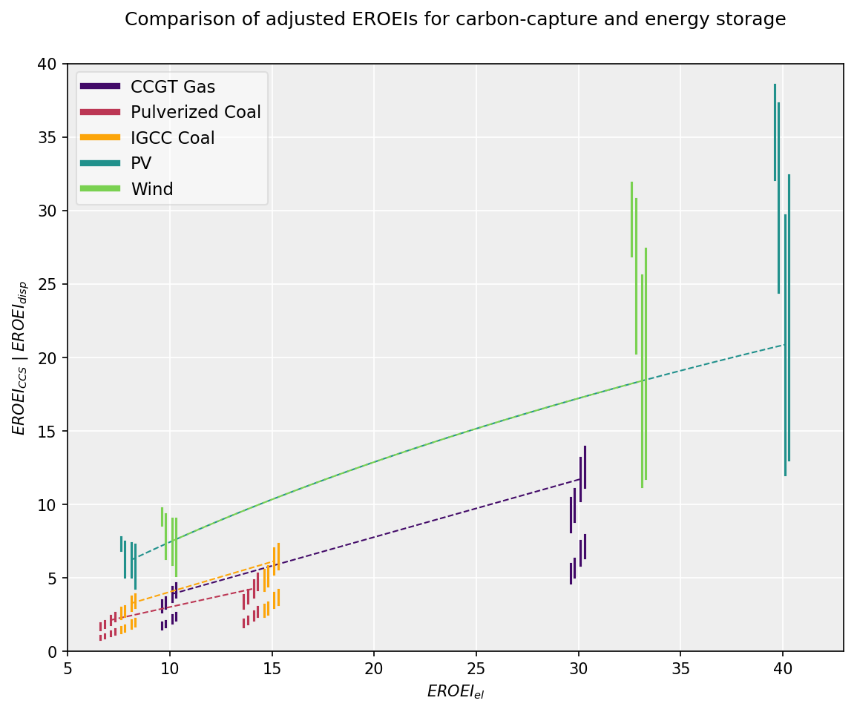
Φ = 0.1
ESOI = 200
Φ = 0.6
ESOI = 10
EROEI_{disp} for η=0.8, ESOI=10
EROEI_{CCS} for R=2, CF=90, CR=90
CR = 90
η = 0.8
η = 0.4
CF = 90
CF = 50
CR = 50
R = 2
R = 2
R = 3
R = 1

