Slide 1
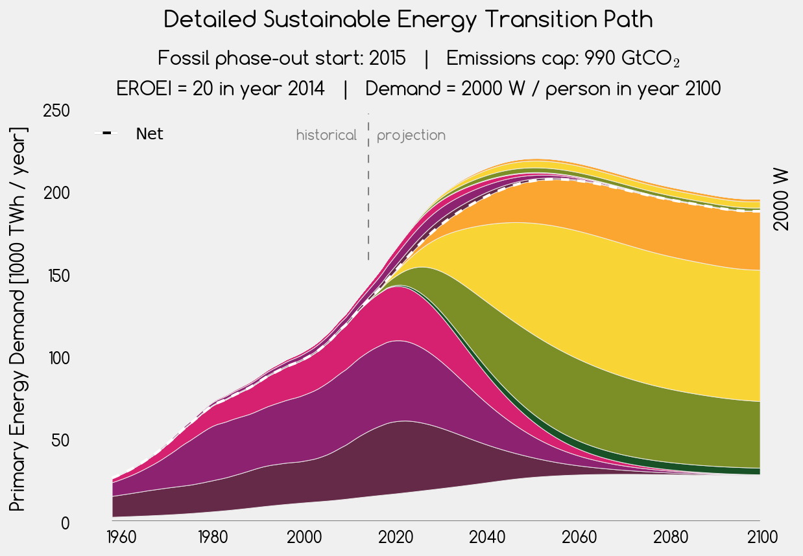











energy investment into energy
solar thermal
net energy for society
gas
photovoltaic
oil
wind
coal
geothermal
scale-limited

Slide 2
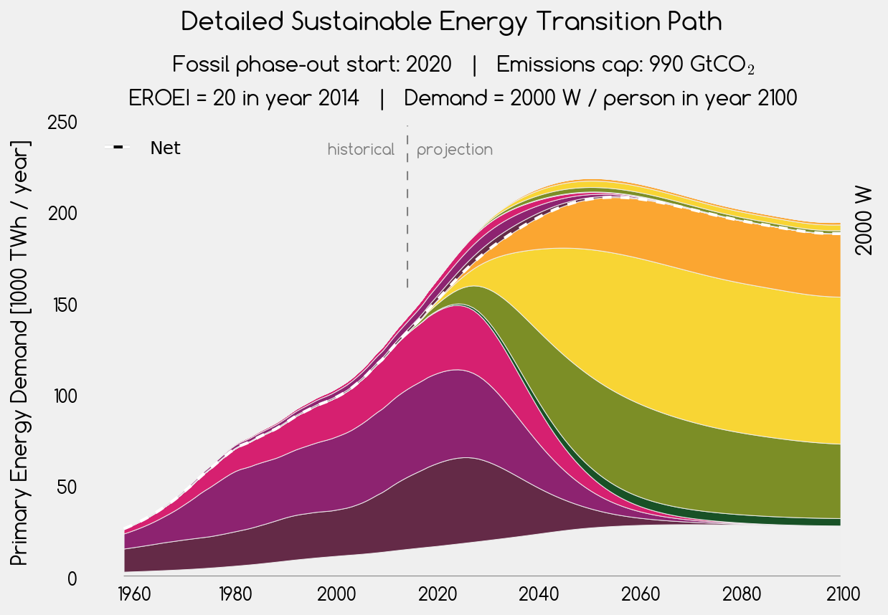
energy investment into energy
solar thermal
net energy for society
gas
photovoltaic
oil
wind
coal
geothermal
scale-limited

Slide 3

energy investment into energy
solar thermal
net energy for society
gas
photovoltaic
oil
wind
coal
geothermal
scale-limited

Slide 4
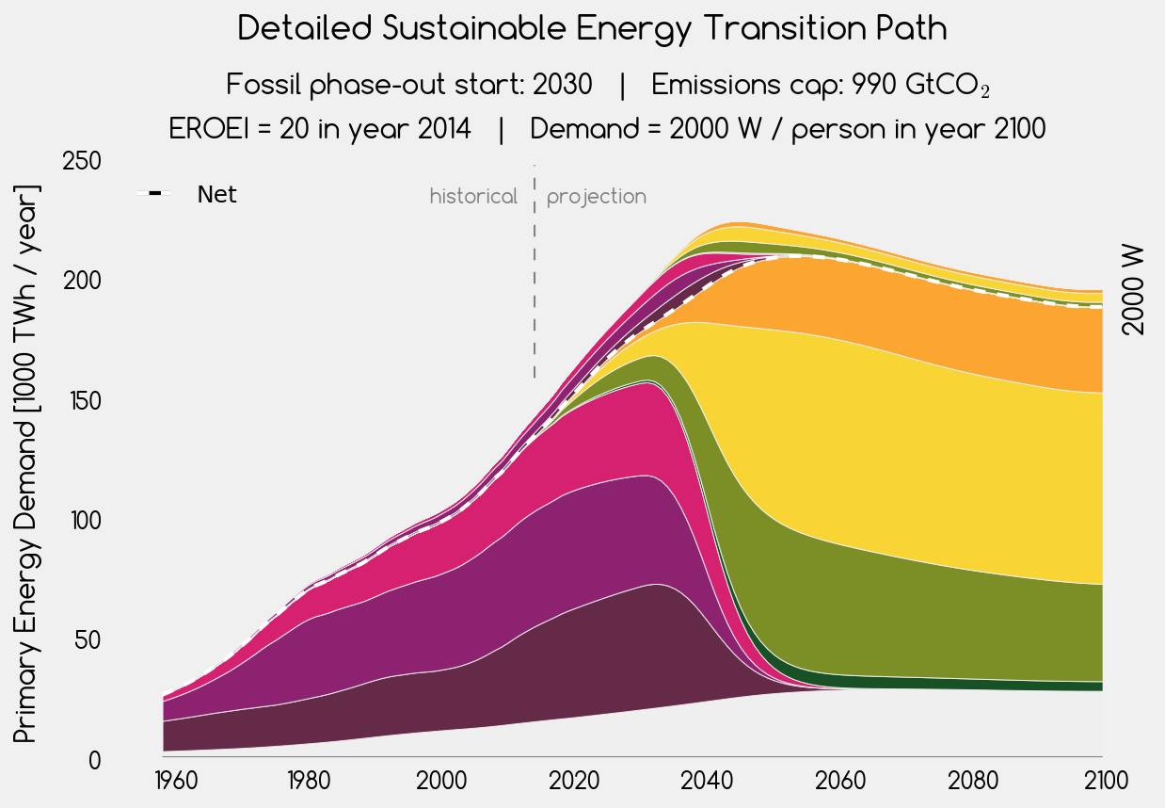
energy investment into energy
solar thermal
net energy for society
gas
photovoltaic
oil
wind
coal
geothermal
scale-limited

Slide 5

energy investment into energy
solar thermal
net energy for society
gas
photovoltaic
oil
wind
coal
geothermal
scale-limited

