Slide 1
Regression
Hung-yi Lee
李宏毅
Notes:
国立台湾大学

Slide 2

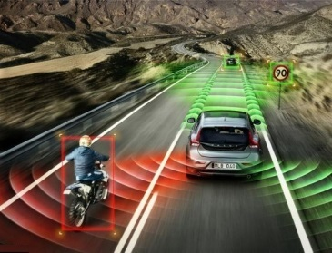


Regression: Output a scalar
Stock Market Forecast
Self-driving Car
Recommendation
Dow Jones Industrial Average at tomorrow
$$f\left( \right)=$$
$$f\left( \right)=$$
方向盤角度
$$f\left( \right)=$$
購買可能性
使用者 A
商品 B

Slide 3








Example Application
Estimating the Combat Power (CP) of a pokemon after evolution
$$x_{cp}$$
CP after evolution
$$f\left( \right)=$$
$$y$$
$$x_{s}$$
$$x$$
$$x_{hp}$$
$$x_{w}$$
$$x_{h}$$

Slide 4
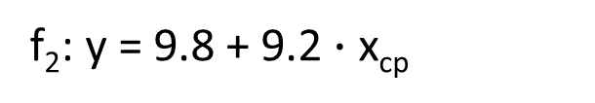

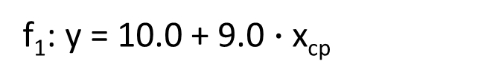

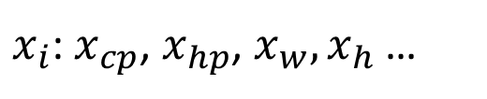

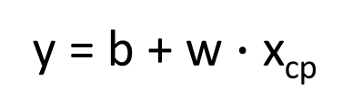
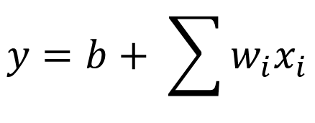
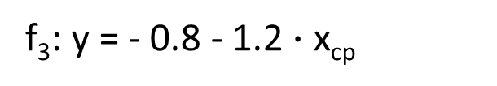

Step 1: Model
w and b are parameters (can be any value)
y = b + w $∙$ x_{cp}
f₁: y = 10.0 + 9.0 $∙$ x_{cp}
A set of function
Model
f₂: y = 9.8 + 9.2 $∙$ x_{cp}
f₃: y = - 0.8 - 1.2 $∙$ x_{cp}
…… infinite
CP after evolution
$$x$$
$$y$$
$$f\left( \right)=$$
$x_{i}$: $x_{cp}$, $x_{hp}$, $x_{w},x_{h}$ …
$$y=b+ \sum{w_{i}x_{i}}$$
Linear model:
feature
$w_{i}$: weight, b: bias
权重
偏差

Slide 5






Step 2: Goodness of Function
y = b + w $∙$ x_{cp}
A set of function
Model
function
input:
function
Output (scalar):
$${\hat{y}}^{1}$$
$$x^{1}$$
$${\hat{y}}^{2}$$
$$x^{2}$$
Training
Data
Notes:
卡咪龜

Slide 6
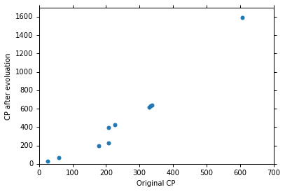







Step 2: Goodness of Function
Training Data: 10 pokemons
$$\left(x^{1},{\hat{y}}^{1}\right)$$
$$\left(x^{2},{\hat{y}}^{2}\right)$$
$$\left(x_{cp}^{n},{\hat{y}}^{n}\right)$$
$$……$$
$$\hat{y}$$
$$\left(x^{10},{\hat{y}}^{10}\right)$$
This is real data.
$$x_{cp}$$
Source: https://www.openintro.org/stat/data/?data=pokemon

Slide 7

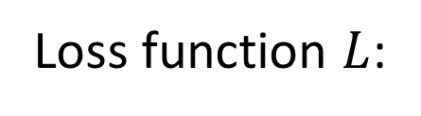

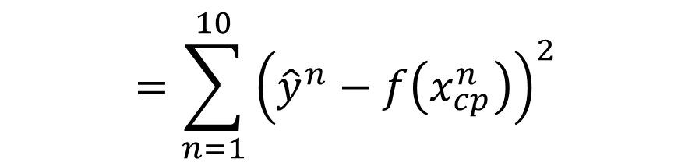
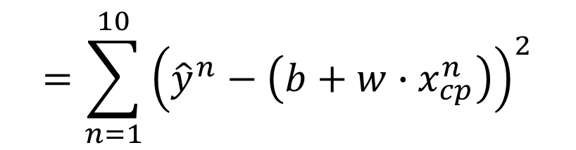
Step 2: Goodness of Function
y = b + w $∙$ x_{cp}
A set of function
Loss function $L$:
Model
Input: a function, output: how bad it is
Estimation error
$$=\sum_{n=1}^{10}{{\left({\hat{y}}^{n}−f\left(x_{cp}^{n}\right)\right)}^{2}}$$
Goodness of function f
$$L\left(f\right)$$
Estimated y based on input function
Sum over examples
Training
Data
$$L\left(w,b\right)$$
$$=\sum_{n=1}^{10}{{\left({\hat{y}}^{n}−\left(b+w∙x_{cp}^{n}\right)\right)}^{2}}$$

Slide 8
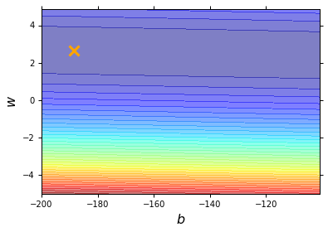
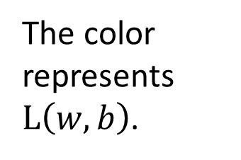
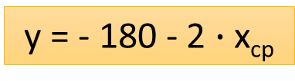
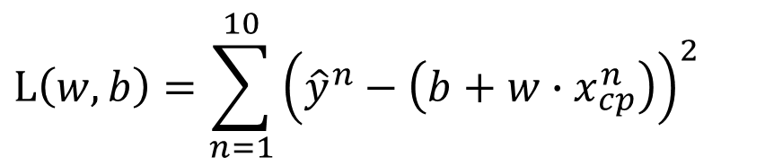
Step 2: Goodness of Function
$$L\left(w,b\right)=\sum_{n=1}^{10}{{\left({\hat{y}}^{n}−\left(b+w∙x_{cp}^{n}\right)\right)}^{2}}$$
Loss Function
Each point in the figure is a function
smallest
y = - 180 - 2 $∙$ x_{cp}
The color represents $L\left(w,b\right)$.
Very large
(true example)

Slide 9
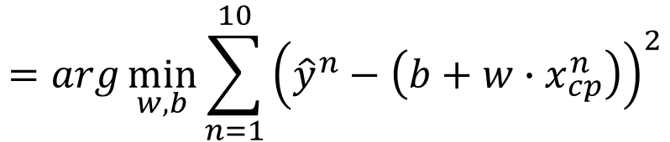

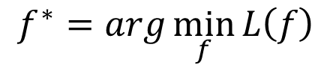

Step 3: Best Function
$$L\left(w,b\right)$$
$$=\sum_{n=1}^{10}{{\left({\hat{y}}^{n}−\left(b+w∙x_{cp}^{n}\right)\right)}^{2}}$$
A set of function
Model
Goodness of function f
Pick the “Best” Function
$$f^{∗}=\arg{\min_{f}{L\left(f\right)}}$$
Gradient Descent
Training
Data
$$w^{∗},b^{∗}=arg\min_{w,b}{L\left(w,b\right)}$$
$$=arg\min_{w,b}{\sum_{n=1}^{10}{{\left({\hat{y}}^{n}−\left(b+w∙x_{cp}^{n}\right)\right)}^{2}}}$$
Notes:
http://speech.ee.ntu.edu.tw/~tlkagk/courses/LA_2016/Lecture/orthogonal%20projection%20(v2).ecm.mp4/index.html

Slide 10

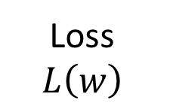


Step 3: Gradient Descent
http://chico386.pixnet.net/album/photo/171572850
$$w^{∗}=arg\min_{w}{L\left(w\right)}$$
Consider loss function 𝐿(𝑤) with one parameter w:
(Randomly) Pick an initial value w⁰
Compute $\frac{dL}{dw}|_{w=w^{0}}$
Loss
$$L\left(w\right)$$
Negative
Increase w
Positive
Decrease w
w⁰

Slide 11

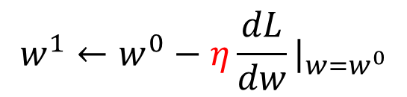
Step 3: Gradient Descent
http://chico386.pixnet.net/album/photo/171572850
$$w^{∗}=arg\min_{w}{L\left(w\right)}$$
Consider loss function 𝐿(𝑤) with one parameter w:
(Randomly) Pick an initial value w⁰
Compute $\frac{dL}{dw}|_{w=w^{0}}$
$$w^{1}←w^{0}−η\frac{dL}{dw}|_{w=w^{0}}$$
Loss
$$L\left(w\right)$$
η is called “learning rate”
w⁰
$$−η\frac{dL}{dw}|_{w=w^{0}}$$

Slide 12



Step 3: Gradient Descent
$$w^{∗}=arg\min_{w}{L\left(w\right)}$$
Consider loss function 𝐿(𝑤) with one parameter w:
(Randomly) Pick an initial value w⁰
Compute $\frac{dL}{dw}|_{w=w^{0}}$
$$w^{1}←w^{0}−η\frac{dL}{dw}|_{w=w^{0}}$$
Loss
$$L\left(w\right)$$
Compute $\frac{dL}{dw}|_{w=w^{1}}$
$$w^{2}←w^{1}−η\frac{dL}{dw}|_{w=w^{1}}$$
…… Many iteration
Local minima
global minima
w⁰
w¹
w²
w^{T}

Slide 13


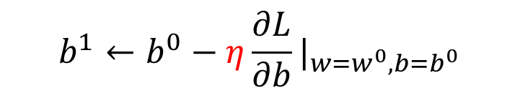
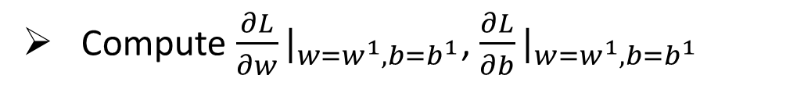

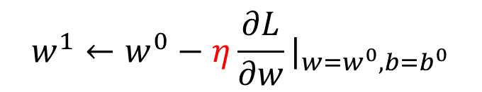


Step 3: Gradient Descent
$$\left[\begin{aligned}\frac{∂L}{∂w} \\ \frac{∂L}{∂b}\end{aligned}\right]$$
$$∇L=$$
gradient
How about two parameters?
$$w^{∗},b^{∗}=arg\min_{w,b}{L\left(w,b\right)}$$
(Randomly) Pick an initial value w⁰, b⁰
Compute $\frac{∂L}{∂w}|_{w=w^{0},b=b^{0}}$, $\frac{∂L}{∂b}|_{w=w^{0},b=b^{0}}$
$$w^{1}←w^{0}−η\frac{∂L}{∂w}|_{w=w^{0},b=b^{0}}$$
$$b^{1}←b^{0}−η\frac{∂L}{∂b}|_{w=w^{0},b=b^{0}}$$
Compute $\frac{∂L}{∂w}|_{w=w^{1},b=b^{1}}$, $\frac{∂L}{∂b}|_{w=w^{1},b=b^{1}}$
$$w^{2}←w^{1}−η\frac{∂L}{∂w}|_{w=w^{1},b=b^{1}}$$
$$b^{2}←b^{1}−η\frac{∂L}{∂b}|_{w=w^{1},b=b^{1}}$$
Notes:
鄭凱文

Slide 14
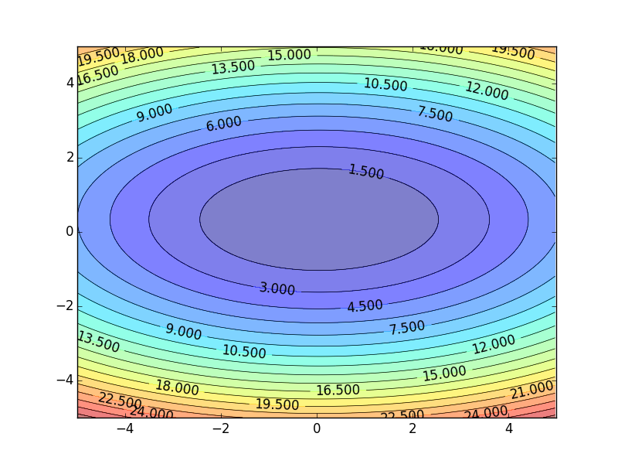
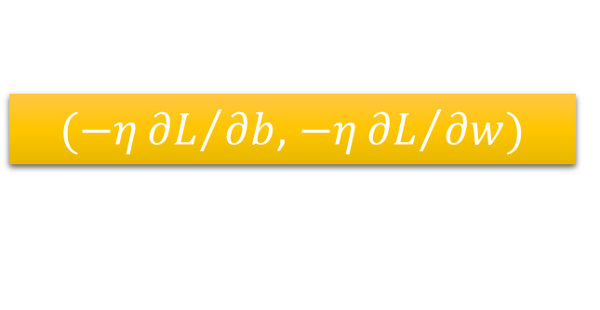
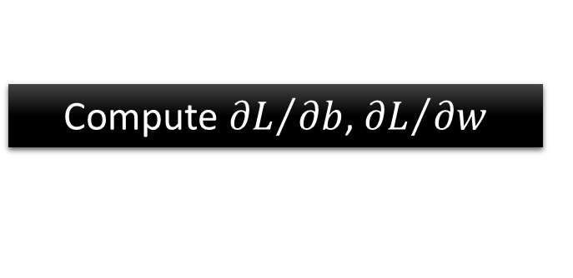


Step 3: Gradient Descent
Color: Value of Loss L(w,b)
$$w$$
$(−η{∂L}/{∂b}$, $−η{∂L}/{∂w})$
Compute ${∂L}/{∂b}$, ${∂L}/{∂w}$
$$b$$
Notes:
Don’t worry. In linear regression, the loss function L is convex.
No local minima
Questions: image you are playing AOC
A network can have millions of parameters.
Backpropagation is the way to compute the gradients efficiently (not today)
Ref: http://speech.ee.ntu.edu.tw/~tlkagk/courses/MLDS_2015_2/Lecture/DNN%20backprop.ecm.mp4/index.html

Slide 15
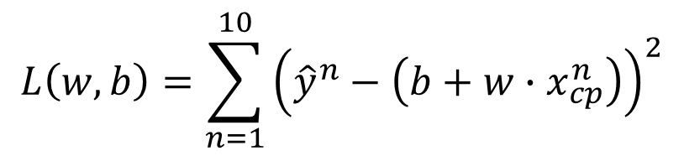

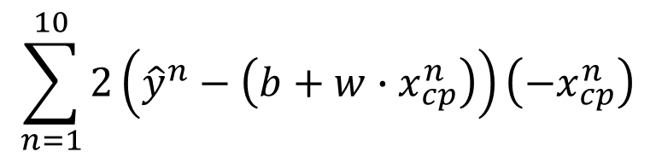


Step 3: Gradient Descent
Formulation of ${∂L}/{∂w}$ and ${∂L}/{∂b}$
$$L\left(w,b\right)=\sum_{n=1}^{10}{{\left({\hat{y}}^{n}−\left(b+w∙x_{cp}^{n}\right)\right)}^{2}}$$
$$\sum_{n=1}^{10}{2\left({\hat{y}}^{n}−\left(b+w∙x_{cp}^{n}\right)\right)\left(−x_{cp}^{n}\right)}$$
$$\frac{∂L}{∂w}=?$$
$$\frac{∂L}{∂b}=?$$

Slide 16
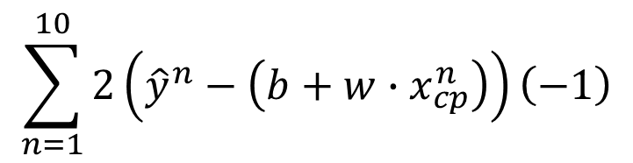
Step 3: Gradient Descent
Formulation of ${∂L}/{∂w}$ and ${∂L}/{∂b}$
$$L\left(w,b\right)=\sum_{n=1}^{10}{{\left({\hat{y}}^{n}−\left(b+w∙x_{cp}^{n}\right)\right)}^{2}}$$
$$\sum_{n=1}^{10}{2\left({\hat{y}}^{n}−\left(b+w∙x_{cp}^{n}\right)\right)\left(−x_{cp}^{n}\right)}$$
$$\frac{∂L}{∂w}=?$$
$$\frac{∂L}{∂b}=?$$
$$\sum_{n=1}^{10}{2\left({\hat{y}}^{n}−\left(b+w∙x_{cp}^{n}\right)\right)\left(−1\right)}$$

