Slide 1
01:198:211 Computer Architecture
Abhishek Bhattacharjee
Rutgers University
abhib@cs.rutgers.edu
Spring 2014

Slide 2
Instructors
Me: Abhishek Bhattacharjee
abhib@cs.rutgers.edu
Office Hour: M 5:00-6:00PM (CoRE 306)
TA: Md Haque Section: T 8:25-9:20 PM (LSH-B 105) Contact: mdhaque@cs.rutgers.edu Office Hours: TBA, W 11:00-12:00 PM
TA: Brian Poppy Section: Th 3:35-4:30 PM (BE 252) Contact: bpoppy@cs.rutgers.edu Office Hours: TBA
TA: Chaowei Tan Section: Th 5:15 - 6:10 PM (TIL 251) Contact: ct382@cs.rutgers.edu Office Hours: TBA, F 1:00-2:00 PM
TA: Ioannis Manousakis
Section: T 3:35 - 4:30 PM (BE 252) Contact: im159@cs.rutgers.edu Office Hours: TBA

Slide 3
Course Web
Course information on:
Sakai: https://sakai.rutgers.edu
Announcements, course material, assignment hand-in, etc.
If you are registered, when you login to Sakai using your netid, you should see a tab “CS 211 F11”
If not, it may be under the “My Active Sites” tab

Slide 4
Text Books
Required Book:
Bryant and O’Hallaron. Computer Systems: A Programmer’s Perspective. Prentice Hall.
Recommended Book: Patterson and Hennessy. Computer Organization and Design: The Hardware/Software Interface. Morgan Kauffman.
Kernighan and Ritchie. The C Programming Language, 2nd Edition, Prentice Hall, 1988.
Any good C book should be fine
A free online C book: http://publications.gbdirect.co.uk/c_book/
Disclaimer: I know nothing about the quality of this book

Slide 5
What You Should Know
Prerequisite: 198:112 ➔
You know some math
You know a bit about algorithms
You know at least one programming language (Java)
You know something about how to write, run, and test programs

Slide 6
What You Will Learn …
How to program in two more programming languages (C and Assembly)
The major hardware components in computer systems
Trends in technology and computer architecture
How hardware components are built from digital logic
How programs written in a high-level language (e.g., C) is actually executed by the hardware
How to understand and improve the performance of programs

Slide 7
Course Expectations
The fun part
3 programming assignments
1 paper & pencil homework assignment
The not so fun part
2 midterm and 1 final exams
All exams are comprehensive (all materials up to the exam)
What we expect from you
Attend lectures and recitations
Read the assigned readings before lecture
Read and think about the programming and homework assignments
Ask questions
Start programming assignments early

Slide 8
No Late Assignments
We will NOT accept late assignments
Programming assignments to be handed-in on Sakai
Deadline will be enforced by Sakai
Assignments will not be accepted after deadline passes
Can hand-in assignments multiple times so if you are working at the last minute, hand-in a version early (e.g., ½ hour before deadline)
Homework assignments to be handed-in in lecture
I will stop accepting assignments once I leave the lecture room
Emails with assignments attached will be discarded

Slide 9
Collaboration vs. Cheating
Collaboration is encouraged
You learn by discussing with others
BUT, must not cheat…
Cheating
We hate it, we will not tolerate it, we will look for it
If we find cheating, everyone involved will be punished
Department’s academic integrity policy: http://www.cs.rutgers.edu/policies/academicintegrity/
If you are having trouble with the course for any reason
Come talk to me
Please observe my “door policy”
I will help you if I can
Corollary: once cheating has occurred, there’s nothing I can do to help you avoid the consequences

Slide 10
Tentative List of Topics
Introduction
Hardware trends
C programming
Information representation
Assembly (x86) programming
Digital logic
Processor architecture
Pipelining (?)
Memory hierarchy
Compiling & linking (?)
Measuring & optimizing program performance

Slide 11
Programming Assignments
3 programming assignments
Program in C and/or Assembly
Don’t wait until the last minute
Learn how to use tools
Don’t program/debug “by accident” or “by blind search”
Will be done using the Instructional Lab
http://ilab.rutgers.edu
If you don’t already have an account, get one asap
http://www.cs.rutgers.edu/resources/new_users/getting_started.whtml
You will be programming in a Linux environment
http://www.cs.rutgers.edu/resources/new_users/beginners_doc.whtml
You can use Eclipse and/or the gnu tools (gcc, gmake, gdb, etc.)
We’ll point you to documentation on the class Web

Slide 12
Grading
Grading:
30%: 2 midterm exams
30%: final exam (cumulative)
10%: homework assignments
30%: programming assignments
No make-up exams except for university sanctioned reasons.
Must inform professor before the exam
Informing professor ≠ ok to take make-up

Slide 13

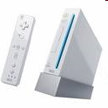
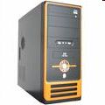

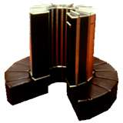
Computer Architecture
?

Slide 14
Main Components
CPU
Memory
Bus
I/O devices
Human Interface
Mouse, keyboard, screen, etc.
Storage
Networking
Graphics
Memory
Input
CPU
Output
Bus

Slide 15
Von Neumann Model
Memory
CPU
0
1
ALU
+
-
*
/
2
3
4
Store both
instructions
and data
5
6
7
PC
N
8
9

Slide 16
Basic CPU Function
FETCH[PC++]
DECODE
EXECUTE
Arithmetic: +, -, *, /
Logic: bre, jmp

Slide 17
Programming Meets Hardware
#include <stdio.h>
int main() {
int x, y, temp;
x=1; y=2;
temp =x; x=y; y=temp;
printf("%d %d %d\n",x,y,temp);
}
High-Level Language Program
Compiler
movl $1, -8(%ebp)
movl $2, -12(%ebp)
movl -8(%ebp), %eax
movl %eax, -16(%ebp)
movl -12(%ebp), %eax
movl %eax, -8(%ebp)
movl -16(%ebp), %eax
movl %eax, -12(%ebp)
movl -16(%ebp), %eax
movl %eax, 12(%esp)
movl -12(%ebp), %eax
movl %eax, 8(%esp)
movl -8(%ebp), %eax
movl %eax, 4(%esp)
Assembly Language Program
Assembler
ISA
Machine Language Program
7f 45 4c 46 01 01 01
00 00 00 00 00 00 00
00 00 02 00 03 00 01
00 00 00 f0 82 04 08
34 00 00 00 c4 0c 00
00 00 00 00 00 34 00

Slide 18
Input/Output
Memory
CPU
0
1
+
-
*
/
2
Devices:
Input: mouse, keyboard
Output: screen, speaker
Storage: disk, tape
Graphics
Networking
3
4
5
6
7
N
8
9

Slide 19
Von Neumann in Practice
CPU
Register file
ALU
PC
System bus
Memory bus
Main
memory
Bus interface
I/O
bridge
I/O bus
Expansion slots for
other devices such
as network adapters
USB
controller
Graphics
adapter
Disk
controller
Mouse
Keyboard
Display
Disk
Input
Output

Slide 20
Where Is the OS?
App
App
App
OS
OS
Hardware
Hardware
Does this mean apps run
on OS rather than the hardware?
Apps typically runs directly on
hardware. Will switch over to
OS when need help.
Actually, 1st picture is used frequently because OS does extend the hardware, making the hardware appear more “powerful” through abstractions such as processes, threads, virtual memory, files, etc.

Slide 21
Computer Architecture
How to design and build the components
How to design and build systems from the components
In this class:
Understand basics of current components and systems
Understand how programs run on current systems
Understand how current architecture affect my high-level language programs
How can I make my program run faster?
How can I make my program more power efficient?
Run longer when on battery

Slide 22
Architecture Trends: Moore’s law
Gordon Moore was an Intel Engineer
An observation about improvements in hardware
No of transistors on a chip double every 18 months
Exponential growth seen in other hardware dimensions
Processor speed: 2x every 18 months
Memory capacity: 2x every 2 years
Disk capacity: 2x every year

Slide 23
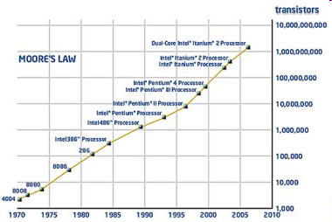
Number of Transistors on a Chip

Slide 24
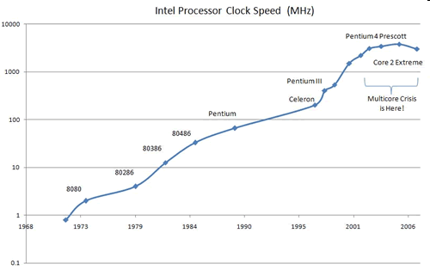
Clock speed

Slide 25
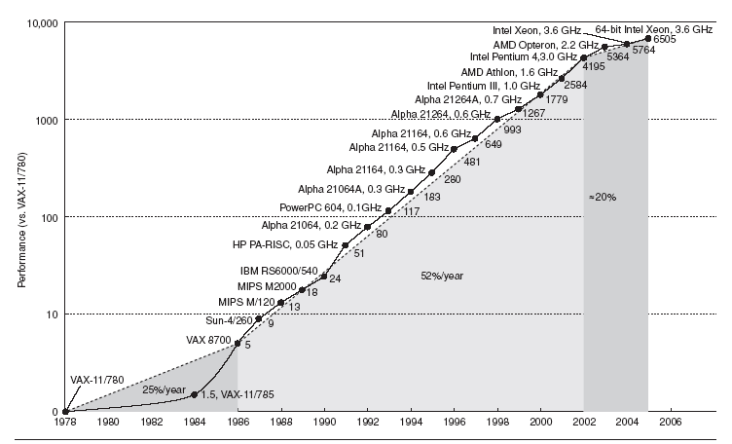
Processor Performance
2x every 18 months

Slide 26
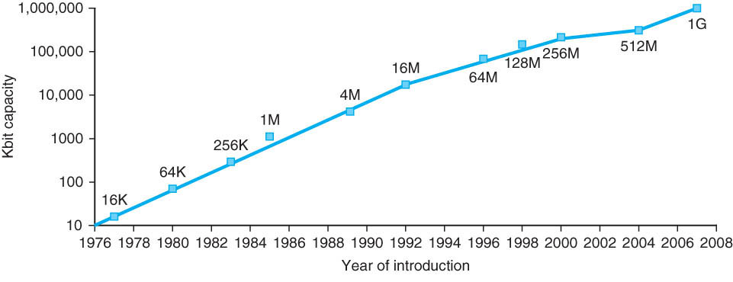
Memory Capacity

Slide 27
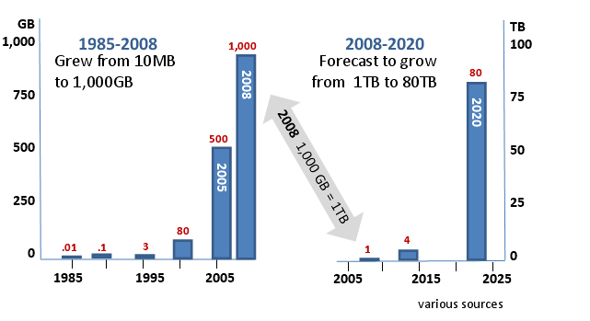
Disk Capacity

Slide 28
CPU/Memory Performance Gap
Implication: memory hierarchy
registers, caches
1000
µProc
60%/yr.
CPU
100
Processor-Memory
Performance Gap: (grows 50% / year)
Performance
10
DRAM
7%/yr.
DRAM
1
1980
1981
1982
1983
1984
1985
1986
1987
1988
1989
1990
1991
1992
1993
1994
1995
1996
1997
1998
1999
2000

Slide 29
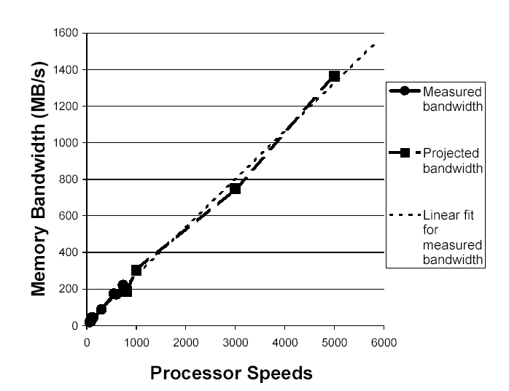
Processor Speed vs. Memory Bandwidth
Source:
Heath, Kaur,
Martin, Nguyen.
HPCA 2001.

Slide 30
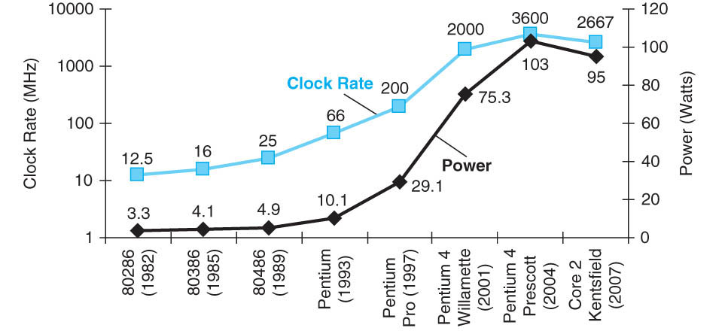
“Power Wall”

