Slide 1
CS 211: Computer Architecture Digital Logic: Sequential Circuits and Finite State Machines
Abhishek Bhattacharjee
Reading:
Uploaded materials on Sakai

Slide 2
Quick Review

Slide 3
Bit Storage Summary
We considered increasingly better bit storage until we arrived at the robust D flip-flop bit storage

Slide 4
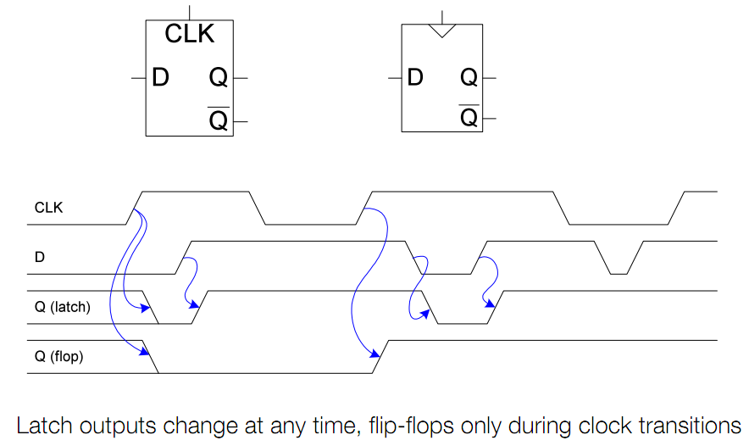
Flip-Flop versus Latch

Slide 5
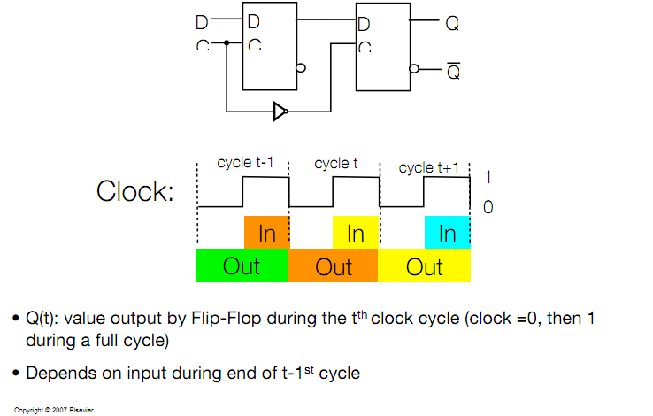
Master Slave D Flip Flop

Slide 6

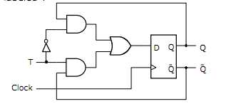

T Flip-Flop
This is a toggle flip-flop – when input T is 1, toggle output Q
Can be realized with a D flip-flop

Slide 7
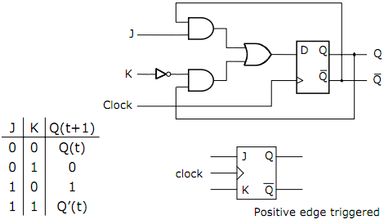
JK Flip-Flop
The JK Flip-Flop can also be derived from the basic D Flip-Flop
Its purpose it to combine aspects of the SR Flip-Flop and the T Flip-Flop
Behaves like an SR flip-flop for all values except J=K=1 (in these cases J = S, and K = R)
For J = K = 1, it toggles like a T flip flop
It can be built from a D flip flop

Slide 8
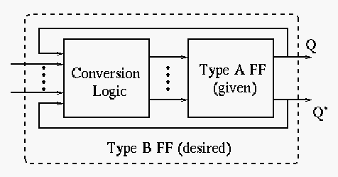
Flip-Flop Conversion
The purpose is to convert a given type A flip-flop to a desired type B flip-flop using conversion logic
The key is to use excitation tables, which show the necessary triggering signal (S, R, J, K, D, and T) for the desired flip-flop transition

Slide 9
Excitation Tables
Q(t) | Q(t+1) | S | R | J | K | D | T
0 | 0 | 0 | x | 0 | x | 0 | 0
0 | 1 | 1 | 0 | 1 | x | 1 | 1
1 | 0 | 0 | 1 | x | 1 | 0 | 1
1 | 1 | x | 0 | x | 0 | 1 | 0
This is the combination of input assignments (S, R, J, K, D, and T) required to realize state transitions

Slide 10
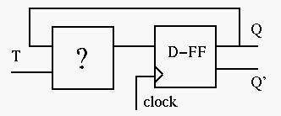
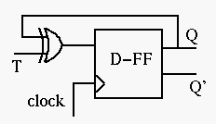
Convert a D-FF to a T-FF
We need to design the circuit to generate the triggering signal D as a function of T and Q → D = f(T, Q)
Consider the excitation tables of T and D
Make a k-map
Q(t)/T | 0 | 1
0 | 0 | 1
1 | 1 | 0
D = T’Q + TQ’ = T xor Q

Slide 11
Register File
W_data
32
32
bus
R_data
Internal design uses drivers and bus
d0
load
reg0
driver
d0
2x4
32
2x4
d1
load
reg1
d1
a
driver
W_addr
i0
32
i0
i1
i1
R_addr
d
q
d2
load
reg2
d2
write
32
read
q=d
decoder
decoder
Boosts signal
e
d3
load
reg3
d3
e
W_en
32
R_en
three-state driver
4x32 register file
a
c
Internal design of 4x32 RF; 16x32 RF follows similarly
d
q
c=1: q=d
d
q
′
′
c=0: q= Z
d
q
like no connection
Note: Each driver in figure actually represents 32 1-bit drivers

Slide 12
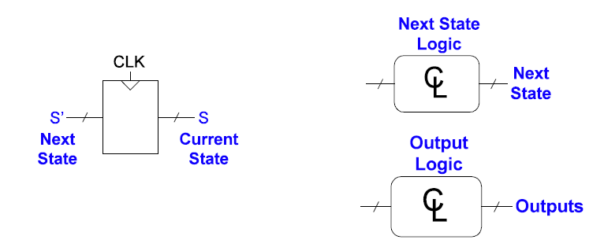
Finite State Machines
FSM = State register + combinational logic
Stores the next state and
loads the next state at
clock edge
Computes the next state
and computes the outputs

Slide 13
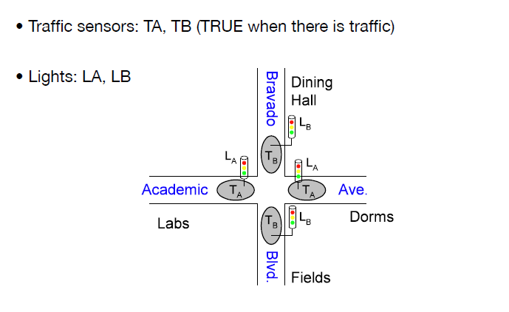
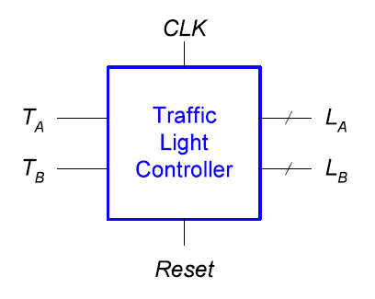
Traffic Light Controller Example

Slide 14
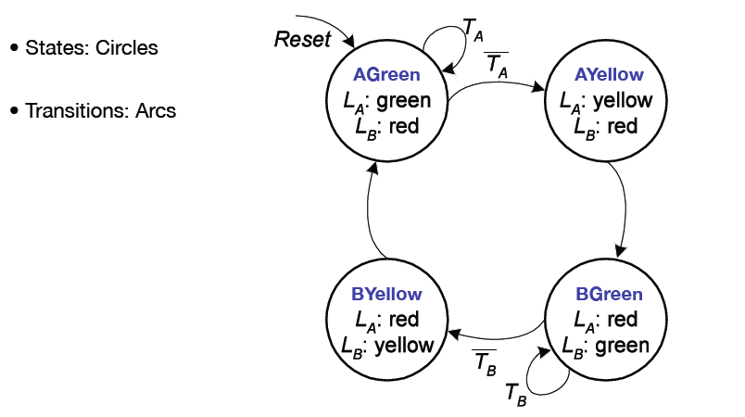
FSM State Transition Diagram

Slide 15
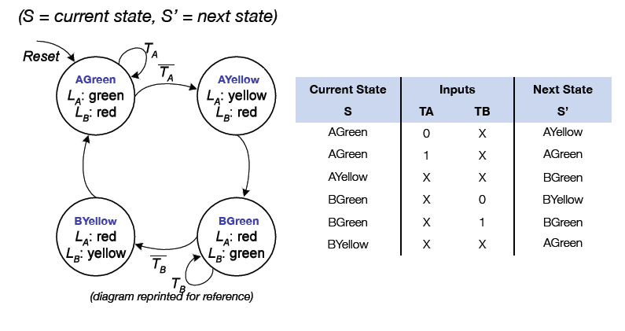
FSM State Transition Table
State transitions from diagram can be rewritten in a state transition table

Slide 16
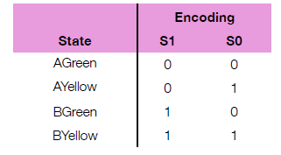
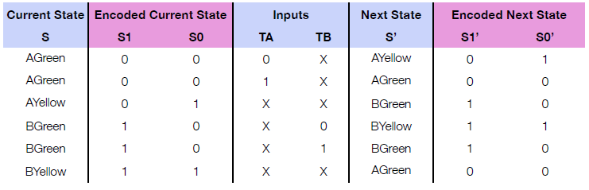
Encoded State Transition Table
After selecting a state encoding, the symbolic states in the transition table can be realized with current state/next state bits

Slide 17

Computing Next State Logic
From K-maps, figure out expressions for the next state:
S1(t+1) = S1(t) xor S0(t)
S0(t+1) = S1’(t) S0’(t) TA + S1’(t) S0’(t) TB
Another way of writing the same thing (just a change of notation):

Slide 18
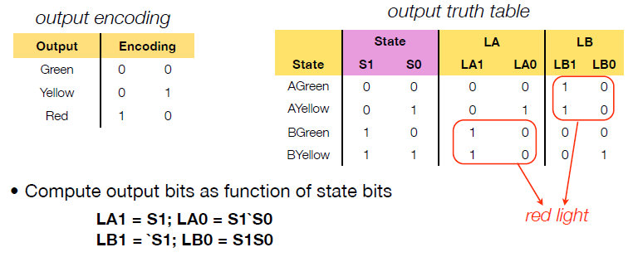
FSM Output Table
FSM output logic is computed in similar manner as next state logic
In this system, output is a function of current state (Moore machine)
Alternative – Mealy machine (output function of both current state and inputs, though we won’t cover this in class)

Slide 19
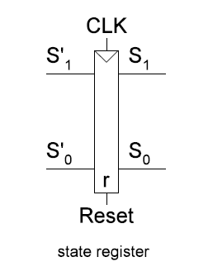
State Register: Assume D-FF

Slide 20
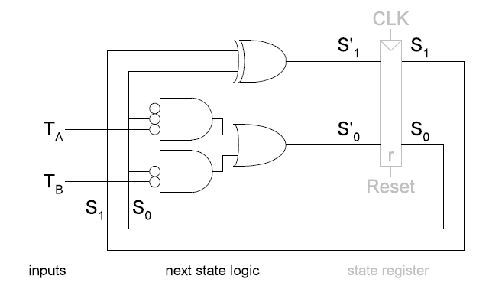
FSM: Figure out Next State Logic

Slide 21

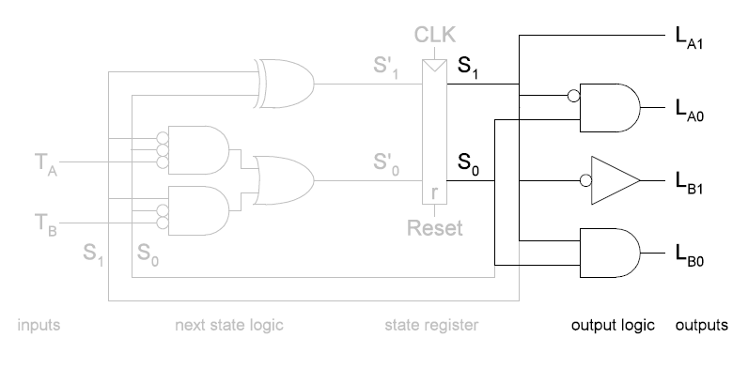
FSM: Figure out Output Logic

Slide 22
FSM Example 2
Design an FSM that detects a stream of three or more consecutive 1s on an input stream
Input: 0 1 1 1 0 1 0 1 1 0 1 1 1 0 1 …
Output: 0 0 0 1 0 0 0 0 0 0 0 0 1 0 0 …

Slide 23
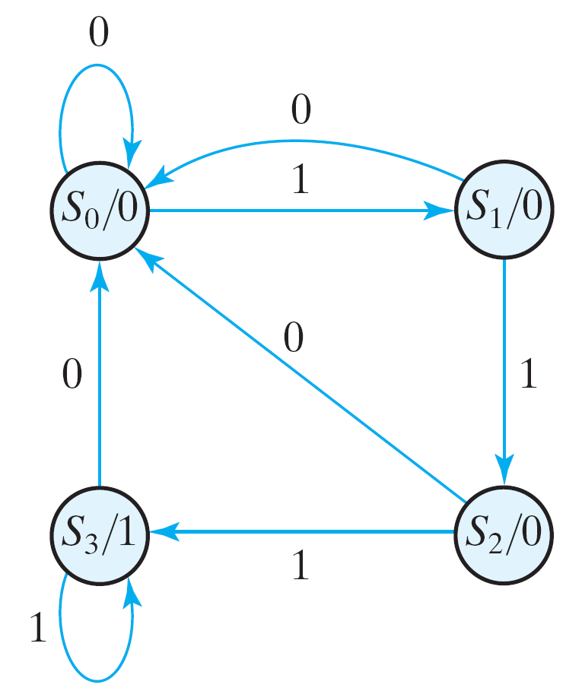
FSM: State Diagram
State
Diagram

Slide 24
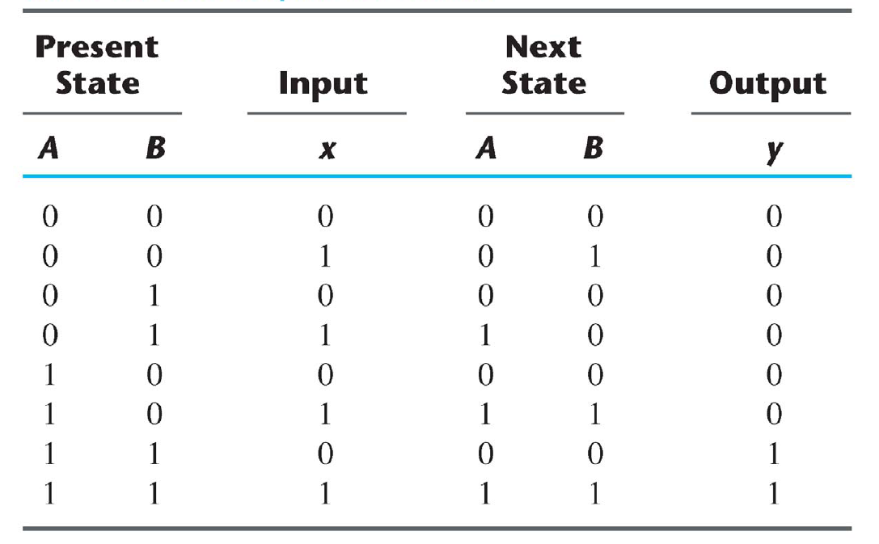
FSM Design: Truth Tables
Q_{A}
Q_{B}
Q_{A}⁺
Q_{B}⁺
State Table

Slide 25
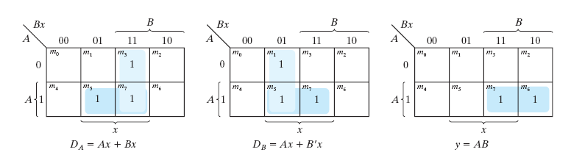
FSM: Assuming D-Flip Flops for State

Slide 26
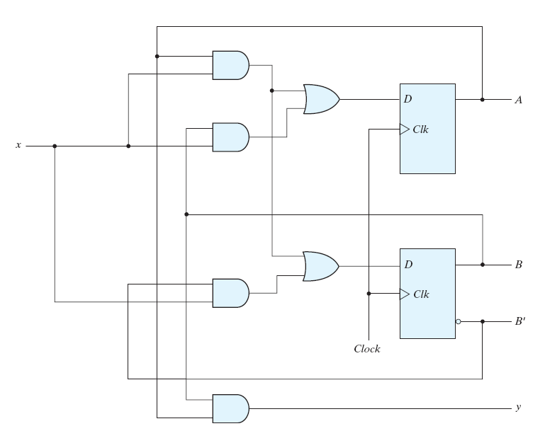
FSM Design: Example (Moore)
Q_{A}
Q_{B}
Q'_{B}

Slide 27
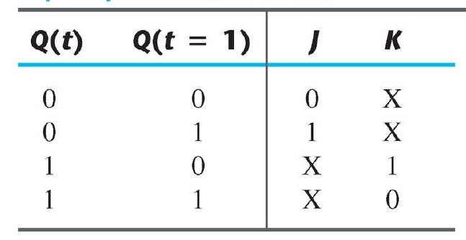
FSM Design: What if we have JK Flip Flops, not D Flip Flops
+
Excitation Table

Slide 28
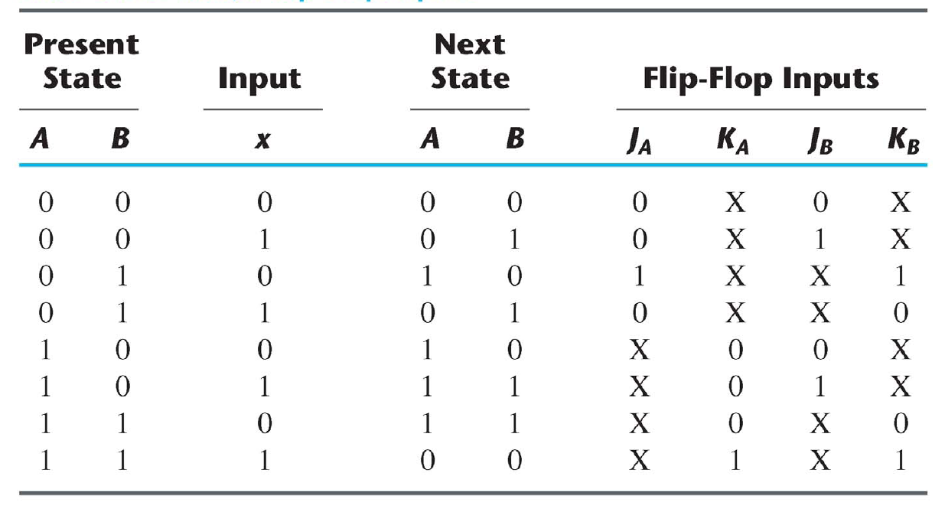
Assume we have the following NEW State Table: With JK Flip Flops

Slide 29
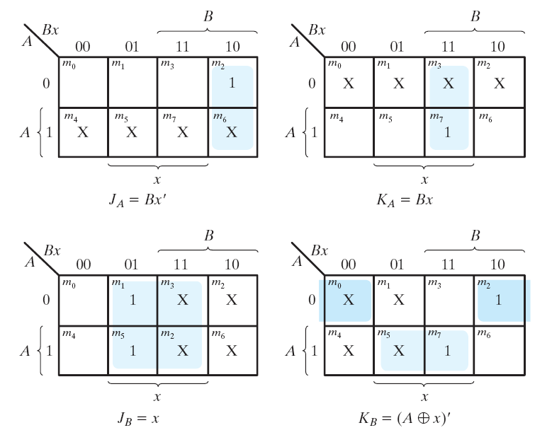
FSM Design: JK Flip Flops

Slide 30
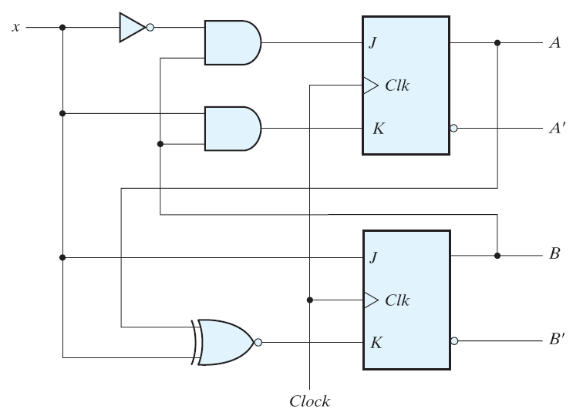
FSM Design: JK Flip Flops
Q_{A}
Q'_{A}
Q_{B}
Q'_{B}

