Slide 1
Building a RAP for Survey Sampling

Slide 2
Project Overview

Slide 3
Project Overview
Survey | Sampling Design | Sampling Frequency | Timescale
Scottish Household Survey (SHS) | Stratified systematic random sample | Annual | ~ 1 week
Scottish Health Survey (SHeS) | Two-stage clustered stratified systematic random sample | Annual | ~ >1 week
Scottish Crime and Justice Survey (SCJS) | Stratified systematic random sample | Annual | ~ <1 week

Slide 4
Project Steps
1
2
3
Upskilling
Process mapping
Moving code from SAS to R
5
6
Improving usability
QA
4
Automating post-processing
and checking

Slide 5
Timeline
Process mapping
From SAS to R
Post-processing
& checking
Improving usability
Upskilling
Jun
Nov
Dec
Jan
Feb
Mar
Apr
May
SCJS
sampling
SSCQ publication
Weighting season

Slide 6
Upskilling

Slide 7
Upskilling
Topic | Name | Provider
SAS | SAS® Programming 1: Essentials (Introduction to SAS) | SAS (In-house training)
R | Introduction to R (Introduction to R) | ONS Learning Hub (In-house training)
RAP | Reproducible Analytical Pipelines (RAP) using R | Udemy
Git/GitHub | Command line basics Introduction to Git | ONS Learning Hub ONS Learning Hub
Sampling | Awareness in sample design and estimation | ONS Learning Hub

Slide 8
Process Mapping

Slide 9
Sampling Process
SHS
sampling
Post-
processing
Checking
Only needs to be run once a year
Address file
Used
addresses
SHeS
sampling
Checking
SCJS
sampling
Post-
processing
Checking

Slide 10
From SAS to R

Slide 11
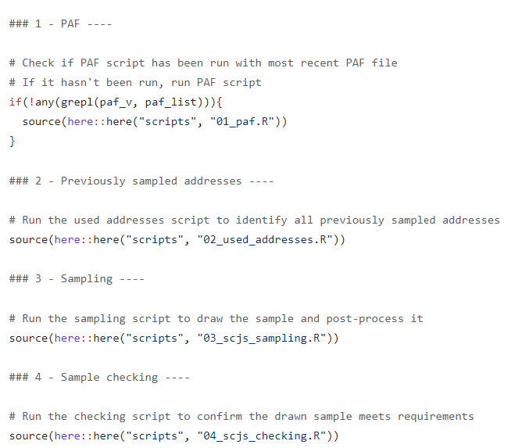
From SAS to R
Understand SAS code
Understand sampling methods
Keep variable names and code structure (at least initially)
Don’t copy line-by-line
QA throughout
SCJS master script

Slide 12
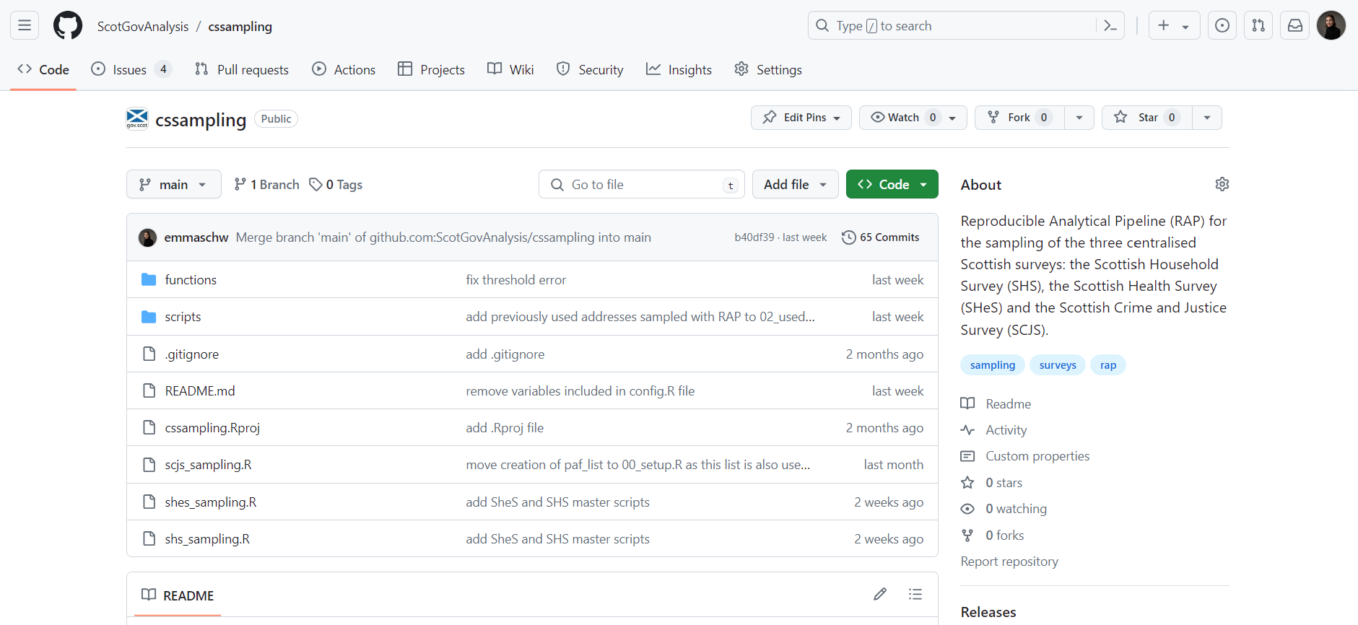
RAP Structure
Master scripts
cssampling repository

Slide 13
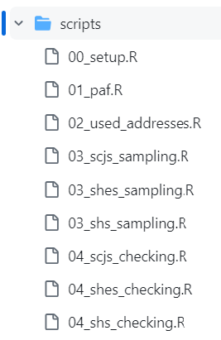
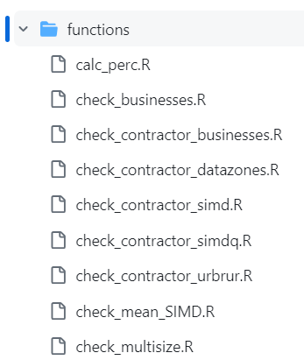
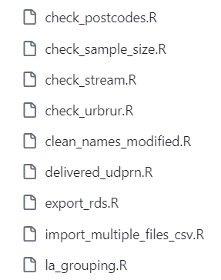
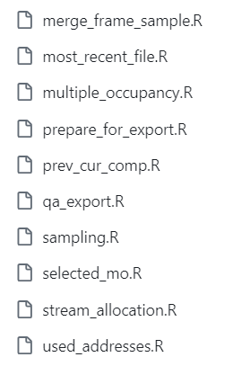
RAP Structure
config.R
cssampling scripts
cssampling functions

Slide 14
Sample QA Automation

Slide 15
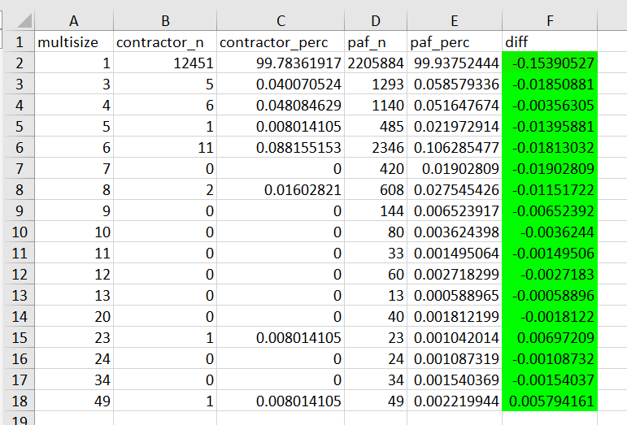
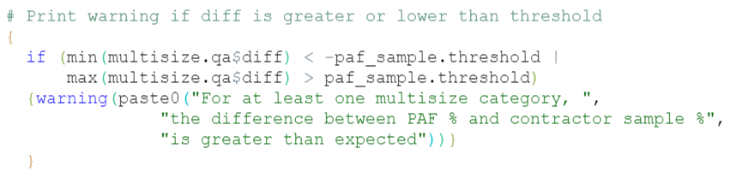
Automated QA
Built-in check in function
Conditionally formatted Excel file (R output)

Slide 16
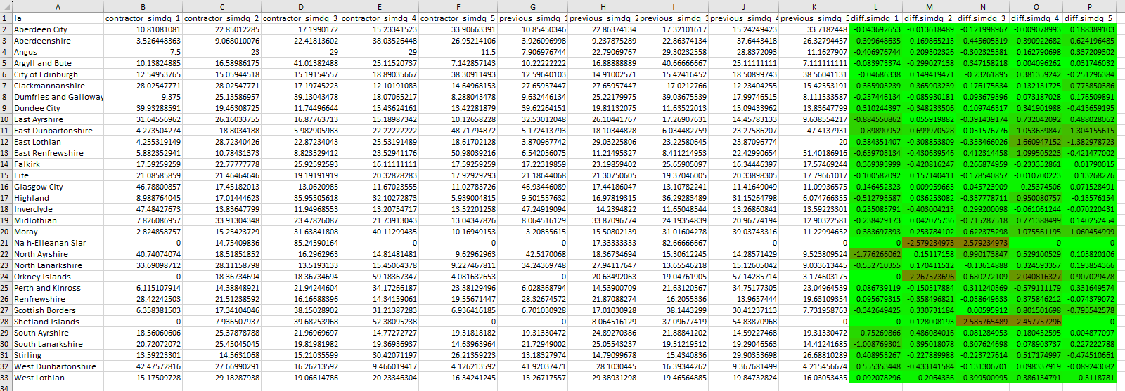
Automated QA
Conditionally formatted Excel file (R output)

Slide 17
Code Improvements

Slide 18
Code Improvements
Consistency
merge() vs _join()
data.table vs tidyverse
Efficiency
Minimise execution time
Replicability
set.seed()
Use functions for repetitive code
Rationalise sample checking
Usability
multisize <50 vs multisize <=50
Address memory issues
Introduce master scripts
Improve annotations
Have only one file that needs to be updated

Slide 19
Challenges

Slide 20
Challenges
Hard deadline of September 2024
Interrelation of surveys
Non-deterministic nature
Crunch times
Data storage post-2026

Slide 21
R Tips

Slide 22
R Tips
Edit -> Find in files… (Ctrl + Shift + F)
warning() and stop()
Progress bars (e.g., pbapply::pblapply)
Configuration file
Annotate your code!

Slide 23
General Advice

Slide 24
General Advice
Use version control from the start
Work with the Data Innovation team
Have a dedicated time slot
Connect with other statisticians
Plan your next steps

