Slide 1
A data validation infrastructure for R
The validate R package: benefits, drawbacks, and a real-world implementation Joseph Adams

Slide 2
My team: Exchequer Analysis
Scottish Exchequer
Tax
Public Spending
Strategy
Budget and fiscal coordination
Fiscal Strategy and Analysis
Exchequer Analysis
Notes:
Scottish Exchequer is responsible for the overall Scottish Budget
75 people in total – 2 statisticians

Slide 3
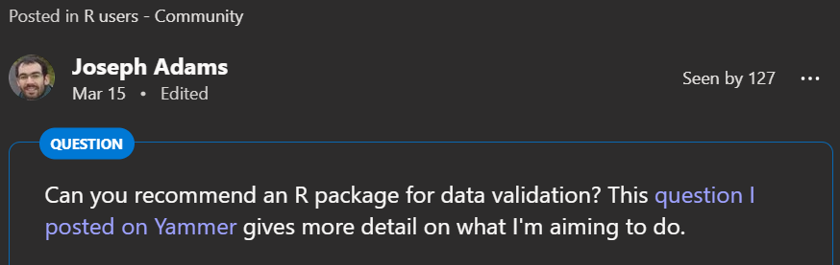
Motivation for this presentation
The challenge:
50 columns by 1,000 rows
Dozens of contributors and ~10 leads
Issues with data quality and validation
Notes:
Projected spending across Scottish Government portfolios
Quite a few data quality issues; often resolved via correspondence which takes up quite a lot of resource.
Thank you to those who reached out to me in response to this post on Viva Engage: https://engage.cloud.microsoft/main/threads/eyJfdHlwZSI6IlRocmVhZCIsImlkIjoiMjY5NDI2NjAwMjQwNzQyNSJ9?trk_copy_link=V1

Slide 4
The scope of this presentation
I’m going to talk about:
A definition of data validation
How and why I did it this way
I’m not going to talk about:
Designing validation rules
Creating a good quality validation output
Engaging with stakeholders

Slide 5
Four approaches to validation
Write bespoke validation code
Use an R package
Rules as code Rules as data

Slide 6
Four approaches to validation
A bespoke VBA script
…
Assertr
Pointblank
validate
Write bespoke validation code
Use an R package
Rules as code Rules as data

Slide 7
Write bespoke validation code
'loop through all the data with i and j as indexes for rows and columns respectively. Checking for missing data
For i = 8 To lastRow
For j = 1 To lastCol
'Check that the cells are not empty, if they are, add a problem.
If Len(dataArr(i, j)) = 0 Then
Call AddProblem(i, j, "missing_data", "Data from a required field is missing, please complete this cell.")
End If
Next j
Next I
Notes:
What we had before
Pros
You can get started quickly
Cons
VBA – added an extra coding language to learn
A lot of work and room for error
A lot of code
11 lines of VBA
two nested for loops
message for user
Comments explaining details of implementation
n statisticians would probably find ~n ways of implementing this check

Slide 8
assertr
our.data %>%
verify(mpg >= 0) %>%
group_by(cyl) %>%
summarise(avg.mpg=mean(mpg))
Notes:
assertR
Pros:
Seems convenient for small scale validation
Cons:
This doesn’t seem scalable (especially with the risk of validation rules getting lost in the code)
The flexibility may tempt people to spread validation across their project rather than keeping it in one place
Essentially, it’s a try catch mechanism, so you’re not getting insights into the validation (e.g. what rules are passing/failing the most)
Pointblank: similar to assertr
Pros
Nice looking documentation and outputs (e.g. gt-based reporting)
Cons
Not yet reached version 1 on CRAN

Slide 9
validate
rules.csv
name | description | rule
is_unique_id | The id column is unique. | is_unique(id)
is_complete_id | The id column is complete. | is_complete(id)
rules <- validator(.file="rules.csv")
confront(my_dataset, rules)
Notes:
validate treats validation rules as first 'class citizens’
For example, you can
See how many rules you have
View metadata such as severity
Combine rulesets
The validate package
academically rigorous (see authors’ credentials)
been around for a while
authors are engaged and respond to queries (within limits!)

Slide 10

validate: two examples
1. A simple example to show the basic principles and benefits
2. A real example to show where we’re at now and the drawbacks
Notes:
Benefits of storing rules as a dataset
version control
Easy to change the rules
Engage stakeholders on the rules
Apply the same ruleset to a different dataset
Less bespoke/boilerplate code
Scalable for large and complex rule sets
No limits on rule types
validatetools for finding redundancies and problematic rules
Drawbacks
A learning curve: papers
building the validation output is a lot of work. For example:
telling people what the issue is, where it is, and what rules were broken
gotcha: putting = TRUE next to any function that returns a Boolean vector

Slide 11
Reflections
Successes
We now have a validation process that is:
Robust
Efficient
Scalable
Challenges
Learning curve
Building a good quality validation output for data providers

Slide 12
Recommended resources
Methodology for data validation (markvanderloo.eu)
Data Validation Infrastructure for R | Journal of Statistical Software (jstatsoft.org)
The Data Validation Cookbook (r-project.org)
Issues · data-cleaning/validate (github.com)
Notes:
This list goes from the most general (at the top) to the most practical/specific (at the bottom)

Slide 13
What is data validation?
Data Validation is an activity verifying whether or not a combination of values is a member of a set of acceptable combinations. - Methodology for data validation
Dataset
Validation
☺ Valid
☹ Invalid
Notes:
Clearly defining this helps us to separate this into a discrete task in our workflow and not mix it up with other tasks (such as data manipulation or correction)

