Slide 1
Road Casualty Map
Ivet Gazova
Transport Scotland

Slide 2
Road Safety Framework
lots of presentations with focus groups on specific road users/locations based on our annual publications
users are policy colleagues, council employees, road user focus groups who might not have analytical support
stakeholders were interested in where the collisions happen (hotspots)

Slide 3
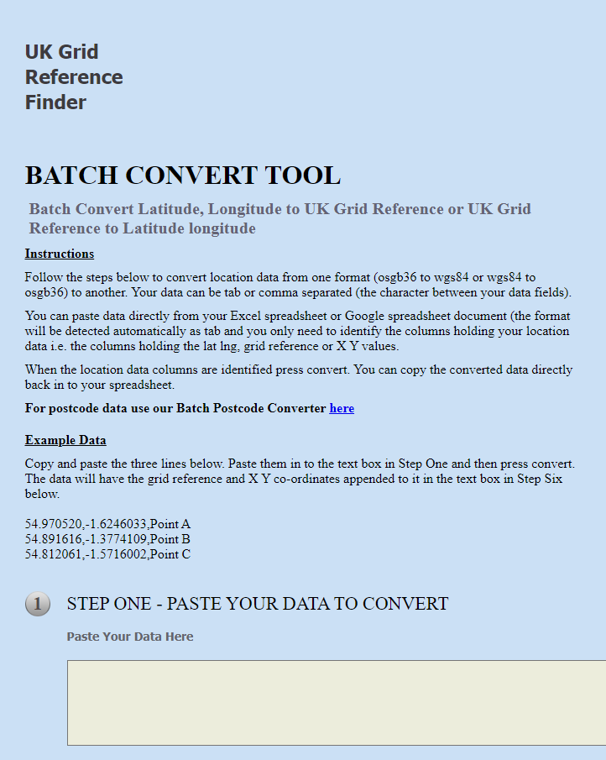
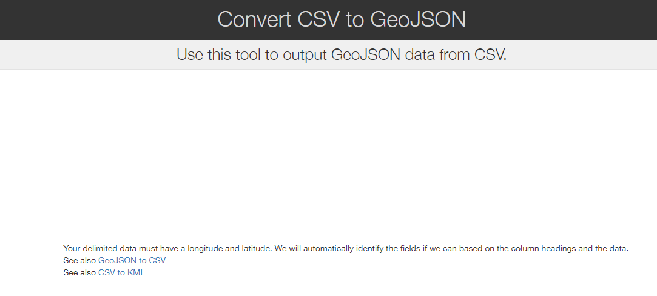
Without R:
1.) create a list of collisions in SAS (year, mode) and take the UK reference grid coordinates from the data
2) convert Northing and Easting to longitude and latitude (copy-paste 1)
3) convert to geoJSON
(copy-paste 2)

Slide 4
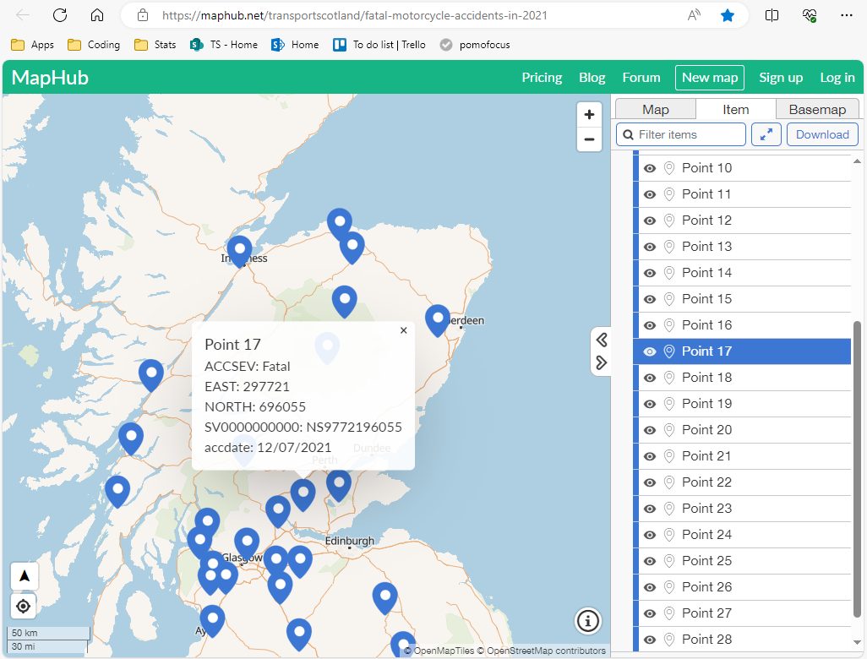
4) upload to external website
(copy-paste 3)

Slide 5
Without R
lots of copy pasting
not very customisable
you have to generate the list of collisions each time in SAS depending on who asks

Slide 6
Road casualty map
create a map using R/Rmarkdown so it’s faster and easier
short and defined project
help from Alice Byers/Tom Wilson (Data Innovation Team)
beginner with Rmarkdown, so not a complicated code

Slide 7


Main code organisation
script to filter the dataset to select the right rows and variables
code which produces a map using R package Leaflet
Rmarkdown code

Slide 8
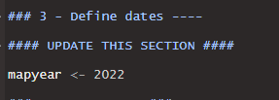
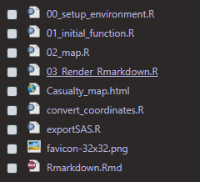
Main code organisation
added a set up environment script – where it’s easy to update the year
adjacent functions

Slide 9
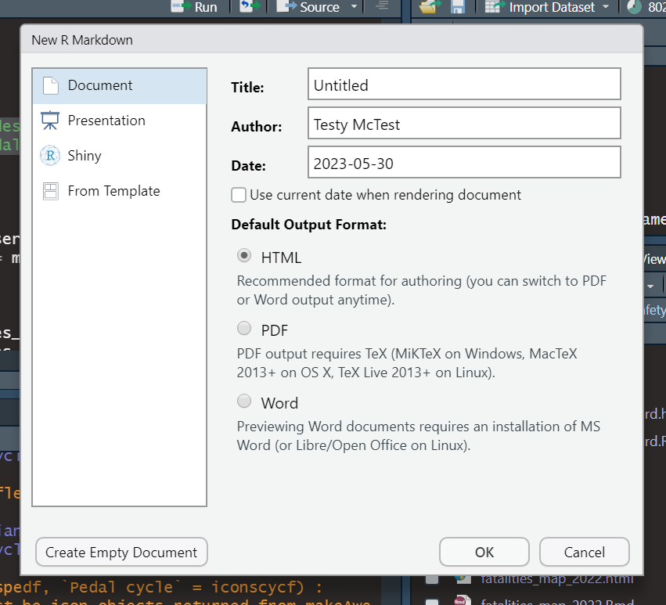
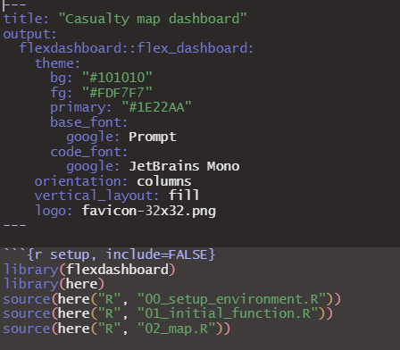
R markdown
various outputs
flexdashboard

Slide 10
How to share it?
initially I sent the html document to various stakeholders so they can view it in their own time
did not work for everyone. Local Authorities have different IT emails etc, some are blocking html documents, some can’t view the map
Alice came up with a different idea

Slide 11
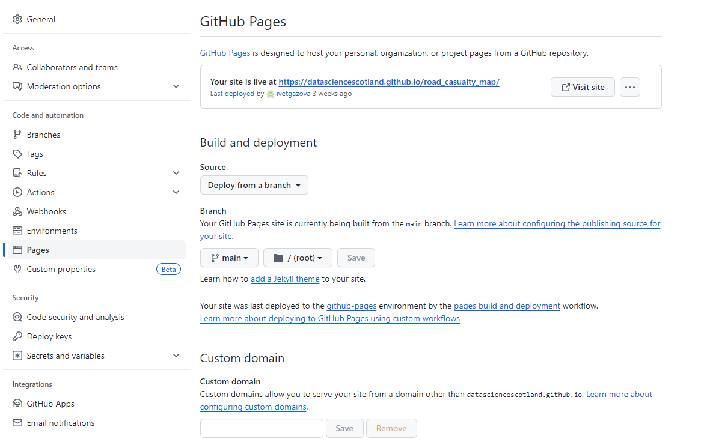
Github Pages
Needs to be a public repository

Slide 12
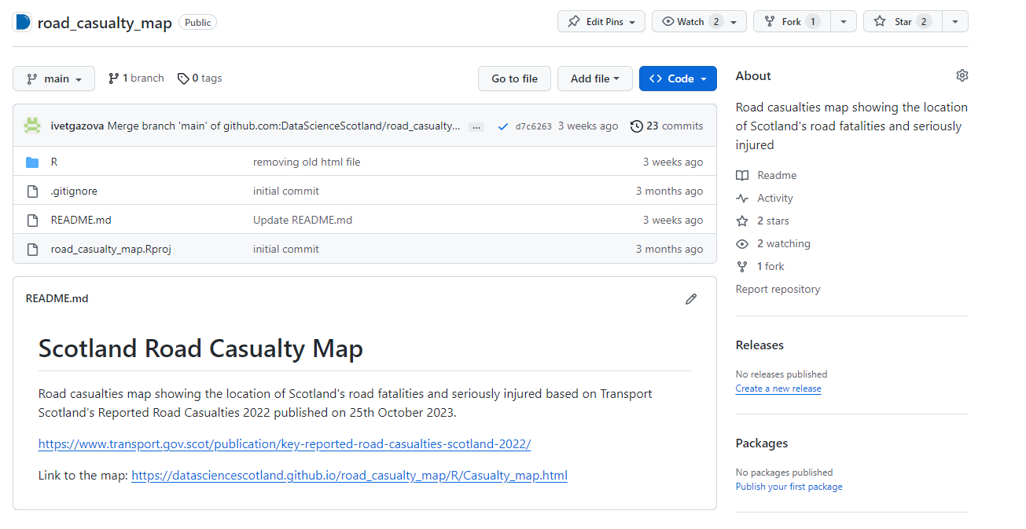
repository name/ folder structure/name of your html document

Slide 13
Why I’m glad I used git/github
I wasn’t scared to delete code – if I ever needed it again, I could look it up
Alice could work on the code simultaneously
share the link on Github pages

Slide 14
Issues
have to save SAS dataset as csv files every time we update the dataset for publishing (2x a year) (but you have to remember!)
learning curve for Git/Github

Slide 15
Conclusions
good feedback from stakeholders, much faster and easier to change based on their feedback than before
starting with Rmarkdown: do smaller project with a deadline and don’t be afraid to get help!

Slide 16
Thank you for your attention!
ivet.gazova@gov.scot

