Slide 1
Moving From SAS to R
Jay ware
OCEA: national Accounts

Slide 2
Moving a Project From SAS to R
Overview of old project
Why we moved to R
Planning the move
Challenges and lessons learnt

Slide 3
Supply-Use Tables
Flows of goods and services across economy
Relationship between producers and consumers
23 years
111 Industries and products
Notes:
- Annual set of tables we produce, showing the flows of goods and services across the economy
- Includes a matrix showing the relationship between producers and consumers – with 111 industries and 111 products
- Tables for 23 years
- There are a lot of cells!

Slide 4

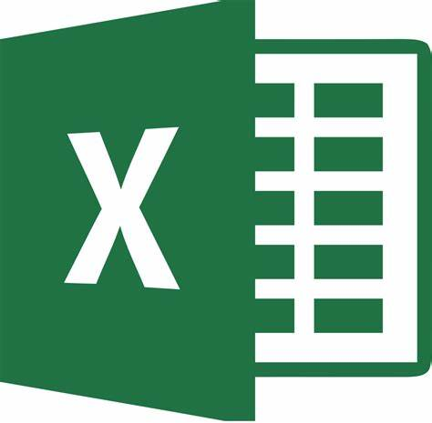
Raw Data System
Brings together raw data for the tables
Transforms data to the SUT structure
Converts to 111 industries/products
Ensure data ends up in right cell
Select appropriate data where we have multiple sources available
Notes:
- SAS project we moved was part of producing the Supply Use Tables

Slide 5
Limitations of System
Manual steps pre-processing data in Excel
SAS code largely unchanged for several years…
…but data sources changed
ad hoc fixes and code bolted on
Difficult to trace what happened to data through the code
Difficult to maintain and debug
Issues not unique to our code
Technical Debt
“As an evolving program is continually changed, its complexity, reflecting deteriorating structure, increases unless work is done to maintain or reduce it” - Manny Lehman
Notes:
- We were running into limitations and difficulties with the old SAS system
- Lots of manual steps pre-processing data in Excel
- large workbooks with many formulae that needed updating each year
- very easy to make typos and introduce errors
- very difficult and time-consuming to debug
- SAS code not been looked at in detail for a long time
- data source changes resulted in lots of ad hoc fixes and code bolted on
- Difficult to trace what happens to data through the code
- identifying where in the code a cell is modified is a challenge
- difficult to maintain and debug
**Technical Debt**
- concept from computer science that is useful to us
- idea that code will inevitably get more complicated and messy as what we need it to do changes UNLESS ongoing work is done to clean up the code
- Our project built up a lot of technical debt. New data sources shoe-horned in, and fixes added each year as data sources changed.
- Short-term this might be quicker, but code got messy to the point where it takes longer and longer to get it working or make any further changes

Slide 6
Refactor or Rewrite?
Refactor
Rewrite
Restructuring and cleaning code without changing it’s behaviour
More Maintainable
Optimisation
Easier to debug
Easier to add features
Start from scratch
Rewrite large portions of code
Redo parts that aren’t working as well as intended (or broken!)
Opportunity to rethink how we want the code to work
Notes:
- We had two approaches to resolve this: Refactor or Rewrite
- Not a clear divide between these, broadly refactor involves working with the code we have and cleaning it up without making substantive changes to what it does
- Rewriting is redoing large portions of the code. Allows rethinking what we need the project to do and how we want the code to fit together
- We decided to largely rewrite the project. Amount of refactoring that would have been required to get the code in a decent state wouldn’t have been much quicker

Slide 7
Why R?
PROS
CONS
Open-source with a large range of packages available
Tidyverse packages for data wrangling
R can handle importing non-standard tables in spreadsheets
Tools for functional programming
Will need to transfer data between R, SAS and Excel at several points
Can’t directly reuse code from old system
Notes:
- Our reasons for moving to R
- Open-source with a large range of packages available that are designed for what we need
- Data wrangling – tidyverse
- Reading in Excel tables – tables with multiple header rows, blank rows, inconsistent column lengths, easier to handle in R
- FP – covered in later slide
- Disadvantages
- can’t reuse existing SAS code – though less of an issue for a rewrite than a refactor
- added in another piece of software that data is transferred between

Slide 8
Scope
Not enough time to move everything to R at once
Prioritised moving the sections that would give the biggest pay-off
Difficult to maintain
Bug/error-prone
Time-consuming manual processes
Minimise times needing to transfer between R, SAS and Excel
Notes:
- We didn’t have enough time to move everything over to R
- In deciding what to move we aimed to minimise times data transferred between software – so consecutively run bits of the system
- prioritised parts that involved time consuming manual processes, difficult to maintain and/or error-prone – migrating these sections of the system would save the most time in the long-run

Slide 9
Planning the Move to R
Decide on what the new system needs to be able to do
What the old system could do
Easier to make changes
Dashboard to aid viewing and selecting between different data sources
Good coding practices
DRY – don’t repeat yourself
standardise data structures where appropriate
variable naming conventions
Functional programming principles
Pure functions (where appropriate)
Vectorise
Purrr package
Rethought code structure
scripts for running system
scripts that do data processing
core functions
Store commonly used functions in an R package
Unit tests
Documentation!
Version control (Git)
Notes:
- Started off with deciding on requirements for the new system
- Everything SAS version could do
- Less susceptible to errors
- Easier to switch cells from one data source to another
- Dashboard for viewing and switching between data sources – previously this could only be done by coding a change and looking at what it did after running though everything
Good coding practices
- covered in other talks today
- Functional Programming
- Previous system coded in a linear step-by-step way – each cell could be modified at any point and difficult to track what was happening within the system
- Switched to a FP approach – data is modified through functions, with code inside functions generally unable to impact or be impacted by code elsewhere in the system
- Easier to reason with and limiting when data is modified makes it easier to debug and track what is happening
- Used single functions for processing all data rather than having lots of duplicated code
- R is designed for functional programming and has FP packages like purrr available
Code structure
- arranged in a hierarchy
- scripts for running the system – these contain everything used day-to-day and where common changes are made such as changing what data source is being used for each cell
- scripts that do the data processing – always run, but kept separate as it’s not code that needs regular attention
- core functions – common tasks such as mapping data to our 111 industry/product classification – code is done once and stuck in a function. These are stored in an R package to make it easy to use between R projects along with documentation
Git – for version control
- very useful for keeping track of what changes have been made (and why!)

Slide 10
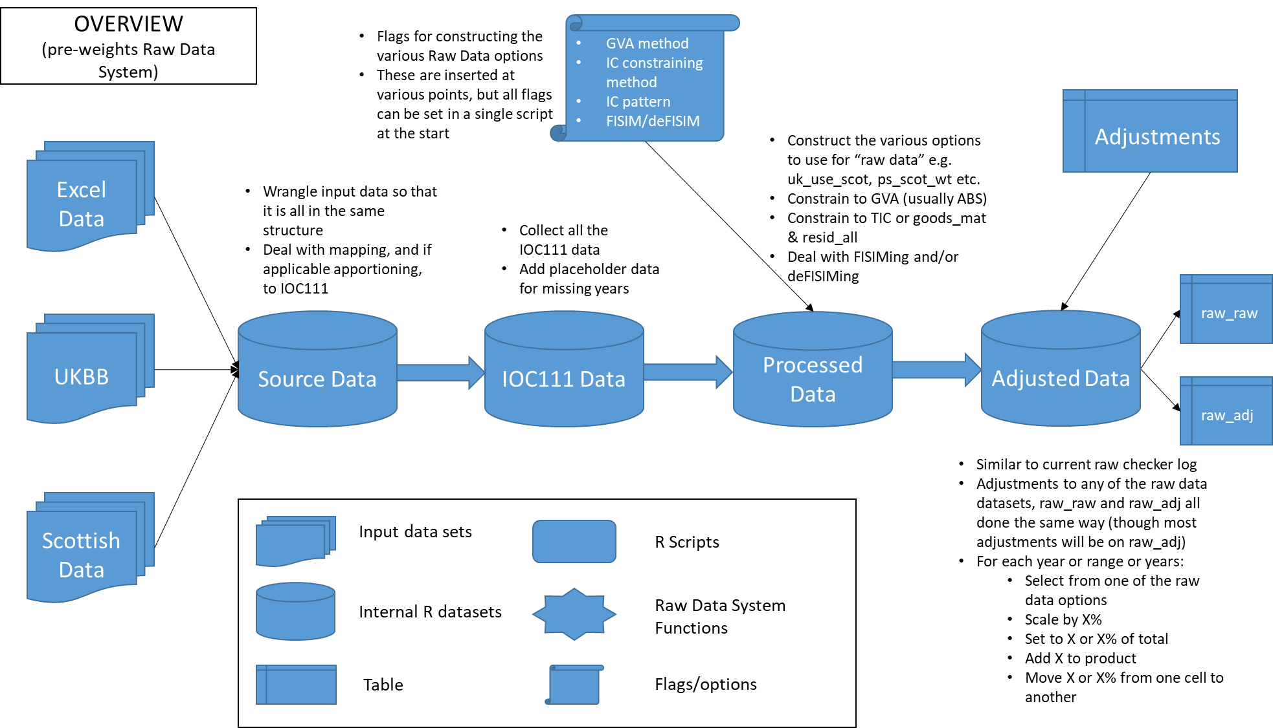
Putting it all together
Mapped out each “step” of the old system
Each block independent and shows dependencies
Iterated on several times as we moved bits around to work better together
Tried to consider future requirements – and ensure these can easily be added later
Notes:
- Broke down the code into discrete chunks/steps – roughly one chunk does one “thing”
- Mapped relationships between them
- Iterated to simplify and get everything to fit logically together
- First version closer to what the older system was doing, then moved stuff around

Slide 11
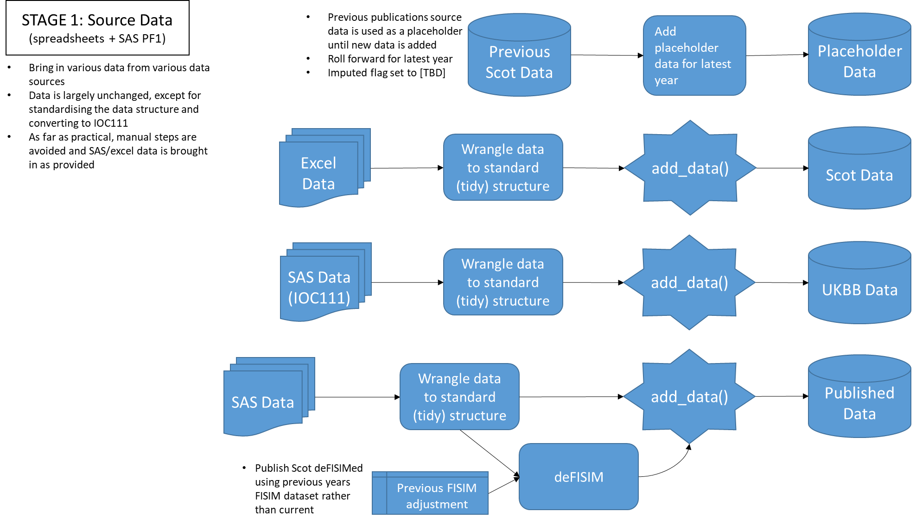
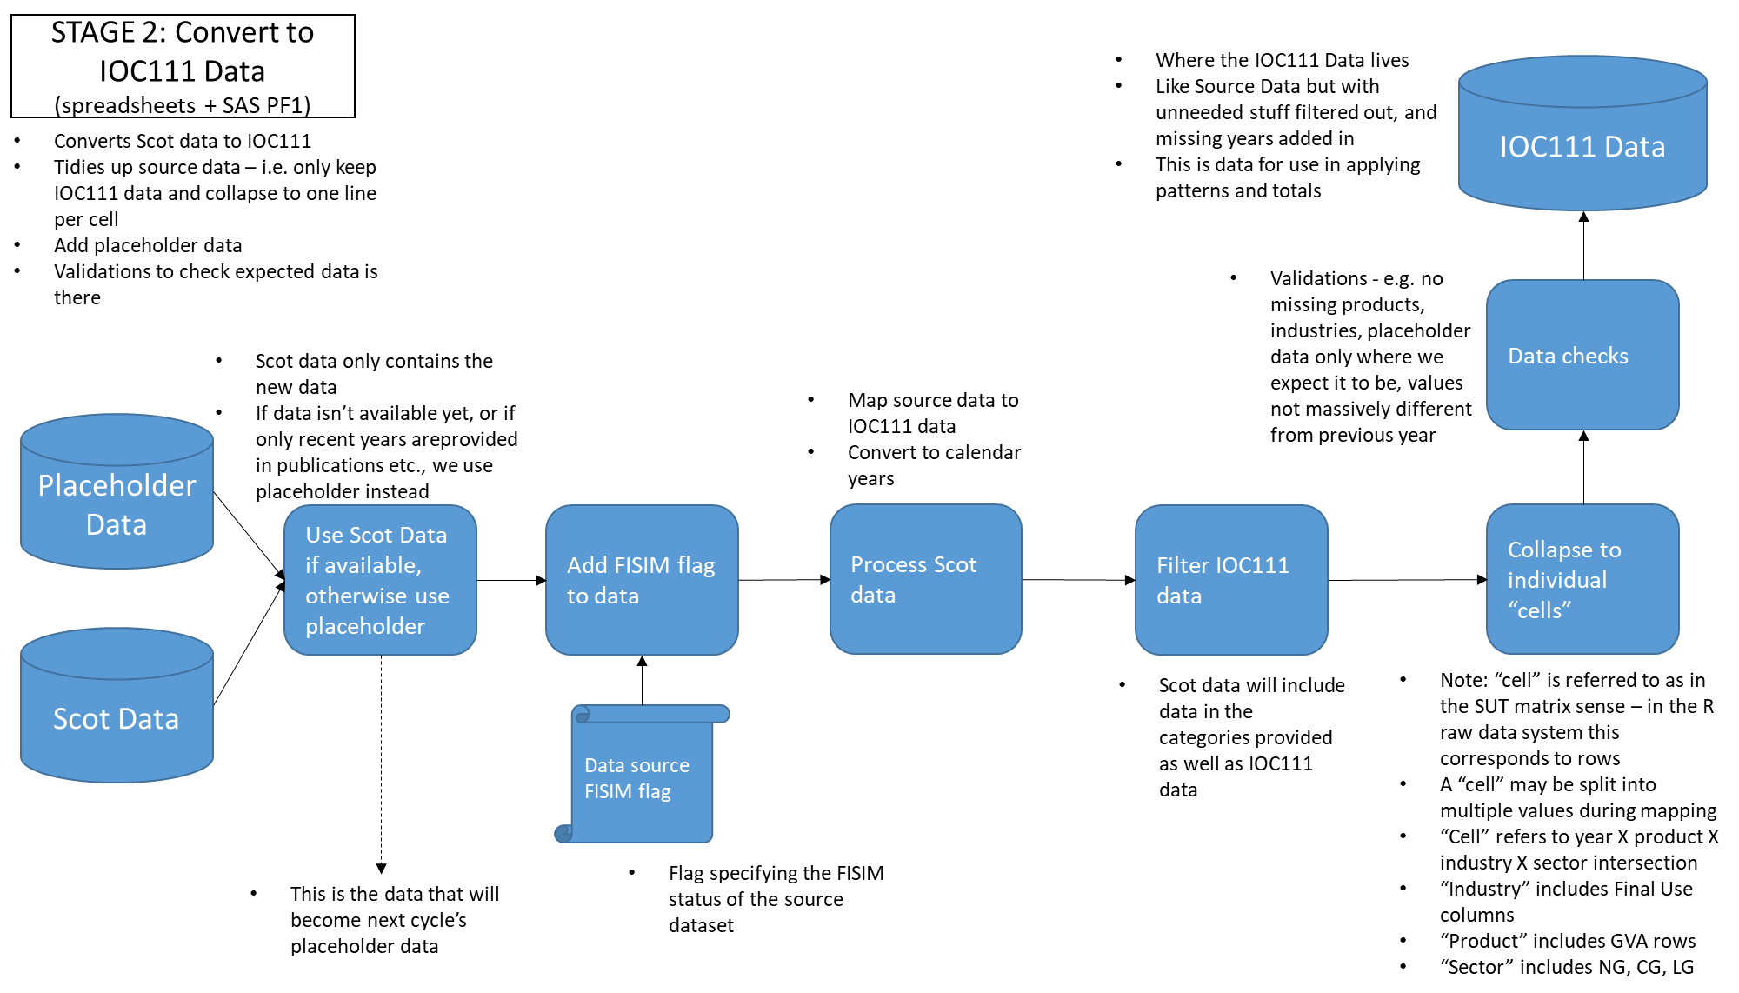

Slide 12
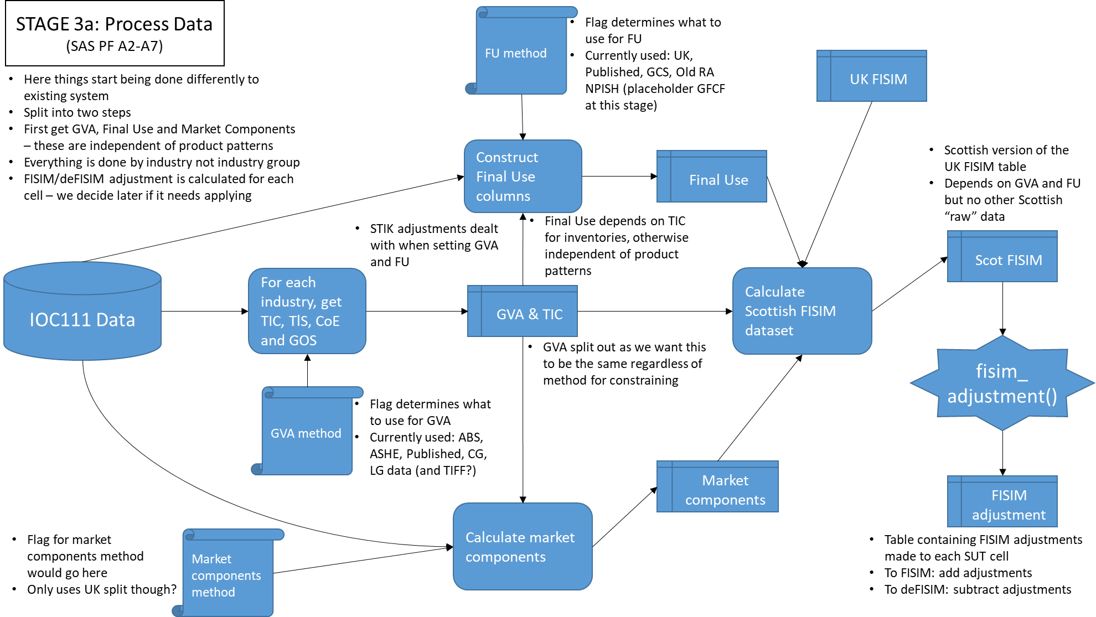
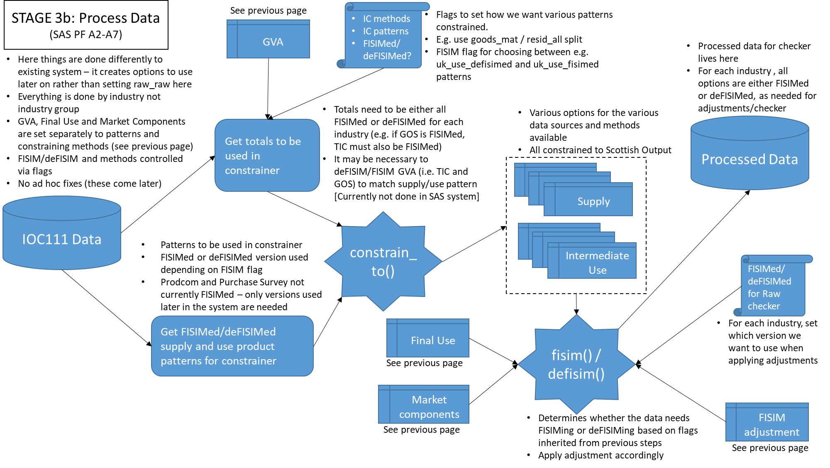
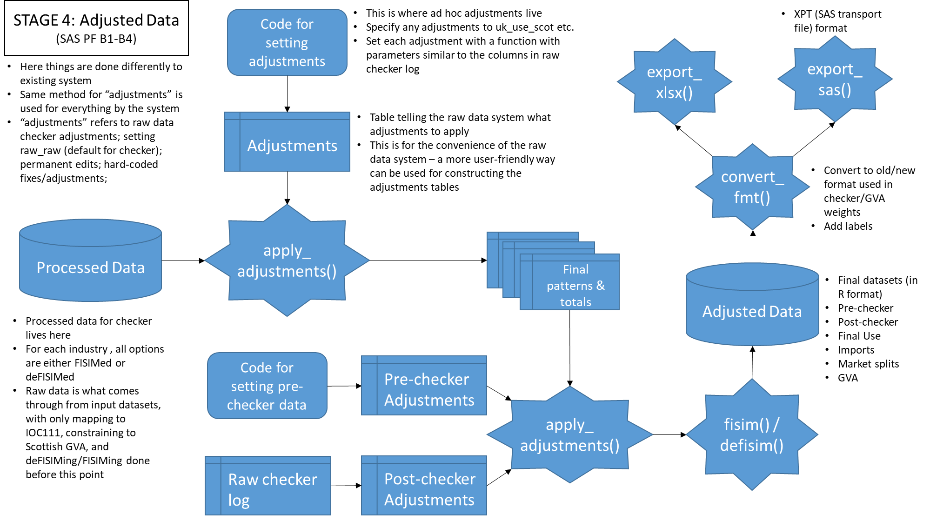

Slide 13
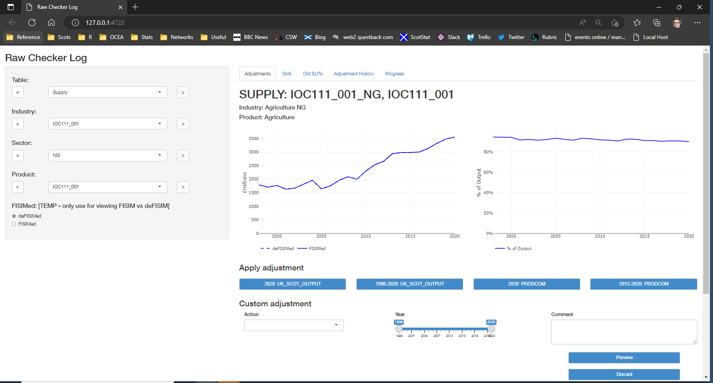
Dashboard
Added a dashboard to help with checking data and switching between data sources
Previously this was done through inserting 1000s of lines of SAS code
Also allows previewing impact of changes we make
Previously this could only be done after running through the entire system

Slide 14
Challenges
Transferring data between R and SAS
Used SAS transport files
Automating processing of spreadsheets
Multiple-row headers
Unusual structured tables
Spreadsheet may change from year-to-year
Git learning curve
Bugs in the old system
Makes checking the new system against the old system challenging
Understanding what the old system was doing

